Slide 2
حذف چاقی کودکان
دکتر فریدون عزیزی
پژوهشکده علوم غدد درون ریز و متابولیسم
دانشگاه علوم پزشکی شهید بهشتی

Slide 3
با توجه به افزایش مستمر و روزافزون اضافه وزن و چاقی در کودکان و نوجوانان در دنیا خانم مارگات چن، دبیر کل سازمان جهانی بهداشت گروهی از خبرگان از سراسر جهان را جهت بحث در مورد شواهد علمی این مسئله مهم بهداشتی درمانی دعوت کردند. این اجلاس در روزهای 28-30 خرداد 1393 در ژنو، مقر مرکزی سازمان جهانی بهداشت برگزار شد.

Slide 4
Report of the First Meeting of the ad hoc Working Group on
Science and Evidence forEnding Childhood Obesity
18 – 20 June 2014 - Geneva, SWITZERLAND

Slide 5
First Meeting of the Ad hoc Working Group on Science and Evidence for Ending Childhood Obesity
Professor Linda S. Adair (USA) Dr Narendra Kumar Arora (India) Professor Fereidoun Azizi (Iran) Professor Louise Baur (Australia) Dr Frank J. Chaloupka (USA) Professor Partha Dasgupta (United Kingdom) Professor Terrence Forrester (Jamaica) Professor Mark Hanson (United Kingdom) | Professor Gerard Hastings (United Kingdom) Dr Shiriki Kumanyika (USA) Professor Ronald Ching-Wan Ma (China) Professor John Reilly (United Kingdom) Dr Rachel Rodin (Canada) Dr Mark Tremblay (Canada) Professor Wenjuan Wang (China) Professor Chittaranjan S Yajnik (India)

Slide 6
چاقی در کودکان و نوجوانان زمینه‌ساز بروز دیابت و فشارخون در سنین نوجوانی و بین 20-30 سالگی است که زمینه را برای وقوع بیماری‌های قلبی عروقی، سکته و مرگ زودرس مهیا می‌کند. در کودکان چاق بلوغ زودتر اتفاق می‌افتد و در دختران اختلالات عادت ماهیانه و بروز بیماری تخمدان پولی‌کیستیک شایع‌تر است که ممکن است بعدها سبب ناباروری شود. در نوجوانان و سنین بالاتر، چاقی سبب کبد چرب، خواب‌آلودگی، آسم، بیماری‌های عضلانی استخوانی و برخی حالات روانی می‌شود.

Slide 7
ثابت شده است که سلامت مادران و پدران قبل از لقاح و نیز مادران حین بارداری بر بروز چاقی و دیابت در کودکان آینده آنها تاثیرگذار است. چاقی مادران و داشتن دیابت (و یا حالت قبل از دیابتی) و اختلالات بعضی ویتامین‌ها و مواد ریزمغذی‌ قبل از لقاح و نیز در زمان بارداری و یا کم وزنی مادر و تغذیه ناسالم زمان بارداری می‌تواند در وزن فرزند آینده تاثیرگذار باشد و زمینه چاقی و یا دیابت و یا هر دو را در سنین بالاتر ایجاد کند. وزن، فشارخون، قندخون از جمله مواردی هستند که حد مناسب و وسط آن سلامت را به همراه دارد و حدود کمتر و یا بیشتر از طبیعی آنها با خاطرات سلامت همراه است.

Slide 8
توجه خاص به سلامت مادران قبل از اقدام به بارداری ودر حین حاملگی برای پیشگیری از چاقی کودکان ضروری است. زایمان طبیعی، تغذیه یا شیر مادر، توجه به تغذیه صحیح سال‌های اول و دوم زندگی و مواد غذایی که هنگام شیر گرفتگی مصرف می‌شود، در کاهش چاقی کودکان موثر است. ایجاد اشتهای اولیه در کودکان با مصرف غذاهای نامناسب (شیرینی‌ها، سیب‌زمینی سرخ کرده، چیپس، فست‌فوت‌ها) زمینه‌ساز چاقی در دوران کودکی و نوجوانی است.

Slide 9
Topic A (intervention selection and prioritization)
A1. What works to reduce obesity/ adiposity in infants and pre-school children.
A2. What works in the preconception period and in pregnancy to reduce poor pregnancy outcomes/ obesity risk in offspring
A3. Health problems among actors beyond Ministries of Health.

Slide 10
Topic B (justification)
B1. Economic consequences of childhood obesity.
B2. Psychosocial and developmental aspects of childhood obesity in various settings.
B3. Impact of childhood obesity on NCDs throughout the life course.
B4. The obesogenic impact of global marketing and advertising aimed at children, including digital marketing.

Slide 11
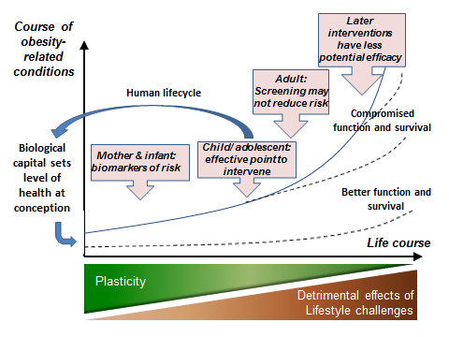
Life-course model of obesity and other NCD risk
(fromWHO Meeting Report: Nurturing human capital along the life course: Investing in early child development. 2013)

Slide 12
Modifiable risk factors in the pre-conceptional period
Biological - genotype to phenotype and causal or correlated | Behavioural (*may also be biological rather than solely learned)
Maternal obesity Paternal obesity Maternal nutritional status (amount and balance of macro-, micronutrients eg. balanced B12 and folate) Maternal body composition Use of assisted reproductive technologies Maternal glycaemia Maternal lipid metabolism Young age or physical immaturity (adolescent pregnancy) Short maternal stature | Parental behaviours, including smoking, alcohol use, low physical activity, sedentary behavior Dietary patterns Overuse of nutritional supplements (eg folic acid)

Slide 13
Modifiable risk factors during gestation
Biological - genotype to phenotype and causal or correlated | Behavioural (*may also be biological rather than solely learned)
Maternal gestational weight gain Maternal diet (micro- and macronutrients) Maternal body composition: fat and skeletal muscle mass Maternal workload Maternal stress Maternal glycemia, and gGestational diabetes Pre-eclampsia Hypertension Glucocorticoid or other drug treatment Pre-existing maternal or paternal diabetes Multiple conception Parity Infection and inflammation: STIs, malaria, HIV | Maternal behaviours as above Stress Depression

Slide 14
Modifiable riskfactors in infancy
Biological - genotype to phenotype and causal or correlated | Behavioural (*may also be biological rather than solely learned)
Gestational age/degree of prematurity Birthweight Anthropometry and body composition Genetic and epigenetic factors Hormone levels and growth factors (IGF, C-Peptide) Linear growth rate Breast/ formula feeding Taste development Appetite control/satiety set point Metabolic set point Development of gut microbiome Infection | Age-specific dietary patterns Caregiver’s infant feeding behaviours and dietary quality(breast feeding, timing of introduction of complementary foods, caregiver responsive feeding ) Food preference Nurturing behaviour Stimulation Activity Sleep patterns Child care Level of physical activity

Slide 15
Modifiable risk factors in childhood
Behavioural | Familial and Social | Broader Environmental Context
Frequent consumption ofsugary beverages Low intake of fruits and vegetables Frequent consumption of calorically-dense snacks Eating while watching TV High frequency/long duration of TV watching (screen time) Eating in restaurants High use of digital devices Eating before bed Insufficient outdoor play Long periods of uninterrupted sitting Poor sleep quality and quantity | Parenting practices Parental role models Gender roles Peer influences Social norms about eating and physical activity or inactivity Food traditions and preparation practices Food provision in schools and child care settings Limited income Physical activity provision in schools and child care settings Limited education | Upstream food supply factors (e.g. agriculture and trade) Food supply –food composition, availability, access, affordability Marketing of high calorie, low nutrition packaged foods to children and parents – intensity and forms Built environments related to physical activity Health systems (eg health professional training and service delivery in antenatal, postnatal, infant and child/adolescent health care) “Street food” vending and its economic role

Slide 16
Potential policies approaches and interventions to promote healthy eating
Reduce unhelpful influences | Increase helpful influences
Proposed Framework Convention on Nutrition Look back provisions (egset targets for reductions in childhood obesity and fine industry if they don’t make it) Mandatory Standards: Product formulation (eg reduced sugar, salt, fat) Pricing (eg price promotions on healthy options) Advertising and promotions Distributions (egnot in schools) | Marketing healthy options Institutional meals standards Social enterprises to support healthy eating Health and media literacy interventions Social marketing on healthy eating and activity Training of healthcare and childcare professionals

Slide 17
Report of the second meeting of the Ad hoc Working Group on Science and Evidence
Geneva, 15-17 December 2014
Professor Mark Hanson (co-Chair)

Slide 18
Background
Life-course studies suggest that interventions in early life (even before conception) likely to have greatest positive sustained effects.
Obesity risk is passed across generations, affecting children before they are able to make conscious choices about diet/ behaviour
  “mismatch” of undernutriton in fetal and early childhood, followed by overnutrition and sedentary lifestyle later
  Maternal obesity, overnutrition and pre-existing diabetes/ GDM pass risk to next generation
  Two pathways can operate simultaneously in some populations
Many children not currently defined as obese by BMI for age may nonetheless be on a pathway to obesity.
Overweight and obesity are becoming social norms

Slide 19
Summary of evidence: rationale
Childhood and adulthood consequences of childhood obesity :
  Delayed motor development during infancy
  Cardio-metabolic risks (dyslipidaemia, high blood pressure, insulin resistance, glucose intolerance)
  Minor and major orthopaedic complications
  Non-alcoholic fatty liver
  Obstructive sleep apnoea
  Range of psychosocial complications
  Type-2 diabetes
Consistent increased risk of children affected by overweight or obesity becoming adults with overweight or obesity, with NCD risks

Slide 20
Summary of evidence: rationale
Literature on economic consequences of childhood obesity scarce compared with the economic burden of adult obesity, but
  Emerging evidence on life-time health costs, such as early onset of adult diseases and tracking of obesity into adulthood
  Early onset of obesity and chronic diseases impair individual life-time education and labour-market outcomes
  Place a long-term burden on health care systems, employer and society

Slide 21
Summary of evidence: rationale
In HICs children in ethnic minority populations, including migrants and first-nation children, are at increased risk of obesity
  Adaptation/mismatch to new/different environment and lifestyle,
  social norms re eating/feeding, movement and sleep behaviours, and body image
In LMICs highest rates of obesity found in children of higher socio-economic status
  Mismatch – fetal/infant malnutrition and subsequent energy abundance
  Increasing urbanisation associated with access to ultra-processed foods, decreased physical activity and increasingly sedentary lifestyle

Slide 22
Summary of evidence: rationale
The marketing of unhealthy, ultra-processed foods is causally related to childhood obesity, affecting children too young to make conscious choices
Any attempt to tackle childhood obesity should include a reduction in exposure of children and adolescents to this marketing (including all 4 P’s of marketing – products, place, promotions, and prices)
Available evidence supports the case that regulatory and statutory approaches are needed

Slide 23
Summary of evidence: interventions
Evidence shows that the following modifiable pre-conceptional or gestational influences can increase the likelihood of obesity during infancy and childhood
  maternal malnutrition,
  maternal overweight or obesity,
  excess pregnancy weight gain,
  maternal hyperglycaemia (including gestational diabetes),
  smoking or exposure to toxins
Guidelines to address both undernutrition and obesity risk are needed, but as yet no evidence on the content or effectiveness of interventions in settings where undernutrition is prevalent.

Slide 24
Summary of evidence: interventions
Some evidence to support the development of interventions commencing during preconception and pregnancy in HICs; these interventions prevent other adverse pregnancy outcomes.
Some evidence for preconception interventions reducing the risk of developing gestational diabetes.
There is evidence for the beneficial effects of exercise programmes in pregnancy on maternal BMI, gestational weight gain and birth outcomes linked to risk of childhood obesity, although the effect size varies.

Slide 25
Summary of evidence: interventions
Breastfeeding and appropriate complementary feeding are important for preventing all forms of malnutrition in infancy and early childhood.
The evidence for interventions in early childhood to prevent obesity in HICs is still emerging but looks very promising.
Evidence supports interventions in pre-school and child care settings for early child feeding, activity patterns, media exposures, and sleep for healthy behaviours and weight for children 2 to 5y.
Compatible with recommendations for the prevention of undernutrition while adding additional dimensions.

Slide 26
Summary of evidence: interventions
Relatively large and convincing evidence base to support interventions in school settings and the wider community for pre-adolescent and adolescent children as an obesity prevention strategy.
Qualitative assessments suggest that their effectiveness on obesity prevention behaviours and outcomes is related to
  quality of implementation and
  positioning school-based efforts within the context of broader community efforts.

Slide 27
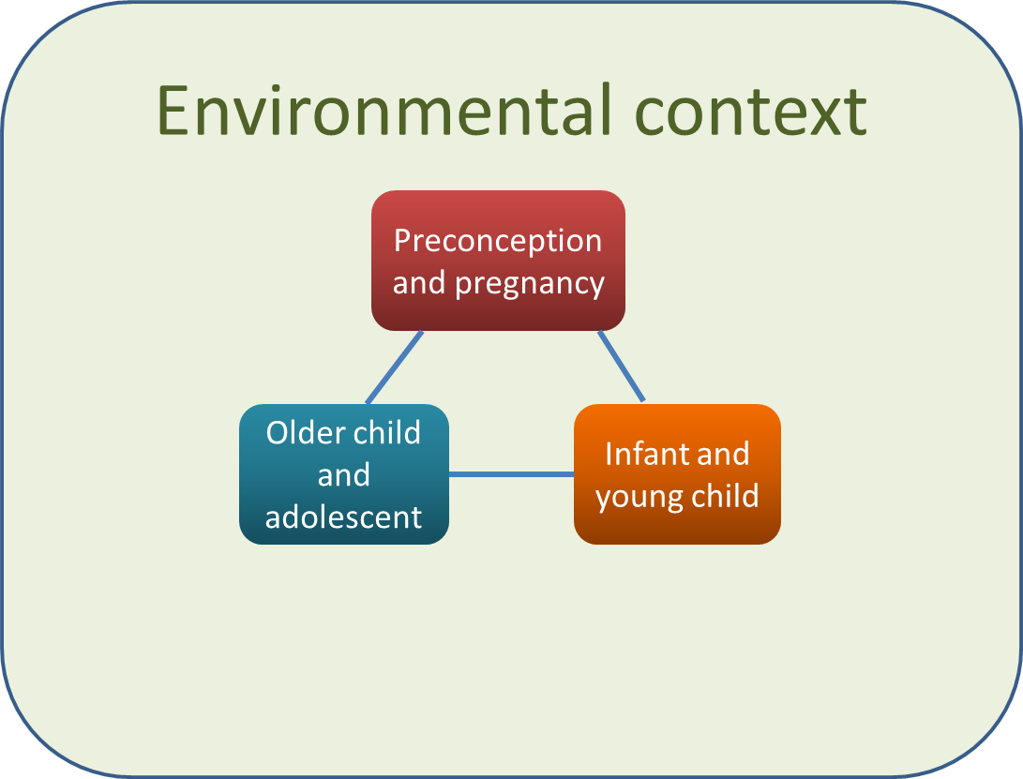
Conceptual framework
Notes:
Life-course approach
Concurrent interventions, sequential and cumulative
3 sensitive life periods identified as new or enhanced points of intervention
But in the context of the encompassing obesogenic environment
Path dependency develops across life-course

Slide 28
Goal of interventions to end childhood obesity
To
prevent children and adolescents from developing obesity, and
treat pre-existing obesity in children and adolescents,
in order to reduce the risk of morbidity and mortality due to noncommunicable diseases, the psychosocial effects of obesity both in childhood and adulthood and the trans-generational passage of risk of obesity.

Slide 29
Proposed strategic objectives
To shift environmental exposures and community capacity to support healthier eating and movement and sleep-related behaviours from preconception through adolescence.
To target healthy fetal development and maternal health status with respect to NCD prevention as part of overall strategies for optimizing fetal development and birth outcomes.
To target healthy child development with respect to obesity and NCD prevention as part of overall strategies for optimizing child development in the first 5 years of life.
To take full advantage of educational settings and related community contexts to foster healthy eating and movement environments and behaviours for children and adolescents while embedding school-oriented efforts into broader whole-community approaches.

Slide 30
Preliminary package of interventions
Focus on existing guidelines, where there is a need for more effective implementation and monitoring
Provide new avenues for intervention
Indicate how guidance can be leveraged and enhanced from perspective of ECHO
Interdependent and mutually reinforcing
Will be most effective if applied simultaneously
  childhood obesity is known to be influenced by previous exposure and intergenerational effects
Notes:
3 sensitive periods

Slide 31
Preliminary package of interventions for a healthier environment
Eliminate exposure of children and adolescents to the marketing of unhealthy foods and beverages through a variety of strategies.
Run large-scale, sustained social marketing programmes, including, but not limited to, mass media campaigns, with the aim of replacing the current unhealthy commercial marketing environment with a health-promoting one.

Slide 32
Preliminary package of interventions for a healthier environment
Implement fiscal policies, such as taxes on sugary beverages and high-fat, high-sugar manufactured snack foods and subsidies for healthy foods. These strategies could be directly linked to other childhood obesity prevention strategies.
Create safe, physical-activity friendly communities, which enable the use of active transport and improved access to natural spaces and places/facilities for active living.

Slide 33
Preliminary package of interventions for a healthier environment
Promote “policy coherence” between health and trade/investment policies and trade/agriculture agreements in order to ensure that international trade/investment law promotes – rather than hinders – public health objectives, and the prevention of childhood obesity more specifically.

Slide 34
Preliminary package of interventions for a healthier environment
Health care systems should provide family-based, multi-component lifestyle weight management services for children and young people affected by obesity as part of a community-wide, multi-agency approach to promoting a healthy lifestyle and preventing and managing obesity.
Notes:
These services should be provided as part of a contextually relevant/locally agreed obesity care or weight management pathway.
This also requires measures to ensure that health professional staff are trained and have the necessary knowledge and skills to provide these services.

Slide 35
Preliminary package of interventions for a healthier environment
Improve access to healthy foods through strengthening of local and regional food systems by, for example, encouraging support for local farmers/agriculture, production, processing and retailers.
Build legal capacity within all sectors of government to ensure childhood obesity prevention policies are compliant with national and international laws including treaties and agreements.

Slide 36
Preliminary package of interventions for a healthier environment
Ensure that all policies comply with the UN Convention on the Rights of the Child and take the best interest of the child as a primary consideration.

Slide 37
Preliminary package of interventions for preconception and pregnancy
Integrate current guidance for preconception and antenatal care with guidance for NCD prevention applicable to this life stage.

Slide 38
Preliminary package of interventions for infants and young children
Integrate targets related to healthful eating/feeding and movement behaviours with current guidance on best practices for parenting and child care during the first 5 years of life.
This could involve strengthening existing Infant and Young Child Feeding guidelines (ICYF) to include a focus on specific categories of foods (e.g., sugar-sweetened beverages or poor quality high energy density foods) for prevention of excess weight gain.

Slide 39
Preliminary package of interventions for infants and young children
States should respect, protect, and promote women’s rights to breastfeed their children, according to guidelines, using regulatory measures as needed.

Slide 40
Preliminary package of interventions for infants and young children
Use whole-of-community approaches to improve/strengthen processes and environments for early child care and education and parenting support in
  communities at large,
  the curricula and eating/physical activity environments in formal child care settings or institutions,
  health care delivery (e.g., primary or paediatric care) and
  through social institutions and community leaders (e.g., religious leaders).

Slide 41
Preliminary package of interventions for older children and adolescents
Strengthen the infrastructure for implementing whole-of-school programs that promote healthy eating, physical activity and reduce sedentary behaviours, including environmental modification (e.g. addressing available food choices and recreational spaces) and engage parents and the community, including health care providers, community health workers.
Programmes should ensure the engagement of older children and adolescents as actors

Slide 42
Preliminary package of interventions for older children and adolescents
Improve local access to healthy food retailers, restrict unhealthy food access around schools (e.g. through zoning) and increase access to potable water in schools.

Slide 43
Conclusions
The interventions focus on three stages of the life-course
  pre-conception and pregnancy
  infancy and early childhood, and
  older childhood and adolescence.
The pre-conception period is particularly novel, although there is a need to institute new approaches and strengthen existing ones at each period.

Slide 44
Conclusions
The new scientific evidence revealing trans-generational transmission of risk of obesity emphasises the need to commence interventions early and to sustain them.
For this reason the interventions during the three periods need to be instituted simultaneously.
Isolated interventions are unlikely to be effective.
Nevertheless, the precise interventions at each time will need to be context-specific.

Slide 45
Conclusions
During these critical periods, unhealthy responses to the contemporary obesogenic environment to which young people are increasingly exposed are partly established, or are exacerbated.
The suggested interventions are unlikely to be effective without simultaneous attention to reducing the exposure of, and impact on, young people of the obesogenic environment.

Slide 46

Thank you

Slide 47



