Slide 1
MIND diet and obsity
Somayeh Hosseinpour-Niazi, PhD
Nutrition and Endocrine Research Center
Research Institute for Endocrine Sciences
Shahid Beheshti University of Medical Sciences

Slide 2
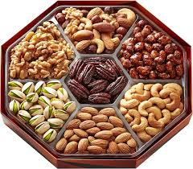
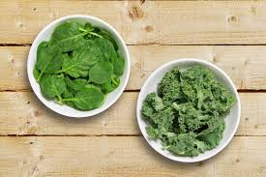
MIND diet and obsity
10 Foods to Eat on the MIND Diet

Slide 3
10 Foods to Eat on the MIND Diet
MIND diet and obsity
1) Green, leafy vegetables
Six or more servings per week
Includes kale, spinach, cooked greens and salads
2) All other vegetables
Try to eat another vegetable in addition to the green leafy vegetables at least once a day.
It is best to choose non-starchy vegetables because they have a lot of nutrients with a low number of calories

Slide 4
10 Foods to Eat on the MIND Diet
MIND diet and obsity
3) Berries
Eat berries at least twice a week
Includes strawberries, blueberries, raspberries and blackberries for their antioxidant benefits
4) Nuts
Try to get five servings of nuts or more each week
Don’t specify what kind of nuts to consume, but it is probably best to vary the type of nuts you eat to obtain a variety of nutrients.

Slide 5
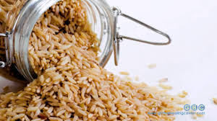
10 Foods to Eat on the MIND Diet
MIND diet and obsity
5) Olive oil
Use olive oil as your main cooking oil
The safety of cooking with olive oil.
6) Whole grains
Aim for at least three servings daily
Choose whole grains like oatmeal, quinoa, brown rice, whole-wheat pasta and 100% whole-wheat bread.

Slide 6
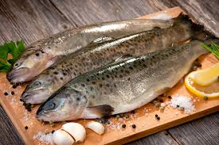
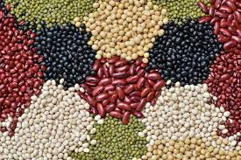
10 Foods to Eat on the MIND Diet
MIND diet and obsity
7) Fish
Eat fish at least once a week
It is best to choose fatty fish like salmon, sardines, trout, tuna and mackerel for their high amounts of omega-3 fatty acids.
8) Beans
Include beans in at least four meals every week
This includes all beans, lentils and soybeans.

Slide 7
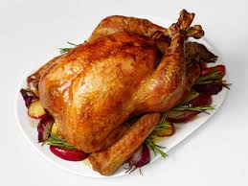
10 Foods to Eat on the MIND Diet
MIND diet and obsity
9) Poultry
Try to eat chicken or turkey at least twice a week
Note that fried chicken is not encouraged on the MIND diet

Slide 8
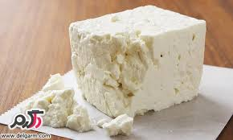
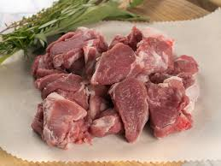
MIND diet and obsity
5 Foods to Avoid on the MIND Diet

Slide 9
MIND diet and obsity
5 Foods to Avoid on the MIND Diet
Butter and margarine
Try to eat less than 1 tablespoon (about 14 grams) daily
Instead, try using olive oil as your primary cooking fat, and dipping your bread in olive oil with herbs.
2) Cheese
limiting your cheese consumption to less than once per week

Slide 10
MIND diet and obsity
5 Foods to Avoid on the MIND Diet
3) Red meat
Aim for no more than three servings each week
4) Fried food
Discourages fried food, especially the kind from fast-food restaurants
Limit your consumption to less than once per week.

Slide 11
MIND diet and obsity
5 Foods to Avoid on the MIND Diet
5) Pastries and sweets
This includes most of the processed junk food and desserts you can think of. Ice cream, cookies, brownies, snack cakes, donuts, candy and more.
Try to limit these to no more than four times a week

Slide 12
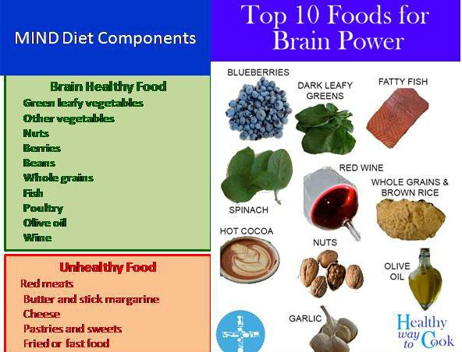
MIND diet and obesity

Slide 13
از توجه شما سپاسگزارم

