Slide 2
POSTOPERATIVE MANAGEMENT Of DTC
MS,Hosseini ,Associate Professor Of Endocrinology, Baqiyatallah University of Medical Science

Slide 3
Agenda
INITIAL MANAGEMENT
Postoperative remnant ablation
TSH suppression therapy
LONG-TERM MANAGEMENT
Serum Tg measurement
Implication of TgAb positivity in patients with DTC

Slide 4
Major Factors Impacting Decision Making in Radioiodine Remnant Ablation

Slide 5
recommendATION
RAI ablation is recommended for selected patients with 1- to 4-cm thyroid cancers confined to the thyroid, who have documented lymph node metastases, or other higher risk features when the combination of age, tumor size, lymph node status, and individual histology predicts an intermediate to high risk of recurrence or death from thyroid
Thyroid. 19(11):1167-214, 2009

Slide 6
remnant ablation
When the primary tumor is confined to the thyroid, is between 1 and 4 cm, and lacks other risk factors (worrisome histological subtypes, intrathyroidal vascular invasion, multifocal disease), patients are considered to be at low risk of death or recurrence
For these patients, RAI ablation is still controversial because of conflicting data concerning the benefit of the risk of recurrence

Slide 7
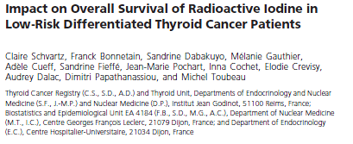
J Clin Endocrinol Metab 97:1526–1535, 2012

Slide 8
Patient characteristics according to RAI

Slide 9
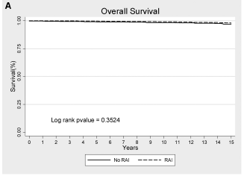

Slide 10
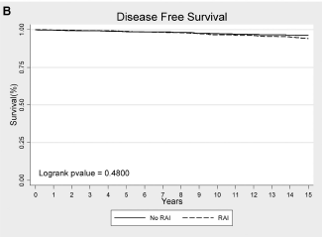

Slide 11
Conclusion
This study failed to prove any survival benefit of RAI after surgery in a large
cohort of low-risk DTC patients
Low-risk patients should not be overtreated

Slide 12
TSH suppression therapy
DTC expresses the TSH receptor on the cell membrane and responds to TSH stimulation by:
Increasing the expression of several thyroid specific proteins
Increasing the rates of cell growth
Suppression of TSH, is used to decrease the risk of recurrence
Thyroid 8:737–744,1998
Thyroid 16:1229–1242,2006
Ann Med 34:554–564,2002

Slide 13
RECOMMENDATION
Initial TSH suppression to below 0.1mU/L for:
high-risk and intermediate-risk patients
TSH at or slightly below the lower limit of normal (0.1–0.5mU/L) for:
low-risk patients and low-risk patients who have not undergone remnant ablation

Slide 14
long-term management
Major goals of long-term follow-up:
Accurate surveillance for possible recurrence
Measurement of serum Tg levels is an important modality to monitor patients for
residual or recurrent disease

Slide 15
Variables influencing the serum- Tg concentrations in DTC

Slide 16
Variables influencing the serum- Tg concentrations in DTC

Slide 17
Serum Thyroglobulin Measurements
Measurements in individual patients over time be performed in the same assay
Immunometric assays
Radioimmunoassays
In the absence of antibody interference, serum Tg has a high degree of sensitivity and specificity to detect thyroid cancer
Clin Endocrinol. 61:61–74,2004

Slide 18
Serum Thyroglobulin Measurements
Serum Tg measurements may fail to identify patients with relatively small amounts of residual tumor
Even TSH stimulated Tg measurement may fail to identify patients with clinically significant tumor due to:
Anti-Tg antibodies
Absent production and secretion of immunoreactive Tg
J Clin Endocrinol Metab. 62:376–379,2005
J Clin Endocrinol Metab. 88:4508–450,2005

Slide 19
RECOMMENDATION
Serum Tg should be measured every 6–12 months by an immunometric assay
Serum Tg should be assessed in the same laboratory and using the same assay, during follow up
Thyroglobulin antibodies should be quantitatively assessed with every measurement of serum Tg
Recommendation rating: A

Slide 20
Recommendation
Periodic serumTg measurements and neck US should be considered during follow-up of patients with DTC
who have undergone less than total thyroidectomy, and in patients who have had a total thyroidectomy
but not RAI ablation
While specific cutoff levels during TSH suppression
or stimulation that optimally distinguish normal
residual thyroid tissue from persistent thyroid cancer are unknown, rising Tg values over time are suspicious for growing thyroid tissue or cancer
Recommendation rating: B

Slide 21
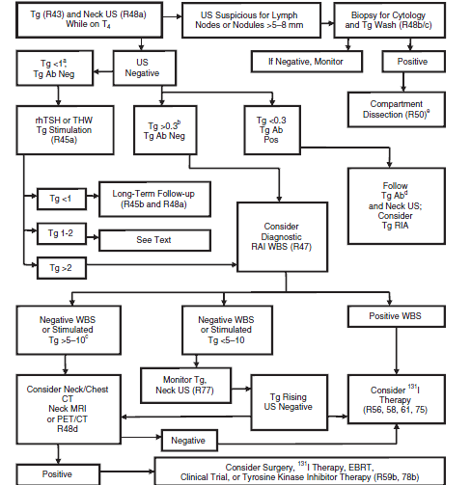
ALGORITHM for MANAGEMENT of DTC 6 TO 12 MONTHS after REMNANT ABLATION

Slide 22
Implication of TgAb positivity in patients with DTC

Slide 23
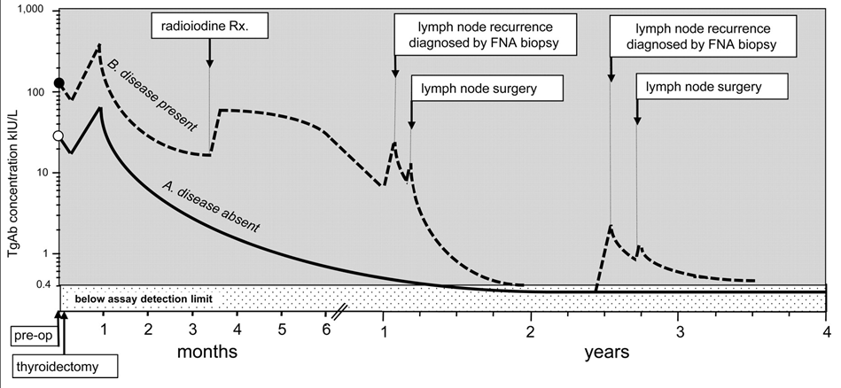
J Clin Endocrinol Metab.19,2011
Long-term serial TgAb monitoring

Slide 24
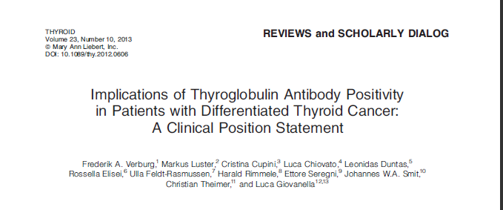
up to 25%–30% of patients with DTC have a positive test for TgAbs at the time of initial diagnosis
A small to moderate percentage of Patients show HAb interference in thyroglobulin measurement
Ann Intern Med 139:346–351,2003
Acta Endocrinol (Copenh) 119:373–380,1988
ClinChim Acta 388:211–213.2008
Clin Chem Lab Med 47:952–954.2009...

Slide 25
How to define a ‘‘positive’’ TgAb level in DTC patients?
Currently there is no consensus in the literature on how to define a positive test for TgAbs in DTC patients
up to 20%of samples may be misclassified if the MCOs are used to define a positive test for TgAbs
J Clin Endocrinol Metab 96:1283–1291,2011
Thyroid 13:659–661,2003

Slide 26
How to define a ‘‘positive’’ TgAb level in DTC patients?
The LoD is defined as the lowest concentration of an analyte that can be detected with a stated uncertainty
20% of DTC patients had TgAb levels between
the LoD and the MCO
J Clin Endocrinol Metab 96:1283–1291,2011

Slide 27
How to define a ‘‘positive’’ TgAb level in DTC patients?
LoQ is the level of the analyte at which the assay is able to reproduce the results with an interassay coefficient of variation not exceeding 20%
Using the LoQ instead of the LoD as a lower limit for TgAb detection would provide a higher degree of certainty
Further study is needed to confirm this

Slide 28
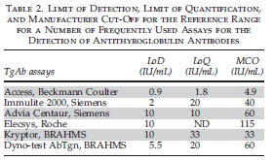

Slide 29
Recommendations

Slide 30
When should serum TgAb levels be measured?

Slide 31
Can serum TgAb levels be used as a surrogate tumor marker?
TgAb levels 6–12 months postablation have a remarkable prognostic significance:
TgAb-negative DTC patients had a disease-free survival rate of more than 95% over the
course of 160 months, while TgAb-positive
patients had a disease-free survival rate below 80%
J Clin Endocrinol Metab. 93:4683–4689,2008

Slide 32
Can serum TgAb levels be used as a surrogate tumor marker?
Based on a comparison of TgAb levels 6–12 months after
ablation to TgAb levels immediately before ablation, three
groups emerged in the
1)Those patients in whom postablation serum TgAb levels had dropped to less than 50% of the baseline value had a good prognosis with none of them showing recurrence
2)Those patients in whom serum TgAb levels had dropped less than 50%, but had not increased, had a disease-free survival of approximately 80%
3)Those in whom TgAb levels 6–12 months after ablation
had increased compared to baseline only had a 55% disease
-free survival during the subsequent follow-up
Cancer 117:4506–4511,2011

Slide 33
Recommendation

Slide 34
What type of follow-up is appropriate for patients with TgAbs?
It seems appropriate to differentiate
follow-up based on the course of serum TgAb levels:
Decreasing TgAb levels
Unchanged TgAb levels
Rising TgAb levels

Slide 35
Decreasing TgAb levels
Remission can be assumed and the follow-up may be less aggressive
The indication for dxWBS would be similar to that of a patient with undetectable Tg and a
negative TgAb test
The reappearance of TgAbs should prompt a strong suspicion of recurrence requiring an appropriate clinical work-up

Slide 36
Unchanged TgAb levels
In patients in whom serum TgAb levels neither rise nor fall considerably (<50%), the disease status is uncertain because the persistence of TgAbs may or may not indicate persistent disease
More intensive follow-up has to be considered
serum TgAb levels do not provide a sense of direction and serum Tg measurement cannot be used reliably, periodic dxWBS may well be the only method to ascertain the disease

Slide 37
Rising TgAb levels
In these patients ,progressive disease is likely
In addition to the routine cervical ultrasound, other diagnostic procedures, including radioiodine dxWBS and, if negative, further imaging methods, should be undertaken

Slide 38
RECOMMENDATIONS

Slide 39
What type of follow-up is appropriate for patients with TgAbs?

Slide 40
Thanks

Slide 41
J Clin Endocrinol Metab. 10. 2013

Slide 42
The purpose: to determine diagnostic performance of hsTg assays in the follow-up of DTC patients and demonstrate whether and when basal hsTg measurement could
replace stimulated Tg measurement in the follow-up of DTC patients

Slide 43
definitions
FS: the concentration that results in an interassay coefficientof variation (CV) 20%
Two different cut-off values for positivity of serum stimulated Tg measurement ,was considered
True positive: a basal hsTg level ≥ 0.1 ng/ml in a DTC patient with a positive stimulated Tg
True negative: a basal hsTg level< 0.1 ng/ml in a DTC patient with a negative stimulated Tg
false positive: a basal hsTg assay≥ 0.1 in a DTC patient with a negative stimulated Tg
false negative: a basal hsTg assay< 0.1 in a DTC patient with a positive stimulated Tg

Slide 46
conclusion
Basal hsTg measurement has a very high NPV but an insufficient PPV for monitoring
DTC patients
Therefore, a Tg stimulation test can be avoided in patients with an undetectable basal hsTg whereas a stimulated Tg measurement should be considered when hsTg levels are Detectable
.

