Slide 1
Case presentation
MALBOOSBAF, Ramin. MD.
4 JAN 2017

Slide 2
Case 1
خانم نسرین. ش
56 y/o ,Woman, New case of DM
PH: HTN(-) IHD(-) Thalassaemia Minor (+)
Retinopathy(-) Nephropathy(-)
HH: Smoking(-)
W: 93 Kg, H: 162Cm, BMI: 35.4, BP: 130/80
Drug Hx:
Tab Atorvastatin 20 mg/d,

Slide 3
Case 1
W=93 kg
1395/6/10
Lab Data:
FBS: 126mg/dl
A1C: 5.6% (N<6%)
Cr: 1 mg/dl
TG: 150 mg/dl
Total Cholesterol: 164 mg/dl
HDL Cholesterol: 56 mg/dl
LDL Cholesterol: 80 mg/dl
AST: 15
ALT: 17
Hb: 11.6
TSH: 2.58 µIU/ml
T4: 10.8 µg/dl
خانم نسرین. ش

Slide 4
Case 1
خانم نسرین. ش
What is your recommendation?
Lifestyle Management only (for 3 Month)
Lifestyle Management & Add Metformin
Lifestyle Management & Add sulfonylurea
Lifestyle Management & Add Liraglutide

Slide 5
ADA 2017
Metformin monotherapy should be started at diagnosis of type 2 diabetes unless there are contraindications.
Metformin is effective,
safe and
inexpensive,
and may reduce risk of cardiovascular events and death .

Slide 6
Case 1
خانم نسرین. ش
R
Tab ASA 80 mg/d
TaB Atorvastatin 20 mg/d
Tab Metformin 500 mg/BD

Slide 7
Case 1
W=93 kg
W=92 kg
خانم نسرین. ش
1395/6/10
Lab Data:
FBS: 126mg/dl
A1C: 5.6% (N<6%)
Cr: 1 mg/dl
TG: 150 mg/dl
Total Cholesterol: 164 mg/dl
HDL Cholesterol: 56 mg/dl
LDL Cholesterol: 80 mg/dl
AST: 15
ALT: 17
Hb: 11.6
TSH: 2.58 µIU/ml
T4: 10.8 µg/dl
1395/9/20
Lab Data:
FBS: 95mg/dl
A1C: 5.4% (N<6%)
Cr: 0.9 mg/dl
TG: 230mg/dl
Total Cholesterol: 161 mg/dl
HDL Cholesterol: 39 mg/dl
LDL Cholesterol: 80 mg/dl
AST: 16
ALT: 16
25(OH)Vit D: 3.3 ng/mL

Slide 8
Case 2
آقای محمد. ر
59 y/o ,Man, DM from 15 years ago
PH: HTN(-) IHD(-)
Retinopathy(-) Nephropathy(-)
HH: Smoking(-)
W: 81 Kg, H: 170 Cm, BMI: 28.0, BP: 145/80
Drug Hx:
Tab Metformin 500 mg/BD

Slide 9
Case 2
81kg
آقای محمد. ر
1395/9/20
Lab Data:
FBS: 188 mg/dl
A1C: 9 % (N<6%)
Cr: 1.1 mg/dl
TG: 79 mg/dl
Total Cholesterol: 160 mg/dl
HDL Cholesterol: 58 mg/dl
LDL Cholesterol: 86 mg/dl
Hb: 15.4
TSH: 3
Urine Pr (24h): 80 mg

Slide 10
Case 2
آقای محمد. ر
What is your recommendation?
Increase dose of Metformin to 1500mg/d
Add sulfonylurea
Add Sitagliptin
Add Liraglutide
Add Basal Insulin
Increase dose of Metformin to 1500mg/d
& Add sulfonylurea

Slide 11
Case 2
آقای محمد. ر
R
Tab ASA 80 mg/d
Tab Atorvastatin 10 mg/d
Tab Metformin 1500 mg/d
Tab Gliclazide MR 30 mg/d

Slide 12
Case 3
آقای غلام. ر
84y/o ,Man, DM from 6 Months ago
Referred by Nephrologist
PH: HTN(+) IHD(-)
Retinopathy(-) Nephropathy(+)
HH: Smoking(-)
W: 70Kg, H: 168Cm, BMI: 24.8, BP: 130/70
Drug Hx:
Tab Glibenclamide 5 mg/TID,
Tab Valsartan 80 mg/BID,
Tab Methoporolol 50mg/BID,
Tab Amlodipin 5mg/BID,
Tab ASA 80 mg/d,
Tab Atorvastatin 10 mg/d.

Slide 13
Case 3
W=70 kg
آقای غلام. ر
1393/9/23
Lab Data:
FBS: 119 mg/dl
BS (2hpp): 220 mg/dl
A1C: 6.6 % (N<6.1%)
Cr: 1.62 mg/dl
TG: 96mg/dl
Total Cholesterol: 187 mg/dl
HDL Cholesterol: 36 mg/dl
LDL Cholesterol: 122 mg/dl
AST: 13
ALT: 12
Urine Pr (24h): 2800 mg
eGFR= 38 ml/min/1.73 m2

Slide 14
Case 3
آقای غلام. ر
What is your recommendation?
Deacrese dose of Glibenclamide to 10 mg/d
Add Metformin
DC of Glibenclamide & Add Pioglitazone
DC of Glibenclamide & Add Metformin
DC of Glibenclamide & Add Repaglinide
DC of Glibenclamide & Add Sitagliptin
DC of Glibenclamide & Add Basal Insulin

Slide 15
Renal failure & OHA
eGFR:
The Chronic Kidney Disease Epidemiology Collaboration (CKD-EPI) equation is generally preferred (ADA 2017).
eGFR is routinely reported by laboratories with serum Cr,
eGFR calculators are available from http://www.nkdep.nih.gov.

Slide 16
Renal failure & Metformin
Many diabetologists as well as practitioners are fear to use metformin in patients with renal problems even if they have only albuminuria.
Nevertheless, analysis of data from may trials from Cochrane Database systematic review in 2010, showed no cases of lactic acidosis in 70490 patient-years of metformin.

Slide 17
Renal failure & Metformin
Kidney function be assessed using (eGFR) instead of blood creatinine concentration.
Metformin may be safely used in patients with eGFR ≥30 mL/min/1.73 m2.

Slide 18
Renal failure & Glibenclamide
Glibenclamide (glyburide) is metabolized in the liver and excreted by the kidneys equally and intestine.
Hypoglycemia may be serious and lasting more than 24 h in CKD.
The drug is contraindicated in eGFR < 60 mL/min.

Slide 19
Renal failure & Gliclazide
Gliclazide is metabolized by the liver to inactive metabolites that are eliminated in the urine.
Thus, gliclazide causes less hypoglycemia than other sulfonylureas.
In eGFR > 30 mL/min gliclazide can be used.

Slide 20
Gliclazide MR
1 tablet of Gliclazide MR 30 mg is comparable to 1 tablet of Gliclazide 80 mg Tablets.
The recommended starting dose is 30 mg daily; taken orally in a single intake at breakfast time.
The maximum recommended daily dose is 120 mg.
The safety and efficacy in children and adolescents have not been established.
There is no or limited amount of data (less than 300 pregnancy outcomes) from the use of gliclazide in pregnant women.
it is preferable to avoid the use of Gliclazide during pregnancy.
It is unknown whether gliclazide or its metabolites are excreted in human milk.
Given the risk of neonatal hypoglycaemia, the product is therefore contra-indicated in breast-feeding mothers.

Slide 21
Renal failure & Repaglinide
Repaglinide is exclusively metabolized in the liver to inactive metabolites and secreted in the bile.
Repaglinide can be used even in CKD stages 4 and 5 without dose reduction.
In patients with a GFR ≤30 ml/min/1.73 m2 starting with a 0.5 mg does before each meal and gradually increasing the dose.

Slide 22
Renal failure & Acarbose
Acarbose is contraindicated in liver cirrhosis and IBD (inflammatory bowel disease).
The National Kidney Foundation (NKF) advise avoiding acarbose if the GFR <30 ml/min/1.73 m2.

Slide 23
Renal failure & GLIPTINES
Sitagliptin:
100 mg daily, regardless of food.
Sitagliptin is excreted in the intact form in the urine.
Dose to be reduced to
50 mg/d if GFR 30-50 or
25 mg/d if GFR <30.
Vildagliptin:
50 mg BID, regardless of food.
reduce the daily dose to
50 mg/d if GFR <50.
Vildagliptin may be associated with an increase in the liver enzymes and is contraindicated in liver impairment.

Slide 24
Renal failure & Pioglitazone
Pioglitazone has only and exclusively hepatic metabolism; This class should be avoided in the presence of heart failure and liver disease.
Pioglitazone increases the risk of bladder cancer and was banned in Japan, India, Australia and Canada.
However, a recent study of a large cohort failed to demonstrate a significant association between pioglitazone use and the risk of bladder cancer.
It does not cause hypoglycemia and it can be given theoretically without dose adjustment at all stages of CKD.
Pioglitazone is related with
fluid retention,
anemia and
osteoporosis.
These side effects complicate the existing problems with anemia and bone disease in subjects with diabetes and CKD.

Slide 25
Renal failure & Liraglutide
Liraglutide is degraded entirely in the body and is not excreted in urine and feces.
These characteristics indicate that we can use in all stages of CKD.
Nevertheless we have not yet clinical studies in patients with eGFR < 60 mL/min.

Slide 26
Case 3
آقای غلام. ر
R
Tab ASA 80 mg/d
Tab Atorvastatin 10 mg/d
DC of Glibenclamide
Tab Repaglinide 2mg/TID

Slide 27
Case 3
W=70 kg
W=69 kg
آقای غلام. ر
1393/9/23
Lab Data:
FBS: 119 mg/dl
BS (2hpp): 220 mg/dl
A1C: 6.6 % (N<6.1%)
Cr: 1.62 mg/dl
TG: 96mg/dl
Total Cholesterol: 187 mg/dl
HDL Cholesterol: 36 mg/dl
LDL Cholesterol: 122 mg/dl
AST: 13
ALT: 12
Urine Pr (24h): 2800 mg
1394/1/15
Lab Data:
FBS: 101 mg/dl
BS (2hpp): 233 mg/dl
A1C: 6.3 % (N<6.1%)
Cr: 1.54 mg/dl
TG: 76 mg/dl
Total Cholesterol: 141 mg/dl
HDL Cholesterol: 37 mg/dl
LDL Cholesterol: 80 mg/dl
AST: 13
ALT: 14
Hb: 13.8

Slide 28
Case 4
آقای حبیب ا... ک
60y/o ,Man, DM from 2 years ago
PH: HTN(+) IHD(+) CABG(+) CHF(+) (LVEF=30%)
Retinopathy(-) Nephropathy(-)
HH: Smoking(-)
W: 96 Kg, H: 181 Cm, BMI: 29.3, BP: 130/80
Drug Hx:
Tab Metformin 500 mg/TID
Tab Acarbose 50 mg/BD
Tab Atorvastatin 20 mg/d
Tab ASA mg/d
Tab Losartan 20 mg/BD
Tab digoxin 0.25 mg/d
Tab Carvedilol 6.25mg/BD

Slide 29
Case 4
W=96 kg
آقای حبیب ا... ک
1394/7/28
Lab Data:
FBS: 105 mg/dl
BS (2hpp): 188mg/dl
A1C: 7.3% (N<6%)
Cr: 1.1 mg/dl
TG: 138mg/dl
Total Cholesterol: 125 mg/dl
HDL Cholesterol: 32 mg/dl
LDL Cholesterol: 54 mg/dl
AST: 24
ALT: 24

Slide 30
Case 4
آقای حبیب ا... ک
What is your recommendation?
DC of Metformin & Lifestyle Management
DC of Metformin & Add sulfonylurea
DC of Metformin & Add Pioglitazone
DC of Metformin & Add Liraglutide
DC of Metformin & Add Basal Insulin
Keep Metformin & Add Sitagliptin

Slide 31
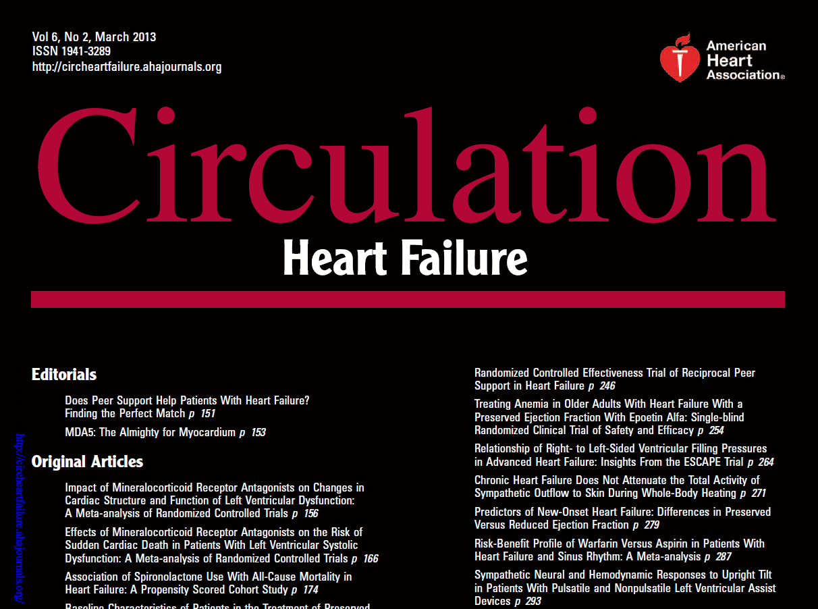
Heart failure & Metformin
Notes:
Historically, metformin had been considered absolutely contraindicated in patients with HF due
to concerns about lactic acidosis.9 However, both the US Food and Drug Administration (2006)
and Health Canada (2010) have removed the absolute HF contraindication from metformin
(although strong warnings persist) 9, 10 in response to observational studies and clinical
experience suggesting that the risk of metformin-associated lactic acidosis is minimal and similar
to that of other diabetes drugs

Slide 32
Heart failure & Metformin
Metformin was associated with reduced mortality compared to controls (mostly sulfonylurea):
pooled adjusted risk estimates 0.80, (0.74-0.87); P<0.001.
Metformin was associated with a small reduction in all-cause hospitalizations: pooled estimate 0.93, (0.89- 0.98), P=0.01.
Metformin was not associated with increased risk of lactic acidosis.

Slide 33
Heart failure & Metformin
Conclusions:
Metformin is at least as safe as other glucose lowering treatments in patients with diabetes and HF, even in those with reduced LVEF or concomitant CKD.
Metformin should be considered the treatment of choice for those with diabetes and HF.

Slide 34
ADA 2017
In patients with DM-2 with
stable CHF, metformin may be used if eGFR > 30 mL/min,
But should be avoided in unstable or hospitalized patients with CHF.

Slide 35
Case 4
آقای حبیب ا... ک
R
Tab ASA 80 mg/d
Tab Atorvastatin 10 mg/d
Tab Metformin 1500 mg/d
Tab Acarbose 50 mg/d
Tab Sitagliptin 100 mg/d

Slide 36
Case 4
W=96 kg
آقای حبیب ا... ک
W=96 kg
1394/11/8
Lab Data:
FBS: 105 mg/dl
BS (2hpp): 188mg/dl
A1C: 7.3% (N<6%)
Cr: 1.1 mg/dl
TG: 138mg/dl
Total Cholesterol: 125 mg/dl
HDL Cholesterol: 32 mg/dl
LDL Cholesterol: 54 mg/dl
AST: 24
ALT: 24
1395/3/20
Lab Data:
FBS: 95mg/dl
BS (2hpp): 145mg/dl
A1C: 6.6% (N<6%)
Cr: 1.1mg/dl

