Slide 1
Mediterranean diet and obesity
Somayeh Hosseinpour-Niazi, PhD
Nutrition and Endocrine Research Center
Research Institute for Endocrine Sciences
Shahid Beheshti University of Medical Sciences

Slide 2
Mediterranean diet and obesity
In the weight loss studies lasting 1 year or longer reviewed by the ADA only 2 study groups achieved weight losses of 5% or greater:
Mediterranean- style eating pattern (26.2 kg) in persons with newly diagnosed diabetes
The intensive lifestyle intervention in the Look AHEAD (Action for Health in Diabetes) (28.4 kg)
The other weight loss interventions resulted in weight losses of less than 5% (4.8 kg or less) at 1 year
The weight losses greater than 5% : improvements in A1C, lipids, and blood pressure
Esposito et al, 2009, Look AHEAD Research Group, 2010; Franz, 2013; Evert et al, 2013

Slide 4
Mediterranean diet and obesity
Feature of Mediterranean diet
Enjoying meals with family and friends
Getting plenty of exercise

Slide 5
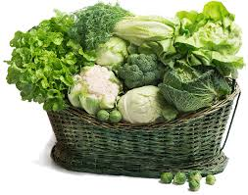

Mediterranean diet and obesity
Feature of Mediterranean diet
Fruit and vegetables
An abundance and variety of plant foods should make up the majority of your meals
Strive for seven to 10 servings a day of veggies and fruits
Greater number of servings of fruits and vegetables (mostly fresh) with an emphasis on root vegetables and greens vegetables
Using herbs and spices instead of salt to flavor foods

Slide 6
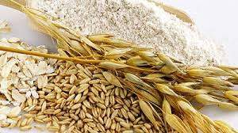
Mediterranean diet and obesity
Grains :
Are typically whole grain
Bread is an important part of the diet
Usually contain very few unhealthy trans fats
Bread is eaten plain or dipped in olive oil
Bread contain no saturated or trans fats

Slide 7

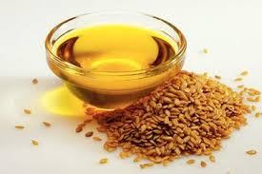
Mediterranean diet and obesity
Features of the diet
FAT and OILS
Moderate in total fat (32% to 35%)
Relatively low in saturated fat (9% to 10%)
High in polyunsaturated fatty acids (especially omega-3)
High levels of monounsaturated fatty acids such as olive oil
Use of olive oil, canola oil, nut oil, or margarine blended with rapeseed oil or flaxseed oil.

Slide 8
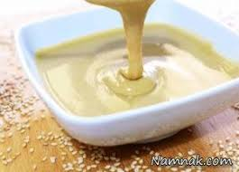
Mediterranean diet and obesity
FAT and OILS
Try olive or canola oil as a healthy replacement for butter or margarine
Use it in cooking
Dip bread in flavored olive oil or lightly spread it on whole-grain bread for a tasty alternative to butter.
Try tahini as a dip or spread
Mediterranean-style diet rich in monounsaturated fats can be an effective alternative to a diet low in total fat but relatively high in carbohydrates.
The type of fats consumed is more important than total amount of fat when looking at metabolic goals and CVD risk

Slide 9
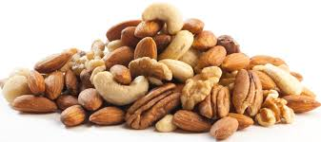
Mediterranean diet and obesity
Nuts:
Nuts are high in fat (approximately 80 percent of their calories come from fat)
Because nuts are high in calories, they should not be eaten in large amounts — generally no more than a handful a day
Most of the fat is not saturated
Avoid candied or honey-roasted and heavily salted nuts

Slide 10
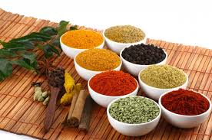
Mediterranean diet and obesity
Herbs and spices
Using herbs and spices instead of salt to flavor foods
Herbs and spices make food tasty and are also rich in health-promoting substances.
Season your meals with herbs and spices rather than salt

Slide 11
Mediterranean diet and obesity
Fish and seafood
Fatty fish- such as mackerel, lake trout, herring, sardines, albacore tuna and salmon
Rich sources of omega-3 fatty acids
Fish is eaten on a regular basis in the Mediterranean diet.
Eat fish once or twice a week
Fresh or water-packed tuna, salmon, trout, mackerel and herring are healthy choices
Grilled fish tastes good and requires little cleanup.
Avoid fried fish, unless it's sauteed in a small amount of canola oil.

Slide 12
Mediterranean diet and obesity
Dairy products
Limit higher fat dairy products such as whole or 2 percent milk, cheese and ice cream.
Switch to skim milk, fat-free yogurt and low-fat cheese.

Slide 13
Mediterranean diet and obesity
MEAT
Substitute fish and poultry for red meat
When eaten, make sure it's lean and keep portions small (about the size of a deck of cards)
Also avoid sausage, bacon and other high-fat meats.

Slide 14
Mediterranean diet and obesity

Slide 15
Mediterranean diet and obesity

Slide 16
Mediterranean diet and obesity

Slide 17

از توجه شما سپاسگزارم

