Slide 1
Oral Hypoglycemic agent Treatment of T2DM
A.Amouzegar, MD
Endocrine Research Center,
Research Institute for Endocrine sciences
12.2.98

Slide 2
Agenda
Review ADA guideline
Case presentations
Conclusion

Slide 3
Patient-Centric Focus of 2016 AACE/ACE and 2015 ADA/EASD Recommendations
T2DM

Slide 4
Drug choice
Patient- centered approach
Cost
Level of HbA1C
HbA1C goal
Weight
Hypoglycemia
Established ASCVD or CKD or HF

Slide 5
Clinical Inertia: A Hurdle in Insulin Therapy

Slide 6
Pharmacological therapy
Metformin is the preferred initial pharmacologic agent for the treatment of T2DM.
Once initiated, metformin should be continued as long as it is tolerated and not contraindicated; other agents, including insulin, should be added to metformin.
Consider initiating dual therapy in patients with newly diagnosed T2DM who have A1C >1.5% above their glycemic target.
Intensification of treatment for pts with T2DM not meeting treatment goals should not be delayed.

Slide 7
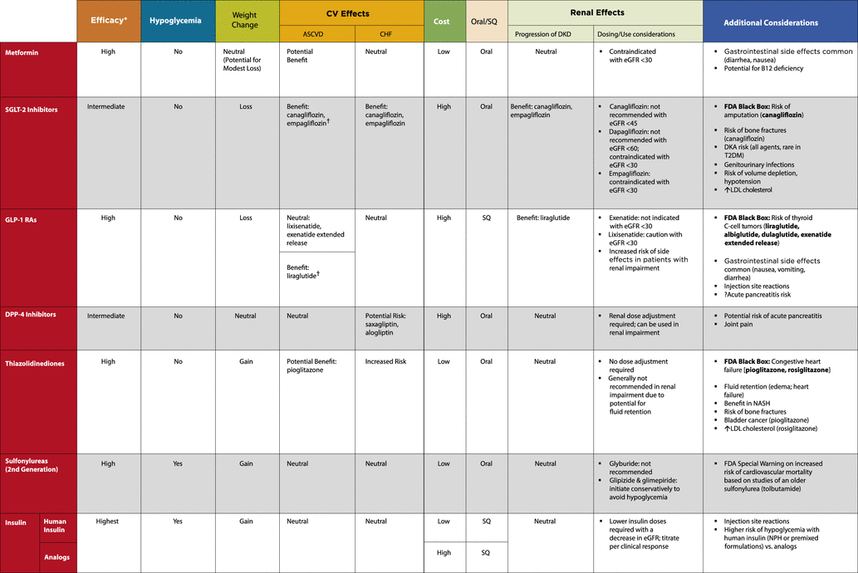

Slide 8
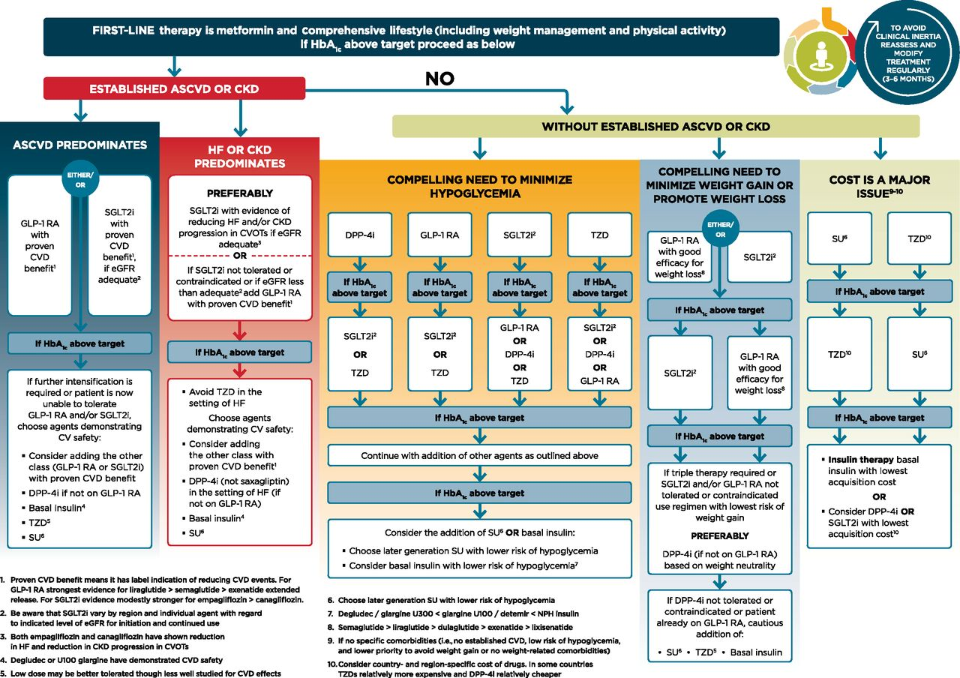

Slide 9
Case presentation 1
61-year-old man, history of T2DM and 4 years, Metformin monotherapy .
HbA1c level 7.4%
History of obesity,HTN,Hyperlipidemia,BPH
Currently taking metformin, Lisinopril/Hydrochlorothiazide combination,amlodipine,rosuvastatin
PHEx: BP reasonably controlled, overweight, mild acanthosis
What do you recommend for the patients?

Slide 10
Cont
1- Sitagliptin 100 mg /D
2- Empagliflozin 10 mg/D
3- liraglutide 1.2mg D
4- Gliclazide 40 mg /D

Slide 11
Case Presentation 2
A 53-year old male (height: 167; weight 80 kg, BMI28.6 kg/m2) was diagnosed with T2DM.
His FPG level was 174 mg/dL and HbA1c value was suboptimal at 8.4%.
The patient had normal renal and hepatic function.
He stated that he had gained a significant amount of weight over the past 2 years, and he largely attributed this to both his increasingly stressful workload and sedentary lifestyle since switching jobs.
He was instructed by his physician to modify his diet, increase his level of activity as much as possible, and was prescribed oral metformin (2000 mg daily) to be taken with meals.

Slide 12
Cont
At a follow-up examination 3 months later, the patient's status had not really changed that significantly;
He weighed 83 kg, his FPG was 157 mg/dL, and his HbA1c was 8.0%.
He admitted that he had not really increased his level of exercise or modified his diet that much, but insisted that he was taking his metformin every day.
What do you do for the patient before adding another drug?
What is the best second choice for him?

Slide 13
Cont
1- Tab Gliclazide 80mg, BiD
2- Tab Empagliflozine ,10 mg daily
3- Pen Liraglutide ,1.2 mg daily
4- Tab Sitagliptin ,100 mg daily

Slide 14
Case presentation 3
A 46-year-old obese businessman (BMI = 32 kg/m ²) with hypertension and T2DM of 8 years' duration presented with poor glycemic control (HbA1c - 9.4%).
He was on maximal dosage of metformin and Gliclazide and has been following his diet and exercise schedule very strictly.
He has Hyperlipidemia treated with Atorvastatin 20 mg/daily and his current LDL was 120 mg/dl.
He is also concerned about his weight and wants advice on which class of oral antidiabetic drug would be best suited in his case that may provide efficacious glycemic control, weight loss, and cardiovascular protection.
What do you do for the patient?

Slide 15
Cont
1- Add Liraglutide as the third drug
2-Stop Gliclazide and add Lirglutide
3- Insulin initaion
4- Add Empagliflozin

Slide 16
Case presentation 4
A 49-year-old man with a history of diabetes, diagnosed at the age of 43, associated with renal impairment.
The patient underwent nephrectomy due to a renal cell carcinoma and experienced two heart attacks. His mother was diabetic.
BP 145/95 mmHg under control with ramipril 5 mg, absence of edema, BW 104 kg, height 181 cm, BMI 31.25 kg/m².
The blood parameters : Cr of 1.3 mg/dL, BUN 25 mg/dL, FPG 145 mg, Hb1Ac 7.8 %, TG 405 mg/dL, TC 281 mg/dL, LDL 145 mg/dL, and microalbuminuria 136 mg/L.
GFR calculated by MDR Dequation was 60 mL/min/1.73 m².
With regard to organ impairment, the fundus oculi showed an initial damage with rare microaneurysm and intraretinal hemorrhages, without edema or exudates.
The echocardiogram showed normal values for the whole cardiac measurement except for (LVH), with a normal result of 60% for the LVEF and without valvular abnormalities.

Slide 17
Cont
The glycemic parameters were not kept under control with metformin 1000 mg twice a day.
The patient was a nonsmoker, not addicted to alcohol, but his overweight suggested that a prompt lifestyle change was mandatory.
What do you for the patient?
Is the BP under control?
Is lipid profile within the recommended goal?
What do you do for his weight?

Slide 18
What is the best option for glucose control?
What is the best option for glucose control?
1-Adding a GLP1 agonist
2-Adding a SGLT2 inhibitor
3-Adding a SU
4-adding a Dpp4i

Slide 19
Case Presentation 5
59-year-old woman who has had type 2 diabetes (T2D) for 10 years, which she manages with diet and metformin. She’s a nonsmoker. She had a myocardial infarction one year ago, and was recently hospitalized for heart failure (HF).
Her HbA1c is 9.2 % and LDL-C is 99 mg/dL, with a blood pressure (BP) of 138/88 mm Hg.
In addition to metformin, the patient is on 80 mg of atorvastatin and is taking daily aspirin.
What is the next best choice for her?

Slide 20
Cont
1-Empagliflozin
2-Sitagliptin
3-Liraglutide
4-Gliclazide

Slide 21
Cont
The who has T2DM, ASCVD and a history of recent HF hospitalization, empagliflozin may be the preferred second agent.
Empagliflozin :Effective in reducing HF hospitalizations by 35 %, a secondary endpoint demonstrated in the EMPA-REG OUTCOME clinical trial, besides the 14 % overall reduction in the primary cardiovascular disease composite endpoint and the reported 38 % reduction in cardiovascular disease death.
While liraglutide was shown in the LEADER trial to reduce by 13 % the composite cardiovascular disease endpoint (and reduce CV death by 22 %), there was no significant reduction in HF hospitalizations.
N Engl J Med 2015;373:2117-28
N Engl J Med 2016;375:311-22.

Slide 22
Case presentation 6
A 46 year-old woman with recent onset polyuria, BMI 28 kg m2,
BP, 139/95 LDL, 89 mg/dl
No remarkable past medical history
FBS 172 mg/dl, HbA1C, 8.9%
No CVD, No HF, Normal renal function
How do you approach to the patient?

Slide 23
Case Presentation 7
A 76- year old man with recent onset of T2DM
Has a long history of hypertension but is active and healthy
He walks 1 h daily and plays golf 3 days per week
His wife cooks the meals and has worked to change their diet given his recent diagnosis
MBI, 26 kg/m2 HbA1C,7.9%
eGFR 40 ml/min/1.732 m²
What is the best drug for him?

Slide 24
Cont
Gliclazide, 40 mg BID
Sitagliptin, 100 mg/D
Metformin, 1000 mg/D
Linagliptin, 5 mg / D

Slide 25
Treatment consideration
Consider target of ≤ 7.5% without causing hypoglycemia
Approach cautiously based on age
DPP-4 inhibitors ( oral-weight neutral, low risk hypo) is a reasonable choice
Consider dose adjustment
InZucci SE, et al.Diabetes Care . 2015
Abbetacola Am ,et al. Drug aging . 2008

Slide 26
Conclusion
Patient center approach
Cost is one of the most important barriers
Consider other aspect of treatment, weight management and life style change
Intensification in right time
We need a medical multidisciplinary team

Slide 27
با تشکر از توجه شما

