Slide 1
Diabetic nephropathy
s.Jafary nodushan
Fellow of endocrinology
Research institute for endocrine sciences.
Shahid Beheshti University of Medical Sciences.
Jul.2017

Slide 2
Agenda
Prevalence
Natural history
Pathogenesis
Pathology
Staging
Screening
Measurements of urinary albumin (Literature review)
Recommendations
Diagnosis
Normoalbuminuric renal impairment in diabetes (Literature review)
novel biomarkers for the early detection of Diabetic nephropathy
Surveillance

Slide 3
prevalence
Diabetic kidney disease, or CKD attributed to diabetes, occurs in 20–40% of patients with diabetes and is the leading cause of end-stage renal disease (ESRD).
Diabetic kidney disease typically develops after a diabetes duration of 10 years, or at least 5 years in type 1 diabetes,but may be present at diagnosis of type 2 diabetes

Slide 4
Natural history of diabetic nephropathy
WILLIAMS TEXTBOOK OF ENDOCRINOLOGY,13THEDITION

Slide 5
Time course of development of diabetic nephropathy.

Slide 6
Pathogenesis
WILLIAMS TEXTBOOK OF ENDOCRINOLOGY,13THEDITION

Slide 7
pathology

Slide 8
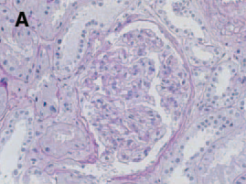
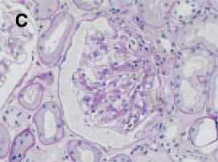
Glomerular classification of DN
Class I : Mild or nonspecific LM changes and
EM-proven GBM thickening
Biopsy does not meet any of the criteria
mentioned below for class II, III, or IV
GBM 395 nm in female and 430 nm
in male individuals 9 years of age and
oldera
Clas IIa : Mild mesangial expansion
Biopsy does not meet criteria for class III or IV Mild mesangial expansion in ˃25% of the observed mesangium
Journal of the American Society of Nephrology, 2010

Slide 9
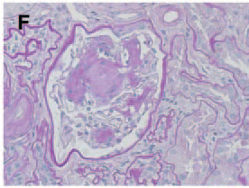
Class IIb : Severe mesangial expansion
Biopsy does not meet criteria for class
III or IV
Severe mesangial expansion in ˃25% of
the observed mesangium
Class III : Nodular sclerosis (Kimmelstiel–
Wilson lesion)
Biopsy does not meet criteria for class
IV
At least one convincing Kimmelstiel–
Wilson lesion
Journal of the American Society of Nephrology, 2010

Slide 10
Class IV: Advanced diabetic
glomerulosclerosis
Global glomerular sclerosis in ˃50% of
Glomeruli Lesions from classes I through III
Journal of the American Society of Nephrology, 2010

Slide 11
Tubulointerstitial and Vascular Lesions in DN
Journal of the American Society of Nephrology, 2010

Slide 12
Staging of DN

Slide 13
American Journal of Kidney Diseases, 2007

Slide 14
Screening of DN
Screening should include:
● Measurements of urinary albumin
● Measurement of serum creatinine
and estimation of GFR
American Journal of Kidney Diseases, 2007

Slide 15
American Journal of Kidney Diseases, 2007

Slide 16
Measurements of urinary albumin
(Literature review)

Slide 17
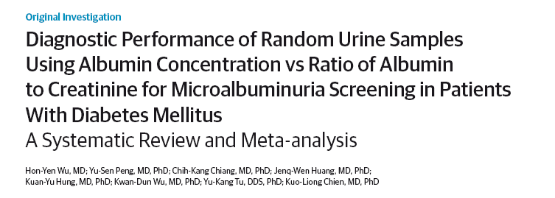
OBJECTIVE To compare the diagnostic performance of the UAC vs the ACR in random urine samples for microalbuminuria screening among patients with DM.
STUDY SELECTION Clinical studies assessing the UAC or the ACR of random urine samples in detecting the presence of microalbuminuria among patients with DM using a urinary albumin excretion rate of 30 to 300mg/d in 24-hour timed urine collections as the criterion standard

Slide 18
MAIN OUTCOMES AND MEASURES : The primary end pointwas the diagnostic performance measures of the UAC or the ACR in random urine samples, as well as comparisons between them.
RESULTS : We identified 14 studies, with a total of 2078 patients; 9studies reported on the UAC, and 12 studies reported on the ACR. Meta-analysis showed pooled sensitivities of 0.85 and 0.87 for the UAC and the ACR, respectively, and pooled specificities of 0.88 and 0.88,respectively. No differences in sensitivity (P = .70), specificity (P = .63), or diagnostic odds ratios (P = .59) between the UAC and the ACR were found. The time point of urine collection did not affect the diagnostic performance of either test.

Slide 19
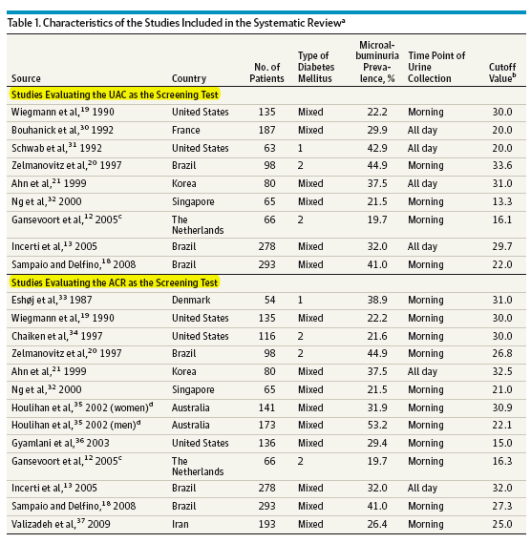

Slide 20
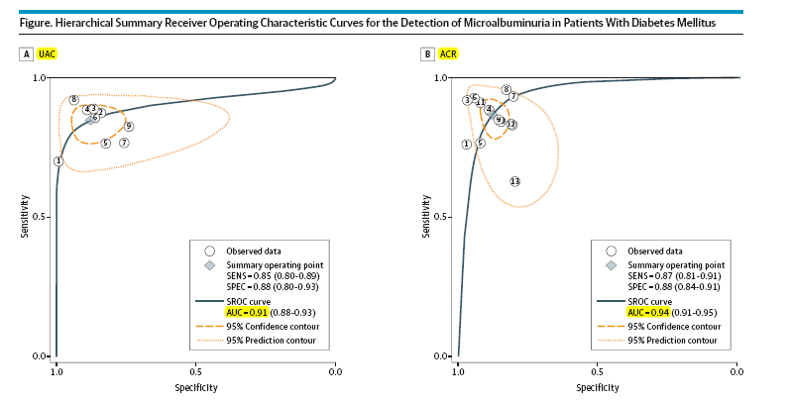

Slide 21
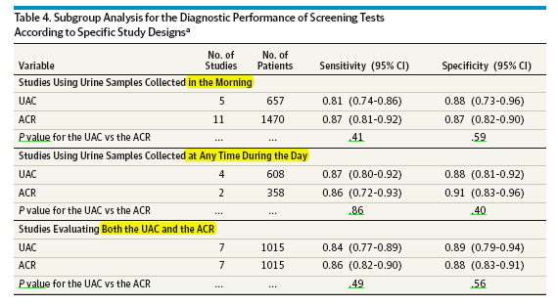

Slide 22
Conclusions
The UAC and the ACR yielded high sensitivity and specificity for the detection of microalbuminuria. Because the diagnostic performance of the UAC is comparable to that of the ACR, our findings indicate that the UAC of random urine samples may become the screening tool of choice for the population with DM, considering the rising incidence of DM and the constrained health care resources in many countries.

Slide 23
OBJECTIVE : To assess the performance of measurements of urinary albumin concentration (UAC) and urinary albumin: creatinine ratio (UACR) in a diurnal random urine specimen (RUS) for the screening of diabetic nephropathy

Slide 24
RESEARCH DESIGN AND METHODS: A total of 95 ambulatory NIDDM patients(49 women, ages 40-75 years) collected 123 RUSs during the morning after completing a timed 24-h urine collection. Albumin was measured by immunoturbidimetry. According to timed urinary albumin excretion rate (UAER) measured in the 24-h collection (criterion standard), samples were classified as normoalbuminuric (UAER <20 ug/min; n = 54), microalbuminuric (UAER 20-200 ug/min; n = 44), and macroalbuminuric (UAER >200 ug/min; n = 25). The receiver operating characteristics (ROC) curve approach was used. The ROC curves of UAC and UACR in RUS for screening of microalbuminuria (normo- and microalbuminuric samples; n = 98) and macroalbuminuria (micro- and macroalbuminuric samples; n = 69) were plotted

Slide 25
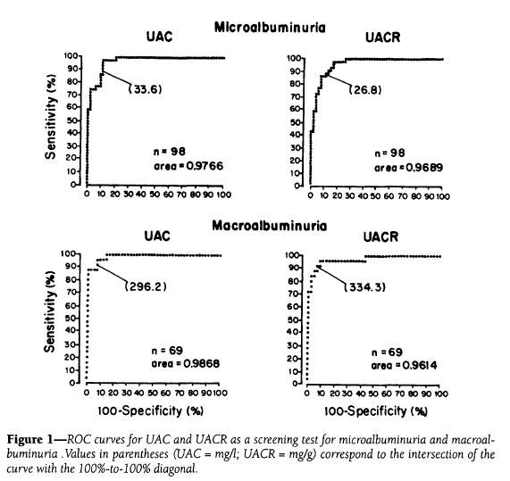

Slide 27
Conclusion
Albumin measurements (UAC and UACR) in an RUS presented almost perfect accuracy for the screening of micro- and macroalbuminuria and UAC measured in an RUS is simpler and less expensive than UACR and UAER. It is suggested as a valid test for use in screening for diabetic nephropathy.

Slide 28
Recommendations
Screening
At least once a year, assess urinary albumin (e.g., spot urinary albumin–to– creatinine ratio) and estimated glomerular filtration rate in patients with type 1 diabetes with duration of ≥5 years, in all patients with type 2 diabetes, and in all patients with comorbid hypertension. B

Slide 29
Screening…
Screening for albuminuria can be most easily performed by urinary albumin–to– creatinine ratio (UACR) in a random spot urine collection
Timed or 24-h collections are more burdensome and add little to prediction or accuracy.
Measurement of a spot urine sample for albumin alone without simultaneously measuring urine creatinine (Cr) is less expensive but susceptible to false-negative and false positive determinations as a result of variation in urine concentration due to hydration

Slide 30
Screening…
Normal UACR is generally defined as˂30 mg/g Cr, and increased urinary albumin excretion is defined as ≥30 mg/g Cr.
because of biological variability in urinary albumin excretion, two of three specimens of UACR collected within a 3- to 6-month period should be abnormal before considering a patient to have albuminuria.
Exercise within 24 h, infection, fever , congestive heart failure, marked hyperglycemia, menstruation, and marked hypertension may elevate UACR independently of kidney damage.

Slide 31
American Journal of Kidney Diseases, 2007

Slide 32
eGFR should be calculated from serum Cr using a validated formula. The Chronic Kidney Disease Epidemiology Collaboration (CKD-EPI) equation is generally preferred
An eGFR ˂60 mL/min/ 1.73 m2 is generally considered abnormal, though optimal thresholds for clinical diagnosis are debated

Slide 33
Diagnosis of Diabetic Kidney Disease
Diabetic kidney disease is usually a clinical diagnosis made based on the presence albuminuria and/or reduced eGFR in the absence of signs or symptoms of other primary causes of kidney damage.
The typical presentation of diabetic kidney disease is considered to include a long-standing duration of diabetes, retinopathy, albuminuria without hematuria, and gradually progressive kidney disease.

Slide 34
Diagnosis…
Signs of CKD may be present at diagnosis or without retinopathy in type 2 diabetes, and reduced eGFR without albuminuria has been frequently reported in type 1 and type 2 diabetes and is becoming more common over time as the prevalence of diabetes increases in the U.S.
It is rare for patients with type 1 diabetes to develop kidney disease without retinopathy. In type 2 diabetes, retinopathy is only moderately sensitive and specific for CKD caused by diabetes, as confirmed by kidney biopsy.

Slide 35
Diagnosis…
An active urinary sediment (containing red or white blood cells or cellular casts), rapidly increasing albuminuria or nephrotic syndrome, rapidly decreasing eGFR, or the absence of retinopathy (in type 1 diabetes) may suggest alternative or additional causes of kidney disease. For patientswith these features, referral to a nephrologist for further diagnosis.

Slide 36
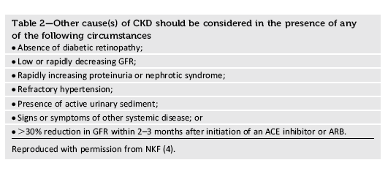
Diabetes Care Volume 37, October 2014

Slide 37
Normoalbuminuric renal impairment in diabetes (Literature review)

Slide 38
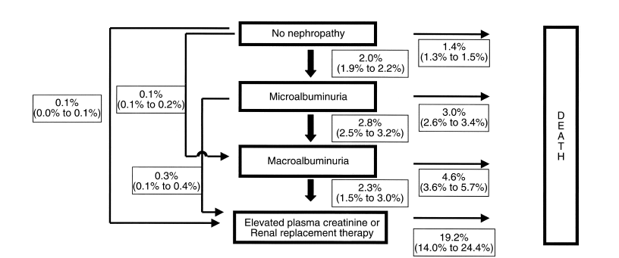
Kidney International , Vol 63 ,2003

Slide 39
OBJECTIVE: About 20% of diabetic patients with chronic kidney disease (CKD) detected from the new ADA recommendations (albumin excretion rate ˃30mg/24 h or GFR]˂60 ml/min per 1.73 m2) may be normoalbuminuric. Do the characteristics and outcome differ for subjects with and without albuminuria?
RESEARCH DESIGN AND METHODS: A total of 89 patients (mean age 64 ± 11 years )with diabetes(type1 and type2) and a MDRD estimated GFR (e-GFR) ˂60 underwent a 51Cr-EDTA B- isotopic GFR determination. The AER was determined on one 24-h urine collection and they were followed up for 38 ± 11 months.

Slide 40
RESULTS: A total of 15 subjects (17%) were normoalbuminuric mean MDRD e-GFR was 41.3 ±13.1 ml/min per 1.73m2 (11–59.9), it did not significantly differ from their isotopic GFR (45.6 ± 29.7, P = 0.12), Most of the normoalbuminuric patients (71%) had serum creatinine levels in the normal range. Despite their lower serum creatinine levels, their MDRD e-GFR did not significantly differ from the albuminuric group.

Slide 41
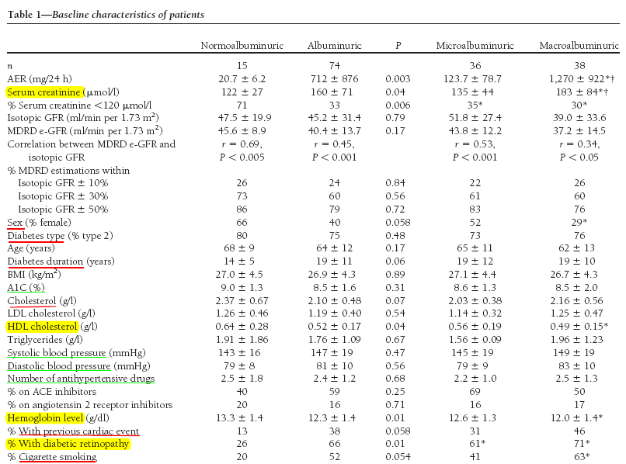

Slide 42
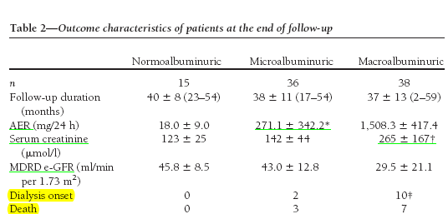
The primary outcome was requirement for dialysis, or death. The secondary outcomes were the AER and serum creatinine for living nondialyzed patients at the end of the follow-up

Slide 43
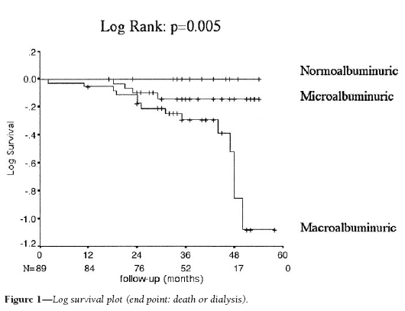

Slide 44
Conclusion
Although their Cr is usually normal, most of the normoalbuminuric diabetic subjects with CKD according to an MDRDe-GFR below 60 ml/min per 1.73m2 do really have a GFR below 60 ml/min per 1.73 m2. However, as expected, because of normoalbuminuria and other favorable characteristics, their risk for CKD progression or death is lower.
Further studies on the outcome of normoalbuminuric CKD in diabetes are required to demonstrate that the awareness of this condition is a benefit

Slide 45
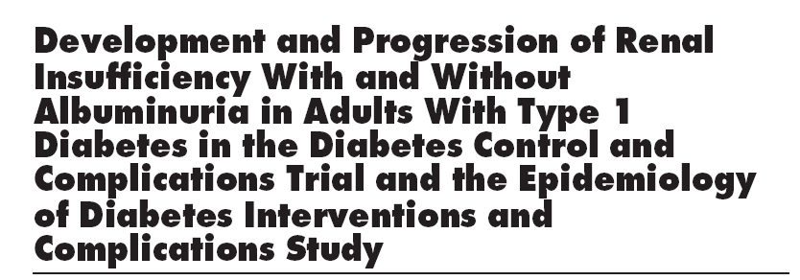
OBJECTIVE : This multicenter study examined the impact of albumin excretion rate (AER) on the course of estimated glomerular filtration rate (eGFR) and the incidence of sustained eGFR ˂ 60 in type 1 diabetes up to year 14 of the Epidemiology of Diabetes Interventionsand Complications (EDIC) study (mean duration of 19 years in the Diabetes Control and Complications Trial [DCCT]/EDIC).

Slide 46
RESEARCH DESIGN AND METHODS : 1,439 participants had normal GFR (serum creatinine ≤1.3 mg/dl and/or creatinine clearance˃ 100 ml/min/1.73 m2)were examined. At baseline, the AER was˂40 mg/24 h for the primary prevention cohort and ˂200 mg/24 h for the secondary intervention cohort.
Urinary albumin measurements from 4-h urine collections were obtained from participants annually during the DCCT and every other year during the EDIC study, and serum creatinine was measured annually in both the DCCT and EDIC study. GFR was estimated from serum creatinine using the abbreviated MDRD equation. Analyses used all AER and eGFR values from the 1,439 participants over the 23 years of the DCCT/EDIC study.

Slide 47
RESULTS : A total of 89 of 1,439 subjects developed an eGFR˂ 60 ml/min/1.73 m2 (stage3 chronic kidney disease on two or more successive occasions (sustained) during the DCCT/EDIC study (cumulative incidence 11.4%). Of these, 20 (24%) had AER˂30 mg/24 h at all prior evaluations, 14 (16%) had developed microalbuminuria (AER 30–300 mg/24 h) before they reached stage 3 chronic kidney disease, and 54 (61%) had macroalbuminuria (AER˃300 mg/24h) before they reached stage 3 chronic kidney disease. Macroalbuminuria is associated with a markedly increased rate of fall in eGFR (5.7%/year vs. 1.2%/year with AER ˂30 mg/24 h, P ˂0.0001) and risk of eGFR˂ 60 ml/min/1.73 m2 (adjusted hazard ratio 15.3, P ˂ 0.0001), whereas microalbuminuria had weaker and less consistent effects on eGFR.

Slide 48
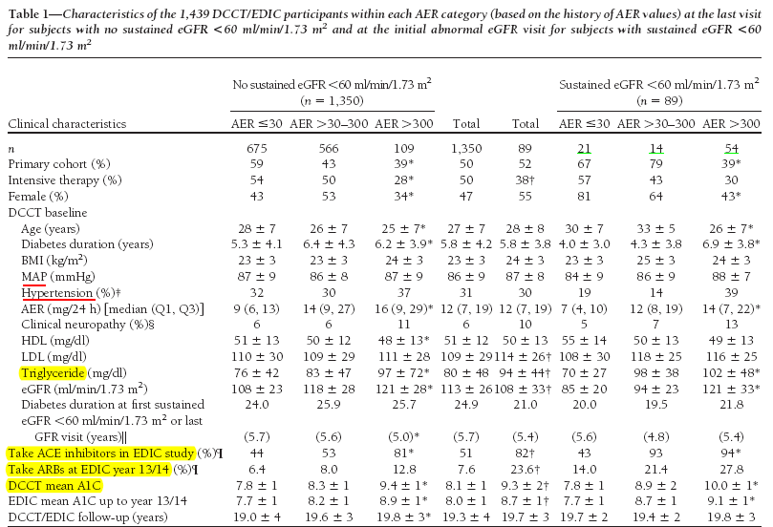

Slide 50
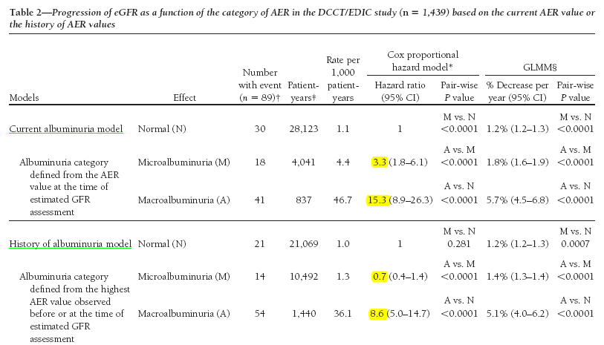

Slide 51
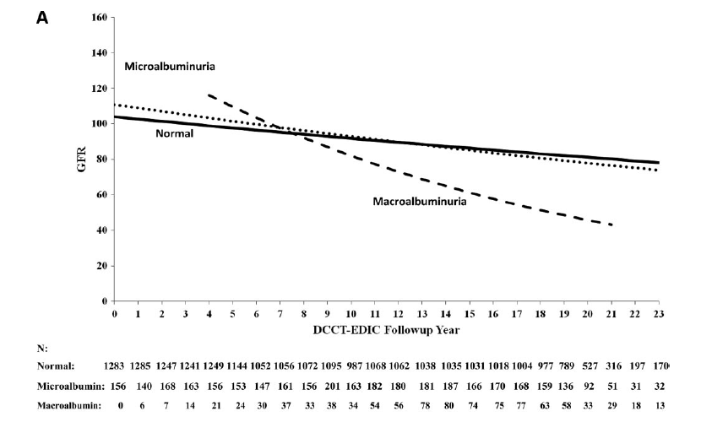

Slide 52
Conclusion
In summary, 24% of the 89 subjects with sustained eGFR levels ˂60 in the DCCT/EDIC study did not have a history of microalbuminuria or macroalbuminuria on annual visits before developing sustained eGFR levels ˂60 .
However, we also show that the course of renal function in the DCCT/EDIC subjects, based on eGFR levels, is substantially worse when macroalbuminuria is present. Our findings support this recommendations that both eGFR and AER should be assessed in the evaluation of kidney disease in diabetic patients.

Slide 53
Objective : In type 2 diabetes, prevalence of nonalbuminuric renal impairment is increasing worldwide, though its clinical significance remains unclear. This large-cohort study aimed at evaluating the association of this phenotype with cardiovascular risk factors and other complications.
Methods : Type 2 diabetic patients from the Renal Insufficiency And Cardiovascular Events (RIACE) Italian Multicenter Study (n=15773),visiting consecutively 19 hospital-based Diabetes Clinics in years 2007–2008, were examined.

Slide 54
Results : Of patients with renal impairment, as identified by an estimated glomerular filtration rate (eGFR) less than 60 ml/min per 1.73m2, 56.6% were normoalbuminuric,30.8% were microalbuminuric, and 12.6% were macroalbuminuric.
Percentages were similar when GFR was estimated using the more CKD-EPI instead of the simplified MDRD formula, and were independent of age, thus indicating that the increasing prevalence of this phenotype does not reflects misclassification of elderly patients.

Slide 56
Nonalbuminuric renal impairment was not associated with HbA1c and correlated less strongly with retinopathy and hypertension than albuminuria, either alone or associated with reduced eGFR. It was associated with a higher prevalence of cardiovascular disease (CVD) than albuminuria alone, but lower than albuminuric renal impairment. Female sex correlated with nonalbuminuric renal impairment and male sex with the albuminuric forms

Slide 57
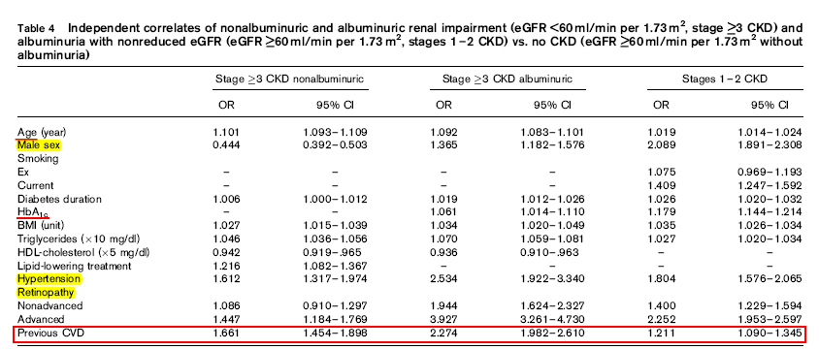

Slide 58
Conclusion
These data show that type 2 diabetic patients with nonalbuminuric renal impairment exhibit distinct clinical features, suggesting predominance of macroangiopathy as underlying renal pathology,and that this phenotype is associated with significant CVD burden.

Slide 59
novel biomarkers for the early detection of Diabetic nephropathy

Slide 60
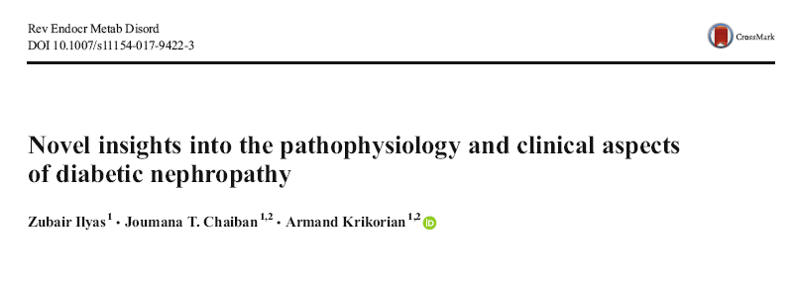

Slide 61
Potential novel biomarkers for the early detection of DN
NGAL: Neutrophil gelatinase associated lipocalin (NGAL), a protein described as a ‘troponin-like’ biomarker , is secreted in the urine following acute kidney injury (AKI) and may allow for a more timely diagnosis of AKI, Furthermore, studies have shown that urinary NGAL levels can be elevated during normoalbuminuric states, suggesting its use for earlier detection of DN. but may not be specific to DN.

Slide 62
NAG: N-acetyl-beta-glucosaminidase (NAG) is a urinary enzyme found in the proximal tubule of epithelial cells. One study compared levels of NAG in patients with normoalbuminuria with that of patients with varying degrees of microalbuminuria and found that NAG was elevated in all patients, even those with normoalbuminuria and correlated positively with worsening renal function
Cystatin C: Cystatin C is a cysteine protease inhibitor, It can be elevated in the urine of patients with diabetes before microalbuminuria manifests itself

Slide 63
Alpha 1-microglobulin: is a peptide that is produced primarily in the liver and can be found as a part of the oxidative stress response.it is being investigated as a screening and monitoring tool for DN as a marker of tubular stress. A recent study in patients with Type 2 diabetes found that urinary alpha 1-microglobulin can be elevated without the presence of microalbuminuria.
IgM / IgG: Besides albumin, several other proteins can be detected in the urine of individuals with DN, including immunoglobulins IgG and IgM, it was thought their presence occurred after the development of microalbuminuria, but recent studies demonstrated it to occur in normoalbuminuric patients as well.

Slide 64
Type IV collagen: In the kidneys, type IV collagen is found primarily in the extracellular matrix and constitutes part of the glomerular basement membrane and the mesangial matrix. Early studies have suggested its relevance as a urinary biomarker in the absence of albuminuria.
Nephrin: Nephrin is part of the podocyte structure that can be damaged by byperfiltration injury from hyperglycemia. Nephrinuria may also be present before microalbuminuria in patients with diabetes and may therefore represent an important test to detect DN earlier.

Slide 65
Angiotensinogen: The RAAS has been the target of extensive investigation and successful drug development for DN.Recently, Zhuang et al. explored using urinary angiotensinogen levels (UAGT) as an early marker of DN. In their comparison of UAGT/creatinine ratios between patients with and without diabetes, they found elevated levels of UAGT even in the normoalbuminuric, normotensive patients with diabetes, with levels increasing further with the onset of albuminuria, suggesting a role for UAGT as an early marker of DN.

Slide 66
Surveillance

Slide 67
Albuminuria and eGFR should be monitored regularly to enable timely diagnosis of diabetic kidney disease, monitor progression of diabetic kidney disease, assess risk of CKD complications, dose drugs appropriately ,and determine whether nephrology referral is needed.
For patients with eGFR ˂60 mL/min/1.73 m2, appropriate medication dosing should be verified, exposure to nephrotoxins should be minimized, and potential CKD complications should be evaluated.

