Slide 2
اهمیت پیشگیری و درمان بیماری های تیروئید در ایران
پژوهشکده علوم غدد درون ریز و متابولیسم، دانشگاه علوم پزشکی شهید بهشتی
روز تیروئید – 31 اردیبهشت 1394

Slide 3
Early detection and optimized management
Four levels of prevention:
Primordial prevention is the prevention of occurrence of risk factors of disease.
Primary prevention is the prevention of new disease in previously healthy individuals, Achieved by decreasing risk factors for disease.
Secondary prevention is the prevention of progression of mild or latent disease to more severe disease, Typically involves screening for occult disease.
Tertiary prevention is the term used by some to describe medical care intended to improve already established disease.

Slide 4
Outline
Primordial prevention
Iodine nutrition, Autoimmunity, Disruptors
Primary prevention
Iodine deficiency, Tobacco smoking, Thyroid autoimmunity (TAI)
Secondary prevention
Subclinical hypothyroidism, TAI, Pregnancy, Orbitopathy
Tertiary prevention
Hypothyroidism, Hyperthyroidism, Iatrogenic, Neonatal disease

Slide 5
Primordial prevention of thyroid disease
Iodine nutrition
Pregnant and lactating women in iodine sufficient areas
Whole population in iodine deficient regions (primary)
Autoimmunity
Thyroid disruptors

Slide 6
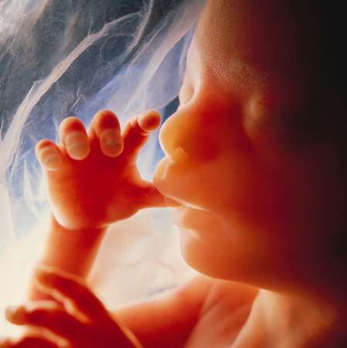
Importance of iodine in brain development
50,000 brain cells produced/second in developing fetal brain
100 billion brain cells in adult
One million billion connections between these brain cells: Determine IQ

Slide 7
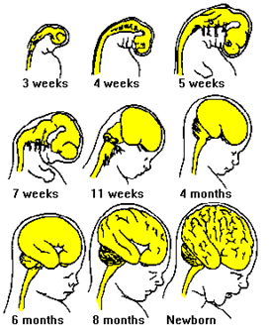
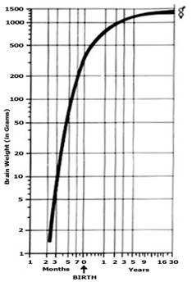
Importance of iodine in brain development
90 % of human brain development occurs between 3rd month of pregnancy & 3rd year of life (Critical period)

Slide 9
Iodine Requirement in Pregnancy (μg/day)
During pregnancy
Basal 150
40-50 % increased T4 requirements 50-100
transfer of T4 and I from mother to fetus 50
Increased renal clearance of I 50
Total requirement 250-300
Delange: Int.J. Endocrinol. Metab. 2: 1, 2004

Slide 10
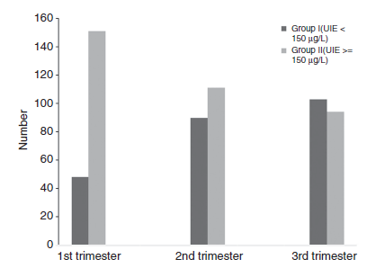
Urinary iodine excretion in groups I (UIE<150 μg/L and II (UIE ≥150 μg/L)
Amouzegar A, Khazan M, Hedayati M, Azizi F. An assessment of the iodine status and the correlation between iodine nutrition and thyroid function during pregnancy in an iodine sufficient area. Europ J Clin Nutr 2014; 68: 397

Slide 11
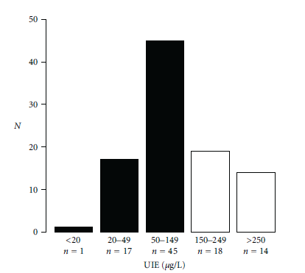
Distribution of ioduria (UIE) in healthy euthyroid pregnant women
Median UIE= 116 μg/L; 63% <150 μg/L
Brucker-Davis F, et al, Iodine Status Has No Impact on Thyroid Function in Early Healthy Pregnancy. J Thyroid Res 2012; 168-764

Slide 12
Recommendations
Strengthen and expand USI programs
In mild-moderate iodine deficiency, consider an I-containing supplement (~150 μg/d) for pregnant and lactating women, and those planning a pregnancy.
Encourage prenatal supplement manufacturers to include adequate iodine (~150 μg/d) in their products
Ensure national/international regulatory bodies for food supplements to establish optimal minimum and maximum iodine doses
Azizi & Smyth Clin Endocrinol 2009;70:803

Slide 13
ATA Recommendation
To achieve a total of 250 μg iodine ingestion daily, in North America all women who are planning pregnancy, pregnant, or breastfeeding, should supplement their diet with a daily oral supplement that contains 150 μg of iodine. This is optimally delivered in the form of potassium iodide, because kelp and other forms of seaweed do not provide a consistent delivery of daily iodide.
Stagnaro-Green A, Abalovich M, Alexander E, Azizi F, Mestman J, Negro R et al. Thyroid 2011; 21: 1081-1125

Slide 14
How much iodine we get from iodized salt? (number in red are daily iodine intake)*
Daily salt intake (gm) | Amount of iodine in table salt
 | 20 ppm | 30 ppm | 40 ppm
2 | 40 | 60 | 80
4 | 80 | 120 | 160
6 | 120 | 180 | 240
240
* Daily requirement of pregnant women: 200-300 μg/day

Slide 15
پایش ملی دریافت ید و عملکرد غده تیروئید زنان باردار کشور در سال 1392
هدف : بر رسی وضعيت دريافت يد و عملکرد غده تيروئيد زنان باردار کشور
روش کار : در طی يک بر رسی مقطعی ملی تعداد 1200 زن باردار در تريمستر های مختلف بارداری از 12 استان کشور از آبان ماه تا بهمن ماه سال 1392 وارد مطالعه شدند
شاخص ها : ميانه يد ادرار T4, T3RU, FT4I, TSH, تيروگلوبولين و آنتی تيروئيد پراکسيداز سرم مورد اندازه گيری قرار گرفتند.

Slide 16
نتايج کلی
 | میانه ید ادرار UIE (µg /L) | T4 (µg/dl) | TSH (miU/L)
Min. | 20 | 4.92 | 0.01
Max. | 400 | 23.92 | 14.05
Mean | 114 | 11.19 | 2.20
Median | 98 | 10.88 | 1.95
Preliminary Results :

Slide 17
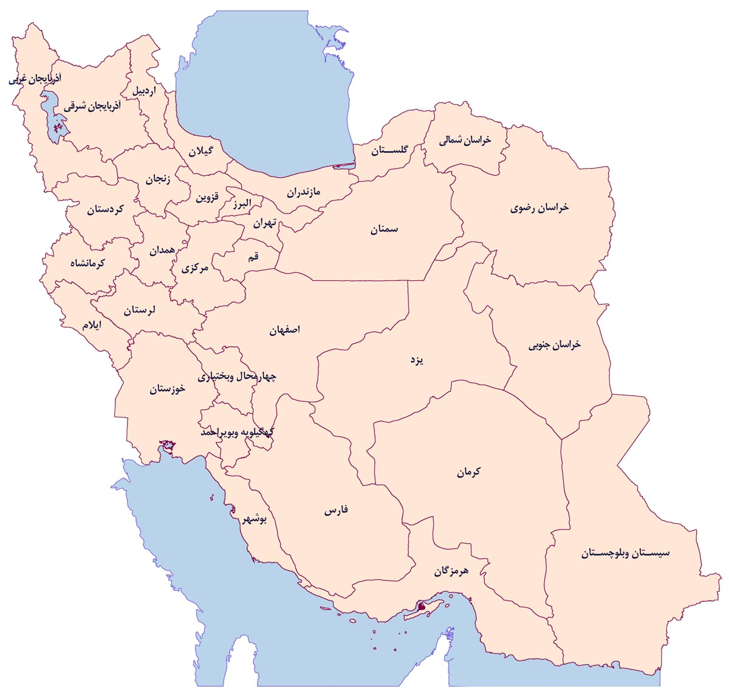
میانه ید ادرار کمتر از 100
میانه ید ادرار بین 100 و 150

Slide 18
آخرین استاندارد میزان ید در نمک های خوراکی (ابلاغ شده معاون بهداشت وزارت 94/2/19)
میزان گاما ید موجود در نمک | وضعیت نمک
10 ± 40 گاما | خوب
60 – 51 | در حد قابل قبول
کمتر از 30 بیشتر از 60 | غیرقابل قبول

Slide 19
Iodine Supplementation in Pregnancy
First trimester:
Folic Acid + Iodine 150 μg
Second and third trimesters:
Multivitamins + Iodine 150 μg

Slide 20
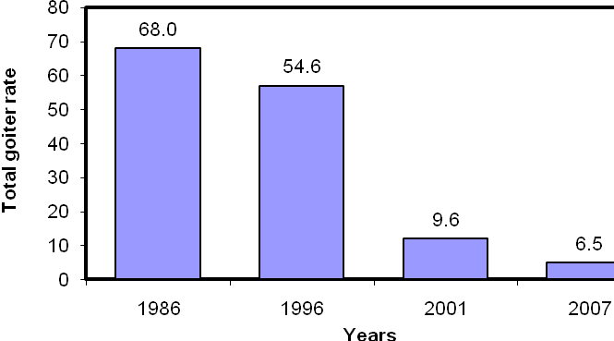
Median urinary iodine excretion in 4 national surveys in the I.R.Iran
Total goiter rate in 4 national surveys in the I.R. Iran
Azizi F. Thyroid International 2009;4:1

Slide 21
Monitoring progress towards sustainable elimination of IDD Iran-2007
Indicator | Optimum | Result
1. Salt iodization
Proportion of households consuming effectively iodized salt | >90% | >98%
2. Goiter rate | <6% | 5.4%
3. Urinary iodine
Median (n=3600) | ≥100 | 134 µg/L
proportion below 100μg/L | <50% | 12%
proportion below 50μg/L | <20% | 5%
4. Programmatic Indicators
Attainment of the indicators listed | 8/10 | All 10

Slide 22
تاثير حذف كمبود يد در سلامت جامعه ايراني
پيشگيري از بروز گواتر در بيش از 20 ميليون متولدين 20 سال اخير
افزايش 60،000،000 ضريب هوشي در كودكان و نوجوانان
صرفه جويي 17،500،000،000،000ريال
(12،000،000،000 يورو) در هزينه هاي بهداشتي درماني

Slide 23
وضعیت ید ادرار بزرگسالان (تهران، 88-1387)
Nazeri P, Mirmiran P, Mehrabi Y, et al. Thyroid 2010; 20: 1399-1406.

Slide 24
کاستی های میانه ید ادرار دانش آموزان در استان های مختلف کشور (1388)
میانه ید ادرار کمتر از 100 میکروگرم در لیتر:
آذربایجان غربی (72)، خوزستان (86)، لرستان (91)، تهران (97)
ید ادرار کمتر از 50 میکروگرم در لیتر در بیش از 20 درصد نمونه ها
آذربایجان غربی، خوزستان، لرستان، تهران
زنجان، سیستان و بلوچستان، قم، همدان
سئوال: وضعیت تغذیه در مادران باردار چگونه است؟

Slide 25
Secondary prevention of thyroid disease
Congenital hypothyroidism
Subclinical hypothyroidism
Subclinical hyperthyroidism
Ultrasonographic detection of thyroid cancer
Nodules
Lymph nodes
Siblings
Calcitonin screening in NTD for MTC
RET analysis
Screening in pregnancy
Graves’ orbitopathy

Slide 26
Health burden of congenital hypothyroidism
The findings of Le´ger et al. highlight the continuing health burden of CH in the screening era. Although having to take a tablet of T4 daily and lifelong to ensure normal development, growth, and metabolism may seem a minor hassle to physicians, it may not be so for all parents and children. A recent study in the United States found evidence suggesting that many parents discontinue treatment without following a testing protocol
Van Vliet & Grosse. JCEM 2011; 96: 1671

Slide 27
Health care professionals must both remain alert to parents’ perceptions, which may be different than those of their affected children, and promote the need for patient adherence to treatment throughout life, if confirmed to have permanent CH, using a standard clinical protocol
Leger J, et al. JCEM 2011; 96: 1771.

Slide 28
Secondary prevention of thyroid disease
Screening of individuals for subclinical hyperthyroidism or hypothyroidism with thyrotropin (TSH) testing.
Treatment with antithyroid drugs/radioiodine or thyroxine to prevent sequelae or progression to a more advanced degree of thyrotoxicosis or thyroid failure, respectively.

Slide 29
Criteria for Screening
The condition sought should be an important health problem
Facilities should be available for confirmation of the diagnosis
There is an effective treatment
Early detection and treatment reduces morbidity and mortality
The expected benefits of early detection exceed the risks and costs.
There is a test that can detect the disease prior to the onset of signs and symptoms
The test must satisfy the criteria of:
Acceptability, Repeatability, Validity, Simplicity, Safety, Rapidity
ease of administration, cost.

Slide 30
Two Important and Controversial Issues in Pregnancy:
Screening for thyroid
dysfunction
2. Treatment of subclinical
hypothyroidism

Slide 31
Screening for Thyroid Disease in Pregnancy
The benefits of universal screening for thyroid dysfunction may not be justified at this time, selected screening for the following should be done:
Positive FHx or personal history of thyroid disease
Prior thyroid surgey
>30 years
Infertility
Miscarriage or preterm delivery
Head and neck radition
Type 1 DM
Other autoimmune disease
Iodine deficiency
Morbid obesity
Symptoms
Goiter
TPOAb+
Amiodaron, lithium, iodinated
contrast media
ATA Guidelines: Thyroid 2011; 21: 1081-1125

Slide 32
Comparison of recommendations of American Thyroid Association and Endocrine Society on the time and target group for screening for hypothyroidism before and during pregnancy
Who should be screened?
American Thyroid Association guideline (2011) | Endocrine Society guideline (2012)
There is insufficient evidence to recommend for or against universal TSH screening at the first trimester visit. | Some members recommended screening of all pregnant women for serum TSH abnormalities by the 9th week or at the time of their first visit. Others recommended against universal screening of pregnant women at the time of their first visit and instead supported aggressive case finding to identify high-risk women
A case-finding approach targeting thyroid function testing in high-risk groups has been advocated | The same
Amouzegar A, et al. Hormone 2014

Slide 33
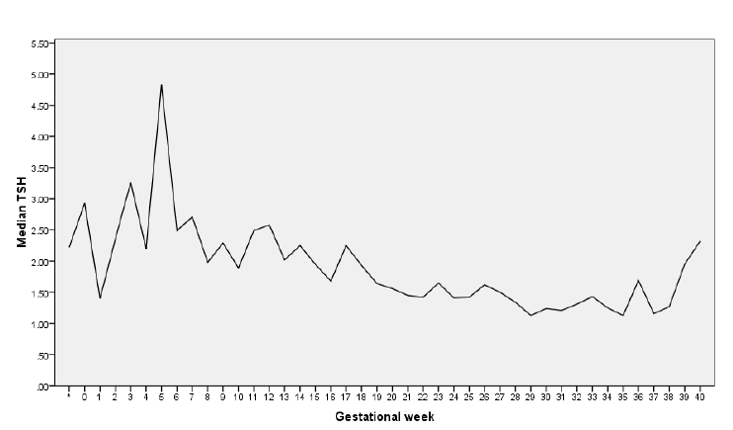
Serum TSH concentrations in pregnant women by weeks of gestation
* Median at pre-pregnancy
The line indicates the median value at each gestational week
Vadiveloo T, et al. Clin Endocrinol ,2012

Slide 34
Guidelines Recommendations
Recommendation 8
There is insufficient evidence to recommend for or against universal LT4 Rx in TPOAB negative women with SCHypo
Recommendation 9
Women who are positive for TPOAb and have SCHypo should be treated with LT4
Thyroid 2011; 21: 1081-1125
* National Institute of Child Health and Human Development’s Maternal-Fetal Medicine Units Network. * Tehran Thyroid Study in Pregnancy

Slide 35
Subclinical hypothyroidism fits all the criteria except for the second one: many experts do not believe that subclinical hypothyroidism is associated with significant morbidity: that is, it remains controversial whether mild thyroid failure is associated with significant symptoms or health problems

Slide 36
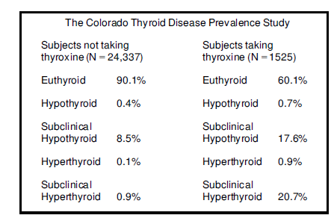
Prevalence of thyroid disease in adults screened in a series of health fairs in Colorado
Canaris GJ, et al. Arch Intern Med 2000; 180: 526

Slide 37
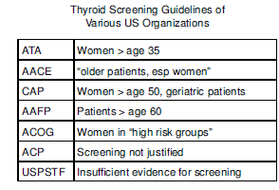
Recommendations for screening for thyroid disease of various professional societies
ATA 2012 All >age 60
ATA 2012

