Slide 1
“PTH Related Hypercalcemia in an Adolescent” case report
B.Rezvankhah.MD
January.2017

Slide 2
What is the diagnosis?
What is the treatment?

Slide 3
Hypercalcemia & Elevated or Inappropriately NL PTH Levels
Primary Hyperparathyroidism
Familial Hypocalcuric Hypercalcemia(FHH)
Multiple Endocrine Neoplasia Type 1 (MEN 1)
! Considering young age of Pt,PTH level,no other clinical manifestation,negative imaging investigations & no side effects of Hypercalcemia,the diagnosis of FHH would rather be ruled out.

Slide 4
lithium and thiazide usage should be excluded

Slide 5
The upper normal range for plasma PTH depends on several variables including plasma 25OHD, age, body weight and smoking.
PTH levels normally rise with age & the broad nl range(10-65pg/ml) reflects values for entire population;
A narrower lower nl range (10-45 pg/ml) in younger than 45 individual
De Groot 2016

Slide 6
Souberbielle et al(2001) have illustrated that the normal range depends whether the reference population is or is not vitamin D deficient.
When Vit D–deficient individuals were excluded, the upper limit of the PTH reference interval decreased from 65 to 46 pg/mL.
When vitamin D–deficient individuals were excluded from the subjects used to establish a reference interval for “whole PTH,” the upper limit decreased from 44 to 34 ng/L.

Slide 7
Primary Hyperparathyroidism (PHPT)
PHPT currently is recognized as the third most common endocrine disorder in adults,
PHPT is most common in patients who are between the ages of 50 and 60 yrs,
It has an annual incidence of 30/100,000;
with a lifetime prevalence of approximately 1/1000 persons,
Females outnumber males with PHPT by an approximate 3:1 ratio.

Slide 8
Primary Hyperparathyroidism in Adolescent
Prior to 1984, fewer than 150 children with PHPT had been described in the literature
Primary studies have quoted MEN and familial non-MEN HPT to constitute as much as 30% to 50% of pediatric PHPT
Estimated incidence of 2-5/100,000
Most often sporadic and caused by a parathyroid adenoma

Slide 9
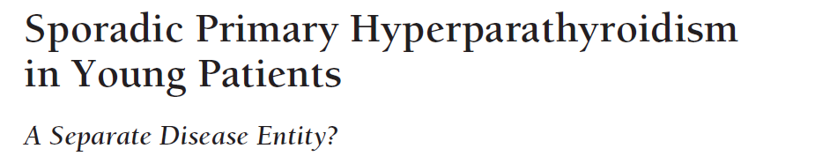
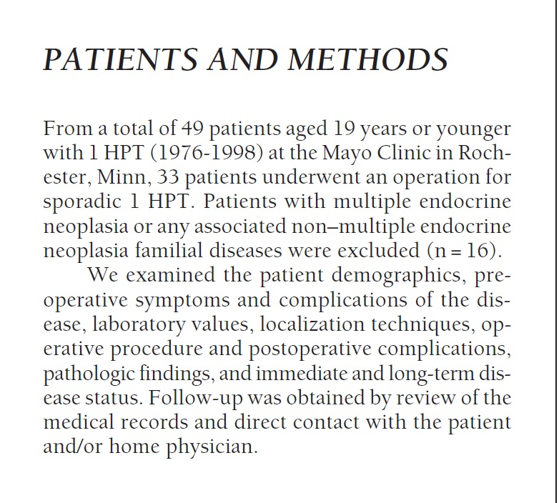
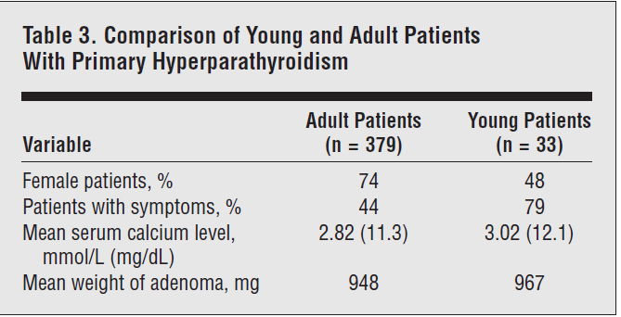
Arch Surg 1999

Slide 10
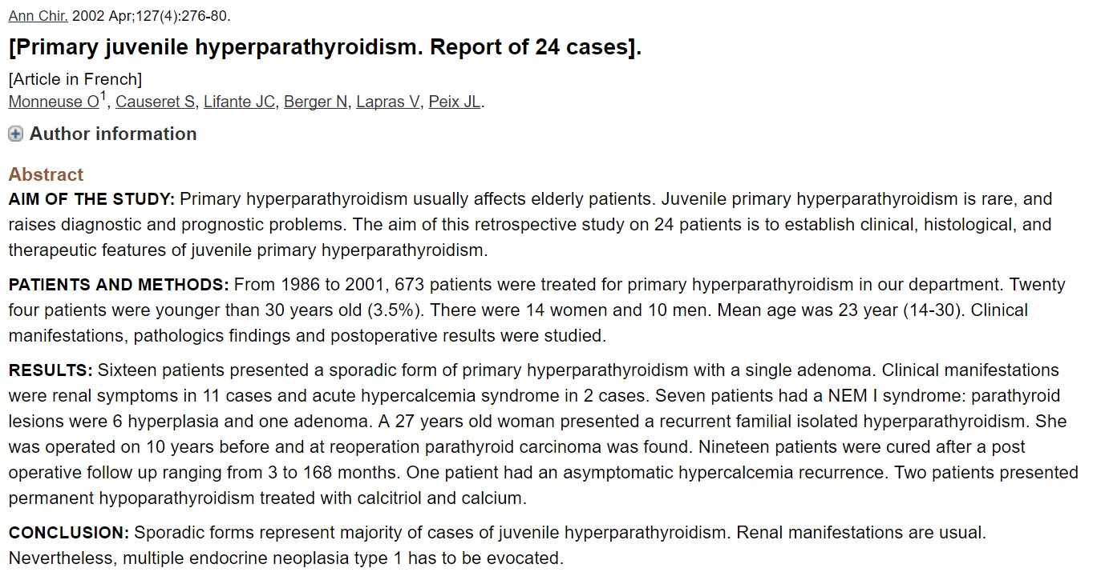

Slide 11
Indian J Pediatr 2010
A retrospective analysis of 15 children and adolescents with PHPT (age <20 yr) between 1993 and 2006.
89% of the patients had bone disease and all demonstrated severe changes on radiology.
This high incidence in children may not be surprising considering the high bone turnover rate in them.

Slide 12
Journal of the Chinese Medical Association 2012

Slide 14
In recent large studies investigating the changing biochemistry of PHPT in adults show;
Ca: 2.8 mmol/L (normal range 2.1-2.6),
i-Ca:1.45 nmol/L (normal range 1.15-1.2),
PTH:103 pg/mL (normal range 15-65)
For comparison, in the studies reviewed here,at presentation in children and adolescents the measurements were;
Ca: 3.27 mmol/L (nl range 2.1-2.6),
i-Ca:1.56 nmol/L (nl range 1.15-1.2),
PTH: 200 pg/mL (nl range 10-70).
The increased magnitude of deviation from the normal range observed in childhood and adolescent PHPT biochemical measurements is consistent with the idea that PHPT is more severe in children and adolescents than in adults.

Slide 15
PHPT is clinically symptomatic in most young patients(skeletal complications, and/or nephrolithiasis). Few if any young patients with PHPT are discovered incidentally to have asymptomatic hypercalcemia,
Most cases are associated with a single parathyroid adenoma patients with multigland disease usually have germline mutations associated with genetic syndromes such as MEN1,MEN2a and familial hyperparathyroidism
It is unlikely that ascertainment bias, due to infrequent biochemical testing of children and adolescents, can explain the absence of asymptomatic PHPT in younger populations.

Slide 16
World J Surg (2006)
Methods: Over a 3-year period consecutive unselected patients with PHPT underwent Tc99m-sestamibi scanning and high-resolution ultrasound (US) scanning by the same radiologist.
Results:158 patients underwent localization studies. Sestamibi scans were negative in 52 (32%) and positive in 106 (68%) patients.
There was a higher incidence of hyperplasia in the group of patients with negative sestamibi scans (4 out of 52 vs. 4 out of 103, P < 0.05, v2 test).
In patients with negative sestamibi scans the majority of adenomas were formed predominantly from chief cells (26 out of 36) while the majority of patients with adenomas composed predominantly of oxyphil cells had positive scans (21 out of 23)
(P < 0.05, v2 test).
The weight of parathyroid adenomas was higher when sestamibi scans were positive (median: 1,180 vs. 517 mg, P < 0.05, Students t-test)

Slide 17
J. Nucl. Med 2014
Methods: A retrospective review of 55 patients with primary hyperparathyroidism who underwent MIBI scan from January 2012 to December 2014 were included in this study. All patients underwent parathyroid surgery followed by histopathological confirmation.
Results: In total, 55 patients were studied. MIBI scan was true positive in 37 cases and false negative in 18 cases. The sensitivity of MIBI scan was 67.2 %. Mean serum calcium level was 12.3 mg/ dL. More than 62.2 % of patients with calcium level greater than 12.3 mg/dL had a positive scan as compared with 37.8% of those with lesser value (P<0.05). Similarly a serum PTH level greater than 316 ± 139 pg/mL correlated with positive scans in 78.4 % as opposed to 21.6 % in those with lower levels (P< 0 .01).

Slide 18
Familial Hypocalcuric Hypocalcemia(FHH)
FHH has affected a small but important minority of pt with hypercalcemia;about 2% (The prevalence 1:10 000 to 1:100 000)
Familial hypocalciuric hypercalcemia (FHH) is a heritable disorder of mineral homeostasis that is transmitted as an autosomal dominant trait with a high degree of penetrance
Very mild CASR mutations have been associated with an autosomal recessive form of FHH
Type I heterozygous loss-of-function mutations in the CASR gene on
chromosome 3q21
Type II mutation in the GNA11 gene on chromosome 19p13
Type III mutation in the AP2S1 gene on chromosome 19q13

Slide 19
Calcium-Sensing Receptor(CaSR)
The calcium-sensing receptor (CaSR) is expressed in: the parathyroid glands, kidneys, bone marrow, osteoclasts and osteoblasts, breast, thyroid C-cells, gastrin-secreting cells in the stomach, intestine, some areas of the brain, and others
There are clearly PTH-independent roles for the CaSR in maintaining tight regulation of serum calcium concentration.
! Mice lacking both the PTH and CaSR genes develop marked hypercalcemia in response to oral calcium loads, while those lacking only PTH can mount an effective defense against hypercalcemia via the CaSR by upregulating renal calcium excretion and calcitonin secretion.

Slide 20
The Ca(2+)-sensing receptor belongs to the superfamily of 7-membrane-spanning G protein-coupled receptors
Mutations in the human CaSR gene cause both familial hypocalciuric hypercalcemia and neonatal severe hyperparathyroidism
Two thirds of FHH kindreds will have unique heterozygous mutations of the CaSR
FHH 2 is due to loss-of-function mutations in the G protein subunit α11 (Gα11), which decrease the sensitivity of cells expressing CaSR,such Gα11 loss-of-function mutations may occur in <5% of FHH patients.
FHH 3 is due to loss-of-function mutations of the adaptor protein 2 (AP-2) sigma subunit (AP2σ).AP-2 is a central component of clathrin-coated vesicles (CCVs) and is pivotal in clathrin-mediated endocytosis, which internalizes plasma membrane constituents such as GPCRs

Slide 22
Most patients with FHH are asymptomatic, and the condition is diagnosed on routine blood tests. Occasionally, some persons with BFHH may notice weakness, fatigue, thought disturbance, and polydipsia. These symptoms, if present, are less severe in FHH than in primary hyperparathyroidism.
Relapsing pancreatitis may be slightly increased in patients with FHH and it may also be associated with an increased incidence of chondrocalcinosis and premature vascular calcification. However, the survival rates of patients with FHH are identical to those in the general population. Furthermore, an increased incidence of cardiovascular events has not been demonstrated in persons with FHH when compared with the normal population.

Slide 23
Eur J Endocrinol 2008

Slide 24
The plasma level of calcitriol in FHH is usually in the midnormal range in contrast to a tendency to elevated levels in PHPT.
Recent intervention studies have documented that vitamin D status may influence the phenotype of FHH
The patients tend to have hypermagnesemia as opposed to the hypomagnesemia of hyperparathyroidism
Serum Ph is mildly decreased, but not as low as in primary hyperparathyroidism. In many affected patients, serum phosphate may be normal
Compared with PHPT, FHH patients have significantly lower levels of bone markers of formation, alkaline phosphatase, and resorption

Slide 25
The urinary calcium excretion is usually less than 100 mg/24 hour (25 mmol/24 hour), in contrast with true PHPT, where it is usually greater than 120 mg/24 hours
FHH generally has a very low (<1%) fractional excretion of calcium (FeCa) . (Nl or even elevated urinary calcium excretion has been described in members of several FHH kindreds,and hypocalciuria can be present in some patients with common PHPT who also have vitamin D insufficiency)
Using the traditional cutoff value of 0.010 for CCCR leads to 35% of FHH patients misdiagnosed as PHPT and 4% of PHPT being misdiagnosed as FHH
Clin Endocrinol (Oxf) 2008
The ratio of CaC to CrC in FHH is generally <0.013
Clin Nephrology (Oxf)2016

Slide 28
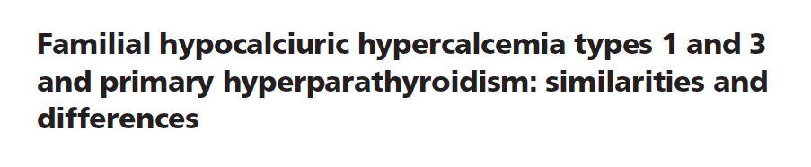
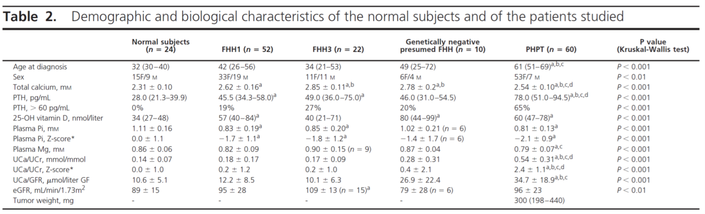
J Clin Endocrinol Metab 2016

Slide 29
On average, patients with PHPT had lower total calcium, phosphate and magnesium concentrations and a higher PTH concentration than patients with FHH types 1 and 3 or genetically negative FHH.
Individuals with FHH types 1 or 3 or genetically negative presumed FHH can actually have normal, low or high levels of urinary calcium excretion
AP2S1 mutations are responsible for a more severe impairment of calcium homeostasis than CaSR mutations

Slide 30
Acquired Hypocalciuric Hypercalcemia
Kifor et al. (2003) studied sera from 4 patients with PTH-dependent hypercalcemia who also had other autoimmune manifestations.Their sera stimulated PTH release from dispersed human parathyroid cells.
Pallais et al. (2004) described a 66-year-old woman with acquired hypocalciuric hypercalcemia due to autoantibodies targeting the calcium-sensing receptor.
This condition may be associated with other autoimmune disorders such as Hashimoto thyroiditis or celiac sprue.
The distinction between the acquired and hereditary forms is important because glucocorticoids may control the acquired form.

Slide 31
PNAS 2007
This is the first report of a disease-related autoantibody that functions as an allosteric modulator and maintains G protein coupled receptors (GPCRs) in a unique active conformation with its agonist.
These data suggest that calcium-stimulated CaSR, primed by this autoantibody, remains in a unique active conformation that activates Gq but not Gi
These results also suggest, but do not conclusively prove, that both Gq and Gi may be important mediators of the calcium-dependent inhibition of PTH release

Slide 32
Hypocalciuric Hypercalcemia due to De novo Mutation
A de novo heterozygous inactivating mutation of calcium-sensing receptor (CASR) gene typically causes neonatal hyperparathyroidism (NHPT) with moderate hypercalcemia and hyperparathyroid bone disease.
There are six mutations of CASR as de novo heterozygous mutations have thus far been reported in NSHPT
Most studies have reported apparent hypercalcemia only in homozygous carriers because of low potency of the mutations
Endo Diabet & Met 2015
The frequency of de novo CASR mutations was estimated at 6.5%
J Clin Endocrinol Metab2016

Slide 33
! Some reports have described infants with manifestation of NSHPT who possess only a single defective CASR allele. In these cases the mutant CASR was inherited from an affected father or arose as a de novo mutation. Presumably,exposure of the affected fetus to normal maternal calcium concentrations intensifies development of hyperparathyroidism in utero and leads to severe hypercalcemia after birth

Slide 34
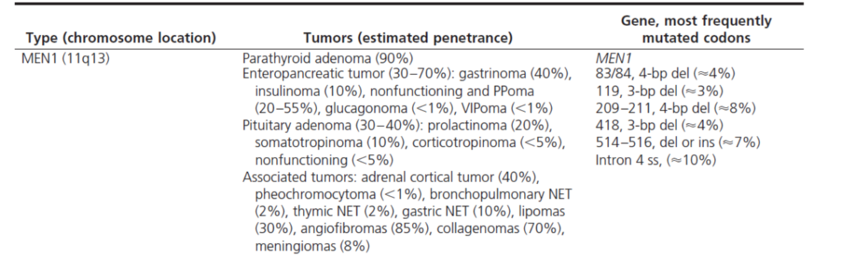
Multiple Endocrine Neoplasia Type 1 (MEN 1)
MEN1 is inherited as an autosomal dominant disorder with a high degree of penetrance (>50%penetrant by 20 yr of age & >95%by 40 yr)
The incidence of MEN1 has been estimated from random postmortem studies to be 0.25%, and to be 1–18% in patients with primary hyperparathyroidism, 16–38% in patients with gastrinomas, and less than 3% in patients with pituitary tumors
Parathyroid tumors occur in 95% of MEN 1 patients, and the resulting hypercalcemia is the first manifestation of MEN 1 in about 90% of patients.

Slide 35
…
A nonfamilial form may have developed in 8 to 14% of patients with MEN1
(The occurrence of de novo mutations of theMEN1gene:10% of all pt with MEN1)
In the absence of treatment,endocrine tumors are associated with an earlier mortality in patients with MEN1(50%probability of death by the age of 50 yr)
The diagnosis of MEN1 may be established in an individual by 1 of 3 criteria:
1)The occurrence of two or more primary MEN1-associated endocrine tumors
2)The occurrence of one of the MEN1-associated tumors in a first-degree relative of a pt with a clinical diagnosis of MEN
3)Identification of a germlineMEN1mutation in an individual

Slide 36
The hypercalcemia is usually mild,other differences compared with patients without MEN1, include:
earlier age at onset (20 to25 yr vs. 55 yr), greater reduction in bone mineral
density & an equal male/female ratio (1:1 vs. 1:3)
Preoperative imaging is of limited benefit because all parathyroid glands may be affected, and neck exploration is required irrespective of preoperative localization studies.

Slide 37
Parathyroidectomy may be reserved for symptomatic hypercalcemic patients with MEN1 and those patients withMEN1 who do not undergo parathyroid surgery should have regular assessment for symptom onset and complications
It suggest that individuals at high risk for MEN1 undergo biochemical screening at least once/yr and also have baseline pituitary and abdominal imaging
Screening should possibly commence in early childhood, and it should be repeated throughout life because the disease may not manifest in some individuals until the eighth decade.
It suggests biochemical screening should include(Ca,PTH, gastrointestinal hormones, chromogranin A, prolactin, and IGF-I in all individuals

Slide 38
Coexisting AIT and parathyroid disease;
are they related?
The association between thyroid diseases and PHPT was first described in 1947
(AIT association with PHPT was find in 3.8-17.6%)
The inflammatory process found in AIT may interfere the uptake mechanism of 99mTc-MIBI, giving a false negative image
Earlier experimental studies in rats have shown that chronic high TSH induces parathyroid hyperplasia and high PTH values.
Recent studies have shown that vitamin D & Selenium deficiency may be associated with both thyroid and parathyroid diseases
Arch Clin Cases 2015

Slide 39
Hell J Nucl Med 2013
Method:That was a prospective study during 3 years. The study included 45,231 patients, which were referred under suspicion of having thyroid and/or parathyroid disease. In these patients the following parameters were measured: (antiTPO-Ab), (Tg-Ab),(TSHR-Ab),(TSH), (PTH) and (Ca).
Results:In 2,267 of these 45,231 patients (5.01%) we noticed elevated antiTPO-Ab , with statistical significant difference from nl values, and nl levels of other antithyroid antibodies (Tg-Ab, TSHR-Ab).
In this group, 43 patients (1.89%) also had elevated serum levels of PTH & CA
! Under the reported rate of prevalence of PHPT in the general population of about 0.3%,this study indicated a 1.89% occurrence of PHPT in 2267 patients with HT.

Slide 40
NOTE: Althouth overall findings are more consistent with FHH because of the lack of genetic studies,diagnosis of the pt chould’t be confirmed,hence considering the fact that no clinical findings showed hypercalcemia side effects,we can follow “watch & wait” approach!

Slide 41
Parathyroid hyperplasia is found in some cases of FHH
Single or multiple parathyroid adenomas have recently been described in several family members in a setting of apparent FHH based on a mutation in the cytoplasmic tail of the CaSR
It remains unclear whether the parathyroid hyperplasia seen in some patients may predispose to PHPT
AACE/AAES Task Force on Primary Hyperparathyroidism 2005

Slide 42
Clinical Endocrinology (2011)
Asian J Surg (2009)
European J of Endocrinology (2009))
The J of Clinical Endoc & Met(2002)

Slide 43
!The urinary calcium excretion remaines low in coexistence of PHPT & FHH,and bone turnover markers remains normal in the patient despite PHPT
!Symptoms may be obscured by CaSR mutation in PHPT

Slide 44

J Clin Endocrinol Metab 2008

Slide 45

Over the 15-yr follow-up period, 37% of asymptomatic patients showed evidence for disease progression at some time Point
Meeting surgical criteria at study entry did not predict who would have worsening disease
In those who did not undergo surgery, lumbar spine BMD continued to be relatively stable during yr 10–15. Although progressive osteoarthritic changes at this site could have contributed to the stable lumbar spine findings.
It is also consistent with our prior observations that the lumbar spine is a site that is relatively protected from bone loss in PHPT.

Slide 46
BMD AFTER PARATHYROID SURGERY
BMD WITHOUT PARATHYROID SURGERY

Slide 48
Medical Management
Hypercalcemia in patients with FHH does not respond to medications such as diuretics or bisphosphonates. Calcimimetic drugs such as cinacalcet might be considered in the future in patients with symptoms of dangerous hypercalcemia.
At birth, the unaffected offspring of a mother with BFHH may show symptomatic hypocalcemia; it is advisable to check calcium levels during the first few days of life
Endoc Practice 2010

Slide 49
Diet
Dietary management of PHPT has long been an area of controversy. Many patients are advised to limit their dietary calcium intake because of the hypercalcemia.
Locker et al noted no difference in urinary calcium excretion between those on high (1000 mg/day) and low (500 mg/day) calcium intake diets in patients with nl levels of 1,25(OH)D. On the other hand, in those with elevated levels of 1,25(OH)2D3,high calcium diets were associated with worsening hypercalciuria.

Slide 50
Pharmaceuticals
Molecules that mimic the effect of extracellular calcium by altering the affinity of calcium for the receptor could activate G protein–coupled receptor and inhibit parathyroid cell function
A second-generation ligand, cinacalcet, has been the subject of more extensive investigations in PHPT. Studies indicate that this drug can reduce the serum calcium concentration to normal in PHPT but despite normalization of the serum calcium concentration, PTH levels do not return to normal; they do fall by 35% to 50% after administration of the drug. Urinary calcium excretion does not change; serum phosphorus levels increase but are maintained in the lower range of normal; and 1,25(OH)2D3 levels do not change. The average BMD does not change, even after 3 years of administration of cinacalcet.
Marcocci et al have shown that cinacalcet is effective in subjects with intractable PHPT & also it can reduces calcium levels effectively in inoperable parathyroid carcinoma.

Slide 51
Bisphosphonates
They do not affect PTH secretion directly, but they could reduce serum and urinary calcium levels.
The results of studies suggest that a bisphosphonate like alendronate might be useful in patients with low bone density in whom parathyroid surgery is not to be performed

Slide 52
Thank you

