Slide 1
Central diabetes insipidus
Maryam-kabootari MD
Research Institute for Endocrine Sciences Shahid Beheshti University of Medical Sciences
mordad 95

Slide 2
Diabetes insipidus (DI) belongs to the spectrum of polyuric and polydipsic diseases, a group of hereditary or acquired disorders mainly associated with an inadequate arginine vasopressin (AVP) secretion or renal response to AVP, which clinically results in hypotonic polyuria and a compensatory or underlying polydipsia.
Current State and Future Perspectives in the Diagnosis of Diabetes Insipidus: A Clinical Review. J Clin Endocrinol Metab, October 2012, 97(10):3426–3437

Slide 3
Differential Diagnosis
clinical presentation:
Patients with hypothalamic DI often have a sudden onset of symptoms and persistent thirst throughout the day and night associated with a desire for cold liquids."
Patients with DI usually have serum Na in the high range of normal, whereas patients with primary polydipsia have serum Na in the low range of normal.

Slide 4
The blood urea nitrogen concentration is often low in both hypothalamic DI and primary polydipsia because of the high renal clearance.
Serum uric acid is elevated in hypothalamic DI because of the modest volume contraction and the absence of the normal action of vasopressin on V1 receptors in the kidney to increase urate clearance.
A serum uric acid value greater than 5 µ/dL was reported to separate hypothalamic Dr from primary polydipsia.

Slide 5
Urine volume greater than 18 L is highly suggestive of primary polydipsia.
Most patients with hypothalamic Dl have modest dehydration, decreased GFR, and urine volumes in the range of 6 to 12 L/day.

Slide 7
The water restriction test in adults is continued until one of the following end points is reached:
●The urine osmolality reaches a clearly normal value (above 600 mosmol/kg), indicating that both ADH release and effect are intact. Patients with partial DI may have a substantial rise in urine osmolality, but not to this extent.
●The urine osmolality is stable on two or three successive hourly measurements despite a rising plasma osmolality.
●The plasma osmolality exceeds 295 to 300 mosmol/kg or the plasma sodium is 145 meq/L or higher.

Slide 8
●Central DI is usually partial, and therefore both ADH release and the urine osmolality may increase as the plasma osmolality rises, but submaximally. desmopressin will lead to a rise in urine osmolality (and an equivalent fall in urine output) of more than 100 percent in complete central DI and 15 to 50 percent in partial central DI.
●Nephrogenic DI is also associated with a submaximal rise in urine osmolality in response to water restriction. The elevation in plasma osmolality stimulates ADH release which, since most patients with acquired nephrogenic DI are partially (not completely) resistant to ADH, may induce a modest increase in urine osmolality. The administration of exogenous desmopressin (which increases plasma levels five- to tenfold) produces:
•No elevation in urine osmolality in complete nephrogenic DI.
•A small (up to 45 percent) elevation in urine osmolality in partial nephrogenic DI.

Slide 9
●Primary polydipsia will be associated with a rise in urine osmolality, usually to above 500 mosmol/kg, and no response to desmopressin, since endogenous release is intact. Maximum concentrating ability is frequently impaired in this disorder, resulting in a maximum urine osmolality that may reach 500 to 600 mosmol/kg, as compared to 800 mosmol/kg or more in normal subjects. This acquired defect appears to be due to two effects of chronic polydipsia and polyuria: partial wash out the medullary interstitial gradient; and downregulation of ADH release.
If the diagnosis remains uncertain, it is reasonable to try desmopressin therapy. The polyuria and polydipsia will rapidly reverse with central DI.

Slide 10
some times lower than expected urinary response to injected vasopressin in CDI :
chronic polyuria itself can decrease the urinary concentration capacity, probably through a washout mechanism of the renal medullary concentration gradient
by down-regulation of kidney AQP2 water channels
Current State and Future Perspectives in the Diagnosis of Diabetes Insipidus: A Clinical Review. J Clin Endocrinol Metab, October 2012, 97(10):3426–3437

Slide 11
A prospective study the diagnostic accuracy of the previously described urine concentration test in 50 patients presenting the entire differential diagnostic spectrum of DI, we only found a total diagnostic accuracy of 41%.
Current State and Future Perspectives in the Diagnosis of Diabetes Insipidus: A Clinical Review. J Clin Endocrinol Metab, October 2012, 97(10):3426–3437

Slide 13
Causes of multiple ring-enhancing lesions of the brain
Multiple ring-enhancing lesions of the brain. JPGM.2015;56(4): 307-316

Slide 14
CNS involvement in multiple myeloma
The central nervous system (CNS) is affected by multiple myeloma in approximately 1% of all cases, and such involvement is a dire prognostic sign
Intracranial myeloma constitutes less than 1% of intracranial tumors and can occur as a solitary (primary) plasmacytoma in addition to being a manifestation of systemic multiplemyeloma.
Central nervous system myeloma takes many forms, including:
localized intraparenchymal
dural-based lesions and CNS myelomatosis involving leptomeninges
cranial nerves invovement
a combination of different sites of lesions such as intraparenchymal and dural based
Imaging of extraosseous intracranial and intraspinal multiple myeloma,
including central nervous system involvement.Clinical Imaging 39 (2015) 213–219

Slide 15
The central nervous system may be involved at all stages of multiple myeloma by direct invasion from contiguous bone lesions or by hematogenous spread with parenchymal infiltration.
Autopsy studies in patients with leptomeningeal myeloma demonstrated that circulating myeloma cells can infiltrate arachnoid veins diffusely, spilling over into the cerebrospinal fluid (CSF).
Imaging of extraosseous intracranial and intraspinal multiple myeloma,
including central nervous system involvement.Clinical Imaging 39 (2015) 213–219

Slide 16
Clinical manifestations are nonspecific and may include:
Headache
nausea and vomiting
Paraparesis
cranial nerve palsies
mental status changes
rarely, seizures
ROLE OUT: hypercalcemia, hyperviscosity, drug neurotoxicity, or spinal cord compression
Imaging of extraosseous intracranial and intraspinal multiple myeloma,
including central nervous system involvement.Clinical Imaging 39 (2015) 213–219

Slide 17
Intracranial lesions may have perilesional edema, focal calcifications, or intralesional hemorrhage.
Differential diagnosis includes:
Meningioma
Sarcoma
Lymphoma
metastatic carcinoma
plasma cell granuloma
infectious meningitis
leptomeningeal carcinomatosis
Imaging of extraosseous intracranial and intraspinal multiple myeloma,
including central nervous system involvement.Clinical Imaging 39 (2015) 213–219

Slide 18
Magnetic resonance imaging findings are often nonspecific, and differentiation of leptomeningeal myelomatosis from infectious meningitis requires clinical and laboratory correlation.
Final diagnosis is made by direct biopsy of localized masses and/or by detection of monoclonal plasma cells in the CSF
Imaging of extraosseous intracranial and intraspinal multiple myeloma,
including central nervous system involvement.Clinical Imaging 39 (2015) 213–219

Slide 19
The median interval from diagnosis of multiple myeloma to diagnosis of CNS myeloma is 6–18 months, although, rarely, CNS involvement may be the initial presentation of multiple myeloma.
While CNS myeloma is usually associated with a higher tumor burden and circulating plasma cells, a significant minority of patients with CNS myeloma appear to be in clinical remission at the time of lesion detection.
Imaging of extraosseous intracranial and intraspinal multiple myeloma,
including central nervous system involvement.Clinical Imaging 39 (2015) 213–219

Slide 20
Predictors of poor survival include cytogenetic abnormalities (especially translocations and deletions of chromosome 13 and deletions of 17p13.1, which affect the p53 tumor-suppressor gene), plasmablastic morphology, high lactate dehydrogenase levels, and other concurrent extramedullary manifestations.
Treatment of CNS myeloma usually consists of aggressive systemic and intrathecal chemotherapy, and autologous stem cell transplantation.
Agents such as thalidomide and lenalidomide, which penetrate the blood brain barrier, as well as a novel drug bortezomibwith immunomodulatory properties are showing promise.
Cranial and spinal irradiationmay also aid survival.
Imaging of extraosseous intracranial and intraspinal multiple myeloma,
including central nervous system involvement.Clinical Imaging 39 (2015) 213–219

Slide 21
Despite the available therapies, patients with CNS myeloma have a poor prognosis, with a median survival ranging from 1 month for those who show no initial response to therapy to up to 5 months for those who have at least an initial response to therapy.
Imaging of extraosseous intracranial and intraspinal multiple myeloma,
including central nervous system involvement.Clinical Imaging 39 (2015) 213–219

Slide 22
Purpose :to investigate the imaging manifestations of extraosseous intracranial and intraspinal multiple myeloma, including involvement of the central nervous system.
Method: 23 patients included 15 males (65%) and 8 females (35%) ranging in age from 45 to 76 years (median age, 58 years) who had CSF positive for multiple myeloma and had neuroimaging studies available for our review were included in this study.
Patients without positive CSF were included only if they had biopsy-proven intracranial or intraspinal myelomatous lesions that were not primarily osseous

Slide 24
The neuroimaging studies of these 23 patients were classified into 8 different patterns of involvement:
intraparenchymal brain lesions
intracranial extraaxial nonosseous lesions
Intracranial leptomeningeal enhancement
cranial nerve involvement
intramedullary spinal lesions
extraaxial nonosseous
spinal lesions
spinal leptomeningeal enhancement
negative imaging studies

Slide 25
Fig. 1. Patient 2. A 63-year-old woman. (A) Sagittal T1-weighted (T1W) postcontrast MRI demonstrates an enhancing mass within the body of the corpus callosum. (B) Coronal T1W postcontrast MRI shows an enhancing nodule in the left perimesencephalic cistern (arrow) in addition to the callosal mass.

Slide 27
In A a 65-year-old man was admitted to our department because of anorexia, easy fatigue and shortness of breath.
A laboratory investigation showed hemoglobin 8.7 g/dl, white blood cells 7800/ml with normal differential, platelet counts 234,000/ml, and ESR 134 mm/h. Blood urea was 68 mg/dl and serum creatinine 1.5 mg/dl, while serum calcium and serum CRP were within normal range .
A skeletal X-ray survey showed a single osteolytic lesion in the left humerus. Total serum proteins were 8.20 g/dl with a monoclonal spike in the b-region of the electrophorogram representing an IgA k paraprotein.
Bone marrow aspirates and trephine biopsy showed 50% infiltration by plasma cells without plasmablastic morphology.

Slide 28
With the diagnosis of a stage IIA disease, the patient was started on the VMCP protocol (vincristine, cyclophosphamide, melphalan, prednisone) receiving the regimen every 4 – 5 weeks.
This protocol was retracted after the second cycle because of protracted hematological toxicity, and treatment was continued with the classical orally administered MP protocol (melphalan, prednisone).
2 days after the fifth course, the patient experienced frontal headache, fever, and vomiting.
A neurological examination showed a right sixth nerve palsy with concomitant papilledema.

Slide 29
A solid mass in the sellar region is shown. The mass extends upwards to the suprasellular fossa, comes into contact with the optic chiasm and infiltrates the sphenoid sinus. Meningeal uptake is also noted, especially in the anterior cranial fossa. (A) Post-contrast coronal T1-W magnetic resonance image, (B) transverse T2-W magnetic resonance image.

Slide 30
The CSF analysis showed protein 228 mg/dl with a small IgAk fraction on immunofixation, glucose 82 mg/dl, and 137/ml nucleated cells, mainly plasma cells.
The diagnosis of intracranial plasmacytoma associated with myelomatous meningitis was considered and the patient was subjected to cranial radiotherapy.
However, 5 weeks later, the sellar mass remained unchanged in size.
Hormonal evaluation demonstrated hypopituitarism.
Moreover, the patient developed polydipsia and hypotonic poluyria, suggestive of central diabetes insipidus.

Slide 31
Appropriate hormone replacement therapy was administered, i.e. thyroxine 100 mg/day, desmopressin 0.1 mg/day and hydrocortisone 35 mg/day.
The patient died 2 years later, due to disease progression, but with no signs of deterioration in the CNS.

Slide 32
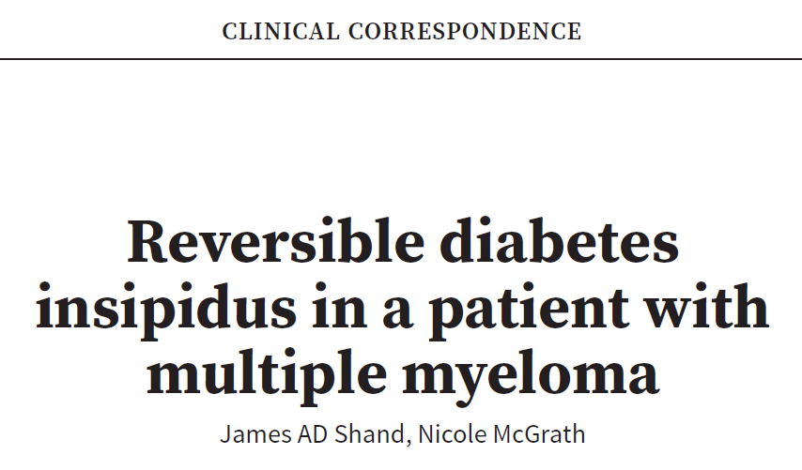

Slide 33
A 64-year-old man presented with diagnosis of advanced IgA lambda multiple myeloma (MM)
The patient commenced chemotherapy with cyclophosphamide, dexamethasone and bortezomib.
On the day of his third weekly dose of the first cycle of chemotherapy, he required hospital admission with profound dehydration and hypotension.
He then underwent a formal 7-hour water deprivation test, as per the local protocol.

Slide 34
A diagnosis of central DI was made and nasal desmopressin prescribed.
The patient reported resolution of his nocturia and return to a normal fluid intake.
There was no evidence of anterior pituitary dysfunction.
He had a normal plasma glucose and none of his medications were known to cause central DI.

Slide 35
Figure 1: MRI pituitary demonstrating persistent primitive trigeminal artery (solid lines) :anomalous cerebral vasculature with a primitive trigeminal artery that caused distortion of the pituitary gland and mottled changes of the clivus (broken line)

Slide 36
Figure 2: CT head demonstrating lytic lesions of the clivus (arrow) The bone lesions were consistent with myeloma.

Slide 37
Chemotherapy was continued with good effect associated with a rapid fall in serum free light chains after three cycles of four doses each.
With this improvement the polydipsia and polyuria also decreased and the patient stopped his desmopressin nasal spray after 6 weeks without a recurrence of symptoms.

Slide 38
Design: A retrospective review of patients with pituitary stalk lesions seen at Mayo Clinic Rochester between 1987 and 2006 was conducted. Demographic, clinical presentation, imaging, laboratory, operative, and pathology data were reviewed and are reported using descriptive statistics.
Results:
Of the 152 pituitary stalk lesions included, 49 (32%) were neoplastic, 30 (20%) were inflammatory, 13 (9%) were congenital anomalies, and 60 (39%) were of unclear etiology.
Diabetes insipidus was diagnosed in43(28%)of the 152 patients, and 49(32%) patients had at least one anterior pituitary hormone deficit.
Secondary hypogonadism was the most common endocrine deficiency.

Slide 40
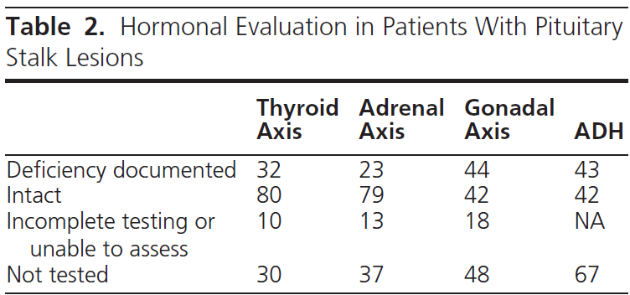

Slide 42
Thank you

