Slide 1
به نام خدا

Slide 2
14 years old woman
Presented with:
Blurred vision ,headache ,amenorrhea
MRI Image: large intrasellar mass about 55x50 mm with suprasellar extention probable invasion to cavernous sinuses & sellar erosion with cyctic component ….
severe hyperprolactinemia : ( 17700 ng/ml)

Slide 3
Prolactin 17700( ng/ml )
T4 9.5 ( mic/ml )
T3 RU 27.6%
TSH 2.5
FSH 6.0 ( IU / L )
LH 0.7
Corisol 8A.M 15.7
ACTH -
IGF-1 160 ng/ml

Slide 4
The challenges in managing giant prolactinomas
European Journal of Endocrinology (2014) 170, R213–R227.

Slide 5
Giant prolactinomas are traditionally defined as prolactin-secreting adenomas greater than 4 cm in diameter and/or those with more than 2 cm of suprasellar extension and no concomitant GH or ACTH secretion.
They are usually associated with very high serum PRL concentrations, in the range of 20,000-100,000 ng/ml.
Giant prolactinomas are rare tumours, representing only 2–3% of all prolactin (PRL)-secreting tumours.
Giant prolactinomas are much more frequent in young to middle-aged men than in women, with a male to female ratio of about 9:1.

Slide 6
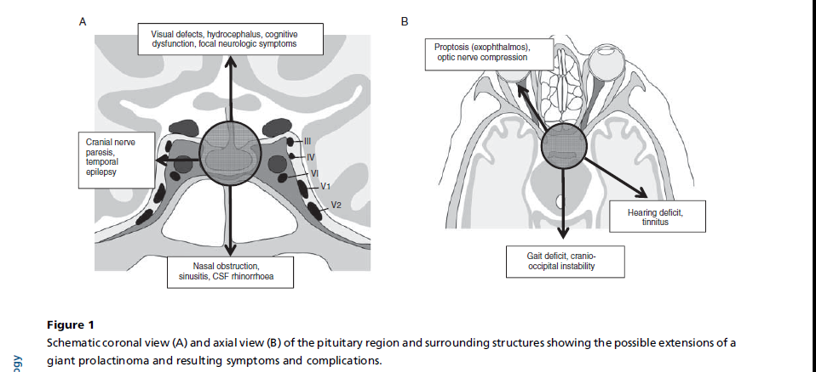

Slide 7
In the peri-pubertal period, the most common
symptoms are again mass effects together with endocrine
symptoms such as delayed puberty, primary amenorrhoea or menstrual irregularities in girls, or gynaecomastia in
boys.
Impairment of other pituitary hormone secretions is
also common in patients with large adenomas and
extrasellar extension

Slide 8
Endocrine symptoms are often present but overlooked for a long period of time, and diagnosis is eventually made when neurologic complications arise from massive extension into the surrounding structures.

Slide 9
The first goal of treatment is usually to obtain a rapid relief of neurologic symptoms.

Slide 10
giant prolactinomas excellent potential results with dopamine agonists and poor results of surgery in most patients, the authors Recommend dopamine agonists as initial therapy for patients with giant prolactinomas.

Slide 11
Hormonal resistance was defined by the absence of normalization of serum prolactin levels despite a cabergoline dose >2.0 mg/week or a bromocriptine dose >15 mg/day.
By comparison, hormone resistance rates previously reported
in invasive macroprolactinomas were 33% with BRC (78) and 24% with CAB.

Slide 12
Resistance to cabergoline
Ono et al. found that 11/60 (18.3%) previously untreated patients required a greater than usual dose, i.e., greater than 2 mg/week, of cabergoline to normalize PRL levels [374]. Of these, four required 3 mg/week, two required 6 mg/week, four required 9 mg per week and one required 11 mg/week to normalize PRL levels. Of their total 150 patients, normalization of PRL could eventually be achieved in all but one, but doses had to be raised to higher than standard levels in ~15% [374].

Slide 13
The absolute indications for surgical intervention
Patients with giant prolactinomas are the same for all prolactinomas, and include :
1- continued tumor growth on medical therapy
2- acute neurologic defects that do not respond rapidly to medical therapy
3-unstable pituitary apoplexy
Surgical cure is not a realistic attainable goal for giant prolactinomas, but tumor debulking may be necessary in the aforementioned specific situations.

Slide 14
Radiotherapy may be used post-operatively in aggressive and proliferative giant tumours, which are not controlled by DA treatment ,although there is no prospective study demonstrating its usefulness in this setting.
As already mentioned, most of these irradiated patients will not normalize their PRL levels and medical therapy needs to be continued.

Slide 15
Temozolomide (TMZ) is an oral alkylating agent inhibiting tumour cell growth, which has shown some efficacy in pituitary carcinomas and aggressive pituitary Tumours .
TMZ may be a salvage therapeutic option for patients with clinically aggressive giant prolactinomas that remain uncontrolled despite multiple conventional treatment modalities.

Slide 16
In a recent review of available literature, Whitelaw and colleagues reported a good response to TMZ in 15 of 20 aggressive or metastatic prolactinomas and a strong association between negative immunostaining for methylguanine methyltransferase (MGMT) and response to therapy (94). However, such relationship between clinical response and MGMT staining has not been confirmed in all studies (92, 93), and because of the very low number of patients with MGMT-positive prolactinoma reported to date (nZ2), candidates for TMZ treatment trial can hardly be selected on this basis.

