Slide 1
PRIMARY OVARIAN INSUFFICIENCY
(HYPERGONADOTROPIC AMENORRHEA)
AMIRAHMAD NEJAT JAN2019

Slide 2
DEFINITION
PATHOPHYSIOLOGY
CLINICAL FEATURES
CLASSIFICATION
CONCLUSION

Slide 3
DEFINITION

Slide 4
DEFINITION
Heterogeneous condition defined by:
  Age less than 40 years
  Oligo/amenorrhea for 4 months or more,
  Two serum FSH levels in the menopausal range (at least 1 month apart)
Other names:
  Premature menopause
  Premature ovarian failure
  Primary ovarian failure
  Hypergonadotropic hypogonadism

Slide 5
DEFINITION
Differs from menopause
  50% have varying and unpredictable residual ovarian function
  5 to 10% of women conceive and deliver a child
Age-specific incidence approximately
  1 in 10,000 by age 20,
  1 in 1000 by age 30,
  1 in 250 by age 35
  1 in 100 by age 40

Slide 6
DEFINITION
Carries significant physical, mental burdens.
Interferes with a woman’s reproductive potential,
Increased risk of
  Osteoporosis
  Cardiovascular disease
  Mortality

Slide 7
PATHOPHISIOLOGY

Slide 8
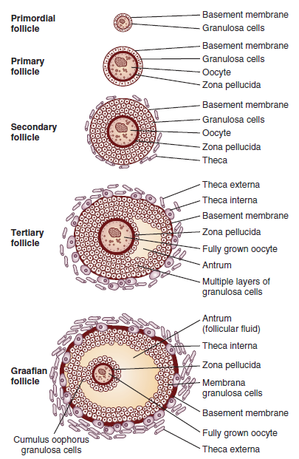

Slide 9
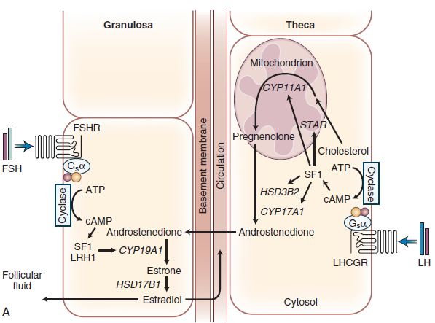
PATHOPHISIOLOGY
INHIBIN B

Slide 10
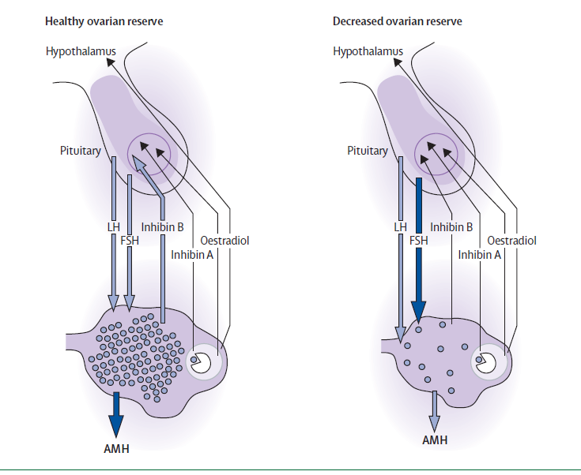
PATHOPHISIOLOGY

Slide 11
PATHOPHISIOLOGY
Primary ovarian insufficiency occurs through two major mechanisms:
Follicle depletion
  no primordial follicles in the ovary
  due to:
    Inadequate initial pool of primordial follicles in utero,
    Accelerate expenditure of follicles, or
    Autoimmune or toxic destruction of follicles
Follicle dysfunction
  follicles in the ovary, pathologic process prevents their normal function

Slide 12
CLINICAL FEATURES

Slide 13
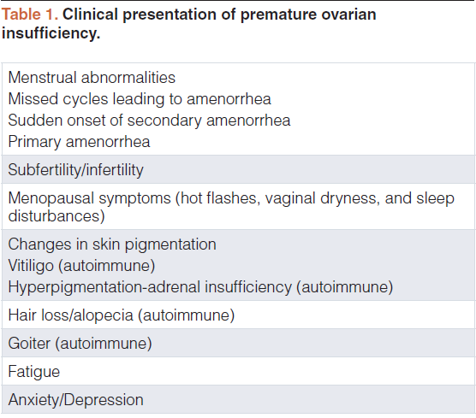
CLINICAL FEATURES
10% of cases
Not in 25%

Slide 14
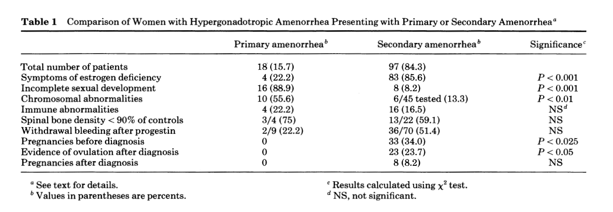
CLINICAL FEATURES

Slide 15
CLINICAL FEATURES
Positive family history,
  Affected 1degree relative,in 10 to 15% of cases
Sometimes first becomes apparent after
  Stopping (OCs)
  Following pregnancy

Slide 16
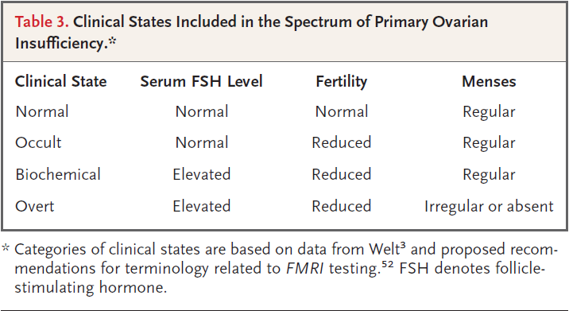
CLINICAL FEATURES

Slide 17
CLINICAL FEATURES
Ultrasonograpy :
  Streak gonads or small ovaries (no follicles)
    (most common) 64%
  Normal Ovaries
    (less frequent) (36%)
  Enlarged, multifollicular ovaries,
    Isolated 17,20-lyase deficiency
    Autoimmune oophoritis

Slide 18
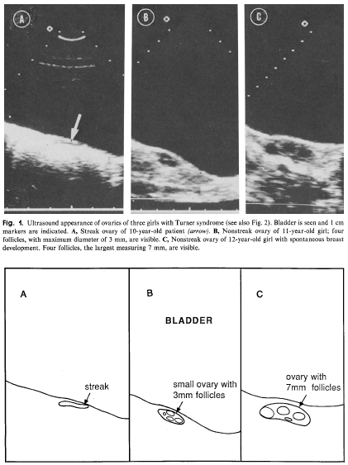
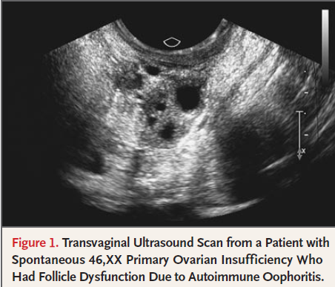
CLINICAL FEATURES
Streak gonads or small ovaries
Enlarged, multifollicular ovaries

Slide 19
CLASSIFICATION

Slide 20
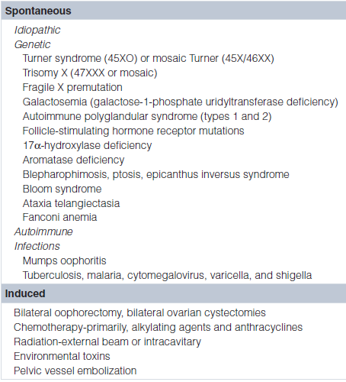
CLASSIFICATION
CAUSES OF PREMATURE OVARIAN “FAILURE”
X Chromosomal causes
Mutations associated with a 46,XY karyotype
Autosomal causes
Environmental insults
Immune disturbances
Idiopathic causes

Slide 21
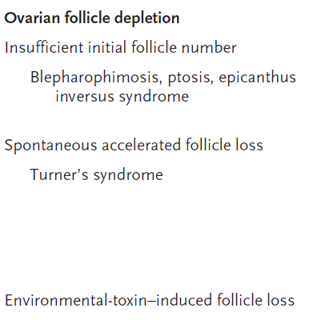
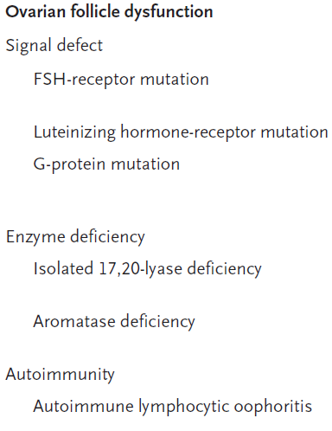
CLASSIFICATION

Slide 22
FOLLICLE DEPLETION

Slide 23
FOLLICLE DEPLETION
X chromosome disorders (TURNER)
Abnormalities in the X chromosome
  in 12–14% of women with POI
  More frequent (50%) in those with:
    Family history of POI
    Presenting with primary amenorrhea
Turner
  Occurs in 1 in 2500 to 3000 live-born girls
  Approximately
    50% have monosomy X (45,X),
    5 to 10 % have (isochromosome) of long arm of one X
    Most have mosaicism for 45,X,

Slide 24
FOLLICLE DEPLETION
X chromosome disorders (TURNER)
Gonads
  Develop normally until 3rd months of gestation
  Accelerated degeneration of oocytes and an increase in stromal fibrosis afterwards (streak gonad)
  Possibly due to haploinsufficiency of genes on X chromosome

Slide 25
FOLLICLE DEPLETION
X chromosome disorders (TURNER)
Overall incidence of spontaneous menarche and puberty is 12%:
  8%in 45X
  10% in isochromosome X
  47% in 45X/46XX
Spontaneous pregnancy
  Occurs in Less than 5%(majority with mosaicism)
  Outcome is very poor:
    40% risk of spontaneus abortion or perinatal death
    37% risk of chromosomal abnormality &congenital malformtion In live born

Slide 26
FOLLICLE DEPLETION other X chromosome disorders/translocations
Include
  X chromosome deletions,
  inversions,
  duplications
  balanced X chromosome-to-autosome translocations
karyotype should be performed in all patients with POI,
  With or without stigmata of Turner syndrome.
  Neither age of onset nor prior parity rules out a chromosomal abnormality.

Slide 27
FOLLICLE DEPLETION
X chromosome disorders (Fragile X premutation)
Fragile X syndrome
  X-linked disorder
  Most common cause of inherited mental retardation
  Most common known genetic cause of autism
prevalence
  between 1 in 4000 to 6000 in males (one-half in females)
  Carrier rate is approximately 1 in 750 men and 1 in 250 women

Slide 28
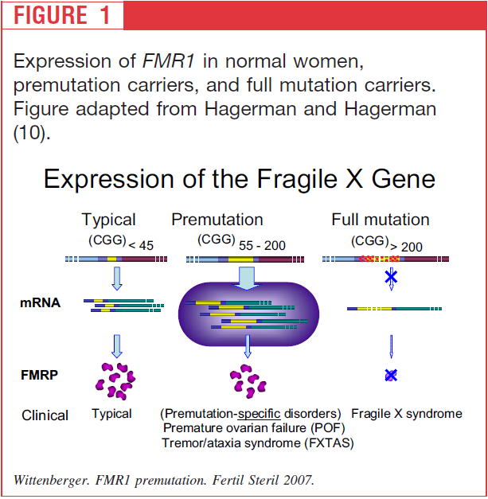
FOLLICLE DEPLETION
X chromosome disorders (Fragile X premutation)
increased levels of mRNA may cause toxic effect (?)

Slide 29
FOLLICLE DEPLETION
X chromosome disorders (Fragile X premutation)
(FMR1) gene premutation
  Most frequently identified single-gene mutation associated with POI
  Constitutes
    3% of sporadic POI
    11% of familial POI
  POI in 21% of carriers(95% CI: 15–27%)

Slide 30
FOLLICLE DEPLETION
X chromosome disorders (Fragile X premutation)
Risk for FMR1 expansion when passed to child depends on
  Repeat size
  Sex of the parent (mother)
  Frequency of (AGG) trinucleotide interspersion
ACOG recommends that all women with POI without known cause should be screened for FMR1 premutations

Slide 31
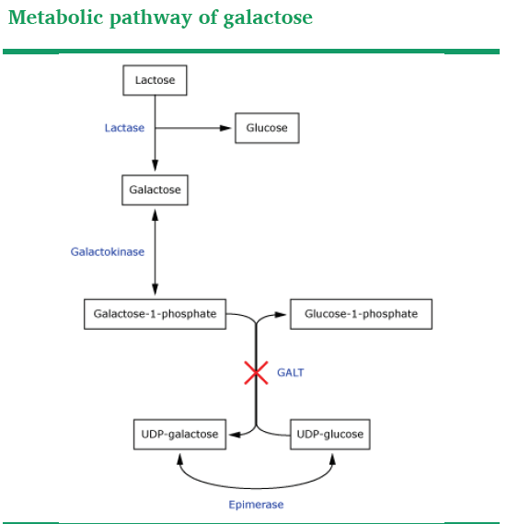
FOLLICLE DEPLETION
Galactosemia

Slide 32
FOLLICLE DEPLETION
Galactosemia
Autosomal recessive
Affects about 1 in 60 000 newborns
Untreated patients typically have
  Failure to thrive
  liver and renal dysfunction
  Sepsis
Both treated and untreated patients may have:
  Cataracts
  Abnormal neurodevelopment
  Premature ovarian insufficiency(early gonadal toxicity)

Slide 33
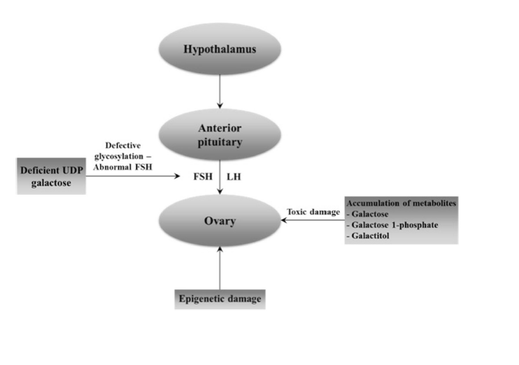
FOLLICLE DEPLETION
Galactosemia

Slide 34
FOLLICLE DEPLETION
Galactosemia
POI
  Prevalence >90% in women
  Most frequent long-term complication
  Wide phenotypic spectrum of POI

Slide 35
FOLLICLE DEPLETION
Chemotherapy/radiation therapy
CHEMOTHERAPEUTIC DRUGS
RADIATION THERAPY
Affect the granulosa and theca cells more than oocytes
normal to mildly decreased numbers of primordial follicles
Effects are age-, dose-, and drug-dependent
Alkylating drugs, such as cyclophosphamide , are best documented and most potent
Particularly toxic to oocytes
More damaging to ovarian tissue than chemotherapy.
Its effects are dose- and age-dependent
radiosensitivity of the oocyte <2 Gy
doses that result in ovarian failure in 97.5 % of patients
  20.3 Gy at birth
  18.4 Gy at age 10 years
  16.5 Gy at age 20 years
  14.3 Gy at age 30 years

Slide 36
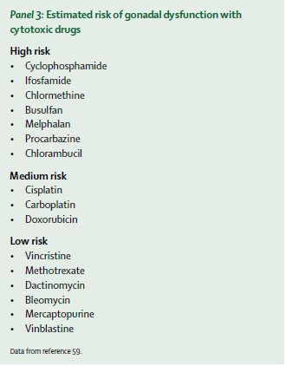
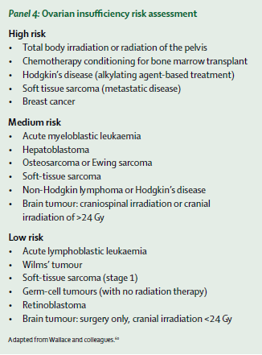
FOLLICLE DEPLETION
Chemotherapy/radiation therapy

Slide 37
FOLLICLE DEPLETION
VIRUSES
POI has been associated with several different infections including
  Mumps
    2–8% of women following mumps oophoritis
  tuberculosis,
  malaria,
  varicella,
  cytomegalovirus
  herpes simplex virus but
  HIV infection or antiretroviral therapy
direct causal links have not been established

Slide 38
FOLLICLE DYSFUNCTION

Slide 39
FOLLICLE DYSFUNCTION
Autoimmune ovarian insufficiency
Autoimmune lymphocytic oophoritis is characterised by:
  Mononuclear cell infiltration theca cells
  Sparing of primordial follicles
  5% of POI cases
  Adrenal autoimmune origin in 60–80% of case
  Development of irregular menses precedes symptomatic AI by several years

Slide 40
FOLLICLE DYSFUNCTION
Autoimmune ovarian insufficiency
three different situations of autoimmune ovarian insufficiency:
  associated with adrenal autoimmunity,
    Strongest association
    May be In the context of APS 1&2
      POI in 60% of cases of type 1
      POI in 10% of cases of type 2
  associated with non-adrenal autoimmunity
    thyroid diseases
    hypoparathyreoidism,
    type 1 diabetes mellitus,
  isolated idiopathic POI

Slide 41
FOLLICLE DYSFUNCTION
Autoimmune ovarian insufficiency
Diagnosis:
  Clinical evidence of (POI),
  Presence of steroidogenic cell autoantibodies

Slide 42
FOLLICLE DYSFUNCTION
Autoimmune ovarian insufficiency
clinical features unique to autoimmune oophoritis:
  Enlarged cystic ovaries(early)
  Presenc of antiadrenal antibodies
    21-hydroxylase antibodies
    adrenal cortical autoantibodies by indirect immunofluorescence antibodies
  Evidence of theca cell (but not granulosa cell) destruction.
    Low Serum estradiol and androstenedione
    Normal inhibin B (preantral primordial and primary follicles are preserved)
    Upper limit normal FSH

Slide 43
FOLLICLE DYSFUNCTION
Autoimmune ovarian insufficiency
Antiadrenal antibodies should be measured in all women at the time of diagnosis of POI
Women with adrenal autoimmunity
  Have a 50 % risk of developing AI
  Should be evaluated for the presence of AI
  If normal should be followed annually

Slide 44
FOLLICLE DYSFUNCTION
Steroidogenic enzyme defects
  Due to genetic defects in the enzymes involved in aAs and E2 biosynthesis.
  Result in low estrogen , high serum FSH
  enzyme defects include mutations in:
    (StAR),
      typically have severe AI soon after birth,
      occasionally present later in infancy.
      absence of pubertal development
    CYP17
      hypertension, hypokalemia, hypogonadism.
      primary amenorrhea
    aromatase

Slide 45
FOLLICLE DYSFUNCTION
Intraovarian modulators
  BMP15
    Missense mutation, X-linked dominant POI
    critical regulator of folliculogenesis and granulosa cell activities
    member of the TGF family of growth factors (includes activin and inhibin)
    associated with primary or secondary amenorrhea

Slide 46
FOLLICLE DYSFUNCTION
FSH receptor mutations
  result in production of receptors that either
    do not bind FSH or
    cannot transduce the signal normally
Gs alpha subunit gene mutations
  Defect in the guanine nucleotide of regulatory protein
    linked to the receptors
    via which activated receptors stimulate adenylate cyclase activity.
  Multiple receptors activated by G-protein,may have
    pseudohypoparathyroidism,
    abnormal gonadal function,
    hypothyroidism,

Slide 47
CONCLUSION
IN ALL PATIENTS WITH POI
karyotype
FMR PREMUTATION
Adrenal antibodies
R/O anomalies
MR
R/O addison

Slide 48

Thanks for your patience!

