Slide 1
In The Name of God
IDIOPATHIC SHORT STATURE
Ali azizi, MD
Research Institute for Endocrine Sciences
Shahid Beheshti university of medical sciences
August 4 , 2014
Tehran

Slide 2
Agenda:
Brief review of textbook
Review of clinical practice
Review of a clinical review
Conclusion

Slide 3
Idiopathic Short Stature.
ISS is defined as “a condition in which the height of the individual is more than 2 SD below the corresponding mean height for a given age, sex and population group, and in whom no identifiable disorder is present.
this definition includes children with CDGD, those with GSS, and short children who will not have delayed puberty and whose height is not consistent with parental heights.
Therefore, this definition includes both normal, healthy children (those with GSS and CDGD) and children who are presumed to have an unidentified disorder impairing their growth.
It is not always a simple matter to distinguish among these possibilities: CDGD can be definitively diagnosed only at the completion of growth, and GSS does not exclude inherited disorders of growth.

Slide 4
Children with ISS may have undiagnosed disorders outside the GH-IGF1 axis (e.g., an uncharacterized chondrodystrophy), or they may have more subtle disorders of the hypothalamic-pituitary-IGF axis than those that are identified by the currently available diagnostics tests.
Because of the lack of a gold standard for the diagnosis of GHD, the distinction between isolated partial GHD and ISS is somewhat arbitrary, relying heavily on the results of the nonphysiologic provocative stimulation tests.
Some children with ISS may have GH neurosecretory dysfunction that cannot be detected with current diagnostic tests.
Similarly, although the severe GH insensitivity of Laron syndrome can be identified by laboratory testing, partial GH insensitivity may be an unrecognized cause of ISS.
Heterozygous mutations in the GHR have been found in significant numbers of children with ISS.

Slide 5
Short Stature in Childhood — Challenges and Choices
David B. Allen, M.D., and Leona Cuttler, M.D.
N Engl J Med 2013;368:1220-8.

Slide 6
A family seeks evaluation and treatment of short stature in their 11.5-year-old son.
He previously was in the 3rd percentile for height, but his growth rate has slowed during the past 2 years, and his height is now just below the 1st percentile (Fig. 1).
His mother is 5 ft 0 in. (152 cm), and his father is 5 ft 6 in. (167 cm). The child’s size at birth was normal. His medical history and a review of systems are unremarkable.
His physical examination is normal and shows prepubertal development. The complete blood count, erythrocyte sedimentation rate, thyrotropin, tissue transglutaminase antibody, and insulin-like growth factor I (IGF-I) levels and growth hormone levels after provocative testing are normal.
His skeletal maturation (bone age) is approximately 9 years, and his predicted adult height is 5 ft 5 in. (165 cm) plus or minus 1.3 in. (3.3 cm).1 How should his condition be managed?

Slide 7
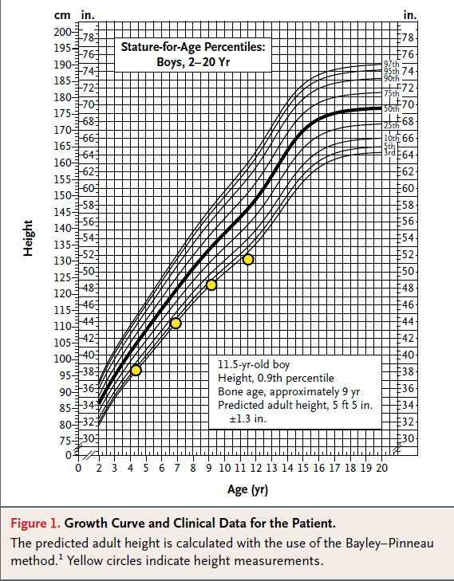

Slide 8
The Clinical Problem
Short stature in childhood is a very common reason for referral to pediatric endocrinologists.
Although evaluation for growth-inhibiting disorders is often indicated ,most children with short stature are essentially healthy.
Testing for growth hormone secretion often does not clearly distinguish isolated growth hormone deficiency from idiopathic short stature.

Slide 9
The Clinical Problem
Treatment with recombinant human growth hormone can increase the adult height of children with idiopathic short stature by 1.2 to 2.8 in. (3.0 to 7.1 cm), with wide variation in the incremental gain.
In 2003, the Food and Drug Administration (FDA) approved human growth hormone treatment for children with idiopathic short stature and height below the 1st percentile (−2.25 SD).
Accordingly, at least 500,000 children in the United States (i.e., approximately 1% of children 4 to 13 years of age) were considered to have a condition for which there is available, effective, and expensive treatment (approximately $10,000 to $60,000 per patient per year).
The FDA approval gave rise to controversies, uncertainties, and inconsistencies regarding therapeutic options that often overshadow the problem of short stature itself.

Slide 10
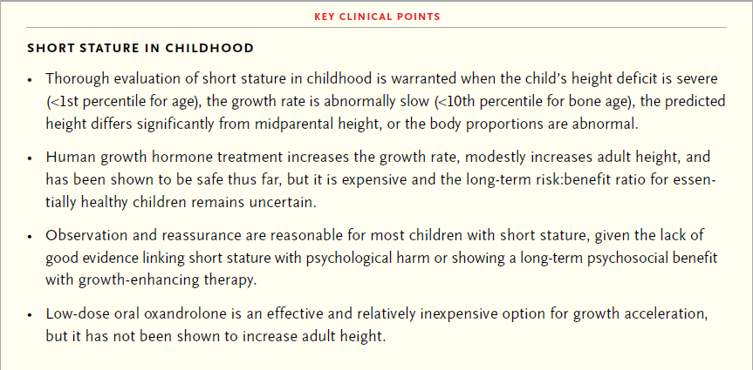
Strategies and Evidence

Slide 11
Evaluation
Clinicians who evaluate children with short stature must consider many potential causes .
Although evaluation is needed to rule out disorders such as
true growth hormone deficiency
hypothyroidism
Turner syndrome
chronic diseases
the majority of children with short stature ultimately receive a diagnosis of idiopathic short stature due to physiological variants
such as familial short stature, constitutional delay of growth and puberty (CDGP), or both.

Slide 12
In general, a growth rate that is abnormally slow for chronologic and bone age should prompt a thorough examination and possible laboratory evaluation.
A family history of late onset of puberty and the age at attainment of adult height may suggest a slowed “tempo” of growth and development (as in CDGP). A history of intrauterine growth restriction should also be assessed, since about 15% of children with this condition continue to have short stature throughout life.

Slide 13
Physical examination
abnormal body proportions (e.g., an increased ratio of the upper to lower body segment, calculated by comparing the height in a sitting
position with the height in a standing position, which suggests bone dysplasia or the Turner syndrome
characteristics that suggest genetic conditions
lymphedema or a low posterior hairline, both of which occur in the Turner syndrome
murmur related to pulmonic-valve stenosis, which occurs in the Noonan syndrome
goiter that suggest hypothyroidism

Slide 14
Physical examination
Poor weight gain (i.e., weight gain that is disproportionate to height gain) may suggest a nutritional disturbance or chronic disease.
Although children with true growth hormone deficiency
may have classic physical findings such as increased subcutaneous fat, most present primarily with attenuated growth from infancy
(congenital growth hormone deficiency) or later (acquired growth hormone deficiency).

Slide 15
Familial short stature, CDGP, or both are the most common causes of short stature.
However, when the height for age is less than the 1st percentile,
the growth rate is less than the 10th percentile for bone age
the predicted adult height differs significantly from the mid parental
Height
the body proportions are abnormal
laboratory evaluation is warranted

Slide 16
Screening laboratory studies target potential
hormonal disorders (with measurement of thyroid hormone levels)
renal disorders (with measurement of electrolyte and creatinine levels)
inflammatory and immune disorders
with measurement of the erythrocyte sedimentation rate and tests for tissue transglutaminase antibodies
hematologic disorders (with a complete blood count).

Slide 17
Genetic testing for specific syndromes may be indicated by physical findings or simply by a growth pattern and height projection that differ significantly from those in other members of the family.
Assessment of the growth hormone– IGF-I axis begins with measurement of the serum IGF-I level
A normal IGF-I level for bone age rules out severe forms of growth hormone deficiency but not necessarily milder forms.

Slide 18
Measurement of growth hormone levels after provocation
with various agents is the classic method for assessing growth hormone deficiency, but the interpretation of the results is complicated by
variation in testing procedures and the unclear sensitivity and specificity (and variation among countries) of cutoff levels used for diagnosis.
The diagnostic value of low stimulated growth hormone levels (especially 5 to 10 ng per milliliter, with levels of >10 ng per milliliter conventionally
thought to indicate adequate growth hormone secretion) is controversial.
Moreover, relatively low growth hormone levels during late childhood may
return to normal levels after puberty begins or with sex-steroid priming.
A low IGF-I level and low provoked growth hormone level (e.g., <5 ng per milliliter) in a child with attenuated growth strongly suggest growth hormone deficiency.

Slide 19
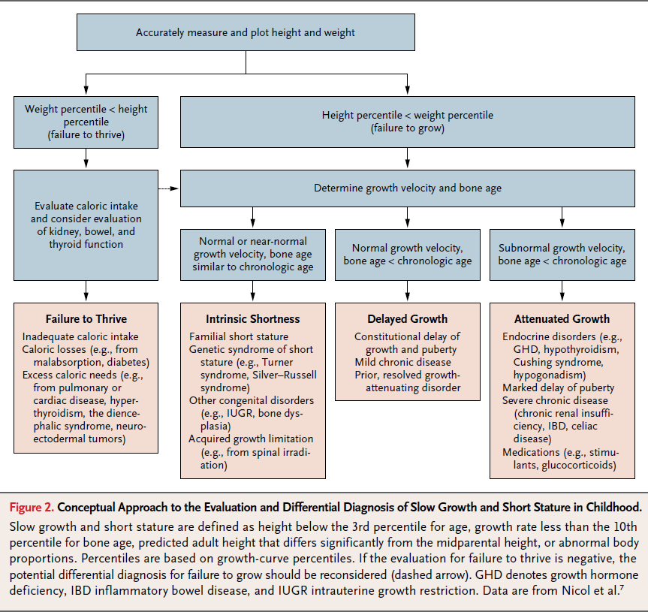

Slide 20
Management
The rationale for treating short stature in childhood includes increasing height and alleviating psychosocial disability while maintaining favorable risk:benefit and cost:benefit ratios.
Selection among management options may therefore depend on the degree to which each one meets these goals.

Slide 21
Observation and Reassurance with No Treatment
Observation is a reasonable strategy for most children with familial short stature or CDGP.
Although a child may be teased or feel sad about being short, comparisons of children with short stature that is not related to growth hormone deficiency with taller peers and psychosocial assessment of short adults indicate that psychological stress can be but is not predictably related to stature.

Slide 22
Height-Promoting Treatment with Human Growth
Hormone
FDA approval of human growth hormone for children with idiopathic short stature implies that the cause of short stature and the growth hormone secretory status are not critical factors in decisions about whether such children should be treated.
Data from randomized, controlled trials, observational dose–response studies,and systematic reviews indicate that human growth hormone therapy in children with idiopathic short increases the growth rate and mean adult height by 1.2 to 2.8 in., or approximately 0.4 in. (1.0 cm) per year of human growth hormone treatment.

Slide 23
The response is variable and is influenced positively by younger age at baseline, delay in skeletal maturation, and taller parents (and
negatively by shorter parents).
Human growth hormone is administered subcutaneously at a dose of 0.2 to 0.375 mg per kilogram of body weight per week.
Daily administration of human growth hormone is superior to
less frequent
Treatment is typically continued until completion of growth or until the child grows to a height subjectively considered to be satisfactory by the child, family, and physician.

Slide 24
Extensive clinical experience indicates that the risks of adverse effects from human growth hormone during treatment
occurrences of intracranial hypertension
glucose intolerance
slipped capital femoral epiphysis are low.
However, safety data from postmarketing surveillance studies probably underestimate risks associated with higher doses of human growth hormone and changing risk factors (e.g., an increased prevalence of obesity, which carries a higher risk of diabetes) and do not inform post-treatment metabolic risks or the risk of cancer.

Slide 25
Human growth hormone treatment for idiopathic short
stature is expensive (conservatively estimated at $35,000 to $50,000 per inch of height gained).
Higher-dose regimens and a longer duration of treatment increase costs and may also increase risks
A long term follow-up study from France involving persons who had growth hormone deficiency or idiopathic short stature or who were small-for gestational- age infants showed an increased standardized mortality rate of 1.33 after human growth hormone treatment, as compared with the general population in France

Slide 26
Other Treatments to Increase Growth
For short peripubertal boys, growth-promoting alternatives to human growth hormone are low-dose androgen therapy with injectable testosterone and low-dose androgen therapy with oral oxandrolone (e.g., 1.25 to 2.5 mg per day).
Both regimens are relatively low in cost, and though they are not FDA-approved for growth acceleration, they increased the growth rate by 1.2 to 2.0 in. (3.0 to 5.1 cm) per year for 1 to 3 years in controlled trials.
To avoid accelerated estrogen mediated epiphyseal maturation, oxandrolone (not aromatized to estrogen) is theoretically preferred over testosterone when the bone age is less than 11 years.

Slide 27
Oxandrolone is usually discontinued after a documented increase in endogenous testosterone; long-term follow-up studies indicate that treatment is followed by normal pubertal growth and eventual attainment of an adult height equal to or slightly greater than the predicted height before treatment .
Extensive clinical experience indicates that the risks of low-dose androgen
treatment (e.g., adverse hepatic or lipid effects) are low.
Aromatase inhibitors (which reduce estrogen production and delay skeletal maturation) have been used experimentally in boys to prolong pubertal growth and increase height, but they are more expensive and have less of a growth accelerating effect than androgens, and actual adult height gains have fallen short of prior predictions of 1.6 to 2.4 in. (4.1 to 6.1 cm).
In view of concerns about potential adverse effects of estrogen deficiency during pubertal growth, including vertebral-body deformities, aromatase
inhibitors cannot be recommended for treatment of short stature outside of investigative studies.

Slide 28
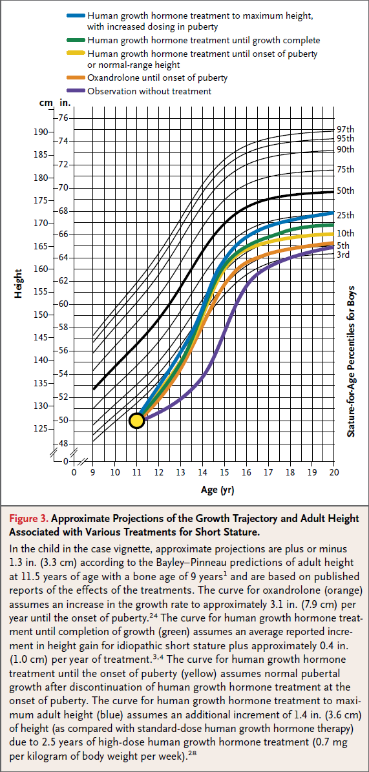

Slide 29
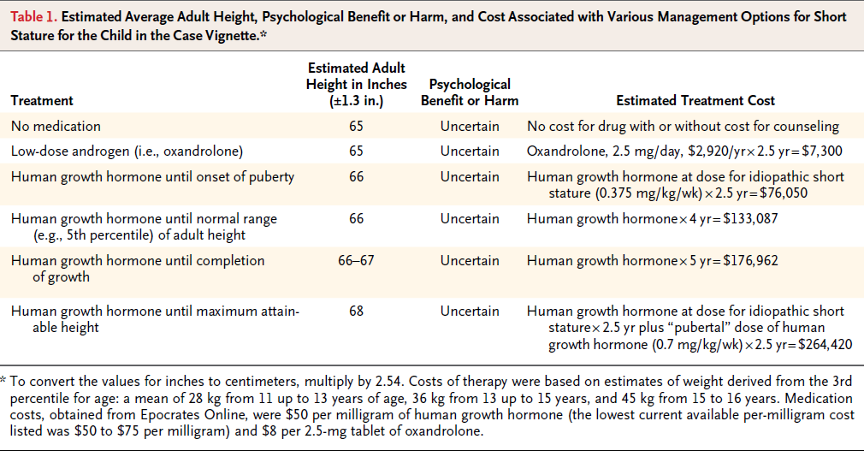

Slide 30
CONCLUSION AND RECOMMENDATIONS
The peripubertal boy described in the vignette is markedly short but otherwise appears to be healthy. Although his growth pattern in earlier life and predicted height match those expected on the basis of parental heights, his slowed growth rate and the severity of his short stature warrant screening studies to rule out underlying disease
and frank growth hormone deficiency.
Normal findings on these tests support a diagnosis of idiopathic short stature (familial short stature combined with and exacerbated by CDGP).

Slide 31
Options for treatment of idiopathic short stature should be discussed with the child and his parents; these options include observation and reassurance, human growth hormone therapy, and low-dose androgen therapy.

Slide 32
Observation is a reasonable strategy that is supported by the lack of good evidence linking short stature with psychological harm or showing a long-term psychosocial benefit of growth-enhancing therapy, and the expectation of eventual achievement of adult height approximating midparental height.
Alternatively, human growth hormone treatment has been shown to increase the growth rate and, to varying and albeit generally modest degrees (1.2 to 2.8 in.), eventual adult height. Although human growth hormone treatment has a strong safety record thus far, it is costly, requires daily injections, and could have adverse effects in the future that are relevant to treatment decisions for an otherwise healthy child.
A third option is lowdose, oral oxandrolone treatment, which also stimulates growth and has a relatively low cost but no proven salutary effect on eventual attained height. Thus, management options for short stature are widely disparate, with important implications with respect to cost and complexity of care.

Slide 33
Thus, for a child such as the one described in the vignette (who is currently just below the 1st percentile for height but whose projected height is at the lower end of the normal range for adults), we would provide reassurance and recommend observation as a reasonable management option.
If intervention is elected because of psychological distress, counseling, treatment with low-dose (and relatively low-cost) oxandrolone, or both could be considered. If human growth hormone is used, we would consider an appropriate treatment goal to be a height in the lower normal range (e.g., approximately the 5th to 10th percentile for U.S. adults rather than the maximal attainable height), and we would take into account both the costs of therapy and the potential risks of prolonged or high-dose therapy.

Slide 34
Idiopathic Short Stature
A Clinical Review
Laurie E. Cohen, MD
JAMA. 2014;311(17):1787-1796. doi:10.1001/jama.2014.3970

Slide 35
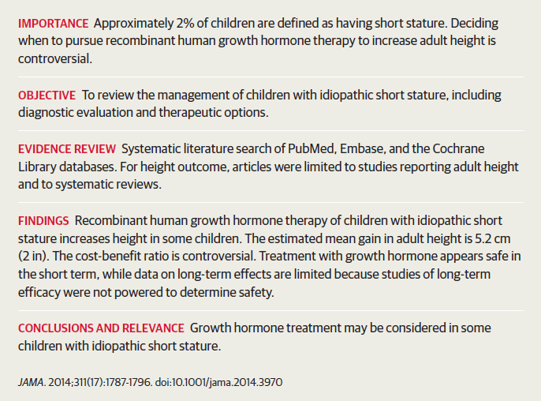

Slide 36
Dr Tess Miss W is a 9-year-old girl with short stature
She was always smaller than her peers, and her height began to decline from her growth curve after age 2 years, with a subsequent reduction in weight gain .
Her growth velocity has fluctuated but most recently has been consistent with a normal delayed tempo of growth pattern .
Her growth rate remains slow at 4.83 cm/y (normal range for age,4.2-7.3 cm/y). She and her parents are considering growth hormone treatment.
She is in third grade, does well in school, and is physically active and participates in sports.
At birth, she was full term, weighed 2640g (approximately fifth
percentile), and was 49.5 cm long (>10th percentile).
She had early Jaundice and feeding problems but appropriate progression through developmental milestones.
She has migraine headaches, takes no medications, and has no allergies.

Slide 37
Her family history includes diabetes, hypothyroidism, hypertension,
and hyperlipidemia in her grandparents.
Her mother is 157 cm(5 ft 2 in) tall and had menarche at age 14 years.
Her father is 168 cm (5 ft 6 in) tall, grew significantly his senior year of high school, and has had a mild stroke.
Her brother is 6years old, has been maintaining height at the 10th percentile, and is healthy. On examination, her height is 115 cm (0.05th percentile; SD, −3.32) and her weight is 21.8 kg (1.99th percentile; SD, −2.06).
Her body mass index is 16.5 (50.29th percentile; SD,0.01).
The remainder of her physical examination results were normal.

Slide 38
Miss W’s laboratory test results were all normal
Free thyroxine level of 1.25 ng/dL (reference range, 0.8-1.9 ng/dL)
thyrotropin level of 1.5 μU/mL (reference range, 0.7-5.7 μU/mL)
insulinlike growth factor 1 (IGF-1) level of 183 ng/mL (reference range, 74-388 ng/mL; median for age, 169 ng/mL)
insulinlike growth factor binding protein 3 (IGFBP-3) level of 4.6μg/mL(reference range, 1.8-7.1 μg/mL; median for age, 3.6 μg/mL)
negative screening results for systemic illnesses.
Chromosomal studies revealed a karyotype of46,XX and SHOX gene mutational analysis was negative.
Her bone age was 6 years 10 months according to the standards of Greulich and Pyle at a chronological age of 9 years 0 months and height of 112.7 cm, predicting an adult height of about 147 cm(4 ft 10in),below her mid-parental height of 156cm(5 ft 1 in).
Other evaluations have included normal results of endoscopy and ileoscopy with biopsy for abdominal pain.

Slide 39
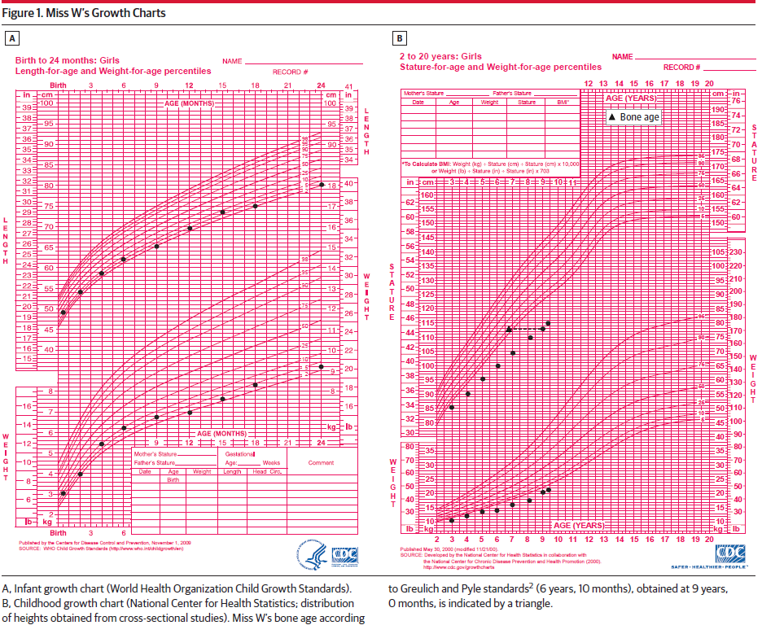

Slide 40
Definitions and Causes of Short Stature
In an initial evaluation of a child for short stature, determination if the child is truly short is the first step. Short stature is defined as a height that is more than 2 SDs below the mean for age, sex, and population, so 23 per 1000 individuals have this diagnosis. MissW meets this definition, as her height SD is −3.3.
The second question is whether the child’s height is appropriate for the family. To determine whether a child’s height is consistent with his or her genetic potential, a target height can be calculated using the formulas in Box 1.
The third question is what is the child’s growth rate? Children who grow at a normal rate are more likely to represent normal variations of growth, while a poor growth rate may indicate an organic problem.
Miss W’s annualized growth velocity has ranged from low to low-normal over the past few years.

Slide 41
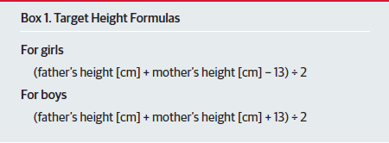

Slide 42
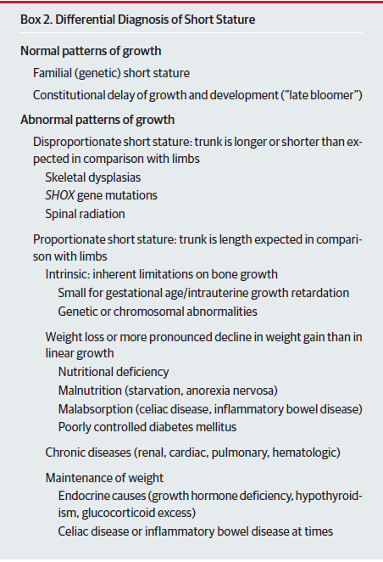

Slide 43
Evaluation of Short Stature
Evaluation of a short child with a concerning growth pattern starts with a detailed medical history.
Birth history should include
gestational age
birth weight and length
prenatal and perinatal complications
A delay in developmental milestones or poor school performance
past medical problems
positive findings on a review of systems may suggest a specific pathology Dietary recall is important for assessment of nutritional intake
Certain medications, such as stimulants used for attention deficit/hyperactivity disorder, anticonvulsants, and antidepressants may affect growth.
A complete physical examination should be performed looking for signs of
systemic illnesses and endocrinopathies
with special attention to dysmorphic features
metacarpal length, body proportions
pubertal staging.

Slide 44
Skeletal maturity is determined from a radiograph of the left hand and wrist (bone age) and is delayed in CDGP,
endocrinopathies,
nutritional deficiency
chronic illness
Laboratory screening should be tailored to the growth pattern

Slide 45
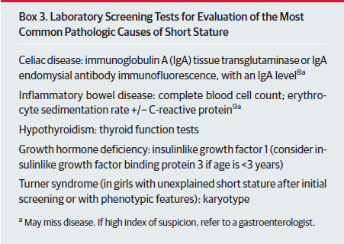

Slide 46
Growth Hormone Evaluation
A typical child with classic growth hormone deficiency (GHD) has increased subcutaneous truncal fat
an immature face with a large calvarium (frontal bossing)
anunder developed nasal bridge
delayed dentition.
There is a positive correlation between the impairment in growth velocity and the severity of GHD.
Distinguishing between mild growth hormone insufficiency and ISS is more difficult.

Slide 47
Because growth hormone secretion is pulsatile, a single growth hormone sample will often be low and not useful for diagnosis.
Screening for GHD may be performed by measuring IGF-1, the major growth hormone–dependent peptide, as its serum level is relatively stable throughout theday.
However, there is considerable overlap in IGF-1 concentrations in healthy children younger than 6 years and in those with GHD.
Levels of IGF-1 vary with sex and ethnicity and may be reduced in malnutrition, hypothyroidism, hepatic disease,diabetes mellitus, and delayed puberty.

Slide 48
A literature review by Federico et al determined that IGF-1 had a specificity of 100% and a sensitivity of about 70% to 90% in diagnosing GHD.
The major serum carrier of IGF-1, IGFBP-3, is also growth hormone dependent but is less affected by nutrition.
Because the normal ranges for IGF-1 are low in young children,IGFBP-3may be more informative for children younger than 3 years.

Slide 49
Provocative tests for growth hormone release are available but
are challenging to interpret.
Following administration of substances such as insulin, levodopa, arginine, glucagon, propranolol, or clonidine that provoke growth hormone release, growth hormone levels are measured over a period of time using antibody based testing.
Thresholds to make the diagnosis of GHD have varied from 2.5ng/mL to 10 ng/mL, with specificity decreasing as the cutoff increases.
The current widely used cutoff is 10 ng/mL by immunoradiometric assay.

Slide 50
Expected Outcomes of Use of Growth Hormone
Replacement in Children With ISS
In 2003, the US Food and Drug Administration (FDA) approved the
use of growth hormone for treatment of ISS in children whose height
is more than 2.25SDs (1.2nd percentile) below the mean for age and
sex without evidence of underlying disease or GHD, such as MissW.
Although it was not part of the FDA criteria, the FDA issued a statement that these children should have “a growth rate that is unlikely to attain an adult height within the normal range,” with a cutoff at the 1.2nd percentile, which is 160 cm(63 in) for men and 150cm(59 in) for women.

Slide 51
The FDA approval of growth hormone for treatment of children
with ISS was based on 2 studies.
Leschek et al performed a randomized, double-blind, placebo-controlled study of peripubertal children and followed up with some of them until near adult height. Treatment effect was 0.51 SD score (95%CI, 0.10-0.92 SD score; P=.02) (3.7 cm). The growth hormone dose used,0.22mg/kg perweek, is lower than that used in later studies,and the weekly dose was divided into 3 times weekly, which has been shown to be less effective than daily treatment for GHD.
Wit et al performed an open-label randomized study investigating the effect of 2 doses of growth hormone, 0.24mg/kg per week and 0.37 mg/kg per week, with a calculated dose-response effect of 0.57 SD score (±0.25 SD score; P=.03) (3.6 cm).

Slide 52
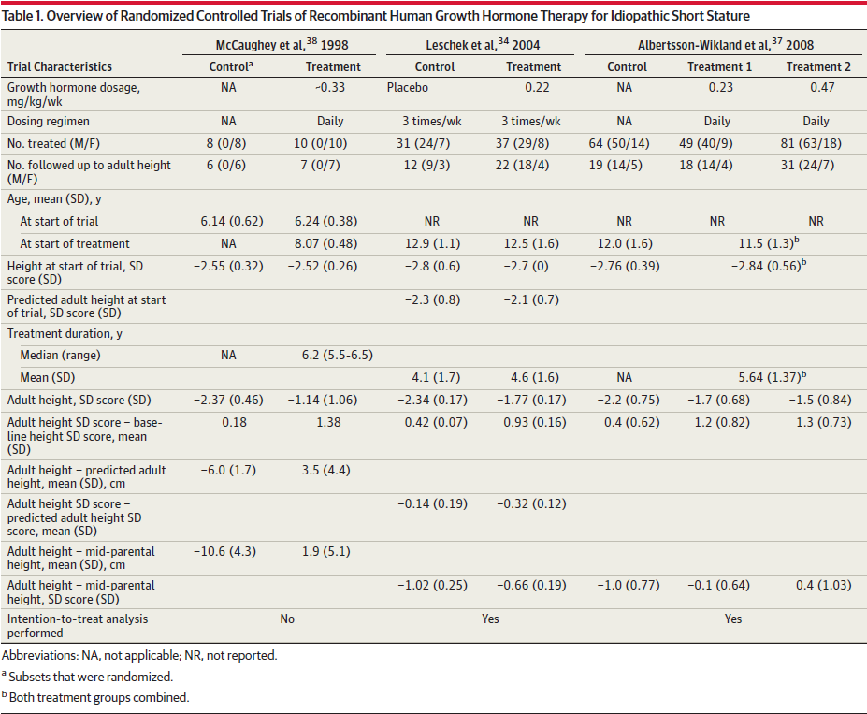

Slide 53
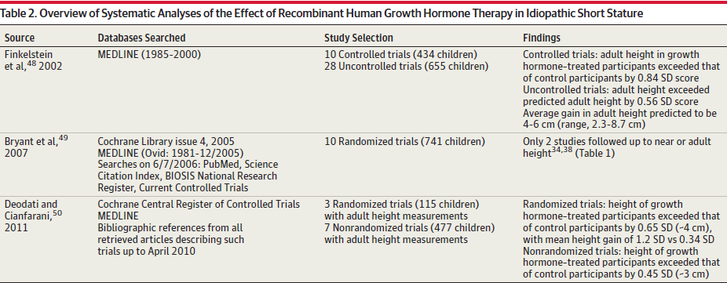

Slide 54
Cost of Treatment
The cost of growth hormone therapy must be considered.
Lee et al created a decision analysis model.
They estimated that the incremental cost-effectiveness ratio of growth hormone treatment was $52 634 per 2.54 cm (1 in) in 2004 US dollars, with an incremental height gain of 4.8 cm (1.9 in) over 5 years and an incremental cost per child of $99 959.
Based on the FDA indication for treatment of children with ISS,
585 000 US children are eligible for growth hormone at a potential annual cost exceeding $11 billion. It is important to recognize that growth hormone therapy is administered to an otherwise healthy child.
Treatments require administration of injections6to7 nights per week for years until growth is near completed, with frequent medical visits and laboratory testing to monitor the treatment.

Slide 55
Safety of Growth Hormone Therapy
Known short-term complications include
insulin resistance (with increased incidence of type 2 diabetes mellitus in children with other risk factors)
pseudotumor cerebri
slipped capital femoral epiphyses
The National Cooperative Growth Study enrolled 8018 children with
ISS and found no significant increase in adverse events or mortality
at doses of 0.37 mg/kg per week or lower in treatment of children
for ISS compared with GHD.
Long-term complications are less clear; adverse events may occur after end of follow-up and thus not be noted or reported.

Slide 56
There are concerns about a correlation between cancer risk and IGF-1 levels observed in nested case-control trials.
Recent interim results from the Safety and Appropriateness of Growth Hormone Treatments in Europe (SAGhE) highlight this possibility, but the data are conflicting and controversial.
The investigators from France reported an increased risk of death in an adult population previously treated with growth hormone compared with the general population.
The data showed an increase in mortality, even in those at low risk of mortality (idiopathic GHD, “neurosecretory”GHD, ISS, and small for gestational age), due to bone tumors (but not global cance mortality) and due to cardiovascular events (mainly sub arachnoid and intracerebral hemorrhage).
Those who received higher Mean doses of growth hormone(>0.35mg/kg per week) had higher mortality rates.
The SAGhE data from Belgium, Scandinavia, and the Netherlands did not show an increase in mortality rate. Both studies lacked statistical power, and long-term safety of growth hormone therapy remains unclear.

Slide 57
Other Treatments Available for Short Stature
Treatment of these children with low-dose androgens in boys increases growth velocity without rapidly advancing bone age or compromising adult height.
There are no comparable studies on the effect of low-dose estrogen in girls.
Gonadotropin-releasing hormone agonists have been used to halt pubertal progression, allowing for a longer period of growth.
However, increases in adult height are often clinically insignificant.
Yanovski et al performed a randomized placebo-controlled study showing that treatment with agonadotropin-releasing hormone agonist for 3.5 years increased adult height over predicted adult height by 0.6 SD (95% CI, 0.2-0.9 SD) for an average increase of 4.2 cm (1.7 in).
Others have used a combination of gonadotropin- releasing hormone agonist and growth hormone treatments

Slide 58
Because estrogen mediates skeletal maturation and epiphyseal
fusion in both sexes (testosterone is converted to estrogen via
aromatase), aromatase inhibitors have been used to block conversion
of androgens to estrogens in boys, alone or in combination with testosterone or growth hormone.
These agents do not delay pubertal development. Most studies have not reported adult height, and treatment response appears to be related to the aromatase inhibitor used and the duration of treatment
Adverse effects include reduced high-density lipoprotein cholesterol, vertebral wedge deformities, and theoretical long-term effects on spermatogenesis and infertility.
At this time, the use of aromatase inhibitors is considered experimental.

Slide 59
Oxandrolone, a nonaromatizable anabolic steroid with a high anabolic-to-androgenic ratio, has been used to stimulate growth in boys with CDGP.
While its mechanism of action on growth is unclear, oxandrolone may increase growth hormone–IGF-1 axis activity and may have effects on the estrogen receptor.
Increases in predicted adult height have been reported in some but not all studies, and there are no studies of adult height.

Slide 60
Recommendations for MissW
There is a high level of evidence that recombinant human growth hormone might be considered in children with ISS.
This therapy is not effective in all children with ISS.
Ideally, clinicians should identify children with ISS who are likely to respond to growth hormone therapy and treat only them.
Predictors of better growth response to growth hormone in ISS include a greater height difference between a child and his/her parents and greater bone age delay.

Slide 61
Miss W had negative screening test results for
celiac disease
inflammatory bowel disease
other systemic illnesses
normal thyroid function test
normal karyotype
no evidence for a SHOX gene mutation
She was not small for gestational age
she has no syndromic features
Her body proportions are normal
Her serum IGF-1 and IGFBP-3 levels are above the median for
a prepubertal girl, which suggests that GHD is unlikely
Nevertheless, she has an adult height prediction of 147 cm (58 in)
therefore, she satisfies the height criteria for treatment with growth hormone according to the FDA indication for children with ISS
Her shorter starting height, lower predicted adult height, and delayed bone age are positive predictors for response although her familial short stature is not.

