Slide 1

بسمه تعالی
دکتر عمید قاسمبگلو
متخصص بیماری های داخلی

Slide 2
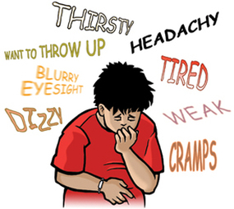

Slide 3
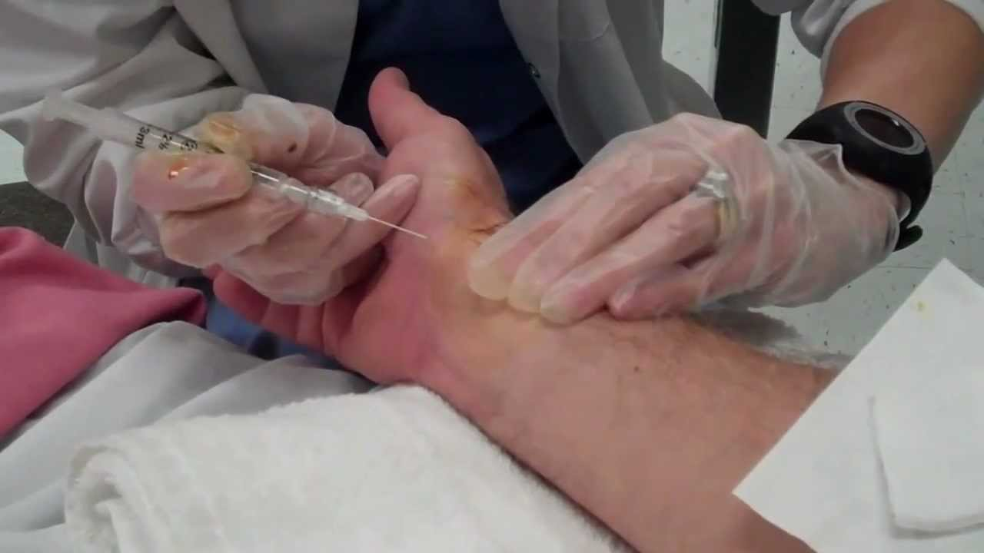
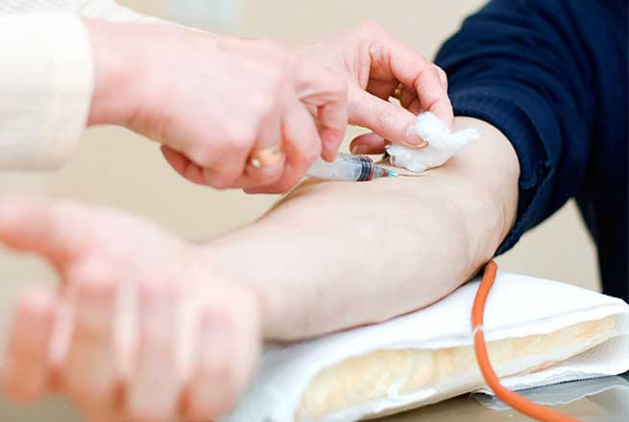

Slide 4
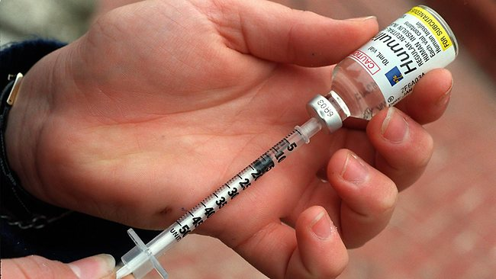



Slide 5
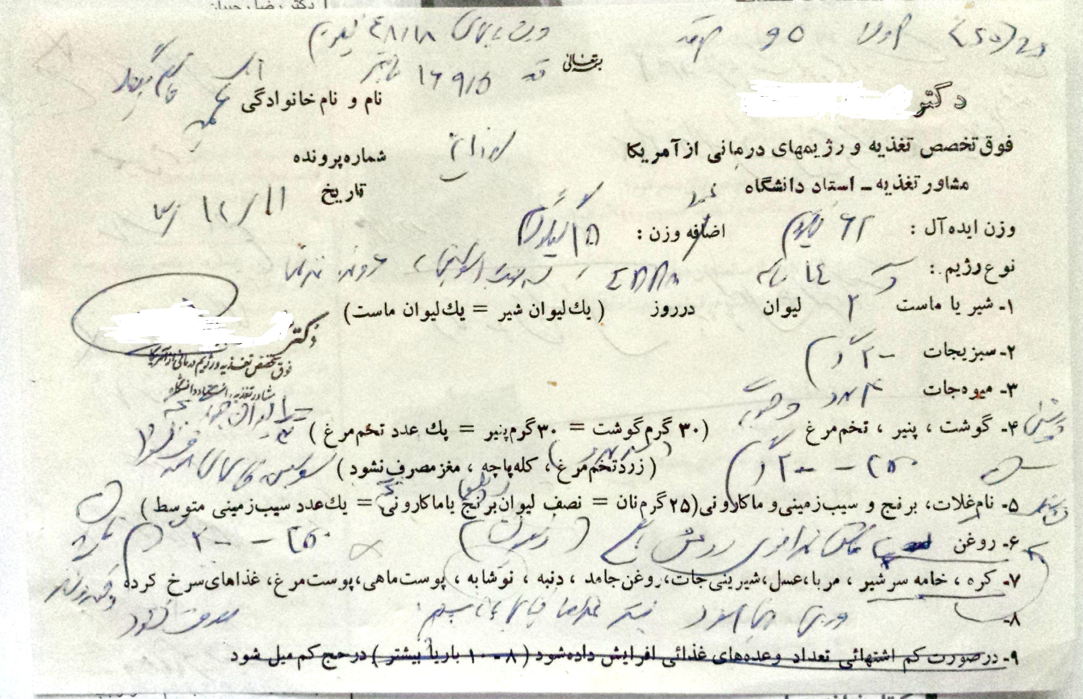

Slide 6
((هر چند دیابت تا پایان عمر با شماست ولی با کنترل آن می توان از بروز عوارض دیابت پیشگیری نمود))

Slide 7
1. دیابت تا پایان عمر با من است.
2.دیابت را باید کنترل نمود.
3.دیابت عوارضی دارد که با کنترل قند خون می توان از بروز آنها پیشگیری نمود.

Slide 8



Slide 9



Slide 10




Slide 11


Slide 12



Slide 13
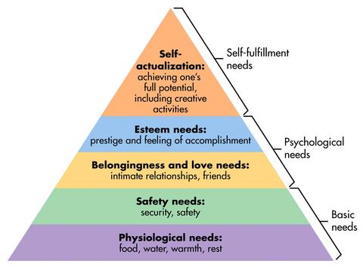
What a Child Needs?
Notes:
Students like adults all have basic needs that must be met in a certain order. We must meet the need for food, water, sleep (physical needs) before emotional or learning needs can be met.
Diabetes interferes with the normal progression of all these needs.

Slide 14
دوره ماه عسل ( (Honeymoon
Not all newly diagnosed individuals experience the Honeymoon Phase
Can last for weeks up to 2 years
We can not let our guard down
Notes:
The Honeymoon Phase is where the pancreas begins to produce insulin (after the diagnosis of diabetes) and some individuals are able to decrease the amount of insulin they take. This can lead the child/teen/parent and us to think the “diabetes has been cured” or there was a child/teen who was mis-diagnosed. Because of this sense of “there’s not much wrong”, there may be a decreased attention to meal planning, eating correctly and checking of blood sugars. We can not let our guard down!!!!!!!!

Slide 15
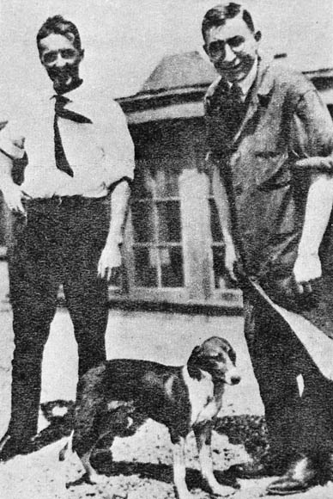
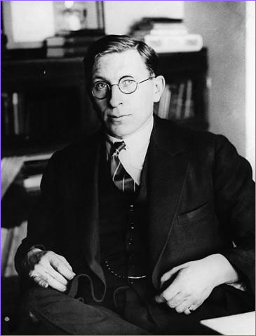
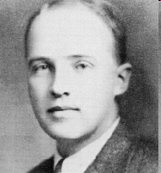
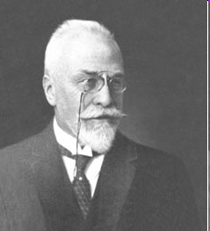
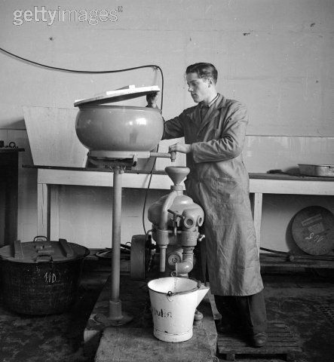
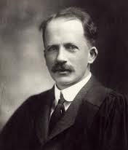
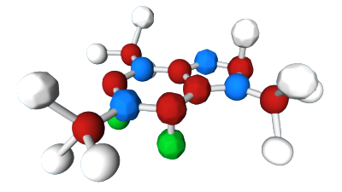
کشف انسولین

Slide 16
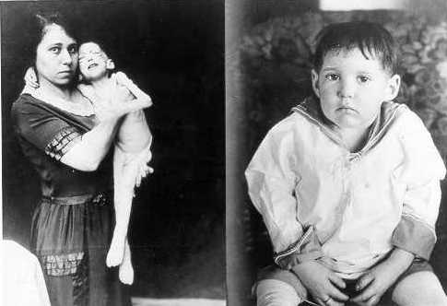

Slide 17



Slide 18



Slide 19


Slide 20


