Slide 1
IN THE NAME OF GOD

Slide 2
Case presentation
Dr.Zahra daraei
1401.7.18

Slide 3
Patient ID
47 y/o woman
Born & live in Mehran
Housewife
Source of history : patient

Slide 4
Chief complain
Referall for the adrenal mass

Slide 5
Present illness
The patient is a 47 years old woman that because of intermittent abdominal pain in the RUQ region was examined for the cause of abdominal pain.
During the examination they noticed numerous stones in the gall bladder and the right adrenal mass greater than 4 CM and she was referred to our hospital for further investigation and treatment.

Slide 6
PMH
Diabetes from 4 years ago
Hypertension from 1 years ago
Gall stone from 1 years ago

Slide 7
Date | LAB | Urin 24h | Metanephrin (up to 90) | Normetanephrin (up to 196) | Overnight test Ug/dl | ACTH | DHEAS Ug/dl | Fbs Mg/dl
1401.5.22 | SALAMAT | V=2300 VMA=64.5 (<13.5) MG CORTISOL=176 (1.5-63) mcg | 29 | 94
1401.6.3 | SALAMAT |  |  |  |  |  |  | 140
1401.6.6 | PARS | V=2200 Cr=1584 Metanephrin=934.3 mcg (0-350) Normetanephrin=5430 mcg (0-600) VMA=7.8 (2-12) |  |  | 2.3 |  | 32.4 (56.2-283) | 161
1401.6.19 | PARS | V=1250 Cr=1125 CORTISOL=251.5 (36-137) mcg |  |  |  | 23 pg/ml (7.2-64) | 36.2 (35-256)

Slide 8
Date | Lab | NA | K | Renin | Aldosteron | Ca | P
1401.5.22 | Salamat | 144 | 4.4 | 128 (1.63-95.5)upright micu/ml | 37.8 p/ml | - | -
1401.6.6 | Pars | 136 | 4.8 | 36.9 (0.5-4) Ng/ml/h | 56.7 ng/dl (3.7-43.2)
1401.6.19 | Taleghani | 138 | 3.5 |  |  | 11.2 | 4.1
1401.6.22 | Taleghani | 140 | 4.5 |  |  | 10.3 | 3.6
1401.6.25 | Taleghani | 140 | 4.1 |  |  | 10 | 4.3

Slide 10
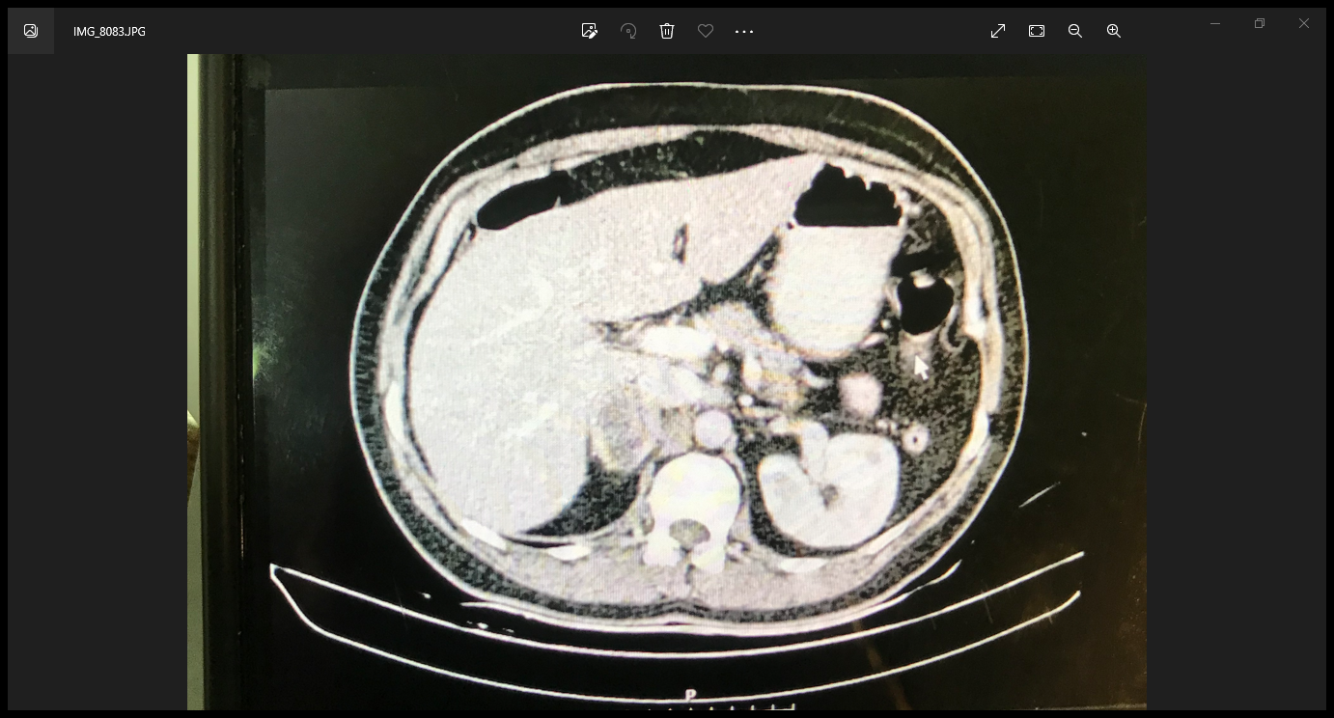

Slide 14
DH
Valsartan 80 mg /day from 1 years ago
Metformin 500 mg/day from 1 years ago

Slide 15
FH
FH OF HTN (-)
FH OF DM (-)
FH OF CANCER (+)

Slide 16
ROS
Headache (-) moon face (-) palpitation(-) weight gain(-)
weight loss(-) sweating(-) blood pressure crisis (-) depression(-)
Recurrent infection(-) poor wound healing(-)
HTN(+) DM(+) RUQ pain(+) Right flunk pain (-)
gall bladder(+) kidney ston(+)

Slide 17
PH / EX
GENERAL APPEARANCE :
47 y/o woman ; awake and alert
Vital sign :
BP=125/80 RR=18 PR=78 T=36.5
WEIGHT=73 kg HEIGHT=154 CM BMI=30

Slide 18
PH / EX
Facial plethora(-) facial fullness(-) acne and hirsutism(-)
Acantosis nigricanse(-) cutaneous stria(-) easy bruising(-)
Skin thining(-) supraclavicular fullness(-) buffalo hump(-)
Central obesity(-)
proximal myopathy(-) muscle force=5/5 peripheral edema(-)

Slide 19
Problem list
HTN
DM
RUQ pain (GALL STONE)
Adrenal mass
High metanephrin and normetanephrine in 24 h.urin
High cortisol in 24 h.urin
No suppress the overnight test

Slide 20
Pheochromocytoma with cortisol exess

Slide 21
AGENDA
What is the causes of pheochromocytoma and cortisol exess ?
Treatment and follow up in this patient

Slide 22
The causes of pheochromocytoma and cortisol excess
Cushing syndrome resulting from ectopic ACTH producing tumor has been infrequently reported in adults
A functioning adrenal adenoma and pheochromocytoma in the same adrenal gland ; two discrete adrenal incidentalomas
Coexistence of ACTH-independent subclinical cushing syndrome (scs) with pheochromocytoma involving the same adrenal tumor is rare ; autonomous cortisol production caused by paracrine stimulation from the pheochromocytom

Slide 23
Cushing syndrome resulting from ectopic ACTH producing tumor :
pheochromocytoma is a very rare disease with an incidence of 1 to 10 cases per million people.
Most cases of pheochromocytoma associated with SCS or CS are caused by ACTH or ACTH precursors produced by the pheochromocytoma, with resulting bilateral adrenocortical hyperplasia.
J Clin Endocrinol Metab, September 2020, 105(9):e3374–e3383

Slide 24
Cushing syndrome resulting from ectopic ACTH producing tumor :
Plasma ACTH levels are higher in EAS than in CS from a pituitary adenoma
tumoral though there remains considerable overlap .
In patients with ectopic ACTH, mean plasma ACTH levels were 358
ng/l in the series by Isidori., et al ; and 204 ng/l in the series by Ilias.,. et al.
. Acta Scientific Clinical Case Reports 3.5 (2022): 72-75

Slide 25
Cushing syndrome resulting from ectopic ACTH producing tumor :
An extra pituitary source for ACTH is more likely in a patient of CS when the ACTH level is very high and in the presence of hypokalemia
since DHEAS is responsive to ACTH, the lowered plasma concentrations of DHEAS might reflect lower plasma concentrations of ACTH, which may result from feedback inhibition of steroids on the hypothalamic–pituitary–adrenal axis.
. Acta Scientific Clinical Case Reports 3.5 (2022): 72-75

Slide 26
two discrete adrenal incidentalomas
very few cases to date have described pheochromocytoma and SCS in the same adrenal gland,
The lack of dexamethasone suppression in combination with low ACTH and high catecholamine levels strongly suggested the coexistence of pheochromocytoma with a cortisol-producing adrenal tumor
journal of International Medical Research 2019, Vol. 47(7) 3360–3370

Slide 27
autonomous cortisol production caused by paracrine stimulation from the pheochromocytom
Subclinical Cushing’s syndrome (SCS) is characterized by endogenous hypercortisolism without the typical symptoms of overt Cushing’s syndrome (CS).
However, criteria for diagnosing SCS have not yet been established, and the prevalence of SCS among adrenal incidentalomas has thus reportedly varied from 6% to 15%.
journal of International Medical Research 2019, Vol. 47(7) 3360–3370

Slide 28
autonomous cortisol production caused by paracrine stimulation from the pheochromocytom
Patients with SCS exhibit a lack of dexamethasone suppression,
increased urinary free cortisol excretion, blunted circadian cortisol
rhythms, low ACTH levels, blunted ACTH responses to corticotropin
-releasing hormone, and reduced DHEAS levels.
journal of International Medical Research 2019, Vol. 47(7) 3360–3370

Slide 29
CASE REPORT
A 74-year-old Japanese woman presented to a local clinic with symptoms of hyperhidrosis, dry mouth, weight loss, and fatigue.
She had no past or family history of diabetes. She had been aware of a tremor for 2 years and had suffered from hyperhidrosis, dry mouth, fatigue, and polyuria for the previous 2 months.
Hypertension (176/ 100 mmHg) and a 4 kg weight loss in 3 months (from 67 to 63 kg) were noted.
journal of International Medical Research 2019, Vol. 47(7) 3360–3370

Slide 30
ACTH levels were initially suppressed but became remarkedly elevated after adrenalectomy
and
Low levels of DHEAS
Was reported

Slide 31
Abdominal computed tomography (CT) revealed a 4 cm wellencapsulated left adrenal tumor, while the right adrenal gland was normal

Slide 33
CASE REPORT
. No symptoms of adrenal insufficiency, such as hypotensive episodes and hypoglycemia, were observed during or after surgery, and her basal cortisol was 11.7 mg/dL after discontinuation of hydrocortisone.

Slide 34
CASE REPORT
Negative staining for SF-1, as a marker of steroid-producing cells, demonstrated that the pheochromocytoma tumor cells did not have adrenal cortex characteristics, thus ruling out a collision and a composite tumor.
The fact that the circulating ACTH levels were initially suppressed but became remarkably elevated after adrenalectomy, together with the absence of bilateral adrenal hyperplasia on CT scan, also denied the possibility of ectopic ACTH production by the pheochromocytoma resulting in autonomous cortisol secretion, even though ACTH immunostaining was slightly positive
journal of International Medical Research 2019, Vol. 47(7) 3360–3370

Slide 35
CASE REPORT
These observations suggested that the cortisol was derived from the adrenal cortex adjacent to the pheochromocytoma.
Taken together, these findings suggest a possible mechanism involving autonomous cortisol secretion from the adjacent adrenal cortex, reflecting the paracrine actions of the pheochromocytoma and other factors.
journal of International Medical Research 2019, Vol. 47(7) 3360–3370

Slide 36
autonomous cortisol production caused by paracrine stimulation from the pheochromocytom
An impact of the adrenal cortex on adrenal medullary catecholamine
synthesis is well established, starting with observations of over
50 years ago that adrenal synthesis of epinephrine depends on
glucocorticoid-mediated induction of phenylethanolamine-N
-methyltransferase (PNMT), the enzyme that converts norepinephrine
to epinephrine
J Clin Endocrinol Metab, September 2020, 105(9):e3374–e3383

Slide 37
autonomous cortisol production caused by paracrine stimulation from the pheochromocytom
Although impact of adrenal cortex-derived steroids on adrenal
medullary catecholamine systems is well established, it has also
become apparent that catecholamines reversely impact
steroidogenesis, possibly through paracrine actions .
It thus seems that the adrenal medullary and cortical systems are
intimately connected
J Clin Endocrinol Metab, September 2020, 105(9):e3374–e3383

Slide 40
Management in this patient
Adrenalectomy :
starting alpha blockers and then beta blockers befor surgery
srarting hydrocortisone before surgery then tapering it up to the
physiological dose
tapering anti hypertensive drugs after surgery

Slide 41
Management in this patient
Check of cortisol 2-5 days after surgery :
If cortisol was less than 10 mcg/dl it means that the source of cortisol secretion
has been removed therefore we continue the treatment with hydrocortisone and
Follow up
If cortisol was more than 10 mcg/dl : 1-Check of UFC or overnight
2-cosyntropine test

Slide 42
Management in this patient
If cortisol was more than 14 : search the source of cortisol secretion
(Ro micro adenoma in opposite adrenal)
Check of catecholamines 2-3 weeks after surgery

Slide 43
Thanks for your attention

