Slide 1
In The Name of God ROLE OF IV GCs THERAPY IN THYROID RELATED OPHTHALMOPATHY
Ali azizi, MD
Research Institute for Endocrine Sciences
Shahid Beheshti university of medical sciences
June 2 , 2014
Tehran

Slide 2
Agenda:
Clinical questions
Brief review of guideline
Review of RCT comparison oral with iv glucocorticoids therapy for graves ophthalmopathy
Review of RCT comparison iv glucocorticoids therapy with different protocols
Conclusion

Slide 3
Clinical Questions
What is the first line treatment for moderately to severe
Active GO?
Which one is more effective IV GCs or oral GCs in management of GO?
Which one IV GCs regimen is more efficient and safer for patient with active moderate-severe GO?

Slide 4
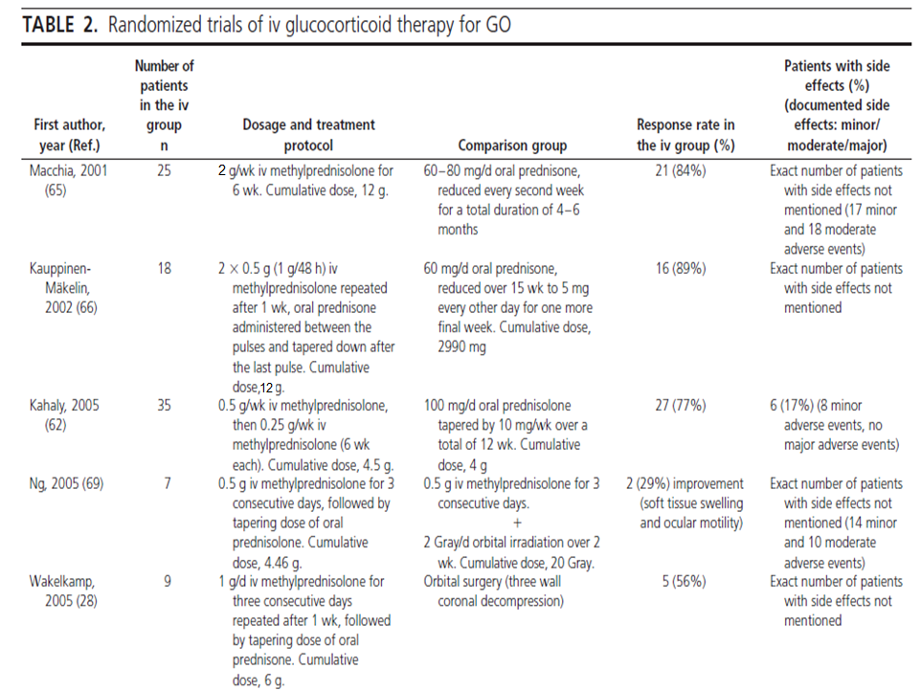

Slide 5
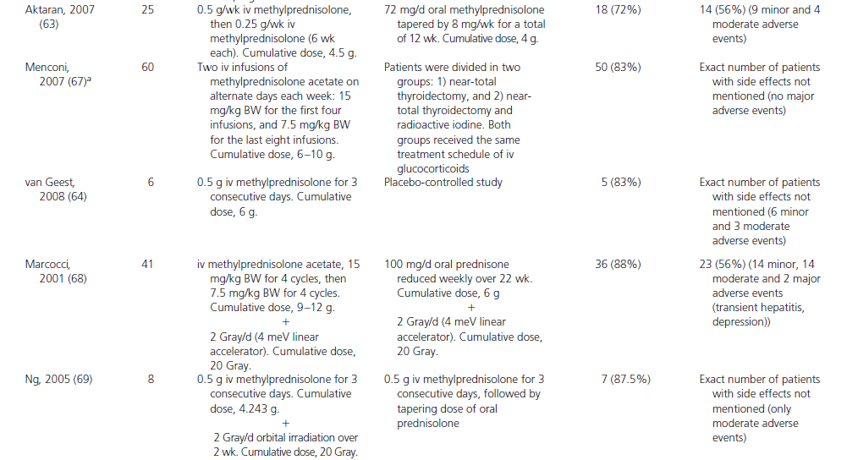

Slide 13
Int J Clin Pract, January 2007, 61, 1, 45–51

Slide 14
Study characteristics
A prospective, randomised and single blind clinical trial was designed to compare IVGC with OGC monotherapy in terms of effectiveness, tolerability and changes in quality of life in patients with untreated, moderately severe and active GO.

Slide 15
Study characteristics
52 patients
Between 2004 and 2005
Division of Endocrinology of the University Hospital, Gaziantep,Turkey

Slide 16
Study characteristics
Inclusion criteria:
Moderately severe and active GO
Duration of <6 months
stable euthyroidism by use the thionamide therapy
None previously treated for GO, except for eye drops without corticosteroids
clinical activity score (CAS) of ≥4 points

Slide 17
Study characteristics
Exclusion criteria:
corneal involvement (exposure keratitis, corneal ulceration, clouding or necrosis)
contraindication to glucocorticoid therapy
patients who had already been treated with glucocorticoids or any other treatment such as surgery or radiotherapy

Slide 18
Study characteristics
Assessment of disease activity
Classification by Mourits et al
activity score ranged from 0 to 10
Patients were determined by assigning 1 point each
for the presence of spontaneous pain behind the globe,
pain on attempted upgaze
redness of the conjunctiva
redness of eyelid
Chemosis
swelling of the caruncule
eyelid swelling
increase of proptosis of ≥2 mm during a period of 1–3 months

Slide 19
Study characteristics
Assessment of disease activity
Decrease of eye movements in any direction ≥5 mm during a period of 1–3 months
decreased visual acuity (VA) of ≥1 line(s) on the Snellen chart during a period of 1–3 months
A score of 6 points represents the maximum activity score
Diplopia was assessed subjectively in four grades: 1 = no diplopia, 2 = intermittent, 3 = inconstant and 4 = constant diplopia

Slide 20
Study characteristics
Study design
IVGC group received 500 mg of methylprednisolone in 100 ml of physiological saline as a 30 min i.v. infusion per weeks for 6 weeks then tapering the dose by 250 mg per weeks for 6 weeks.
Oral methylprednisolone was given in decreasing doses: 72 mg for the first 2 weeks, 64 mg/ day for 2 weeks, 56 mg/day for 2 weeks; thereafter the dose was tapered off by 8 mg per week for 6 weeks.
Treatment period of IVGC and OGC was 12 weeks
The total cumulative doses of IVGC and OGC group were 4.5 and 4g respectively
Blood glucose, renal parameters and liver enzymes were evaluated once a week during glucocorticoid therapy.

Slide 26
Key message
This prospective, randomised and single blind clinical trial confirms that IVGC therapy had more
favourable effects than OGC therapy in terms of
effectiveness, tolerability, quality of life, and was also associated with a lower rate of side effects in euthyroid patients with untreated, moderately active GO severe and

Slide 27
Key message
According to the predefined criteria, patients in the IVGC group had a higher treatment response (72%) at 3 months when compared with in the OGC group (49%) (p < 0.001). Kahaly et al. found a treatment response of 77% in the IVGC group an51% in the OGC group (p < 0.001

Slide 28
Key message
Controlled large randomised trials should be required for judging the effect of treatment in GO. It is not clear yet to which dosage and period of time of glucocorticoids improve GO.

Slide 29
J Clin Endocrinol Metab 97: 4454–4463, 2012)

Slide 30
Study characteristics
200 patients
Between december 2005 to december 2010
Active moderate to severe Go
2.25 g low dose group
4.98 g middle dose group
7.47 g high dose group

Slide 31
Study characteristics
12 weekly infusions starting dose
250 mg LD group
540 mg MD group
830 mg HD group for the six infusions and then
Halved 125 mg LD group
290 mg MD group
415 mg HD group for the remaining six infusions
The regimen did not include the use of oral GCs in decreasing doses After finishing the iv therapy

Slide 39
Key message
THE lower response rate in this study is likely due to selection of patients with relatively longer duration (10 months in the LD group, 12 months in theMDgroup, and, particularly, 18 months in the HD group) and less severe GO.

Slide 40
Key message
study shows that both intermediate and high cumulative doses of MP reduce inflammation more effectively and earlier than low doses.
High doses, at least in the short term, are more efficacious on eye motility. The fact that the duration of GO was slightly longer in the HD group may have underestimated differences between HD group and other groups.

Slide 41
Key message
This study has also limitations.The response rates were lower than expected, and differences between the high and the intermediate doses were modest.
This is possibly due to the exclusion of patients with very severe GO and the inclusion of some patients with relatively long duration of GO.

Slide 42
Key message
the use of a cumulative dose of 7.47 g of MP provides a short-term advantage over lower doses.
However, this benefit is transient and is associated with slightly greater toxicity, suggesting that an intermediatedose regimen may be used in most cases and the high-dose regimen be reserved to most severe cases of GO.
Efficacy may be further enhanced by selecting patients with a short duration of disease. Potential strategies to reduce the risk of relapse/progression of GO at the end of iv GC therapy need to be explored and implemented in RCTs.

Slide 43
J Clin Endocrinol Metab
10.1210/jc.2013-3919

Slide 44
Study characteristics
80 patients
Between 2010 and 2012
Active moderate to severe Go

Slide 45
Study characteristics
Patients were randomized to receive 4.5 g methylprednisolon
in 12 weeks as recommended or four weeks as previously
reported The weekly protocol was as follows:
0.5 g weekly for six weeks followed by 0.25 g weekly for six weeks.
The daily protocol was as follows:
0.5 g daily for three consecutive days per week for two weeks, followed by 0.25 g daily for three consecutive days per week for another two weeks and by tapering oral prednisone.

Slide 50
Primary out come
The primary outcome was overall response. Responsive was defined as at least three of the following outcome measures:
i)reduction in lid width by at least 3 mm;
ii) reduction in any of the class 2 NOSPECS signs by at least two grades
iii) reduction in proptosis by at least 2 mm;
iv) reduction in IOP by at least 2 mmHg;
v) improvement in CAS by at least two points;
vi) improvement in diplopia (disappearance or degrade in degree)
vii) improvement in visual acuity by 1 Snellen line.
Deterioration of each parameter was defined as follows:
i) increase in lid width by at least 3 mm;
ii) increase in any of the class 2 NOSPECS signs by at least two grades;
iii) increase in proptosis by at least 2 mm;
iv) increase in IOP by at least 2 mmHg;
v) increase in CAS by at least two points;
vi) increase in diplopia (new onset or upgrade in degree)
vii) decrease in visual acuity by 1 Snellen line.

Slide 51
Secondary outcome
The second outcome was change in CAS, adverse events and retreatment.

Slide 57
Key message
greater response rate and prolonged retreat free survival, less severe toxicity and decreased serum CXCL10 for patients on the weekly protocol.
patients on the weekly protocol showed greater improvement of diplopia, IOP and visual acuity at multiple time points, suggesting that weekly therapy
is superior to daily therapy in terms of disease severity.

Slide 58
Key message
Significantly fewer retreatment events and prolonged retreatment- free survival for patients on the weekly protocol.
two severe adverse events:
impaired liver function and intractable hiccup No cardiovascular event was recorded.

Slide 59
Key message
One limitation of this study was the selection bias. Patients on the weekly protocol had longer duration of eye symptoms and marginally lower levels ofTRAb compared to patients on the daily protocol, which might be introduced by selection bias.
Longer disease duration and higher TRAb was associated with worse GC efficacy

Slide 60
Key message
weekly therapy protocol of 4.5 g iv methylprednisolone
is not only safer but is also more effective than a daily protocol for treating active moderate-to-severe GO.
This efficacy may be due to greater and more sustained suppression of local inflammation.

Slide 61
Conclusion
IVGC therapy is more effectivness and better tolerated than oral GCs therapy.
weekly therapy protocol of 4.5 g iv methylprednisolone is not only safer but is also more effective than a daily protocol for treating active moderate-to-severe GO.

