Slide 1
Food and nutrient exposures: what to consider when evaluating epidemiologic evidence
Arezoo Rezazadeh
Assistant Professor,
Community Nutrition Department, National Nutrition and Food Technology Research Institute ,Faculty of Nutrition Sciences and Food Technology
Shahid Behehshti University of Medical Sciences

Slide 2
Nutritional Epidemiology
Epidemiology has been defined as the study of the patterns of disease occurrence in human populations and of the factors that influence those patterns.
Nutritional epidemiology is therefore the study of the nutritional determinants of disease .
Most of nutritional epidemiology is concerned with effects of diet on chronic diseases that are multifactorial (ie, nutrition is only one of many factors that cause the disease to occur) and that take years, if not decades, to develop.
The methods used in nutritional epidemiology are designed to take those features into account.
They focus on measuring the exposure to nutritional factors, the frequency and distribution of disease, and the exposure to other factors that could confound the hypothesized association.

Slide 3
Nutritional exposures
Nutritional exposures are defined or measured through the intake of:
Foods, nutrients (total from foods and supplements or separately from these 2 sources)
Non nutrients, additives, contaminants, and chemicals
Nutritional exposures also include:
Biochemical measures of nutritional status,
Biomarkers of intake, biological intermediates influenced by diet (eg, serum cholesterol concentration),
Anthropometric measurements,
Genetic factors,
Clinical findings.
Notes:
Nutritional exposures are defined or measured through the intake of foods, nutrients (total from foods and supplements or separately from these 2 sources), and non nutrients, additives, contaminants, and chemicals in foods that were incorporated into a food as part of the agricultural process or were formed during food processing or preparation.
Nutritional exposures also include biochemical measures of nutritional status, biomarkers of intake, biological intermediates influenced by diet (eg, serum cholesterol concentration), anthropometric measurements, genetic factors, and clinical findings.
Estimated dietary intake, however, may not be the exposure of interest (Table 1).

Slide 4
Dietary Exposures
The diet is an important environmental exposure, and many dietary factors (nutrients and non-nutrients) are associated with disease prevention or causation.
The measurement of habitual dietary intake is thus an essential component of much health-related research, which must be both accurate and applicable to very large numbers of free-living individuals.
This makes measurement of dietary exposure one of the most challenging problems in nutrition.
Notes:
Usual dietary intake refers to the long-run average or habitual daily intake of a nutrient or food.

Slide 5
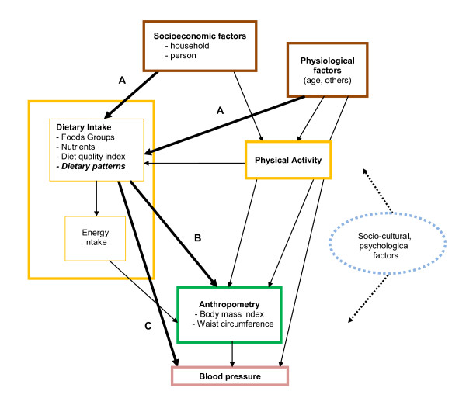

Slide 6
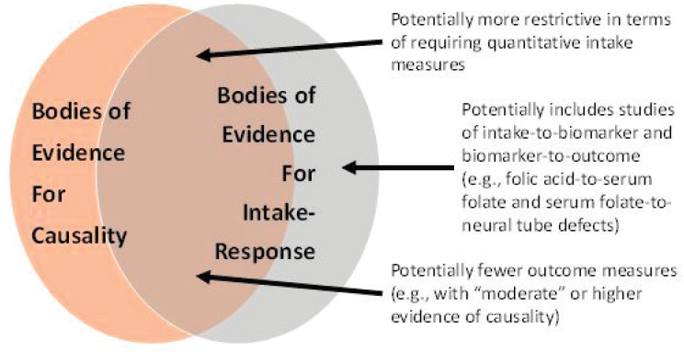

Slide 7
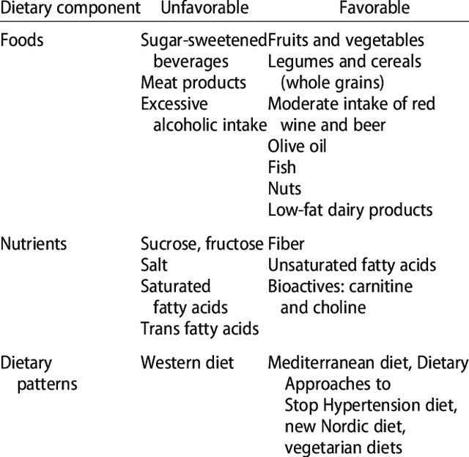

Slide 8
Measurement of Dietary Exposures
Unlike many other exposures used by epidemiologists, diet is so complicated that special knowledge is required to enable the correct exposure measure to be used.
The perspective of nutritional epidemiology thus encompasses factors that influence the availability and consumption of food, on one hand, to the whole body expression of disease, on the other.
The point(s) along this continuum at which to measure the relevant aspect(s) of diet is a key concern of nutritional epidemiology.”

Slide 9
Food consumption data
which food consumed and type (raw, processed, cooked, preparation practices)
how much (serving size)
how often
by whom (e.g.; age, sex, SES, eating habits, health status etc.)
Affected by factors such as
  season
  region / culture
  day of the week

Slide 10
Dietary Assessment data types
Global: FBS, FAOSTAT, (-->food supply)
National: foods consumed/available through household or individual consumption surveys
  Household: HBS (Household Budget Survey)
  Individual:
    FFQ
    24-hour recall
    Duplicate diet
    Food records
    Diet history
Notes:
FAOSTAT provides free access to food and agriculture data for over 245 countries and territories and covers all FAO regional groupings

Slide 11
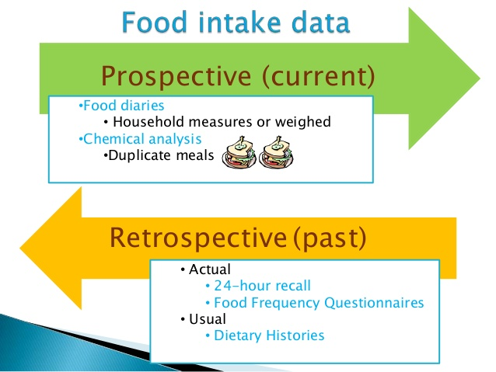

Slide 12
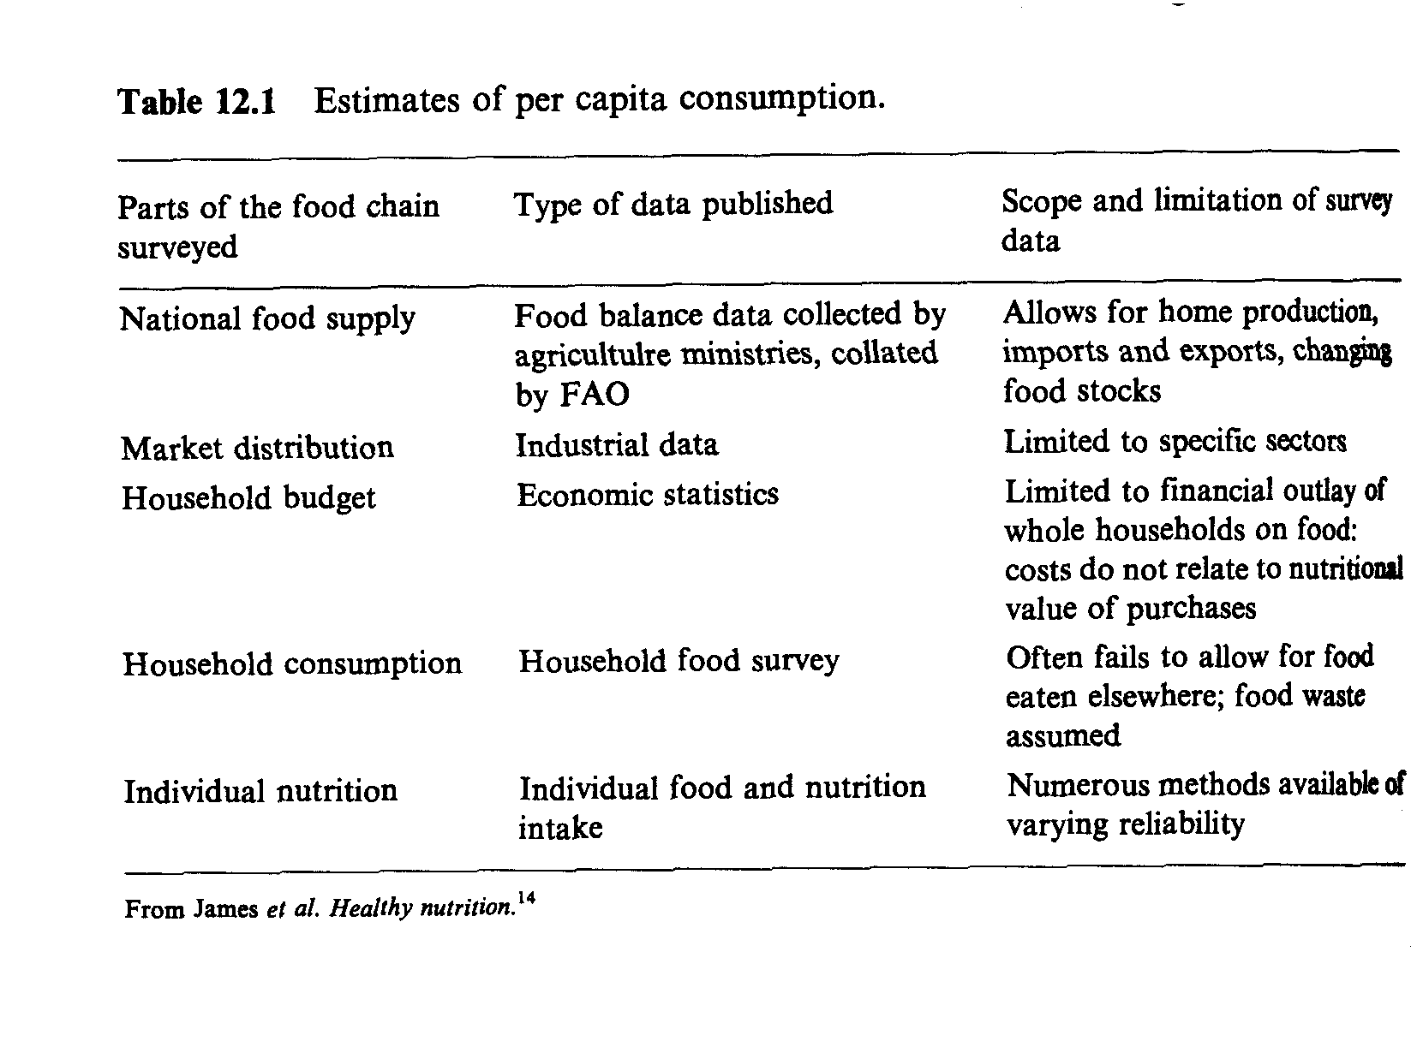
Notes:
Outlay= هزینه

Slide 13
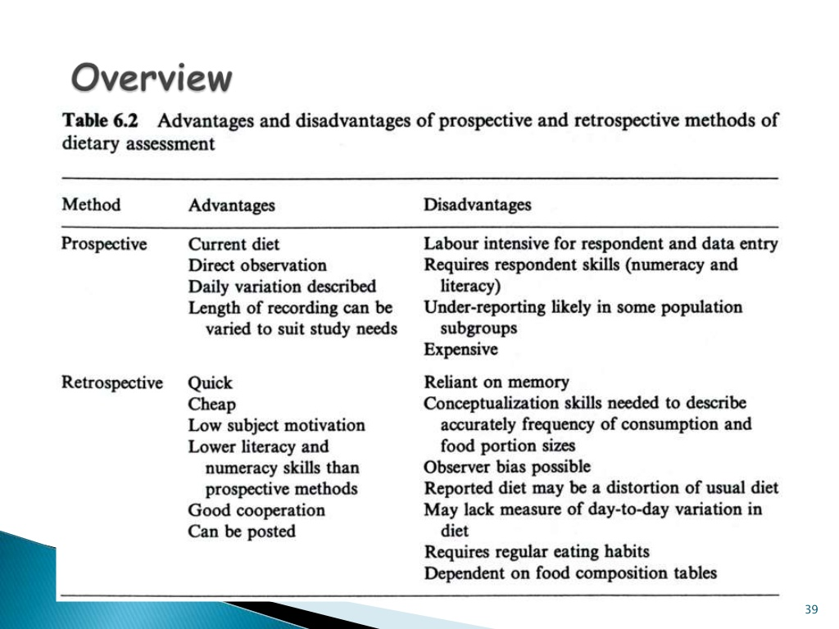
Advantages and disadvantages of prospective and retrospective methods

Slide 14
Average consumption
Estimates of average individual intake can be made from pre-existing data or from population survey data collected de novo
Notes:
Indices of dietary intake

Slide 15
Potential uses of food consumption surveys within country, across countries, over time
Food insecurity
Nutrient adequacy estimation
Diet-disease relationships
Food consumption surveys
Food pattern analysis
Exposure assessment
Additional indicators e.g. :
- anthropometry
- health indicators

Slide 16
Between-country comparisons that include both rich and poor nations may be subject to
  biases in the quality of data collected at national levels

Slide 17
Problems in exposure assessment
Lack of representative and standardized data on
food consumption
food composition (nutrients) and occurrence data (e.g. contaminants)
→ Most data from industrialized countries
Notes:
FAOSTAT provides free access to food and agriculture data for over 245 countries and territories and covers all FAO regional groupings from 1961 to the most recent year available.

Slide 18
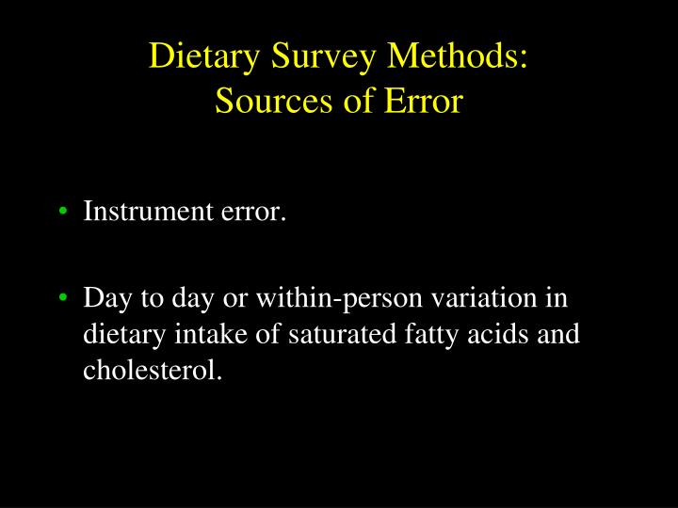

Slide 19
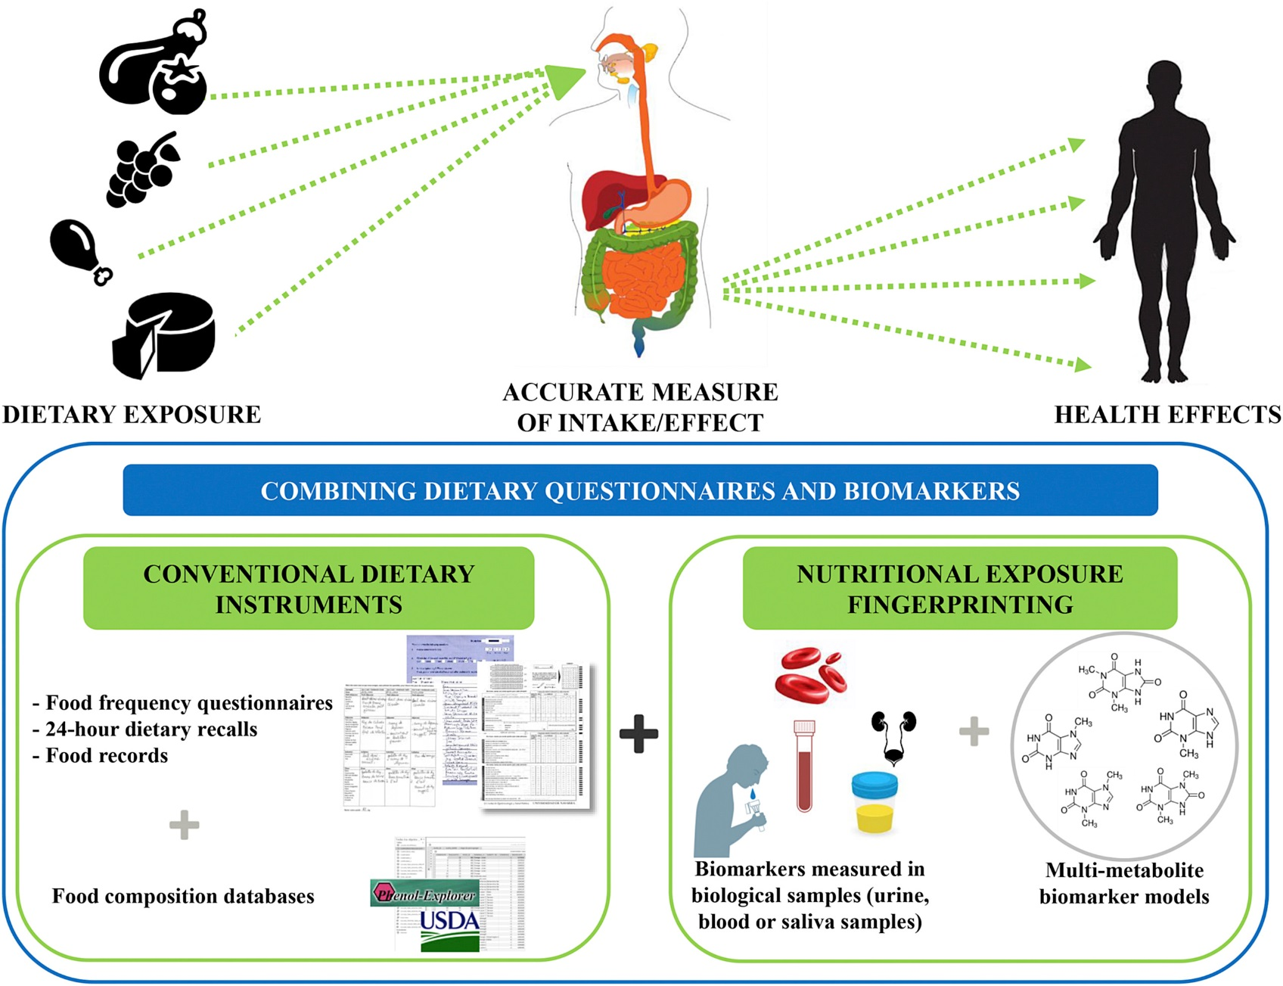

Slide 20
Issues to consider when measuring dietary exposure in epidemiologic studies
1) We eat food, not nutrients.
2) Food consists of many substances, not only nutrients.
3) It is difﬁcult to study food components in isolation. The effects of a food component may be different when studied in isolation than when
studied in conjunction with other food components.
4) Food component effects may be direct or indirect.
5) Food component effects may vary with the amounts of other food components.
Am J Clin Nutr 1999;69(suppl):1330S–8S.

Slide 21
Issues to consider when measuring dietary exposure in epidemiologic studies
6) Intake is not equivalent to biological availability.
7) Some nutrients have bioequivalence, eg, the synthesis of vitamin A from b-carotene.
8) Blood and serum concentrations of a food component may not reﬂect balance or status.
9) All points along the continuum from food consumption to disease development are of interest.
Am J Clin Nutr 1999;69(suppl):1330S–8S. Printed in USA

Slide 22
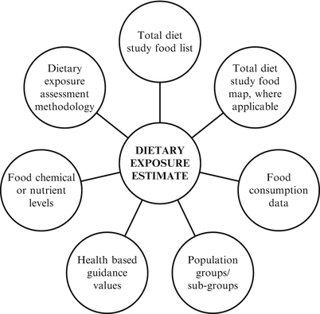
Notes:
Total Diet Study (TDS), we buy samples of food at retail outlets throughout the U.S., prepare the foods as they would be consumed, and analyze them, to measure levels of selected pesticide residues, industrial chemicals, radionuclides, and toxic and nutrient elements.

Slide 23
The sequence of reasoning in epidemiology:
First: to identify statistically significant associations between nutritional or dietary exposures and risk of disease
Second: to determine biological inferences from the emergence of a pattern of these inferences.
Notes:
Inferences= conclusion

Slide 24
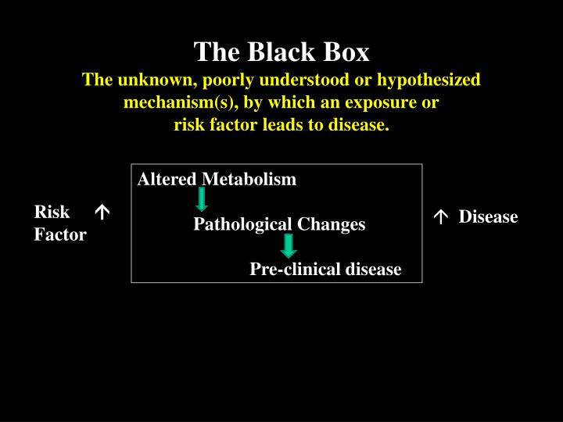

Slide 25
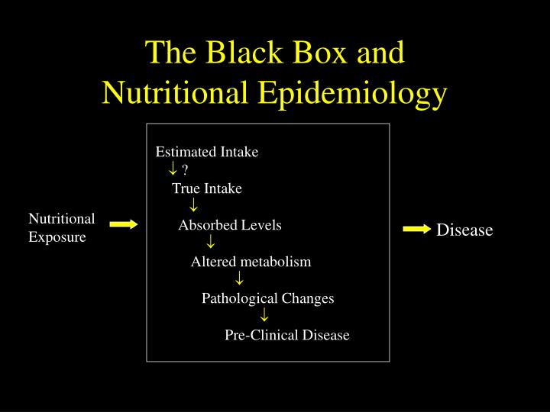

Slide 26
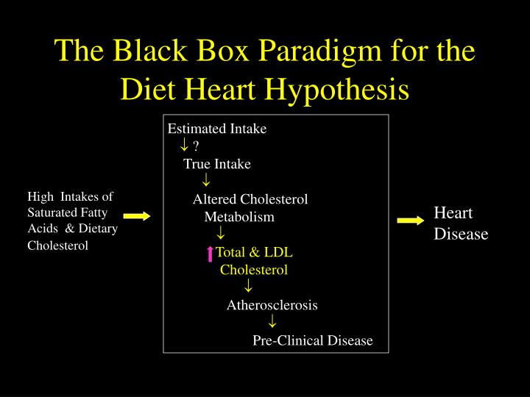

Slide 27
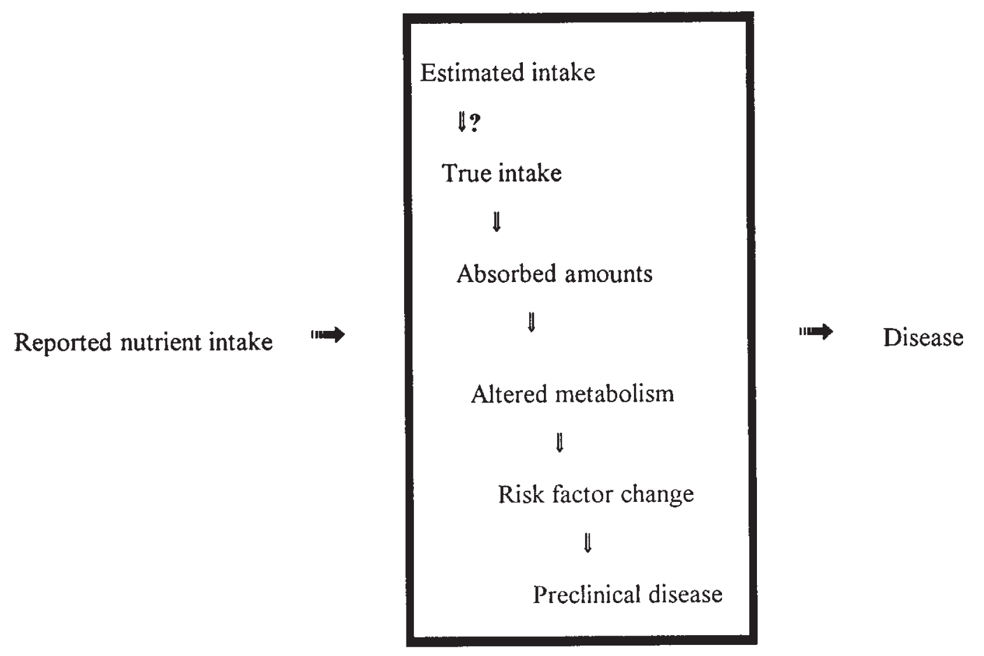
FIGURE 1. The black box approach to the study of diet and disease in nutritional epidemiology
Notes:
The paradigm currently used to investigate possible associations in epidemiology is the black box approach shown in Figure 1
By using that approach and depending on future scientific advancements, only certain limited aspects of this model can be studied in free-living populations. As a result, only through an iterative exchange of ideas and hypotheses among the laboratory, clinical, and epidemiologic sciences can
progress ultimately be made in understanding whether the nutritional exposure is a causal factor and, given the multifactorial nature of chronic disease, what role nutrition or, more precisely, diet can play in disease prevention.

Slide 28
Types of studies in assessing the dietary exposure in relation to disease
There are 2 general types of studies in epidemiology: observational and experimental
Observational studies obtain data measured in individuals or groups of individuals. Studies of individuals include cross-sectional, case-control, and prospective studies whereas studies of groups are referred to as ecologic studies.
For practical and ethical reasons most epidemiologic research is observational.
The nutritional exposure is measured but not manipulated, the frequency and pattern of disease are observed, and the association between a suspected nutritional exposure and disease risk is estimated using statistical techniques.
Notes:
Manipulate= handle or control (a tool, mechanism, etc.), typically in a skillful manner.

Slide 29
Observational studies are not experiments in which one set of individuals is randomly assigned to a treatment or intervention group and the other is assigned to a control group. Two examples of such experiments are feeding studies that examine the effects of varying components of the diet and the double-blind, randomized, clinical trial.

Slide 30
Observational epidemiology: Cross-sectional studies
Design. In cross-sectional studies the question being asked is:
“What is the correlation between currently having the disease and the nutritional exposure?”
People are selected for inclusion in the study without regard for disease status or nutritional exposure.
In these studies disease status and nutritional exposure are both measured at the same time;
this produces a snapshot—a measurement of health at one specific time.

Slide 31
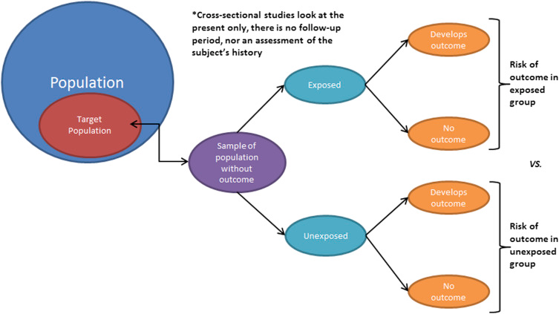

Slide 32
Observational epidemiology: Cross-sectional studies
Strengths.
The chief strengths: a relatively large sample size and, for studies such NHANES and their representativeness.
An ideal design for estimating the mean amounts and distributions of key risk factors (eg, dietary components) and the prevalence of individuals with certain diseases or conditions (eg, coronary heart disease).
Repeated cross-sectional surveys within the same population are essential for monitoring trends in reference distributions and prevalence.
If designed appropriately, surveys can also provide the baseline information for a prospective study.
Notes:
National Health and Nutrition Examination Survey
These features make cross-sectional studies an ideal design for estimating the mean amounts and distributions of key risk factors (eg, dietary components, serum cholesterol concentrations, blood pressure, and weight) and the prevalence of individuals with certain diseases or conditions (eg, coronary heart disease, high blood cholesterol, and high blood pressure).
Repeated cross-sectional surveys within the same population are essential for monitoring trends in reference distributions and prevalence (9).
That information is central to nutrition monitoring and vital to the design and effectiveness of public health programs.
If designed appropriately, surveys can also provide the baseline information for a prospective study.

Slide 33
Observational epidemiology: Cross-sectional studies
Weaknesses.
Weak study design for assessing causal associations.
The problem is that most of the time it is difficult if not impossible to determine whether the nutritional exposure is a cause of the disease or the nutritional exposure was affected by the disease process
For example, the disease may lead individuals to change their dietary intake patterns or the disease process may produce changes in serum concentrations of nutrients.
Notes:
Because both nutritional exposure and disease status are measured at the same time, cross-sectional studies are a relatively weak study design for assessing causal associations.
The problem is that most of the time it is difficult if not impossible to determine whether the nutritional exposure is a cause of the disease or the nutritional exposure was affected by the disease process
For example, the disease may lead individuals to change their dietary intake patterns or the disease process may produce changes in serum concentrations of nutrients.

Slide 34
Observational epidemiology: Cross-sectional studies
For nutritional epidemiology, the goal is to determine how usual diet influences intermediate risk factors and through them the risk of disease.
lack of variation in usual intake by individuals in a particular population,
the large within-person variation in dietary intake,
the inaccuracy of dietary survey methods
As a result, cross-sectional studies are considered to be a relatively weak method for studying diet-disease associations, and results from them should be interpreted cautiously.
Notes:
Cross-sectional studies are often used to assess the factors correlated with other risk factors (eg, serum cholesterol and blood pressure) in an effort to understand how their concentrations or levels are influenced.
For nutritional epidemiology, the goal is to determine how usual diet influences intermediate risk factors and through them the risk of disease.
However, lack of variation in usual intake by individuals in a particular population, the large within-person variation in dietary intake, and the inaccuracy of dietary survey methods all make it difficult to show correlations between diet and intermediate risk factors such as serum cholesterol concentration.
As discussed below, many of these measurement issues affect the ability to study diet-disease relations, even when using more rigorous study designs.
As a result, cross-sectional studies are considered to be a relatively weak method for studying diet-disease associations, and results from them should be interpreted cautiously.

Slide 35
Observational epidemiology: Case-control studies
Design. are also referred to as retrospective and case-referent studies, are designed to answer the question, “Do persons with the disease (case subjects) consume diets that are different in composition from the diets consumed by persons who have not been diagnosed with the disease (control subjects)?”
For example, do individuals with cancer consume less fruit and vegetables than do those without cancer?

Slide 36
Observational epidemiology: Case-control studies
In this type of study, recently diagnosed (ie, incident) case subjects and a set of control subjects are interviewed concerning their dietary habits, or their nutritional status is assessed with a biological measure (for example, the serum concentration of a nutrient).
The goal is to determine the usual nutritional exposure before the onset of the disease.
In most studies, food-frequency or dietary history questionnaires are used to assess usual intake in the recent past (ie, ≤ 1 y before onset of symptoms);

Slide 37
Vitamin D and Fatal and Lethal Prostate Cancer in HPFS
(Shui I. et al., submitted)
-Comparing extreme quartiles of plasma 25-OH vitamin D:
OR = 0.43; 95% CI:0.24-0.76
-Total vitamin D pathway association with lethal prostate cancer risk:
Kernel logistic machine test P = 0.008
Prostate cancer risk (7 SNPs)
20.353

Slide 38
Observational epidemiology: Case-control studies
Strengths. Case-control studies are relatively inexpensive to conduct and require smaller sample sizes than do prospective studies; this makes them especially good for the study of rare diseases. They also yield results relatively quickly.
Weaknesses.
A key assumption is that the measure of nutritional exposure has not been influenced by the disease process or by a change in dietary habits.
However, for a biological measure of exposure, such as serum nutrient concentration, that may be difficult to establish with certainty.
Moreover, it is very difficult to estimate usual intake from recollections about the remote past.
Case-control studies yield only relative estimates of risk

Slide 39
Observational epidemiology: Cohort studies
Design. Cohort studies are also referred to as prospective, incidence, follow-up, and longitudinal studies.
The question: “Do persons with the risk factor develop or die from the disease more frequently or sooner than those who do not have the risk factor?”
Cohort studies begin with a cross-sectional survey that ascertains the presence or absence of the disease of interest as well as dietary intake and other measures of exposure.
It can be reasonably established that the nutritional exposure preceded the development of the disease.

Slide 40
Folate Intake & Relative Risk of Colorectal Cancer by Latency Intervals
(Jung Lee, et al., 2011)
RR for ≥800 mcg/day vs. <250 mcg/day
0-4
(144)
(189)
4-8
(79)
(122)
8-12
(46)
(60)
12-16
(32)
(26)
Years
Exposed F
cases M
11.046

Slide 41
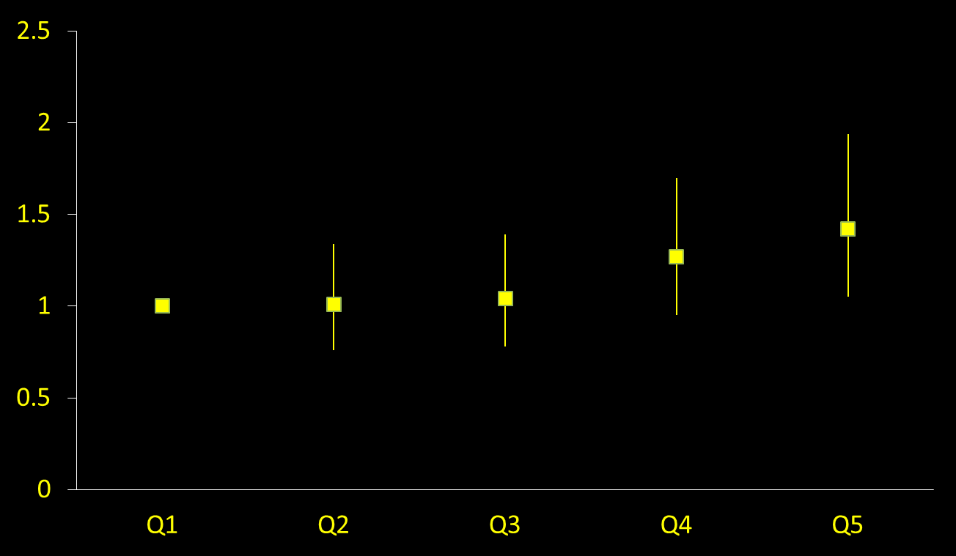
Total Red Meat & Risk of Premenopausal Breast Cancer
Multivariate RR
P,trend = 0.007
Quintiles
(Farvid MS et al., Int J Cancer 2014)
0.339

Slide 42
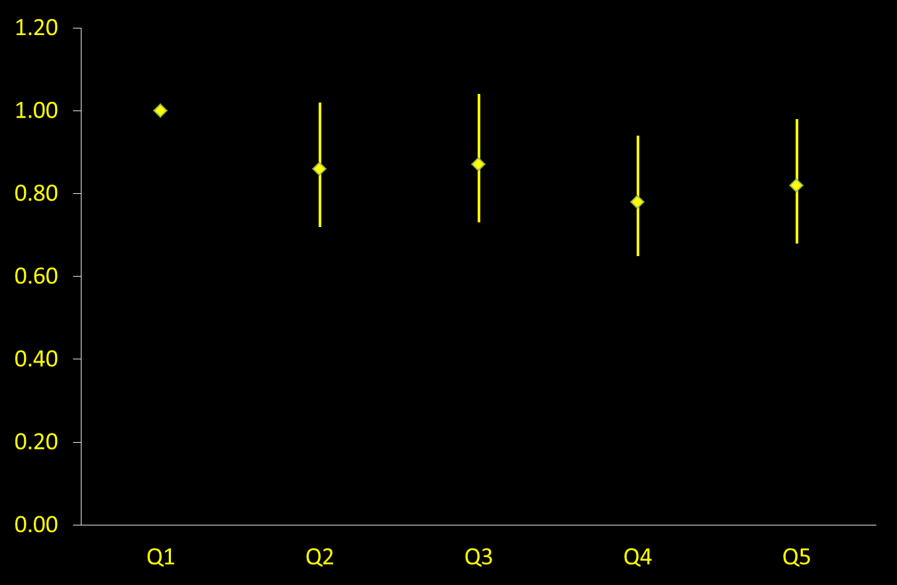
Adolescent fiber intake and breast cancer in NHSII
Multivariate RR for fiber intake
P,trend = 0.02
Quintiles
0.335
(Farvid et al., submitted manuscript)

Slide 43
RR for sweetened beverages & risk of CHD
Relative Risk of CHD
P=0.004
Quintiles of Sweetened Beverage
(Fung et al. 2009)
8.124

Slide 44
Traditional, Western, and Healthy Dietary Patterns and Risk of Gastric Cancer in Japanese Women (Kim MK et al. IJE, 2004)
RR of Gastric Cancer
Traditional
P, trend=0.007
Western
P, trend=0.42
Healthy
P,trend=0.03
20.368
Quartile of Dietary Pattern

Slide 45
Observational epidemiology: Cohort studies
Strengths. Because the time sequence in which the nutritional exposure precedes disease development can be established, prospective studies are considered to be the best of the observational study designs.
Because the goal is to measure the current, usual amounts of nutritional exposures, these can be measured without the results being influenced by the presence of the disease.
Prospective studies can be used to study the risk factors for additional diseases, and prospective studies yield absolute estimates of risk.

Slide 46
Experimental studies

Slide 47
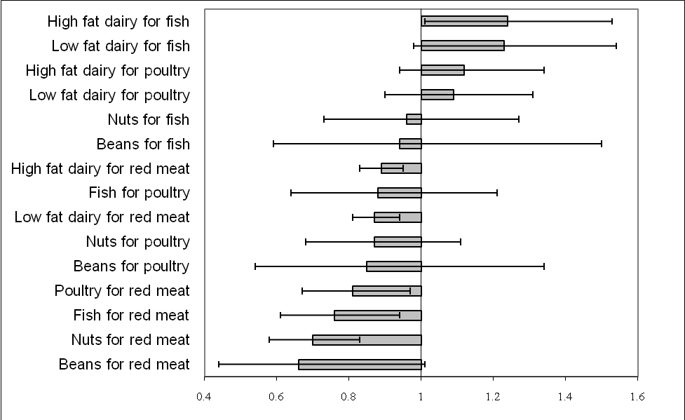
Substitution of Protein Sources (1 sv/day) and Risk of CHD in NHS, 1980-2006 (3162 cases)
9.202
Bernstein A, et al. Circulation. 2010;122(9):876-83

Slide 48
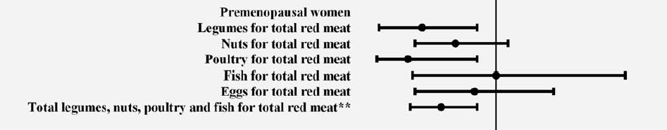

Substitution for 1 serving/day of total red meat in relation to premenopausal breast cancer
(Farvid MS et al., Int J Cancer 2014)
0.340

Slide 49
Ethical considerations in observational studies
Most epidemiologic studies are observational rather than experimental for operational and ethical reasons
Typically, the aspects of the proposed mechanism that are studing humans are based on information gained from animal models. Portions of the mechanism that require the use of invasive measurement methods or that use nutrient intake to initiate or promote the disease or condition are studied in animal models. Experiments in humans must, by their very nature, be restricted to those that study the effects of removing, reducing, or ameliorating the risk factor.
For example, a diet high in saturated fatty acids and cholesterol increases a person’s risk of developing CHD, which may lead to a heart attack and possibly even death. It is not ethical to randomly assign some people to a diet high in saturated fatty acids and cholesterol and see if they die sooner and in greater numbers than control subjects assigned to a diet low in saturated fatty acids and cholesterol.

Slide 50
MEASUREMENT OF DIETARY EXPOSURE
Food consumption and how consumption affects nutritional status and disease risk are highly complex.
If the goal is to study the relation of dietary exposure to disease risk, dietary intake cannot be assumed to be the same as dietary exposure.
Depending on the study design and the hypotheses, any number of methods can be used.
Notes:
Deciding how dietary exposure should be measured in any one study requires careful consideration of the key hypotheses.

Slide 51
Notes:
صورتحساب غذایی/Food accounts
For large studies, the only practical methods are the 24-h recall, hand-written food records, food records using precoded or list-based forms, and food-frequency questionnaires, which are also pre-coded or list-based (Table 2). The choice must be based on the design and objectives of the study and on the type of information required (27).

Slide 52
Selection of the dietary survey methodology
When assessing the type of information desired, there are 2 aspects to consider:
First, is the objective of the study to assess the relative rank or the absolute amount of an individual’s usual intake?
Second, is the objective of the study to estimate the intake of broad classes of foods, intake of nutrients, food patterns, or other more complex aspects of the diet related to the absorption, use, and metabolism of particular food constituents?

Slide 53
Selection of the dietary survey methodology
In principle, any of several dietary assessment methods may be used. Because of the large amount of within-person or day-to-day variation in dietary intake, one 24-h recall or food record is not considered to be a valid estimate of an individual’s usual relative or absolute intake .
Because FFQs are designed, in theory, to estimate an individual’s usual intake over some period of time (eg, 1 y) and because they have low interviewer burden and can be processed rapidly, they are currently the method preferred by most epidemiologists.

Slide 54
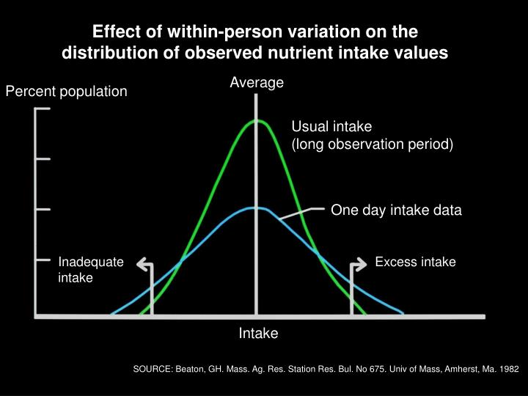

Slide 55
Selection of the dietary survey methodology
The measurement errors characteristic of food-frequency questionnaires.
2 or 3 replicate 24-h recalls or food records are just as useful in estimating the association between diet and disease as a food-frequency questionnaire for most nutrients.
Notable exceptions in which food-frequency questionnaires may be the preferred method are the measurement of intakes of foods that tend to be consumed rarely.

Slide 56
Selection of the dietary survey methodology
Currently, no dietary assessment method is likely to measure the true intake for an individual.
All of the methods involve measurement error; thus, the choice of a method must be made on the basis of assessed relative validity.
For example, regardless of the method, energy intake is underreported by as much as 20–30%.
It is unclear, though, whether all macronutrients are under-reported to that extent. For example, in a recent study men over-reported protein intake and women reported it accurately as compared with protein intake estimated from urinary nitrogen excretion

Slide 57
Selection of the dietary survey methodology
Because memory is less of a problem with one or several days of food records and 24-h recalls, they provide relatively more accurate intake assessments than do food-frequency questionnaires, which attempt to assess usual intake over a longer period of time
Food-frequency questionnaires have been used in case-control studies to estimate usual intake in the distant past, but such assessments of diet appear to be inﬂuenced by current intake and hypothesized assumptions

Slide 58
Selection of the dietary survey methodology
If the hypotheses being studied involve only a few select nutrients, pre-coded food records will sufﬁce or, depending on the food or nutrient, food-frequency questionnaires may be appropriate.
For example, much of our knowledge about the protective effects of fruit and vegetables with regard to cancer risk comes from case-control studies in which dietary intake was based on food-frequency or dietary history questionnaires.

Slide 59
Selection of the dietary survey methodology
Because of the complex ways in which diet and nutrition may affect risk of disease, it is important to have as much dietary intake information as possible.
Pre-coded instruments, regardless of whether they are used as food records or food-frequency questionnaires, generally do not allow for recording of information on food preparation methods, foods consumed together as meals and as mixed dishes, type of food, brand name, packaging, ingredients, and the size of individual portions in the detail that can be obtained from a 24-h recall or a hand-written food record
Another limitation of precoded instruments is that the number of foods on the form is limited.

Slide 60
Selection of the dietary survey methodology
Another limitation of precoded instruments is that the number of foods on the form is limited. Therefore, 24-h recalls and hand-written food records give the researcher much more ﬂexibility to address dietary issues and questions that were not anticipated during the design of the study.
This is not meant to imply that 24-h recalls or food records can be used to study all of the complex issues related to endogenous and exogenous inﬂuences on nutrients and other dietary components, but these methods do provide information that is not usually provided by food-frequency questionnaires.
If and when biomarkers of absolute nutrient intake become more available, detailed study of the effects of nutrients or particular metabolites of nutrients and their relation to disease may become possible

Slide 61
Interpretation of epidemiologic data and assessment of causality
Interpretation of data from observational epidemiologic studies
can be difficult.
Because these studies are not experiments, there is always the possibility that measurement error or confounding affected the results.
A major consideration in the design of nutritional epidemiologic studies is the need to reduce bias.

Slide 62
Interpretation of epidemiologic data and assessment of causality
FIGURE 2. The black box paradigm for studying the diet–heart disease hypothesis

Slide 63
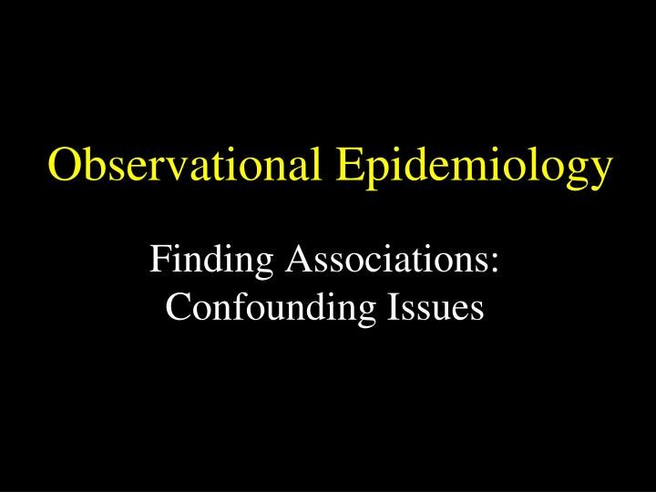
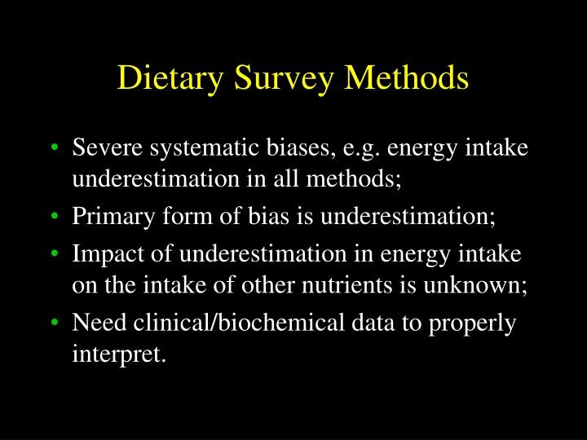

Slide 65
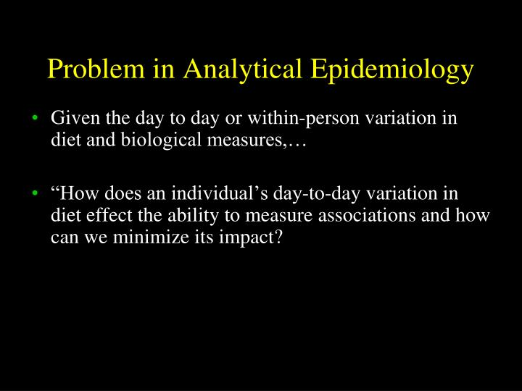

Slide 66
Interpretation of epidemiologic data and assessment of causality
To help reduce the potential for confounding, epidemiologists use multivariate models to simulate an experiment.
By using multivariate models that adjust for possible confounding factors, it is possible to evaluate the association between the exposure of interest and the outcome variable while on-holding all other variables in the model constant.
However, feature of diet cannot be minimized by statistical adjustment: components in the diet are highly correlated. This is also referred to as collinearity or multicollinearity.
Notes:
Collinearity is a condition in which some of the independent variables are highly correlated. Why is this a problem? Collinearity tends to inflate the variance of at least one estimated regression coefficient,ˆβj .

Slide 67
Relative Risk of Coronary Heart Disease
2
2
2.5
1.81
2
1.16
Relative Risk
1.19
1.5
0.94
Glycemic Load
1
Tertile 3 (highest)
1.42
1
1.1
Tertile 2
0.5
Tertile 1 (lowest)
0
<23
23-29
>29
Body Mass Index (kg/M2)
Liu et al., 2000
9.072

Slide 68
Interpretation of epidemiologic data and assessment of causality
Because of multi-collinearity, it is usually not possible to determine the effects of a particular nutrient independent of the other nutrients with which it is correlated.
For example, McGee et al found that because the components of energy intake were highly correlated, the effect of fat as distinct for that of protein cannot be shown in observational studies: “If the question is simply whether the dietary variables as a group predict CHD and we are not interested in the exact relation of a particular diet variable to CHD, solutions clearly exist.
If, on the other hand, we are interested in interpreting how a particular diet variable relates to outcome controlling for other diet variables, the collinearity of the data appears to be a structural rather than a mathematical problem with no apparent solution.” This is the fundamental limitation in observational nutritional epidemiology.

Slide 69
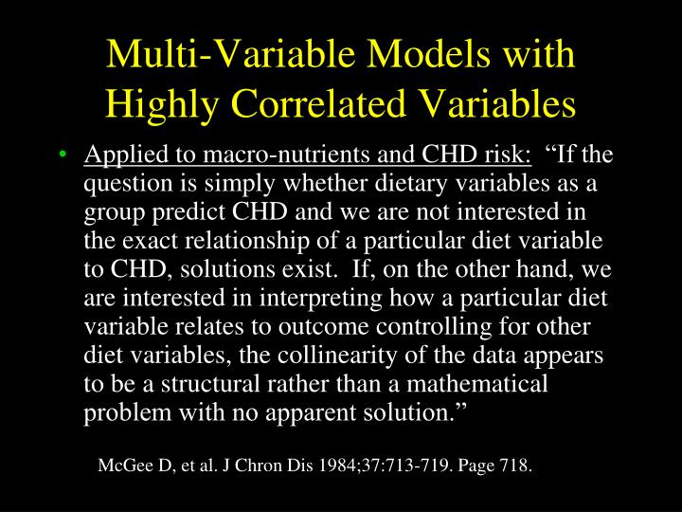

Slide 70
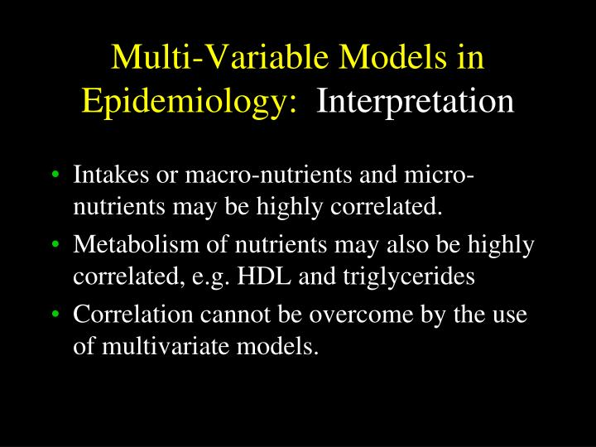

Slide 71
Food networks
Posteriori:
_ FA
PCA
CA
Gaussian graphical models (GGM): are a set of powerful exploratory approaches that can identify dietary intake networks resembling dietary pattern, which may be easier to interpret and may reveal important insight into eating patterns.

Slide 72
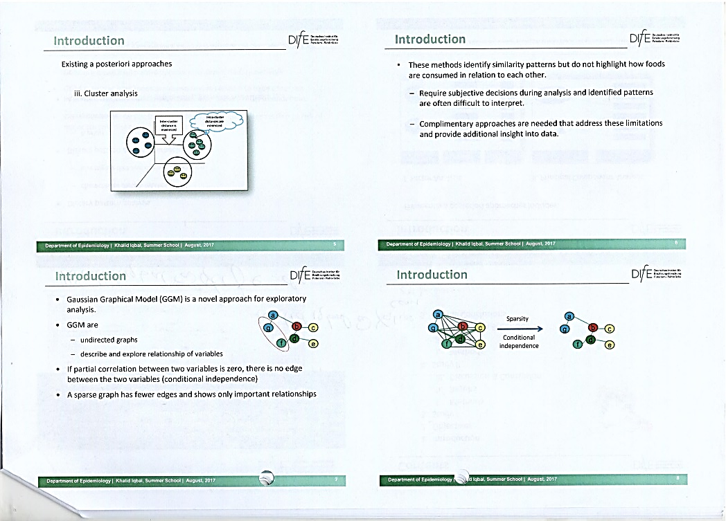

Slide 73
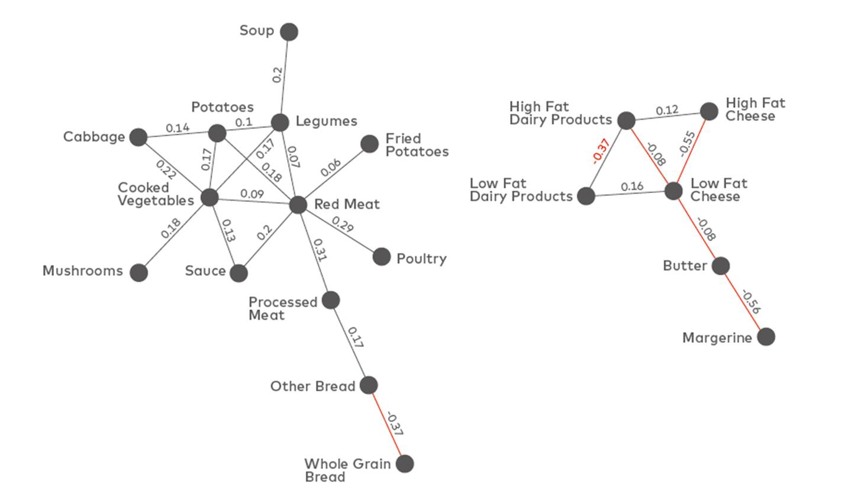

Slide 74
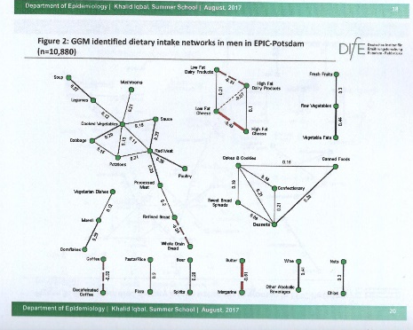

Slide 75
Mixed models (Sven Knüppel, DIfE)
Simialr Models, different names
=Multilevel Models
=Hierarchial Model
=Random Effect Model
=Nested Model

Slide 76
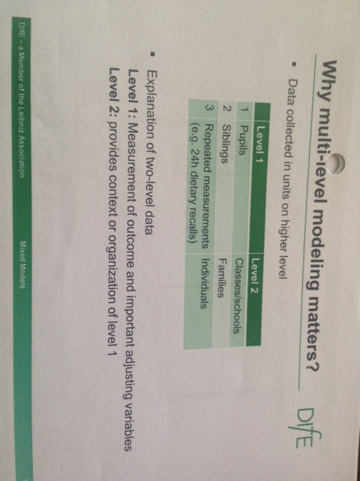

Slide 77
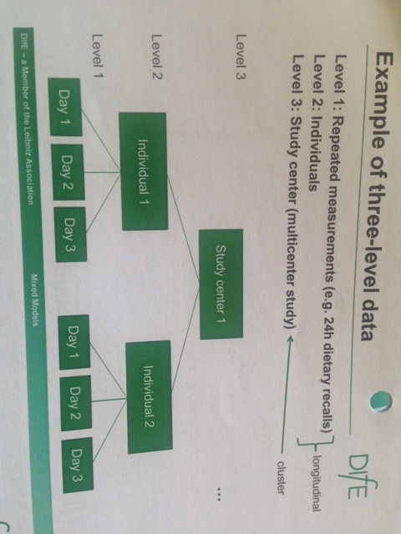

Slide 78
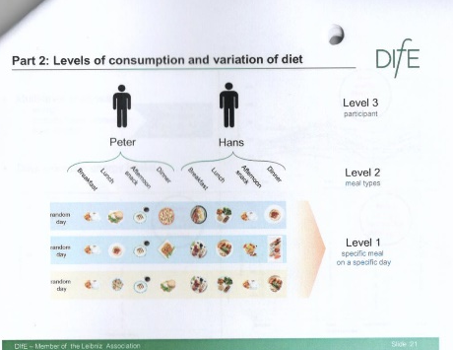
Meal Based Analysis (to obtain Habitual Diet)
Participants
Meal Types
Specific meal on a specific day

Slide 79
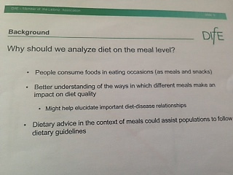

Slide 80
Conclusions
In nutritional epidemiology the goal is to study how nutrient exposures affect the risk of disease by using data collected from both observational and experimental studies.
• The relation of dietary exposure to disease risk is complex.
• The nutrient exposure methodology must reflect that complexity to the greatest possible extent.
• Nutrient exposures can be measures of dietary intake from traditional dietary survey methods, but they can also include biochemical measures of nutritional status; biomarkers of intake; biological intermediates, concentrations of which are influenced by diet (eg, pyridoxal-59-phosphate); anthropometric measures; genetic factors; and clinical findings.

Slide 81
Conclusions
All dietary survey methods are flawed. On average, energy intakes are underestimated by 20–30% and the effects of that underestimation on individual macro- and micronutrients are unknown.
• Prospective studies must capture changes in dietary patterns over time.
Biological measures of exposure are more reliable than dietary survey methods and should be used whenever possible.
Evaluation of causal relations generally requires the integration of information from the basic, clinical, and population sciences, including epidemiology.

Slide 82
Conclusions
By themselves, observational studies of diet and disease should not be considered sufficient evidence for establishing causality.
Moreover, given the large error inherent in dietary intake measurement that is due to the methods themselves and within-person variation in intake, observational studies cannot generally be used to rule out results from more reliable methods (such as clinical trials or metabolic feeding studies) that can control for relevant variables. For example, according to Selhub et al “In the absence of intervention studies, we cannot conclude that lowering plasma homocysteine by increasing vitamin intake will reduce the risk of vascular disease.”

Slide 83
Multicollinearity among nutrients exists and cannot be eliminated by the use of multivariate models.

Slide 84


Slide 85
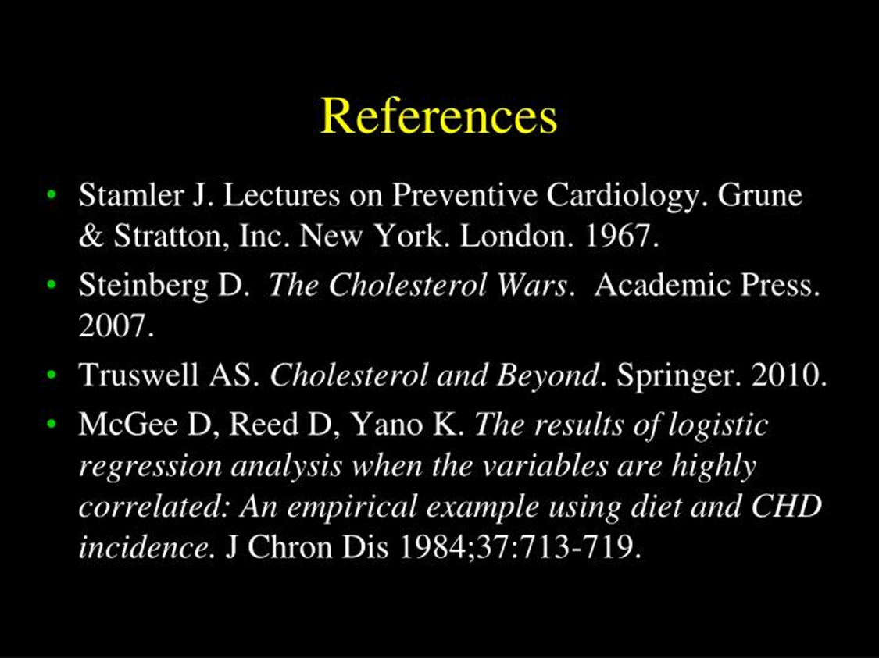

Slide 86
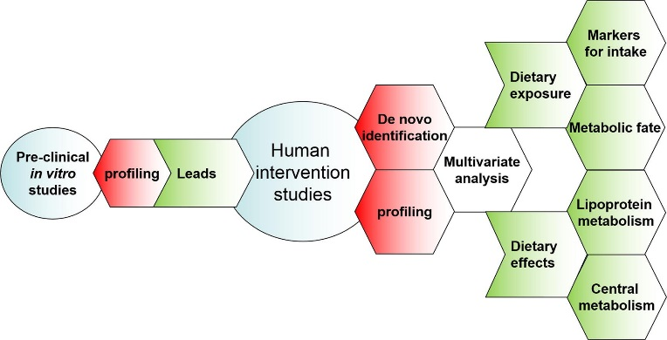

Slide 87
Measures of dietary exposures in groups

Slide 88
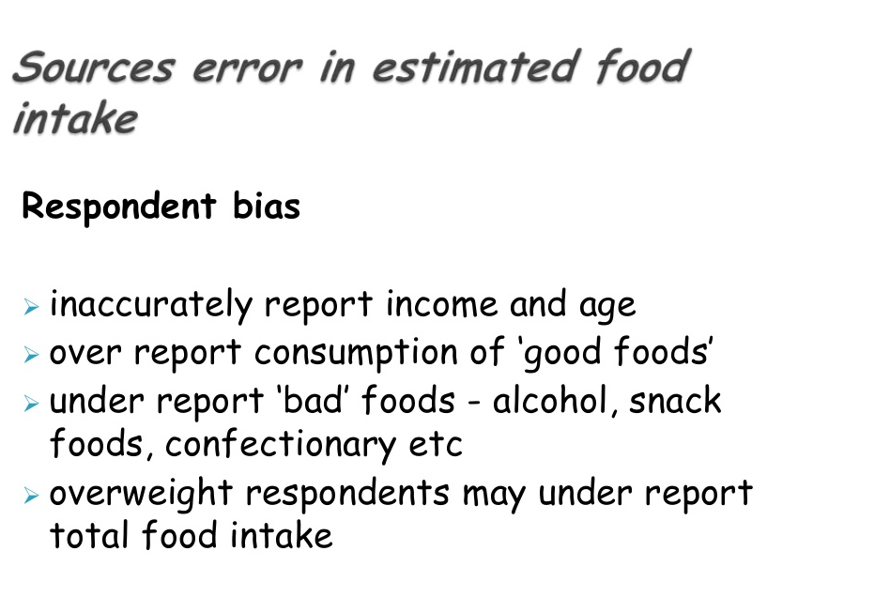

Slide 89
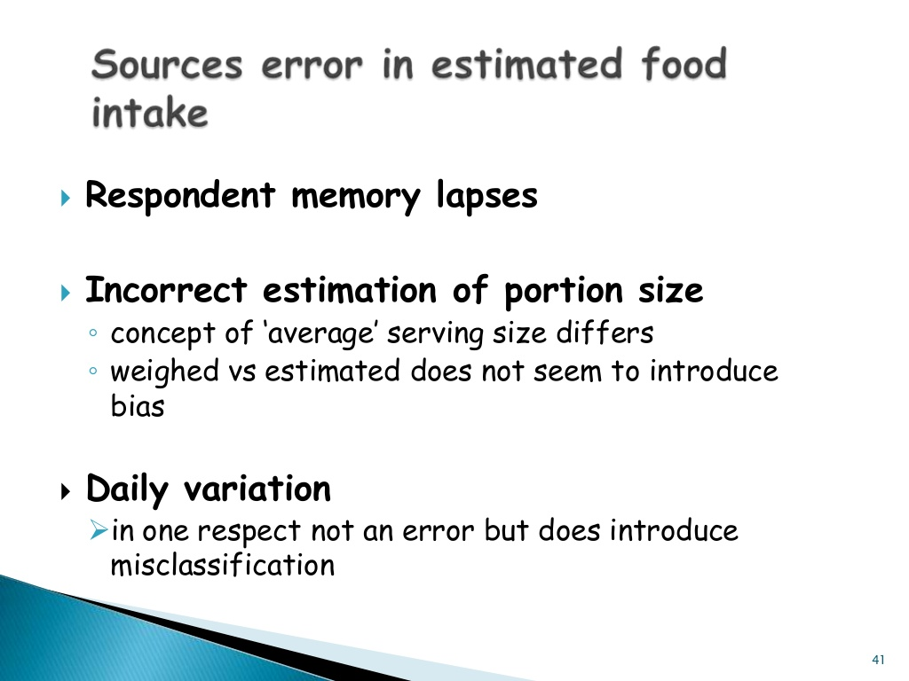

Slide 90
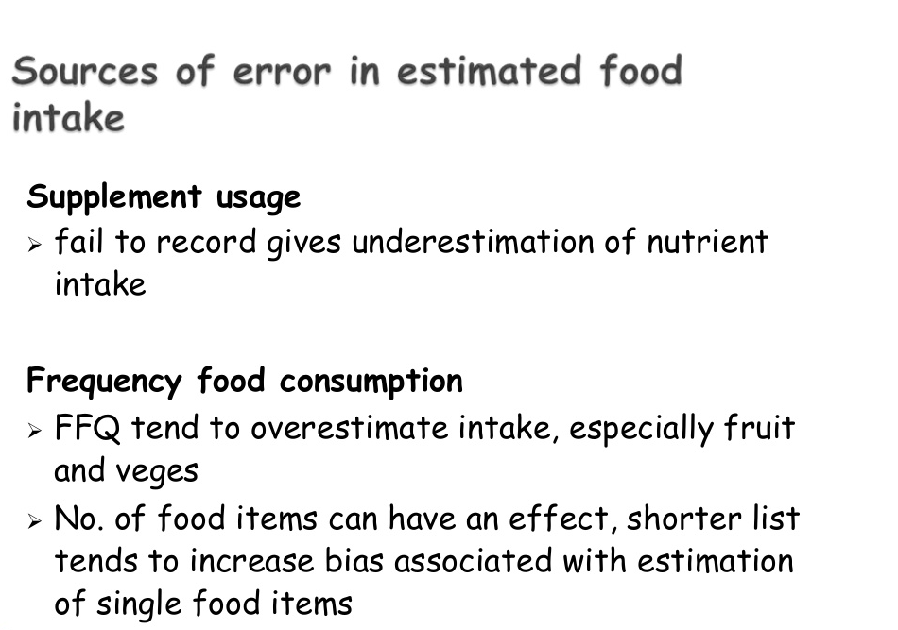

Slide 91
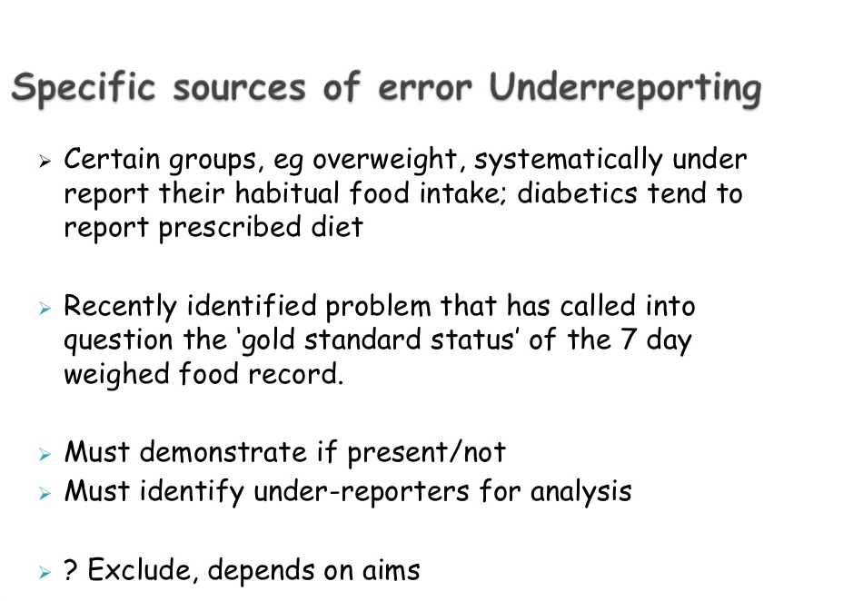

Slide 92
