Slide 1
به نام يگانه پروردگار

Slide 2
Research Methodology Study Design (2)
Davood Khalili, MD, MPH, PhD
Department of Biostatistics & Epidemiology
Research Institute for Endocrine Sciences
Shahid Beheshti University of Medical Sciences

Slide 3
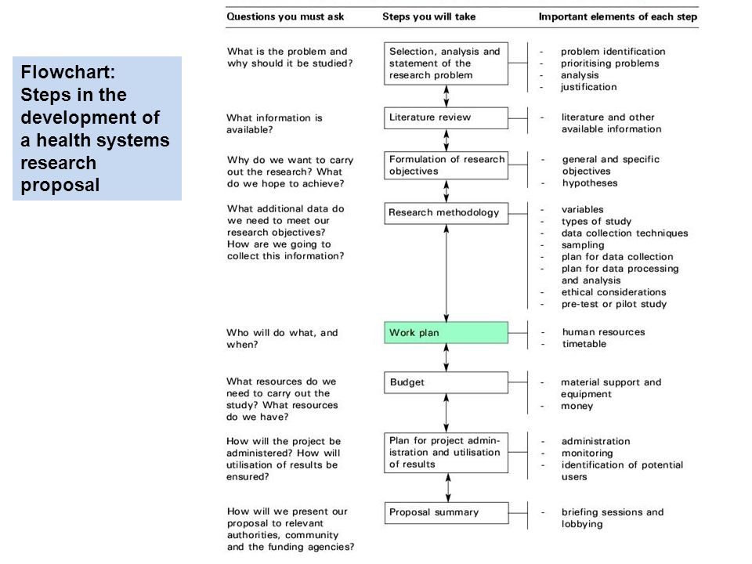

Slide 4
Cohort Study

Slide 5
A major limitation of cross-sectional surveys and case-control studies is difficulty to determine if exposure or risk factor preceded the disease or outcome.
Cohort Study:
is the Key Point:
Presence or absence of risk factor determine before outcome occurs.

Slide 6
WHAT IS COHORT
Ancient Roman military unit, A band of warriors.
Persons banded together.
Group of persons with a common statistical characteristic. [Latin]
E.g. age, birth date,

Slide 7
D +
D -
E +
E -
Cohort
Time
D +
D -
Target population

Slide 8
Cohort studies
longitudinal Study
Forward looking study (Prospectively or Retrospectively)
Incidence study
starts with people free of disease
assesses exposure at “baseline”
assesses disease status at “follow-up”

Slide 9
Indication of a cohort study
When there is good evidence of exposure and disease.
When exposure is rare but incidence of disease is higher among exposed
When follow-up is easy, cohort is stable
When ample funds are available

Slide 12
Elements of cohort study
Selection of study subjects
(A defined population)
Obtaining data on exposure
Follow up to detect outcome

Slide 13
Selection of study subjects
General population
Whole population in an area
A representative sample
Special group of population
Selected group
occupation group / professional group
Exposure groups
Person having exposure to some physical, chemical or biological agent
e.g. X-ray exposure to radiologists

Slide 14
Obtaining data on exposure
Personal interviews / mailed questionnaire
Reviews of records
Dose of drug, radiation, type of surgery etc
Medical examination or special test
Blood pressure, serum cholesterol
By obtaining the data of exposure we can classify cohorts as Exposed and Non-exposed and

Slide 15
Types of Cohort Study
Prospective cohort study
Retrospective (historical) cohort study
Combination of Retrospective and Prospective cohort study.

Slide 16
Cohort studies
Strengths
We can find out incidence rate and risk
More than one disease related to single exposure
can establish cause - effect
good when exposure is rare
minimizes selection and information bias
Weaknesses
losses to follow-up
often requires large sample
ineffective for rare diseases
long time to complete
expensive
Ethical issues

Slide 17
Results of a Cohort Study
Risk factor | Disease
 | Yes (cases) | No (controls)
Yes N1 | a | b
No N2 | c | d
Total
N1 and N2 are fixed numbers

Slide 18
RCT
Randomized
Controlled
Trial
Clinical Trial, Field Trial, Community Trials

Slide 19
Intervention
D +
D -
E +
E -
Cohort
Time
D +
D -
Target population
Cohort:
Patients Healthy peoples Groups
Clinical Trial, Field Trial, Community Trials

Slide 20
Any Question?
Time of team working.

