Slide 1
GLP-1 Receptor Agonists in T2dm treatment
M.Mehrdad
Endocrinologist
1396

Slide 2
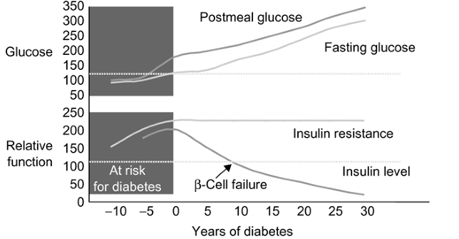
Natural History of T2DM and β-cell Function
Bergenstal R, et al. Endocrinology. Philadelphia, PA: WB Saunders Co;2001:821-835.

Slide 3
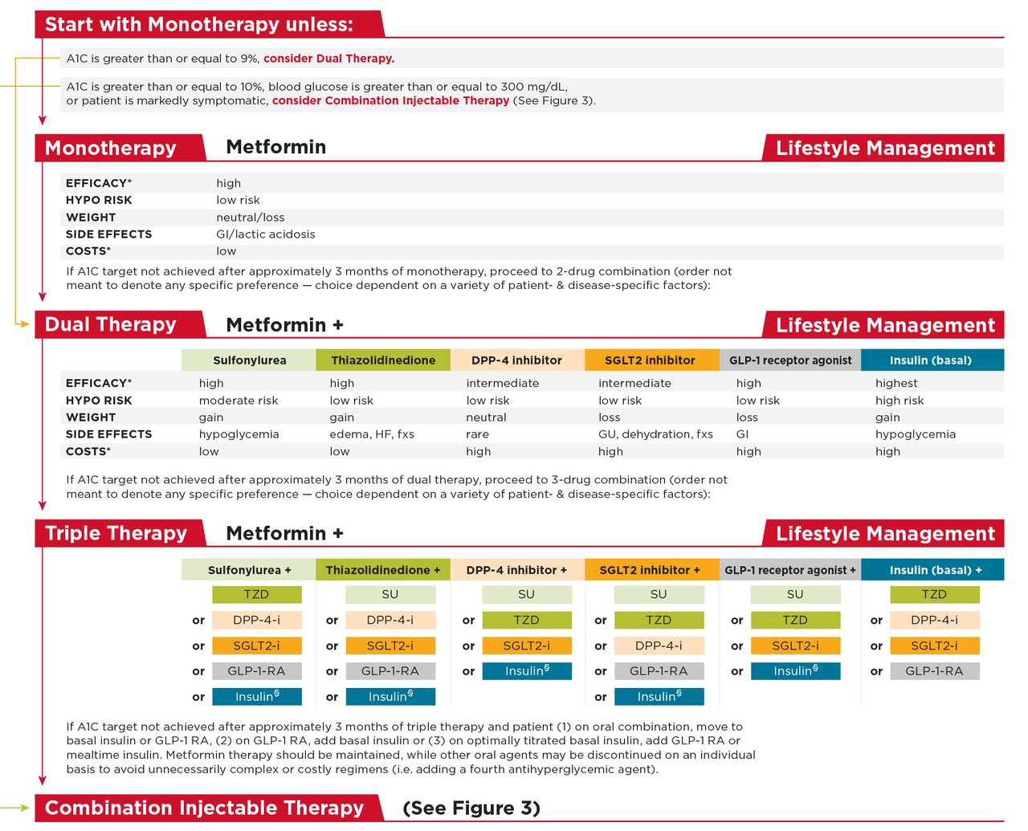
Antihyperglycemic Therapy in
Type 2 Diabetes
Notes:
This slide summarizes the general recommendations for antihyperglycemic therapy in type 2 diabetes,
3
References
American Diabetes Association. Standards of medical care in diabetes—2014. Diabetes Care 2014;37(suppl 1):S25; Figure 2
Inzucchi SE, Bergenstal RM, Buse JB, et al., American Diabetes Association (ADA); European Association for the Study of Diabetes (EASD). Management of hyperglycemia in type 2 diabetes: a patient-centered approach. Position statement of the American Diabetes Association (ADA) and the European Association of the Study of Diabetes (EASD). Diabetes Care 2012;35:1364-1379
Blonde L,MerilainenM, Karwe V, Raskin P; TITRATE Study Group. Patient-directed titration for achieving glycaemic goals using a once-daily basal insulin analogue: an assessment of two different fasting plasma glucose targets the TITRATE study. Diabetes Obes Metab 2009;11:623–631

Slide 4
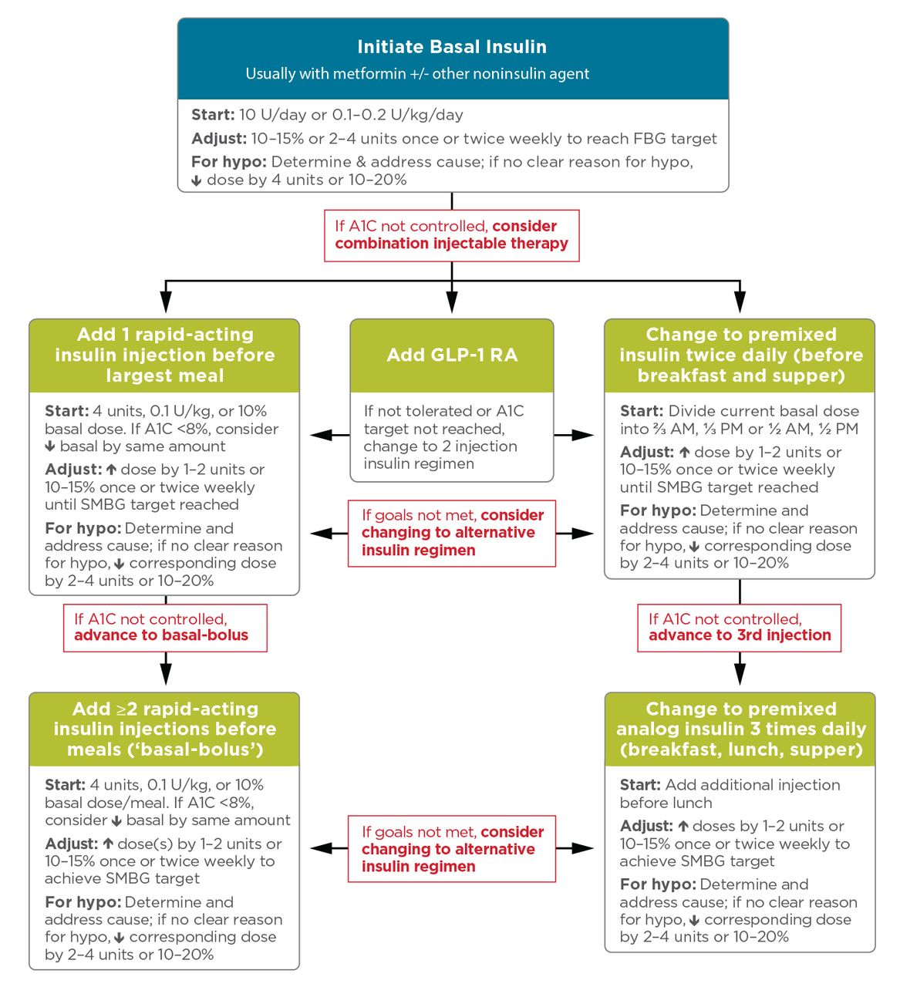

Slide 5
Factors to select the proper component for each individual patient
Effectiveness
Safety profiles
Side effects
Extra-glycemic effects
Cardiovascular
effects
Our experience
in handling
Availability
Patient preference
Cost

Slide 6
Unmet Needs With Conventional Antihyperglycemic Therapies
Many therapies are associated with weight gain
Insulin and more conventional oral insulin secretagogue therapies are associated with significant risk for hypoglycemia
Other adverse effects with some therapies include GI side effects and edema
Many therapies fail to adequately control postprandial hyperglycemia
Therapies often fail to maintain long-term glycemic control
Blonde L. Am J Manag Care. 2007;13:S36-S40.
Blonde L, et al. J Manag Care Pharm. 2006;12(suppl):S2-S12.
Notes:
6
Blonde L, Rosenstock J, Triplitt C. What are incretins, and how will they influence the management of type 2 diabetes? J Manag Care Pharm. 2006;12(suppl):S2-S12.
Blonde L. State of diabetes care in the United States. Am J Manag Care. 2007;13:S36-S40.

Slide 7
Unmet Needs
Type 2 DM Control is Not Durable
3 6 9 12 15 18 21 24 27 30 33 36 39 42 45 48
Time (months)

Slide 8
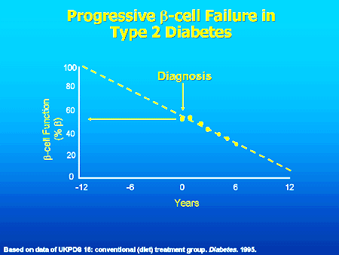
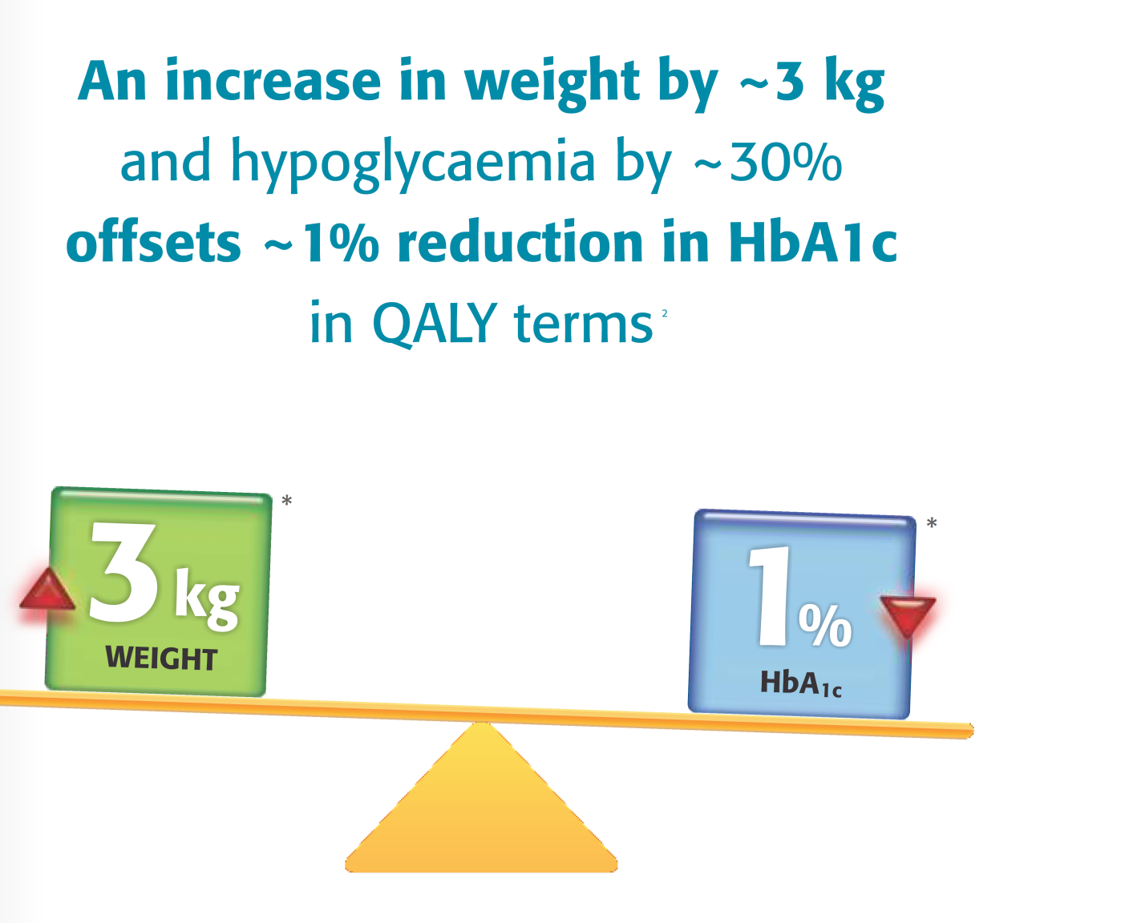
Progressive β Cell Dysfunction and Effect of Weight on Glycemic Control in T2DM
“50% of β cells are dead at diagnosis”
- UKPDS
Every 3 kg weight gain offsets benefits of 1% A1c reduction in terms of QALY.*
* P. McEwan, M. Evans, H. Kan; Diabetes, Obesity and Metabolism 12: 431–436, 2010.

Slide 9



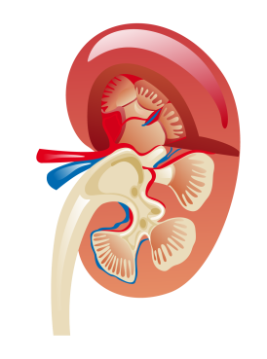
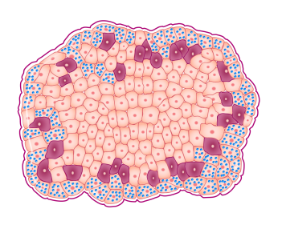
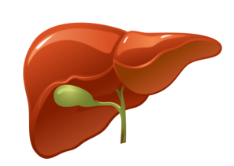
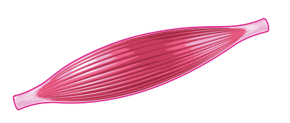

Pathogenesis of type 2 diabetes - The Ominous Octet
Decreased Incretin Effect
Decreased Insulin
Secretion
Increased Lipolysis
Hyperglycaemia
Increased
Glucagon
Secretion
Increased
Glucose
Reabsorption
Islet-α cell
Decreased
Glucose Uptake
Increased Hepatic
Glucose Production
Neurotransmitter
Dysfunction
Adapted from De Fronzo RA. Diabetes. 2009;58:773-95.

Slide 10
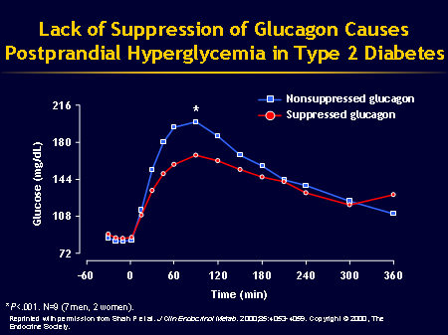
Pathophysiology of Type 2 Diabetes
The Glucagon Factor
In response to a carbohydrate-containing meal, individuals without diabetes not only
  increase insulin secretion but also simultaneously
  decrease pancreatic alpha-cell glucagon secretion.
The decrease in glucagon is associated with a decrease in hepatic glucose production, and along with the insulin response, results in a very modest increase in postprandial glucose.
N Engl J Med. 1971;285:443-449.
In contrast, the glucagon secretion in type 2 diabetics is not decreased, and may even be paradoxically increased.
These insulin and glucagon abnormalities produce an excessive postprandial glucose excursion.

Slide 11
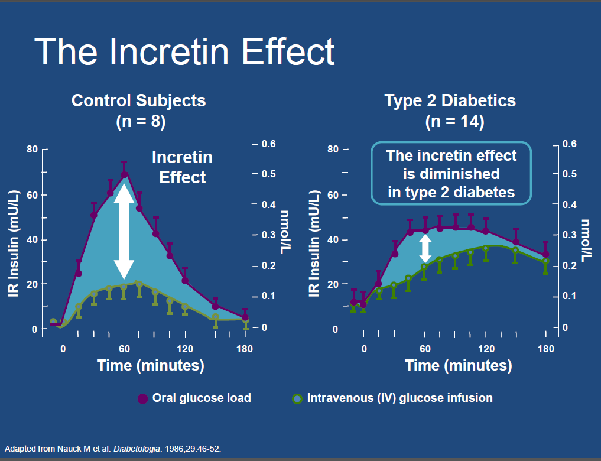
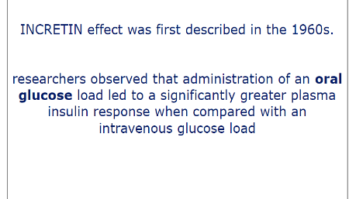

Slide 12
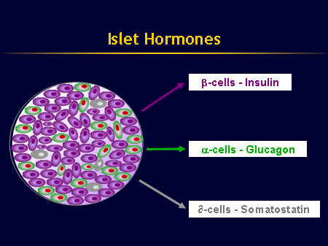
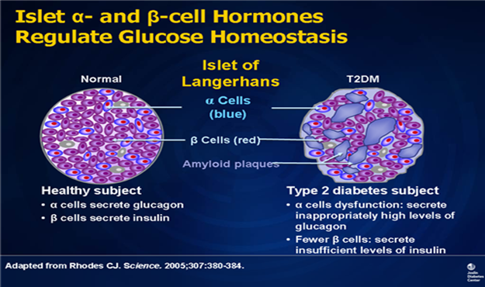

Slide 13
Defect in Type 2 DM
One Hormone Theory
Insulin Deficiency
Two Hormone Theory
Insulin Deficiency
Glucagon Excess
Three Hormone Theory
Insulin Deficiency,Glucagon Excess
Decreased Incretin effect

Slide 14
Role of Incretin in the management of diabetes

Slide 15
What are incretins?
Hormones produced by the GI tract in response to incoming nutrients, and have important actions that contribute to glucose homeostasis.
Two hormones:
  Glucagon-like peptide-1 (GLP-1).
  glucose-dependent insulinotropic peptide (GIP)
INCRETIN= INtestinal+seCRETion of INsulin

Slide 16
GLP-1 and GIP Are Incretin Hormones
GLP-1 |  | GIP
Is released from L cells in ileum and colon^{1,2} |  | Is released from K cells in duodenum^{1,2}
Stimulates insulin response from beta cells in a glucose-dependent manner¹ |  | Stimulates insulin response from beta cells in a glucose-dependent manner¹
Inhibits gastric emptying^{1,2} |  | Has minimal effects on gastric emptying²
Reduces food intake and body weight² |  | Has no significant effects on satiety or body weight²
Inhibits glucagon secretion from alpha cells in a glucose-dependent manner¹ |  | Does not appear to inhibit glucagon secretion from alpha cells^{1,2}
1. Meier JJ et al. Best Pract Res Clin Endocrinol Metab. 2004;18:587–606.
2. Drucker DJ. Diabetes Care. 2003;26:2929–2940.
Notes:
GLP-1 and GIP Are Incretin Hormones
GLP-1 and GIP are the currently identified incretin hormones.
An incretin is a hormone with the following characteristics¹:
It is released from the intestine in response to ingestion of food,
particularly glucose.
The circulating concentration of the hormone must be sufficiently high
to stimulate the release of insulin.
The release of insulin in response to physiological levels of the hormone occurs only when glucose levels are elevated (glucose-dependent).
GIP and GLP-1 are hormones that fulfill these 3 characteristics, qualifying them as incretins.¹
In the fasting state, GIP and GLP-1 circulate at very low levels. Their levels rapidly increase after food ingestion and play a role in the release of insulin.^{2,3}
GLP-1 stimulates insulin response from beta cells in a glucose-dependent manner and suppresses glucagon secretion from alpha cells in a glucose-dependent manner. GIP also potentiates insulin release from beta cells in a glucose-dependent manner.⁴ Other effects of GLP-1 and GIP are summarized on the slide.
References:
1. Creutzfeldt W. The [pre-] history of the incretin concept. Regul Pept. 2005;128:87–91.
2. Gautier JF, Fetita S, Sobngwi E, Salaün-Martin C. Biological actions of the incretins GIP and GLP-1 and
therapeutic perspectives in patients with type 2 diabetes. Diabetes Metab. 2005;31:233–242.
3. Holst JJ, Gromada J. Role of incretin hormones in the regulation of insulin secretion in diabetic and
nondiabetic humans. Am J Physiol Endocrinol Metab. 2004;287:E199–E206.
4. Meier JJ, Nauck MA. Glucose-dependent insulinotropic polypeptide/gastric inhibitory polypeptide. Best Pract Res Clin Endocrinol Metab. 2004;18:587–606.

Slide 17
The two primary incretin hormones
GLP-1 | GIP
30 amino acid peptide¹ | 42 amino acid peptide²
Synthesised and released by L cells of ileum and colon² | Synthesised and released from K cells of jejunum and duodenum²
Sites of action¹: Pancreatic β-cells and α-cells GI tract CNS Lungs Heart | Sites of action²: Pancreatic β-cells Adipocytes
Circulating GIP and GLP-1 levels are regulated by multiple factors²
  Low in the basal fasting state; they rise rapidly following a meal from neuronal, neuroendocrine, and direct nutrient stimulation of intestinal cells
¹Wei Y, et al. FEBS Lett 1995;358:219–224;
²Drucker DJ. Diabetes Care 2003;26:2929–2940.
Notes:
DISCUSSION
GLP-1 and GIP represent the dominant peptides responsible for the ‘incretin effect’
Bioactive forms of both GLP-1 and GIP are short-lived, with active plasma half-lives of ~2–7 minutes. Degradation is by dipeptidyl peptidase IV (DPP-IV)
Drucker DJ. Diabetes Care 2003;26:2929–2940.

Slide 19
Incretin Physiology in Type 2
Diabetes Mellitus
GLP-1 & GIP Secretion in
Type 2 Diabetes Mellitus

Slide 20
Incretins in T2DM:
Decreased Postprandial Levels of GLP-1 in Patients With Type 2 Diabetes
*
*
*
*
*
*
*
(10-15)
Meal
Started
Meal
Finished
*P<0.05, Type 2 diabetes vs NGT.
Reprinted with permission from Toft-Nielsen MB et al. J Clin Endocrinol Metab. 2001;86:3717–3723. Copyright © 2001, The Endocrine Society.
Notes:
Decreased Postprandial Levels of the Incretin Hormone GLP-1 in Patients With
Type 2 Diabetes
This clinical study investigated the meal-stimulated GLP-1 response (shown in the slide) and GIP response (not shown) in patients with type 2 diabetes (n=54) vs subjects with IGT (n=15), and control subjects with NGT (n=33).
After 3 days without antidiabetic medication and after an overnight fast, subjects consumed a mixed meal and underwent blood sampling periodically for 4 hours. The meal was started at time zero and finished within 10 to 15 minutes.
The plasma GLP-1 concentrations for patients with type 2 diabetes vs subjects with IGT and control subjects with NGT are shown on the slide. Postprandial GLP-1 concentrations were significantly decreased in patients with type 2 diabetes compared with those in control subjects with NGT (P<0.05). Concentrations were also decreased in subjects with IGT compared with those in control subjects with NGT. The GLP-1 concentrations of the IGT group ranged between those of patients with type 2 diabetes and control subjects with NGT.
Reference:
Toft-Nielsen MB, Damholt MB, Madsbad S, et al. Determinants of the impaired secretion of glucagon-like peptide 1 in type 2 diabetic patients. J Clin Endocrinol Metab. 2001;86:3717–3723.

Slide 21
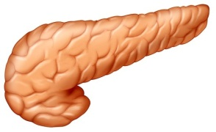
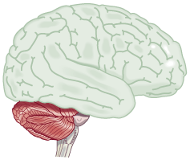
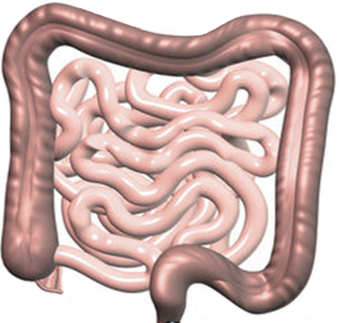
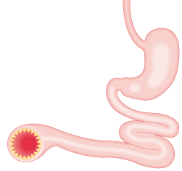
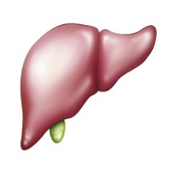
GLP-1: an incretin hormone with multiple direct effects on human physiology
α
β
Pancreas
Brain
Satiety
Intestine
β
Glucose-dependent
insulin secretion
GLP-1
Stomach
β
Insulin synthesis
Gastric
emptying
α
Glucose-dependent glucagon secretion
Cardiovascular system
Blood pressure
Liver
Glucose production
L-cells secrete GLP-1
→ degraded by DPP-4
Adapted from Baggio, Drucker. Gastroenterol 2007;132:2131–57
Notes:
Animated slide
GLP-1 stimulates G-protein coupled GLP-1 receptors, which are found in many organs, including: the pancreas, stomach, intestines, heart, and parts of the peripheral and central nervous systems.
GLP-1 has multiple physiological actions that make it an attractive candidate for the treatment of type 2 diabetes.

Slide 22
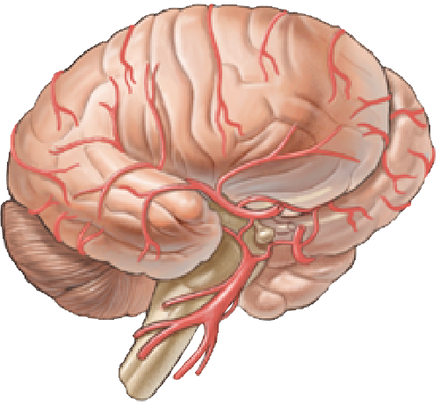

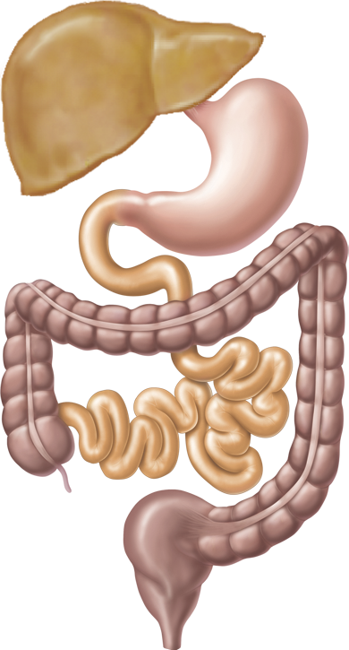
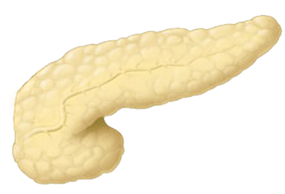

GLP-1: secretion and biological actions
Adipose tissue
Brain/nervous system
Hypothalamus
Appetite ↓, satiety ↑, food intake ↓, water intake ↓
Nucleus tractus solitarii
GLP–1 production
Access:
CNS: circumventricular organs (circulating GLP-1)
Autonomic nervous system
Afferent vagus (GLP-1 from GI tract)
‘Hepatoportal’ region
Glucose uptake ↑
Glycogen synthesis ↑
(? indirect actions)
Stomach
Gastric emptying decelerated
Acid secretion ↓
Muscle
Endocrine pancreas
Secretion
β cells: insulin secretion ↑
α cells: glucagon secretion ↓
δ cells: somatostatin secretion ↑
Biosynthesis
(Pro-) insulin↑
β-cell mass
Growth, regeneration, neogenesis ↑
Apoptosis ↓
Ileum
Site of GLP-1 synthesis from proglucagon, GLP-1 secretion ↑ after meals (carbohydrate, fat)
Adapted from Drucker D, Nauck MA. Lancet. 2006;368:1696–1705.
Notes:
Illustrations: ©2007 GCT II Solutions and Enterprises Ltd. O/A Headcan for unlimited reproduction rights in slide kits.

Slide 23
Pleiotropic effects of GLP‑1 or GLP‑1 receptor agonists on various tissues and organs under experimental conditions
Meier, J. J. Nat. Rev. Endocrinol. advance online publication 4 September 2012

Slide 24
Unfortunately, GLP-1 is rapidly broken down by the DPP-IV enzyme (very short half-life in plasma - requires continuous IV infusion).

Slide 25
Incretin-based therapies
Incretin-based
therapies
Saxagliptin
GLP-1 receptor agonists
DPP-4 inhibitors
Linagliptin
Sitagliptin
Vildagliptin
(EU and Aus)
Human GLP-1
analogues
Exendin-based
therapies
Alogliptin
(Japan only)
Teneligliptin
(Japan only)
Liraglutide
Exenatide OW
Exenatide BID
Aus, Australia; EU, Europe
Notes:
Animated slide
Incretin-based therapies can be subdivided into:
Dipeptidyl peptidase-4 (DPP-4) inhibitors
GLP-1 receptor agonists
GLP-1 receptor agonists can be further classified as either:
Exendin-based therapies (exenatide, exenatide LAR), which have ~50% sequence identity to human GLP-1.
Human GLP-1 analogues (liraglutide), which share a much higher percentage of amino acids with human GLP-1 (97%).

Slide 26
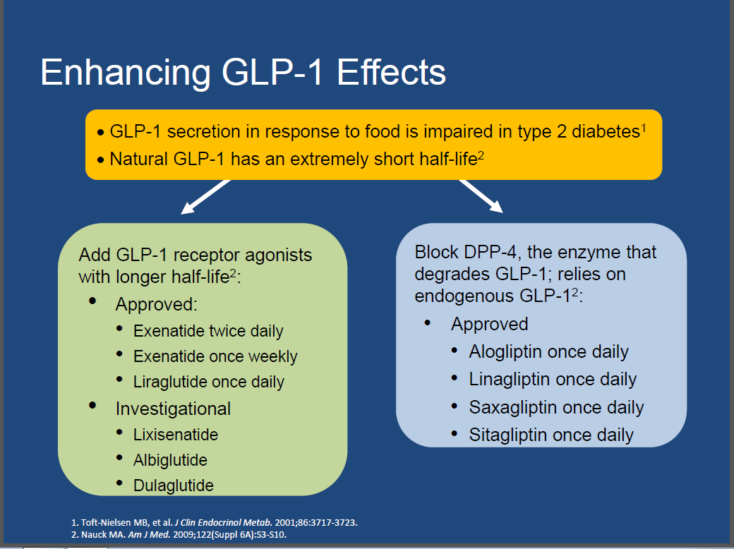

Slide 27
Strategies employed to develop GLP‑1 receptor agonists with prolonged in vivo half-lives

Slide 32
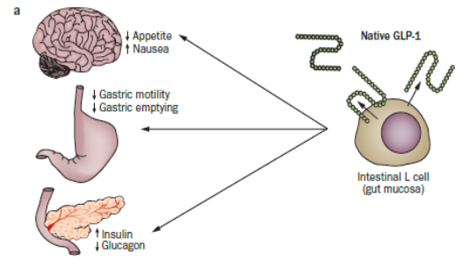
Physiological role of GLP‑1 and proposed working models for the actions of short-acting and long-acting GLP‑1 receptor agonists in the postprandial state.
Meier, J. J. Nat. Rev. Endocrinol. advance online publication 4 September 2012

Slide 33
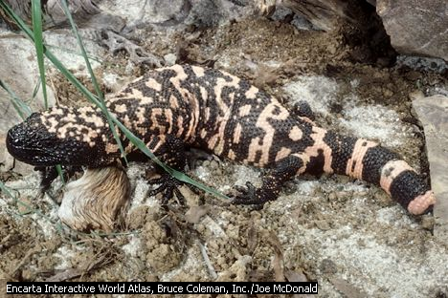
Incretin mimetics
Exenatide
The first incretin-related therapy available for patients with type 2 diabetes.
Naturally occurring peptide from the saliva of the Gila Monster.
Has an approximate 50% amino acid homology with GLP-1.
Binds to GLP-1 receptors and behaves as GLP-1.

Slide 34
Incretin mimetics
Exenatide
Resistant to DPP-IV inactivation.
Following injection, it is measurably present in plasma for up to 10 hours.
Suitable for twice a day administration by subcutaneous injection.
Regul Pept. 2004;117:77-88.
Am J Health Syst Pharm. 2005;62:173-181.

Slide 35
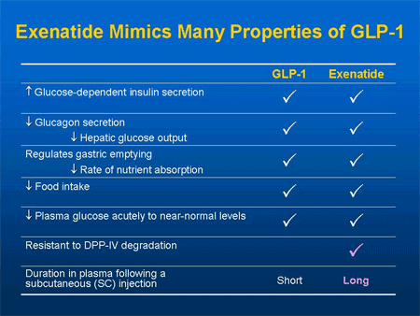

Slide 36
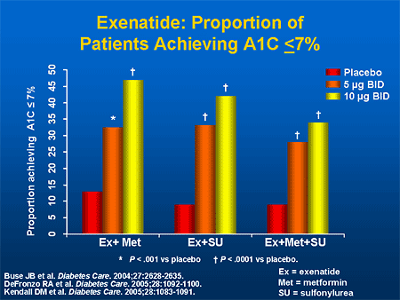

Slide 37
Meier, J. J. Nat. Rev. Endocrinol. advance online publication 4 September 2012

Slide 38
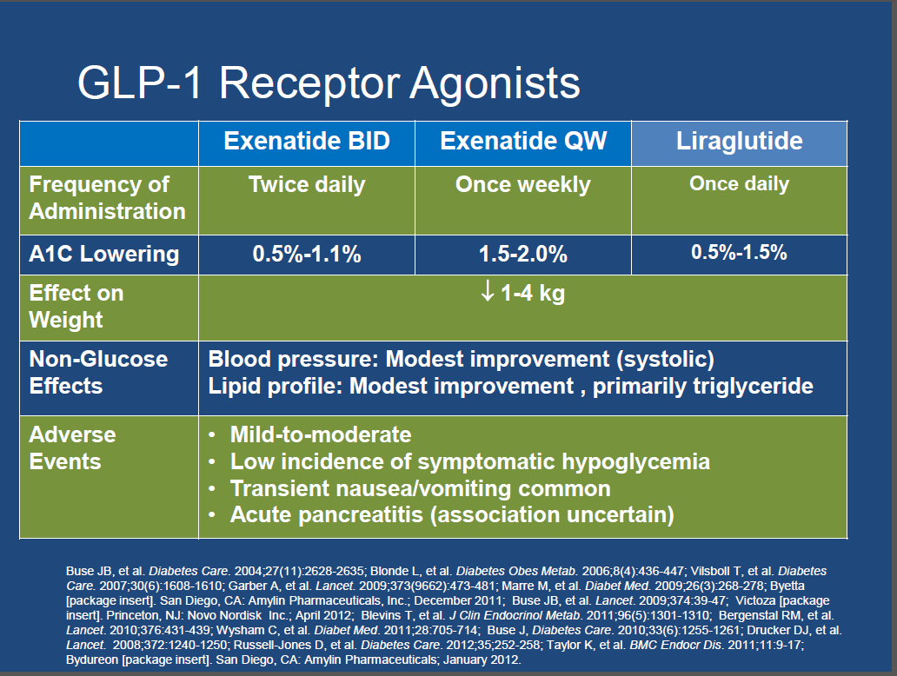

Slide 39
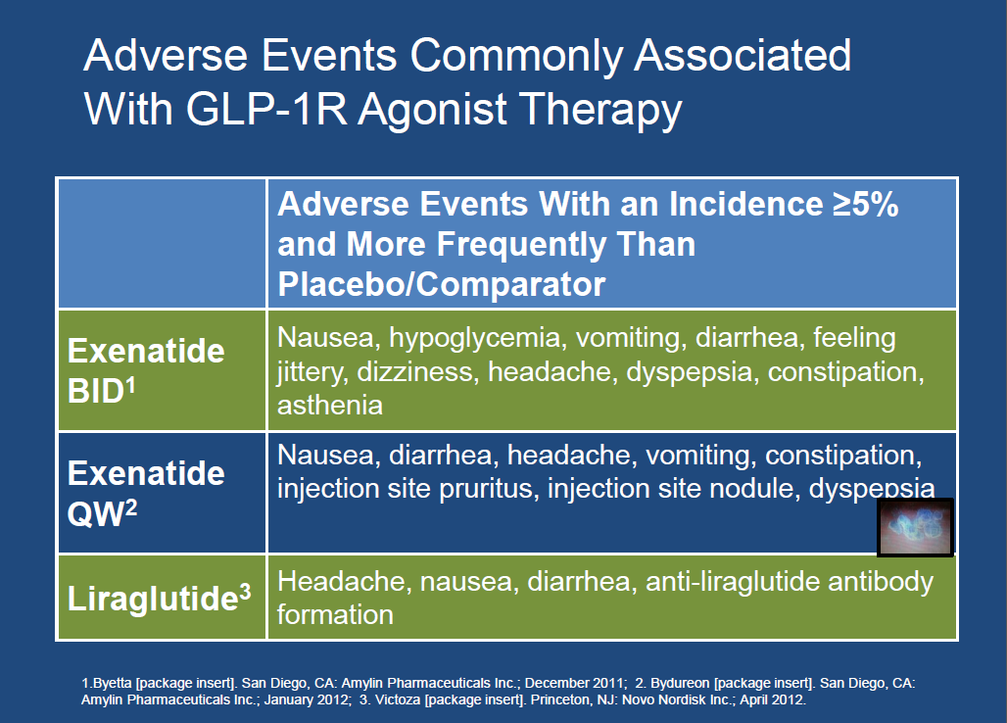

Slide 40
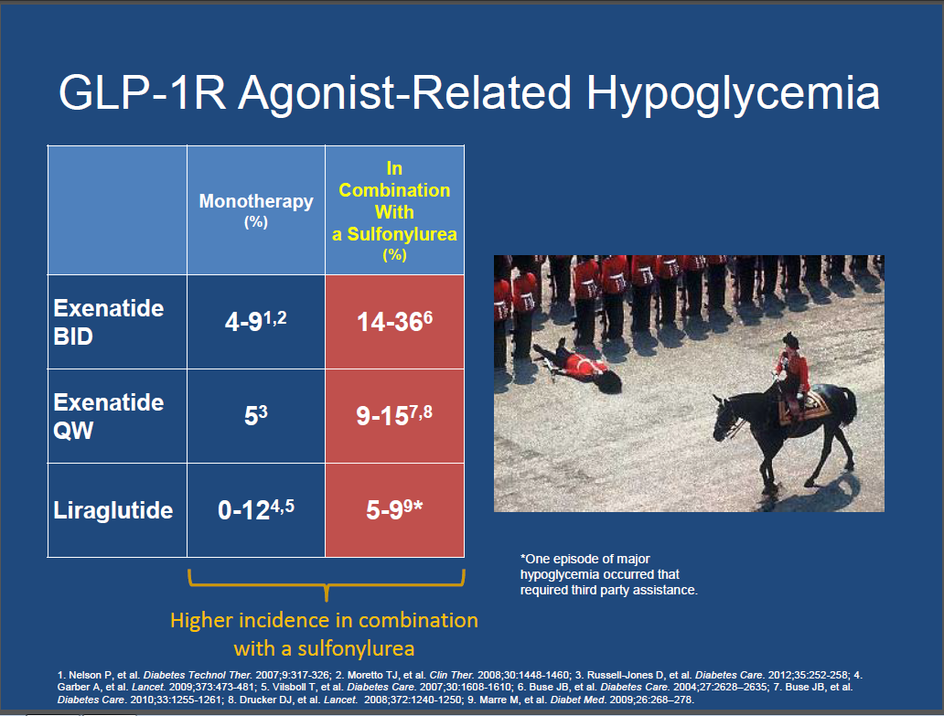

Slide 41
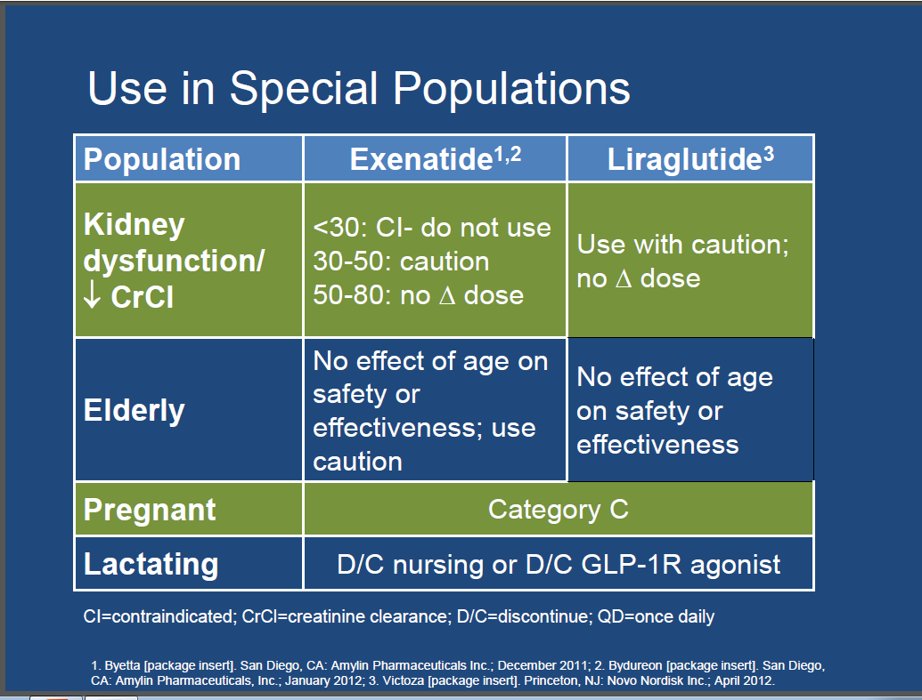

Slide 42
GLP-1 RAs safety profile

Slide 43
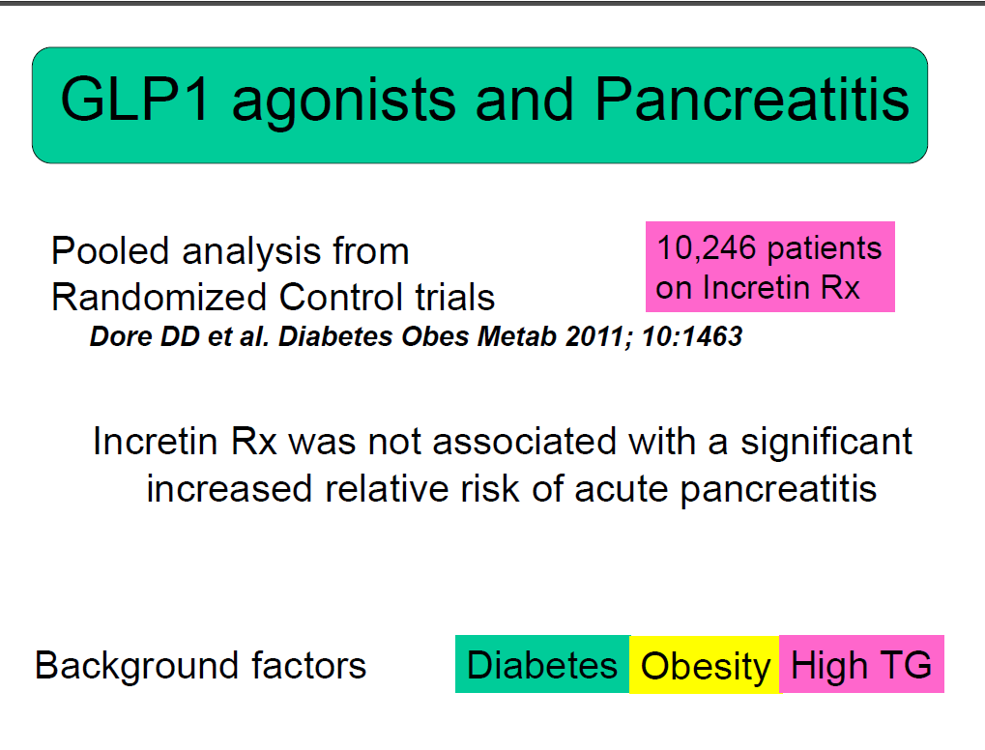

Slide 44
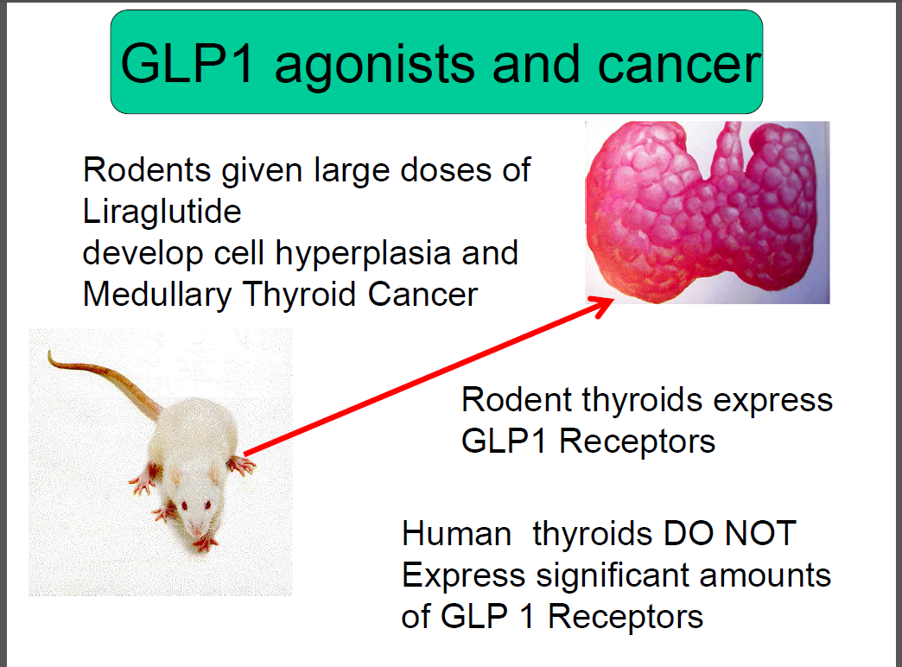

Slide 45
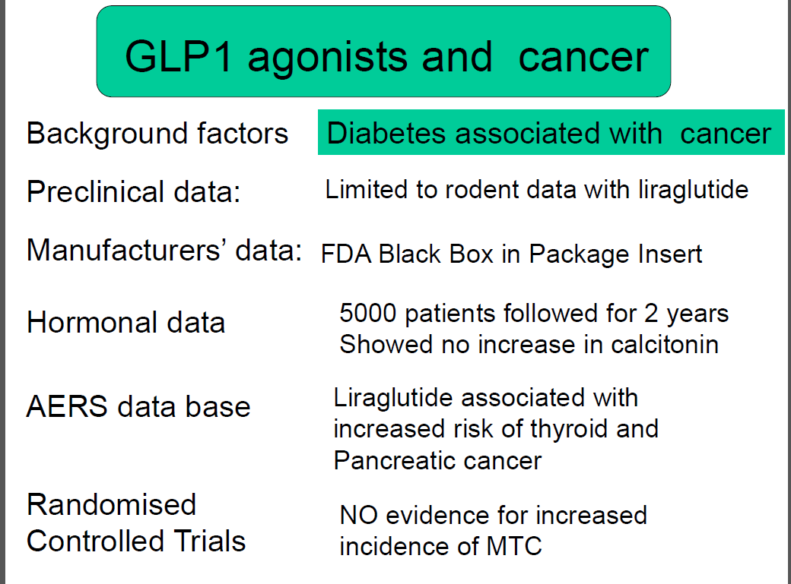

Slide 46
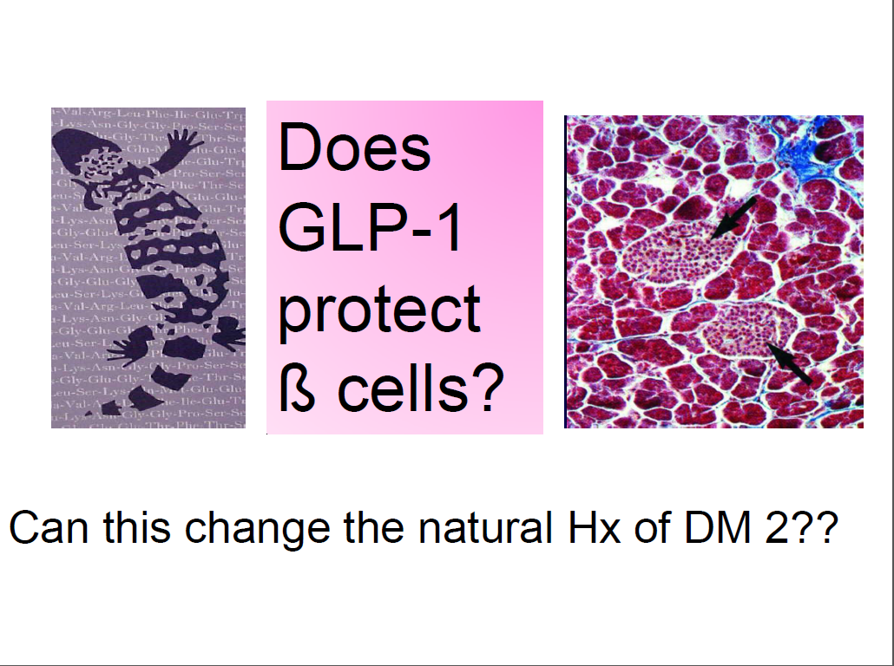

Slide 47
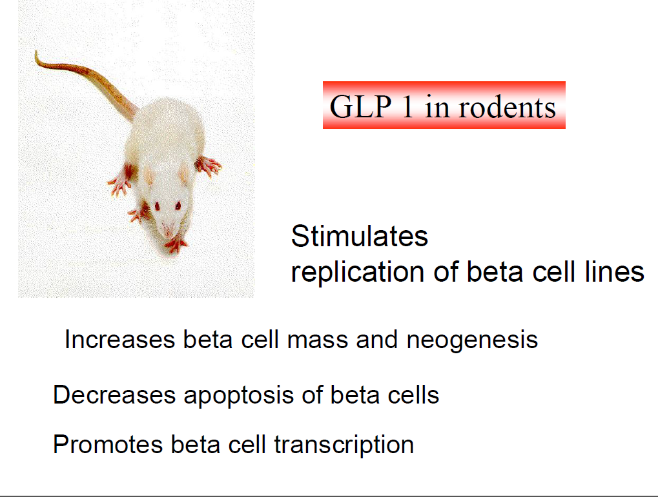

Slide 48
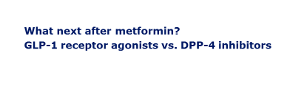
Differences between GLP-1 RAs and DPP-4 inhibitors in clinical practice

Slide 49
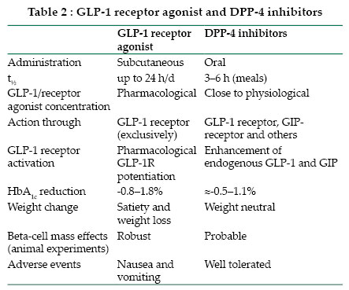

Slide 50
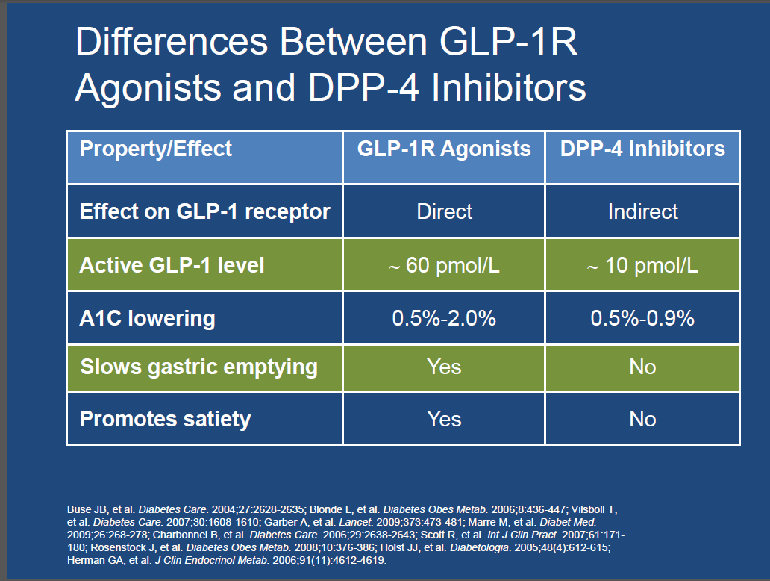

Slide 51
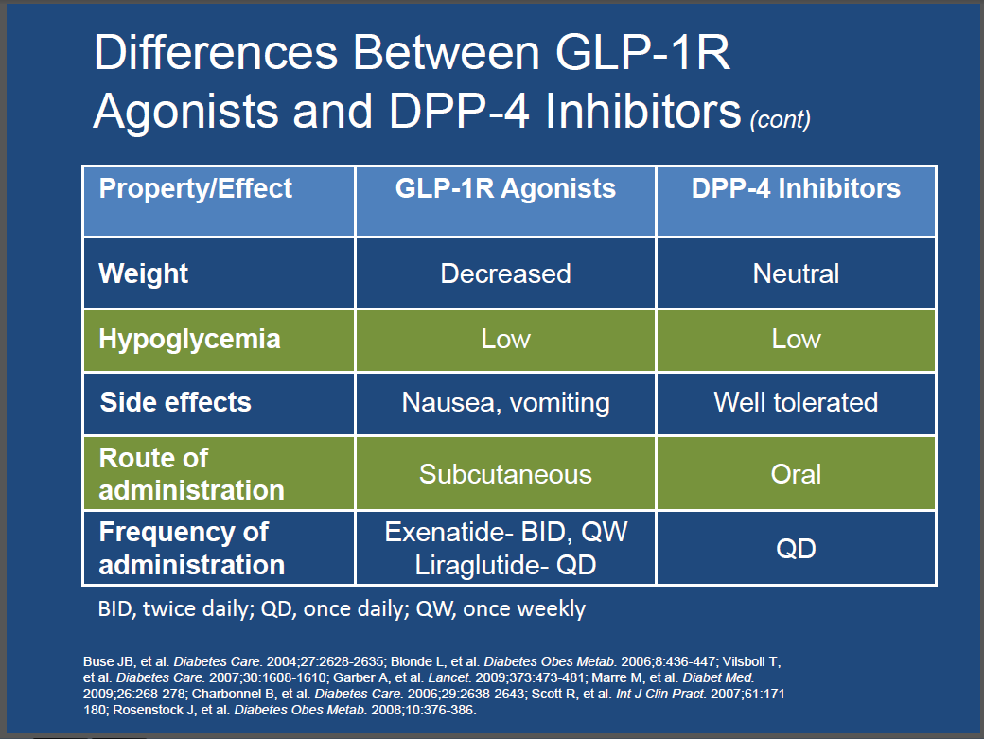

Slide 52
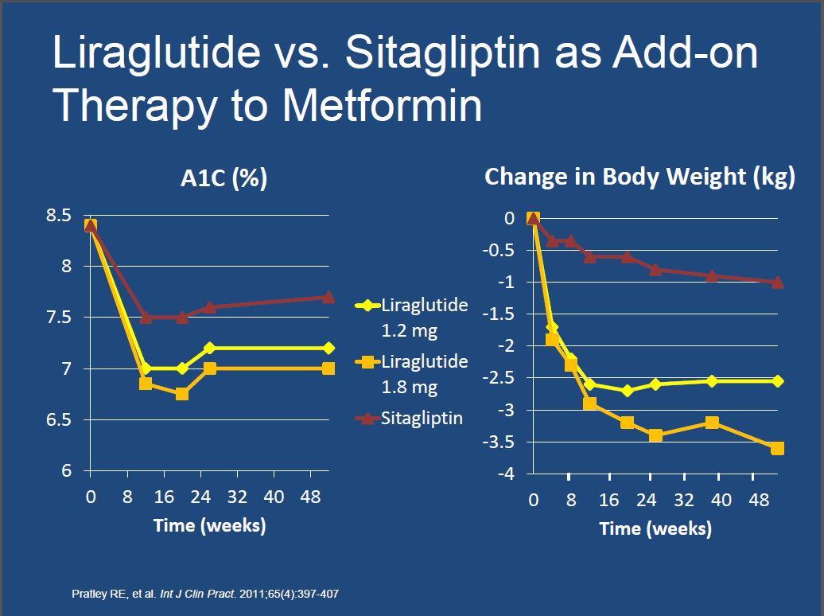

Slide 53
Meta-analysis: subjects achieving HbA_{1c} target and no weight gain
TZD
SU
9%
Glargine
15%
Sitagliptin
100 mg
16%
Exenatide
10 μg
17%
Liraglutide
1.2 mg
32%
More patients treated with liraglutide (1.2 or 1.8 mg) or exenatide BID achieved a composite endpoint of HbA1c <7.0% and no weight gain compared with the DPP-4 inhibitor, sitagliptin.
Liraglutide
1.8 mg
39%
50%
Adapted from Zinman et al. Diabetes Obes Metab 2011;14:77–82

Slide 54
A practical and clinically significant endpoint
Composite Endpoint
HbA_{1c} <7.0%
+
NO weight gain
+
NO hypoglycaemia
Notes:
54

Slide 55
More patients achieve this composite endpoint with liraglutide than with ‘conventional’ therapies
HbA_{1c}<7.0% + no weight gain + no hypos
**
**
Subjects reaching endpoint (%)
*
*
***
*
***
*
***
*
***
Liraglutide
1.8 mg
Liraglutide
1.2 mg
Exenatide
BID
Sitagliptin
SU
TZD
Insulin
glargine
Placebo
*p<0.0001 vs. liraglutide 1.8 mg; **p<0.001 vs. liraglutide 1.8 mg;
***p<0.0001 vs. liraglutide 1.2 mg
Zinman et al. Diabetes Obes Metab 2011;14:77–82
Notes:
Animated slide
More patients treated with liraglutide 1.2 or 1.8 mg achieved a composite endpoint of HbA_{1c} <7.0%, no weight gain and no hypoglycaemia, versus comparators.
Answer = 1: 11% of patients treated with sitagliptin acheived the composite endpoint of HbA_{1c} <7.0%, no weight gain and no hypoglycaemia.
Percentages are from logistic regression model adjusted for trial, previous treatment and with baseline HbA_{1c} and weight as covariates.
55

Slide 56
Conclusions
Compared with DPP-4 inhibitors, GLP-1 receptor agonists are associated with:
  greater HbA_{1c} reduction and greater weight loss
  similar low risk of hypoglycaemia but an increased incidence of gastrointestinal events
  greater improvements in CV biomarkers and selected lipids
  greater overall treatment satisfaction
Switching from a DPP-4 inhibitor to a GLP-1 receptor agonists was associated with:
  significant additional HbA_{1c} reductions
  significant weight loss
  improved overall treatment satisfaction without a change in perceived treatment flexibility or convenience
Notes:
Animated slide

Slide 57


Slide 58
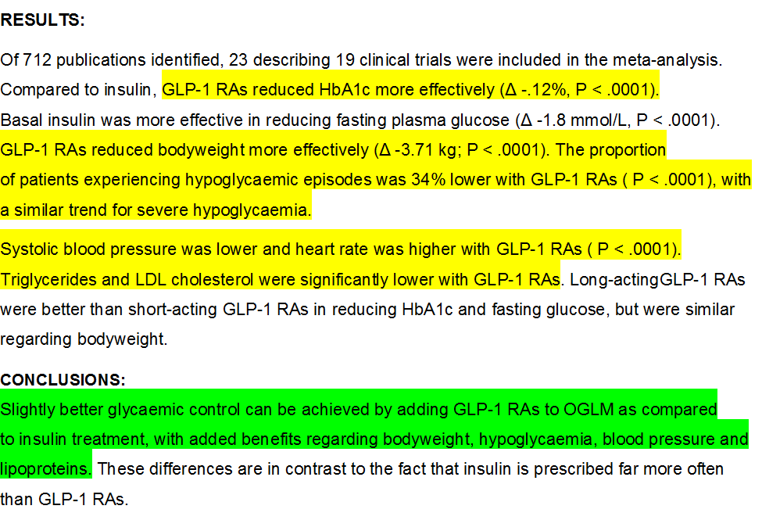

Slide 60


Slide 61
Microvascular efects of glucagon‑like peptide‑1 receptor agonists in type 2 diabetes: a meta‑analysis of randomized controlled trials (Acta Diabetol ,2017, Dicembrini et al )
Aims :Results with GLP1-receptor agonists (GLP-1RA) on microvascular complications of diabetes are contrasting.
In trials designed for CVD outcomes, both liraglutide and semaglutide were associated with a relevant reduction in the incidence and progression of nephropathy.
On the other hand, in the same trials, semaglutide was associated with an increased progression of retinopathy, and a similar trend was observed for liraglutide. This meta-analysis is aimed at assessing the efects of GLP-1RA on retinopathy and nephropathy

Slide 62
Treatment with GLP1-RA was not associated with a signifcant increase in the incidence of retinopathy (MH-OR [95% CI] 0.92 [0.74–1.16]. p = 0.49).
In subgroup analyses, GLP1-RA were associated with a lower risk of retinopathy in comparison with sulfonylureas.
GLP1-RA reduced the incidence of nephropathy with respect to comparators (MHOR [95% CI] 0.74 [0.60–0.92]. p = 0.005). This diference was signifcant versus placebo, but not versus any class of active comparators.

Slide 63
GLP1-RA appear to reduce the incidence and/or progression of nephropathy and to have no specifc effect on retinopathy—with the notable exception of semaglutide, which could have a negative impact on the retina.

Slide 64
Introduction: The publication of the results of LEADER and SUSTAIN-6 trials suggested a possible beneficial effect of the class of GLP-1 receptor agonists on cardiovascular morbidity and mortality.
The aim of the present metaanalysis is to collect and synthetize all available evidence on the effect of GLP-1 receptor agonists on cardiovascular events and mortality.
Methods: A Medline search for GLP-1 receptor agonists (exenatide, liraglutide, lixisenatide, albiglutide, dulaglutide, or semaglutide) was performed, collecting all randomized clinical trials with a duration >11 weeks, enrolling patients with type 2 diabetes, and comparing a GLP-1 receptor agonist with placebo or any other non-GLP-1 receptor agonist drug.
The principal outcome of this analysis was the effect of GLP-1 receptor agonists on all-cause and cardiovascular mortality, overall (fatal plus nonfatal)myocardial infarction, stroke, and heart failure. IJC 2017

Slide 66
Comparison of Clinical Outcomes and Adverse Events Associated With
Glucose-Lowering Drugs inPatientsWithType2 Diabetes :A Meta-analysis
(JAMA.2016;316(3):313-324, SuetoniaC.Palmer et al)

Slide 67
Impacts of different drugs added to MET +SULF
There was no evidence of significantly different associations with all-cause mortality or serious adverse events between any of the drug classes given as triple therapy.
As add-ons to MET + SUL, α-glucosidase inhibitors ranked worst for lowering HbA1C levels, whereas TZD or basal insulin were best.
MET +SUL + basal insulin ranked best for avoiding treatment failure, whereas MET + SUL+ DPP-4 inhibitor was the worst.
When added to MET +SUL, GLP-1 receptor agonists were ranked best for avoiding hypoglycemia, while TZD ranked worsts

Slide 68
In patients with long-standing suboptimally controlled type 2 diabetes and established atherosclerotic cardiovascular disease, empagliflozin or liraglutide should be considered as they have been shown to reduce cardiovascular and all-cause mortality when added to standard care. (Level of evidence B)
ADA. Diabetes Care 2017;40 (Suppl 1)

