Slide 1


M.Tohidi

Slide 2
Reference Values for
Thyroid Function Tests & TPO-Ab in Iranian population
Maryam Tohidi
Associate professor of anatomical & clinical pathology
Research Institute for Endocrine Sciences
Shahid Beheshti University of Medical Sciences
M.Tohidi

Slide 3
Agenda
Introduction to reference value
Reference values for TSH & FT4 in Iranian adults
Reference values for TPO-Ab in Iranian adults
Trimester specific reference values for TSH & FT4 I in Iranian pregnant women
M.Tohidi

Slide 4
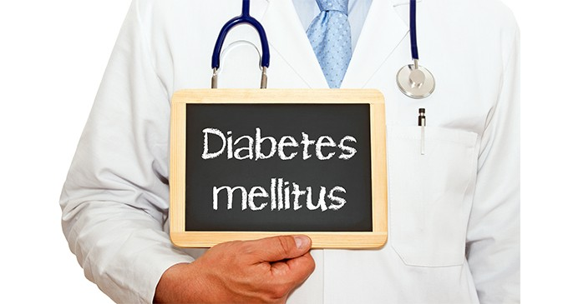
Reference value
This concept was launched by Saris and Ralph Gra¨sbeck in a specific conference devoted to normal values during a Congress of Clinical Laboratory Medicine in 1969.
The concept of normal values was scientifically flawed & needed a well defined nomenclature & recommended procedures in the field.
History
M.Tohidi

Slide 5
Reference values could be derived from many kinds of:
individuals provided the selection criteria
the state of health of individuals (including poor health)
specimen collection
analytical procedures
Reference value
M.Tohidi

Slide 6
Selection of reference individuals & population
Purpose of ordered laboratory tests (diagnosis, epidemiological information & disease prevention)
The principal purpose of medicine is to make or keep people well, to give them health and to help them maintain it.
These goals justifies that you know the values of healthy persons.
M.Tohidi

Slide 7
Determination of Reference values
1. Select a reference group representative of the population
Free of disease and conditions that might cause an “abnormal” result
Establish excluding criteria including factors that may impact the test
Screen and test reference group
5. Calculate reference values
M.Tohidi

Slide 8
Types of reference values
Na, reference value determined on a reference population; physiologically determined so it should be independent of region and ethnicity
TSH, reference value determined by age, sex, ethnicity, geographic location, iodine intake
CHOL., reference value not relevant; level to treat determined by epidemiologic studies of risk
M.Tohidi

Slide 9
TSH & FT4

Slide 10
Reference limit thyroid function tests
Thyroid stimulating hormone (TSH):
A sensitive indicator of hypothalamo-pituitary-thyroid (HPT) axis integrity.
The most common test used for evaluation of HPT axis function.
Reciprocal log-linear relation with free thyroxine (FT4).
Thus the definition of TSH reference range is of critical importance for the diagnosis of thyroid dysfunction.
M.Tohidi

Slide 11
Guideline of the National Academy of Clinical Biochemistry
(NACB) for determination of TSH reference intervals
95% confidence limits of the log-transformed values of at least 120 rigorously screened normal euthyroid volunteers
No family history of thyroid dysfunction
No visible or palpable goiter
No detectable thyroid auto-antibodies
No medications (except estrogen)
M.Tohidi

Slide 12
Methods
Subjects in TTS
5704 (≥20 yrs)
↓
2199
(43.3% M and 56.7% F)
TSH & FT4 assays:
ECLIA (Roche Diagnostics)
Intra- & inter-assay CV% : 1.2 & 3.5%
TPO assay: ELISA
Intra- & inter-assay CV% : 3.9 & 4.2 %
Statistical analysis
Normal-based methodology using fractional polynomial regression models
Exclusion criteria
Known history of thyroid disease
Medicine such as levothyroxine, methimazole, carbimazole, amiodarone, lithium
Pregnancy or breast feeding
TSH<0.1 mU/l
TSH>10 mU/l
Positive thyroid peroxidase antibody
M.Tohidi

Slide 13
TSH
0.30 – 5.06 mU/L
FT4
0.91 – 1.55 ng/dL
M.Tohidi

Slide 14
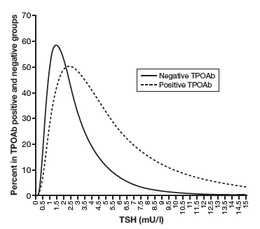
Comparison of TSH concentration between TPOAb negative & positive subjects
Groups (No.) | 2.5 centile | 97.5 centile | Mean±SD | IQR | Median
TPO-negative (2199) | 0.32 | 5.06 | 1.77±1.24 | (0.93-2.23) | 1.46
TPO- positive (260) | 0.38 | 8.15 | 3.06±2.07 | (1.56-4.18) | 2.55
TSH distribution of TPOAb positive individuals shifted
to significantly higher TSH levels than TPOAb negative
individuals.
M.Tohidi

Slide 15
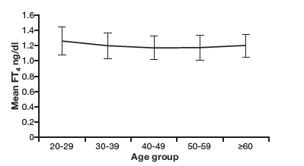
Serum FT4 levels in the TPOAb negative subjects of different age groups
Significant differences in medians of FT4 between the age groups of 20-29 & subjects ≥60 yr
1.24 ng/dl vs 1.18 ng/dl, respectively; p<0.001
M.Tohidi

Slide 16
This finding is contrary to studies reporting that is not necessary to exclude thyroid antibodies positive cases for developing TSH distribution curves or calculating FT4 reference limits.
A guideline published by Baloch et al. stated that TSH reference limits should be established in disease free.
Considering the gradual increase in TSH concentrations with age reported in other studies, we found no increase of this concentration in our elderly.
M.Tohidi

Slide 17
Strength of this study
Population based samples
Measurement of FT4
Measurement of TPO-Ab in all individuals
M.Tohidi

Slide 19
Methods
Subjects
4174 (≥20 yrs)
↓
2823 (1081 M & 1742 F)
Method of assay:
TPO assay: ELISA
(AccuBind™, Monobind, Costa Mesa, CA, USA)
Intra- & inter-assay CV% : 3.9 & 4.2 %
Statistical analysis
Exponential–normal (EN) model & modulus exponential–normal (MEN)
Exclusion criteria
Thyroid surgery
Taking thyroid hormones & antithyroid drugs
Abnormal thyroid function tests
Taking glucocorticoids
Pregnancy
Smoking
Outlier data
M.Tohidi

Slide 20
Age specific serum TPOAb concentration (IU/mL) and corresponding percentiles in 1081 males
 |  | TPOAb Percentiles
Age (years) | 2.5th | 5th | 10th | 25th | 50th | 75th | 90th | 95th | 97.5th
20-30 | 1.27 | 1.51 | 1.86 | 2.75 | 4.48 | 7.95 | 14.7 | 22.6 | 34.51
30-40 | 1.4 | 1.66 | 2.04 | 2.98 | 4.8 | 8.39 | 15.28 | 23.22 | 35.07
40-50 | 1.58 | 1.86 | 2.27 | 3.26 | 5.15 | 8.79 | 15.6 | 23.3 | 34.58
50-60 | 1.83 | 2.13 | 2.56 | 3.59 | 5.52 | 9.1 | 15.59 | 22.71 | 32.88
60-70 | 2.16 | 2.49 | 2.94 | 4.00 | 5.91 | 9.32 | 15.2 | 21.4 | 29.96
70-80 All | 2.64 1.50 | 2.98 1.81 | 3.45 2.22 | 4.51 3.21 | 6.33 5.70 | 9.41 8.70 | 14.41 15.29 | 19.4 22.52 | 26.00 32.80
Male:
1.50 – 32.80 IU/mL

Slide 21
Age specific serum TPOAb concentration (IU/mL) and corresponding percentiles in 1742 females
 |  | TPOAb Percentiles
Age (year) | 2.5th | 5th | 10th | 25th | 50th | 75th | 90th | 95th | 97.5th
20-30 | 1.38 | 1.60 | 1.92 | 2.77 | 4.75 | 9.06 | 16.59 | 24.47 | 35.13
30-40 | 1.51 | 1.74 | 2.08 | 2.97 | 5.02 | 9.40 | 16.92 | 24.7 | 35.12
40-50 | 1.65 | 1.89 | 2.25 | 3.18 | 5.30 | 9.75 | 17.27 | 24.94 | 35.10
50-60 | 1.80 | 2.06 | 2.44 | 3.41 | 5.59 | 10.12 | 17.62 | 25.17 | 35.09
60-70 | 1.96 | 2.24 | 2.64 | 3.65 | 5.90 | 10.49 | 17.97 | 25.41 | 35.08
70-80 All | 2.15 1.55 | 2.43 1.79 | 2.86 2.15 | 3.91 3.08 | 6.23 5.18 | 10.89 9.61 | 18.34 17.13 | 25.66 24.84 | 35.06 35.04
Female:
1.55 – 35.04 IU/mL

Slide 22
Thyroid. 2016 Mar;26(3):458-65. doi: 10.1089/thy.2015.0276.
Sex- and Age-Specific Reference Values and Cutoff Points for TPOAb: Tehran Thyroid Study.
Amouzegar A, Bakhtiyari M, Mansournia MA, Etemadi A, Mehran L, Tohidi M, Azizi F.
PMID: 26650261

Slide 23
Reference values
in Pregnancy

Slide 24
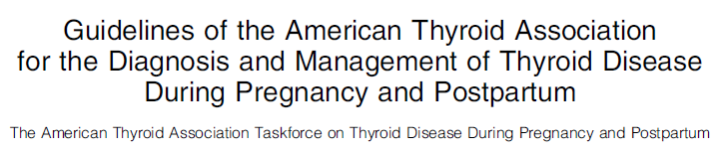
RECOMMENDATION 1
Trimester-specific reference ranges for TSH, as defined in
populations with optimal iodine intake, should be applied.
Level B-USPSTF
M.Tohidi

Slide 25
Recommendations of ATA 2011 and the ES 2012 guidelines
The normal thyrotropin reference range should be:
0.1- 2.5 mIU/L, in the first trimesters of pregnancy
0.2-3.0 mIU/L, in the second trimesters
0.3-3.5 mIU/L in the third trimesters
Probably not valid worldwide (variable in different geographic region and ethnic origin)
M.Tohidi

Slide 27
Justification for Population based and Trimester specific Reference rang for TSH and FT4
The normal reference ranges of TSH and FT4 differ markedly during pregnancy
Significantly different in each of the three trimesters
Variable values in different geographic region and ethnic origin

Slide 29
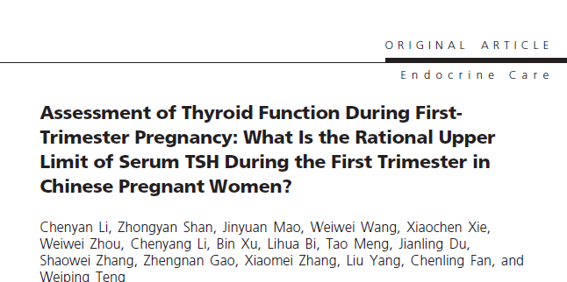
Use of the ATA 2011 and the ES 2012 guidelines would have resulted in 27.8% of pregnant Chinese women being diagnosed as having subclinical hypothyroidism versus 4% if the ethnic specific reference range had been used
J Clin Endocrinol Metab 2014;99:73-9

Slide 30
Methods
Subjects
466
Tehranian preganant women
Assay methods:
TSH: IRMA
T4 & T3: RIA
All intra-assay CV% < 3.9%
Inter-assay CV%: 7.1%
Statistical analysis
5th and 95th
percentiles using the bootstrap technique
Exclusion criteria
Preexisting thyroid disorders, nodules & high thyroid volume
Taking medications affecting thyroid function
Thyroid autoantibody positivity
Not available in all trimesters or lost to follow-up
Low urinary iodine level (<150 𝜇g/L in two out of 3 in the first trimester)
Family history of thyroid diseases

Slide 31
First trimester
TSH: 0.2 – 3.9 mU/L
Second trimester
TSH: 0.5 – 4.1 mU/L
Third trimester
TSH: 0.6 – 4.1 mU/L

Slide 33
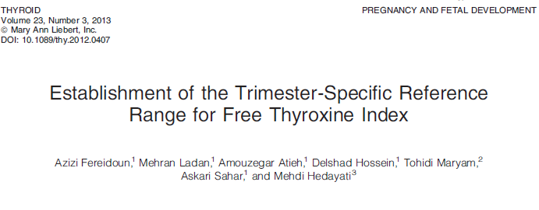

Slide 34
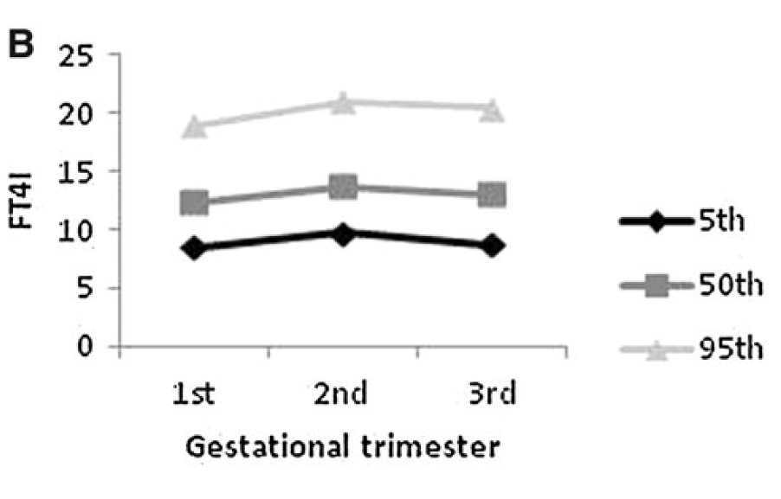
Trends of reference intervals during three trimesters of pregnancy for FT4I
First trimester
FT4I: 8.5-19
Second trimester
FT4I: 9.7-21
Third trimester
FT4I: 8.7-20.4

Slide 35
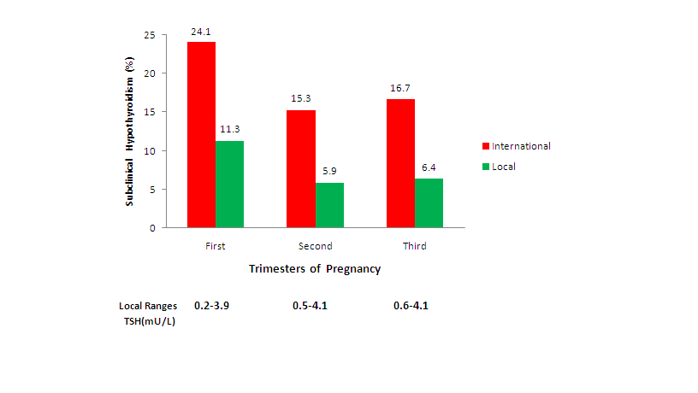
Local versus international recommended TSH references in a iodine sufficient region
Local versus international recommended TSH references in the assessment of thyroid function during pregnancy.
Amouzegar A, et al. Hormone Metab Res 2014; 46: 206

Slide 36
Conclusions
The reference value is one important issue in laboratory medicine.
Reference ranges for thyroid function tests need to be derived from national databases.
Result of TTS is in contradiction to age & sex specific TSH reference ranges for diagnosis & monitoring of patients.
M.Tohidi

Slide 37
These published trimester specific reference values of thyroid hormones can be used for Iranian pregnant women in order to accurately detect thyroid dysfunction during pregnancy.
Using arbitrary cutoff values for TSH instead of population-specific reference intervals may inappropriately increase the rate of thyroid function abnormality (subclinical hypothyroidism).
Because of problems with accuracy and reliability of most FT4 immunoassay methods during pregnancy, and until standard methods become more widely available for accurate measurement of FT4, FT4I could be used for an accurate estimation of FT4 during pregnancy.
M.Tohidi

Slide 38

از توجه شما بسیار سپاسگزارم

