Slide 1
Considering 3rd Factor(S) in Causality
3rd variable(s)
Exposure
1st var
Outcome
2nd var

Slide 2
Kinds of RELATIONSHIPS OF 3rd VARIABLE(S) IN RESEARCH
CONFOUNDING
MEDIATION
COLLINEARITY
EFFECT MODIFICATION
(INTERACTION OR MODERATION)

Slide 3
A confusion of effect

Slide 4
Some points in:

Slide 5
Effect Modification
Some points in:
It’s not a bias.
Global analysis / Crude OR is meaningless.
Results should be analysed in each stratum separately.

Slide 6
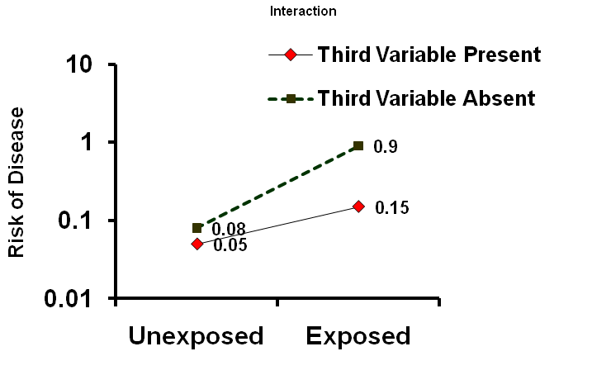
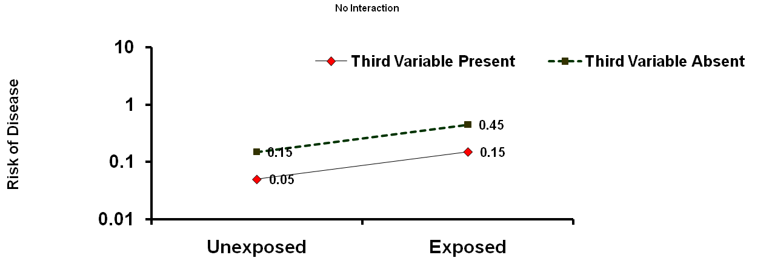

Slide 7
Strategy to take into account a third factor in data analysis
1) Crude analysis
2) Stratified analysis
a₁
b₁
OR₁
c₁
d₁
a
b
≠ levels of third factor
c
d
a₂
b₂
OR₂
Crude OR
c₂
d₂
Notes:
Let’s see how to proceed in practice to …

Slide 8
Strategy to take into account a third factor in data analysis
3) Compare stratified ORs:
4) Where is the crude OR?
Notes:
Compare stratified ORs : there is a statistical test for that, the Woolf test.
Look at the position of the crude OR with regards to the stratum-specific Ors.

Slide 9
Strategy to take into account a third factor in data analysis
5a)
OR₁ ≠ OR₂
OR₁
Crude OR
OR₂
Third factor = Effect modifier
If it is clinically important
Don’t compute an adjusted OR
Report Stratum-specific results of the association between exposure and outcome
Notes:
(read / comment slide)

Slide 10
Strategy to take into account a third factor in data analysis
5b)
OR1 ≈ OR2
OR₁
OR₂
Crude OR
Computation of adjusted OR
Notes:
(read / comment slide)

Slide 11
Strategy to take into account a third factor in data analysis
5c)
OR1 ≈ OR2
OR₁
Crude OR
OR₂
OR_{ad} ≈ OR_{Crude}
Third factor = no role
Use crude OR to measure the association between exposure and outcome
Notes:
(read / comment slide)

Slide 12
How to take into account several potential third factors
a₁
b₁
c₁
d₁
OR₁
a₁
b₁
a₁
b₁
c₁
d₁
OR₁
c₁
d₁
OR₁
a₂
b₂
a₁
b₁
a₁
b₁
c₁
d₁
OR₁
c₂
d₂
OR₂
OR₁
a₂
b₂
a₁
b₁
a₂
b₂
c₁
d₁
OR₁
c₂
d₂
OR₂
c₁
d₁
c₂
d₂
OR₂
a_{i}
b_{i}
a₂
b₂
c₂
d₂
OR₂
c_{i}
d_{i}
a₂
b₂
a_{i}
b_{i}
a_{i}
b_{i}
OR_{i}
c_{i}
d_{i}
c₂
d₂
OR₂
a₁
a_{i}
b_{i}
OR_{i}
c_{i}
d_{i}
OR_{i}
b₁
c_{i}
d_{i}
a_{i}
b_{i}
OR₁
c₁
d₁
OR_{i}
a
b
a₁
b₁
c_{i}
d_{i}
OR₁
a₁
c₁
d₁
OR_{i}
a₁
b₁
a₂
b₂
b₁
a₂
b₂
a₁
b₁
OR₁
c₁
OR₁
OR₁
c₁
d₁
d₁
c₁
d₁
c₂
d₂
OR₂
OR₂
a₂
b₂
a₁
b₁
c₁
d₁
OR₁
a₂
c₂
d₂
OR₂
a₂
b₂
c
d
c₂
d₂
b₂
a_{i}
b_{i}
a₂
b₂
OR₂
c₂
OR₂
c₂
d₂
d₂
c₂
d₂
OR₂
c_{i}
d_{i}
a₂
b₂
a_{i}
b_{i}
OR_{i}
a_{i}
c_{i}
d_{i}
c₂
d₂
OR₂
a_{i}
b_{i}
b_{i}
a_{i}
b_{i}
OR_{i}
c_{i}
c_{i}
d_{i}
d_{i}
OR_{i}
c_{i}
d_{i}
OR_{i}
a_{i}
b_{i}
OR_{i}
a₃
b₃
a₁
b₁
c_{i}
d_{i}
OR_{i}
c₁
d₁
OR₁
a₁
b₁
a₁
b₁
c₃
d₃
OR₁
c₁
d₁
OR₁
OR crude
c₁
d₁
a₂
b₂
a₁
b₁
OR₃
c₁
d₁
OR₁
c₂
d₂
OR₂
a₂
b₂
a₂
b₂
a₁
b₁
c₁
d₁
OR₁
etc.
c₂
d₂
OR₂
c₂
d₂
OR₂
a_{i}
b_{i}
a₂
b₂
c₂
d₂
OR₂
c_{i}
d_{i}
a₂
b₂
a_{i}
b_{i}
a_{i}
b_{i}
OR_{i}
a_{i}
b_{i}
c_{i}
d_{i}
c₂
d₂
OR₂
c_{i}
d_{i}
OR_{i}
a_{i}
b_{i}
OR_{i}
c_{i}
d_{i}
a_{i}
b_{i}
OR_{i}
c_{i}
d_{i}
OR_{i}
c_{i}
d_{i}
OR_{i}
Notes:
We have seen how to proceed with a third factor and 2 strata.
But a third factor could have more than 2 categories
and in each category, you may want to stratify again on another variable
etc, etc.
... and you reach the limit of stratification in analyzing data!

Slide 13
How to take into account several potential third factors
Multivariable analysis …
The most practical one:
Logistic Regression

Slide 14
Should we consider any interaction?

Slide 15
Research by Love . . .
از توجه شما سپاسگزارم

