Slide 1
Presented by:
Dr Batoul Birjandi

Slide 2
Definition
Hirsutism is excessive terminal hair that appears in a male pattern in women as a Ferriman–Gallwey score above the 95th percentile for the population. (2008: FGS at least 8)
Ferriman–Gallwey total scores that define hirsutism in women of reproductive age are as follows:
United States and United Kingdom black or white women, ≥ 8
Mediterranean, Hispanic, and Middle Eastern women, ≥ 9 to 10
South American women, ≥ 6
Asian women, a range of ≥ 2 for Han Chinese women to ≥ 7 for Southern Chinese women.
2018
2018

Slide 3
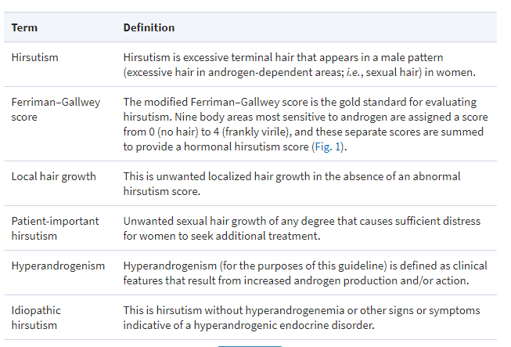
2018

Slide 4
Pathogenesis of hirsutism
The growth of sexual hair is entirely dependent on the presence of androgen. Androgens appear to induce vellus follicles in sex-specific areas to develop into terminal hairs, which are larger and more heavily pigmented.
Hirsutism results from an interaction between the plasma androgens and the apparent sensitivity of the hair follicle to androgen.(by the local metabolism of androgens, particularly by conversion of testosterone to dihydrotestosterone by the enzyme 5a-reductase and subsequent binding of these molecules to the androgen receptor).
The hirsutism score does not correlate well with the androgen level , apparently because the androgen-dependent pilosebaceous follicle response to androgen varies considerably.
( 2008:Most women with a 2-fold or greater elevation of androgen levels have some degree of hirsutism or an alternative pilosebaceous response, such as acne vulgaris, seborrhea, or pattern alopecia).

Slide 5
Etiology & diagnosis of hirsutism
PCOS: 70% to 80%
Idiopathic hirsutism :constitutes 5% to 20%(hirsutism develops without the presence of excess androgen)
NCCAH: 4.2%
Androgen-secreting tumors are present in ≈ 0.2%
presence of a combination of two of three symptoms or findings: otherwise unexplained chronic hyperandrogenism, oligoovulation, and ultrasonographic polycystic ovarian morphology(2018)
Unexplained chronic hyperandrogenism and oligoanovulation(2008)

Slide 6
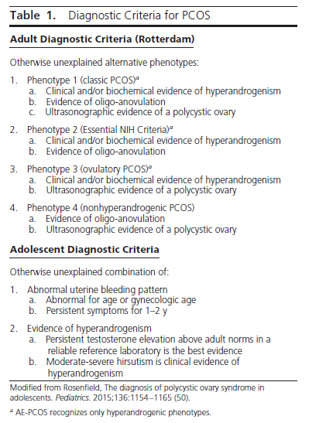
Robert L. Rosenfield and David A. EhrmannEndocrine Reviews, October 2016

Slide 7
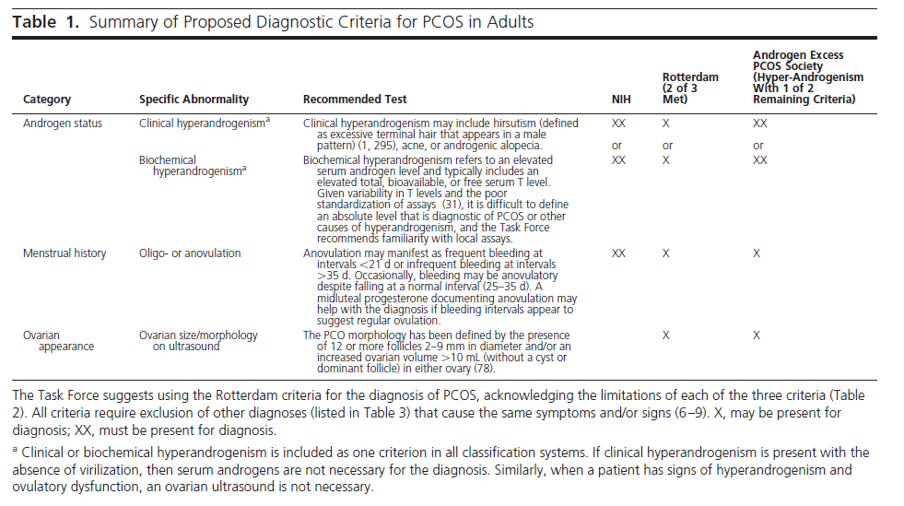
Richard S. Legro, Silva A. ArslanianJ Clin Endocrinol Metab, December 2013

Slide 8
Richard S. Legro, Silva A. ArslanianJ Clin Endocrinol Metab, December 2013

Slide 9
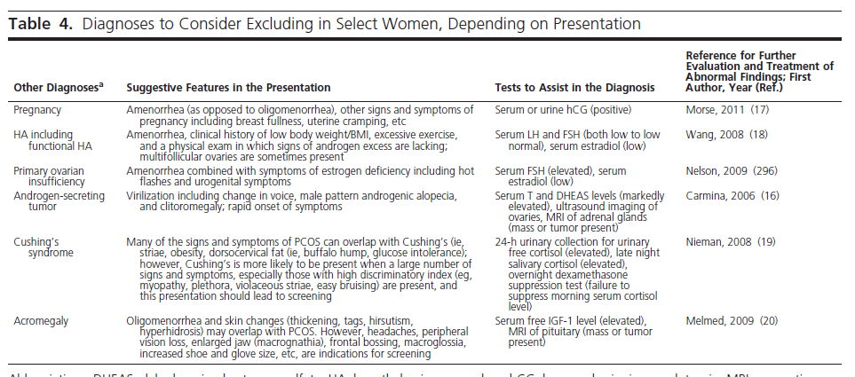
Richard S. Legro, Silva A. ArslanianJ Clin Endocrinol Metab, December 2013

Slide 10
Etiology & diagnosis of hirsutism
PCOS: 70% to 80%
Idiopathic hirsutism :constitutes 5% to 20%(hirsutism develops without the presence of excess androgen)
NCCAH: 4.2%
Androgen-secreting tumors are present in ≈ 0.2%
presence of a combination of two of three symptoms or findings: otherwise unexplained chronic hyperandrogenism, oligoovulation, and ultrasonographic polycystic ovarian morphology(2018)
Unexplained chronic hyperandrogenism and oligoanovulation(2008)

Slide 11
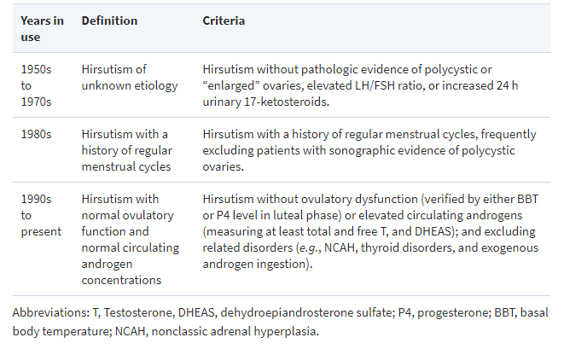
RICARDO AZZIZ et al .Endocrine Reviews, Volume 21.August 2000.

Slide 12
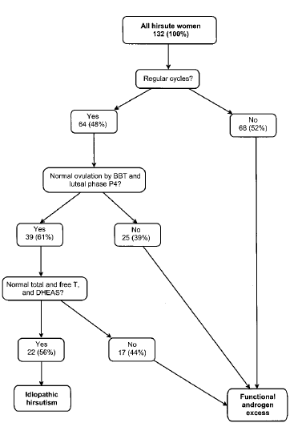
Pathogenesis of IH
Exaggerated peripheral 5a-RA activity in IH
Androgen receptor polymorphisms
Altered androgen metabolism
Serum Markers of IH
increase in peripheral 5a-RA activity, increased circulating levels of DHT could be expected. However, serum levels of this 5a-reduced androgen are frequently normal in hirsute women because most DHT produced in skin is not secreted into the circulation but acts locally before its rapid metabolism.
RICARDO AZZIZ et al .Endocrine Reviews, Volume 21.August 2000.

Slide 13
Etiology & diagnosis of hirsutism
PCOS: 70% to 80%
Idiopathic hirsutism :constitutes 5% to 20%(hirsutism develops without the presence of excess androgen)
NCCAH: 4.2%
Androgen-secreting tumors are present in ≈ 0.2%
presence of a combination of two of three symptoms or findings: otherwise unexplained chronic hyperandrogenism, oligoovulation, and ultrasonographic polycystic ovarian morphology(2018)
Unexplained chronic hyperandrogenism and oligoanovulation(2008)

Slide 14
We suggest screening hyperandrogenemic women for NCCAH due to 21-hydroxylase deficiency by measuring early morning 17-hydroxyprogesterone levels in the follicular phase or on a random day for those with amenorrhea or infrequent menses(2 |OO).
In hirsute patients with a high risk of congenital adrenal hyperplasia (positive family history, member of a high-risk ethnic group), we suggest this screening even if serum total and free testosterone are normal. (2 |OO)
2018

Slide 15
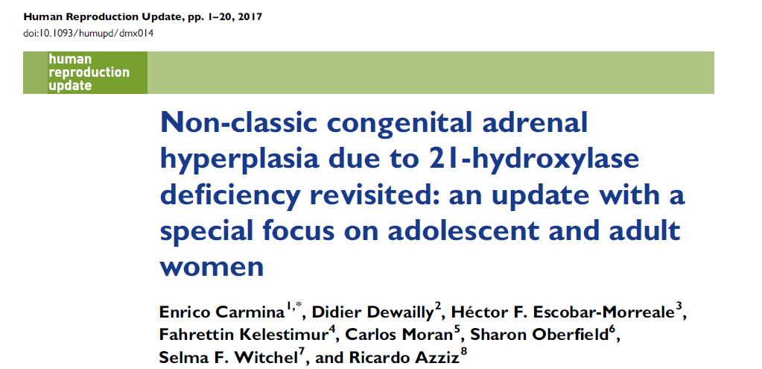
OBJECTIVE AND RATIONALE: a systematic review and critical assessment of the available evidence pertaining to the epidemiology, pathophysiology, diagnosis and management of NCAH. A meta-analysis of epidemiological data was also performed.
SEARCH METHODS: Peer-reviewed studies evaluating NCAH published up to October 2016 were reviewed. Multiple databases were searched including MEDLINE, EMBASE, Cochrane, ERIC, EBSCO, dissertation abstracts, and current contents.

Slide 16
OUTCOMES:
41 study
worldwide prevalence of NCAH amongst women presenting with signs and symptoms of androgen excess is 4.2% (95% confidence interval: 3.2–5.4%).
The clinical consequences of NCAH:
infancy:accelerated growth
adolescence and adulthood: premature pubarche/cutaneous symptoms and oligo-ovulation in a polycystic ovary syndrome (PCOS)-like clinical picture.
Diagnosis :
for screening: a basal 17-OHP concentration ≥2 ng/ml (6 nmol/l)
Definitive diagnosis requires a 17-OHP concentration ≥10 ng/ml (30 nmol/l), either basally or after cosyntropin-stimulation.
Molecular genetic analysis of the CYP21A2 gene, which is responsible for 21-hydroxylase activity, may be used for confirmation purposes and should be offered to all patients with NCAH along with genetic counseling because these patients frequently carry alleles that may result in classic CAH, the more severe form of the disease, in their progeny.

Slide 18
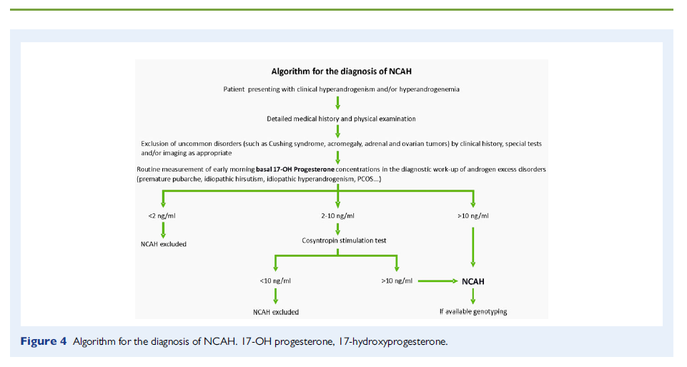
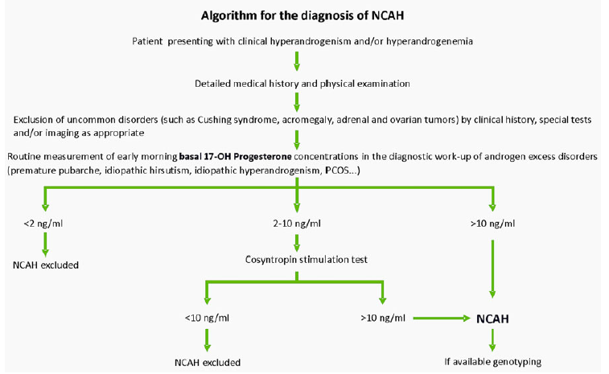

Slide 19
Etiology & diagnosis of hirsutism
PCOS: 70% to 80%
Idiopathic hirsutism :constitutes 5% to 20%(hirsutism develops without the presence of excess androgen)
NCCAH: 4.2%
Androgen-secreting tumors: are present in ≈ 0.2%
presence of a combination of two of three symptoms or findings: otherwise unexplained chronic hyperandrogenism, oligoovulation, and ultrasonographic polycystic ovarian morphology(2018)
Unexplained chronic hyperandrogenism and oligoanovulation(2008)

Slide 20
Rapid onset of symptoms and a single measurement of serum testosterone alone will suffice to identify patients who require more extensive investigation.
some tumors may run an indolent course with subtle symptoms resembling those of patients with nontumorous hyperandrogenism In addition, a single testosterone measurement has a low predictive value for an androgen-secreting tumor because it overlaps with values obtained from women with nontumorous hyperandrogenism, and particularly because some tumors may secrete androgens other than testosterone.
Therefore, discrimination between these disorders on the basis of symptoms or basal testosterone levels alone may not be possible.
GREGORY A. KALTSAS, J Clin Endocrinol Metab. 2003

Slide 21
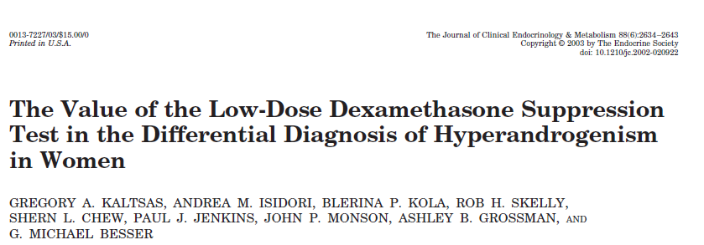
Design: retrospective
Method:211 consecutive women who presented over an 8-yr period (1990–1998) with symptoms of hyperandrogenism and who had undergone an LDDST. None of these patients had evidence of an androgen-secreting tumor at diagnosis or during the subsequent follow-up period of 2–11 yr (median, 6 yr). The results in these patients were compared with those of 17 patients with histologically proven androgen-secreting tumors. The patients with tumors were collected over a 20-yr period (1980–2000), and 11 of them underwent an LDDST.

Slide 22
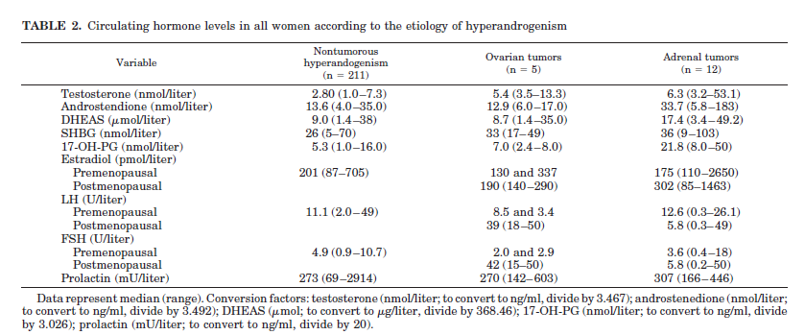

Slide 23
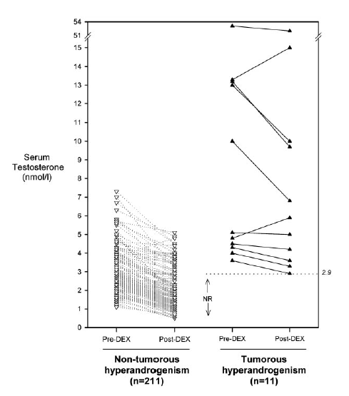
Response of serum testosterone levels during the 48-h low-dose dexamethasone suppression test in 211 women with nontumorous hyperandrogenism and in 11 women with adrenal and ovarian androgen secreting tumors.
Blood samples were collected at 0900 h before and after 8 doses of dexamethasone administered as 0.5 mg every 6 h for 48 h. The second blood sample was obtained 6 h after the last administration of dexamethasone.

Slide 24
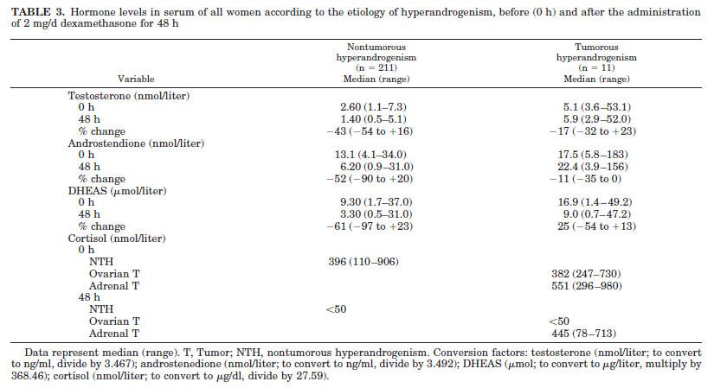

Slide 25
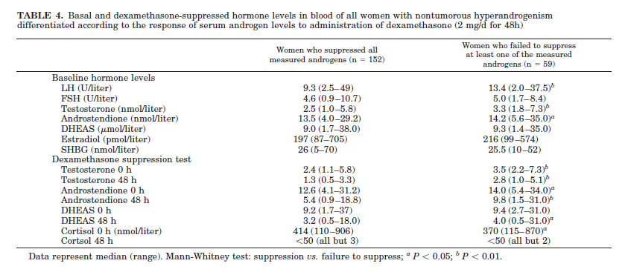
Patients who failed to achieve adequate androgen suppression had significantly higher androgen levels, suggesting that androgen suppression to the LDDST may be related to baseline androgen levels. Although there was a weak but significant negative correlation between basal androgen levels and degree of suppression to the LDDST (r= - 0.16; P < 0.05)

Slide 26
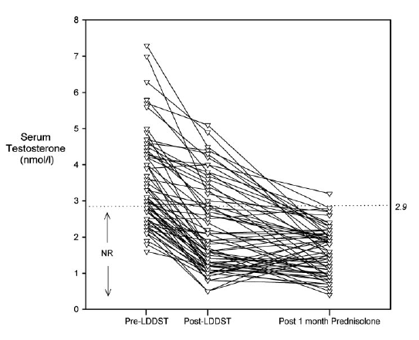
Response of serum testosterone levels
during the 48-h low-dose dexamethasone
suppression test and after a 4-wk treatment with reverse circadian rhythm prednisolone in 42 women with nontumorous hyperandrogenism.
The great majority, 95% (20 of 21), of patients with nontumorous hyperandrogenism who failed to achieve adequate testosterone suppression after the LDDST normalized all previously elevated androgens after treatment with prednisolone for 1 month ,no tumor was found in the 6-yr clinical and biochemical follow-up of the single patient who failed to normalize testosterone on prednisolone.

Slide 27
conclusion
Serum basal testosterone levels that are elevated but less than 7.3 nmol/liter occur in both patients with androgensecreting tumors and patients with nontumorous hyperandrogenism.
In women with clinical features of hyperandrogenisma greater than 40% suppression or normalization of serum testosterone after the LDDST was associated with 100% sensitivity and 88% specificity in distinguishing patients with ovarian and adrenal androgen-secreting tumors from patients with nontumorous hyperandrogenism.
A4-wk treatment with prednisolone 2.5 mg on awakening and 5 mg on retirement is associated with suppression of circulating androgens in over 95% of patients with nontumorous hyperandrogenism who have high clinical and/or biochemical suspicion of an androgen-producing tumor but negative imaging studies.
In addition, adequate cortisol suppression to the LDDST can detect patients with Cushing’s syndrome and also identify patients with glucocorticoid insensitivity or alterations of glucocorticoid metabolism.

Slide 28
We suggest against testing for elevated androgen levels in women with isolated mild hirsutism because the likelihood of identifying a medical disorder that would change management or outcome is low (2QEEE).
We suggest against testing for elevated androgen levels in eumenorrheic women with unwanted local hair growth (i.e., in the absence of an abnormal hirsutism score) because of the low likelihood of identifying a medical disorder that would change management or outcome
. (2 | O OO)
2008
2018

Slide 29
Hirsutism is defined medically as excessive terminal hair that appears in a male pattern (i.e., sexual hair) in women.
Hirsutism must be distinguished from hypertrichosis— generalized excessive hair growth that occurs as the result of either heredity or the use of medications such as glucocorticoids, phenytoins, minoxidil, or cyclosporine. Hypertrichosis, in which hair is distributed in a generalized, nonsexual pattern, is not caused by excess androgen (although hyperandrogenism may aggravate this condition).
The history is particularly important in ascertaining whether androgenic drugs have been used, since most such drugs are not detected by testosterone assays, with the exception of valproic acid, which raises plasma testosterone levels.
Hirsutism Robert L. Rosenfield, M.D. N Engl J Med 2005

Slide 30
We suggest testing for elevated androgen levels in women with (2QEE
• Moderate or severe hirsutism
• Hirsutism of any degree when it is sudden in onset, rapidly progressive, or when associated with any of the following:
Menstrual irregularity or infertility
Central obesity
Acanthosis nigricans
Rapid progression
Clitoromegaly
We suggest testing for elevated androgen levels in:
all women with an abnormal hirsutism score (2 |OO).
In those cases where serum total testosterone levels are normal, if sexual hair growth is moderate/severe or sexual hair growth is mild but there is clinical evidence of a hyperandrogenic endocrine disorder (such as menstrual disturbance or progression in spite of therapy), we suggest measuring an early morning serum total and free testosterone by a reliable specialty assay. (2 |OO)
:
2008
2018

Slide 31
Determinations of androgen levels are most accurately performed by a specialty laboratory. The normal upper limit for total plasma testosterone levels in women varies from about 70 to 90 ng / dl (2.43 to 3.12 nmol / L). This is because there are systematic differences among assays, and many laboratories provide excessively broad normal ranges because the general population includes women with unrecognized androgen excess.
Testing for plasma free testosterone is 50 percent more sensitive than that for total testosterone in detecting androgen excess and is the best single indicator of hyperandrogenism
Testosterone levels during the midfollicular phase of the menstrual cycle vary by about 25 percent above and below the mean and are highest in the early morning; levels are slightly lower in the premenstrual phase and slightly higher in midcycle.
Rosenfield RL. Clinical practice: hirsutism. N Engl J Med. 2005

Slide 32
Routine testing for other androgens is of little use. The level of DHEAs is increased in approximately 15 percent of women who have normal levels of total and free testosterone.
Very high levels of total testosterone (more than 200 ng per deciliter [6.94 nmol per liter]) or of DHEAs (more than 700 μg per deciliter [19 μmol per liter]) heighten the likelihood of an underlying neoplasm (with elevated levels of DHEAs indicating an adrenal source) A total testosterone level that is normal or marginally elevated (within about 20 ng per deciliter [0.69 nmol per liter] of the upper limits of normal) in the absence of other features of concern probably indicates idiopathic hirsutism or idiopathic hyperandrogenism.
Further workup is generally not necessary unless the hirsutism progresses despite therapy or worrisome features, such as menstrual irregularity, obesity, or increasing masculinization, become apparent.
Rosenfield RL. Clinical practice: hirsutism. N Engl J Med. 2005

Slide 33
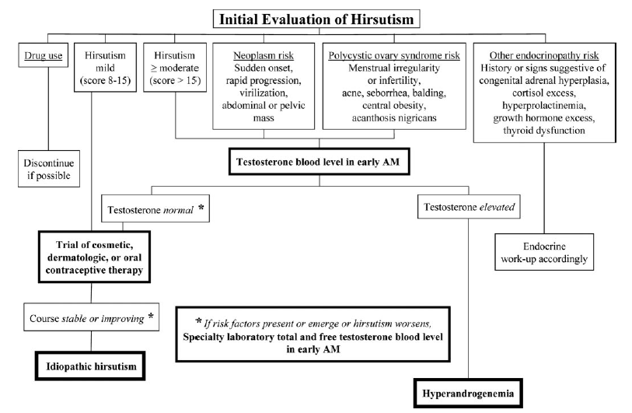
2008

Slide 34
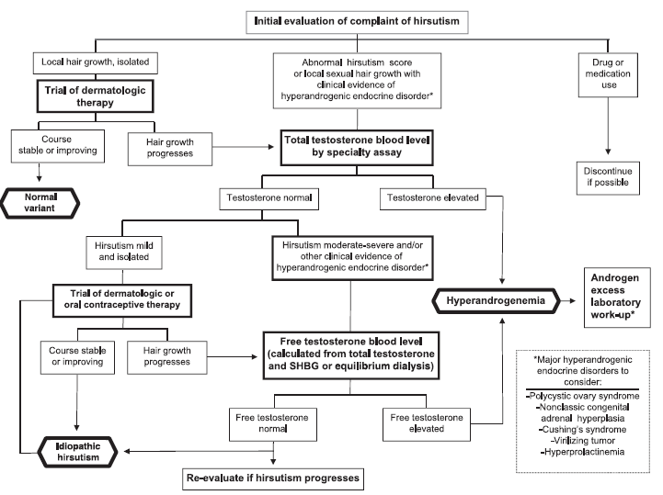
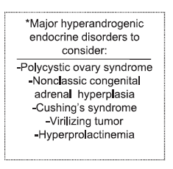
2018

Slide 35
The evaluation of hyperandrogenemic women may include the following:
pregnancy tests in patients with amenorrhea
DHEAS to screen for adrenal hyperandrogenism
assessing for Cushing syndrome, thyroid dysfunction, acromegaly, and hyperprolactinemia if features of these conditions are present
pelvic ultrasonography (preferably transvaginal) to detect an ovarian neoplasm in women with severe or progressive hyperandrogenism.

Slide 36
Further workup to identify the origin of androgen excess:
measuring serum androstenedione (the immediate precursor for testosterone) or other steroid intermediates
assessing the response to cosyntropin of 17-hydroxyprogesterone,DHEA, 17-hydroxypregnenolone,
and 11-deoxycortisol, and/or genotyping to exclude rare forms of congenital adrenal hyperplasia
assessing urinary corticoid metabolites by mass spectrometry to exclude apparent cortisone reductase deficiency
dexamethasone suppression testing to suppress androgens arising from a functional adrenal source
adrenal computed tomography, ovarian ultrasound, or more specialized imaging studies
assessing the suppressive response to combined OC or gonadotropin-releasing hormone (GnRH) agonist
transvaginal ultrasound is also helpful if ovarian hyperthecosis is suspected; absence of follicles and or the polycystic ovarian morphology supports the diagnosis of hyperthecosis.

Slide 37
Treatment of Hirsutism in Premenopausal Women

Slide 38
For women with patient-important hirsutism despite cosmetic measures, we suggest either pharmacological therapy or direct hair removal methods (2QEEE). The choice between these options depends on 1) patient preferences, 2) the extent to which the area of hirsutism that affects well-being is amenable to direct hair removal, and 3) access to and affordability of these alternatives.
2.1. For most women with patient-important hirsutism despite cosmetic measures, we suggest starting with pharmacological therapy (2 QEEE). For women who then desire additional cosmetic benefit, we suggest adding direct hair removal methods. However, for women with mild hirsutism and no evidence of an endocrine disorder, we suggest either approach. (2 QEEE)
2.2. For hirsute women with obesity, including those with PCOS, we also recommend lifestyle changes. (1QQ EE)
2008
2018

Slide 39
Most women also use cosmetic measures (shaving, plucking, waxing) before their first medical consultation and continue to use them during pharmacotherapy. We suggest pharmacotherapy
as initial therapy for most women with patient-important hirsutism (adding direct hair removal methods later if needed); however, some women may choose to start both therapies simultaneously.

Slide 40
We suggest that weight loss strategies begin with calorie-restricted diets (with no evidence that one type of diet is superior) for adolescents and women with PCOS who are overweight or obese (2QQEE). Weight loss is likely beneficial for both reproductive and metabolic dysfunction in this setting. Weight loss is likely insufficient as a treatment for PCOS in normal-weight women.
Richard S. Legro, Silva A. ArslanianJ Clin Endocrinol Metab, December 2013

Slide 41
For the majority of women, we recommend oral contraceptives to treat patient-important hirsutism (2QEEE); because of its teratogenic potential, we recommend against antiandrogen monotherapy unless adequate contraception is used (1QEEE). For women who cannot or choose not to conceive, we suggest the use of either oral contraceptive preparations (OCPs)
or antiandrogens (2QEEE). The choice between these options depends on patient preferences regarding efficacy, side effects,
and costs.
For the majority of women with hirsutism who are not seeking fertility, we suggest OCs as initial therapy for treating patient-important hirsutism. (2 |OO)
For most women with hirsutism, we suggest against antiandrogen monotherapy as initial therapy (because of the teratogenic potential of these medications) unless these women use adequate contraception
(2 |OOO). However, for women who are not sexually active, have undergone permanent sterilization, or who are using long-acting reversible contraception, we
suggest using either OCs or antiandrogens as initial therapy (2 |OOO). The choice between these options depends on patient preferences regarding efficacy, side effects, and cost.
2008
2018

Slide 42
in this guideline, OCs refers only to combined oral estrogen–progestin contraceptives containing EE and not to newer OCs that contain 17-b-estradiol or estradiol valerate combined with highly potent progestins, as the doses of estrogen in these pills are unlikely to suppress ovarian androgens. The guideline also does not refer to oral progestin-only contraceptives, which are ineffective for hirsutism.

Slide 43
Most progestins are derived from 19-nortestosterone and exhibit varying degrees of androgenicity:
Androgenicity | progestine
low | norgestimate, desogestrel, gestodene(third)
medium | Norethindrone( first )
high | norgestrel and levonorgestrel( second)

Slide 44
Cyproterone acetate(CPA) / drosperinone(DSP)
CPA and DSP are structurally unrelated to testosterone and function as weak androgen receptor antagonists.
Several Ocs contain DSP, a progestin structurally related to spironolactone that exhibits weak antiandrogenic activity.
3 mg DSP (the dose used in OCs) was equivalent to only 9 to 10 mg spironolactone
2 mg CPA (the dose used in OCs) was equivalent to ;50 mg spironolactone
(For comparison, 100 to 200 mg spironolactone is the therapeutic dose for hirsutism)

Slide 45
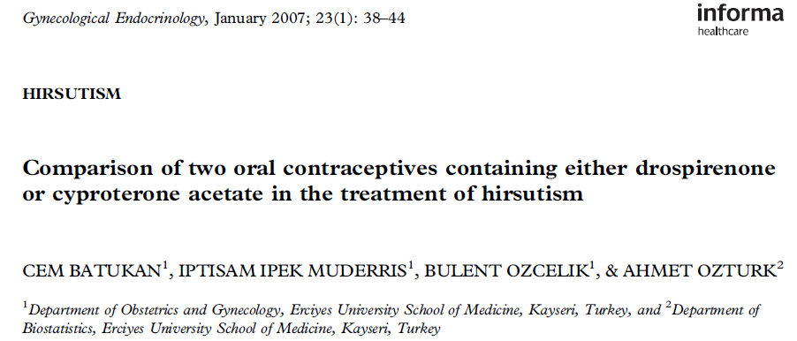
This study prospectively compared the clinical and biochemical efficacy of 3 mg DRSP/30 mg ethinyl estradiol (EE) and 2 mg CPA/35 mg EE combinations in a total of 91 patients with hirsutism for 12 months.
non-pregnant premenopausal women with FG score ≥8 & no evidence of androgensecreting adrenal or ovarian neoplasm (total plasma T <200 ng/dl, plasma dehydroepiandrosterone sulfate( DHEAS) < 7000 ng/ml),Cushing’s syndrome, or congenital adrenal hyperplasia (early follicular-phase plasma 17-hydroxyprogesterone < 3 ng/ml).

Slide 47
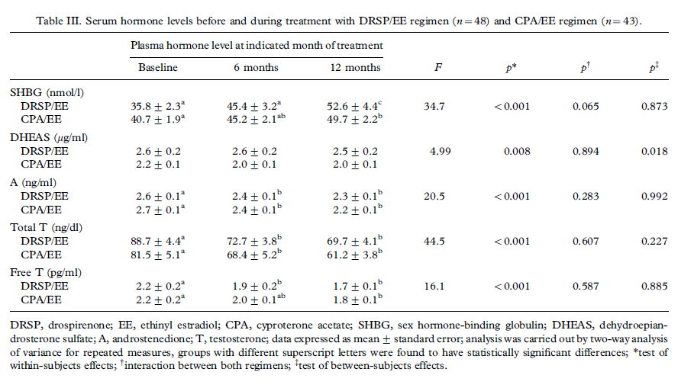

Slide 49
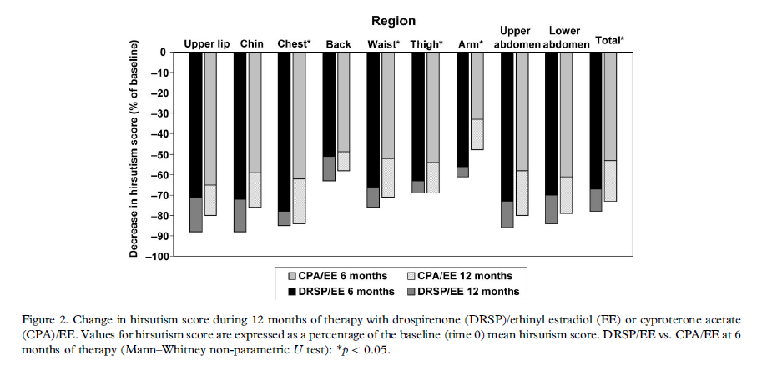

Slide 50
conclusion
CPA- and DRSP-containing COCs have similar effects in patients with hirsutism, in terms of improving clinical hirsutism scores and serum androgen and SHBG levels
Hypertension could become a major problem during long-term treatment of COCs. Here, the unique antimineralocorticoid activity of DRSP may be of advantage.

Slide 51
For most women, we do not suggest one OC over another as initial therapy, as all OCs appear to be equally effective for hirsutism, and the risk of side effects is low. (2 |OO)
2018

Slide 52
We suggest against using insulin-lowering drugs as therapy for hirsutism (2QEEE).
We suggest against using insulin-lowering drugs for the sole indication of treating hirsutism. (2 |OO)
2008
2018

Slide 53
J Clin Endocrinol Metab, April 2018
Methods: We searched MEDLINE, EMBASE, and CENTRAL through January 2017 for randomized controlled trials (RCTs) with follow-up of at least 6 months that evaluated antiandrogens, insulin sensitizers, and oral contraceptives in women with hirsutism. Random-effects network meta-analysis was used to compare individual drugs and classes.(43 trials)

Slide 54
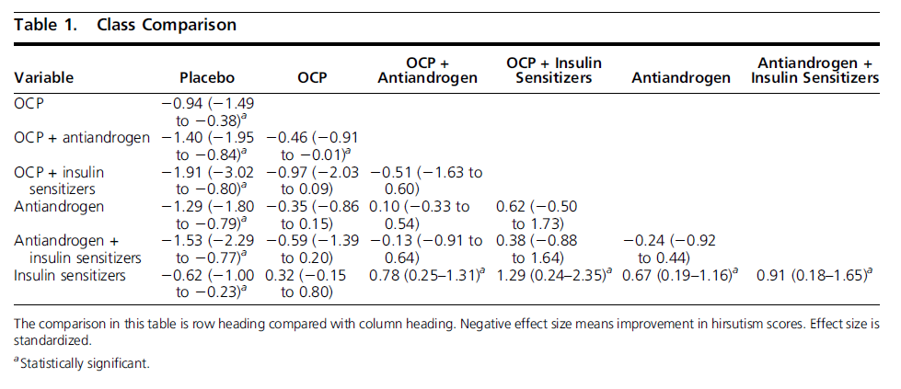

Slide 55
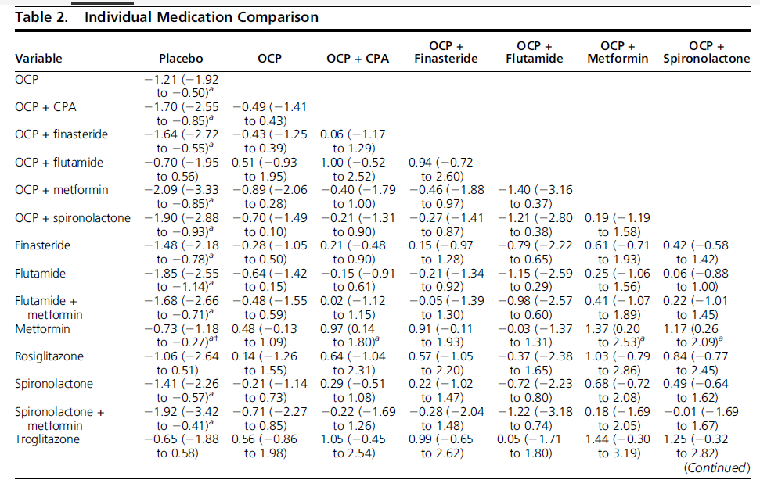

Slide 56
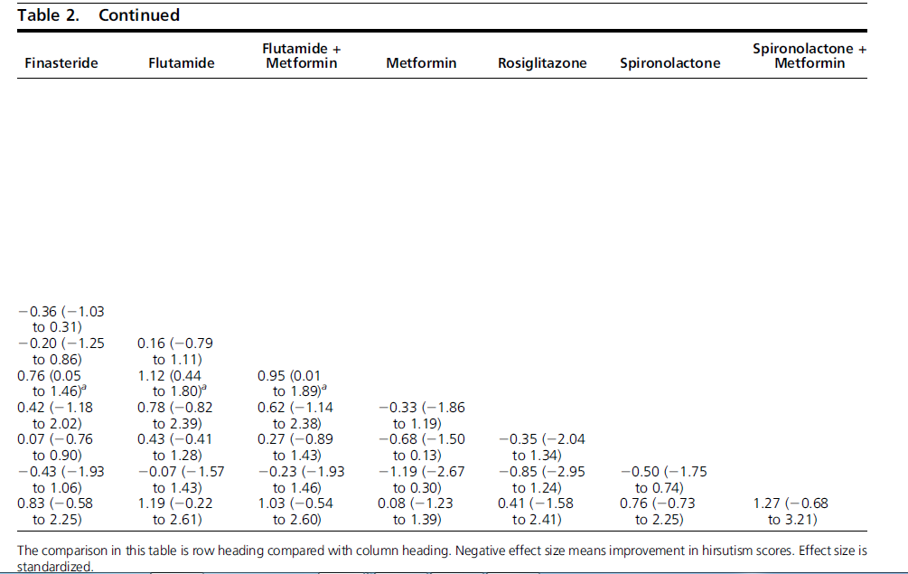

Slide 57
conclusion
OCPs, antiandrogens, and insulin sensitizers were each effective means of treating hirsutism
Insulin sensitizer monotherapy appeared to be the least effective
OCPs containing levonorgestrel, CPA, or DRSP were similar in effectiveness to other OCPs or had trivial differences.
finasteride, flutamide,and spironolactone were more effective than placebo

Slide 58
For women with hirsutism at higher risk for VTE (e.g., those who are obese or over age 39 years), we suggest initial therapy with an OC containing the lowest effective dose of ethinyl estradiol (EE) (usually 20 mcg) and a low-risk progestin. (2 |OOO)
2018

Slide 59
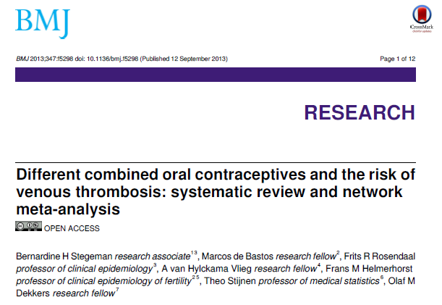
2013
Data sources: PubMed, Embase, Web of Science, Cochrane, Cumulative Index to Nursing and Allied Health Literature, Academic Search Premier,and ScienceDirect up to 22 April 2013.
Review methods: Observational studies that assessed the effect of combined oral contraceptives on venous thrombosis in healthy women. The primary outcome of interest was a fatal or non-fatal first event of venous thrombosis with the main focus on DVT or PTE. Publications with at least 10 events in total were eligible. (9 Cohort,3 Nested case-control, 14 Case-control= 26 study)

Slide 60
selected 10 frequently prescribed oral contraceptives for the network meta-analysis:
• 20 μg ethinylestradiol with levonorgestrel (20LNG)
• 30 μg ethinylestradiol with levonorgestrel (30LNG)
• 50 μg ethinylestradiol with levonorgestrel (50LNG)
• 20 μg ethinylestradiol with gestodene (20GSD)
• 30 μg ethinylestradiol with gestodene (30GSD)
• 20 μg ethinylestradiol with desogestrel (20DSG)
• 30 μg ethinylestradiol with desogestrel (30DSG)
• 35 μg ethinylestradiol with norgestimate (35NRG)
• 35 μg ethinylestradiol with cyproterone acetate (35CPA)
• 30 μg ethinylestradiol with drospirenone (30DRSP)

Slide 61
Medium A: Norethindrone
High A:norgestrel and levonorgestrel
Low A: norgestimate, desogestrel, gestodene

Slide 62
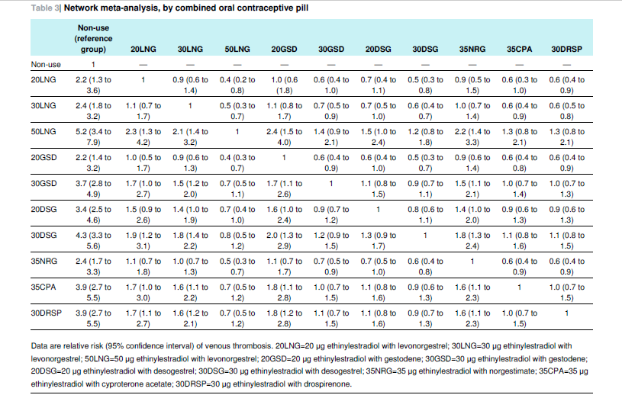

Slide 63
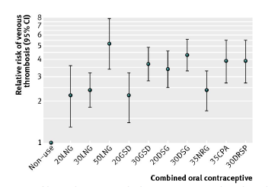

Slide 64
conclusion
all generations of progestogens were associated with an increased risk of venous thrombosis and that third generation users had a slight increased risk compared with second generation users.
All individual types of combined oral contraceptives increased thrombosis risk compared with non-use more than two-fold.
The highest risk of venous thrombosis was found among 50LNG users, and the risk was similar in 30DRSP, 35CPA, and 30DSG users. Users of 30LNG, 20LNG, and 20GSD had the lowest thrombosis risk.

Slide 65
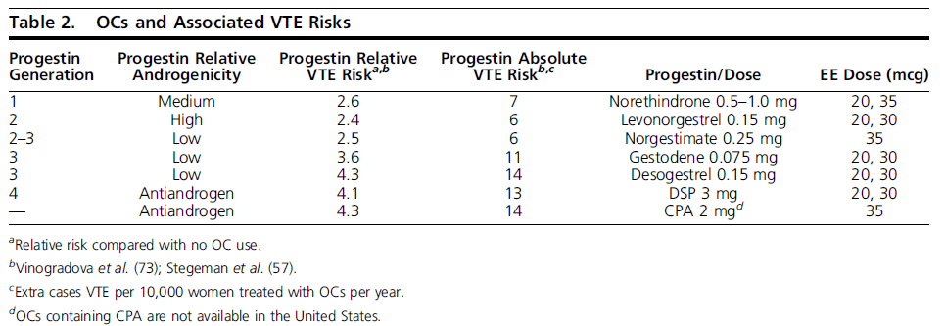
2018

Slide 66
If patient-important hirsutism remains despite 6 months of monotherapy with an OC,we suggest adding an antiandrogen. (2 |OO)
2018

Slide 67
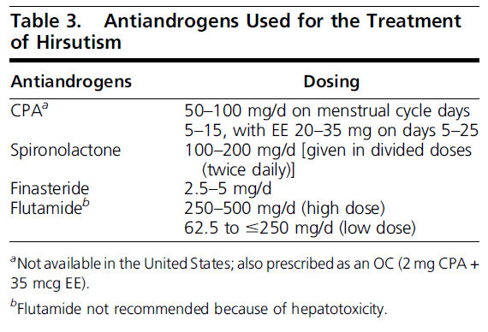

Slide 68
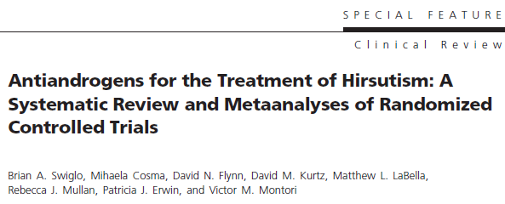
J Clin Endocrinol Metab, April 2008, 93(4):1153–1160
Objective: We performed a systematic review and metaanalyses of randomized controlled trials
(RCTs) evaluating the effect of antiandrogens on hirsutism.
Data Sources: We used librarian-designed search strategies for MEDLINE, EMBASE, and Cochrane CENTRAL (up to May 2006), review of reference lists, and contact with hirsutism experts to identify eligible RCTs.
Study Selection: Eligible studies were RCTs of at least 6 months of antiandrogen use in women with hirsutism.(Of 348 candidate studies, 12 were eligible (18 comparisons).

Slide 69
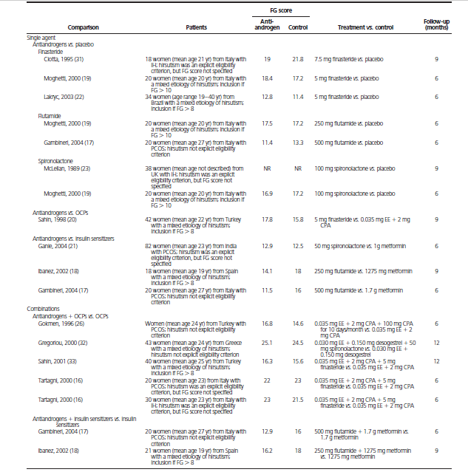
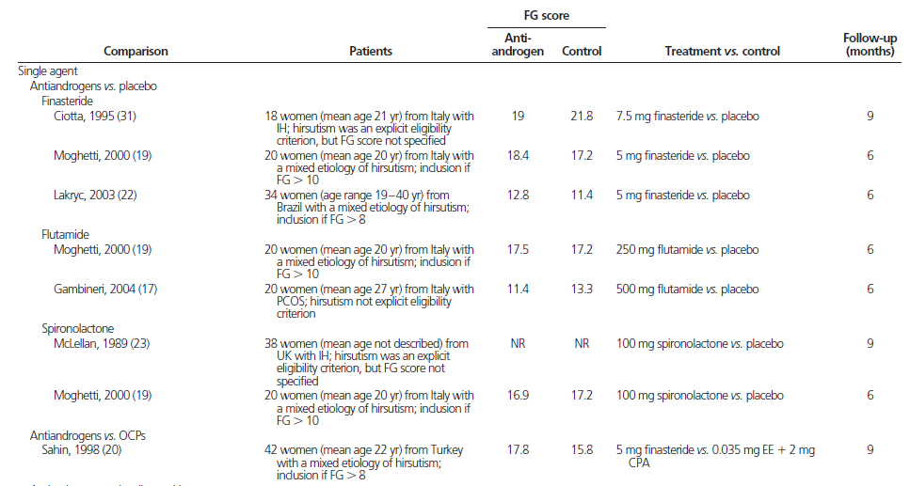
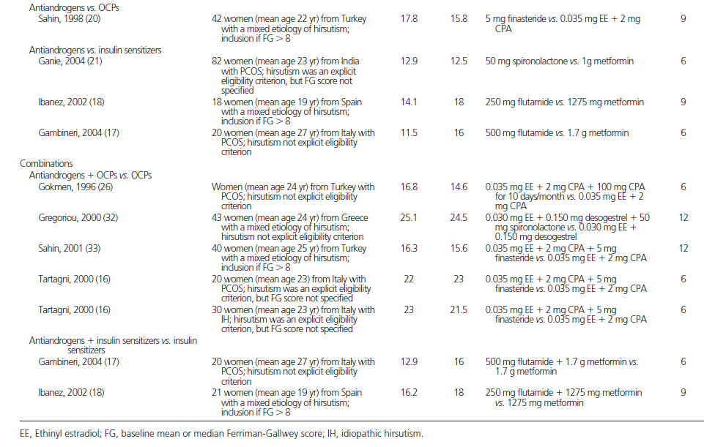

Slide 70
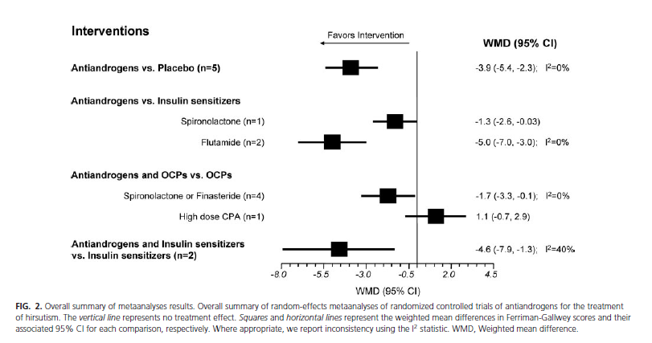

Slide 71
conclusion
antiandrogens are superior to placebo and metformin.
when spironolactone or finasteride are combined with OCPs, or when flutamide is combined with metformin, these regimens are superior to monotherapy with OCPs and metformin, respectively.

Slide 72
For all pharmacological therapies for hirsutism, we suggest a trial of at least 6 months before making changes in dose, changing medication, or adding medication (2QEEE
For all pharmacologic therapies for hirsutism, we suggest a trial of at least 6 months before making changes in dose, switching to a new medication, or adding medication. (2 |OOO)
2008
2018

Slide 73
We suggest against the use of flutamide therapy (2QEEE).
We suggest against the use of topical antiandrogen therapy for hirsutism (2QEEE).
we recommend against the use of flutamide because of its potential hepatotoxicity. (1 |OO)
We suggest against the use of topical antiandrogen therapy for hirsutism.
(2 |OOO)
2008
2018

Slide 74
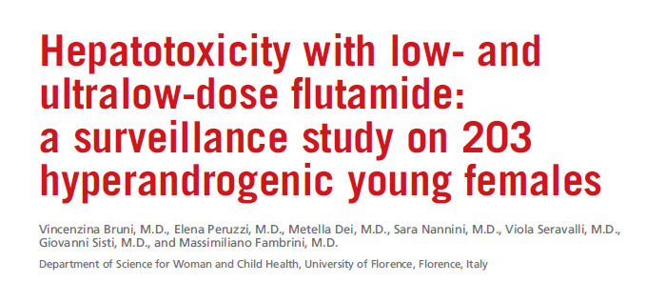
Fertil Steril. 2012;98(4):1047–1052.
Objective: To investigate the impact of low- and ultralow-dose regimens of flutamide on liver function of young hyperandrogenic females.
Design: A 10-year surveillance study.
Patient(s): 203 hyperandrogenic young females (mean age: 20.9 ± 4.9 years).
Intervention(s): Inclusion criterion was receiving low- or ultralow-dose of flutamide as antiandrogenic treatment. Patients were categorized into Groups A and B, according to the administered dose (Group A 62.5 mg/daily, Group B 125 mg/daily). The two groups were further subdivided into subgroups (A1, A2, B1, B2) depending on the coadministration of estroprogestagen oral contraceptives (OCs) (A2, B2).
Main Outcome Measure(s): Serum levels of alanine aminotransferase (ALT) and aspartate aminotransferase (AST) were periodically evaluated and used as markers of hepatotoxicity.

Slide 75
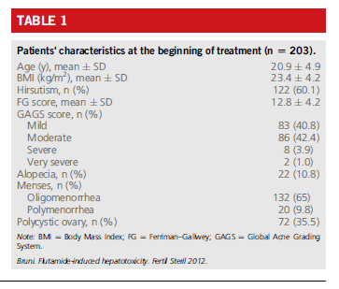

Slide 77
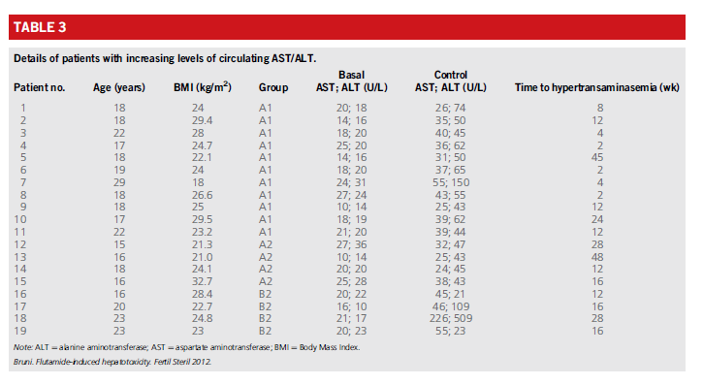

Slide 78
conclusion
Hepatotoxicity is a rare but possible event also with low- and ultralow-dose regimens

Slide 79
OCs vs antiandrogens
In patients with severe hirsutism causing emotional distress and/or in those women who have used OCs in the past and have not experienced sufficient improvement, we suggest initiating combination therapy with an OC and antiandrogen (2 |OO). However, we suggest against combination therapy as a standard first-line approach. (2 |OO)
2018

Slide 80
42 women with hirsutism were included in the study. 21 patients treated with cyproterone acetate (CPA) 2 mg and ethinyl estradiol (E) 35 I-Ig daily on days 5-25 of the menstrual cycle, 21 with finasteride 5 mg daily.
Hirsutism score, hormone levels, multiscreen blood chemistry and side effects were evaluated at 3 monthly intervals for 9 months.

Slide 83
conclusion
both drugs are effective and well tolerated, but CPA+E appears to be more effective than 5a-reductase inhibitor finasteride in long-term treatment of hirsute women.
After 9 months of treatment, there was no significant difference in hirsutism score between the finasteride group and the group receiving this OC.
G.2018

Slide 84
Which OCs should be used for hirsutism?
For most women, we do not suggest one particular OC formulation over another for treating hirsutism.
There were no clinically important advantages of OCs containing the antiandrogen progestins CPA or DSP Although we were concerned that OCs containing levonorgestrel (the most androgenic progestin) would be less effective for hirsutism. Whereas a potential benefit of OCs containing levonorgestrel is their lower VTE risk, an important concern is the adverse effects of levonorgestrel on metabolic biomarkers.
Although there are no data to suggest that the metabolic effects are associated with adverse clinical outcomes, we tend to avoid this progestin in women with PCOS, a population with metabolic concerns at baseline.
Knopp RH,et al. Contraception. 2001 Jan;63(1):1-11

Slide 85
for women with hirsutism at higher risk for VTE (e.g., those who are obese or over age 39 years), we suggest initial therapy with an OC containing the lowest effective dose of EE (usually 20 mcg) and a low-risk progestin
Ovarian androgen suppression may be similar with OCs containing different doses of EE.
Limited data suggest that OCs containing DSP with 20 or 30 mcg EE have a similar effect on Ferriman–Gallwey scores
Zimmerman Y,et al. Hum Reprod Update. 2014
Oner G,et al. Contraception. 2011

Slide 86
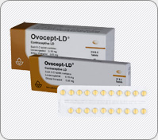
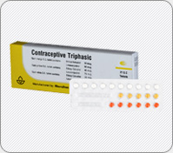
Second generation
Ovocept -LD
Trifarbe
Ethinyl Estadiol+Levonorgestrel,
Orange tab.:30µg +50 µg
Yellow tab.:40 µg + 75µg
White tab.:30 µg +125µg
30 μg EE and 3 mg norgestrol.

Slide 87
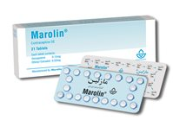
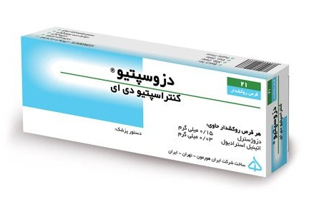
Third genaration
Ethinyl Estradiol 30µg ;
Desogestrel 150µg
Ethinyl Estradiol 30 µg
Desogestrel 150 µg

Slide 88
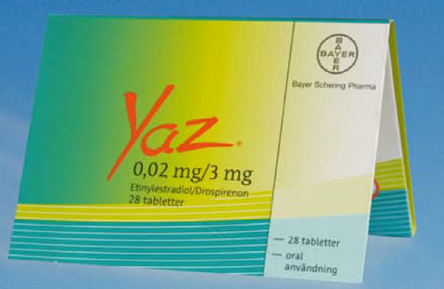
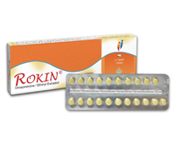
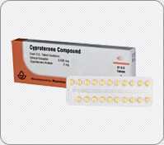
Antiandrogen
20 µg ethinyl estradiol)
3 mg derosperinone(DSP)
30 µg ethinyl estradiol)
3 mg derosperinone(DSP)
30 µg ethinyl estradiol)
2mg CPA

Slide 89
Glucocorticoid therapy
Clinicians administer glucocorticoids long-term to suppress adrenal androgens in women with classic congenital adrenal hyperplasia due to 21-hydroxylase deficiency.
In these patients, glucocorticoids help prevent or manage hirsutism, and they are effective for maintaining normal ovulatory cycles.
In women with the nonclassic form of 21-hydroxylase deficiency, glucocorticoids are effective for ovulation induction, but their role in the management of hirsutism is less clear.

Slide 90
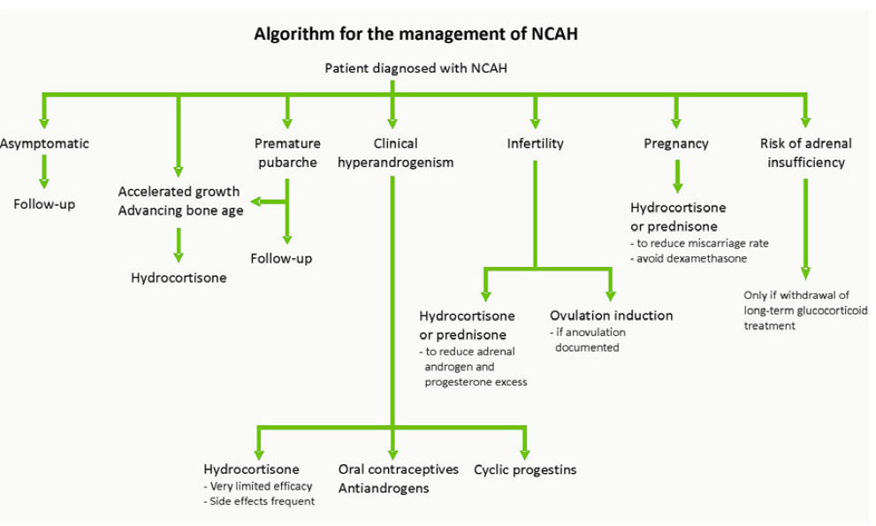
Enrico Carmina,et al. Human Reproduction update.2017

Slide 91
Hirsutism in women with NCCAH
Our approach to treating hirsutism in women with NCCAH is the same as for women with PCOS.
We suggest starting with an OC and adding an antiandrogen after 6 months if necessary.
Clinicians can administer an antiandrogen as initial therapy if the woman is not pursuing pregnancy and has a reliable form of contraception.
We only suggest glucocorticoids for the management of hirsutism in women who have a suboptimal response to OCs and/or antiandrogens, or cannot tolerate them. For hirsutism, we use prednisone 4 to 6 mg daily or dexamethasone 0.25 mg/d.

Slide 92
ovulation induction in NCCAH
For ovulation induction, we suggest glucocorticoid therapy. We typically start with prednisone 5 mg daily
If ovulation has not occurred, the dose can be increased to 7.5 mg
Clomiphene citrate is then added if ovulation does not occur with prednisone alone
We do not suggest dexamethasone because it is not inactivated by placental 11- b-hydroxysteroid dehydrogenase type 2

Slide 93
We suggest against using GnRH agonists except in women with severe forms of hyperandrogenemia, such as ovarian
hyperthecosis, who have a suboptimal response to OCPs and antiandrogens (2QEEE).
We suggest against using GnRH agonists except in women with severe forms of hyperandrogenemia (such as ovarian hyperthecosis) who have a suboptimal response to OCs and antiandrogens.
(2 |OOO)
2008
2018

Slide 94
Although GnRH agonist therapy is more effective than placebo or no therapy for hirsutism, it appears to have no advantages when compared with other available agents (such as OCs and antiandrogens).
In addition, GnRH agonist therapy is expensive, requires injections, and, unless clinicians add some form of estrogen, results in severe estrogen deficiency with menopausal symptoms (such as hot flashes and bone loss).
We therefore suggest against using GnRH agonists except in women with severe forms of hyperandrogenemia (such as ovarian hyperthecosis) who have a suboptimal response to Ocs and antiandrogens.

Slide 95
Direct Hair Removal Methods

Slide 96
For women who choose hair removal therapy, we suggest photoepilation therapy (2QQEE).
For women who choose hair removal therapy, we suggest photoepilation for those whose unwanted hair is auburn, brown, or black, and we suggest electrolysis for those with white or blonde hair. (2 |OO)
2008
2018

Slide 97
Depilation,Plucking, waxing, mechanical devices,Chemical depilatory agents
Temporary
methods of hair removal
Permanent
Electrolysis / photoepilation
permanent hair reduction : attaining at least a 30% reduction of terminal hairs and sustaining this reduction for a period longer than the complete growth cycle of hair follicles (4 to 12 months, depending on body site).

Slide 98
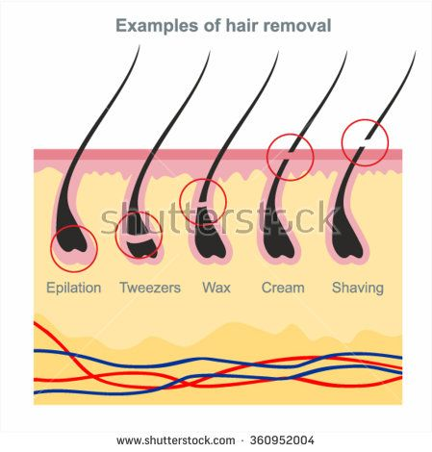

Slide 99
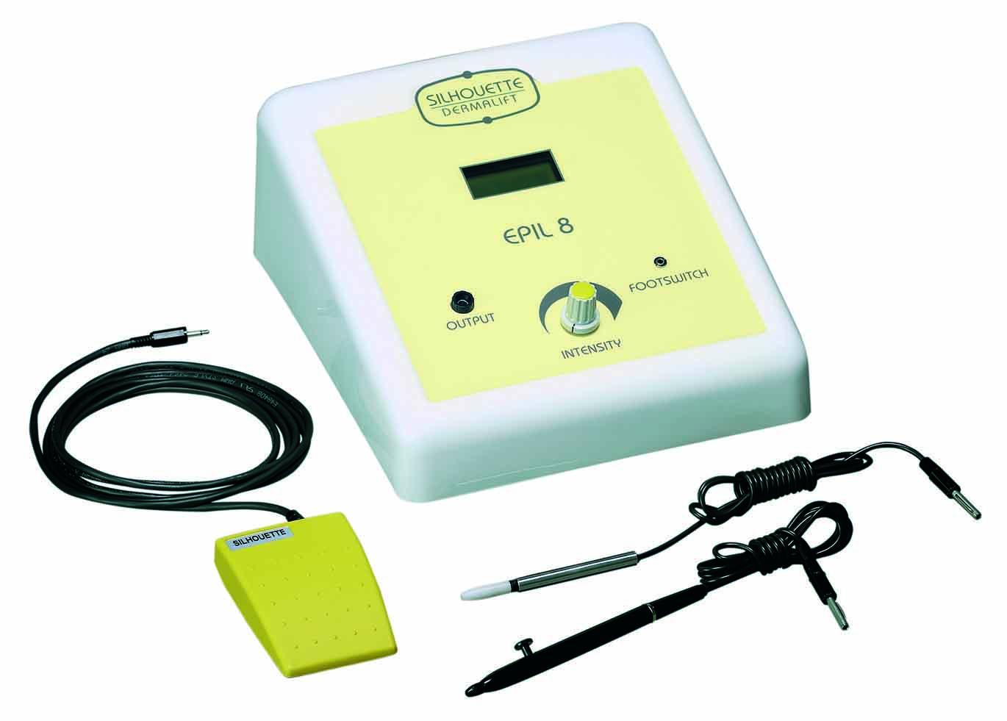
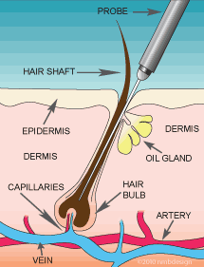
Electrolysis
is generally limited to small treatment areas, and it does not depend on hair pigmentation.
Electrical current is passed through a fine wire electrode, which is manually inserted sequentially into individual hair follicles. The galvanic electrolysis technique uses direct current, causing electrochemical reactions that locally release toxic products within the hair follicle.
The thermolysis technique uses a higher level of alternating current to produce heat in the hair follicle immediately surrounding the wire electrode. Some claima combination of these (“The Blend”) is more effective .(painful; topical anesthesia)

Slide 100
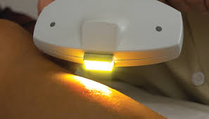
photoepilation
laser
IPL(intense pulsed light)
is a method capable of rapidly treating large areas; it requires the presence of pigmented, terminal hair.
Photoepilation uses pulses of light absorbed by melanin in the hair shaft and follicle to cause selective photothermolysis of pigmented terminal hair follicles.
it selectively injures pigmented tissues based upon wavelength, pulse duration, and fluence (energy applied per area of skin surface).
Photoepilation sources include four types of laser (ruby, alexandrite, diode, and Nd: YAG) and various IPL sources emitting specific wavelengths between 500 and 1200 nm that the melanin absorbs.
Some photoepilation devices are able to rapidly treat very large areas (e.g., the lower face, neck, chest, and both axillae) within 20 minutes.

Slide 101
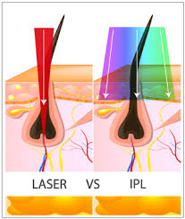

Slide 102
At wavelengths within the low absorption index of water (400 to 1000 nm, visible and near-infrared spectrum), dispersal within the dermis decreases with increasing wavelengths whilst penetration deepens and photothermolytic effects become stronger. In spite of high dermal penetration, wavelengths higher than 1,100 nanometers (nm) are less useful for selective photothermolysis.
Martella A, Raichi M. Dermatol Reports. 2017 Jun 13;9(1):7116.

Slide 103
Photoepilation vs electrolysis
Laser treatment was 60 times faster (30 seconds vs 30 minutes).
Six months following the initial treatment, there was a 74% reduction in terminal hair count after laser and 35% after electrolysis.
The advantages of electrolysis over photoepilation are its ability to permanently reduce hair of any color in any skin type and the lack of reported PH (the rare occurrence of paradoxical hair growth instead of hair removal after laser epilation).
The disadvantage of electrolysis is longer treatment time.

Slide 104
systematic review on the clinical trials with use of various laser sources for hair removal, so all clinical trials related to hair removal lasers in 1998–2003
Our study clarified that hair reduction at least 6 months after the last treatment and hair reductions were 57.5, 42.3, 54.7, and 52.8% after three sessions for diode, Nd:YAG, alexandrite and ruby, respectively.
Our results clarified that diode laser is the most effective, and Nd:YAG has the least effect of hair removal. It seems that diode and alexandrite lasers are proper for hair removal, but as we need high fluence in the darker skin types and this is accompanied with higher complications, diode is advised for lighter skin, and we advised alexandrite laser for darker skin types.

Slide 105
Photoepilation laser vs IPL
carried out a split-face study directly comparing the efficacy of a 3 milliseconds pulse duration alexandrite laser with the Lumina IPL system in 38 women with PCOS.
Each patient underwent six treatments using both systems, with 1, 3 and 6 months follow-up. Hair counts, hair-free intervals and patient satisfaction were recorded for all patients.

Slide 107
Conclusions:
The alexandrite laser resulted in significantly longer hair-free intervals, a larger reduction in hair counts and greater patient satisfaction than the IPL and appeared to be more effective in this patient group.

Slide 108
Home-use lasers
Home-use diode lasers and IPLs cleared for over-the counter sale have not been studied in RCTs. Reported hair count reductions range from 6% to 72% at 3 to 6 months after multiple treatments given to various body sites.
The limited power of home-use photoepilation devices makes them slower than medical photoepilation devices. Despite safety concerns, there are no reports of injury from home-use photoepilation.

Slide 109
Side effects and risks of photoepilation
The risk of side effects appears to be greater after IPL and ruby laser (694 nm) treatments
Because melanin pigment is necessary for photoepilation, unwanted hair that is naturally white or blonde is not amenable to treatment.
Patients with tanned or darkly pigmented skin are at higher risk for unintended thermal injury to the epidermis during photoepilation, resulting in inflammation, burns, blistering, hyperpigmentation, hypopigmentation, and/or scarring (rarely).
(Nd:YAG (1064 nm) lasers (which have the same cost of efficacy) are effective for photoepilation in darkly pigmented skin because of the lower risk of epidermal injury and pigmentary side effects)
Eye injury Because the highest concentration of melanin in the body exists in retina and uvea, they can be damaged by light passing through a closed eyelid or soft tissues around the eye

Slide 110
Topical treatment
Eflornithine reduces the rate of hair growth by irreversibly inhibiting ornithine decarboxylase, which catalyzes the rate-limiting step for follicular polyamine synthesis. A topical preparation, eflornithine hydrochloride cream 13.9%, is FDA approved for the treatment of unwanted facial hair in women.
Noticeable results take ≈ 6 to 8 weeks; after discontinuation of treatment, hair returns to pretreatment levels after≈ 8 weeks
Systemic absorption is extremely low .Skin irritation has been reported only with experimental overuse . With clinical use, side effects include itching and dry skin.
Eflornithine can be used alone or in conjunction with other therapies, including lasers and IPL.

