Slide 2
PI:
The patient is 56 years old woman that was referred from a nephrologist to our clinic because of high blood level of PTH (1116 ng/ml nl:15-65
ALKP:1141 Ca:8.8 P:4.9 VITD3:8.27 ) . 95/11
She received medical treatment (cinacalcet 30/TDS from 2month ago, PTH:1002). She had bone pain from one year ago which is exaggerated in 6 month ago and because of this pain she came to the clinic with using walker.
The patient is the known case of ESRD from 1.5 years ago . She is under hemodialysis by permicath .the cause of ESRD is unknown .she had no history of diabetes , HTN or kidney biopsy .
.

Slide 3
PI:
She dose not have pruritus and no sign of calciphylaxia has been shown.
She had no history of bone fracture .
She also suffer from general weakness but she’s muscle’s force is normal.
We decided to increase the dosage of cinacalcet to 180 mg daily and add calcitriol 0.25/BD and calcium forth 500/BD for 6 weak and if the PTH level dose not improve , surgical treatment will be considered for her .(96/4/11)
After in 96/10 : PTH:2526 ng/ml alkp:1759 ca:8.2 p:6
Therefore We referred her for total parathyroidectomty .

Slide 4
PMH:
ESRD since 1395
HTN since 1395
Cataract surgery in 1394
Uterine fallache surgery in 1392
NVD
Menopause 1 years ago

Slide 5
DH:
Metoral 50 BD
Calcium forth 500 TDS
Losartan 25 BD
Atorvastatin 20 daily
ASA 80 daily
Zavitrol QID
Cinacalcet 60 TDS

Slide 6
P/E:
BP:140/80 HR:70 T:36.9 RR:14
Wt:89 ht:156 BMI:36.6
HEAD AND NECK: NL Thyroid:nl no LAP
Skin:NL
LUNG : Clear
Heart: S1 S2 regular W/O any murmur
Abdomen : NL
Extermities : NL
Force:NL
Gait:NL

Slide 7
LAB TEST: 96/10/20 WBC:3.4 VIT D3:13 HGB:12.9 ESR:28 PLT:170 SPEP:NL ALB:4
96/11/17 | 96/10/20 | 96/3/20 | 95/11/19 | 95/9/13
7.2 | 8.2 | 9.4 | 8.8 | 7.8 | calcium
3.9 | 6 | 4.3 | 4.9 | 6.1 | phosphorus
2031 | 1759 | 822 | 1141 | 1107 | ALKP
371 | 2526 | 1886 | 1116 | 1002 | PTH

Slide 12
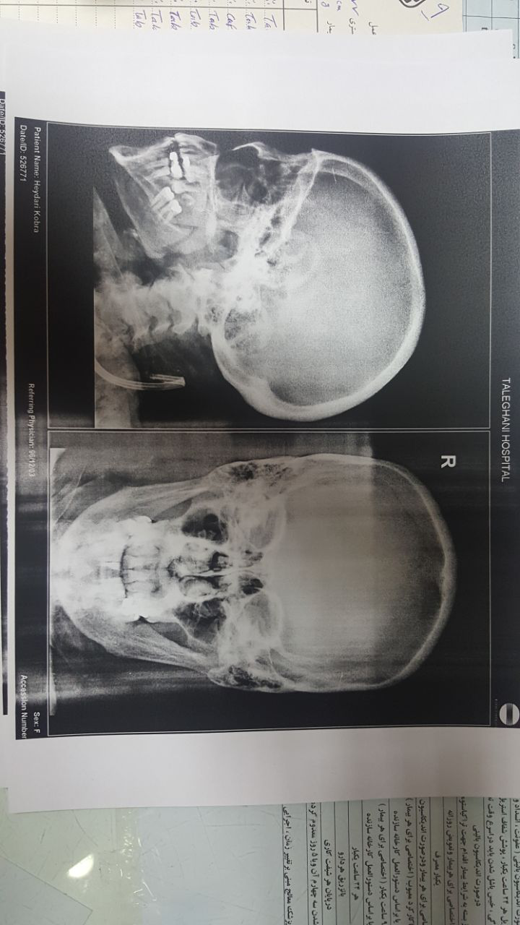

Slide 16
سونوگرافی:
لوب راست تیروئید:40*16 لوب چپ:34*15 ابعاد و اکوی هتروژن
تصویر یک ندول به سایز 8*5 میلی متر در لوب راست تیروئیدمشهود است.
تصویر یک ندول هیپواکو به ابعاد 18*17در خلف تیروئید مشهود است که بیش از همه مطرح کننده آدنوم پاراتیروئید و در درجه بعدی آدنوپاتی میباشد.

Slide 29
با سپاس از توجه شما

