Slide 1
In The Name Of GOD

Slide 2
Non‑functioning pituitary adenomas indications for pituitary surgery and post‑surgical management
Soheila sadeghi

Slide 3
Introduction
estimated prevalence of NFPAs is 7–41.3 cases/100,000
the annual incidence is 0.65–2.34 cases/100,000
NFPAs are histologically benign tumors
increased comorbidities and excess mortality
Careful clinical examination as well as endocrine, radiological, and ophthalmological assessment determine the best treatment strategy

Slide 4
Two hundred and fifteen patients (124 females, 91 males, mean age 50.9 years) 1997 to 2014
Complete evaluation of pituitary tumours in a single tertiary care institution : Endocrine (2018)

Slide 5
Complete evaluation of pituitary tumours in a single tertiary care institution : Endocrine (2018)

Slide 6
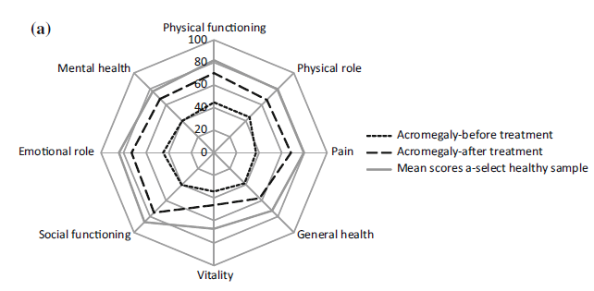
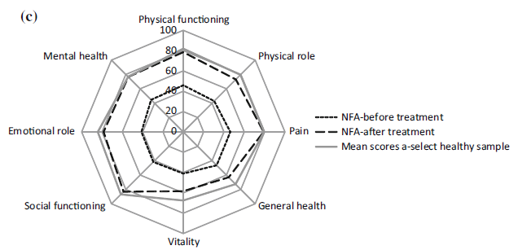
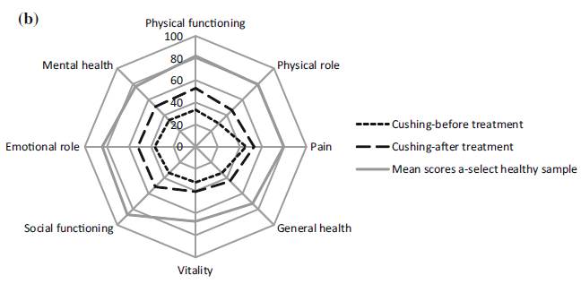
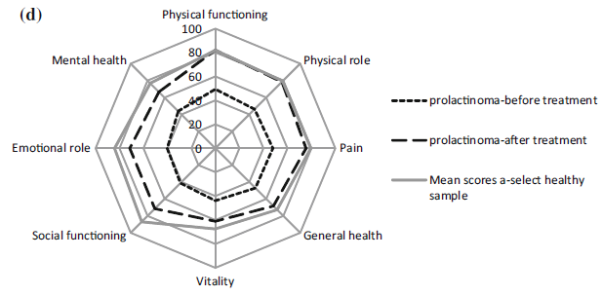
Quality of life (QoL) impairments in patients with a pituitary adenoma: a systematic review of QoL studies (2015)

Slide 7
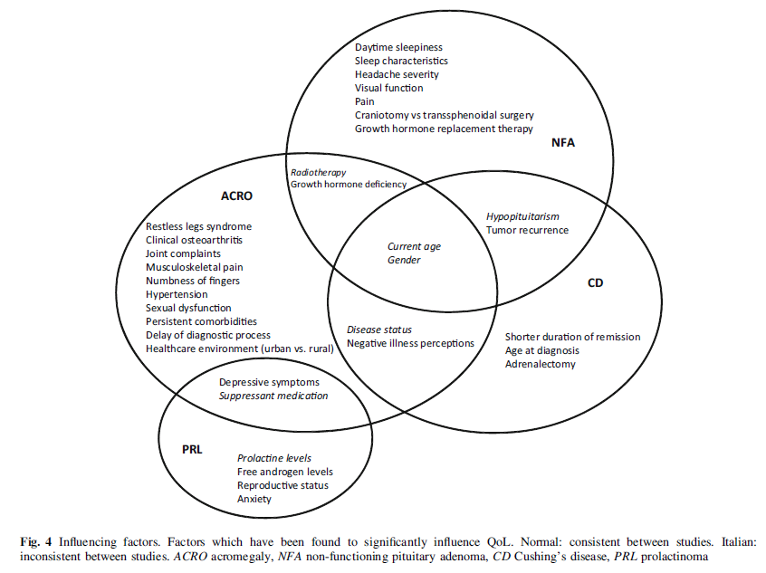
Quality of life (QoL) impairments in patients with a pituitary adenoma: a systematic review of QoL studies (2015)

Slide 8
Clinical presentation
symptoms related to the mass effect
Headache : 16–70%
Tumor enlargement )stretching of the diaphragm of the sella with activation of pain fibers within the dura mater)
frontal and occipital regions
visual impairment * :bitemporal visual defects
) mid-chiasmal compression(
the frequency at diagnosis =28 -100%
* Diplopia is rare, but when present
compression of the cavernous sinus

Slide 9
Clinical presentation
symptoms related to the mass effect
The mechanical compression of normal pituitary cells, pituitary stalk, and portal vessels may lead to hormone deficiencies, hyperprolactinemia, and, rarely, diabetes insipidus
The prevalence of hypopituitarism at diagnosis : 37 -85 %
rarely present with pituitary apoplexy : endocrine emergency caused by an acute infarction or hemorrhage in the tumor
Common clinical features include sudden severe headache,visual loss, nausea, vomiting, impaired consciousness , symptoms of meningeal irritation, acute endocrine dysfunction

Slide 10
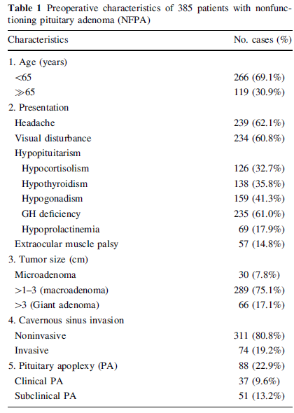
Between January 2000 and December 2008
NFPAs were treated surgically in 385 patients.
14 - 87 years (mean, 51 years)
The ratio of male to female was 10:9
A prospective study of nonfunctioning pituitary adenomas: presentation, management, and clinical outcome: J Neurooncol (2011)

Slide 11
Preoperative evaluation
Endocrine assessment
laboratory assessment in all patients with pituitary macroadenomas and larger microadenomas (6–9 mm), with or without symptoms, to detect hormonal hypersecretion or hypopituitarism
Growth hormone (GH) deficiency and hypogonadism are the most commonly found deficits followed by central hypothyroidism and secondary adrenal insufficiency
Panhypopituitarism at diagnosis : 6–29%
DI is a rare finding at diagnosis
hyperprolactinemia at diagnosis : 25–65%
NFPA : prolactin (PRL) level < 100 ng/mL (~ 2000 IU/L)
prolactinomas : prolactin (PRL) level > 250 ng/mL (~ 5000 IU/L)

Slide 12
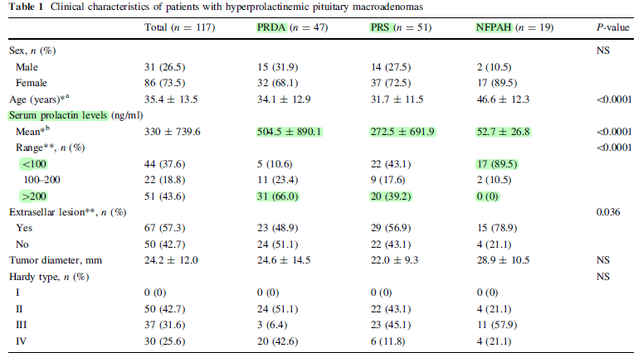
117 patients with hyperprolactinemic pituitary macroadenomas
(A) prolactinoma that responded to dopamine agonist (DA) treatment (PRDA)
(B) prolactinoma requiring surgical treatment (PRS)
(C) non-functioning pituitary adenoma with hyperprolactinemia (NFPAH)
Discrimination of prolactinoma from hyperprolactinemic non-functioning adenoma : (ORIGINAL ARTICLE) Endocr (2010)

Slide 13
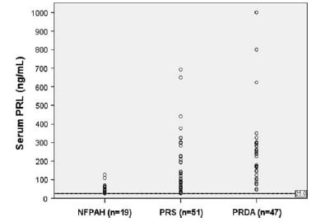
It is sometimes difficult to distinguish prolactinoma from NFPAH, especially in patients with macroadenoma
Most patients with NFPAs have macroadenomas and the main presenting symptoms are visual defects and headache
In the clinic, the possibility of NFPA should be considered, especially when patients are older than 40 years of age with pituitary masses and mild hyperprolactinemia
Discrimination of prolactinoma from hyperprolactinemic non-functioning adenoma : (ORIGINAL ARTICLE) Endocr (2010)

Slide 14
Preoperative evaluation
Radiological assessment
MRI ± gadolinium contrast is the gold standard
NFPAs usually appear hypointense or isointense on T1-weighted images
After contrast administration, pituitary adenomas exhibit delayed enhancement, appearing hypointense in relation to the pituitary gland, which has an earlier and more intense enhancement
In the case of atypical radiological findings, other diseases should be considered, e.g. hypophysitis, meningioma, granulomatous disorders, metastases

Slide 15
Preoperative evaluation
Radiological assessment
microadenomas < 1 cm
macroadenomas ≥ 1 cm
giant adenomas ≥ 4 cm
clinically and prognostically relevant radiological classification
grading system of parasellar adenoma
grade 0 = an adenoma without any parasellar extension
grade 4 = total encasement of the intracavernous carotid artery
The parasellar adenoma extension is considered to be a negative prognostic factor for surgical outcome

Slide 16
Preoperative evaluation
Ophthalmologic assessment
A complete neuro-ophthalmologic evaluation
- assesment visual field and acuity examination
If visual complaints or if the tumor abuts the optic chiasm
or optic tract on MRI
In order to be able to judge the operative impact on any pre-operative abnormalities
Is not required in patients with microadenomas or macroadenomas remote from the chiasma and cavernous sinus
NFPAs in contact with the optic chiasm, strict ophthalmologic surveillance should be performed in the case of conservative management. In these patients, the onset of new visual defects is a strong indication for surgery

Slide 17
Preoperative management
Endocrine assessment
Rule out a hormone-producing adenoma clinically and biochemically
HPA axis | - Morning serum cortisol; dynamic testing if needed - Introduce GC replacement if SAI is confirmed
Thyroid | - Serum TSH and free T4 - Introduce L-thyroxine in severe CH
HPG axis | - Evaluate hypogonadism clinically and biochemically - Sex hormone replacement is usually not indicated preoperatively
Somatotropic axis | - Diagnosis and/or treatment for GHD is not recommended preoperatively
Radiological assessment
MRI evaluating the relationship to the chiasma and optic nerve, and grading of extrasellar extension using the Knosp scale
Ophthalmologic assessment
Visual field, visual acuity, and eye movement

Slide 18
Indication for surgery and perioperative management
Treatment options for NFPAs include active surveillance, surgical treatment, and radiotherapy
In patients with large NFPAs and visual impairment or other signs and symptoms related to tumor compression, transsphenoidal surgery is the recommended first-line treatment
Radiotherapy, as a primary therapy, is only considered in cases where surgery is contraindicated, such as in patients with other serious co-morbidities or in inoperable cases
The goal of surgical treatment :symptom relief, reverse any functional impact on visual nerves, chiasma, and the pituitary gland

Slide 19
Indication for surgery and perioperative management
Symptomatic non‑functioning pituitary adenoma
Surgery is the recommended treatment in patients with visual field deficits or other visual abnormalities, adenomas abutting or compressing the optic nerves or chiasm, and in patients with pituitary apoplexy with visual disturbances
In the absence of visual impairment, the optimal treatment choice is still a matter of debate, especially in patients presenting with hypopituitarism, headache, or tumors close to the chiasma
Surgery may improve pituitary function in up to 30% of patients with pre-existing hypopituitarism but the risk of new hormone deficiency following surgery is 2–15%
Therefore, hypopituitarism alone is not an indication for surgical treatment. Unremitting headache may be an indication for surgery even though relief cannot be guaranteed

Slide 20
Indication for surgery and perioperative management
Asymptomatic non‑functioning pituitary adenoma
Surgical resection of non-functioning microadenomas is not indicated since tumor growth is rare (3–13%) with less than 5% growing > 1 cm during long-term follow-up
The median rate of tumor enlargement in macroadenomas has been reported to be 0.6 mm/year
Conservative management is recommended for macroadenomas not reaching the optic chiasm with regular surveillance of tumor status and endocrine function
However, treatment decisions should be individualized and based on age, pituitary function, and patient preference

Slide 21
Microadenoma growth is possible but rare (10–13%of cases) and fewer than 5% of lesions grow to more than 1 cm over long-term follow-up
In all, increasing macroadenoma size is reported in 20% of cases at 4 years and in 40% at 8 years
progression of NF adenoma is associated with the development of anterior pituitary deficiency in 2.4 per 100 patients per year
Solid tumors show greater progression than cystic lesions
Galland F, et al. Management of nonfunctioning pituitary incidentaloma. Ann Endocrinol (Paris) (2015)

Slide 22
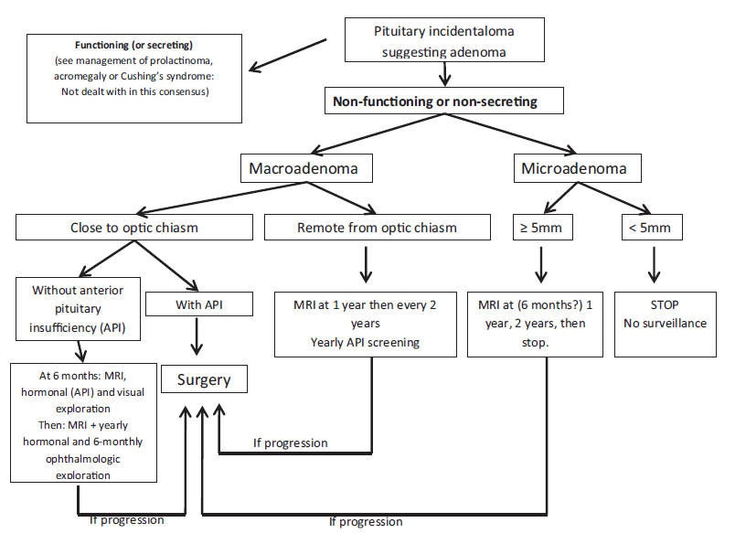
Galland F, et al. Management of nonfunctioning pituitary incidentaloma. Ann Endocrinol (Paris) (2015)

Slide 23
Indication for surgery and perioperative management
Asymptomatic non‑functioning pituitary adenoma
Surgery may be favored in younger patients given the higher lifetime probability of tumor growth and discouraged in older patients with comorbidities and risk of surgical complications
Despite NFPAs usually have a slow growth rate, some may enlarge and become symptomatic. Biochemical evaluation for hypopituitarism should therefore be considered every 6–12 months during conservative management because remaining pituitary function may deteriorate by tumor enlargement
Radiological assessment by MRI should be repeated within 6–12 months after initial tumor detection; if no progression is detected, MRI can be performed less often.
The timing of visual field followup usually depends on the distance between the adenoma and the optic chiasm

Slide 24
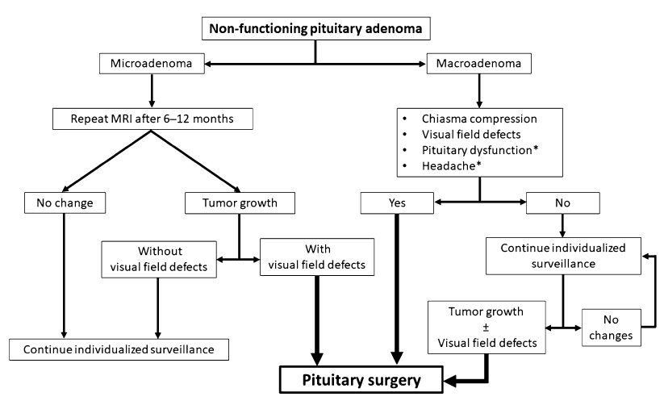

Slide 25
Results
Radiological evidence of tumor growth was observed in 14 out of 28 patients (50%) after duration of follow-up of 118±24 months
Six patients (21%) were operated (tumor growth was accompanied by visual field defects)
Visual impairments improved in all the cases after transsphenoidal surgery
Spontaneous reduction in tumor volume was observed in eight patients (29%)
No independent predictors for increase or decrease in tumor volume could be found by regression analysis
in the absence of visual impairments, observation alone is a safe alternative for surgery in selected patients with NFMA, especially in patients without compromised pituitary function and without compression of the optic chiasm
CLINICAL STUDY
The natural course of non-functioning pituitary macroadenomas : European Journal of Endocrinology (2007)

Slide 26
Perioperative endocrine care
Patients with confirmed secondary adrenal insufficiency should be adequately treated with glucocorticoid (GC) replacement therapy and stress GC doses should be administered during the perioperative period
Perioperative GC therapy is also frequently used in patients with intact hypothalamus–pituitary–adrenal (HPA) function. The rationale is to cover these patients in case adrenal insufficiency develops during the surgical procedure

Slide 27
Perioperative endocrine care
Cortisol response to major surgical stress has been shown to last for 48 h in healthy subjects . Based on this, it has been suggested to discontinue GC therapy 48 h after surgery .
In many centers, GC therapy is administered in tapering doses and then discontinued when proper re-evaluation of HPA has been performed
Patients with preoperative overt central hypothyroidism should receive thyroxine replacement therapy before surgery. Patients with severe hypothyroidism have increased risk of surgical complications
In case of non-emergency surgery, it is suggested to wait until thyroxine replacement therapy has been initiated and optimized

Slide 28
Perioperative and early postoperative management
GC therapy | - Administrate stress doses of GCs in patients with confirmed and suspicion of SAI - Monitor morning serum cortisol regularly in patients without SAI who do not receive GCs perioperatively -Introduce GCs if cortisol deficiency is detected
Fluid balance | - Monitor urine volume and serum sodium regularly to detect hyponatremia and/or DI

Slide 29
Surgical technique
The current standard technique for most NFPAs is transsphenoidal surgery (TSS), while the transcranial approach is used for predominantly suprasellar tumors which lack significant intrasellar portions
Intraoperative imaging shows the tumor status during the surgery, making it possible to continue surgical resection of a tumor remnant
Hypothetically, intraoperative MRI may improve surgical outcomes

Slide 30
Surgical outcomes and complications
Gross total resection is achieved in 60–73% of patients with NFPAs
In a recent meta-analysis on NFPA patients, TSS was associated with 1% mortality
Postoperative complications such as cerebrospinal fluid (CSF) leakage, fistula, meningitis, vascular injury, persistent DI, or new visual field defect occurred in ≤ 5% of patients
The risk of CSF leakage is increased in patients with large adenomas with suprasellar extension, intraoperative CSF leakage, repeat TSS, and high body mass index

Slide 31
Postoperative management
There is a lack of evidence on timing, frequency, and duration of postoperative endocrine, radiologic, and ophthalmologic assessments
Most studies describe postoperative endocrine evaluation 4–8 weeks after the surgical procedure and others 2–6 months postoperatively
In the early postoperative phase, patients should be carefully monitored for potential surgical complications, including sellar hematoma, CSF leakage, meningitis, hydrocephalus, and epistaxis
If neurological symptoms, significant rhinorrhea, or new visual impairments occur after surgery, an early postoperative computerized tomography or sellar MRI should be performed

Slide 32
Postoperative management
Potential endocrine complications include acute adrenal insufficiency and electrolyte abnormalities
Unrecognized secondary adrenal insufficiency in the postoperative period can result in adrenal crises and even death
Morning cortisol levels, electrolytes, and urine production should be carefully monitored in the early postoperative period

Slide 33
Postoperative management Postoperative endocrine assessment
Transient syndrome of inappropriate antidiuretic hormone secretion (SIADH)
SIADH may occur within the first 3–7 days postoperatively, with an incidence ranging from 4 to 20% .
Transient SIADH is due to iatrogenic manipulation of the posterior pituitary gland resulting in excessive antidiuretic hormone (ADH) release
Treatment strategies include fluid restriction, hypertonic saline administration, or vasopressin two receptor antagonist treatment
It is important to avoid excessive administration of intravenous fluids in the postoperative period and prophylactic fluid restriction is recommended by some during the first 10 days after surgery in order to reduce SIADH frequency or minimize the degree of hyponatremia due to SIADH

Slide 34
Postoperative management Postoperative endocrine assessment
Diabetes insipidus
DI occurs in 18–31% of patients after pituitary surgery
Several factors are associated with the increased risk of postoperative DI, including male sex, young age, large pituitary mass, CSF leak, and administration of high perioperative glucocorticoid doses
In most patients, the disease is transient, being caused by the temporary dysfunction of ADH-secreting neurons
It usually occurs 24–48 h postoperatively and resolves when ADH-secreting cells recover their normal function

Slide 35
Postoperative management Postoperative endocrine assessment
Diabetes insipidus
Triphasic DI occurs in 3–4% of patients
The first phase is characterized by DI (usually 5–7 days) due to a partial or complete posterior pituitary dysfunction
The second phase is caused by an uncontrolled release of ADH leading to SIADH, which usually lasts 2–14 days
Finally, the last phase occurs if > 80–90% of the ADH-secreting cells have degenerated, which leads to permanent DI
Postoperative DI should be suspected if polyuria (≥ 3 L per day) and polydipsia occur in combination with low urine osmolality.
Serum hyperosmolality and hypernatremia strongly support the diagnosis of DI.
In this clinical context, a water deprivation test is not needed

Slide 36
Postoperative management Postoperative endocrine assessment
Diabetes insipidus
In treated patients, urine output and osmolality, as well as serum sodium levels, should be monitored regularly to avoid hyponatremia
each dose of desmopressin should be administered after the recurrence of polyuria and thirst
This approach allows recognition of restored ADH secretion and transient DI in the early and late postoperative phases

Slide 37
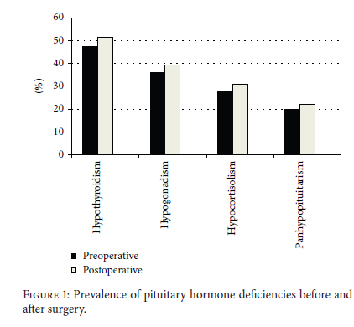
Retrospective
2008 and 2013
485 patients (54% men, mean age 53 ± 14 years)
followed for a median of 6.5 years
Research Article
Clinical Characteristics and Treatment Outcome of 485 Patients with Nonfunctioning Pituitary Macroadenomas :International Journal of Endocrinology 2015

Slide 38
Postoperative management Postoperative endocrine assessment
Hypothalamus–pituitary–adrenal axis
immediate postoperative morning cortisol level is a reliable marker of HPA axis function and accurately predicts postoperative secondary adrenal insufficiency.
Marko et al. studied 100 patients undergoing pituitary surgery and found that postoperative cortisol level ≥ 15 μg/ dL was a sensitive and accurate predictor of normal postoperative HPA axis function, with a positive predictive value of 99%
In case of diagnostic doubts, serial morning cortisol evaluation seems to be useful
Ambrosi et al. has suggested that low serum dehydroepiandrosterone sulfate is a more reliable marker than basal morning cortisol for the assessment of HPA function but this is rarely used in clinical praxis

Slide 39
Postoperative management Postoperative endocrine assessment
Hypothalamus–pituitary–adrenal axis
The insulin tolerance test (ITT) is considered the gold standard among provocative tests, since it evaluates the integrity of the whole HPA axis
However, ITT may have serious side effects and it is contraindicated in older patients and in patients with comorbidities such as epilepsy and ischemic heart disease
The high-dose (250 μg) short Synacthen test (SST) is widely used to test HPA axis function

Slide 40
Postoperative management Postoperative endocrine assessment
Hypothalamus–pituitary–adrenal axis
Concerns have therefore been raised on the reliability of SST immediately after pituitary surgery because there may be a normal response to SST despite having secondary adrenal insufficiency
some studies have reported that HPA axis dysfunction in the early postoperative period may normalize 1–3 months after surgery, suggesting that neither SST nor ITT is helpful immediately after surgery and patients should be tested later
Some studies suggest that low-dose (1 μg) SST is more concordant with ITT than the high-dose (250 μg) SST in the early postoperative period while other studies do not support this finding

Slide 41
Postoperative management Postoperative endocrine assessment
Hypothalamus–pituitary–adrenal axis
Hydrocortisone is the most commonly used glucocorticoid replacement in patients with confirmed secondary adrenal insufficiency
A typical starting dose consists of 10–12.5 mg/day, which is then titrated based on clinical features
Whether the optimal management of partial adrenal insufficiency is to use lower doses (hydrocortisone 5–10 mg) or only use stress doses when needed is unclear
Munro et al. reported that approximately one in six patients with secondary adrenal insufficiency recover adrenal function, even up to 5 years after surgery
Regular re-evaluations should therefore be performed, at least during the first 6–12 months postoperatively, by using morning serum cortisol before first morning dose and provocative tests when needed to prevent unnecessary GC replacement therapy

Slide 42
Postoperative management Postoperative endocrine assessment
Hypothalamus–pituitary–thyroid axis
The frequency of central hypothyroidism in NFPA patients varies from 18 to 43% preoperatively, and 16–57% postoperatively
The diagnosis of central hypothyroidism is mainly biochemical, based on finding a low serum free thyroxine (FT4) concentration in combination with inappropriately low, normal, or only mildly elevated serum thyrotropin (TSH) concentration
FT4 concentrations should be followed and thyroxine replacement initiated if FT4 level decreases by 20% or if symptoms develop
GH-deficient patients with low normal FT4 have increased risk of developing central hypothyroidism after GH therapy has been initiated. These patients should receive thyroxine if serum FT4 level decreases below the reference range

Slide 43
Postoperative management Postoperative endocrine assessment
Hypothalamus–pituitary–gonadal axis
Hypogonadotropic hypogonadism is reported in half of men with NFPAs preoperatively
Pituitary surgery restores normal total serum testosterone (T) concentrations in 71% of cases
The presence of low total T, with low gonadotropin concentrations on two occasions is indicative of central hypogonadism
If the diagnosis is doubtful, assessment of sex hormone-binding globulin and free T should be performed

Slide 44
Postoperative management Postoperative endocrine assessment
Hypothalamus–pituitary–gonadal axis
Premenopausal women with hypogonadotropic hypogonadism frequently present with menstrual irregularities, amenorrhea, impaired ovulation, and infertility
Low serum estradiol levels with non-raised gonadotropin levels are needed for diagnosis
Preoperatively, 25% of women with NFPAs have hypogonadism
In 15% of women with NFPA, hypogonadism improves following pituitary surgery

Slide 45
Postoperative management Postoperative endocrine assessment
Somatotropic axis
GH deficiency (GHD) is described in 79% of NFPA patients in the early postoperative period
Recovery of the somatotropic axis function has been reported within 1–2 years after surgery and this occurs more commonly in younger patients and in patients with isolated GHD
It is important to note that provocative testing of the somatotropic axis should be performed only after other hormone deficiencies have been adequately replaced. Therefore, testing of the somatotropic axis sooner than 6–12 months after surgery is not recommended
Insulin growth factor-1 (IGF-1) levels are not reliable for assessment of GHD, as 20% of patients with GHD have normal IGF-1 levels

Slide 46
Postoperative management Postoperative endocrine assessment
Somatotropic axis
The ITT test is considered the gold standard and it allows to assess both the somatotropic axis and the HPA axis.
The growth hormone-releasing hormone-arginine test is generally well tolerated and has therefore gained wider use
In patients with three other pituitary hormone deficits, together with a low IGF-1, a stimulation test for GHD is not needed

Slide 47
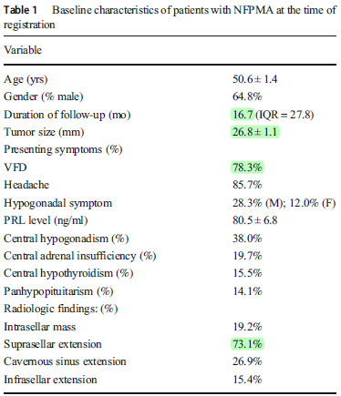
115 patients with a diagnosis of NFPA between 2015 and 2017
71 patients who underwent surgery
Non-functioning pituitary macroadenoma: surgical outcomes, tumor regrowth, and alterations in pituitary function—3-year experience from the Iranian Pituitary Tumor Registry 2018 (ORIGINAL ARTICLE)

Slide 48
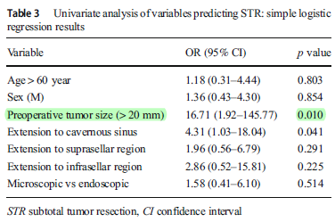
Non-functioning pituitary macroadenoma: surgical outcomes, tumor regrowth, and alterations in pituitary function—3-year experience from the Iranian Pituitary Tumor Registry 2018 (ORIGINAL ARTICLE)

Slide 49
Postoperative radiological management
MRI is usually performed 3–6 months after surgery, when most of the postoperative changes have disappeared
early MRI has nowadays significantly higher sensitivity and specificity for detecting residual tumor than previously reported, providing valuable information to guide future care
The intervals for further radiological follow-up should be decided based on individual characteristics such as residual tumor size and distance from the optic chiasm

Slide 50
In the 9 series
166 patients with microadenomas, only 17 patients (10%) experienced tumor growth
356 patients with macroadenomas, only 86 patients (24%) showed evidence of tumor enlargement
follow- up MRI scans over an 8-year period
Tumor volume–doubling periods range from 0.8 to 27.2 years
Diagnosis and Treatment of Pituitary Adenomas : A Review -JAMA, 2017

Slide 51
Postoperative ophthalmologic management
In patients with decreased visual acuity preoperatively, postoperative overall improvement is recorded in 68% of cases, whilst 5% deteriorate
Patients with visual field deficit have better prognosis, with an overall improvement in 81%, a complete recovery in 40%, and a deterioration in only 2%
Longer duration of visual field deficits as well as severity of visual symptoms have been associated with worse postoperative visual outcomes
Visual defects improve progressively after surgical treatment for NFPAs, especially during the first postoperative year
visual examination should be performed 3 months after surgery, then every 4–6 months until visual function stabilizes

Slide 52
Postoperative management
Endocrine assessment
HPA axis | - Re-evaluation of HPA axis with morning serum cortisol and a dynamic testing, if needed, after 6–12 weeks
Thyroid | - Morning serum TSH and free T4 - In case of CH, introduce L-thyroxine only after HPA axis has been assessed and cortisol deficiency corrected
HPG axis | - Clinical and biochemical evaluation of hypogonadism - Introduce sex hormone replacement in pre-menopausal women, if needed - Introduce testosterone replacement in men, if needed
Somatotropic axis | - Assess GHD after 6–12 months and only after any other hormone deficiency is adequately replaced - Introduce GH replacement therapy if GHD is confirmed
Radiological assessment
Perform the first MRI 3–6 months following surgery Subsequent follow-up is individualized based on MRI findings and histopathological diagnosis
Ophthalmologic assessment
First examination within 3 months Patients with postoperative visual defects need further follow-up

Slide 53
Long‑term aspects of management
Patients with NFPAs have a lower chance of remission than patients with functioning pituitary adenomas
NFPAs may progress after surgical treatment, with regrowth rates of 15–66% in NFPA patients treated with surgery alone and 2–28% in those treated with surgery and radiotherapy
long-term radiologic surveillance after treatment of NFPAs is recommended
Recurrence rate of NFPAs peaks between 1 and 5 years after surgery and decreases after 10 years

Slide 54
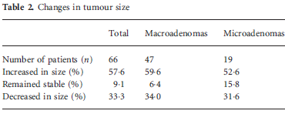
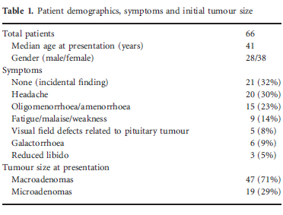
O R I G I N A L A R T I C L E
Clinical outcomes in patients with nonfunctioning pituitary adenomas managed conservatively : Clinical Endocrinology (2015)

Slide 55
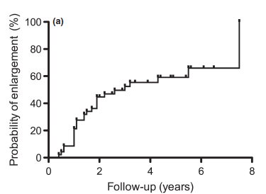
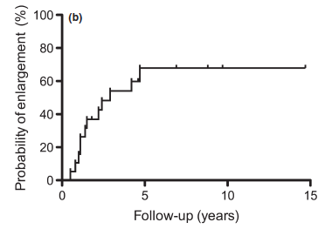
O R I G I N A L A R T I C L E
Clinical outcomes in patients with nonfunctioning pituitary adenomas managed conservatively : Clinical Endocrinology (2015)

Slide 56
Long‑term aspects of management
Roelfsema et al. have showed that clinical factors such as age, sex, tumor size, and tumor invasion have limited predictive value for tumor progression.
On the other hand, Ki-67 has been described as an independent cellular marker of tumor progression and recurrence
A grading system is based on predictor factors, such as tumor invasion on MRI, immunohistochemical profile, mitotic index, Ki-67, and p53 positivity that can be used to identify patients with high risk of tumor recurrence or progression

Slide 57
Long‑term aspects of management
there are concerns about longterm complications of radiotherapy (e.g. hypopituitarism, radiation-induced optic neuropathy, increased risk of cerebrovascular events and secondary brain tumors)
radiotherapy is usually reserved for cases with incomplete resection with histology showing high proliferative activity and recurrence after repeated surgical procedures

Slide 58
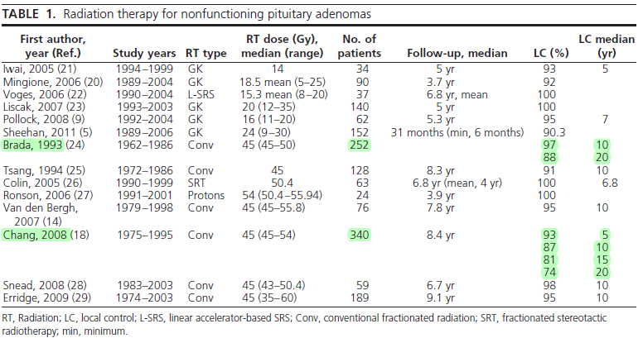
Radiation therapy in the management of nonfunctioning adenomas is given adjuvant to subtotal resection or as primary therapy in the setting of surgical inaccessibility, medical inoperability, or by patient choice
The goal of radiation therapy in nonfunctioning adenomas is to arrest tumor growth
Partial shrinkage and less commonly complete resolution may occur in approximately two thirds of cases
Radiation Therapy in the Management of Pituitary Adenomas : J Clin Endocrinol Metab, 2011

Slide 59
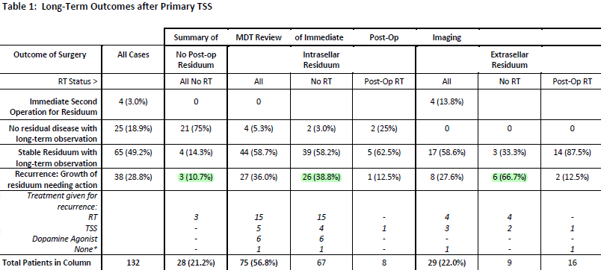
We identified 190 cases of NFPA. Trans-sphenoidal surgery (TSS) had been performed as primary therapy in 132 cases (all macro-adenomas)
Long-term follow up of a large prospective cohort of patients with non-functioning pituitary adenomas: the outcome of a conservative management policy (2018)

Slide 60
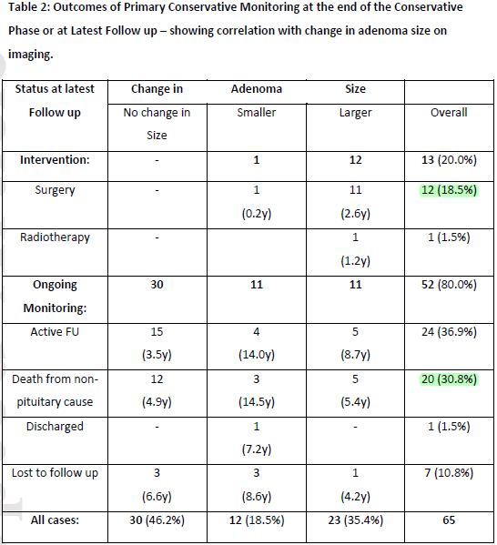
This study differs from others because our definition of recurrence was based on the MDT clinical opinion of what represents clinically significant disease requiring action, rather than simply a review of radiological appearance
Long-term follow up of a large prospective cohort of patients with non-functioning pituitary adenomas: the outcome of a conservative management policy(2018)

Slide 61
Long‑term aspects of management
Available data suggest that medical therapy with dopamine agonist may have a positive effect in NFPA patients with tumour remnant
Finally, chemotherapy may be considered in selected patients with aggressive adenomas after failure of standard therapies
This positive development could be explained by the decreasing prevalence of hypopituitarism recorded over time, that could be an effect of improved surgical techniques

Slide 62
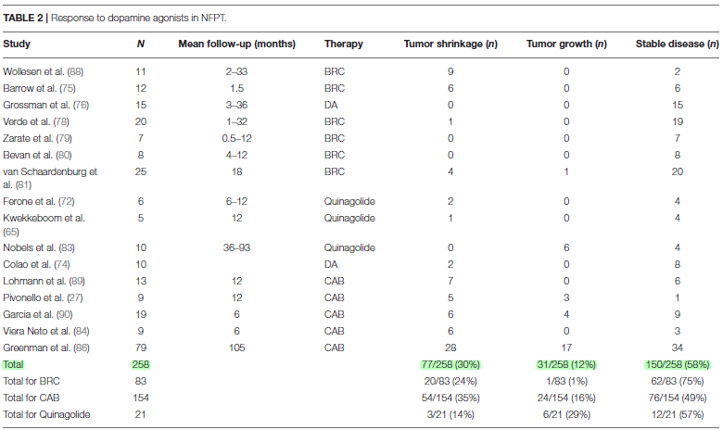
Most NFPT express D2R
Patients with NFPT typically lack serum markers reflecting tumor proliferation, so treatment efficacy is based on tumor size assessment
Dopamine Agonists for Pituitary Adenomas ) MINI REVIEW (Frontiers in Endocrinology 2018

Slide 63
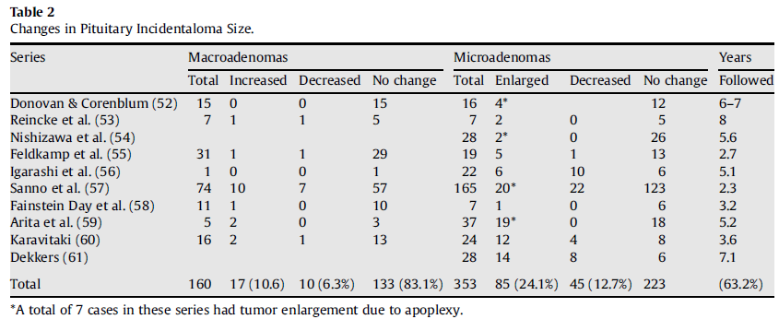
Of the 160 patients with microadenomas reported in these series, 17 (10.6%) experienced tumour growth, 10 (6.3%) showed evidence of a decrease in tumour size and 133 (83.1%) remained unchanged in size in follow-up MRI scans over periods of up to 8 years.
Of the 353 patients with macroadenomas, 85 (24.1%) showed evidence of tumour enlargement, 45 (12.7%) showed evidence of a decrease in tumour size and 223 (63.2%) remained unchanged in size on follow-up MRI scans over periods of 8 years
Dekkers et al. suggested that with longer follow-up, up to 50% of patients with macroadenomas will have an increase in tumour size
Pituitary incidentalomas : Best Practice & Research Clinical Endocrinology & Metabolism 23 (2009)

Slide 64
Tumours greater than 1 cm in diameter have already indicated a propensity for growth
When there is no evidence of visual field defects or hypopituitarism and the patient is asymptomatic, an attempt at medical therapy with a dopamine agonist or octreotide is reasonable, realising that only about 10–20% of such patients will respond with a decrease in tumour size
Dekkers et al. estimated a growth rate of 0.6 mm per year or 236 mm3 per year
Pituitary incidentalomas : Best Practice & Research Clinical Endocrinology & Metabolism 23 (2009)

Slide 65
coclusion
NFPAs are histologically benign tumors
increased comorbidities and excess mortality
The mechanical compression of normal pituitary cells, pituitary stalk, and portal vessels may lead to hormone deficiencies, hyperprolactinemia
MRI ± gadolinium contrast is the gold standard
Rule out a hormone-producing adenoma clinically and biochemically
Treatment options for NFPAs include active surveillance, surgical treatment, and radiotherapy
in the absence of visual impairments, observation alone is a safe alternative for surgery in selected patients with NFMA, especially in patients without compromised pituitary function and without compression of the optic chiasm

Slide 66
coclusion
The median rate of tumor enlargement in macroadenomas has been reported to be 0.6 mm/year
Patients with NFPAs have a lower chance of remission than patients with functioning pituitary adenomas
Available data suggest that medical therapy with dopamine agonist may have a positive effect in NFPA patients with tumour remnant

