Slide 2
Endocrine Grand Rounds Case 07-11-98: A 41-year-old lady with “a history of papillary thyroid carcinoma and total thyroidectomy” presents with lack of response to levothyroxine treatment
Dr. L Mahmoudieh and Dr. M Takyar

Slide 3
Medical History and Physical Examination

Slide 4
Chief Complaint and HPI
CC: “feeling weak and depressed”
Reason for Referral: Very high TSH levels not controlled with extreme doses of Levothyroxine.
HPI: Our patient is a 41-year-old lady who was referred to be admitted to the Endocrine ward following detection of persistently very high TSH levels for the past two years despite receiving extreme doses of Levothyroxine.
Duration: Extreme weakness and feeling depressed for one month prior to admission.
Onset: She has been feeling like this for the past two years, but this latest episode of extreme symptoms started relatively abruptly last month.
Constant/Intermittent: The problem has been constant.
Precipitating factor: None elicited.
Alleviating factors: No specific factors identified.
Aggravating factors: Stressful life events.
Progression: Has not progressed significantly since it started.
Frequency: She has experienced such extreme symptoms twice during the past two years.
Associated symptoms: Malaise, headache, dizziness, blurred vision, occasional diarrhea following consumption of certain food items, lack of energy for talking, anxiety, lack of concentration.

Slide 5
HPI (Course of the illness)
Painful neck swelling → isthmus nodule → scan: non-functioning
Two nodules (8x5mm and 22x4 mm), hetero-echo with microcalcifications and some cystic changes. → FNA: many clusters of follicular epithelial cells with slightly enlarged nuclei, moderate anisonucleosis and rare intracellular inclusions (suggestive of neoplastic processes) → isthmectomy.
Follow-up sonography → Lfet lobe: heterogenous, hypo-echoic nodule w/ calcifications/ reactive lymph nodes in the anterior jugular and left parotid regions. → total thyroidectomy → RAI treatment started (100 mCu)
Labs at discharge: TSH: 22.1, PTH: 48.9, Ca: 10.1, P: 4.2
Pathology: PTC → Classic form, multifocal (left lobe + isthmus), margin-free (closest margin: 0.2cm), NO vascular, lymphatic, or perineural invasion.
Whole Body Scan: Negative
Labs: TSH: 1.2,Thyroglobulin: 1.2, Anti-Tg: negative, Anti-TPO: negative
Rx: RAI continued + Levothyroxine: (5x200mcg)+(2x150mcg)
05/1395
08/1395
09/1395
12/1395

Slide 6
HPI (Course of the illness)
Labs: TSH: 0.34/Thyroid Sonography → Normal
Rx: Levothyroxine: (6x200mcg)+(1x150mcg)
Labs: TSH: 0.007, Thyroid Sonography → Normal
Rx: Levothyroxine: (5x200mcg)+(2x100mcg)
Labs: TSH: 78
Rx: Levothyroxine: (5x300mcg)+(2x250mcg)
Labs: TSH: 5.9; CBC → WBC:4.95, Hb:9.7, MCV: 72, Plt:166,
Rx: Levothyroxine: 300mcg Daily + FerFolic
Labs: TSH: 136.2, Thyroid Sonography → Normal
Rx: Euthyrox: 400mcg Daily
Labs: TSH: 0.57
Rx: Euthyrox: 400mcg Daily
Labs: TSH: 55.6
Rx: Euthyrox: (4x500mcg)+(3x600mcg)
04/1396
07/1396
10/1396
Fe: 37
(45-150),
Ferritin: 2.5 (10-124)
12/1396
05/02/1397
26/02/1397
05/1397

Slide 7
HPI (Course of the illness)
Labs: TSH: 50.06
Rx: Euthyrox: (5x600mcg)+(2x700mcg)
First referral to Gastroenterology → Endoscopy:
Chronic active gastritis; H.pylori +
Duodenum: NO villous atrophy or crypt hyperplasia
H. pylori treatment initiated
Labs: TSH: 116, Whole Body Scan → NO recurrence or mets
Rx: Euthyrox: 800mcg Daily
Terminal ileal biopsy: Mature lymphocyte infiltration in lamina propria
Labs: TSH: 439, T4: 5.6 (5.1-14.1), FT4: 0.9 (0.95-1.57)
Rx: Euthyrox: 800mcg Daily
Gluten-free diet started (impression: malabsorption)
Labs: TSH: 128.79; No improvement on gluten-free diet
Rx: Euthyrox: 800mcg Daily + Prednisolone 50mg/d
06/1397
08/1397
09/1397
10/1397

Slide 8
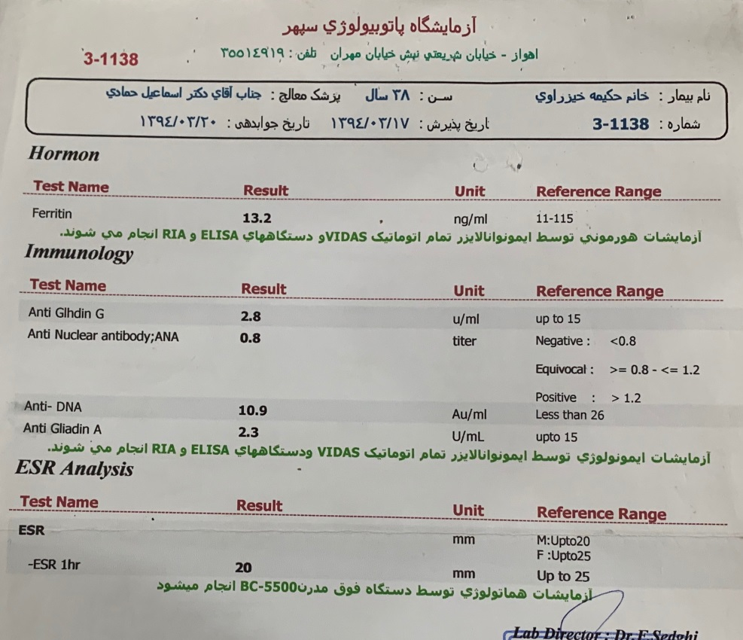
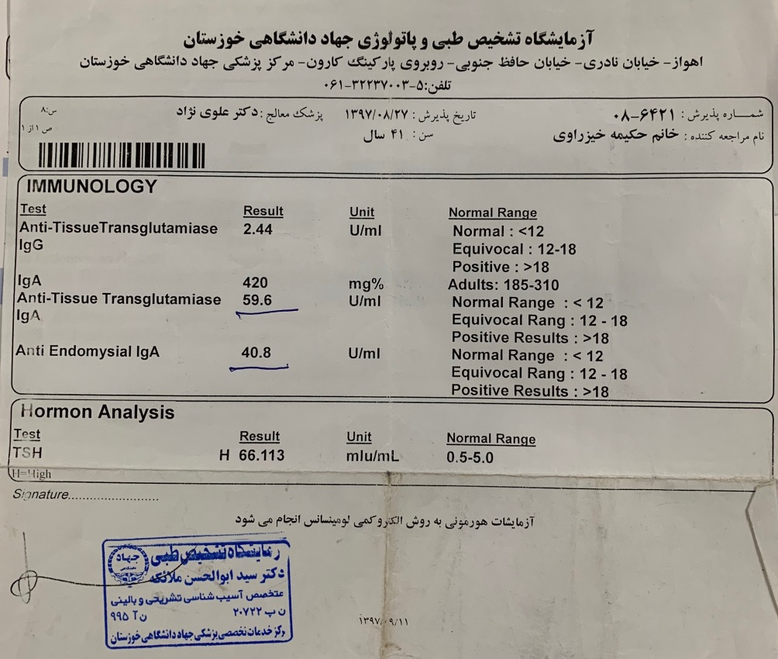
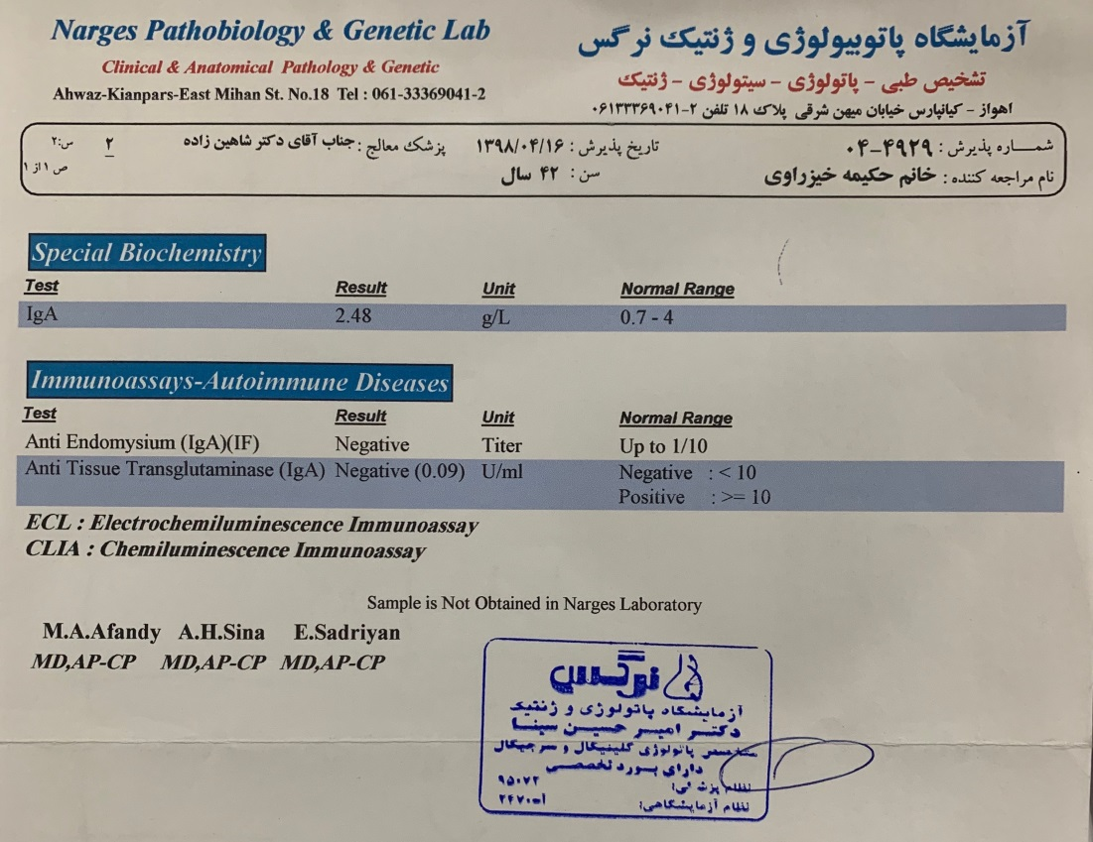
Laboratory Data

Slide 9
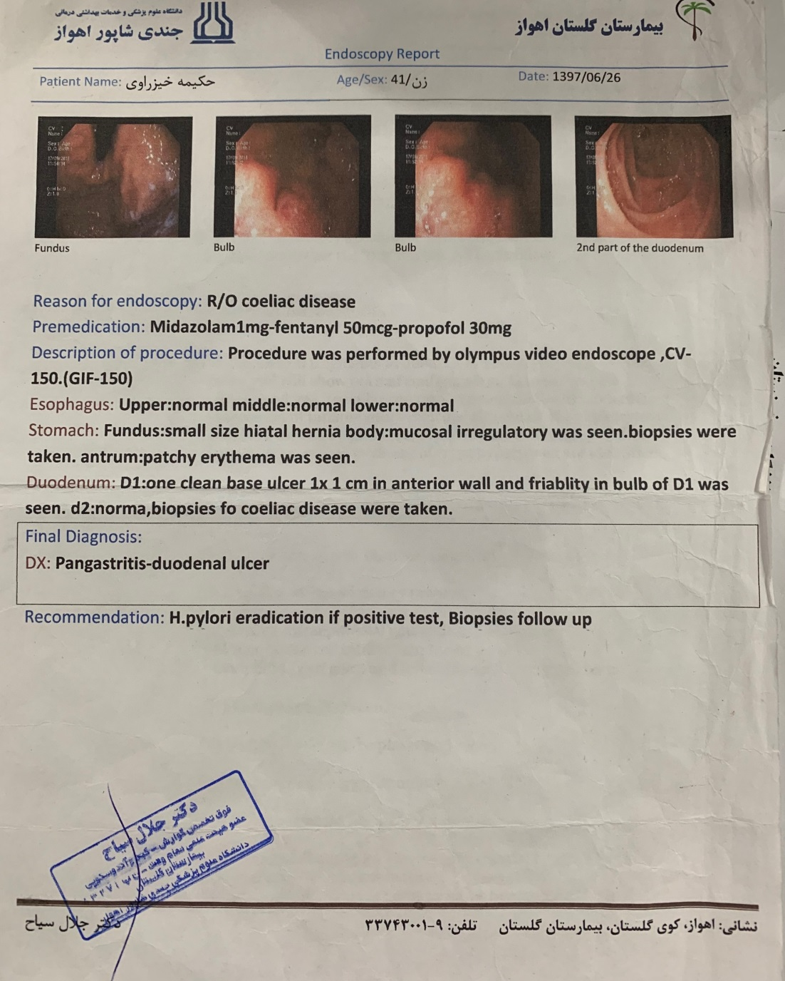
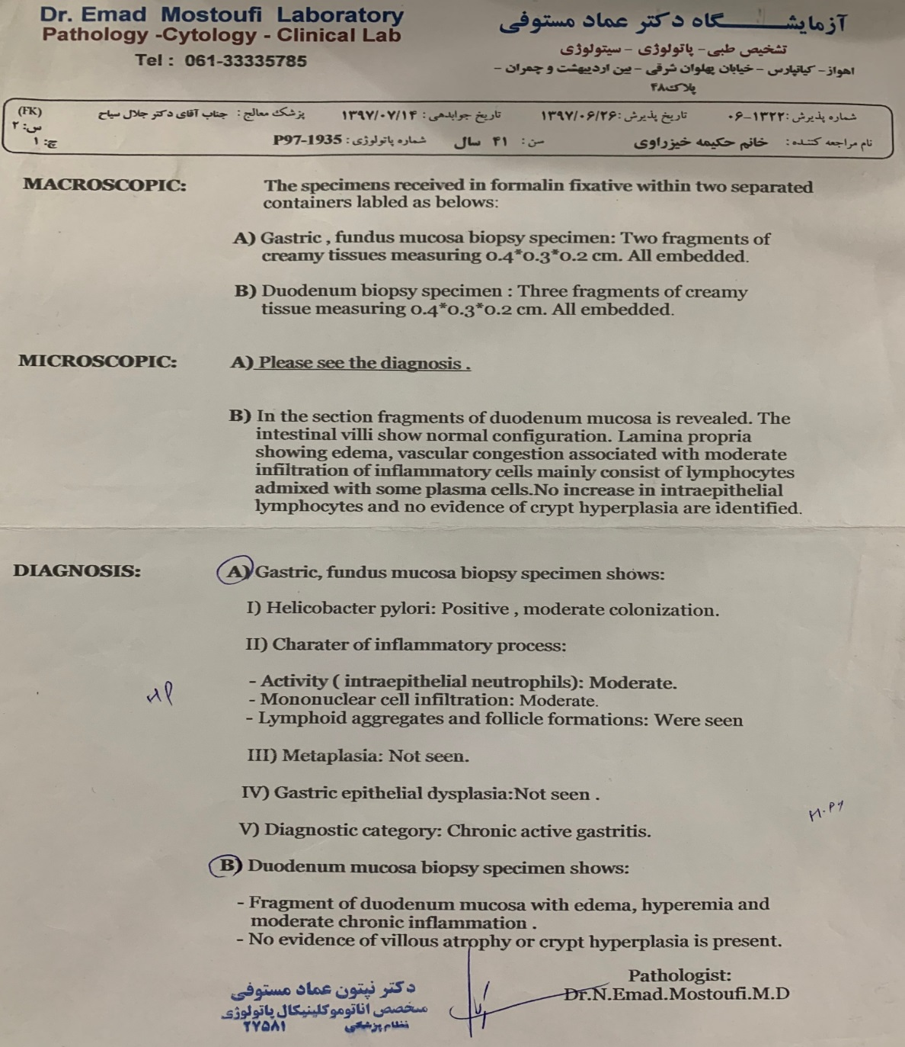
Endoscopy (1): 06/1397

Slide 10
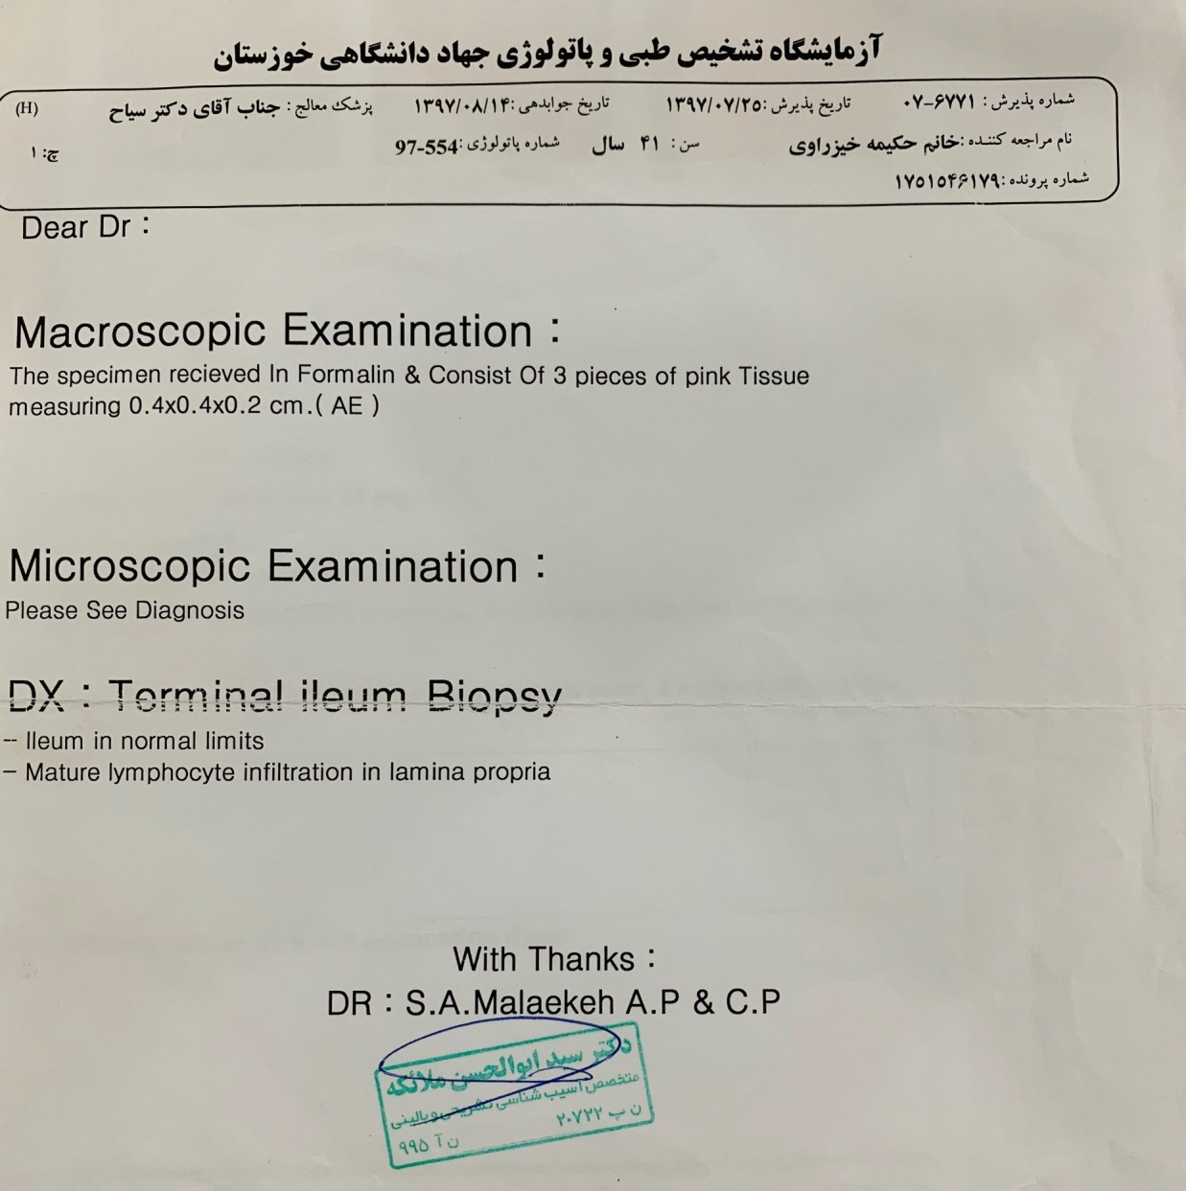
Endoscopy (2): 07/1397

Slide 11
HPI (Course of the illness)
Labs: TSH: 16.8
Rx: Euthyrox: 900mcg Daily + Prednisolone 25mg/d
Labs: TSH: 81, 1,25(OH)-Vit-D3: 10.2
Rx: Euthyrox: 1000mcg Daily (Prednisolone D/C)
Labs: TSH: 118
Rx: Euthyrox: 1000mcg Daily
Labs: TSH: 105; 1,25(OH)-Vit-D3: 10.2; Hb:6.6; Plt:131
Anemia following severe vaginal bleeding → ADMISSION (Ahwaz):
BMB → No malignant cells/normal myeloid, erythroid lineages and normal megakaryocytes/No specific changes
Endoscopy → pan-gastritis + duodenitis
Duodenal Bx →Normal vilous pattern/Intraepithelial lymphocytes/No giardia
TSH: 127.8, Ferritin: 138, WBC: 3.65, HB:11.4, Plt: 116, VitD: 18.3
Rx: Euthyrox: 1000mcg Daily → Referred for current admission
11/1397
12/1397
01/1398
04/1398
09/1398

Slide 12
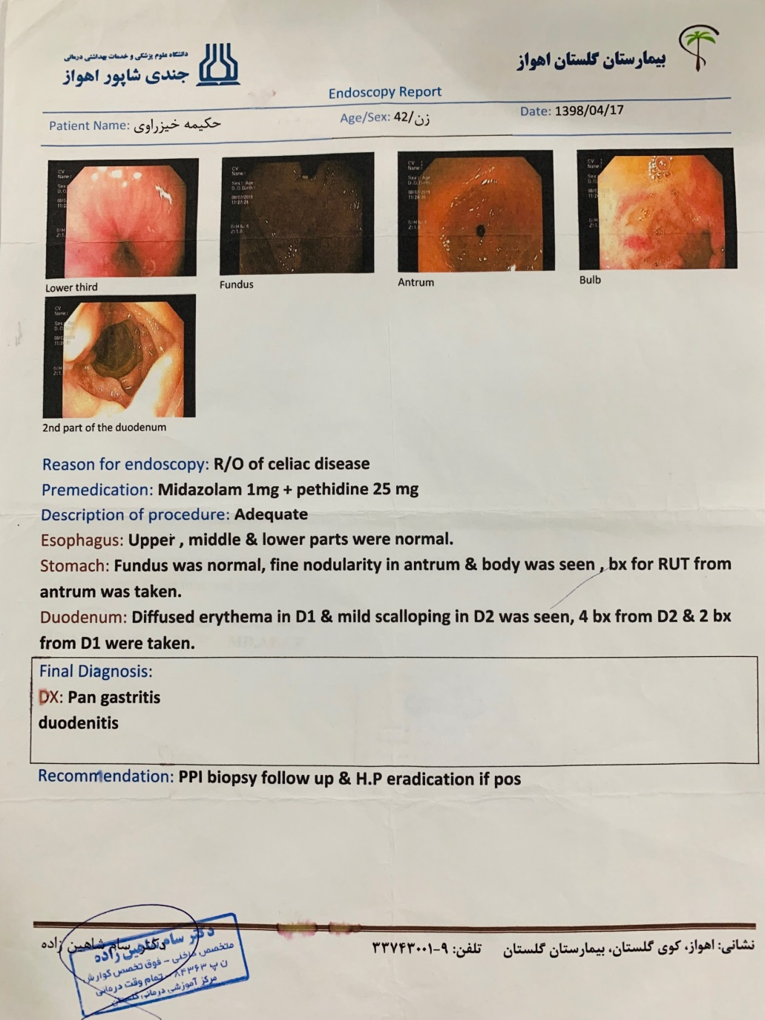
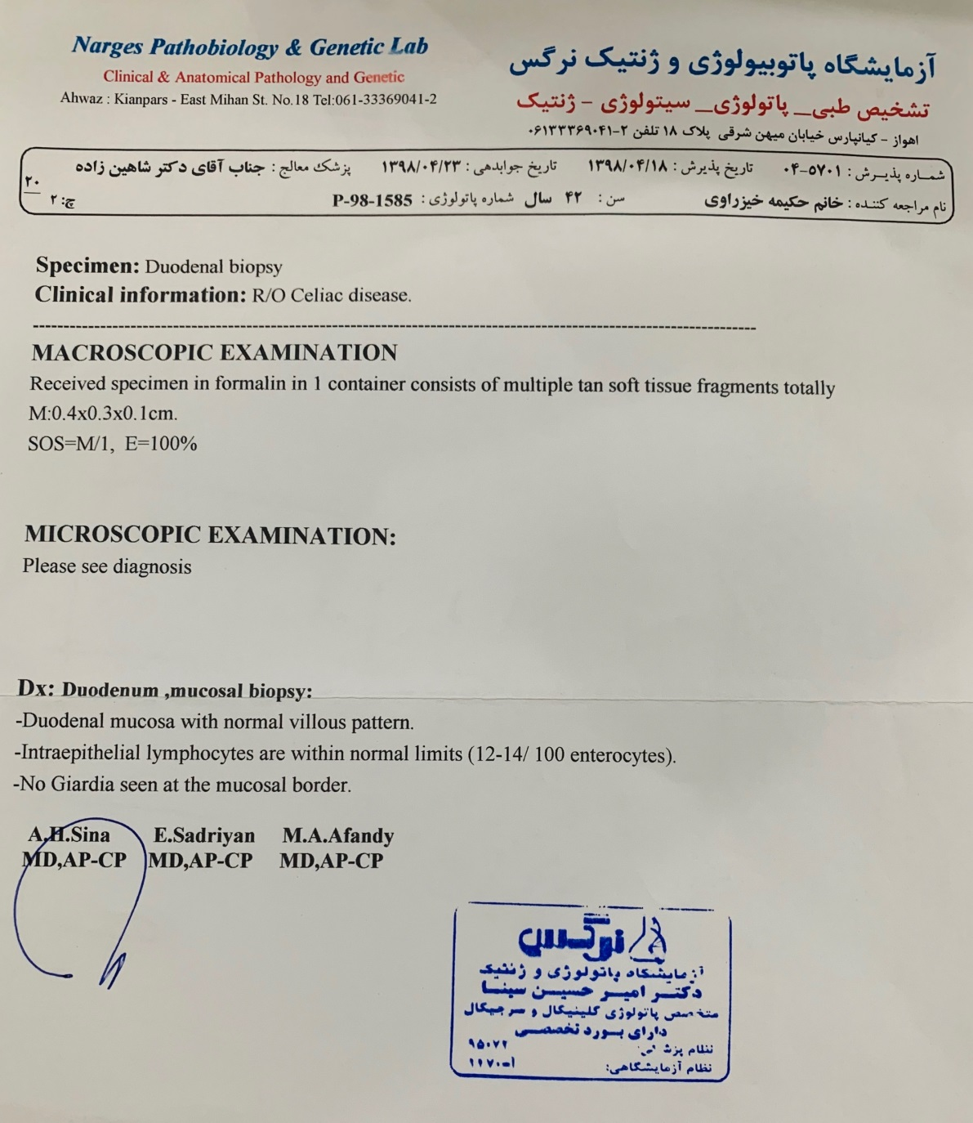
Endoscopy (3): 04/1398

Slide 13
CURRENT ADMISSION

Slide 14
Chief Complaint and HPI
CC: “feeling weak and depressed”
Reason for Referral: Very high TSH levels not controlled with extreme doses of Levothyroxine.
HPI: Our patient is a 41-year-old lady who was referred to be admitted to the Endocrine ward following detection of persistently very high TSH levels for the past two years despite receiving extreme doses of Levothyroxine.
Duration: Extreme weakness and feeling depressed for one month prior to admission.
Onset: She has been feeling like this for the past two years, but this latest episode of extreme symptoms started relatively abruptly last month.
Constant/Intermittent: The problem has been constant.
Precipitating factor: None elicited.
Alleviating factors: No specific factors identified.
Aggravating factors: Stressful life events.
Progression: Has not progressed significantly since it started.
Frequency: She has experienced such extreme symptoms twice during the past two years.
Associated symptoms: Malaise, headache, dizziness, blurred vision, occasional diarrhea following consumption of certain food items, lack of energy for talking, anxiety, lack of concentration.

Slide 15
Family, Drug, and Social Hx
Past Medical/Surgical Hx:
Negative except for what mentioned before
Family Hx:
4 children
No history of similar problems in first- and second-degree relatives.
Drug Hx:
Thyroid medications mentioned before
Tab Mirtazapine 25mg, ½ qHS
Amp FerInject 500mg → 3 doses in the past year
Allergies: None
Social Hx:
Middle class family.
Education → Secondary education → Has good understanding of her diseases and is fully cooperative with the medical teams.
Has adequate access to health care and food resources.

Slide 16
Review of Systems
Constitutional symptoms: Lack of energy and malaise, loss of appetite, prior diagnosis of PTC.
Eyes, Ears, nose, mouth, throat: Negative (Difficulty with hearing, sinus problems, runny nose, post-nasal drip, ringing in ears, mouth sores, loose teeth, ear pain, nosebleeds, sore throat, facial pain or numbness).
Cardiovascular: Negative (Irregular heartbeat, racing heart, chest pains, swelling of feet or legs, pain in legs with walking).
Respiratory: Negative (Shortness of breath, night sweats, prolonged cough, wheezing, sputum production, prior tuberculosis, pleurisy, oxygen at home, coughing up blood, abnormal chest x-ray).
Gastrointestinal:
constipation (usual bowel habit: twice/week, hard, difficult),
intolerance to gluten-containing foods,
occasional diarrhea → small volume, very frequent, fatty, following consumption of certain foods,
Last year she had diarrhea for one month → lost 9 kg in one month.
Genitourinary: Frequent urination.

Slide 17
Review of Systems
Musculoskeletal → Pain in wrist and ankle and knee that subsides with OTC painkillers.
Integumentary: hair loss (Persistent rash, itching, new skin lesion, change in existing skin lesion, hair loss or increase, breast changes).
Neurological: Negative (Frequent headaches, double vision, weakness, change in sensation, problems with walking or balance, dizziness, tremor, loss of consciousness, uncontrolled motions, episodes of visual loss).
Psychiatric: Insomnia, irritability, depression, anxiety.
Endocrine: Hot flushes, menstrual irregularities → Anovulatory AUB (q2-3 mo., 15-20 days, > 1pad q2hr) /during admission she had not had her menses for 3 months, breast atrophy (past few months), no dyspareunia.
Hematologic/Lymphatic: Anemia, thrombocytopenia (Easy bleeding, easy bruising, leukemia, unexplained swollen areas).
Allergic/Immunologic: Negative (Seasonal allergies, hay fever symptoms, itching, frequent infections).

Slide 18
Physical Examination
GENERAL APPEARANCE: 41 y/o female who is awake and alert and who appears healthy and looks her stated age. The patient appears plethoric.
Wt.= 85kg, Ht.=167cm, BMI=30 kg/m2
VITALS → PR: 80/min, BP: 110/80 mmHg, RR: 18/min, oT: 37.2,
(BS=266mg/dl and GFR=56.9mL/min/1.73m²)
HEENT
NECK
BREASTS
THORAX & BACK
LUNGS
HEART
ABDOMEN

Slide 19
Physical Examination
EXTREMITIES
SKIN
LYMPH NODES
NEUROLOGIC → Forces are normal.

Slide 20
3-10-98
GI Consult →Celiac labs → All negative
HLA-DQ8 +
08-10-98
12-hour loading test
(fT4 measured) → No rise
12-10-98
240-minute loading test
(fT4 measured) → No rise
3 days of gluten-unrestricted diet → symptoms +
14-10-98
Endoscopy + Biopsy→ H. pylori (mild)/ Normal otherwise
26-10-98
Tetracosactide test
(cortisol measured) → No rise
25-10-98
H.Pylori treatment started → 4X drugs, ongoing
22-10-98
Baseline Cortisol and ACTH tested → 10.5 (6.4-22.8)
76 (1-72)
21-10-98
Vitamin C started (based on a JCEM paper)
3 days Pred (10mg tid) →
On day 4: 240-minute loading test
(total T4 measured) → No rise
28-10-98
MR entreography → ↑ jejunal mucosal thickness
30-10-98
Clinical improvement → LT4 dose ↓ → 200 mcg/d
3-11-98
TFT @ Gamma Lab →
TSH: 0.1
T4: 15.8 ug/dl
T3RU: 40%
5-11-98
TFT @ Gamma Lab →
TSH: 0.3
T4: 6 ug/dl
T3: 161 ng/dl
06-11-98
Clinical improvement has been stable.

Slide 21
Work-up

Slide 22
Laboratory Data
TFT from 1395 to current admission:

Slide 23
Laboratory Data
TFT throughout current admission:

Slide 24
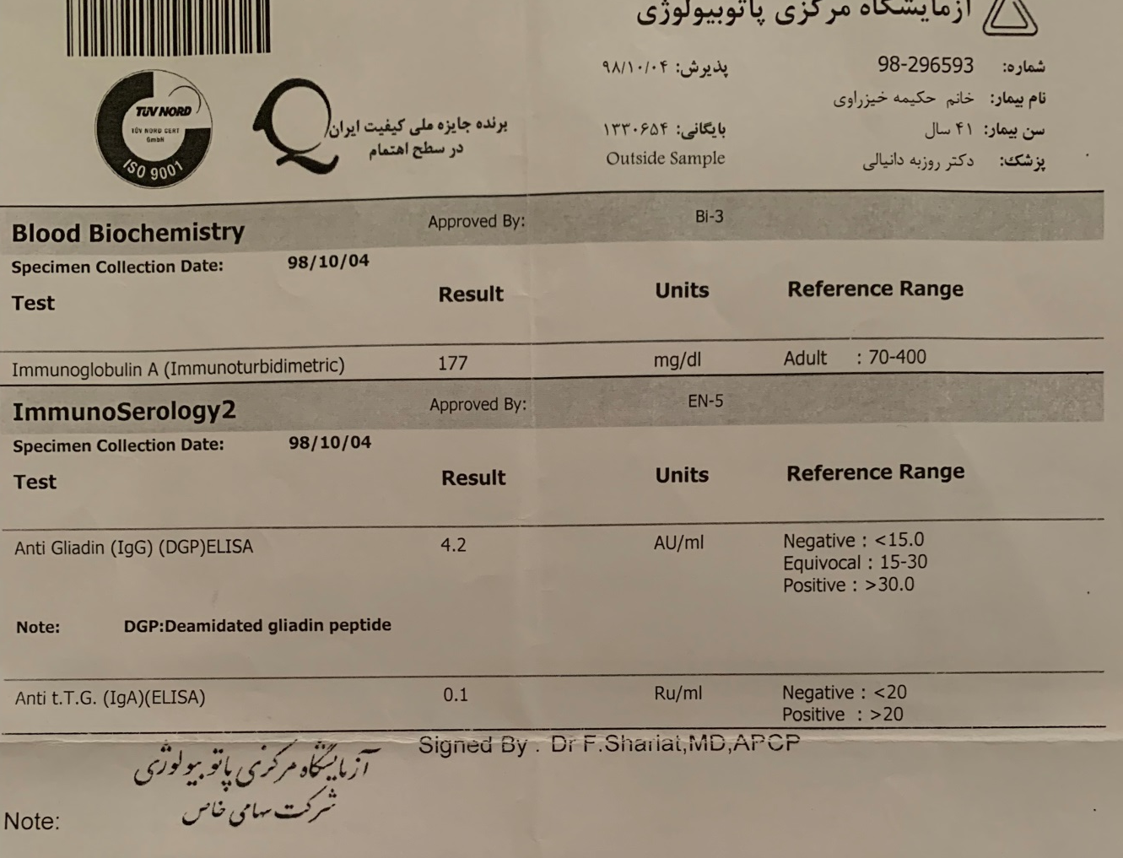
Laboratory Data
Celiac serology:

Slide 25
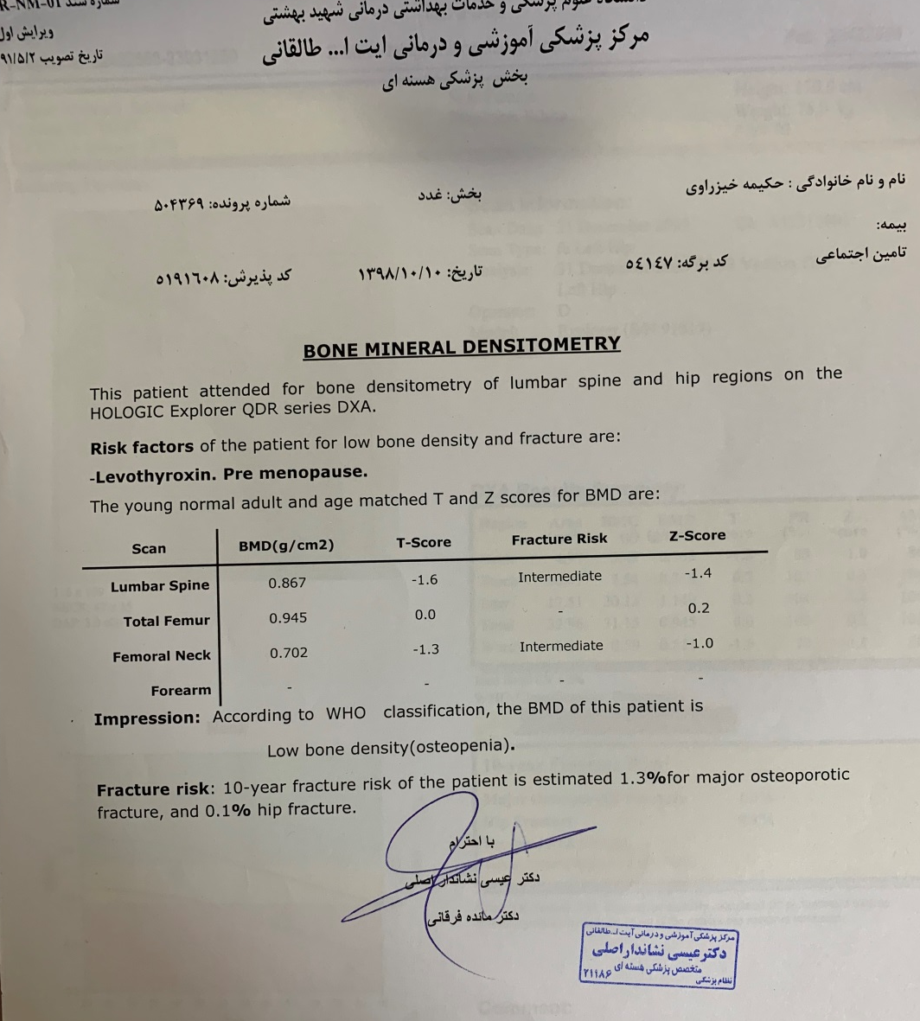
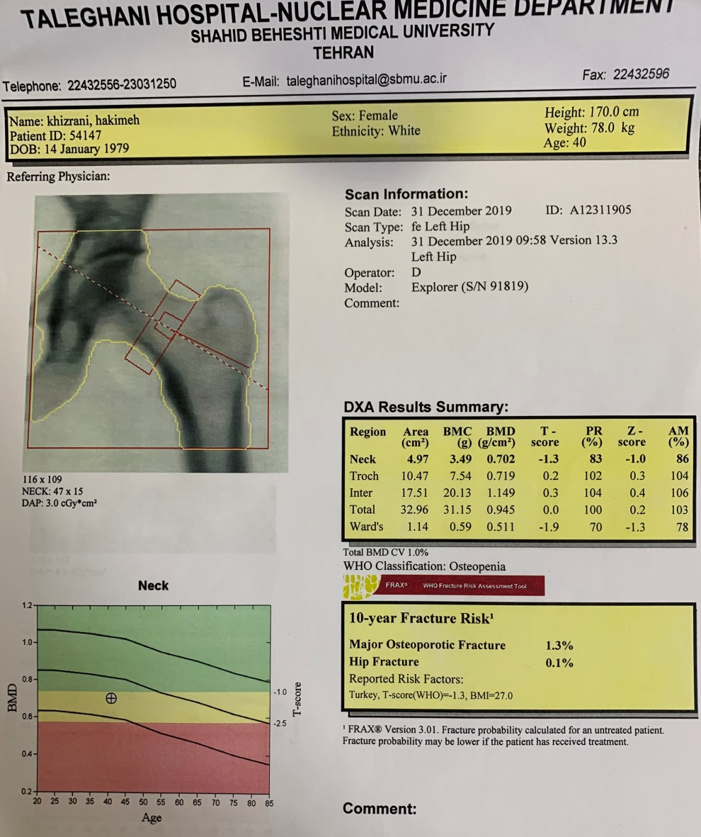
Laboratory Data
Densitometry:

Slide 26
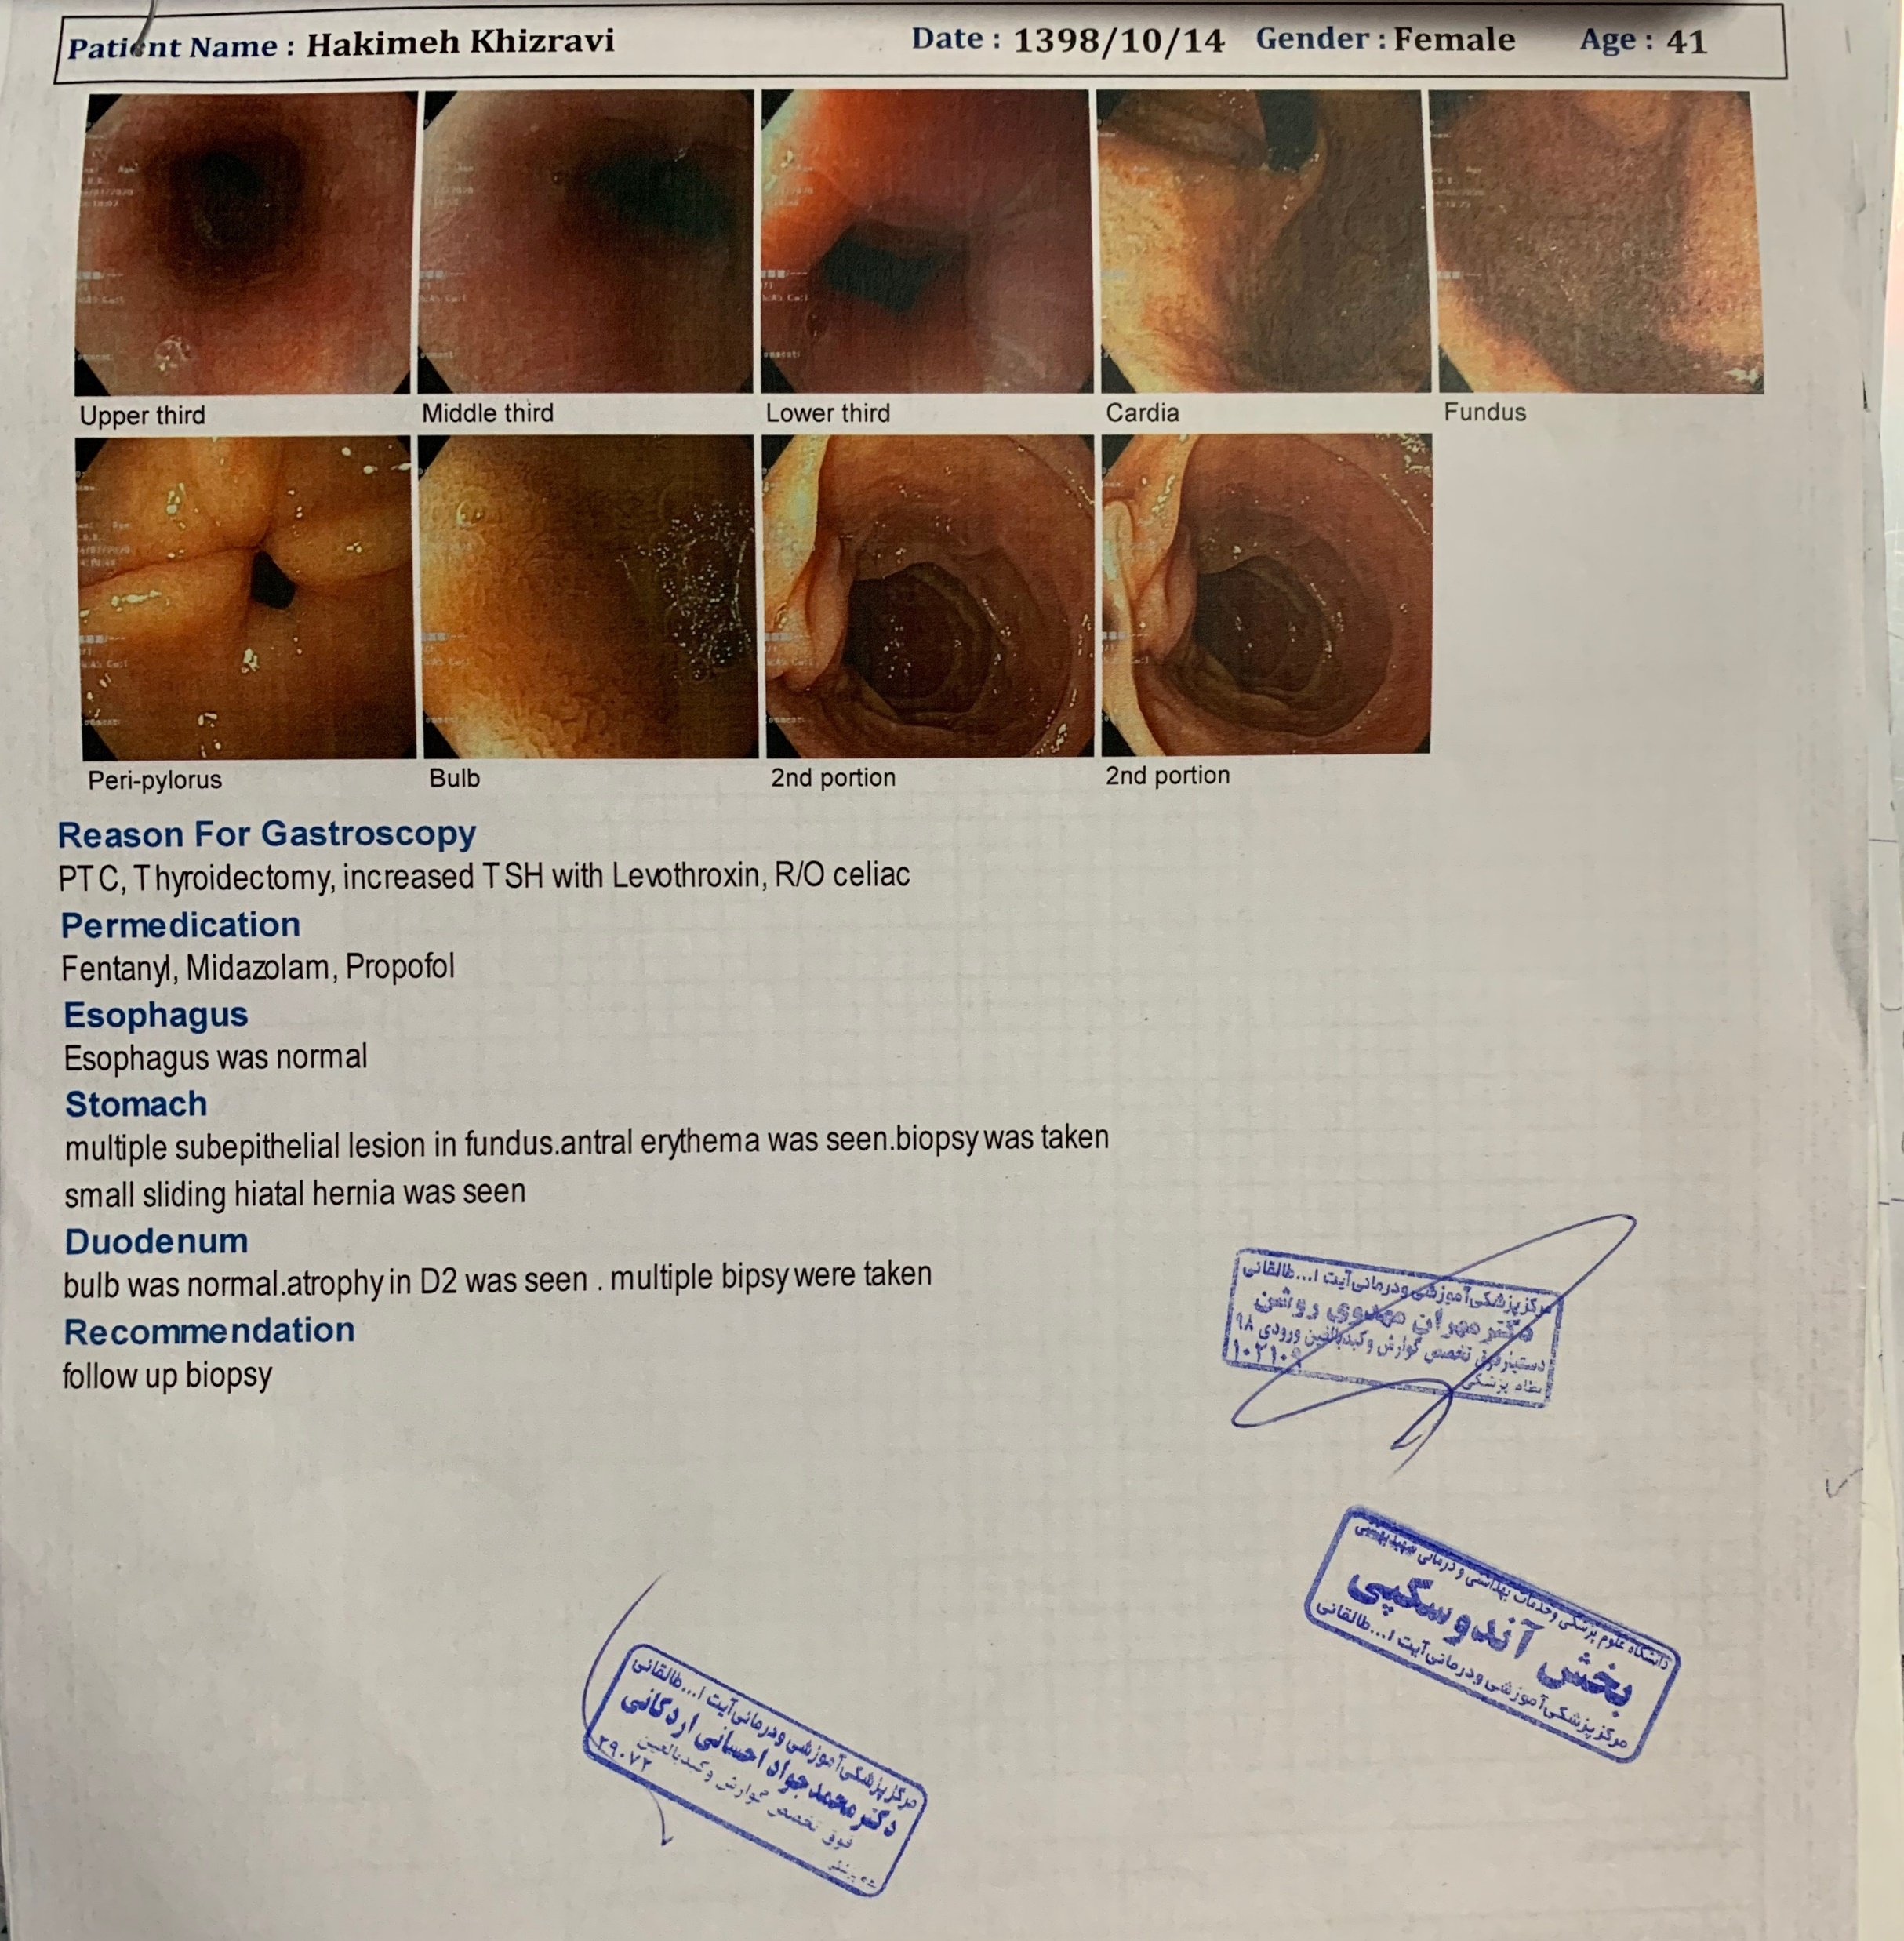
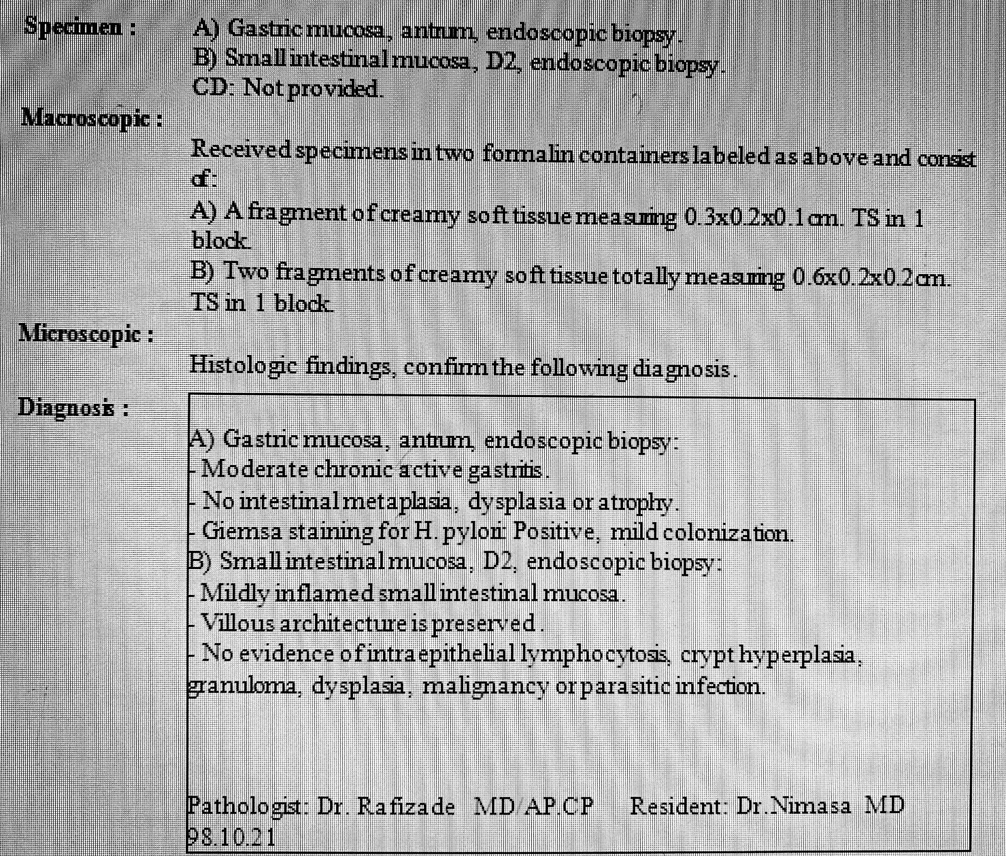
Endoscopy (4): 1398 (Following high-gluten diet)

Slide 27
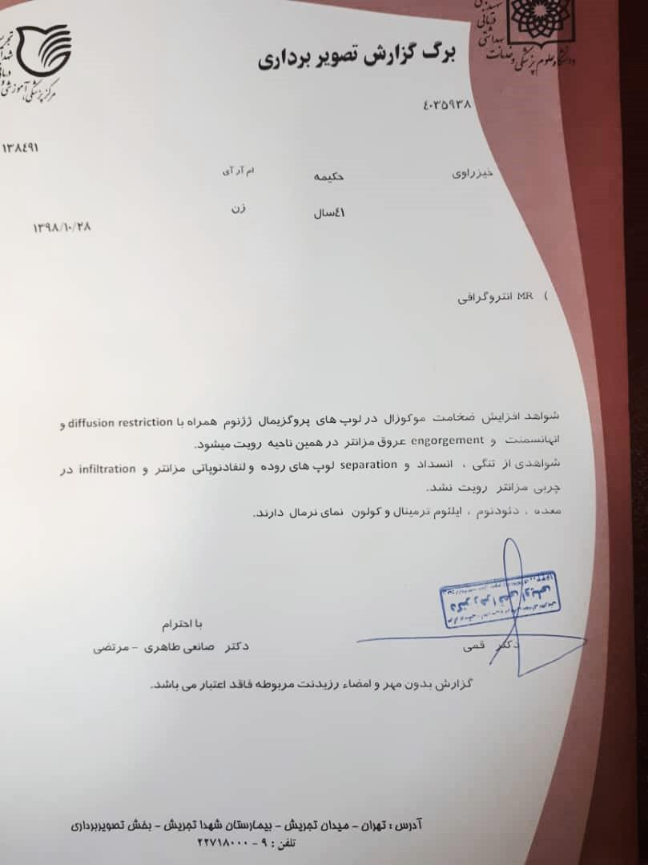
MR Enterography

Slide 28
Problem List
Feeling weak and depressed
Lack of ↓ in TSH despite extreme doses of levothyroxine
History of PTC treated with total thyroidectomy
History of intolerance to gluten (?) and celiac (?)
↓cortisol and tetracosactide test

