Slide 2
Challenges in diagnosis & treatment of thyrotoxicosis During Pregnancy
BY:
Dr. Majid Valizadeh
Associate professor of SBUMS
Research institute for endocrine sciences

Slide 3
Road Map
Case presentation
Introduction (Thyroid hormone economy during pregnancy)
Challenges with diagnosis of thyroid derangement in pregnancy
Thyrotoxicosis in Pregnancy
Case discussion
Conclusion

Slide 4
Case 1:
A 25 years old lady at gestational age 11 (G2P0A1) referred by OBGYN with heat intolerance, 1 kg weight loss and nausea from 8 weeks of the gestation.
PMH: no thyroidal disorders
FH: (-)
Physical exam:
Normal skin / Mild tremor / Weight: 55 Kg
BP: 110/70 PR: 95/min
NO Ophthalmic sign
Thyroid: Mild Enlargement / 25 gr (Rubbery)

Slide 5
Lab. Test Results:
TSH: 0.05 mIu/ml (RR: 0.27-4.2) ---- TT4: 15 µg/dl (4.5-12) --- TT3: 3.2 nmol/L (0.8-3.1)
کدامیک از گزینه های زیر در مورد این بیمار صحیح است؟
الف) اندازه گیری مقادیر آزاد هورمون ها
ب) اندازه گیری Anti-TPO
ج) اندازه گیری TRAb
د)اندازه گیری مجدد هورمون ها 4 هفته بعد

Slide 6
Case 2
A 34 years old lady at gestational age 8 (G2P0A1) referred by OBGYN with palpitation, 3 kg weight loss and nausea from 6 weeks later.
PMH: no thyroidal disorders
FH: (+) autoimmune thyroid disease in her mother
Physical exam:
Wet skin / Mild tremor / Weight: 65 Kg
BP: 100/70 PR: 105/min
NO Ophthalmic sign
Thyroid: 30 gr (Rubbery)

Slide 7
Laboratory test results:
Initial TFT:
TSH: 0.05 mIu/ml ---- FT4: 2.5 (0.8-1.8 ng/dl ) -----T3: 3.2 (0.8-2 nmol/L )
Repeated TFT:
TSH: 0.005 mIu/ml ----- FT4: 1.8 ng/dl ----- T3: 2.9 nmol/L
کدام گزینه را در مورد این بیمار پیشنهاد می کنید؟
الف) اندازه گیری FT4I
ب) شروع درمان با PTU
ج) اندازه گیری TRAb
د)اندازه گیری مجدد هورمون ها 4 هفته بعد

Slide 8
Objectives
Changes in thyroid economy during pregnancy
Challenges with diagnosis of thyroid derangement in pregnancy
Challenges with treatment of thyroid disease in pregnancy

Slide 9
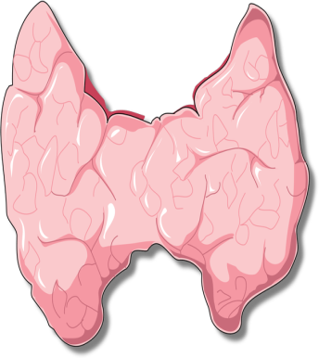
Factors for thyroid stimulation during pregnancy
↑ E
↑ TBG
↑ TSH
↓ FT4
iodine
TPO Ab
↑ HCG
↑ FT4
↑ goiter
↑ Tg
↑ TSH
↓ TSH
↓ T4
↑ TSH
↑ placental DI III
Delange: Int.J. Endocrinol. Metab. 2: 1, 2004

Slide 10
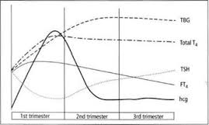

Slide 11
Guidelines on thyroid and pregnancy
The rapidly evolving data on the management of thyroid disorders during pregnancy have been the impetus for development of many guidelines during the past few years.
It is noteworthy that two guidelines on thyroid and pregnancy were documented in October 2011 and August 2012 by American Thyroid Association and Endocrine Society, respectively.

Slide 12
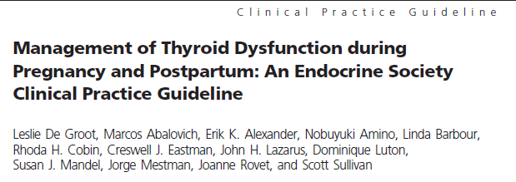
THYROID Volume 21, Number 10, 2011
J Clin Endocrinol Metab 97: 2543–2565, 2012

Slide 13
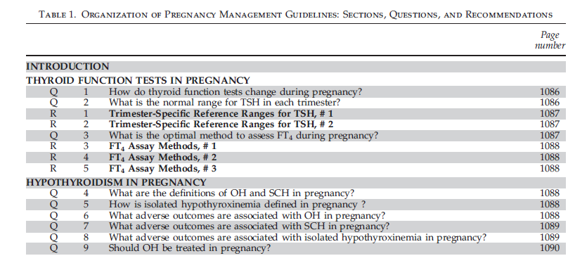

Slide 14
Serum TSH
During pregnancy, women have lower serum TSH concentrations than before pregnancy, and frequently TSH is below the classical lower limit of 0.4 mIU/L.
both the lower normal limit and the upper normal limit of serum TSH are decreased by about 0.1–0.2 mIU/L and 1.0 mIU/L, respectively, compared with the customary TSH reference interval.

Slide 15
Sample trimester-specific reference intervals for TSH*
Reference | 1st trimester | 2nd trimester | 3rd trimester
Haddow | 0.94 (0.08-2.73) | 1.29 (0.39-2.70)
Stricker | 1.04 (0.09-2.83) | 1.02 (0.20-2.79) | 1.14 (0.31-2.90)
Panesar | 0.80 (0.03-2.30) | 1.10 (0.03-3.10) | 1.30 (0.13-3.50)
Soldin | 0.98 (0.24-2.99) | 1.09 (0.46-2.95) | 1.20 (0.43-2.78)
Bocos-Terraz | 0.92 (0.03-2.65) | 1.12 (0.12-2.64) | 1.29 (0.23-3.56)
Marwaha | 2.10 (0.60-5.00) | 2.40 (0.43-5.78) | 2.10 (0.74-5.70)
* median TSH mIU/L with 5th and 95th centiles or P2.5 and P 97.5 between brackets.
Soldin OP et al. Clin Chem Acta 2004; 349: 181
Haddow JE et al. J Med Screen 2004; 11: 170
Panesar NS et al. Ann Clin Biocliem 2001; 34: 67

Slide 16
Since hCG concentrations are higher in multiple
pregnancies than in singleton pregnancies,
the downward shift in the TSH reference interval is greater in twin pregnancies than in singleton pregnancies

Slide 17
Lower limit of TSH
In a small percentage of women, TSH can be very suppressed (<0.01 mIU/L) and yet still represent a normal pregnancy.
There are slight but significant ethnic differences in serum TSH concentrations.
Black and Asian women have TSH values that are on average 0.4 mIU/L lower than in white women; these differences persist during pregnancy.

Slide 18
TSH ranges vary slightly depending on differences between methods of analysis .
Subclinical hyperthyroidism is not associated with adverse pregnancy outcomes; therefore, a TSH value that is within detection is unlikely to be clinically significant.

Slide 19
Guidelines for Serum TSH During Pregnancy
Recommendation 1 Trimester-specific reference ranges for TSH, as defined in populations with optimal iodine intake, should be applied
Recommendation 2 If trimester-specific reference ranges for TSH are not available in the laboratory, the following references ranges are recommend:

Slide 20
Thyroid Function Tests in Pregnancy
Trimester-specific reference ranges for TSH :
- First trimester : 0.1–2.5 mIU/L (up to 4)
- Second trimester: 0.2–3.0 mIU/L (up to 4)
- Third trimester : 0.3–3.0 mIU/L. (up to 4)

Slide 21
initial evaluation of a suppressed serum TSH during the first trimester of pregnancy
TSH can be decreased to 0.03 mIU/mL (or even undetectable)
Any subnormal serum TSH value should be evaluated in conjunction with serum FT4 (TT4 or FTI)

Slide 22
What about TT4 ( & also T3) ?
Also FT4 & FTI

Slide 23
How do thyroid function tests change during pregnancy?
Following conception, circulating total T4 (TT4) and T4 binding globulin (TBG) concentrations increase by 6–8 weeks and remain high until delivery.

Slide 24
Physiologic changes in pregnancy that influence thyroid function tests
Physiologic change | Thyroid function test change
↑ Thyroid-binding globulin | ↑ Serum total T4 and T3
First trimester hCG elevation | ↑ Free T4 and ↓ TSH
↑ Plasma volume | ↑ T4 and T3 pool size
↑ Type III 5-deiodinase (inner-ring deiodination) | ↑ T4 and T3 degradation (resulting in requirement for increased hormone production)
Thyroid enalrgement (in some women) | ↑ Serum thyroglobulin
↑ Iodine clearance | ↓ Hormone production in iodine-deficient areas
hCG= human chorionic gonadotropin; TSH= Thyroid-stimulating hormone; T3= triiodothyronine; T4= thyroxine; ↑= increased; ↓=decreased
Lazarus JH. Treat Endocrinol 2005; 4:31

Slide 26
Thyroid Function Tests in Pregnancy
The non-pregnant total T4 range (5–12 μg/dl or 50–150 nmol/L) can be adapted in the second and third trimesters by multiplying this range by 1.5.
Alternatively, the free T4 index (FTI) appears to be a reliable assay during pregnancy

Slide 27
WHAT IS THE OPTIMAL METHOD TO ASSESS FT4 DURING PREGNANCY?
The normal ranges for FT4 index are calculated by TT4 x T3 uptake and TBG,
and trimester-specific reference intervals for FT4 index have established recently.

Slide 28
Trimesters specific reference intervals for free T4 index in Iranian pregnant women
Free T4 index
Trimester of pregnancy
Azizi F. et al. Thyroid. 2013 Mar;23(3):354-9. doi: 10.1089/thy.2012.0407

Slide 29
How about FT4?
Where is problem?
Laboratory?

Slide 30
Measuring FT4 in the presence of high concentrations of bound T4 has proved challenging especially in abnormal binding-protein states such as pregnancy.
FT4 immunoassay approaches are liable to error by disrupting the original equilibrium, which is dependent on dilution,// temperature, //buffer composition,// affinity, and concentration of the T4 antibody reagent and T4-binding capacity of the serum sample.

Slide 31
Problems with FT4 in pregnancy
High TBG concentrations result in higher FT4 values.
Low albumin in serum will yield lower FT4 values.
In pregnant women higher concentrations of TBG and NEFA and lower concentrations of albumin relative to sera of non-pregnant
Seven commercial FT4 immunoassays in 23 euthyroid women at term:
Albumin-dependent methods showed marked negative bias with up to 50% of subnormal values
Other methods gave values above their non-pregnant reference values
Herbomes M et al. Clin Chem Lab 2003; 41: 942
Roti E. J Endocrinol Invest 1991; 14: 1-9

Slide 32
Accurate Measurement of FT4
The latest development in the field of FT4 analysis is to measure free thyroid hormones in the dialysate or ultrafiltrate using online solid phase extraction - liquid chromatography/tandem mass spectrometry.
The 95% FT4 reference intervals decreased gradually with advancing gestational age: from 1.08-1.82 ng/dL in week 14 to 0.86-1.53 ng/dl in week 20
Yue et al. Clin Chem 2008; 54: 642

Slide 33
The serum of pregnant women:
↑concentrations of TBG and nonesterified fatty acids ↓concentrations of albumin .
Many current FT4 immunoassays fail to account for the effect of dilution.
Because FT4 reference intervals in pregnancy varied widely between methods, interpretation of FT4 values requires method-specific ranges.

Slide 34
such ranges are also influenced by the iodine status of the population studied.
it is customary for manufacturers to suggest that laboratories establish their own reference range for a test, this is impractical in clinical practice.
difficult to recruit subjects with specific conditions such as pregnancy in order to independently establish method- and trimester-specific ranges.
It follows that it is customary for laboratories to adopt the ranges provided by the manufacturer of the test.

Slide 35
20
5.0
15
FT4(pmol/L)
FT3(pmol/L)
4.0
10
0
0
1.5
50
40
1.0
TSH (mU/L)
30
hCG (I.Ux1000/L)
20
0.5
10
0
0
10
20
30
40
Postmenstrual age in weeks
Glinoer, Endocr Rev 1997;18:404-433

Slide 36
RECOMMENDATION 3
The optimal method to assess serum FT4 during pregnancy is measurement of T4 in the dialysate or ultrafiltrate of serum samples employing on-line extraction/liquid chromatography/tandem mass spectrometry (LC/MS/MS).
Level A-USPSTF

Slide 37
RECOMMENDATION 4
If FT4 measurement by LC/MS/MS is not available, clinicians should use whichever measure or estimate of FT4 is available in their laboratory, being aware of the limitations of each method. Serum TSH is a more accurate indication of thyroid status in pregnancy than any of these alternative methods.
( Level A-USPSTF)

Slide 38
RECOMMENDATION 5
In view of the wide variation in the results of FT4 assays, method-specific and trimester-specific reference ranges of serum FT4 are required. (Level B-USPSTF)

Slide 39
Thyrotoxicosis in pregnancy (definition and causes):
Thyrotoxicosis : ‘‘the clinical syndrome of hypermetabolism & hyperactivity that results when the serum concentrations of free thyroxine hormone (T4) and/or free triiodothyronine (T3) are high’’
Graves’ disease (0.1%–1% )
(0.4% clinical and 0.6% subclinical)
First time or recurrence
gestational hyperthyroidism (1-3%)
toxic multinodular goiter,
toxic adenoma,
factitious thyrotoxicosis.
Subacute painful or silent thyroiditis
Struma ovarii

Slide 40
Gestational hyperthyroidism
‘‘transient hyperthyroidism, limited to the first half of pregnancy characterized by elevated FT4 or adjusted TT4 and suppressed or undetectable serum TSH, in the absence of serum markers of thyroid autoimmunity’’
1%–3% of pregnancies
secondary to elevated hCG levels
may be associated with hyperemesis gravidarum

Slide 41
hCG-induced thyrotoxicosis
Hyperemesis gravidarum
multiple gestation,
hydatidiform mole
Choriocarcinoma
A TSH receptor mutation leading to functional hypersensitivity to hCG also has been recognized as a rare cause of gestational hyperthyroidism

Slide 42
Gestational hyperthyroidism differentiation from Graves’ hyperthyroidism in pregnancy
A careful history and physical examination
no prior history of thyroid disease
no clinical signs of Graves’ disease (goiter, endocrine ophthalmopathy)
favor the diagnosis of gestational hyperthyroidism.
In situations in which the clinical diagnosis is in doubt the determination of TSH receptor antibody (TRAb) is indicated

Slide 43
Comparison of recommendations of American Thyroid Association and Endocrine Society on the management of hyperthyroidism before pregnancy and on the diagnosis of hyperthyroidism and pregnancy
 | Recommendations
Topic | American Thyroid Association (2011) | Endocrine Society (2012)
Thyroid function tests | In the presence of a suppressed serum TSH in the first trimester (TSH <0.1 mIU/L), a history and physical examination are indicated. FT4 measurements should be obtained in all patients. Measurement of TT3 and TRAb may be helpful in establishing a diagnosis of hyperthyroidism. | Same (R)

Slide 44
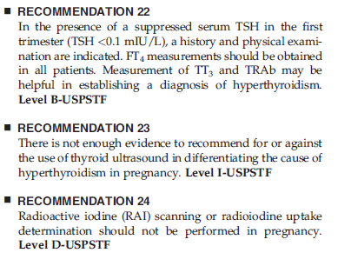

Slide 45
Appropriate management of gestational hyperthyroidism?
depends on the severity of symptoms
In women with hyperemesis gravidarum
control of vomiting
and treatment of dehydration
ATD? (ATD versus Supportive Therapy)
it is difficult to arrive at a definite diagnosis, a short course of ATDs is reasonable.
If the hyperthyroidism returns after discontinuation of ATDs, Graves’ hyperthyroidism is the most likely diagnosis and may require further therapy

Slide 46
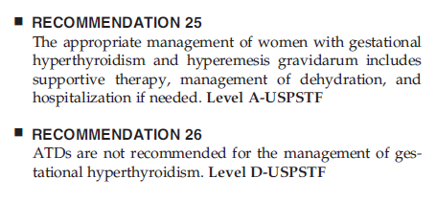

Slide 47
Management of patients with Graves’ hyperthyroidism in pregnancy
Poor control of thyrotoxicosis is associated with:
Miscarriages
Pregnancy-induced hypertension
Prematurity
low birth weight
intrauterine growth restriction
Stillbirth
Thyroid storm
Maternal congestive heart failure

Slide 48
ATDs
the mainstay of treatment for hyperthyroidism during pregnancy
The greatest concern : teratogenic effects
congenital malformations, mainly :
aplasia cutis
syndrome of ‘‘MMI embryopathy (choanal or esophageal atresia & dysmorphic facies)
Hepatotoxicity in patients exposed to PTU

Slide 49
Equivalent doses of PTU to MMI are 10:1 to 15:1 (100mg of PTU 7.5 to 10mg of MMI)
The initial dose of ATDs depends on the severity of the symptoms and the degree of hyperthyroxinemia.
MMI, 5–15mg daily // PTU, 50–300mg daily in divided doses.

Slide 50
Beta adrenergic blocking agents, such as propranolol 20–40mg every 6–8 hours may be used for controlling hypermetabolic symptoms

Slide 52
tests should be performed in women treated with ATDs during pregnancy? // What is the target value of FT4?
maintain FT4 values at, or just above the upper limit of normal, while utilizing the smallest possible dose of ATDs
Free T4 and TSH
every 2–4 weeks at initiation of therapy
every 4–6 weeks after achieving the target value
Over-treatment »»»» possibility of
fetal goiter
fetal hypothyroidism

Slide 53
Serum TSH may remain undetectable through pregnancy. Serum TT3 determination is not recommended in the management of Graves’ hyperthyroidism because normalization of maternal serum TT3 has been reported to cause elevated serum TSH in the infants at birth
exception is the woman with T3 thyrotoxicosis, such as in the presence of a nodular goiter.

Slide 54
Natural Graves course during pregnancy
In the first trimester of pregnancy some women with Graves’ disease will experience an exacerbation of symptoms.
in the second and third trimesters : gradual improvement
after delivery : Aggravation of symptoms often occurs

Slide 55
Thyroidectomy
Allergies to both ATD
contraindications to both ATDs
women requiring large doses of ATDs
patients who are not compliant with drug therapy.
second trimester is the optimal time.
A determination of serum TRAb titers is of value at the time of surgery in order to assess the potential risk of fetal hyperthyroidism

Slide 57
Fetal risk of hyperthyroidism:
1) Fetal hyperthyroidism,
2) neonatal hyperthyroidism,
Risk factor: High titer TRAb (22-26 w) // 1-5% of pregnancy in …
3) fetal hypothyroidism,
4) neonatal hypothyroidism
High dose ATD
5) central hypothyroidism.
Prolonged hyperthyroidism during pregnancy

Slide 58
Indications for ordering a TRAb test in Graves’ disease :
1) mother with active hyperthyroidism
2) previous history of treatment with radioiodine
3) previous history of delivering an infant with hyperthyroidism
4) thyroidectomy for treatment of hyperthyroidism in pregnancy

Slide 59
When ?
A determination of serum TRAb by 24–28 weeks gestation is helpful in detecting pregnancies at risk
Some clinicians recommend to perform the test in the first trimester and if elevated repeat the determination at 22–26 weeks gestation

Slide 61
Lab. Test Results:
TSH: 0.05 mIu/ml (RR: 0.27-4.2) ---- TT4: 15 µg/dl (4.5-12) --- TT3: 3.2 nmol/L (0.8-3.1)
کدامیک از گزینه های زیر در مورد این بیمار صحیح است؟
الف) اندازه گیری مقادیر آزاد هورمون ها
ب) اندازه گیری Anti-TPO
ج) اندازه گیری TRAb
د)اندازه گیری مجدد هورمون ها 4 هفته بعد

Slide 62
Case 2
A 34 years old lady at gestational age 8 (G2P0A1) referred by OBGYN with palpitation, 3 kg weight loss and nausea from 6 weeks later.
PMH: no thyroidal disorders
FH: (+) autoimmune thyroid disease in her mother
Physical exam:
Wet skin / Mild tremor / Weight: 65 Kg
BP: 100/70 PR: 105/min
NO Ophthalmic sign
Thyroid: 30 gr (Rubbery)

Slide 63
Laboratory test results:
Initial TFT:
TSH: 0.05 mIu/ml ---- FT4: 2.5 (0.8-1.8 ng/dl ) -----T3: 3.2 (0.8-2 nmol/L )
Repeated TFT:
TSH: 0.005 mIu/ml ----- FT4: 1.8 ng/dl ----- T3: 2.9 nmol/L
کدام گزینه را در مورد این بیمار پیشنهاد می کنید؟
الف) اندازه گیری FT4I
ب) شروع درمان با PTU
ج) اندازه گیری TRAb
د)اندازه گیری مجدد هورمون ها 4 هفته بعد

Slide 64
Take Home Message
Thyroid hormones economy change during pregnancy
Pregnancy-Specific and Trimester-specific reference ranges for TSH, as defined in populations with optimal iodine intake, should be applied
Normal serum TSH values can be as low as 0.03 mIU/mL (or even undetectable)

Slide 65
Take Home Message
total T4 range (5–12 μg/dl or 50–150 nmol/L) can be adapted in the second and third trimesters by multiplying this range by 1.5.
Alternatively, the free T4 index (FTI) appears to be a reliable assay during pregnancy

Slide 66
Take Home Message
In view of the wide variation in the results of FT4 assays, method-specific and trimester-specific reference ranges of serum FT4 are required.
The optimal method to assess FT4 during pregnancy :
- liquid chromatography/tandem mass spectrometry
TRAb measurement can be used in certain condition in pregnancy for differentiation Graves and GH

Slide 67
GH is the most common causes of thyrotoxicosis during pregnancy
Its must be differentiated from Graves disease according different management
A careful history and physical examination
no prior history of thyroid disease
no clinical signs of Graves’ disease (goiter, endocrine ophthalmopathy)
favor the diagnosis of gestational hyperthyroidism.
In situations in which the clinical diagnosis is in doubt the determination of TSH receptor antibody (TRAb) is indicated

Slide 69
Some common mistakes in laboratory report
Laboratory service do not report:
Age specific
Condition specific reference value

Slide 70
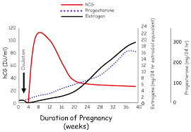

Slide 71
Take Home Message
Following conception, circulating total T4 (TT4) and T4 binding globulin (TBG) concentrations increase by 6–8 weeks and remain high until delivery.
Thyrotropic activity of hCG results in a decrease in serum TSH in the first trimester .

Slide 72
Comparison of recommendations of American Thyroid Association and Endocrine Society on the management of hyperthyroidism before pregnancy and on the diagnosis of hyperthyroidism and pregnancy
 | Recommendations
Topic | American Thyroid Association (2011) | Endocrine Society (2012)
Thyroid function tests | In the presence of a suppressed serum TSH in the first trimester (TSH <0.1 mIU/L), a history and physical examination are indicated. FT4 measurements should be obtained in all patients. Measurement of TT3 and TRAb may be helpful in establishing a diagnosis of hyperthyroidism. | Same (R)

Slide 75
A 25 year-old woman in the 8th week of pregnancy has serum TSH of 0.1 mU/L and serum free T4 of 2.5 and 1.4 ng/dl by two different laboratories. Pulse rate is 90/min, thyroid in not enlarged and there are no physical findings for Graves’ disease or hyperthyroidism.

Slide 85
Objectives
To review and discuss:
Changes in thyroid economy during pregnancy
Challenges with diagnosis of thyroid derangement in pregnancy
Challenges with treatment of thyroid disease in pregnancy

Slide 86
