Slide 1
Combined Pharmacologic Therapy in Postmenopausal Osteoporosis
Mojtaba Malek, MD
Institute of Endocrinology and Metabolism
Iran University of Medical Sciences
1396

Slide 2
Agenda
Introduction
Combination therapy :
PTH + HR or SERM
PTH+ Bisphosphonate
PTH + Denusomab
Meta analysis
Take home massage

Slide 3
Introduction
FDA approved osteoporosis treatments are currently limited to the use of a single drug at a fixed dose
No currently approved therapy is able to restore skeletal integrity in most patients with established osteoporosis
There is no single agent currently available that represents a cure for osteoporosis

Slide 4
Mechanism of action
Antiresorptive medications inhibit osteoclastic bone resorption and, to a lesser degree, bone formation .
The anabolic agents PTH [PTH-(1–84)] and teriparatide [PTH-(1–34)] potently stimulate osteoblastic bone formation but also stimulate bone resorption .
Teriparatide (PTH1-34; TPTD) or PTH1-84 (PTH) combined with antiresorptive agents could theoretically produce additive or perhaps even synergistic skeletal effects .

Slide 5
Two Important Questions
Which one is superior ?Combination thrapy or monothrapy ?
Which one is more effective ? Adding or switching ?

Slide 6
TERIPARATIDE PLUS ESTROGEN OR SELECTIVE ESTROGEN RECEPTOR MODULATOR

Slide 8
Fifty-two women who had been on HRT for at least 2 years were enrolled in this trial
25 were assigned randomly to remain on HRT alone and 27 were assigned to remain on HRT and also receive daily subcutaneous PTH(1–34) 400 U (25 mg) per day for 3 years

Slide 9
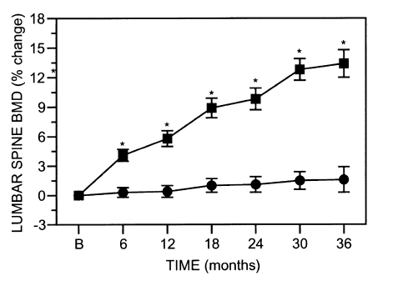
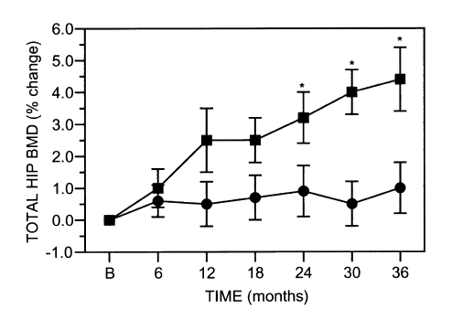
PTH + HRT group increased bone mass by 13.4 + 1.4% in the spine,
4.4 + 1.0% in the total hip,
Bone density measurements remained stable 1 year after
discontinuation of PTH without any significant loss while women continued HRT

Slide 10
Fracture data

Slide 12
A randomized, double-blind, placebo-controlled study was conducted in postmenopausal women with either low bone mass or osteoporosis
Patients were randomized to placebo plus HRT (n= 125) or PTH 40 g/day (SC) plus HRT (TPTD40 + HRT; n= 122)
Median treatment exposure of 13.8 months
Approximately one-half of the patients in each group were pretreated with HRT for at least 12 months before randomization

Slide 13
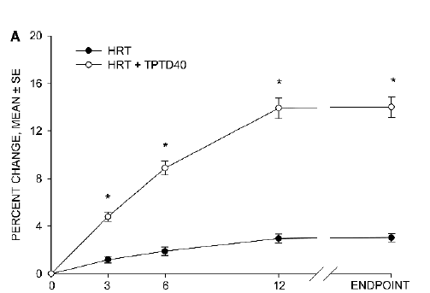
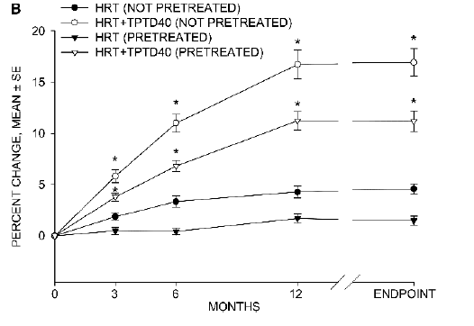
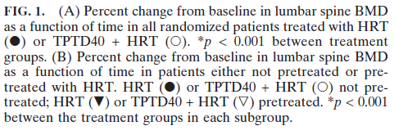

Slide 14
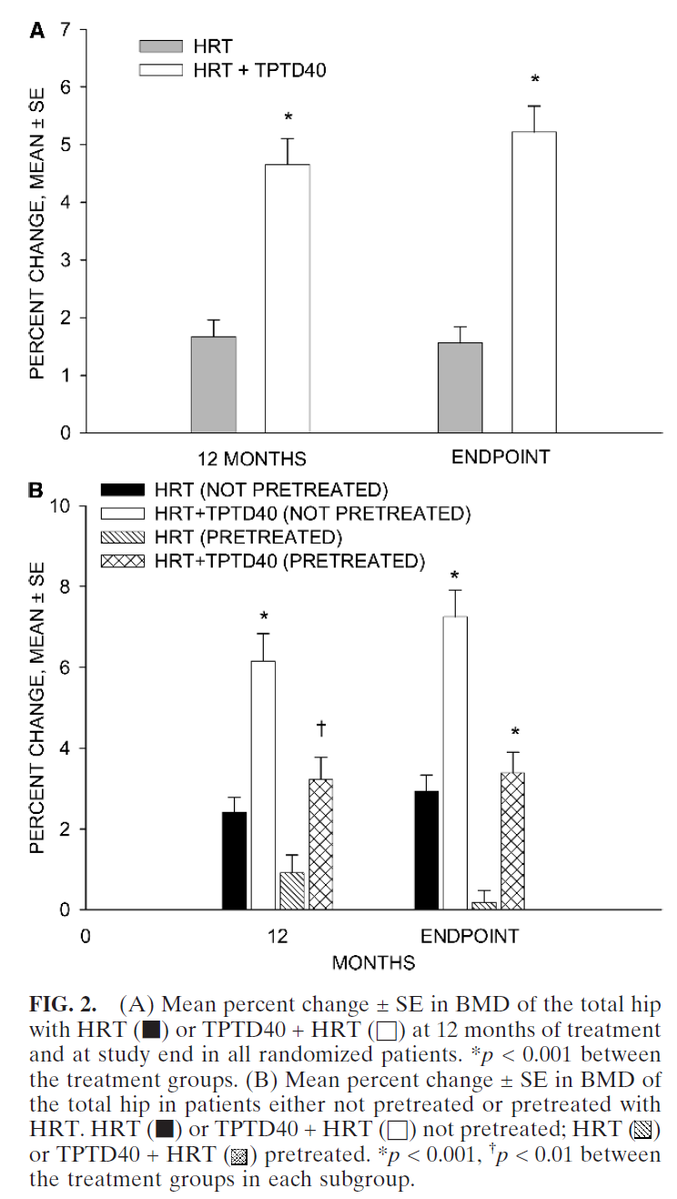

Slide 15
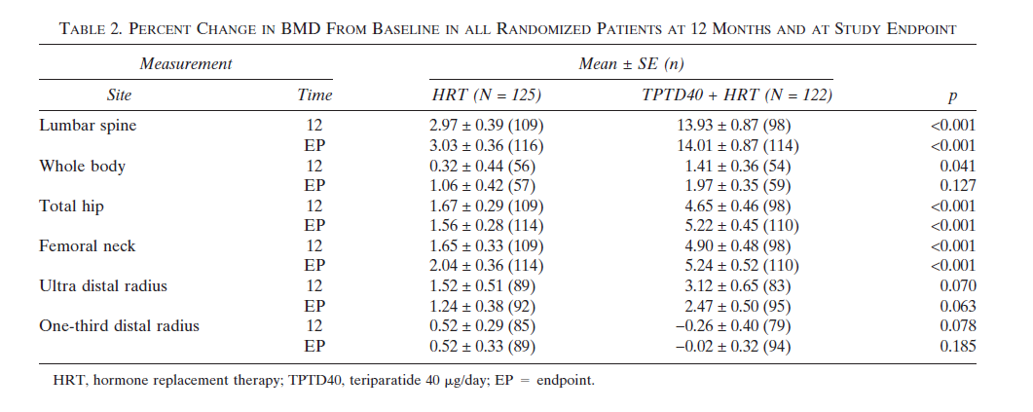

Slide 17
A 6-month randomized, double-blind trial
Teriparatide plus raloxifene(n=69) versus teriparatide plus placebo (n=68)
In postmenopausal women with osteoporosis

Slide 18
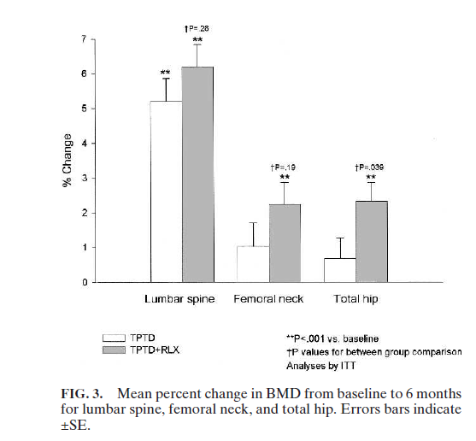

Slide 19
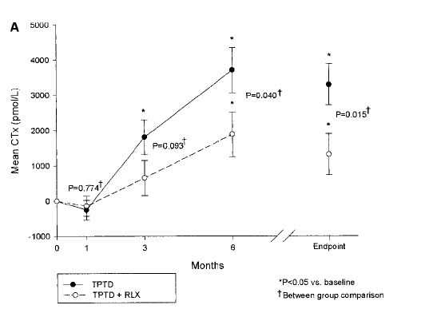
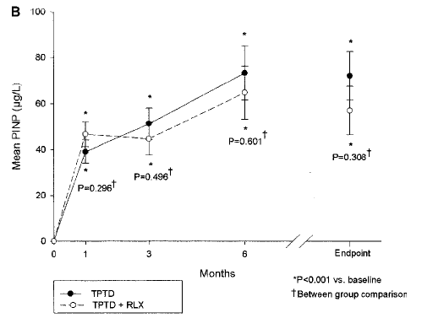

Slide 20
In conclusion, raloxifene blunted the increase in bone resorption observed with teriparatide therapy without decreasing bone formation
Combination therapy resulted in significantly increased BMD from baseline at the lumbar spine, femoral neck, and total hip, with a significantly greater effect at the total hip compared with teriparatide alone

Slide 21
TERIPARATIDE PLUS BISPHOSPHONATE

Slide 23
93 postmenopausal women with low bone density who have never received osteoporosis treatment
alendronate 10 mg daily (group 1)
teriparatide 40 micro sc daily (group 2)
or both (group 3)
for 30 months
Teriparatide was begun at month 6

Slide 24
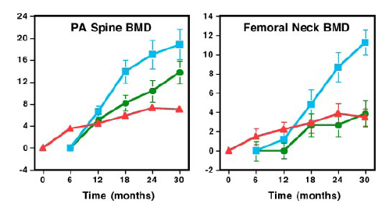
alendronate alone (n 29; red triangles)
teriparatide alone (n 20; blue squares),
or both (n 20; green circles)

Slide 25
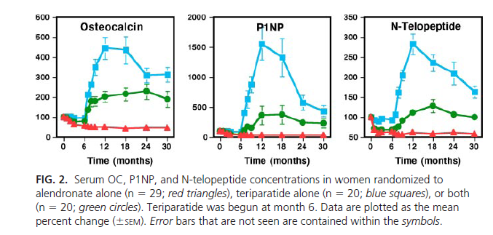

Slide 26
Key massage
Alendronate reduces the ability of teriparatide to increase BMD and bone turnover in women.
Finkelstein et al. J CEM 2010 1838–1845,

Slide 27
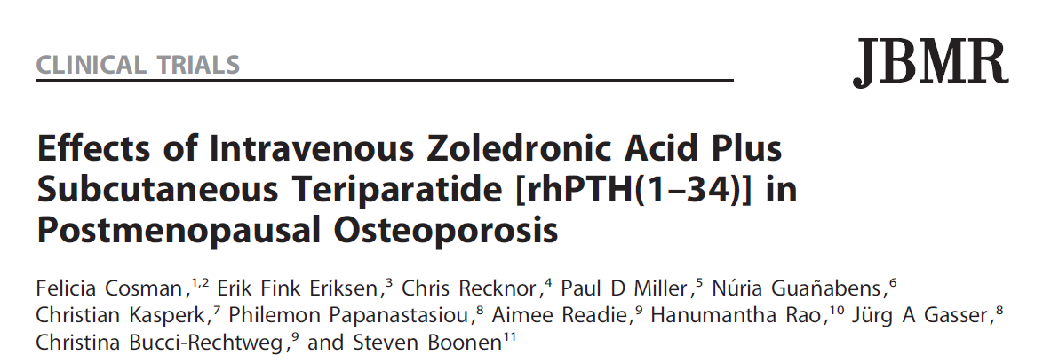

Slide 28
1-year multicenter, multinational, randomized, partial double-blinded, controlled trial.
412 postmenopausal women with osteoporosis were randomized to :
a single infusion of zoledronic acid 5mg plus daily subcutaneous teriparatide 20mg (n=137),
zoledronic acid alone(n=137),
or teriparatide alone (n=138)
The primary endpoint was percentage increase in lumbar spine BMD at 52 weeks versus baseline

Slide 29
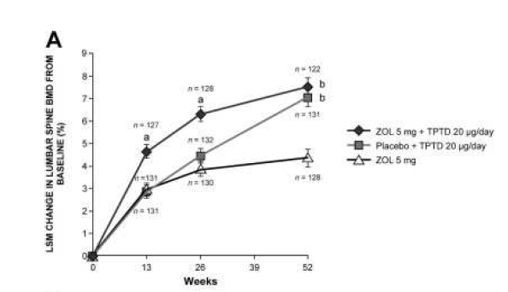
LSM percentage change in BMD from baseline at lumbar spine (A),

Slide 30
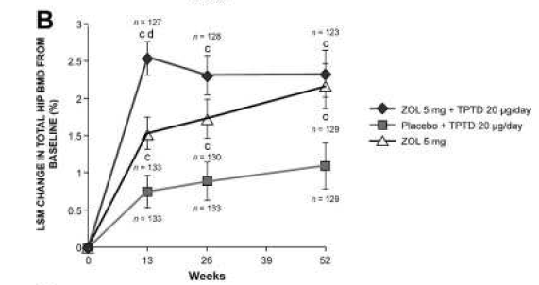
LSM percentage change in BMD from baseline at total hip (B),

Slide 31
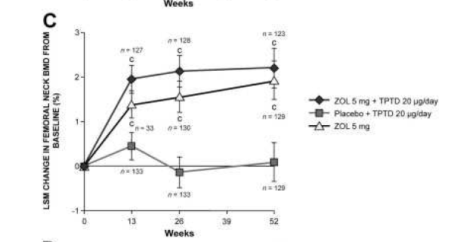
LSM percentage change in BMD from baseline at femoral neck (C),

Slide 32
teriparatide increases spine BMD more than zoledronic acid and zoledronic acid increases hip BMD more than teriparatide, combination therapy provides the largest, most rapid increments when both spine and hip sites are considered.

Slide 33
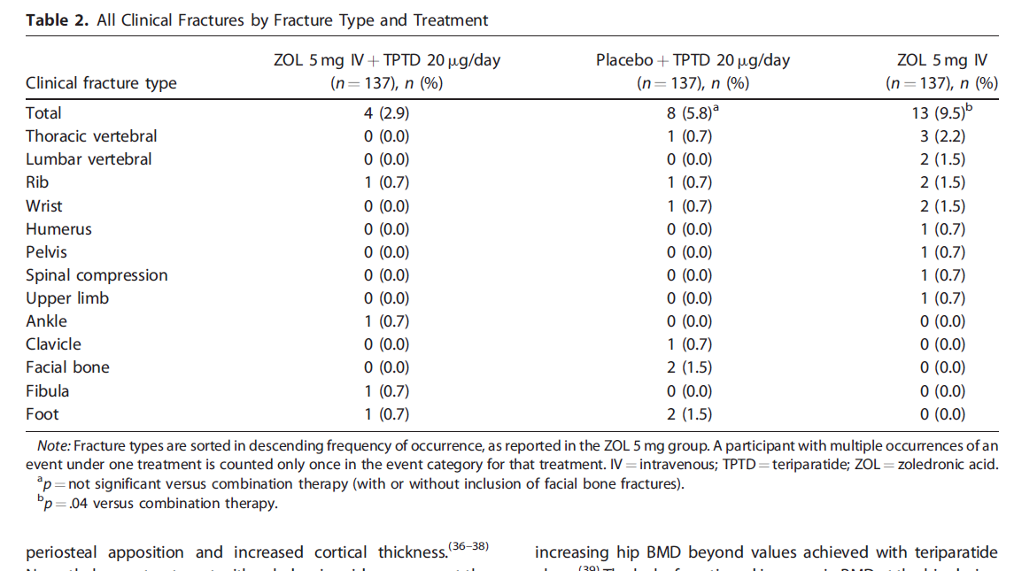
fracture data:
teriparatide + zoledronic acid: 2.9%
teriparatide-alone: 5.8%,,
zoledronic acid–alone ; 9.5%

Slide 34
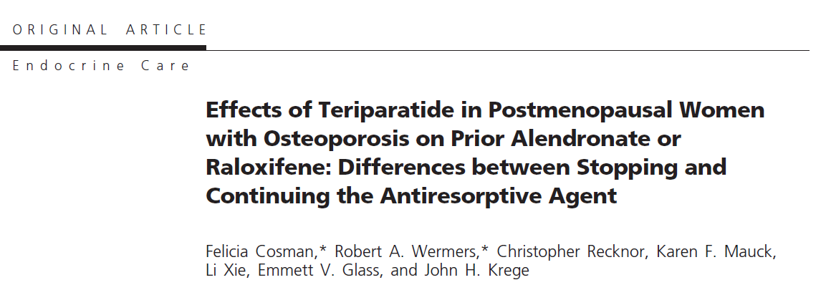

Slide 35
For patients who were treated with antiresorptive therapy, does teriparatide work better with the continuation or discontinuation of the prior therapy?

Slide 36
Patients and Interventions: Postmenopausal women with osteoporosis on alendronate or raloxifene for at least 18 months added teriparatide (Add groups) or switched to teriparatide (Switch groups) for 18 months
Main Outcome Measures: measured bone turnover markers (BTM) and bone mineral density (BMD)

Slide 37
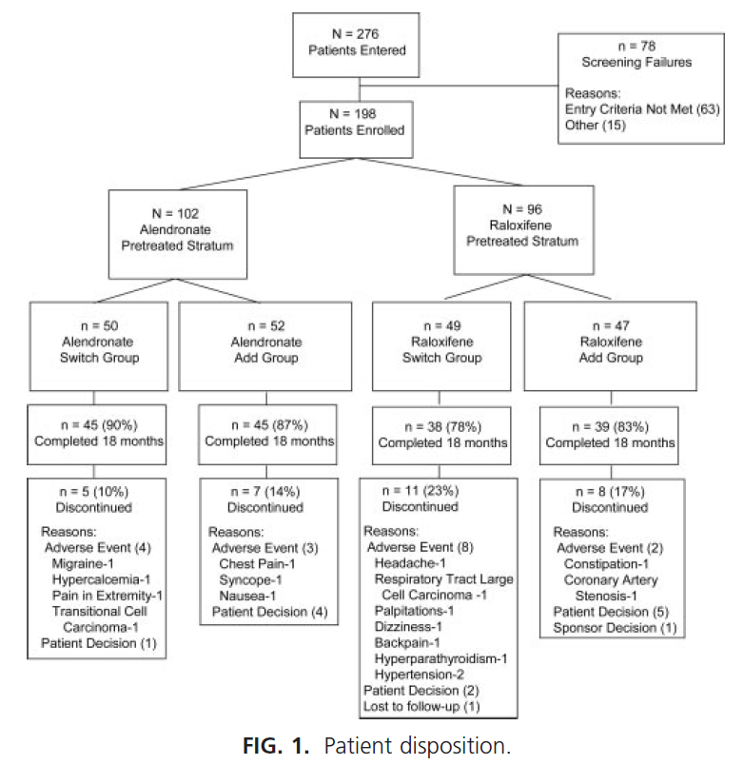

Slide 38
lumbar

Slide 39
Total hip

Slide 40
Femoral neck

Slide 41
The BMD response during this 18-month study was greater when teriparatide was added to ongoing antiresorptive therapy vs. switching from antiresorptive therapy to teriparatide

Slide 42
TERIPARATIDE PLUS DENOSUMAB

Slide 44
women with osteoporosis into this randomised, controlled trial
Patients were assigned in a 1:1:1 ratio
to receive 20 μg teriparatide daily
60 mg denosumab every 6 months
or both
BMD was measured at 0, 3, 6, and 12 months

Slide 45
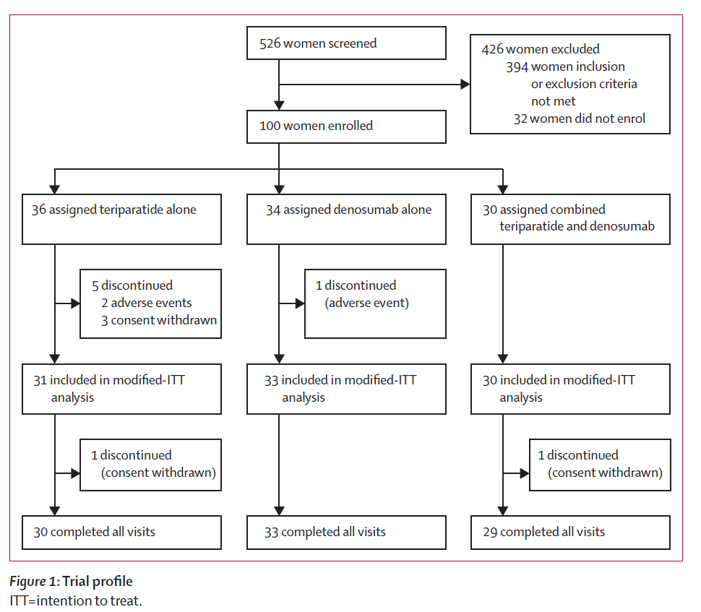

Slide 46
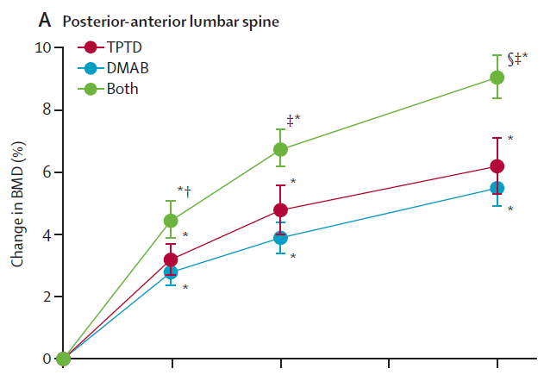
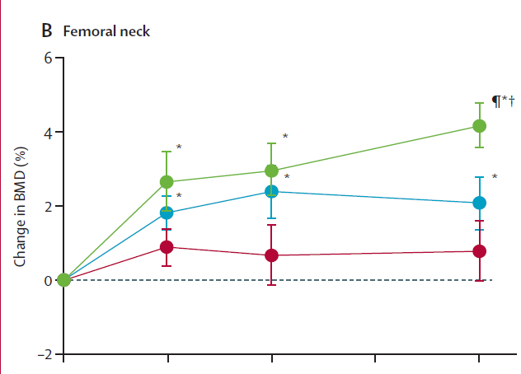
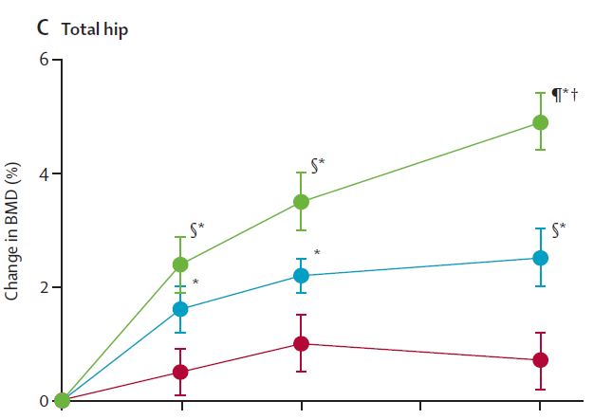

Slide 47
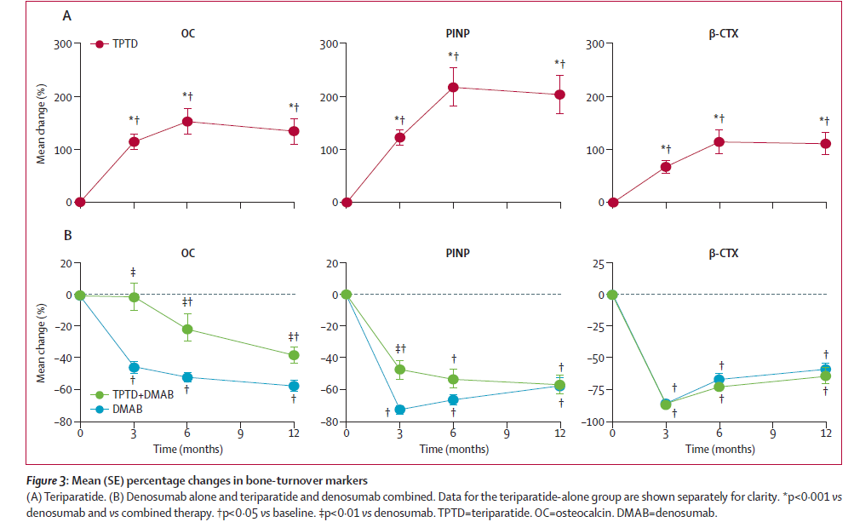

Slide 48
Combined teriparatide and denosumab increased BMD more than either agent alone
Combination treatment might be useful to treat patients at high risk of fracture

Slide 49
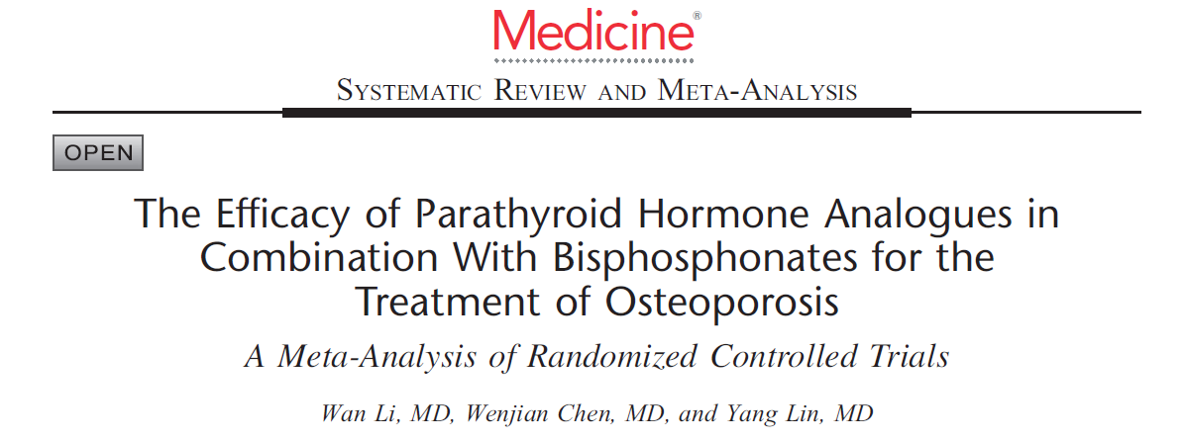

Slide 50
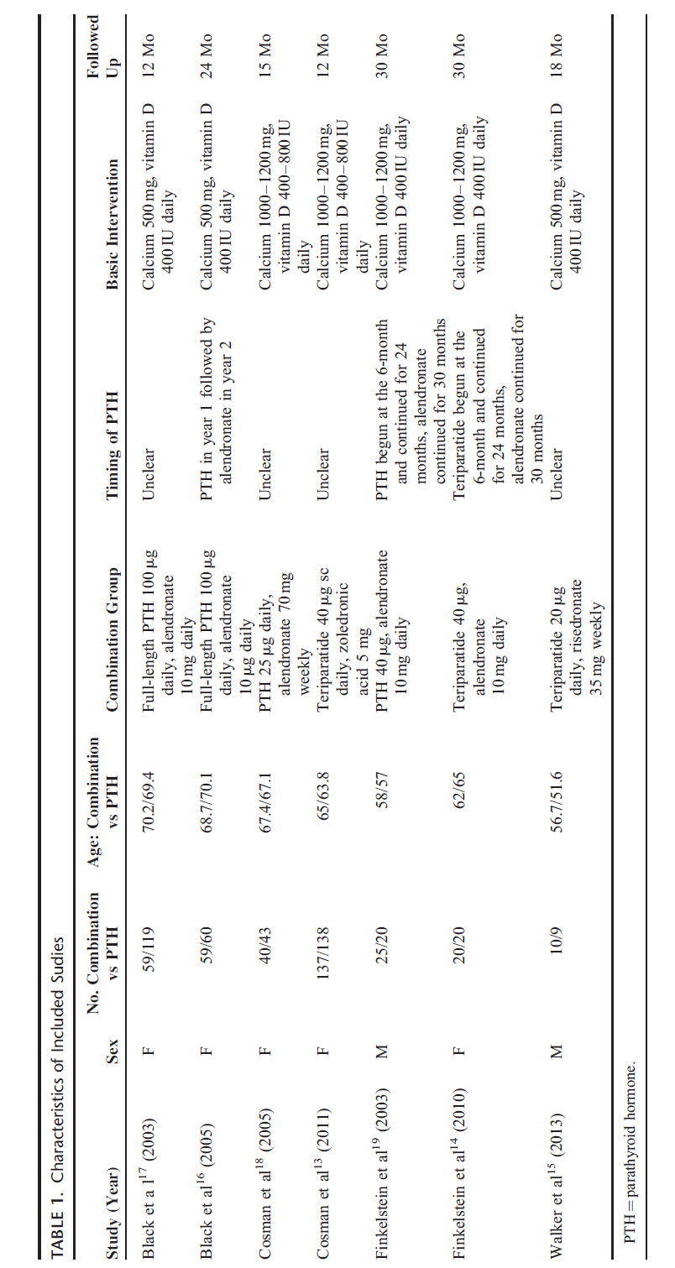

Slide 51
Mean Percent Change in Spine BMD
no significantly statistical differences in spine BMD at either 1 year (MD= -0.97; 95% CI 2.81 to 0.86; P=0.30) or 2 year (MD=-0.57; 95% CI 5.01 to 6.14; P=0.84) follow-up between combination group and PTH analogues group

Slide 52
Mean Percent Change in Hip BMD
Meta-analysis showed that combination group could significantly increase the hip BMD at 1 year (MD=1.16; 95% CI 0.56–1.76; P<0.01) than PTH analogues group
whereas there was no significant difference at 2-year (MD=1.38; 95% CI 0.76 to 3.51; P=0.21) follow-up between groups

Slide 53
Mean Percent Change in Femoral Neck BMD
Meta-analysis demonstrated that there were no significantly statistical differences in femoral neck BMD at 1 year (MD=0.60; 95% CI 0.91 to 2.10; P=0.44) and 2-year (MD=0.73; 95% CI 4.97 to 3.51; P=0.74) follow-up between the 2 groups

Slide 54
Fracture data

Slide 55
Conclusion
Based on 7 studies involving 641 patients
concluded that there was no evidence for the superiority of combination therapy, although significant change was found for hip BMD at 1 year in combination group
Further large multicenter RCTs are still need to investigate the efficacy of combination therapy

Slide 56
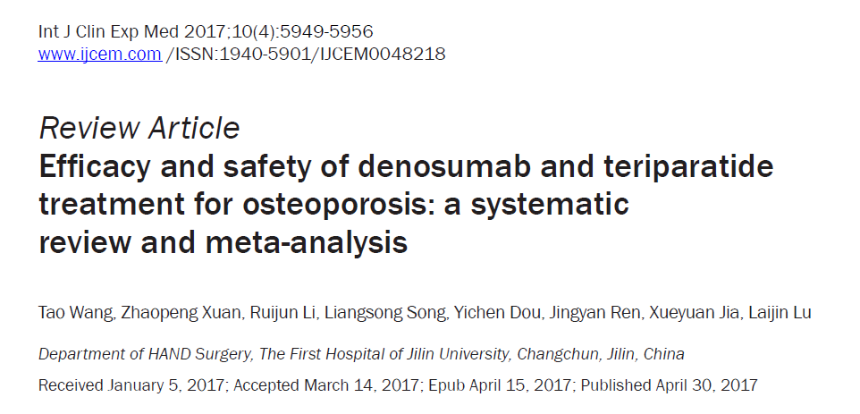

Slide 62
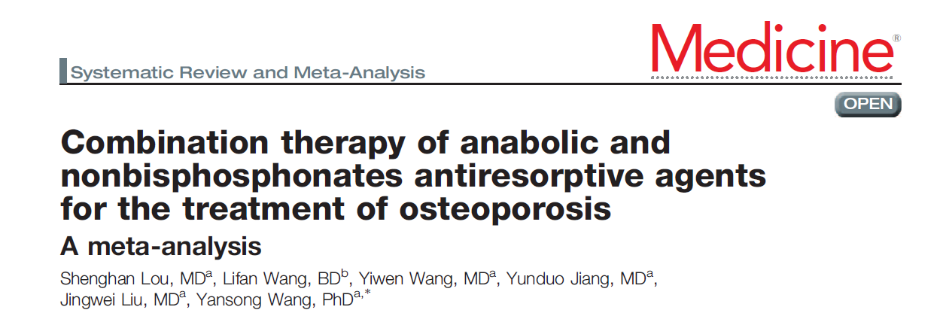

Slide 64
FRACTURE DATA

Slide 65
Lumbar BMD

Slide 66
TOTAL HIP BMD

Slide 67
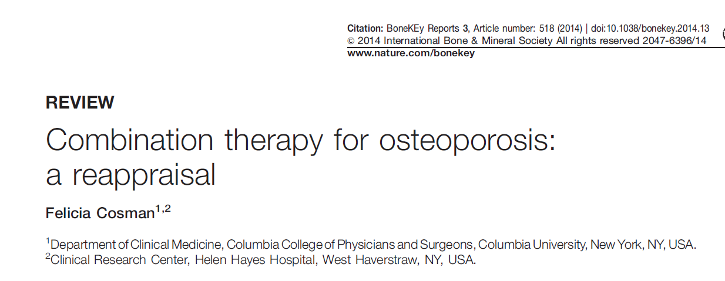

Slide 68
combination treatment might be clinically meaningful in some patients:
In patients on previous bisphosphonates who:
sustain a hip fracture or who have a very low hip BMD
or declining hip BMD while on their bisphosphonate,
adding TPTD might provide a substantial benefit over continuing bisphosphonate monotherapy or switching to TPTD monotherapy.
In treatment naive (and previously treated) individuals with multiple previous fractures,certain combination treatments might be warranted above monotherapy to achieve optimal short-term benefits on bone mass and potentially bone strength

Slide 69
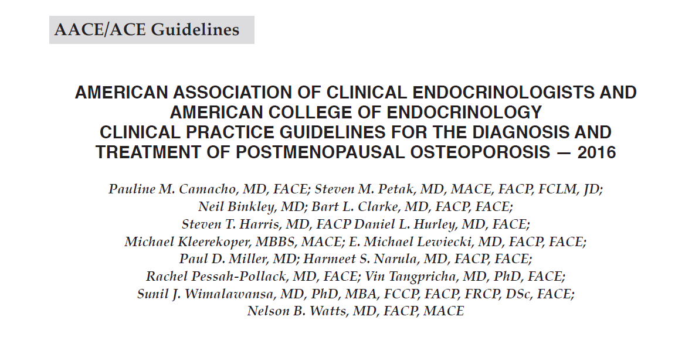

Slide 70
Is Combination Therapy Better Than Treatment With a Single Agent?
R35a. Until the effect of combination therapy on fracture risk is demonstrated AACE does not recommend concomitant use of these agents for prevention or treatment of postmenopausal osteoporosis (Grade C; BEL 4; expert consensus, upgraded due to cost and potential increased side effects).
• R35b. If estrogen is being given for treatment of menopausal symptoms or raloxifene is administered to reduce the risk of breast cancer, an additional agent such as a bisphosphonate, denosumab, or teriparatide may be considered in higher-rise patients (Grade D; BEL 4).
• R35c. Combined denosumab and teriparatide achieves a better BMD response versus either agent alone, but no fracture data are available. (Grade B; BEL 1; downgraded due to potential increased side effects and increased cost).

Slide 71
TAKE HOME MESSAGE
HT and Ral are consistently permissive with the use of TPTD/PTH both in treatment-naive and treatment-experienced women
Combination of an agent such as PTH with Aln or with Zol :does not provide greater increments in spine BMD compared with TPTD/PTH monotherapy but does result in consistent improvements in hip BMD outcomes compared with PTH or TPTD monotherapy

Slide 72
TAKE HOME MESSAGE
Combined teriparatide and denosumab increased BMD more than either agent alone
Combination treatment might, therefore, be useful to treat patients at high risk of fracture

Slide 73
Given the absence of fracture and long term follow-up data, and the additional cost and side effects of taking two agents, combination therapy is not recommended routinely

