Slide 1
Biomarkers of medullary thyroid cancer
AfkhamizadehM.
Assistant professor of endocrinology , Mashhad University of Medical Sciences

Slide 2
SECRETORY PRODUCTS OF MTC
Adrenocorticotropic hormone(ACTH)
B-melanocyte stimulating hormone
Calcitonin( Ctn)*
specific biomarker for the diagnosis of C-cell hyperplasia or MTC
Carcinoembryonic antigen (CEA)
Chromogranin
Neurotensin
Somatostatin
*Kihara M, Miyauchi A, Kudo T, et al (2016). Reference values of serum calcitonin with calcium stimulation tests by electrochemiluminescence immunoassay before/after total thyroidectomy in Japanese patients with thyroid diseases other than medullary thyroid carcinoma. Endocr J, 63, 627-32.

Slide 3
Main biomarkers of MTC
Calcitonin
Basal serum calcitonin
Correlate with tumor mass
almost always high in patients with a palpable tumor
Reflect tumor differentiation*
Overlap between MTC and CCH**
Calcitonin stimulation test
Pentagastrin
Calcium
CEA:
Useful for evaluating disease progression in patients following thyroidectomy as accessory marker
Procalcitonin
High procalcitonin to Ctn ratio is useful in predicting prognosis
A marked elevation in the serum CEA level out of proportion to a lower serum Ctn level or normal or low levels of both serum Ctn and CEA indicate poorly differentiated MTC
*Medullary thyroid carcinoma.Pacini F, Castagna MG, Cipri C, Schlumberger M. Clin Oncol (R Coll Radiol) 2010; 22:475.
**Papadakis G1, Keramidas I2, Triantafillou E2, Kanouta F2, Pappa T2, Kaltzidou V2, Tertipi A2, Iordanidou L3, Trivizaki E3, Vecchini G4, Villiotou V5, Pappas A2.Association of Basal and Calcium-stimulated Calcitonin Levels with Pathological Findings After Total Thyroidectomy. Anticancer Res. 2015 Jul;35(7):4251-8.

Slide 4
Causes of elevated calcitonin
Chronic renal failure
Hypercalcemia
Pseudohypoparathyroidism
Autoimmune thyroiditis
Mastocytosis
Hypergastrinemia
prolonged treatment with
Omeprazole
Beta blockers
Glucocorticoids
Papillary and follicular thyroid carcinomas
Small cell and large cell lung cancers
Prostate cancer
Neuroendocrine tumors*
*Hypercalcitoninemia is not pathognomonic of medullary thyroid carcinoma.AUToledo SP, Lourenço DM Jr, Santos MA, Tavares MR, Toledo RA, Correia-Deur JE SOClinics (Sao Paulo). 2009;64(7):699.

Slide 5
Causes of elevated calcitonin
cross-reactivity with procalcitonin
Heterophilic antibodies
In children <3 years of age
<6months : up to 40pg/ml
6 months – 3 years: up to 15pg/ml
Macrocalcitonin*
Less problems with ICMA (Immunochemiluminometric assay)
ECLIA : more accurate (electrochemiluminescence immunoassay) **
*Alves TG¹, Kasamatsu TS¹, Yang JH¹, Meneghetti MC¹, Mendes A¹, Kunii IS¹, Lindsey SC¹, Camacho CP¹, Dias da Silva MR¹, Maciel RM¹, Vieira JG¹, Martins JR¹.Macrocalcitonin Is a Novel Pitfall in the Routine of Serum CalcitoninImmunoassay. J Clin Endocrinol Metab. 2016 Feb;101(2):653-8. doi: 10.1210/jc.2015-3137.
**Kahaly GJ1, Algeciras-Schimnich A2, Davis TE3, Diana T⁴, Feldkamp J5, Karger S6, König J7, Lupo MA8, Raue F9, Ringel MD10, Sipos JA10, Kratzsch J11.United States and European Multicenter Prospective Study for the Analytical Performance andClinical Validation of a Novel Sensitive Fully Automated Immunoassay for Calcitonin. Clin Chem. 2017 Sep;63(9):1489-1496. doi: 10.1373/clinchem.2016.270009.

Slide 6
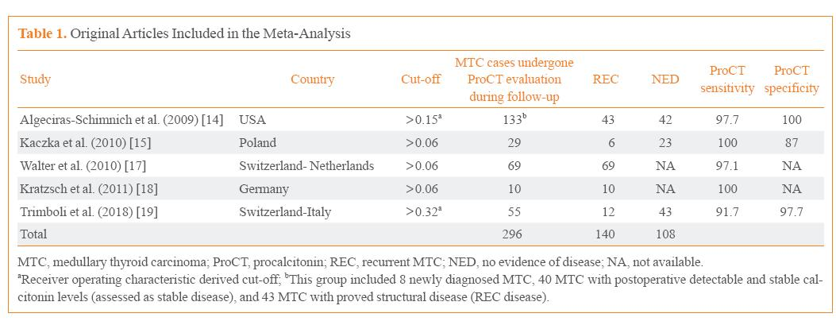
Procalcitonin
Pierpaolo Trimboli, Luca Giovanella.Procalcitonin as Marker of Recurrent Medullary Thyroid Carcinoma: A Systematic Review and Meta-Analysis. Endocrinol Metab 2018;33:204-210

Slide 7
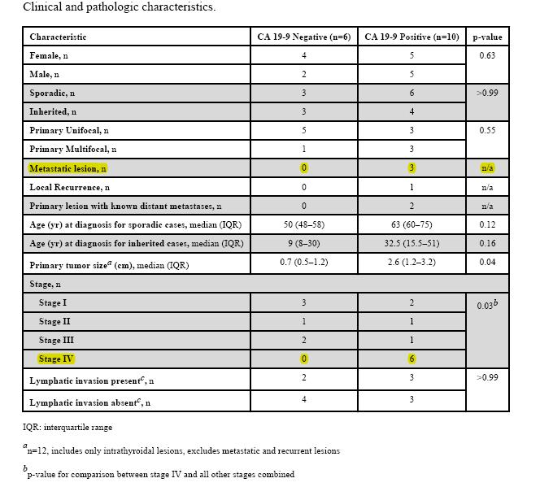
CA19-9
Medullary Thyroid Cancer That Stains Negative For CA 19-9 Has Decreased Metastatic Potential..Endocr Pract. 2015 June ; 21(6): 590–594

Slide 8
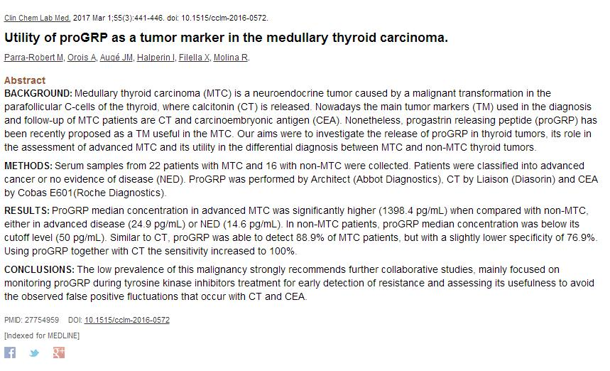
proGRP

Slide 9
Case 1
A 42 years old woman with a firm neck swelling with no other associated complaints
No Family history of MEN syndrome and thyroid diseases
No palpable cervical lymph node
Normal TSH
Ultra sound: a 15*10 mm hypoecho nodule without microcalcification in the upper pole of left lobe
FNA: follicular neoplasm
Lobectomy was performed
Thyroid lobe pathology: MTC
Repeated US after surgery: one lymph node in central neck region
Calcitonin = 160pg/ml
RET germline mutation: negative

Slide 10
Should calcitonin be checked preoperatively ?

Slide 11
Should calcitonin be measured in all thyroid nodule?
Advantages of calcitonin screening :
Better prognosis
early diagnosis and radical surgical treatment reduce MTC-related morbidity and mortality
Sensitivity of FNA for presurgical MTC diagnosis: 40%–50%
Calcitonin measurement of thyroid nodule FNA washings may improve the sensitivity of the test
Reasons against screening:
Increased basal serum calcitonin in 0.5 to 5 % of patients with thyroid nodules
falsely high serum calcitonin values
Pentagastrin is not available in some countries
Potential complications of thyroidectomy in patients with abnormal Ctn who have no MTC
No clearcut evidence that sporadic CCH progresses to MTC
Is screening cost-effective ?

Slide 12
Calcitonin screening of thyroid nodules
ETA :
2006, recommended for it
2010 recommended it only in the presence of clinical risk factors
ATA :declined to recommend for or against this approach
In the United States : controversial *
Elevated basal calcitonin level: repeat the test in the absence of possible modifiers
Calcitonin<100 pg/mL: perform a calcium stimulation test
A Ctn value>100pg/ml should be considered suspicious and an indication for treatment
A Korean study: cutoff of 65 pg/mL
Cutoff of calcium stimulated calcitonin for women:
<67.6pg/mL before total thyroidectomy
<0.5 pg/mL after total thyroidectomy**
* is systematic calcitonin screening appropriate in patients with nodular thyroid disease? Costante G, Filetti S. Early diagnosis of medullary thyroid carcinoma: Oncologist 2011; 16:49.
**Kihara M¹, Miyauchi A², Kudo T³, Hirokawa M⁴, Miya A².Serum calcitonin reference values for calcium stimulation tests by electrochemiluminescence immunoassay in Japanese men with non-medullarythyroid carcinoma. ** Surg Today. 2018 Feb;48(2):223-228. doi: 10.1007/s00595-017-1578-7. Epub 2017 Aug 18.

Slide 13
Clinical and paraclinical features suggestive of MTC
Location in the upper third of a lobe
Family history or clinical suspicion of MTC or MEN2
Suspicious US findings
Flushing and/or diarrhea
Indeterminate /nondiagnostic FNA

Slide 14
The nodule was in the upper pole of thyroid , so calcitonin measurement might help in this patient.

Slide 15
Would any other procedure help to diagnose MTC before surgery?

Slide 16
Calcitonin measurement in the FNA washout fluid
Inconclusive FNA findings or FNA suggestive of MTC
Calcitonin in the FNA washout fluid is recommended
Trimboli P^{1,2}, Guidobaldi L³, Bongiovanni M⁴, Crescenzi A⁵, Alevizaki M⁶, Giovanella L¹.Use of fine-needle aspirate calcitonin to detect medullary thyroid carcinoma: A systematic review. Diagn Cytopathol. 2016 Jan;44(1):45-51. doi: 10.1002/dc.23375.

Slide 17
41 patients
FNA-Ctn distinguished nodules that were MTC from those that were not without overlapping results
Rosario PW¹, Calsolari MR¹.Basal Serum Calcitonin, After Calcium Stimulation, and in the Needle Washout of Patients with Thyroid Nodules and Mild or Moderate Basal Hypercalcitoninemia. Horm Metab Res. 2017 Feb;49(2):129-134. doi: 10.1055/s-0042-121895.
No MTC
basal Ctn≤24.6 pg/ml
stimulated Ctn≤186.5 pg/ml
All without MTC
Ctn<47 pg/ml
stimulated Ctn<655.2 pg/ml
Basal Ctn between 24.6 and 47 pg/ml : 25%had MTC
Stimulated Ctn between 186.5 and 655.2 pg/ml : 22.2%MTC

Slide 18
Is completion thyroidectomy recommended?

Slide 19
MTC completion thyroidectomy following unilateral thyroidectomy
RET germline mutation
Elevated postoperative calcitonin
Imaging studies indicating residual MTC
The presence of an enlarged lymph node in association with a normal serum Ctn level is not an indication for repeat surgery.

Slide 20
Calcitonin was more than normal (5.2) , hence completion thyroidectomy was performed

Slide 21
What is the plan for neck dissection?

Slide 22
Lymph node dissection
Based on :
Location and size of the primary MTC
Frequency and pattern of lymph node metastases relation to location of primary MTC
US findings
Serum levels of calcitonin and CEA

Slide 23
Intra operative calcitonin stimulation test

Slide 24
Calcitonin relation to lymph node involvement
Calcitonin level <20 pg/mL: no risk of lymph node metastases
Calcitonin >20 :Lymph node metastases in the ipsilateral central and lateral neck
Calcitonin>50 : contralateral central neck
Calcitonin >200: contralateral lateral neck
Calcitonin >500 pg/ml: upper mediastinum
Biomarker-based risk stratification for previously untreated medullary thyroid cancer.AUMachens A, Dralle H SOJ Clin Endocrinol Metab. 2010 Jun;95(6):2655-63. Epub 2010 Mar 25.

Slide 25
Lymph node dissection in patients with normal ultrasound
Ipsilateral central and ipsilateral lateral neck compartments
calcitonin > 20 pg/mL
Elective dissection of contralateral lateral neck compartment
Calcitonin > 200 pg/mL

Slide 26
We don’t have calcitonin before lobectomy, now calcitonin is > 50, so at least she needs central and ipsilateral lateral dissection but we couldent decide for contralateral lateral dissection based on calcitonin

Slide 27
Postoperative follow up of the patient
Histopathology after completion thyroidectomy: MTC and lymph node involvement of central region of neck
Three month later : calcitonin =25pg/ml ,CEA=12

Slide 28
Is it any other imaging study recommended?

Slide 29
Preoperative imaging for evaluation of distant metastases
Imaging other than neck ultrasound*
Indications:
Extensive neck disease
Signs or symptoms of distant metastases or
Preoperative serum basal calcitonin >500pg/mL
*Machens A, Dralle H. Biomarker-based risk stratification for previously untreated medullary thyroid cancer. J Clin Endocrinol Metab 2010; 95:2655.

Slide 30
Imagings modalities
Chest CT, neck CT, three-phase contrast-enhanced liver CT or MRI
Axial MRI, and bone scintigraphy( individualized)
¹⁸F-DOPA PET/CT or FDG-PET scanning :
calcitonin levels>1000 :sensitivity 78
Gallium-68 Dotatate PET/CT*
Radionuclide imaging
111-In-octreotide
99m-Tc-DMSA
somatostatin receptor with ^{99m}Tc-HYNIC-TOC
not reutinely recommended
*Tran K1, Khan S, Taghizadehasl M, Palazzo F, Frilling A, Todd JF, Al-Nahhas A.Gallium-68 Dotatate PET/CT is superior to other imaging modalities in the detection of medullary carcinoma of the thyroid in the presence of high serum calcitonin. Hell J Nucl Med. 2015 Jan-Apr;18(1):19-24. doi: 10.1967/s002449910163.

Slide 31
Postoperative evaluation of distant metastases
Indicated if calcitonin >150
Our patient’s calcitonin was <150 after thyroidectomy so she didn’t need imaging more than neck US
before completion thyroidectomy she was neither in preoperative group nor in postoperative group and it wasn’t possible to decide for imaging based on calcitonin

Slide 32
What is the follow up plan?

Slide 33
Calcitonin < 10 pg/mL : biochemically cured
Persistent hypercalcitoninemia : in 40% to 60% of patients after initial therapy
Biochemical persistent or structural persistent

Slide 34
Follow up based on calcitonin
Undetectable or within the normal range
measure calcitonin every 6 months for 1 year, and then yearly thereafter
Calcitonin <150
Physical examination and neck US
Measurement of serum levels of Ctn and CEA, and US every 6 months
Calcitonin > 150 pg/mL:
Imaging procedures other than neck US

Slide 35
Case 2
A 22 years old woman
Thyroid nodule 21*22 mm
FNA : MTC
Calcitonin= 210
Thyroidectomy and lymph node dissection( central and lateral)
3months later : calcitonin= 10
6 months later: calcitonin =12
12 months later: calcitonin= 13.5
18 months later: calcitonin=15
24 months later:clcitonin=16
Is MTC in this patient aggressive?

Slide 36
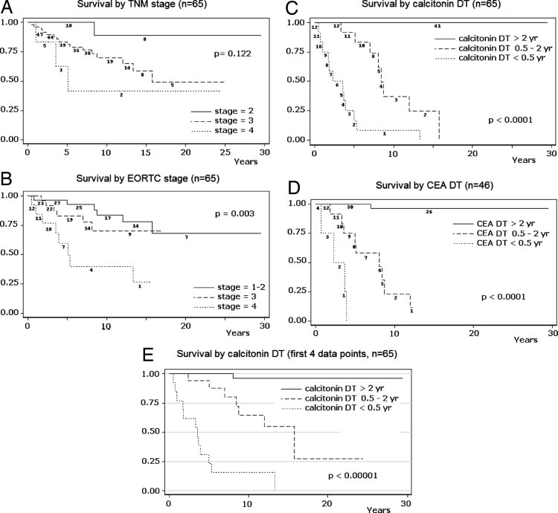
Doubling time
Barbet J,Prognostic impact of serum calcitonin and carcinoembryonic antigen doubling-times in patients with medullary thyroid carcinoma. J Clin Endocrinol Metab 2005 ,90:6077–6084

Slide 37
Doubling time
Assessment of calcitonin and CEA doubling times postoperatively
Sensitive markers for progression and aggressiveness of metastatic MTC*
*Meijer JA1, le Cessie S, van den Hout WB, Kievit J, Schoones JW, Romijn JA, Smit JW.Calcitonin and carcinoembryonic antigen doubling times as prognostic factors in medullary thyroid carcinoma: a structured meta-analysis. Clin Endocrinol (Oxf). 2010 Apr;72(4):534-42. doi: 10.1111/j.1365-2265.2009.03666.x.
Progression of medullary thyroid carcinoma: assessment with calcitonin and carcinoembryonic antigen doubling times.AULaure Giraudet A, Al Ghulzan A, Aupérin A, Leboulleux S, Chehboun A, Troalen F, Dromain C, Lumbroso J, Baudin E, Schlumberger M SOEur J Endocrinol. 2008 Feb;158(2):239-46.
www.thyroid.org/thyroid-hysiciansprofessionals/ calculators/thyroid-cancer-carcinoma

Slide 38
Follow up of case 2
5 years after thyroidectomy: calcitonin= 40
Imaging: mediastinal metastasis
10years after thyroidectomy : calcitonin=160
Doubling time of calcitonin was more than 2 years,so it was expected 100% survival for ten years

Slide 39
Summary
Main biomarkers of MTC are calcitonin and CEA
False positive and negative results of calcitonin should be considered in interpretation of this test
Procalcitonin use is controversial
proGRP is suggested for differentiation between advanced MTC and other cancers with metastasis to thyroid
Calcitonin screening of all nodules is controversial
Calcitonin is useful for choosing lymph node dissection
In patients with calcitonin > 500 before surgery and >150 after surgery imaging other than neck US are recommended
Calcitonin doubling time is used for determining aggressiveness of tumor

Slide 40
Thank you for attention
Imam Reza Hospital, Mashhad ,Iran

