Slide 2
Self-Monitoring of Blood Glucose (SMBG)
Dr Sara Kazempour MD PhD
Research Institute for Endocrine Sciences
Shahid Beheshti University of Medical Sciences

Slide 3
What?
Self-monitoring of blood glucose (SMBG) is an important component of modern therapy for diabetes
SMBG has been recommended for people with diabetes and their health care professionals in order to achieve a specific level of glycemic control and to prevent hypoglycemia

Slide 4
What?
The goal of SMBG is to collect detailed information about blood glucose levels at many time points to enable maintenance of a more constant glucose level by more precise regimens
It can be used to aid in the adjustment of a therapeutic regimen in response to blood glucose values and to help individuals adjust their dietary intake, physical activity, and insulin doses to improve glycemic control on a day-to-day basis

Slide 5
Why?
SMBG is an integral component of effective therapy
SMBG allows patients to evaluate their individual response to therapy and assess whether glycemic targets are being achieved
Evidence supports a correlation between greater SMBG frequency and lower A1C
The Diabetes Control and Complications Trial Research Group. The effect of intensive treatment of diabetes on the development and progression of long-term complications in insulin-dependent diabetes mellitus. N Engl JMed 1993;329:977–986

Slide 6
When?
The patient’s specific needs and goals should dictate SMBG frequency and timing
Most experts agree that insulin treated patients should monitor blood glucose at least four times a day, most commonly fasting, before meals, and before bed
In addition, patients using insulin can benefit by obtaining postprandial blood glucose readings to help them more accurately adjust their insulin regimen

Slide 7
When?
A positive correlation between frequency of SMBG and glycemic control among patients with insulin-treated type 1 or type 2 diabetes has been demonstrated
Patients treated with intermediate, short-acting, or rapid-acting insulin may benefit from SMBG data to make adjustments in their regimen
Miller KM, Beck RW, Bergenstal RM, et al.; T1D Exchange Clinic Network. Evidence of a strong association between frequency of self-monitoring of blood glucose and hemoglobin A1c levels in T1D Exchange clinic registry participants. Diabetes Care 2013;36:2009–2014

Slide 8
When?
Most patients on multiple-dose insulin or insulin pump therapy, including patients with type 1 diabetes should consider SMBG around 6–10 (or more) times daily, although individual needs may vary
A database study of children and adolescents with type 1 diabetes showed that increased daily frequency of SMBG was significantly associated with lower A1C (20.2% per additional test per day) and with fewer acute complications
Ziegler R, Heidtmann B, Hilgard D, Hofer S, Rosenbauer J, Holl R; DPV-Wiss-Initiative. Frequency of SMBG correlates with HbA1c and acute complications in children and adolescents with type 1 diabetes. Pediatr Diabetes 2011;12:11–17

Slide 9
When?
The evidence is insufficient regarding when to prescribe SMBG and how often testing is needed for patients who do not use an intensive insulin regimen, such as those with type 2 diabetes using basal insulin or oral agents
Several randomized trials have called into question the clinical utility and cost-effectiveness of routine SMBG in non-insulin treated patients
Farmer A, Wade A, Goyder E, et al. Impact of self monitoring of blood glucose in the management of patients with non- insulin treated diabetes: open parallel group randomised trial. BMJ 2007;335:132
O’Kane MJ, Bunting B, Copeland M, Coates VE; ESMON Study Group. Efficacy of self monitoring of blood glucose in patients with newly diagnosed type 2 diabetes (ESMON study): randomised controlled trial. BMJ 2008;336: 1174–1177
Simon J, Gray A, Clarke P, Wade A, Neil A, Farmer A; Diabetes Glycaemic Education and Monitoring Trial Group. Cost effectiveness of self monitoring of blood glucose in patients with non-insulin treated type 2 diabetes: economic evaluation of data from the DiGEM trial. BMJ 2008;336:1177–1180

Slide 10
ADA Recommendations on SMBG
Patients on multiple-dose insulin or insulin pump therapy should perform SMBG prior to meals and snacks, occasionally post-prandially, at bedtime, prior to exercise, when they suspect low blood glucose, after treating low blood glucose until they are normoglycemic, and prior to critical tasks such as driving. B (Supportive evidence from well-conducted cohort/case-control studies )
When prescribed as part of a broader educational context, SMBG results may help guide treatment decisions and/or self-management for patients using less frequent insulin injections B or noninsulin therapies. (Expert consensus)
When prescribing SMBG, ensure that patients receive ongoing instruction and regular evaluation of SMBG technique, SMBG results, and their ability to use SMBG data to adjust therapy. (Expert consensus)

Slide 11
How?
SMBG accuracy is dependent on the instrument and user, so it is important to evaluate each patient’s monitoring technique, both initially and at regular intervals thereafter
A key consideration is that performing SMBG alone does not lower blood glucose levels and the information must be integrated into clinical and self-management plans
The ongoing need for and frequency of SMBG should be reevaluated at each routine visit
Wang J, Zgibor J, Matthews JT, Charron-Prochownik D, Sereika SM, Siminerio L. Selfmonitoring of blood glucose is associated with problem-solving skills in hyperglycemia and hypoglycemia. Diabetes Educ 2012;38:207–218

Slide 12
How?
Among patients who check their blood glucose at least once daily, many report taking no action when results are high or low
Patients should be taught how to use SMBG data to adjust food intake, exercise, or pharmacological therapy to achieve specific goals.
SMBG is especially important for insulin-treated patients to monitor for and prevent asymptomatic hypoglycemia and hyperglycemia

Slide 13
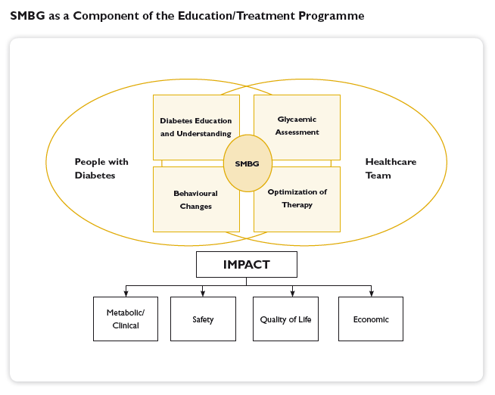

Slide 14
SMBG Protocols
Intensive or ‘focused’ SMBG protocols
use ‘pattern analysis’, a systematic approach to creating glucose profiles that can identify daily glycemic patterns and then take appropriate action based upon those results
These profiles can be generated by performing 5 to 7 measurements per day over 1 to 3 days, or through ‘staggered’ testing, in which the individual performs pre- and postprandial testing for alternating meals over the course of a week

Slide 15
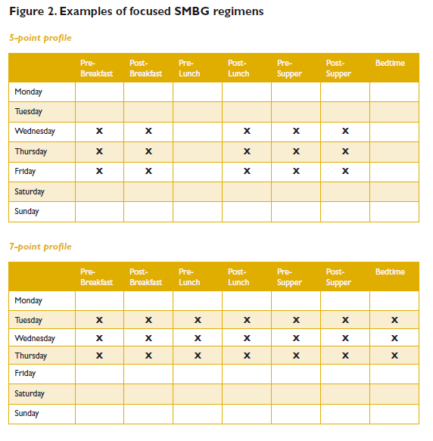

Slide 16
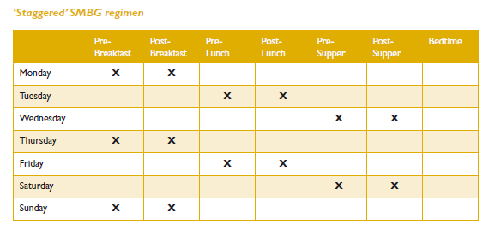

Slide 17
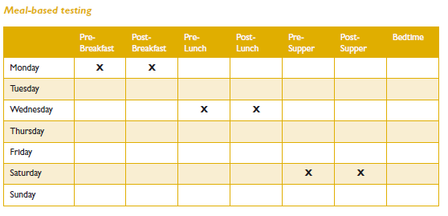
SMBG Protocols
Meal-based SMBG
helps individuals with diabetes understand the effects of their treatment on blood glucose concentrations , assists clinicians in identifying postprandial hyperglycaemia, guides therapeutic adjustments, provides more timely feedback regarding medication changes

Slide 18
SMBG Protocols
A more comprehensive approach, which has been used in early education programs with good results, is to perform 3 tests per day (2 times per week – one weekday and one weekend day) – fasting and preprandial/ postprandial at the largest meal (often supper) for a few weeks
 | Pre-B | Post-B | Pre-L | Post-L | Pre-D | Post-D | Bedtime
Monday
Tuesday | x |  |  |  | x | x
Wednesday
Thursday
Friday | x |  |  |  | x | x
Saturday
Sunday | x |  |  |  | x | x
Rickheim PL, Weaver TW, Flader JL et al. Assessment of group versus individual diabetes education: a randomized study. Diabetes Care. 2002;25:269-274.

Slide 19
SMBG Protocols
Monitor fasting glucose to track trends in glucose control
 | Pre-B | Post-B | Pre-L | Post-L | Pre-D | Post-D | Bedtime
Monday | x
Tuesday | x
Wednesday | x
Thursday | x
Friday | x
Saturday | x
Sunday | x

Slide 20
SMBG Protocols
Monitor preprandial /postprandial (largest meal first) during week and weekend for a few weeks and then change diet and exercise to optimize the result
Then monitor preprandial/postprandial glucose at another meal and repeat it.
 | Pre-B | Post-B | Pre-L | Post-L | Pre-D | Post-D | Bedtime
Monday
Tuesday |  |  | x | x
Wednesday |  |  | x | x
Thursday
Friday
Saturday
Sunday |  |  | x | x
 | Pre-B | Post-B | Pre-L | Post-L | Pre-D | Post-D | Bedtime
Monday |  |  |  |  | x | x
Tuesday
Wednesday |  |  |  |  | x | x
Thursday
Friday
Saturday |  |  |  |  | x | x
Sunday

Slide 21
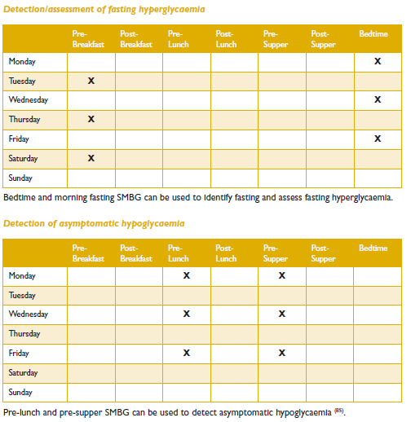
Hoffman RM, Shah JH, Wendel CS et al. Evaluating once- and twice-daily self-monitored blood glucose testing strategies for stable insulin-treated patients with type 2 diabetes : the diabetes outcomes in veterans study. Diabetes Care. 2002;25:1744-1748.

Slide 22
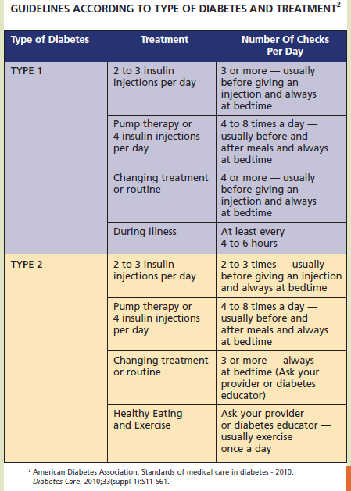
SMBG Protocols
ADA Standards of medical care in diabetes – 2010. Diabetes Care. 2010; 33 (suppl 1): S11-S61

Slide 23
SMBG Practicalities
Strips:
Should be handled with clean, dry hands
Single use and unique to each meter
Must be kept in original canister to avoid moisture
Expiration dates must be checked
Must be kept in cool and dry place and out of direct sunlight
Meters:
Should be handled with dry, clean hands
Some require coding with each canister
Should regularly be checked for comparative accuracy

Slide 24
SMBG Practicalities
Lancing procedure:
Clean area with warm soapy water and dry
Lancets should not be reused or cleaned as they can quickly become dull
Depth settings on lancing devices set the penetration of the stick and can be adjusted for comfort
Sides of the fingers should be used as there is less pain
The 3rd, 4th, 5th fingers are less painful than thumb and index fingers
Some meters approve of alternate test sites (upper arm and thighs); fingertips and outer palm are more accurate
Obtainment of blood should be through a gentle milking from base of finger and not directly on the site of lancing
Disposal of lancets and strips should comply with local sharps laws (sharps bin with screwed top can go in household trash)

Slide 25
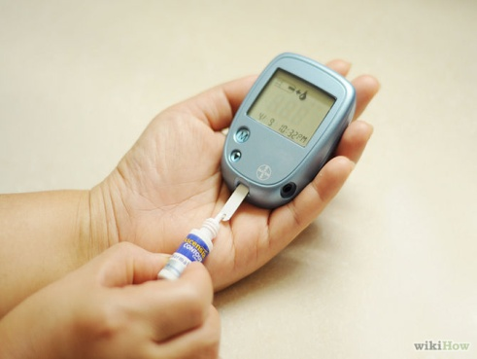
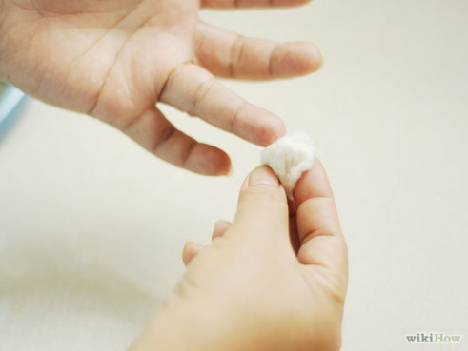
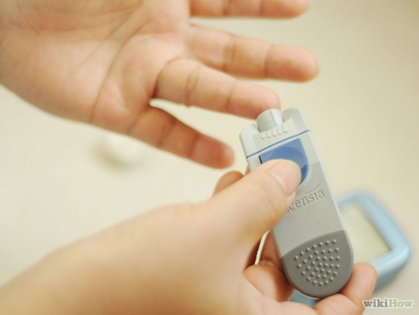
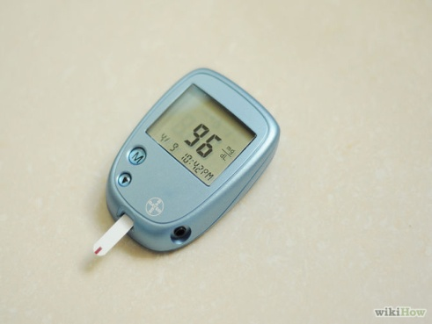
How?

Slide 26
SMBG Practicalities
Tips for successful SMBG education:
Use simple and specific steps
Be sure the patient can demonstrate the steps of SMBG
Observe SMBG procedure at follow-up visits
Give patients written recommendations for frequency and times of testing and desired results
Ask the patient to assess the relationship of SMBG with exercise, food, medications and stress
Specify when SMBG values are most problematic (especially hypos)
Acknowledge the patient for goals achieved with SMBG

Slide 27
SMBG Methodology
Enzymatic amperometric glucose biosensors are the most common devices commercially available, and have been widely studied over the last few decades
Generally, glucose measurements are based on interactions with one of three enzymes:
hexokinase
glucose oxidase (GOx)
glucose-1-dehydrogenase (GDH)
The hexokinase assay is the reference method for measuring glucose using spectrophotometry in many clinical laboratories
Glucose biosensors for SMBG are usually based on the two enzyme families, GOx and GDH.

Slide 28
SMBG Methodology
Chemicals that alter blood glucose measurements

Slide 29
SMBG Methodology
Chemicals that alter blood glucose measurements:
Acetaminophen, in therapeutic concentrations, results in lower and higher glucose measurements with the GOX and GDH POCGMD techniques, respectively.
This may be particularly problematic in overdose patients,in whom hypoglycemia may develop in the presence of hepatic failure.
The presence of high doses of ascorbic acid has the potential to read falsely low in GOX- and GDH-based devices

Slide 30
SMBG Accuracy
What to look for:
ISO 15197 (2013: bias < 15%)
FDA approval
ADA standard (bias < 5%)
Diabetes Sci Technol Vol 6, Issue 2, March 2012

Slide 31
SMBG Problems
Hand washing has always been a problem, but now, with microsample meters, the smallest amount of contaminant can significantly raise the blood glucose
Three naturally occurring substances interfere with electrochemical glucose oxidase based strips: triglycerides, oxygen, and uric acid
Very high TG levels can lead to reduced water content in plasma and lead to “pseudohypoglycemia”
Errors with GOX measurement techniques can occur when PaO2 (blood oxygen content) exceeds 100 mm Hg (underestimation) or falls below 44 mm Hg (overestimation) depending on the type of test strip and measurement method
Uric acid is usually problematic only in very high levels leading to severe gout
J Diabetes Sci Technol Vol 3, Issue 4, July 2009
Diabetes Sci Technol Vol 6, Issue 2, March 2012

Slide 32
SMBG Problems
Altered temperatures:
low temperature diminishes circulation to the skin; does not influence glucose taken from a fingertip, but the blood flow to the skin of the forearm is dramatically decreased and can have a lag of up to an hour when the arm is cooled (instead of the usual 15-30 mins)
Conversely, the effects of fever are unknown
pH : As with any enzymatic reaction changes in pH may affect the performance of the meter. This has not been shown to be a major source of error at a pH range of 6.97–7.84 (32) or at lower pH (6.8 –7.55)
Diabetes Sci Technol Vol 6, Issue 2, March 2012

Slide 33
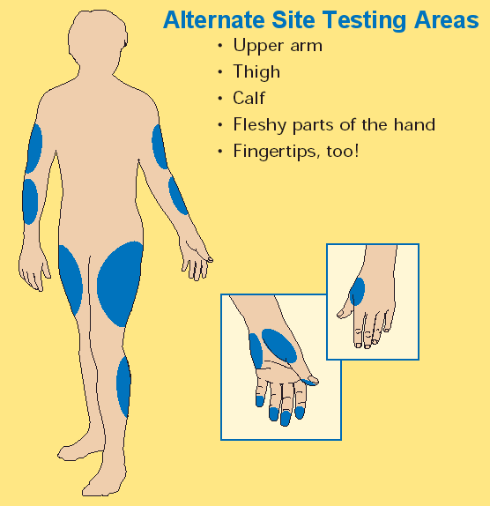

Slide 34
