Slide 1
Bilateral Adrenal incidentaloma
Based on a 52 y/o female patient with bilateral adrenal incidentaloma
A.H. Ghanooni M.D.
Fellow of Endocrinology in SBMU
Mehr 1396

Slide 2
Adrenal incidentaloma refers to the casual detection of an adrenal lesion during imaging performed for reasons unrelated to adrenal disease. There is large consensus that this definition applies to adrenal nodules of at least 1 cm.
In routine clinical practice, the prevalence of adrenal incidentaloma in upper abdominal CT scanning is around 1% in young individuals and higher in older individuals (i.e., 3% at 50 years of age and up to 15% after 70 years of age).

Slide 3
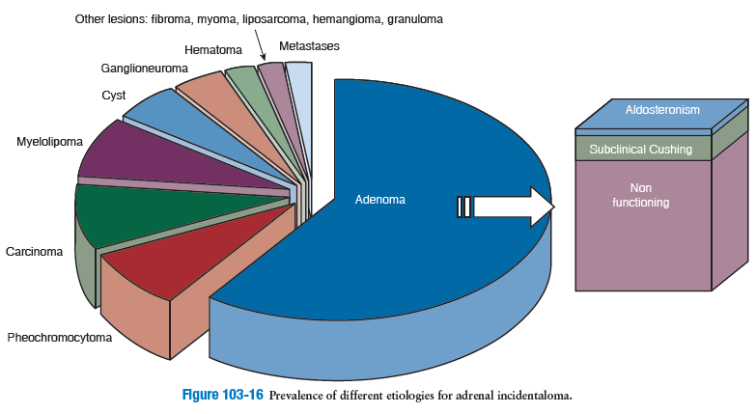

Slide 4
Assessment of the Patient with Adrenal Incidentaloma
Three issues should be addressed upon detection of an adrenal incidentaloma :
(1) establish whether the lesion is benign or malignant,
(2) assess its hormonal activity,
(3) decide upon treatment and follow-up

Slide 5
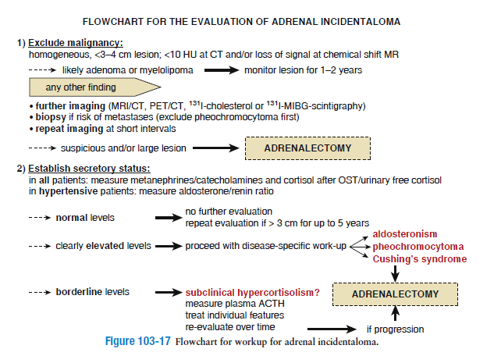
DeGroot 2016

Slide 6
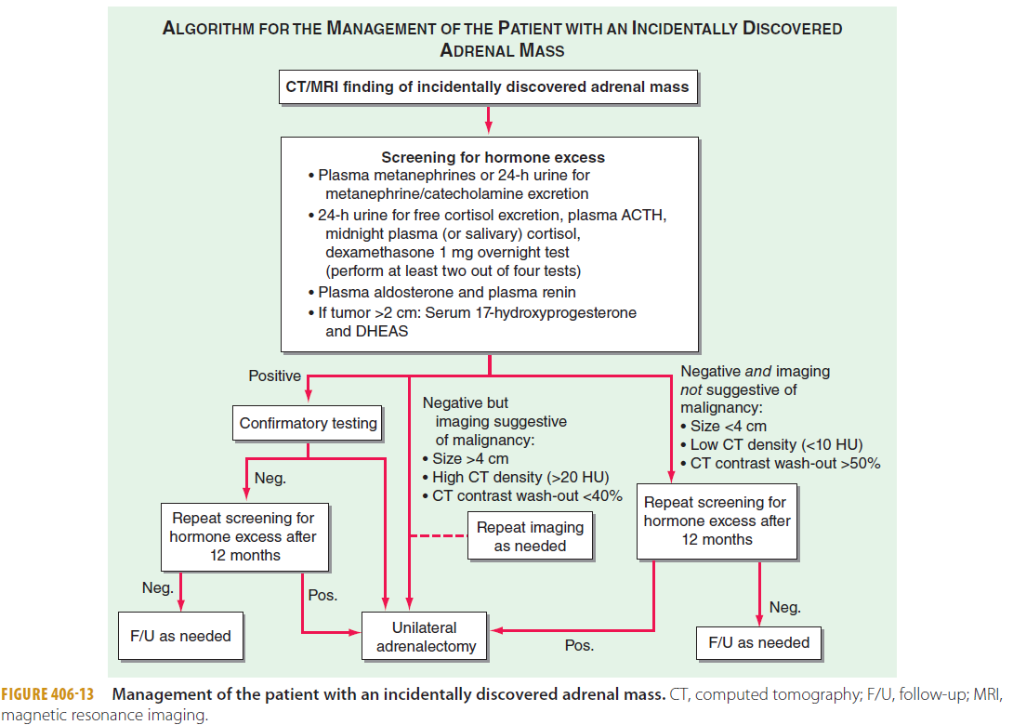

Slide 7
What type pattern of our patient’s adrenal incidentaloma was seen in imaging?
Benign pattern
but bilateral with special feature

Slide 8
Bilateral adrenal incidentaloma
The differential for bilaterally enlarged adrenal glands is relatively limited:
adrenal hyperplasia
congenital adrenal hyperplasia
macronodular adrenal hyperplasia
ACTH-independent macronodular adrenocortical hyperplasia (AIMAH)
adrenal metastases
adrenal haemorrhage
adrenal involvement with granulomatous diseases
adrenal lymphoma
primary pigmented nodular adrenal dysplasia (PPNAD): usually the glands are normal in size, but nodular. In older patients they may be enlarged

Slide 9
Adrenal hyperplasia
Radiographic features
enlarged limbs of one or both adrenal glands >10 mm thick
normal adrenal morphology maintained
nodular or uniform

Slide 10
ACTH-independent macronodular adrenocortical hyperplasia
Radiographic features
CT
CT often characteristically shows massively enlarged multinodular adrenal glands. The nodules tend to vary in size ranging between 1 and 5.5 cm and are generally hypo-attenuating . There is also often distortion of the adrenal contour.
MRI
T1: generally hypointense compared with the liver
T2: hyperintense compared with the liver
in-out phase imaging: nodules usually lose signal on out of phase imaging due to chemical shift from high intrinsic lipid content

Slide 11
Is there a probable hormonal dysfunction for our patient?
Subclinical Hypercortisolism

Slide 12
Subclinical Hypercortisolism or Subclinical Cushing’s Syndrome
Defines the presence of one or more abnormalities in cortisol secretion in patients who do not present features of overt Cushing’s syndrome.
The prevalence of subclinical hypercortisolism 7% to 8% possibly higher in the Japanese population and in bilateral lesions.
urinary free cortisol appeared to provide poor accuracy for the diagnosis of subclinical hypercortisolism, whereas other tests, that is, 1-mg overnight suppression test or late night salivary cortisol, have gained greater acceptance.

Slide 13
Clinical Relevance of Subclinical Hypercortisolism
may lead to detrimental clinical consequences:
increased prevalence of obesity,
hypertension,
impaired glucose and lipid metabolism,
insulin resistance,
increased cardiovascular risk
increased appearance of cardiovascular-metabolic complications over time.
Indeed, the degree of cortisol derangement is
bone mineral loss and vertebral fractures

Slide 14
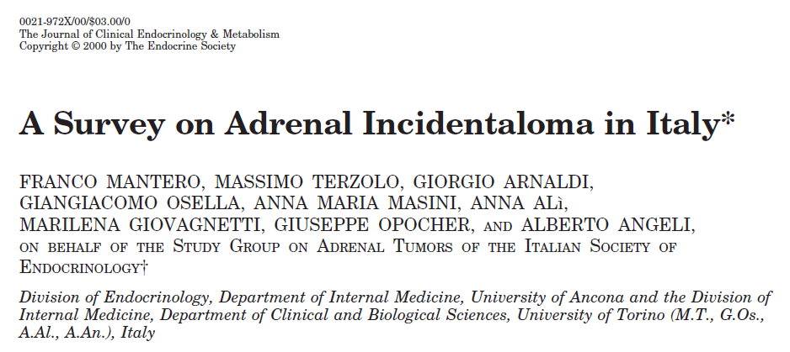
a national survey on occasionally discovered adrenal masses [adrenal incidentalomas (AI)]
Multicentric and retrospective evaluation
includes 1096 cases collected in 26 centers between 1980 and 1995
85% of the masses were nonhypersecretory, 9.2% were defined as subclinical Cushing’s syndrome, 4.2% were pheochromocytomas, and 1.6% were aldosteronomas

Slide 15
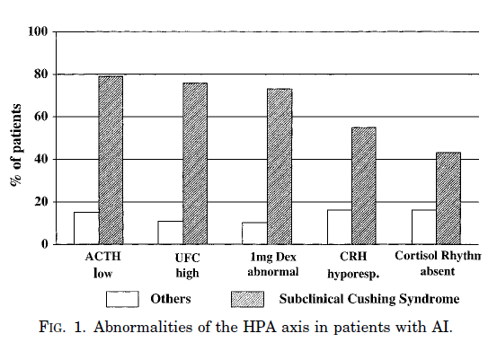

Slide 16
Key message
on adrenal incidentalomas, lack of cortisol suppression by 1 mg DST associated with a low plasma ACTH was found to be the most reliable index of subclinical hypercortisolism,

Slide 17
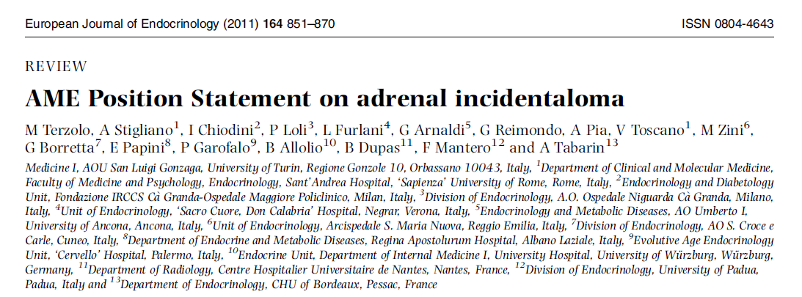
Objective: To assess currently available evidence on adrenal incidentaloma and provide recommendations for clinical practice.
Design: A panel of experts (appointed by the Italian Association of Clinical Endocrinologists (AME)) appraised the methodological quality of the relevant studies, summarized their results, and discussed the evidence reports to find consensus.

Slide 18
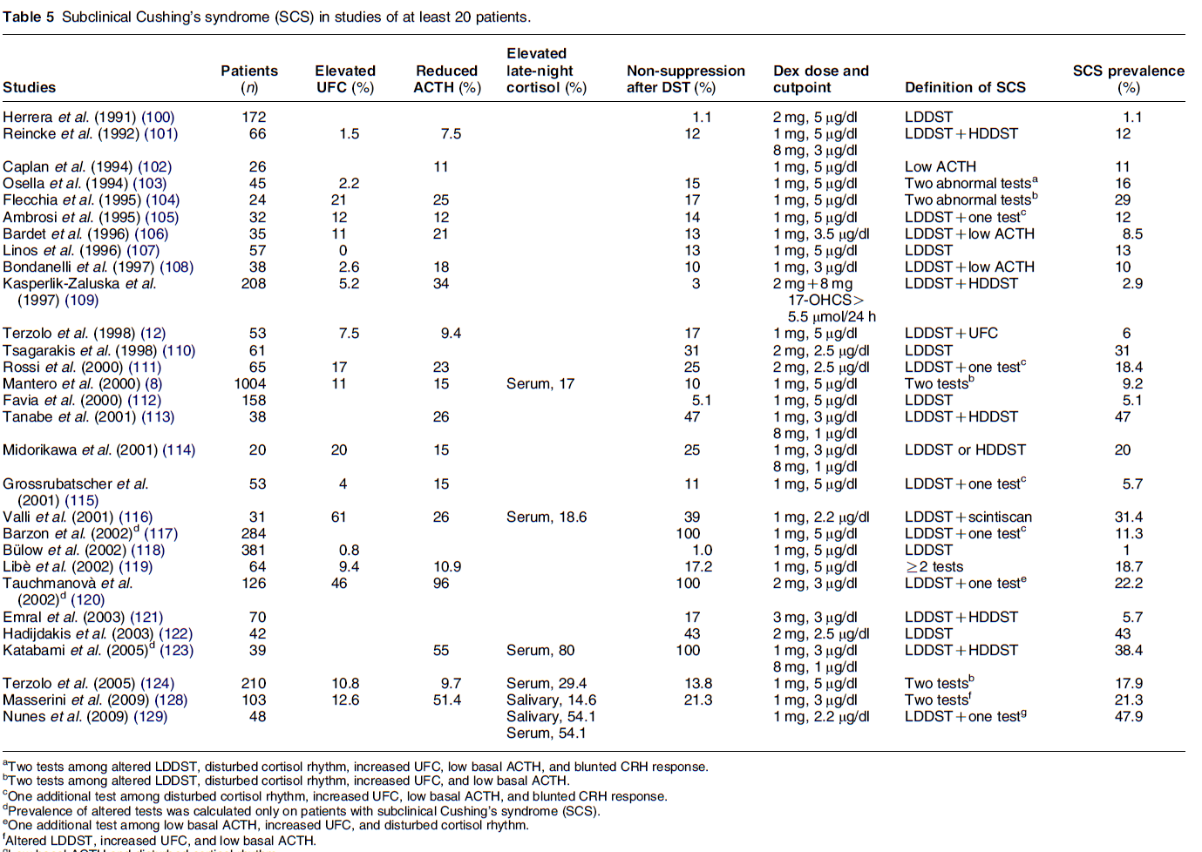

Slide 20
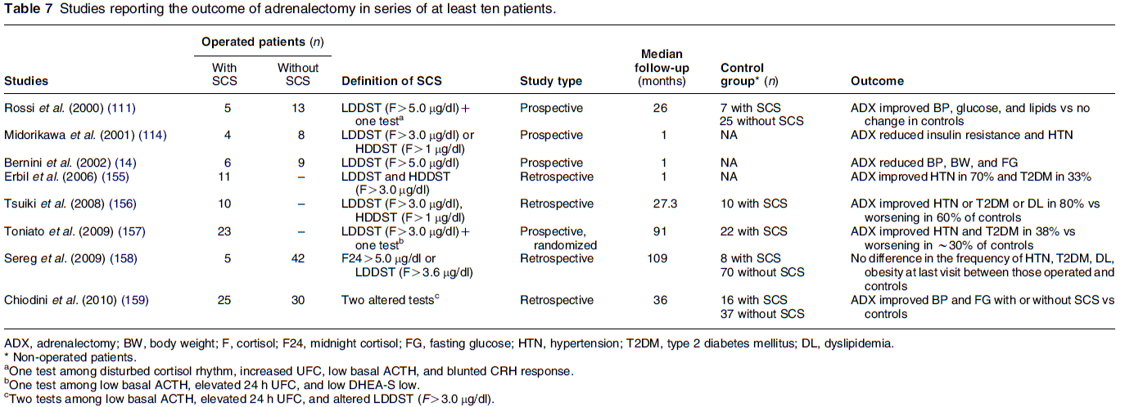

Slide 21
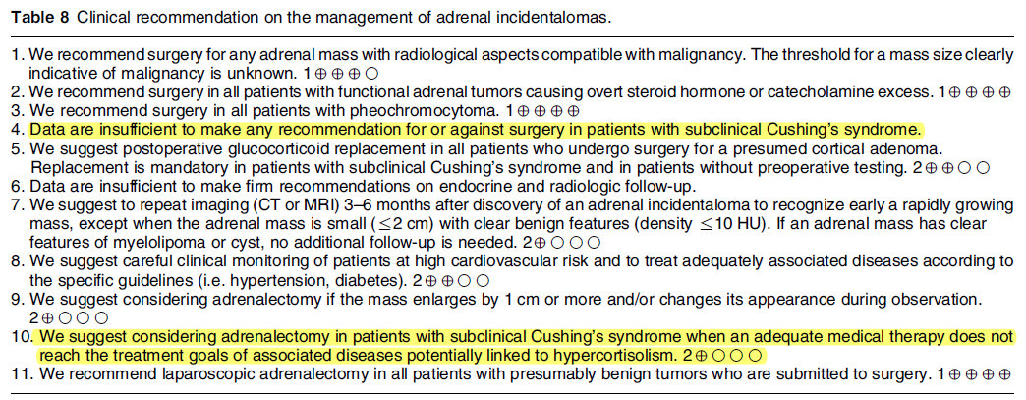

Slide 22
Hypercortisolism + macronodular adrenal hyperplasia + low ACTH
ACTH-independent macronodular adrenocortical hyperplasia (AIMAH)

Slide 23
ACTH-independent bilateral macronodular adrenal hyperplasia (AIMAH)
is an uncommon cause (<2 percent) of endogenous Cushing's syndrome
Salient features of hypercortisolism due to AIMAH are a later age at diagnosis (usually around 50 years of age)
unusually long time to diagnosis—on average 4 years from the appearance of the first symptoms, compared to 2 years for cortisol-secreting adenomas.
Full-blown hypercortisolism may develop even 6 to 7 years after the incidental detection of bilateral adrenal masses

Slide 24
Pathophysiology of AIMAH
Legitimate Adrenal Growth Factor
Adrenal hyperplasia was initially believed to result from prolonged stimulation by ACTH followed by autonomy of adrenal secretion.
Illicit Adrenal Receptors
The capacity of ligands other than ACTH to stimulate the adrenal cortex
food-induced hypercortisolism was due to stimulation of steroidogenesis by the gastrointestinal-inhibitory peptide (GIP).

Slide 25
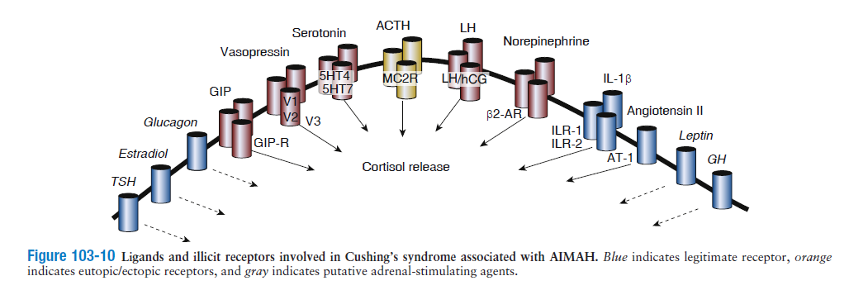

Slide 26
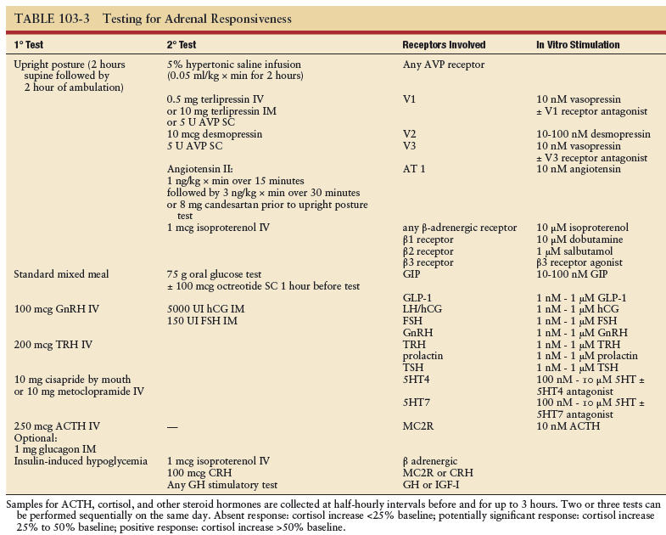

Slide 27
TREATMENT
Patients with AIMAH and no aberrant receptors
Overt Cushing's syndrome
suggest bilateral surgical adrenalectomy for severe Cushing's syndrome (elevated urinary free cortisol [UFC] >3 times above upper limit of normal)

Slide 28
TREATMENT
Modest cortisol excess (less than threefold increase in UFC levels) but with clinical evidence of cortisol excess
Unilateral adrenalectomy
suggest unilateral adrenalectomy
medical therapy with steroidogenesis inhibitors or a second adrenalectomy may become necessary

Slide 29
TREATMENT
Minimal cortisol excess(normal UFC, normal corticotropin [ACTH], cortisol suppression following 1 mg overnight dexamethasone <5 mcg/dL)
Monitoring without surgery
clinical evaluation and biochemical assessment every 6 to 12 months and yearly computed tomography (CT) scan are sufficient
suggest unilateral adrenalectomy if there is disease progression with increased UFC, complete suppression of ACTH, and important clinical effects of hypercortisolism such as osteoporosis, diabetes, hypertension, or neuropsychological manifestations.

Slide 30
TREATMENT
Patients with BMAH and aberrant receptors
Pharmacologic therapy — In some patients in whom aberrant hormone receptors have been identified, specific pharmacologic therapies blocking the aberrant receptors can be effective as alternatives to adrenalectomy.

Slide 31
TREATMENT
beta blocker therapy for aberrant beta-adrenergic receptors.
gonadotropin-releasing hormone (GnRH) agonist therapy for luteinizing hormone (LH) or human chorionic gonadotropin (hCG) receptors.
suggest surgical adrenalectomy rather than pharmacologic therapy for gastric inhibitory polypeptide (GIP)-dependent Cushing's syndrome
Pharmacologic blockade of postprandial release of GIP with octreotide or pasireotide leads to clinical and biochemical improvement of Cushing's syndrome, but the beneficial effect does not persist in the long term,

