Slide 1
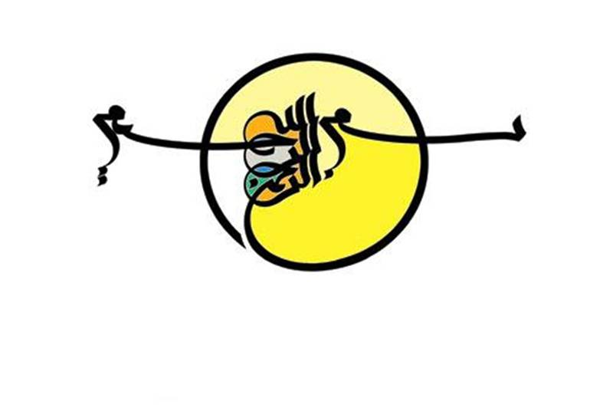

Slide 2

همانا دل ها با یاد خدا ارام می گیرد

Slide 4
AGENDA
How should overt hyperthyroidism due to GD be managed?
If ATDs are chosen as initial management of GD, how should be managed?
What are the Adverse effects of ATDs?
When RAI therapy can be used?
What are the contraindications and adverse effects of RAI therapy?
When thyroidectomy is choosen?

Slide 5
AGENDA
How is the Treatment of Graves’ Hyperthyroidism in Patients with Orbitopathy?
How is the Treatment of Graves’ Hyperthyroidism in Pregnancy and Postpartum?
How is the Treatment of Graves’ Hyperthyroidism in The Elderly, Children and Adolescents, and Immune Reconstitution?
What are the novel drugs and biologicals?

Slide 6
Methodology
The development of this guideline was commissioned by the Executive Committee (EC) and Publication Board of the European Thyroid Association (ETA), which selected a chairperson (G.J.K.) to lead the task force. Subsequently, in consultation with the ETA EC, G.J.K. assembled a team of European clinicians who authored this manuscript.
The task force examined the relevant literature using a systematic PubMed search supplemented with additional published materials. An evidence-based medicine approach that incorporated the knowledge and experience of the panel was used to develop the text and a series of specific recommendations.

Slide 7
The strength of the recommendations and the quality of evidence supporting each was rated according to the approach recommended by the Grading of Recommendations, Assessment, Development , and Evaluation (GRADE system) [18].
The ETA task force for this guideline used the following coding system:
(a) strong recommendation indicated by 1,
(b) weak recommendation or suggestion indicated by 2.

Slide 8
The evidence grading is depicted as follows:
○○○∅ denotes very-low-quality evidence;
∅∅○○, low quality;
∅∅∅○, moderate quality;
∅∅∅∅, high quality.

Slide 9
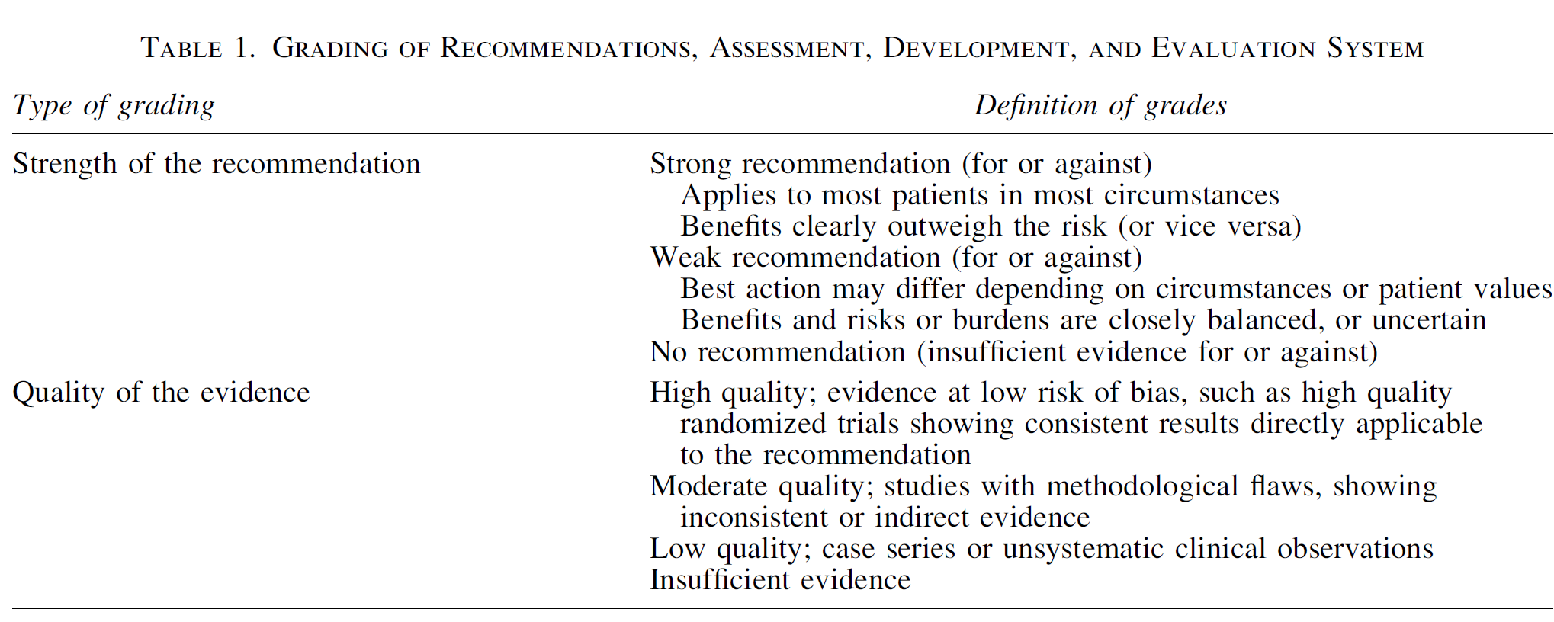
ata

Slide 10
RECOMMENDATION 5 of ETA
Patients with newly diagnosed Graves’ hyperthyroidism should be treated with ATD.
RAI therapy or thyroidectomy may be considered in patients who prefer this approach. 1, ∅∅∅∅
RECOMMENDATION 3 of ATA
Patients with overt Graves’ hyperthyroidism should be treated with any of the following modalities:
RAI therapy
ATDs
thyroidectomy
Strong recommendation, moderate-quality evidence.

Slide 11
RECOMMENDATION 1 of ETA
The measurement of TSH-R-Ab is a sensitive and specific tool for rapid and accurate diagnosis and differential diagnosis of Graves’ hyperthyroidism.
∅∅∅∅1,

Slide 12
RECOMMENDATION 2 of ETA
When technically available, differentiation of TSH-Rab functionality is helpful and predictive in Graves’ patients during pregnancy/postpartum, as well as for extrathyroidal manifestations. 2, ∅∅∅○

Slide 13
RECOMMENDATION 3 of ETA
US examination, comprising conventional grey scale analysis and color-flow or power Doppler examination is recommended as the imaging procedure to support the diagnosis of Graves’ hyperthyroidism.
∅∅∅∅ 1,

Slide 14
RECOMMENDATION 4 of ETA
Scintigraphy of the thyroid is suggested when:
thyroid nodularity coexists with hyperthyroidism
prior to RAI therapy.
2, ∅∅∅○

Slide 15
Original Article
A SURVEY OF CLINICAL PRACTICE PATTERNS IN MANAGEMENT
OF GRAVES DISEASE IN THE MIDDLE EAST AND NORTH AFRICA
ENDOCRINE PRACTICE Vol 23 No. 3 March 2017
The objective of this study was to evaluate the current diagnosis and management of patients with GD in the Middle East and North Africa (MENA).
Methods: An electronic survey on GD management was performed using an online questionnaire of a large pool of practicing physicians. Responses from 352 eligible and willing physicians were included in this study. They were mostly endocrinologists (157) and internal medicine physicians (116).

Slide 16
Results: In addition to serum thyroid-stimulating hormone (TSH) and free thyroxine assays, most respondents would request serum antithyroid peroxidase antibody and TSH-receptor autoantibody (50% and 46%, respectively), whereas serum antithyroglobulin antibodies would be ordered by fewer respondents (36%).
Thyroid ultrasound would be requested by a high nu (63.7%), while only a small percentage would order isotopic thyroid studies.
Antithyroid drug (ATD) therapy was the preferred first-line treatment (52.7%), followed by radioiodine (RAI) treatment (36.8%), b-blockers alone (6.9%), thyroidectomy (3.2%), and no therapy (1.3%).
When RAI treatment was selected in the presence of mild Graves orbitopathy and/or associated risk factors for its occurrence/ exacerbation, steroid prophylaxis was frequently used.
The preferred ATD in pregnancy was propylthiouracil in the first trimester and carbimazole in the second and third trimesters.
On most issues, choices of the MENA physicians fell between European and American practices.

Slide 17
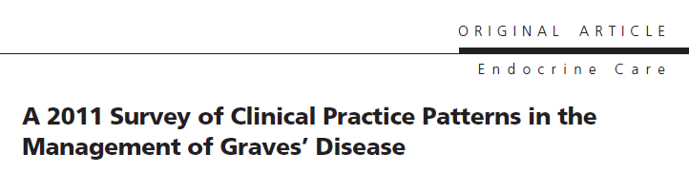
Association (ATA), European Thyroid Association, and Japan Thyroid Association were surveyed on management practices for patients with hyperthyroidism due to Graves’ disease (GD).
Objective: We sought to document current practices in the management of GD and compare these results both to those documented in earlier surveys and to practice recommendations made in the 2011 ATA/American Association of Clinical Endocrinologists (AACE) hyperthyroidism practice guidelines. Lastly, we sought to examine differences in GD management among international members of U.S.-based endocrine societies.
Methods: Members of The Endocrine Society (TES), ATA, and AACE were invited to participate in a web-based survey dealing with testing, treatment preference, and modulating factors in patients with GD.

Slide 18
Results: A total of 730 respondents participated in the survey, 696 of whom completed all sections. Respondents included 641 TES members, 330 AACE members, and 157 ATA members.
The preferred model of therapy in uncomplicated GD was antithyroid drugs (ATDs) by 53.9% of respondents, radioactive iodine (RAI) therapy by 45.0%, and thyroid surgery in 0.7%.
Compared with 1991, fewer U.S. (59.7 vs. 69%) and European (13.3% vs. 25%) respondents would use RAI therapy. Methimazole and carbimazole were the preferred ATDs, with only 2.7% of respondents selecting propylthiouracil. Patients with Graves’ ophthalmopathy were treated with ATDs (62.9%) or surgery (18.5%) and less frequently with RAI plus corticosteroids (16.9%) or RAI alone (1.9%).
Conclusions: Striking changes have occurred in the management of GD over the past two decades, with a shift away from RAI and toward ATDs in patients with uncomplicated GD.)

Slide 19
RECOMMENDATION 6 of ETA
MMI (CBZ) should be used in every non-pregnant patient who chooses ATD therapy for Graves’ hyperthyroidism.
∅∅∅∅1,

Slide 20
Expert Opin Drug Saf. 2006
The safety and efficacy of antithyroid drugs
Azizi F¹
Thionamides, selective inhibitors of thyroid peroxidase-mediated iodination by tyrosine residues in thyroglobulin, have been effectively used in the treatment of hyperthyroidism.
The choices for initial treatment of patients with Graves' disease differ in various countries, and many physicians around the world prefer to administer thionamide drugs as the first choice of treatment for patients with hyperthyroidism.
Although some thyroidologists more often consider radioiodine to be the treatment of choice because of its safety and ease of administration, thionamides remain the mainstay of treatment in thyrotoxic children and adolescents and in hyperthyroid women during pregnancy, postpartum period and lactation.
A recent study with continuous thionamide treatment for patients with Graves' disease shows its efficacy, safety and cost-benefit properties.

Slide 21
RECOMMENDATION 13 of ATA
MMI should be used in virtually every patient who chooses ATD therapy for GD, except during the first trimester of pregnancy
when PTU is preferred, in the treatment of :
thyroid storm
minor reactions to MMI who refuse RAI therapy or surgery
Strong recommendation, moderate-quality evidence.

Slide 22
RECOMMENDATION 10 of ETA
Patients should be informed of potential side effects of ATD and the necessity of informing the physician promptly if they should develop jaundice, light-colored stools, dark urine, fever, pharyngitis, or cystitis.
∅∅○○1,

Slide 23
RECOMMENDATION 14 of ATA
Patients should be informed of side effects of ATDs and the necessity of informing the physician promptly if they should develop;
pruritic rash, jaundice, acolic stools or dark urine, arthralgias, abdominal pain, nausea, fatigue, fever, or pharyngitis.
Preferably, this information should be in writing.
Before starting ATDs and at each subsequent visit, the patient should be alerted to stop the medication immediately and call their physician if there are symptoms suggestive of agranulocytosis or hepatic injury.
Strong recommendation, low-quality evidence.

Slide 24
RECOMMENDATION 20 of ATA
Minor cutaneous reactions may be managed with concurrent antihistamine therapy without stopping the ATD.
Persistent symptomatic minor side effects of antithyroid medication should be managed by cessation of the medication and changing to RAI or surgery, or switching to the other ATD when RAI or surgery are not options.
In the case of a serious allergic reaction, prescribing the alternative drug is not recommended.
Strong recommendation, low-quality evidence.

Slide 25
RECOMMENDATION 7 of ETA
MMI is administered for 12–18 months then discontinued
if the TSH and TSH-R-Ab levels are normal.
∅∅∅∅ 1,

Slide 26
RECOMMENDATION 8 of ETA
Measurement of TSH-R-Ab levels prior to stopping ATD therapy is recommended, as it aids in predicting which patients can be weaned from the medication, with normal levels indicating a greater chance of remission.
∅∅∅∅1,

Slide 27
RECOMMENDATION 9 of ETA
Patients with persistently high TSH-R-Ab at 12–18 months can:
continue MMI therapy, repeating the TSH-R-Ab measurement after an additional 12 months, or opt for
RAI or
thyroidectomy.
1, ∅∅∅○

Slide 28
Recommendation13 of ETA
If a patient with GD becomes hyperthyroid after completing a first course of ATD, definitive treatment with RAI or thyroidectomy is recommended. Continued long-term low-dose MMI can be considered in patients not in remission who prefer this approach. ∅∅∅○1,
RECOMMENDATION 23 of ATA
If a patient with GD becomes hyperthyroid after completing a course of MMI, consideration should be given to treatment with RAI or thyroidectomy. Continued low-dose MMI treatment for longer than 12–18 months may be considered in patients not in remission who prefer this approach.
Weak recommendation, low-quality evidence.

Slide 29
eta

Slide 30
Thyroid. 2017
Long-Term Antithyroid Drug Treatment: A Systematic Review and Meta-Analysis.
Azizi F¹, Malboosbaf R¹.
Medline and the Cochrane Library for trials published between 1950 and May 2016 were systematically searched. Studies containing data for long-term (>24 months) ATD treatment were included. Summary estimates of pooled prevalence, odds ratio, and weighted mean difference were calculated with a random effects model.
RESULTS:
Of 587 related articles found, six fulfilled the inclusion criteria.
Long-term ATD treatment induced a remission rate of 57% [confidence interval (CI) 45-68%], a rate that was higher in adults than in non-adults (61% vs. 53%).
The rate of complications was 19.1% [CI 9.6-30.9%], of which only 1.5% were major complications. The annual remission rate for each year of treatment was 16% [CI 10-27%], which was higher in adults than non-adults (19% vs. 14%). However, it should be noted that this is not a true linear correlation, but a positive relationship can be suggested between time and remission rate.
Meta-regression revealed that smoking had a significant lowering effect on remission rate.
CONCLUSIONS:
Long-term ATD treatment is effective and safe, especially in adults, indicating that it should be considered as an alternative treatment for Graves' disease.

Slide 31
RECOMMENDATION 11 of ETA
In patients taking ATD, a differential white blood cell count should be obtained during febrile illness and/or pharyngitis, and liver function should be assessed in those who experience jaundice, light-colored stools, or dark urine. 1, ∅∅○○
RECOMMENDATION 15 of ATA
Prior to initiating ATD therapy for GD, we suggest that patients have a baseline complete blood count, including white blood cell (WBC) count with differential, and a liver profile including bilirubin and transaminases.
Weak recommendation, low-quality evidence.

Slide 32
RECOMMENDATION 16 of ATA
A differential WBC count should be obtained during febrile illness and at the onset of pharyngitis in all patients taking antithyroid medication.
Strong recommendation, low-quality evidence.
RECOMMENDATION 17 of ATA
There is insufficient evidence to recommend for or against routine monitoring of WBC counts in patients taking ATDs.
No recommendation; insufficient evidence to assess benefits and risks.

Slide 33
RECOMMENDATION 18 of ATA
Liver function and hepatocellular integrity should be assessed in patients taking MMI or PTU who experience:
pruritic rash jaundice
light-colored stool dark urine
joint pain abdominal pain or bloating
anorexia nausea fatigue
Strong recommendation, low-quality evidence.
RECOMMENDATION 19 of ATA
There is insufficient information to recommend for or against routine monitoring of liver function tests in patients taking ATDs.
No recommendation; insufficient evidence to assess benefits and risks.

Slide 34
Recommendation 12 of ETA
Beta-adrenergic blockade is recommended in all suitable
patients with Graves’ hyperthyroidism. 1, ∅∅∅∅

Slide 35
Recommendations14 of ETA
Treatment of SH is recommended in Graves’ patients > 65 years with serum TSH levels that are persistently < 0.1 mIU/L. 1, ∅∅○○
Recommendations15 of ETA
ATD should be the first choice of treatment of Graves’ SH. 1, ∅∅○○

Slide 36
RECOMMENDATION 34 of ATA
The diagnosis of thyroid storm should be made clinically in a severely thyrotoxic patient with evidence of systemic decompensation.
Adjunctive use of a sensitive diagnostic system should be considered. Patients with a Burch–Wartofsky Point Scale (BWPS) of ‡45 or Japanese Thyroid Association (JTA) categories of thyroid storm (TS1or thyroid storm 2 (TS2) with evidence of systemic decompensation require aggressive therapy.
The decision to use aggressive therapy in patients with a BWPS of 25–44 should be based on clinical judgment.
Strong recommendation, moderate-quality evidence

Slide 37
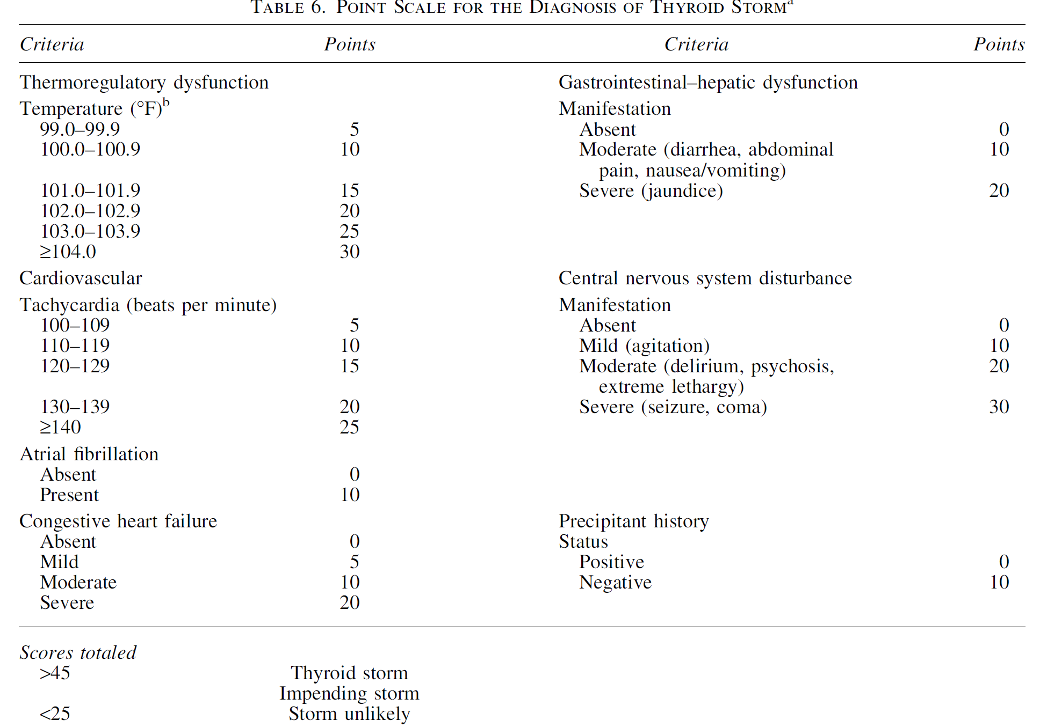
ata

Slide 38
Recommendation16 of ETA
A multimodality treatment approach to GD patients with thyroid storm should be used, including :
ATD therapy
glucocorticoid administration
beta-adrenergic blockade
cooling blankets
volume resuscitation
nutritional support
respiratory care
monitoring in an intensive care unit
1, ∅∅○○

Slide 39
RECOMMENDATION 35 of ATA
A multimodality treatment approach to patients with thyroid storm should be used, including:
b-adrenergic blockade
ATD therapy
inorganic iodide
corticosteroid therapy
cooling with acetaminophen and cooling blanket
volume resuscitation
nutritional support
respiratory care and monitoring in an intensive care unit
Strong recommendation, low-quality evidence.

Slide 40
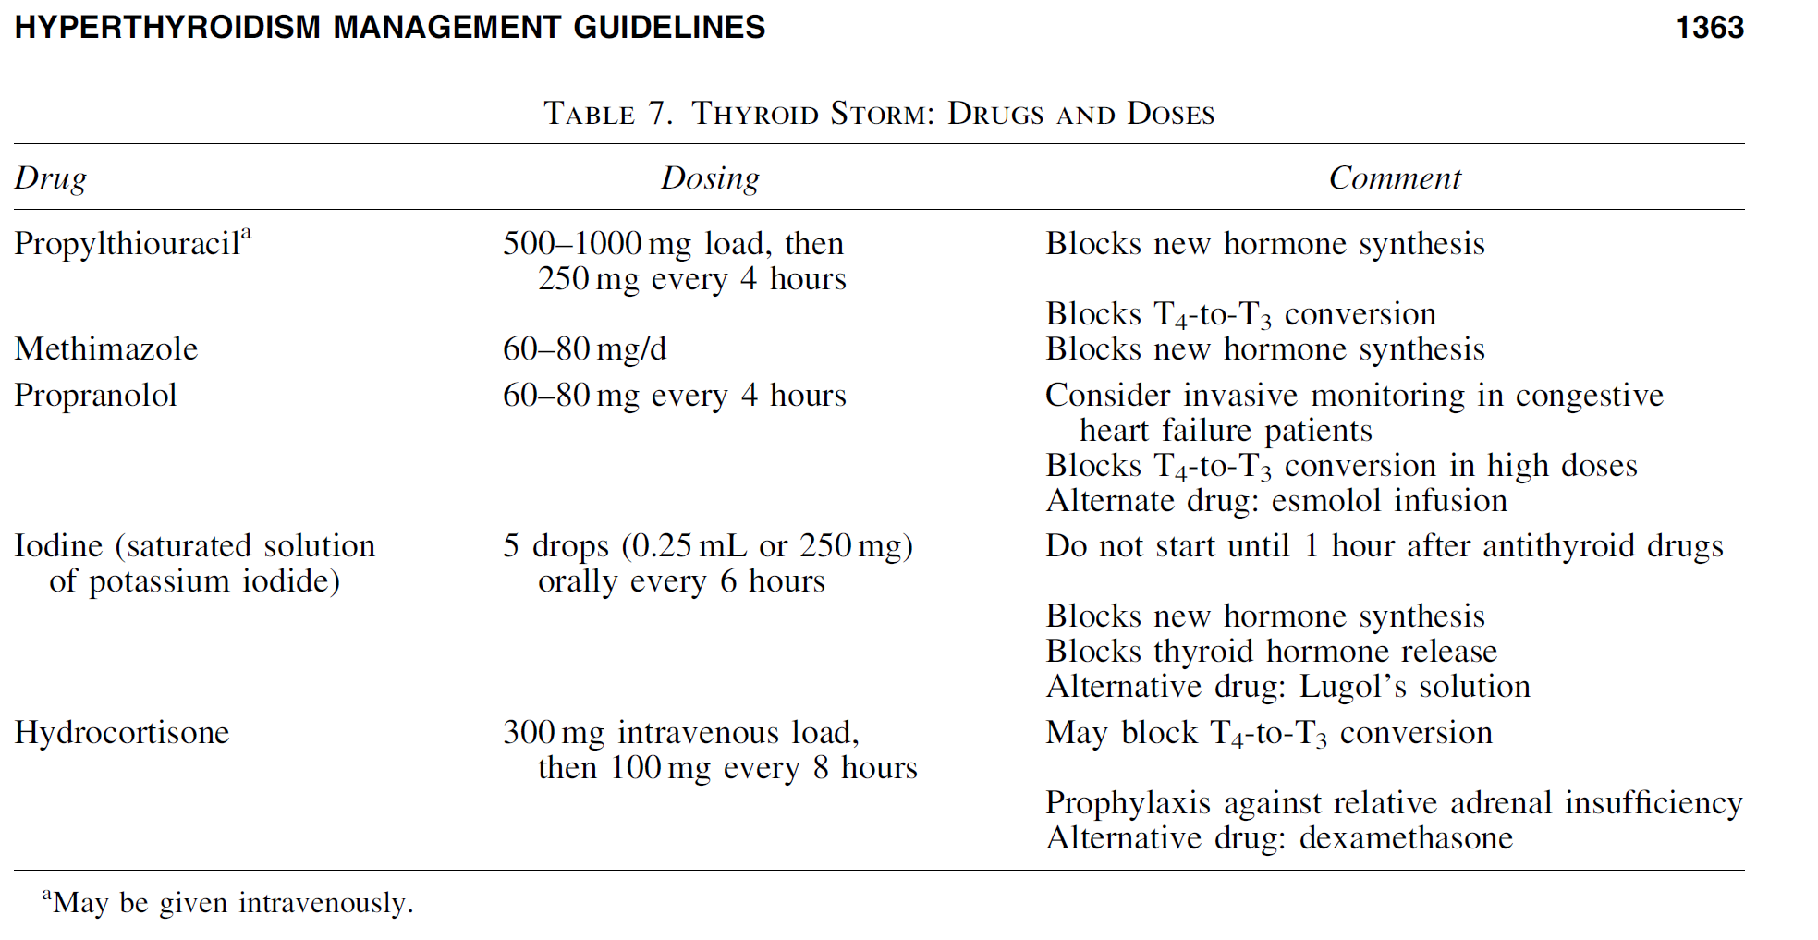
ata

Slide 41
Radioiodine therapy in benign thyroid diseases: effects, side effects, and factors affecting therapeutic outcome.
Endocr Rev. 2012 Dec;33(6):920-80.
Radioiodine ((131)I) therapy of benign thyroid diseases was introduced 70 yr ago, and the patients treated since then are probably numbered in the millions.
Fifty to 90% of hyperthyroid patients are cured within 1 yr after (131)I therapy. With longer follow-up, permanent hypothyroidism seems inevitable in Graves' disease, whereas this risk is much lower when treating toxic nodular goiter.
The side effect causing most concern is the potential induction of ophthalmopathy in predisposed individuals. The response to (131)I therapy is to some extent related to the radiation dose. Besides these obstacles, several potential confounders interfere with the efficacy of (131)I therapy, and they may even interact mutually and counteract each other. The individual radiosensitivity, still poorly defined and impossible to quantify, may be a major determinant of the outcome from (131)I therapy. Above all, the impact of (131)I therapy relies on the iodine-concentrating ability of the thyroid gland. The thyroid (131)I uptake (or retention) can be stimulated in several ways, including dietary iodine restriction and use of lithium. In particular, recombinant human thyrotropin has gained interest because this compound significantly amplifies the effect of (131)I therapy in patients with nontoxic nodular goiter.

Slide 42
Recommendations 17 of ETA
There are no absolute indications for RAI therapy, but it is often recommended for patients with side-effects to or recurrence after a course of ATD.
1, ∅∅○○

Slide 43
good candidates for RAI therapy (ATA)
Women planning a pregnancy in the future
comorbidities increasing surgical risk
previously operated
externally irradiated necks
lack of access to a high-volume thyroid surgeon
contraindications to ATD use
failure to achieve euthyroidism during treatment with ATDs
periodic thyrotoxic hypokalemic paralysis
right heart failure & pulmonary hypertension
congestive heart failure

Slide 44
RECOMMENDATION 7 of ATA
Medical therapy of any comorbid conditions should be optimized prior to RAI therapy.
Strong recommendation, low-quality evidence.

Slide 45
Recommendations 18 of ETA
Verbal as well as written information on all aspects of efficacy an potential side-effects of RAI therapy should be provided. 1, ∅∅○○
Recommendations 10 of ATA
The physician administering RAI should provide written advice concerning radiation safety precautions following treatment. If the precautions cannot be followed, alternative therapy should be selected.
Strong recommendation, low-quality evidence.

Slide 46
Adverse Effects of RAI Therapy
thyroid pain
swelling
sialoadenitis
There is neither evidence of increased thyroid cancer nor total cancer mortality following RAI therapy [103].
Post therapy thyroid storm is extremely rare.

Slide 47
JAMA. 1998
Cancer mortality following treatment for adult hyperthyroidism. Cooperative Thyrotoxicosis Therapy Follow-up Study Group.
High-dose iodine 131 is the treatment of choice in the United States for most adults with hyperthyroid disease. Although there is little evidence to link therapeutic (131)I to the development of cancer, its extensive medical use indicates the need for additional evaluation.
OBJECTIVE:
To evaluate cancer mortality among hyperthyroid patients, particularly after (131)I treatment.
DESIGN:
A retrospective cohort study.
SETTING:
Twenty-five clinics in the United States and 1 clinic in England.

Slide 48
A total of 35 593 hyperthyroid patients treated between 1946 and 1964 in the original Cooperative Thyrotoxicosis Therapy Follow-up Study; 91 % had Graves disease, 79% were female, and 65% were treated with (131)I.
MAIN OUTCOME MEASURE:
Standardized cancer mortality ratios (SMRs) after 3 treatment modalities for Neither hyperthyroidism nor (131)I treatment resulted in a significantly increased risk of total cancer mortality. While there was an elevated risk of thyroid cancer mortality following (131)I treatment, in absolute terms the excess number of deaths was small, and the underlying thyroid disease appeared to play a role. Overall, (131)I appears to be a safe therapy for hyperthyroidism.
Neither hyperthyroidism nor (131)I treatment resulted in a significantly increased risk of total cancer mortality. While there was an elevated risk of thyroid cancer mortality following (131)I treatment, in absolute terms the excess number of deaths was small, and the underlying thyroid disease appeared to play a role. Overall, (131)I appears to be a safe therapy for hyperthyroidism.
Comment in

Slide 49
Recommendations 19 of ETA
If ATD are used before RAI therapy they should be paused around 1 week before and after therapy in order not to decrease the efficacy of RAI therapy.
∅∅∅∅1,
RECOMMENDATION 5 of ATA
In addition to b-adrenergic blockade (see Recommendations 2 and 4), pretreatment with MMI prior to RAI therapy for GD should be considered in patients who are at increased risk for complications due to worsening of hyperthyroidism.
MMI should be discontinued 2–3days prior to RAI.
Weak recommendation, moderate-quality evidence.

Slide 50
RECOMMENDATION 6 of ATA
In patients who are at increased risk for complications due to worsening of hyperthyroidism, resuming MMI 3–7 days after RAI administration should be considered.
Weak recommendation, low-quality evidence.

Slide 51
Recommendations 20 of ETA
No dose calculation can secure long-term euthyroidism and it is fully acceptable to offer a fixed dose of RAI. 1, ∅∅∅○
RECOMMENDATION 8 of ATA
Sufficient activity of RAI should be administered in a single application, typically a mean dose of 10–15 mCi (370–555 MBq), to render the patient with GD hypothyroid.
Strong recommendation, moderate-quality evidence.

Slide 52
Recommendations 21 of ETA
Pregnancy and breast feeding constitute absolut contraindications
to RAI therapy. 1, ∅∅∅○
Recommendations 22 of ETA
Conception should be postponed until at least 6 months after RAI in both males and females. 1, ∅∅∅○
Recommendations 23 of ETA
If used in children, ablative doses aiming at rapid hypothyroidism should be administered. 1, ∅∅○○

Slide 53
Definite contraindications OF RAI therapy include (ATA) :
Pregnancy
Lactation
coexisting thyroid cancer, or suspicion of thyroid cancer
unable to comply with radiation safety guidelines
in women planning a pregnancy within 4–6 months

Slide 54
RECOMMENDATION 11 of ATA
Follow-up within the first 1–2 months after RAI therapy for GD should include an assessment of free T4, total T3, and TSH.
Biochemical monitoring should be continued at 4- to 6-week intervals for 6 months, or until the patient becomes hypothyroid and is stable on thyroid hormone replacement.
Strong recommendation, low-quality evidence.

Slide 55
RECOMMENDATION 12 of ATA
When hyperthyroidism due to GD persists after 6 months following RAI therapy, retreatment with RAI is suggested.
In selected patients with minimal response 3 months after therapy additional RAI may be considered.
Weak recommendation, low-quality evidence.

Slide 56

Recommendations 24 of ETA
If surgery is selected, total thyroidectomy is the procedure of choice, and should be performed by a skilled surgeon with high annual volumes of thyroidectomies
∅∅∅∅1,
RECOMMENDATION 27of ATA
If surgery is chosen as the primary therapy for GD, near total or total thyroidectomy is the procedure of choice.
Strong recommendation, moderate-quality evidence.
RECOMMENDATION 28 of ATA
If surgery is chosen as the primary therapy for GD, the patient should be referred to a high-volume thyroid surgeon.
Strong recommendation, moderate-quality evidence.

Slide 57
Recommendations 25 of ETA
Euthyroidism should be restored by ATD prior to surgery to avoid peri- or postoperative exacerbation of thyrotoxicosis. 1, ∅∅∅∅
Recommendations 27 of ETA
A solution containing potassium iodide can be given for 10 days prior to surgery. 2, ∅∅∅○

Slide 58
RECOMMENDATION 24 of ATA
If surgery is chosen as treatment for GD, patients should be rendered euthyroid prior to the procedure with ATD pretreatment, with or without b-adrenergic blockade.
A Ki containing preparation should be given in the immediate preoperative period.
Strong recommendation, low-quality evidence.

Slide 59
RECOMMENDATION 30 of ATA
ATD should be stopped at the time of thyroidectomy for GD, and b-adrenergic blockers should be weaned following surgery.
Strong recommendation, low-quality evidence.

Slide 60
Recommendations 26 of ETA
Vitamin D deficiency should be corrected to reduce the postoperative risk of hypocalcemia. 1, ∅∅∅∅
RECOMMENDATION 25 of ATA
Calcium and 25-hydroxy vitamin D should be assessed preoperatively and repleted if necessary, or given prophylactically.
Calcitriol supplementation should be considered preoperatively in patients at increased risk for transient or permanent hypoparathyroidism.
Strong recommendation, low-quality evidence.

Slide 61
RECOMMENDATION 29 of ATA
Following thyroidectomy for GD, alternative strategies may be undertaken for management of calcium levels:
serum calcium with or without intact parathyroid hormone (iPTH) levels can be measured,
and oral calcium and calcitriol supplementation administered based on these results, or prophylactic calcium with or without calcitriol prescribed empirically.
Weak recommendation, low-quality evidence.

Slide 63
RECOMMENDATION 26 of ATA
In exceptional circumstances, when :
it is not possible to render a patient with GD euthyroid prior to thyroidectomy
need for thyroidectomy is urgent
when the patient is allergic to ATDs
the patient should be adequately treated with :
b-adrenergic blockade, KI, glucocorticoids, and potentially cholestyramine in the immediate preoperative period.
The surgeon and anesthesiologist should have experience in this situation.
Strong recommendation, low-quality evidence.

Slide 64
RECOMMENDATION 31 of ATA
Following thyroidectomy for GD, L-thyroxine should be started at a daily dose appropriate for the patient’s weight (0.8 lg/lb or 1.6 lg/kg), with elderly patients needing somewhat less, and serum TSH measured 6–8 weeks postoperatively.
Strong recommendation, low-quality evidence.

Slide 65
RECOMMENDATION 32 of ATA
Communication among different members of the multidisciplinary team is essential, particularly during transitions of care in the pre- and postoperative settings.
Strong recommendation, low-quality evidence.

Slide 66
RECOMMENDATION 36 of ATA
Potassium iodide may be of benefit in select patients with hyperthyroidism due to GD:
adverse reactions to ATDs
contraindication or aversion to RAI therapy or surgery
Treatment may be more suitable for patients with:
mild hyperthyroidism
prior history of RAI therapy
No recommendation; insufficient evidence to assess benefits or risks.

Slide 67
RECOMMENDATION 33 of ATA
If a thyroid nodule is discovered in a patient with GD, the nodule should be evaluated and managed according to recently published guideline regarding thyroid nodules in euthyroid individuals.
Strong recommendation, moderate-quality evidence.

Slide 68
GO
Recommendations 28 of ETA
In patients with GO, hyperthyroidism should be promptly controlled by ATD, and euthyroidism stably maintained. 1, ∅∅∅∅

Slide 69
Recommendations 29 of ETA
Patients treated with RAI should receive steroid prophylaxis if mild and active GO preexists or there are risk factors for RAI associated GO occurrence or progression.
∅∅∅∅1,
                RECOMMENDATION 105 of ATA
                In the absence of any strong contraindication to GC use we suggest considering them for coverage of GD patients with mild active GO who are treated with RAI, even in the absence of risk factors for GO deterioration.
Weak recommendation, low-quality evidence.

Slide 70
RECOMMENDATION 106 of ATA
In GD patients with mild GO who are treated with RAI we recommend steroid coverage if there are concomitant risk factors for GO deterioration.
Strong recommendation, moderate-quality evidence.

Slide 71
RECOMMENDATION 103 of ATA
There is insufficient evidence to recommend for or against the use of prophylactic corticosteroids in smokers who receive RAI and have no evidence of GO.
No recommendation, insufficient evidence.

Slide 72
RECOMMENDATION 104 of ATA
In patients with Graves’ hyperthyroidism who have mild active ophthalmopathy and no risk factors for deterioration of their eye disease, RAI therapy, ATDs, and thyroidectomy should be considered equally acceptable therapeutic options.
Strong recommendation, moderate-quality evidence

Slide 73
Recommendations 30 of ETA
In patients with moderate-to-severe and active GO, treatment of GO should be the priority.
Euthyroidism should be promptly restored with ATD and stably maintained. 1, ∅∅∅∅

Slide 74
Recommendations 31 of ETA
Patients with sight-threatening GO should be treated with ATD.
1, ∅∅○○
RECOMMENDATION 107 of ATA
In patients with active and moderate-to-severe or sight threatening GO we recommend against RAI therapy.
Surgery or ATDs are preferred treatment options for GD in these patients.
Strong recommendation, low-quality evidence.

Slide 75
Recommendations 31 of ETA
Treatment for hyperthyroidism in patients with inactive GO can be selected independently of GO.
∅∅○○1,
RECOMMENDATION 108 of ATA
In patients with inactive GO we suggest RAI therapy can be administered without steroid coverage.
However, in cases of elevated risk for reactivation (high TRAb, CAS ‡1 and smokers) that approach might have to be reconsidered.
Weak recommendation, low-quality evidence.

Slide 76
RECOMMENDATION 100 of ATA
We recommend clinicians advise patients with GD to stop smoking and refer them to a structured smoking cessation program. As both firsthand and secondhand smoking increase GO risk, patients exposed to secondhand smoke should be identified and advised of its negative impact.
.Strong recommendation, moderate-quality evidence

Slide 77
RECOMMENDATION 101of ATA
In nonsmoking patients with GD without apparent GO, RAI therapy (without concurrent steroids), ATDs, or thyroidectomy should be considered equally acceptable therapeutic options in regard to risk of GO.
Strong recommendation, moderate-quality evidence.

Slide 78
RECOMMENDATION 102 of ATA
In smoking patients with GD without apparent GO, RAI therapy, ATDs, or thyroidectomy should be considered equally acceptable therapeutic options in regard to risk of GO.
Weak recommendation, low-quality evidence.

Slide 80
Recommendations 33 of ETA
Women with GD of reproductive age should be offered preconception counseling and be stably euthyroid before attempting pregnancy. 1, ∅∅○○

Slide 81
Recommendations 34 of ETA
Women with GD should be instructed to immediately confirm pregnancy and contact their physician.
∅∅∅∅ 1,
RECOMMENDATION 9 of ATA
A pregnancy test should be obtained within 48 hours prior to treatment in any woman with childbearing potential who is to be treated with RAI. The treating physician should obtain this test and verify a negative result prior to administering RAI.
Strong recommendation, low-quality evidence.

Slide 82
Recommendations 34 of ETA
Women treated with MMI should be switched to PTU when planning pregnancy and/or during the first trimester of pregnancy. 1, ∅∅∅∅

Slide 83
Recommendations 36 of ETA
All patients with a history of autoimmune thyroid disease should have their TSH-R-Ab serum levels measured at the first presentation of pregnancy using either a sensitive binding or a functional cell-based bioassay and, if they are elevated, again at 18–22 weeks of gestation. 1, ∅∅∅∅

Slide 84
Recommendations 37 of ETA
If the maternal TSH-R-Ab concentration remains high ( > 3 times the cut-off), monitoring of the fetus for thyroid dysfunction throughout pregnancy is recommended.
∅∅∅∅1,

Slide 85
Recommendations 38 of ETA
During pregnancy the lowest possible dose of ATD should be given and the block-and-replace ATD regimen is discouraged. 1, ∅∅∅∅

Slide 86
Recommendations 39 of ETA
Maternal FT4 (TT4) and TSH should be measured every 2 weeks after the initiation of therapy, and every 4 weeks after achieving the target value. 1, ∅∅○○

Slide 87
Recommendations 40 of ETA
A change from PTU to MMI should be considered if ATD are required after 16 weeks gestation. 1, ∅○○○

Slide 88
Recommendations 41 of ETA
In women on a low dose of MMI (<5–10 mg/day) or PTU (<50–100 mg/day), ATD may be stopped during gestation prior to weeks 6–10. 2, ∅○○○

Slide 89
Recommendations 42 of ETA
Lactating women with GD should be offered the same treatments as non-lactating women. 1, ∅∅○○

Slide 90
Recommendations 43 of ETA
MMI is recommended during lactation, given the concerns about PTU-mediated hepatotoxicity. 1, ∅∅○○

Slide 91
Recommendations 44 of ETA
Older patients who have had atrial fibrillation, cardiac failure, or cardiac ischemic symptoms precipitated by hyperthyroidism should undergo definitive therapy, usually RAI. 1, ∅∅∅○

Slide 92
Recommendations 45 of ETA
Long-term MMI (CBZ) should be considered as a satisfactory treatment for older individuals with mild GD. 2, ∅○○○

Slide 93
Recommendations 46 of ETA
PTU should be avoided in children and adolescents. ∅∅∅∅ 1,

Slide 94
Recommendations 47 of ETA
Long-term MMI (CBZ) should be the mainstay of treatment in children with GD. 1, ∅∅∅○

Slide 95
Recommendations 48 of ETA
Thyroidectomy is the primary definitive therapy in childhood, but in postpubertal children RAI can be considered. 2, ∅∅○○

Slide 96
Recommendations 49 of ETA
Graves’ hyperthyroidism precipitated by an immunomodulatory therapy is not a mandatory indication to stop that precipitating treatment, nor is it a mandatory indication for definitive therapy for hyperthyroidism.
∅○○○1,

Slide 97
Recommendations 50 of ETA
Sequential monitoring of serum TSH-R-Ab levels can be used to guide the duration of ATD therapy in patients with immune reconstitution GD. 2, ∅○○○

Slide 98
Immune Reconstitution
The first demonstration of immune reconstitution GD was in multiple sclerosis patients who had received lymphocyte-depleting alemtuzumab (Campath-H1) antibody treatment [161].
This treatment causes initial lymphopenia, but 12–24 months later 20–30% of patients developed TSH-R-Ab-positive GD, as lymphocyte populations recover.
A similar pattern of GD has been observed in patients with HIV who have received effective highly active antiretroviral therapy, with hyperthyroidism developing as CD4 lymphocyte counts increase [162].
Immune reconstitution GD has also been observed in bone marrow transplant patients.
In most cases, the hyperthyroidism is manageable and, depending on the underlying condition, it is not an indication to discontinue the immunomodulatory therapy that precipitated it.

Slide 99
Perspectives and Conclusions
Ongoing preclinical and clinical trials are assessing the effectiveness of novel drugs and/or substances that could modify the natural history of GD by modulating its pathogenesis.
These therapeutic agents include:
TSH-R monoclonal Abs [164]
immunomodulatory TSH-R peptides
small-molecule TSH-R ligands [165] that can block the thyroid-stimulating effect of TSH-R-Ab, thus acting as TSH-R-Ab antagonists.
the use of biologicals, such as rituximab, although based on a sound rationale, is not supported by sufficient evidence [166].

Slide 100


