Slide 1
Insulin therapy in guidelines
An overview
F.Hosseinpanah
Research Institute for Endocrine Sciences
Shahid Beheshti University of Medical Sciences
Februrary 16,2017
Tehran

Slide 2
What are Clinical Guidelines?
Statements that include recommendations intended to optimize patient care that, ideally, are informed by a systematic review of evidence and an assessment of the benefits and harms of alternative care options

Slide 3
Aims of guideline development
To support clinical decision making in conjunction with physician knowledge and experience
As institutional policy
To inform insurance coverage
For deriving quality of care criteria
Medico legal liability standards

Slide 4
Advantages and limitations
Advantages limitations
Standardization of clinical care
Improved quality of care
Dissemination of new evidence
Enhanced efficiency and reduced cost
Influence health policy and planning
Generalizability to individual practitioners
Generalizability to individual patients
Expert opinion vs evidence-based
Authorship bias
Multiple versions/conflicting recommendations

Slide 5
Evid Based Med March 2017
JAMA February 14, 2017
JAMA, January 9, 2013

Slide 9
Individualization
Although guidelines may point out the best research evidence to guide the care of average patients, they are not the substitute for clinical judgment, which should be applied to each individual patient
Fletcher RH. Practice guidelines and the practice of medicine: Is it the end of
clinical judgment and expertise? Schweiz Med Wochenschr , 1998; 128:1883–8

Slide 10
IDF 2012

Slide 11
NICE 2015

Slide 12
Start insulin therapy for adults with type 2 diabetes from a choice of a number of insulin types and regimens:
Offer NPH insulin injected once or twice daily according to need.
Consider starting both NPH and short-acting insulin (particularly if the person's HbA1c is 9.0% or higher), administered either separately or as a pre-mixed (biphasic) human insulin preparation

Slide 13
Consider, as an alternative to NPH insulin, using insulin detemir or insulin Glargine if:
The person needs assistance from a carer or healthcare professional to inject insulin, and use of insulin detemir or insulin Glargine would reduce the frequency of injections from twice to once daily
The person's lifestyle is restricted by recurrent symptomatic hypoglycaemic episodes
The person would otherwise need twice-daily NPH insulin injections in combination with oral glucose-lowering drugs

Slide 14
Consider pre-mixed (biphasic) preparations that include short-acting insulin analogues, rather than pre-mixed (biphasic) preparations that include short-acting human insulin preparations, if:
A person prefers injecting insulin immediately before a meal
Hypoglycaemia is a problem
Blood glucose levels rise markedly after meals

Slide 15
Consider switching to insulin detemir or insulin Glargine from NPH insulin in adults with type 2 diabetes:
Who do not reach their target HbA1c because of significant hypoglycaemia
Who experience significant hypoglycaemia on NPH insulin irrespective of the level of HbA1c reached
Who cannot use the device needed to inject NPH insulin but who could administer their own insulin safely and accurately if a switch to one of the long-acting insulin analogues was made
Who need help from a carer or healthcare professional to administer insulin injections
For whom switching to one of the long-acting insulin analogues would reduce the number of daily injections

Slide 16
Insulin Therapy….
Monitor adults with type 2 diabetes who are on a basal insulin regimen (NPH insulin, insulin detemir or insulin glargine) for the need for short-acting insulin before meals (or a pre-mixed [biphasic] insulin preparation
Monitor adults with type 2 diabetes who are on pre-mixed (biphasic) insulin for the need for a further injection of short-acting insulin before meals or for a change to a basal bolus regimen with NPH insulin or insulin detemir or insulin glargine, if blood glucose control remains inadequate

Slide 17


Slide 18
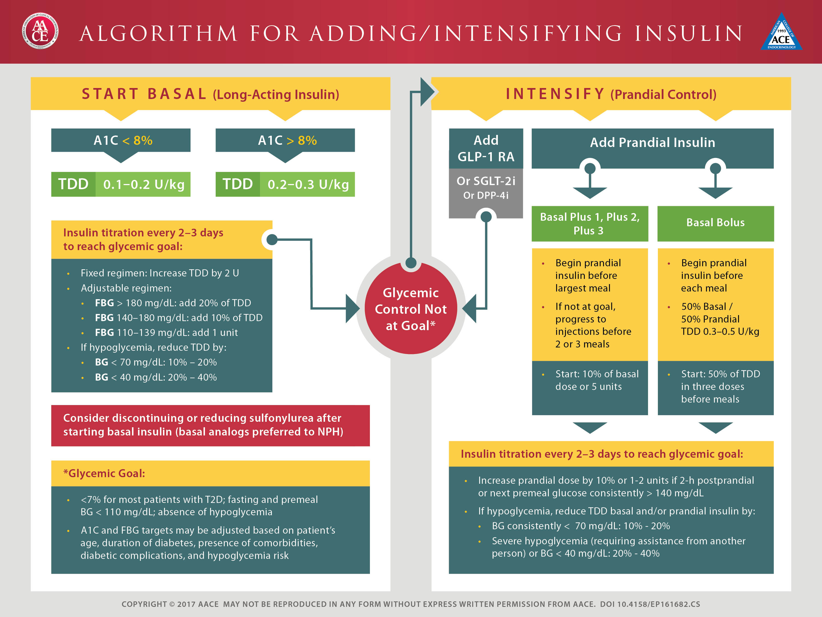

Slide 23
Objective: To compare the efficacy and safety of two insulin intensification strategies in patients with type 2 diabetes inadequately controlled on basal insulin glargine with metformin and/or pioglitazone.
A multinational, randomized, open-label trial that compared insulin lispro low mixture (LM25; n=236) twice daily with a basal–prandial regimen of insulin glargine once daily and insulin lispro once daily (IGL; n=240) over 24weeks in patients with HbA1c 7.5–10.5% and fasting plasma glucose ≤6.7 mmol/l.
Diabetes, Obesity and Metabolism 16: 963–970, 2014.

Slide 24
Estimated change [least squares (LS) mean (95% CI)] in HbA1c after 24 weeks: −1.30 (−1.44, −1.16)% with LM25 and −1.08 (−1.22, −0.94)%with IGL. Non-inferiority was shown [LSmean (95% CI) HbA1c treatment difference−0.21 (−0.38,−0.04) (PP population)]; gated superiority assessment showed a statistically significant advantage for LM25 (p=0.010; ITT population

Slide 26
Key message
In patients with type 2 diabetes inadequately controlled on once-daily basal insulin glargine and metformin and/or pioglitazone, intensification with LM25 was superior to a basal–prandial approach in terms of reduction in HbA1c after 24 weeks and did not increase hypoglycaemia episodes

Slide 27
The purpose of this study was to conduct a systematic review and meta-analysis of randomized controlled trials (RCTs) comparing the effect of intensified insulin regimens (basal-bolus versus premixed) on glycemic control in patients with type 2 diabetes
Endocrine (2016) 51:417–428

Slide 32
Key messages
Our analyses suggest that there is no clinically relevant difference in the efficacy of basal-bolus versus premixed insulin regimens for HbA1c decrease in type 2 diabetic patients who intensified their insulin therapy.

Slide 36
Take home message
Different recommendations in different guidelines, in part, can be explained by various contextual variables
In our country with limited resources, we need to develop a new national evidence based guideline
Considering difficulties in guideline development, and as an easier task, customizing existing guidelines seems to be more practical

