Slide 2
OBESITY PREVENTION AND CONTROL STRATEGIC ARCHITECTURING (OPCSA)
BY:
SH. ALAMDARI, MD
ASSOCIATE PROFESSOR OF ENDOCRINOLOGY AND METABOLISM
ASSOCIATE PROFESSOR OF STRATEGIC MANAGEMENT
RESEARCH INSTITUTE FOR ENDOCRINE SCIENCES
SHAHID BEHESHTI UNIVERSITY OF MEDICAL SCIENCES
NATIONAL SUPREME UNIVERSITY FOR STRATEGIC SCIENCES

Slide 3
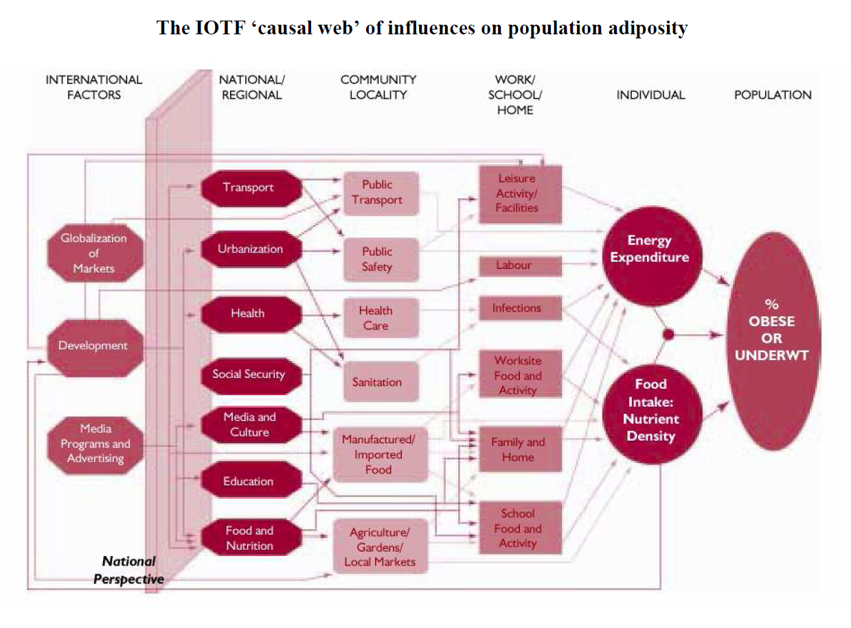

Slide 4
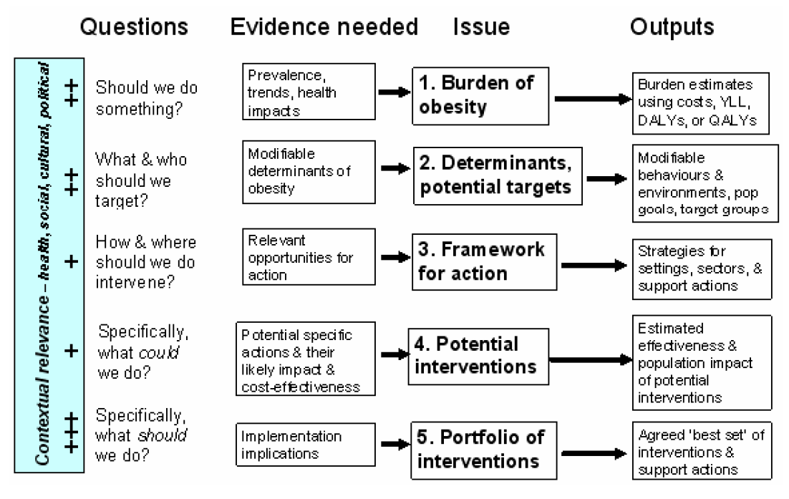

Slide 5
NATIONAL OBESITY PREVENTION AND CONTROL STRATEGIC ARCHITECTURE
SUPPORTING ANNEXES
STRATEGIC FIELDS:
STRATEGIES,
OBJECTIVES,
PROJECTS,
EVALUATION AND MONITORING
INFRASTRUCTURE COMPONENTS

Slide 6
RESOURCE & FINANCIAL MANAGEMENT
GOVERNMENT ADVOCACY
PARLIAMENT
LAW
OBESITY RESEARCH MANAGERMENT
MEDIA & PUBLIC EDUCATION
OBESITY EDUCATION MANAGEMENT
FOOD MARKET AND BUSINESS STRATEGIC FIELD
FOOD AND NUTRITION
STRATEGIC FIELD
BREASTFEEDING STRATEGIC FIELD
PHYSICAL ACTIVITY AND SPORT STRATEGIC FIELD
LIFE SKILLS STRATEGIC FIELD
MEDIA STRATEGIC FIELD
SCHOOL AND CHILD CARE STRATEGIC FIELD
COMMUNITIES AND BUILT STRUCTURE STRATEGIC FIELD
INDIVIDUALS AND FAMILIES STRATEGIC FIELD
PUBLIC HEALTH STRATEGIC FIELD
EMPLOYERS STRATEGIC FIELD
GOVERENMENT STRATEGIC FIELD
SOCIAL SECURITY STRATEGIC FIELD
TRANSPORT STRATEGIC FIELD
AGRICULTURAL STRATEGIC FIELD
SITUATIONAL ANALYSIS
RISK MAP
FUTURE SCENARIOS
PHILOSOPH/ DOCTRINE PRINCIPLES/ POLICIES
VISION / MISSION
STRATEGIC GOALS
TARGET CAPABILITY LIST
EVALUATION CRITERIA
PRACTICE GUIDELINES
ORGANIZATIONAL STRUCTURE

Slide 7
