Slide 1
Dietary Supplements in Diabetes Mellitus M. Abbasinazari Professor of Clinical Pharmacy

Slide 2
Content
History
Definition
Supplementary in DM

Slide 3
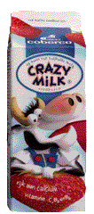
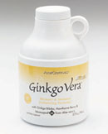
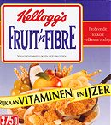
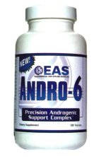
Dietary Supplements Foods or Drugs?

Slide 4
Terminology
Nutraceuticals
Nutrient rich products with limited health claims
Functional Foods
Any modified food or ingredient that may provide a benefit beyond the traditional nutrients it contains
Phytochemicals
Such foods that are derived from naturally occurring ingredients

Slide 5
Dietary Supplements
Alternative therapies and natural remedies
Dietary supplements = 6.5 billion / Prescription Drug sales = 85 billion
Increased consumer dissatisfaction with conventional health care
½ of US population use Dietary Supplements

Slide 6
History of Dietary Supplements
1938 Act established standards of identity for vitamins and minerals
Proxmire Amendments extended FDA jurisdiction to advertising of Vits and mins
Prohibited FDA from setting max limits on potency
Forbade FDA from classifying supplements as drugs

Slide 7
History of Dietary Supplements
1994 President Clinton signed Dietary Supplement, Health and Education Act (DSHEA) into law

Slide 8
DSHEA
Created Office of Dietary Supplements within National Institute of Health (NIH)
Permits statements of nutritional support including structure and function claims
After passage of DSHEA, sales increased to 13 billion per year.

Slide 9
تاریخچه در ایران
همزمان با شروع فعاليت واحدهاي توليدي فرآورده هاي گياهي، گروه کارشناسی فراورده های گیاهی از سال ۱۳۶۰ در معاونت غذا و داروي وزارت بهداشت، درمان و آموزش پزشكي بصورت رسمي نظارت بر فراورده های گیاهی را آغاز نمود.
در سال ۱۳۷۶ ، اداره داروهای گیاهی در چارت سازمانی معاونت غذا و دارو به عنوان یکی از ادارات تابعه اداره کل نظارت بر امور دارو و مواد مخدر به رسميت شناخته شد
با افزايش تنوع فرآورده‌هاي طبيعي، براي تمركز بيشتر بر روي اين فرآورده‌ها در دي‌ماه ۱۳۸۵، اداره داروهای گیاهی به اداره داروهاي طبيعي تغيير نام يافت.
با عنایت به ماده ۳۴ قانون برنامه پنجم توسعه و ابلاغ سند توسعه طب سنتی ایرانی – اسلامی و توسعه روزافزون این فراورده ها در خرداد ماه ۱۳۹۲ اداره کل نظارت و ارزیابی داروهای طبیعی و سنتی تشکیل و در مهرماه همان سال با ادغام فراورده های مکمل ”اداره کل فراورده های طبیعی، سنتی و مکمل“ تشکیل گردید.

Slide 10
What is a Dietary Supplement?
Definition: (Sec 3.)
A product intended to supplement the diet that bears or contains one or more of the following dietary ingredients
Vitamins
Minerals
Herbs or other botanicals
Amino acids
Concentrate, metabolite, constituent, extract or combination of above listed ingredients

Slide 11
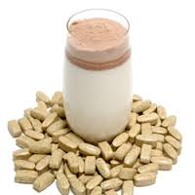
Dietary Supplements
These products are taken by mouth.
These products are found in many forms to include:
Tablets
Capsules
Softgels
Gelcaps
Liquids
Powders
Bars

Slide 12
Dietary Supplements
Distinguished from Drugs:
Drug = article intended to diagnose, cure, mitigate, treat, or prevent disease
Both intended to affect structure and function of body
Drug must undergo FDA approval after clinical studies to determine effectiveness and safety

Slide 13
Labeling of Dietary Supplements
DSHEA authorized to provide accurate information to consumers
Label must include:
Name of each ingredient
Quantity of each ingredient
Total weight of all ingredient if a blend
Identity of part of plant derived from
Term “Dietary Supplement”
Must contain nutritional labeling information also
Calories, fat, sodium

Slide 14
Efficacy & Safety

Slide 15
Evaluation efficacy & Safety

Slide 16
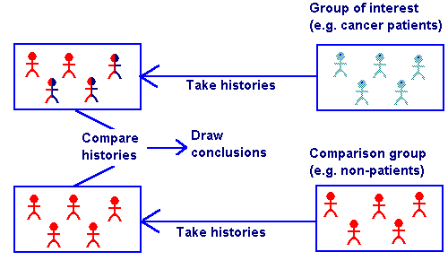
Case control study

Slide 17
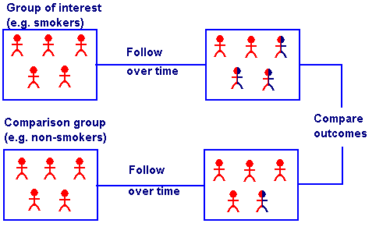
Cohort Study

Slide 18
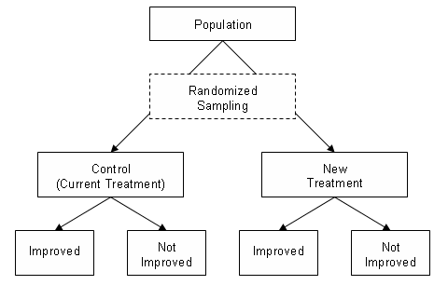
Randomized Clinical Trial

Slide 19
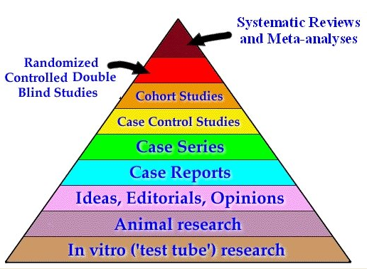
Level of evidence for treatment
A
B
C
D

Slide 20
According to the ADA, the primary approach to controlling
DM involves diet and lifestyle modification combined
with pharmacologic intervention.
The ADA purports that herbal and dietary supplements lack
Evidence to substantiate use in DM. Despite this, the use of
natural products and dietary supplements to help control
DM has become increasingly popular.
In US 29,000 nutritional supplements are available to
consumers, accounting for approximately US$12 billion in
annual spending in the US.

Slide 21
Nicotinamide
Fenugreek
Cinnamon
Ginseng
Chromium
Bitter Melon
Vitamin D3

Slide 22
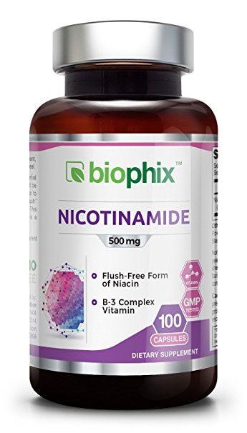
Nicotinamide

Slide 23
Nicotinamide
Nicotinamide (also referred to as niacin, vitamin B3, and nicotinic amide) is a water-soluble
vitamin B derivative that may bolster the release
of C-peptide and insulin.
These factors may help reserve residual beta-cell
function in patients with newly diagnosed type 1 diabetes.

Slide 24
Although it is most frequently used in high doses
for treating hyperlipidemia studies suggest that
prolonged use may prevent the onset of DM.

Slide 25
New Zealand study in school children aged 5 to 7.9 years
Duration :about 7 years
16.07 vs 7.14 per 100000 personper year in two groups
Adverse Drug Reactions

Slide 26
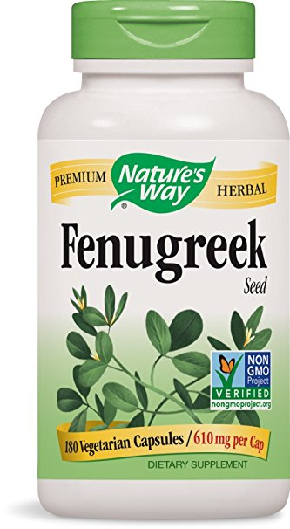
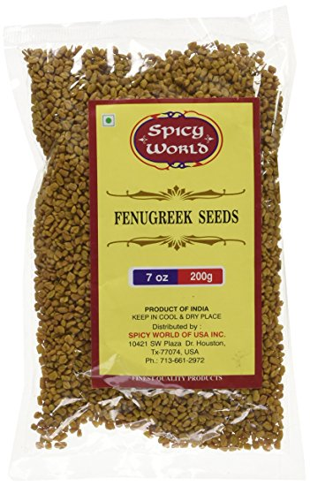
Fenungreek

Slide 27
It is a widely used herb in many countries including
India, China, Egypt, and the Middle East.
Although commonly used in cooking, it is often
used in patients with DM, especially for those
with limited health-care access.

Slide 28
In animal studies, fenugreek has shown a potential reduction in glucose absorption in the GI tract, as well as slower digestion of carbohydrates via enzymes
High content of dietary fiber and pectin in fenugreek which are responsible for slowing the GI transit.
Fenugreek seeds also contain free amino acids, which
have the potential to stimulate insulin release in the
presence of elevated glucose concentrations

Slide 29
Evidence
Studies indicate reduction in HbA1C levels as well as postprandial glucose and fasting glucose
Inconclusive evidence of recommended doses

Slide 30
ADRs
Dyspepsia, mild abdominal distension, stomach discomfort, and nausea
Increased risk of bleeding with concomitant
antiplatelet and anticoagulant agents
Potentially oxytocic

Slide 31
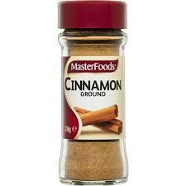
Cinnamon

Slide 32
Cinnamon is a widely used spice that is hypothesized to improve glucose control by phosphorylating insulin receptor tyrosine kinase which increases insulin sensitivity.
In addition, cinnamon extracts have been implicated in the production of transcription factors that modify insulin resistance through
possible modulation of GLUT4 transporters involved with mobilizing glucose into the cell

Slide 33
A 2013 meta-analysis reviewed 10 randomized control trials
a total of 543 participants.
The results revealed that cinnamon, compared to control, resulted in statistically significant reductions in FPG, LDL and total cholesterol
The analysis failed to determine a statistically significant difference in HbA1C
Reductions in FPG (24.59 mg/dL) are less than those achieved by metformin monotherapy (58
mg/dL) and somewhat more than the newer
agents, such as sitagliptin (16 to 21 mg/dL).

Slide 34
There were many inconsistencies between studies in the analysis
Dose: 6 to 120 mg/d
Kind of cinnamon:
Cinnamon cassia, the most commonly used and
inexpensive formulation of cinnamon& coumarin
Cinnamon zeylanicum has far less coumarin and is thought to be more effective in diabetes

Slide 35
Summary
The effects of cinnamon on the reduction in glucose levels are documented but lack reproducible data to encourage widespread use.
Larger, long-term trials with consistencies in product formulation, potency, and subject baseline characteristics are warranted before any recommendations can be made

Slide 36
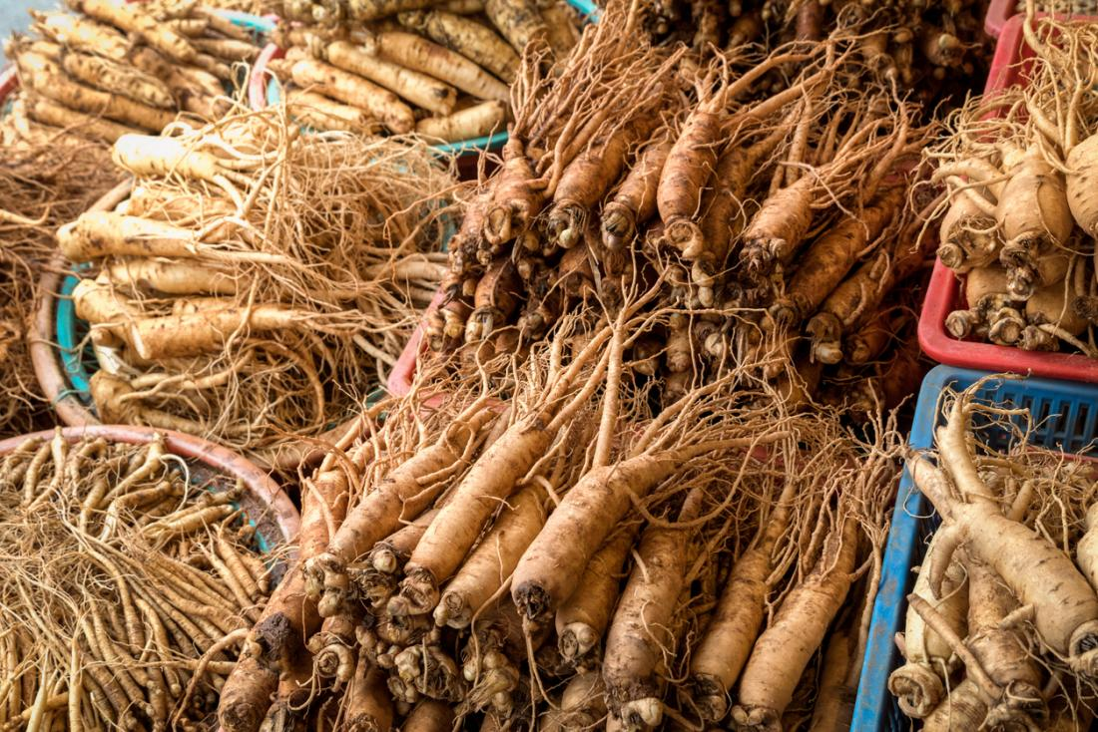
Ginseng

Slide 37
Mechanism
The roots of North American and Eastern Asian ginseng (common forms of ginseng) have long been used in diabetes.
Active constituents of ginseng roots include ginsenosides and possibly polysaccharides, which are thought to reduce PPG
Reduce postprandial glucose levels by either tissue insulin sensitization and/or direct stimulation of insulin release

Slide 38
Evidence
Most regarding American instead of Asian
Results in reduction of fasting blood glucose
Long-term evidence with substantial study size lacking
Optimal daily dosing unknown

Slide 39
ADRs
GI: Dyspepsia, constipation
Hot flashes
Insomnia
Decreases effectiveness of warfarin

Slide 40
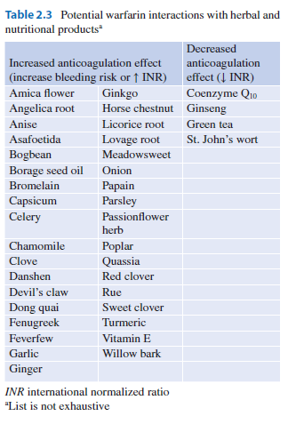

Slide 41
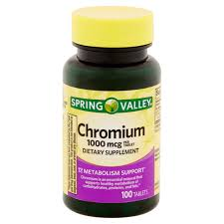
Chromium

Slide 42
Chromium is a trace element obtained in the diet through foods such as fish, clams, meat,
whole-grain cereals, and nuts.
On average, Americans obtain between 25
and 33 mg of dietary chromium a day, well
below the recommended daily allowance
of 50 to 200 mg

Slide 43
Benefit in DM
Prolongs action of the insulin receptor; allows
longer stimulation of the insulin receptor and
up regulation of insulin receptor

Slide 44
Evidence
Mixed results due to poor study designs and low sample sizes
A 2004 review of 21 studies demonstrated no significant differences in placebo versus chromium supplementation in
terms of reducing HbA1C, FPG, or OGTT.
A major contributing factor was that many of these
studies were poorly designed; 1/3 of the available data
were open-label trials subject to participant bias. Sample
sizes were small, with under 30 participants in most studies,
and were short term in nature; the longest trial duration
was 10 months.

Slide 45
ADRs
Isolated reports of kidney and liver function
impairment

Slide 46
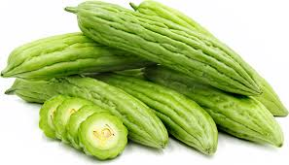
Bitter Melon (Momordica charantia)

Slide 48
It is consumed as a vegetable in countries such
as India and Asia.
The fruit and seeds are the parts thought to
help diabetes control
Theoretical mechanisms include insulin-like
properties, glucose uptake, decreased hepatic
gluconeogenesis, increased peripheral glucose
oxidation, and inhibition of enzymes involved
in glucose production

Slide 49
RCT was conducted in 40 adults with newly diagnosed or poorly controlled type 2 diabetes.
Patients were instructed to take two capsules of the bitter melon product after meals TDS for 3 months.
In both the bitter melon and placebo groups, A1C increased from a mean baseline of ~ 8%, although the increase was less pronounced in the bitter melon group (0.28 vs. 0.5% increase for bitter melon vs. placebo, respectively; P = 0.4825).
Fasting glucose declined from 151.2 to 143.8 mg/dl in the bitter melon group, but the decrease was not significant

Slide 50
Vitamin D

Slide 51
Several studies have suggested an association
between suboptimal blood levels of vitamin D
and an increased risk of DM.
Seasonal variations in glycemic control in patients with type 2 DM have been reported
with worse glycemic control in the winter when vitamin D deficiency is most prevalent.

Slide 52
Mechanism
There are several postulations of the mechanism of altered
glycemic control and vitamin D.
Since vitamin D has immunomodulatory effects, the
autoimmune pathogenesis of type 1 and the chronic
inflammation implicated in insulin-resistant type 2 may be
influenced by low vitamin D levels.
Vitamin D plays a role in stimulating insulin release by
pancreatic beta cells. Individuals with vitamin D
deficiency may also have elevated PTH levels, which can
also impair insulin release

Slide 53
Evidence
Mitri et al
A systemic review of 8 observational cohort studies
and 11 RCT including 238,423 participants showed that type 2 decreased by 13% in individuals who took > 500 IU/d of vitamin D versus individuals who took <200 IU/d.
When comparing patients with the highest vitamin D status
(>25 ng/mL) to patients with lower vitamin D (<14 ng/mL),
those with higher levels had a 43% lower risk of type 2 diabetes (95% CI: 24-57)

Slide 54
Evidence
George et al
included 15 trials
This review found no significant improvement in HbA1C, insulin resistance, or FPG in all patients with vitamin D supplementation compared to placebo.
However in patients with IGT , there was a small but
significant decrease in FPG and a slight improvement in
insulin resistance.
These results suggest a modest effect of decreased
fasting glucose and improved insulin resistance
in patients with type 2 DM

Slide 55
ADRs
No documented adverse effects found in trials

Slide 56
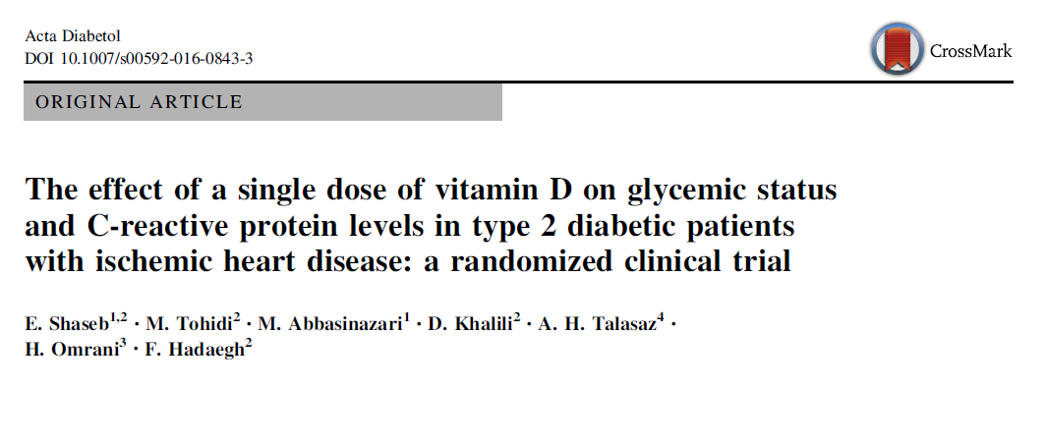

Slide 57
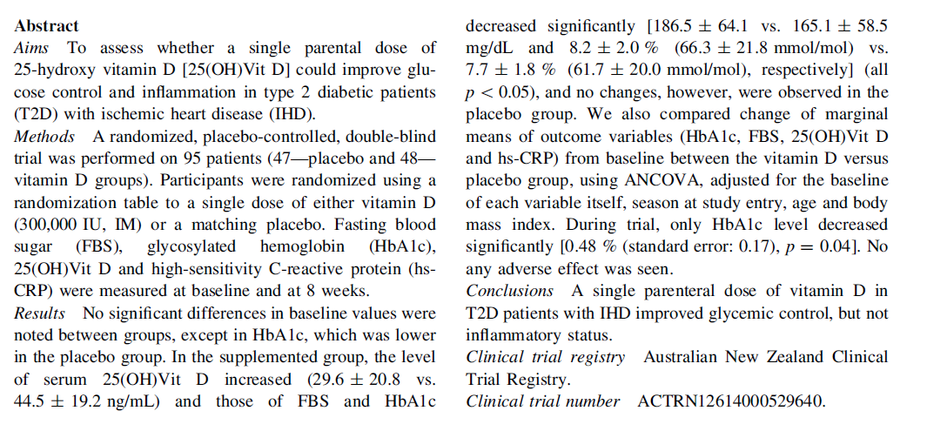

Slide 58
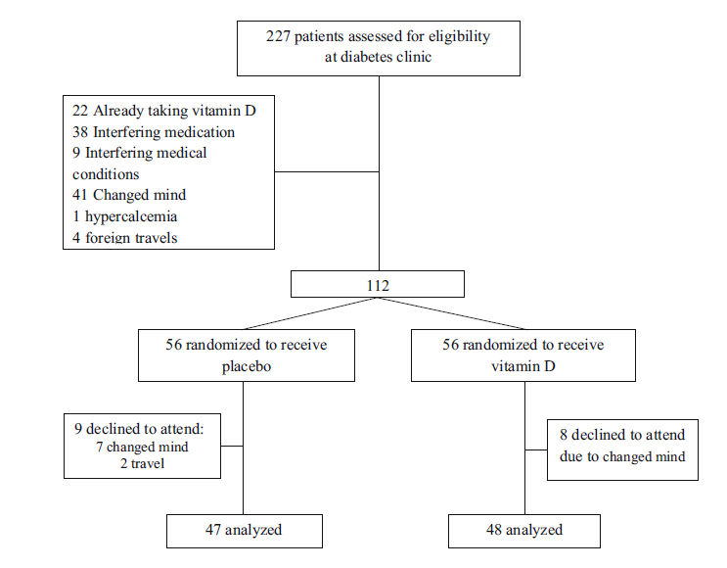

Slide 60
THE END

