Slide 1
xxxxxxxxxxxxxxxxxxxxxxxxxx
IN THE NAME OF ALLAH
shahin nosratzehi

Slide 2
manifestations of glucocorticoid excess were rapid and progressive
Weight loss
myopathy
and glucose intolerance are prominent symptoms and signs.
Hypokalemic metabolic alkalosis (EAS patients 90% vs. 10 - 15% in CD)
ACTH levels in the ectopic ACTH syndrome are high (usually >20 pmol/L [>90 pg/mL]); nevertheless, overlap values are seen in CD in 30% of cases.

Slide 3
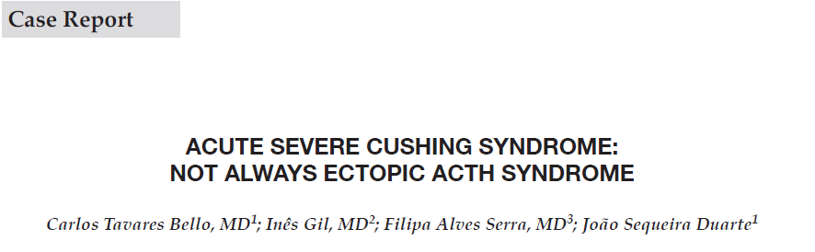
AACE CLINICAL CASE REPORTS 2018

Slide 4
A 62-year-old man with a past medical history of obesity and HTN, without any previous medication
was admitted to the emergency department With
altered mental status, polyuria, polydipsia
irritability
easy bruising
and proximal muscle weakness of sudden onset. (1 month prior)

Slide 5
physical examination
slight dehydration, obesity (BMI:31.2 kg/m2)
moon face, echymoses on the upper limbs
proximal muscle weakness
There was no peripheral edema, striae
At admission, plasma glucose was 452 mg/dL (25 mmol/L), serum potassium 2.7 mmol/L, arterial pH 7.6, and bicarbonate 50 mmol/

Slide 6
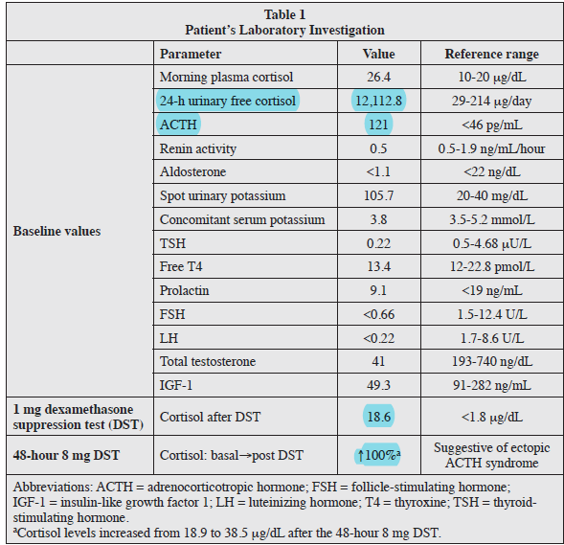

Slide 7
cranial magnetic resonance imaging (MRI) was performed:
a right-sided sellar expansive lesion with suprasellar and right cavernous sinus extension measuring 22 mm maximum diameter
The patient underwent endoscopic transsphenoidal tumor excision, with pre-operative preparation with metyrapone.

Slide 8
Clinical benefits regarding mental status ,hyperglycemia, and HTN were rapidly evident over a 4-week period.
Blood and UFC and plasma ACTH soon normalized after surgery
(postoperative day 7, plasma cortisol 11.1 µg/dL; ACTH, 10.4 pg/ mL) while on oral hydrocortisone replacement therapy.
Histology report was a pituitary adenoma without cellular atypia or mitosis.

Slide 9
COCLUSION
CD often presents with the gradual onset of signs and symptoms of prolonged supraphysiologic cortisol levels.
Sudden and drastic onset of CS often suggests an ectopic ACTH-secreting tumor.
Severe cushing syndrome not always ectopic ACTH syndrome
The biochemical testing has limitations, and these should be kept in mind in the investigation of hypercortisolism.

Slide 10
Clinical question
Is there any difference in the clinical symptoms between macroadenoma and microadenoma?
Is there any difference in the biochemichal assessment between macroadenoma and microadenoma?
How is Outcome of transsphenoidal surgery for Cushing’s disease in both group?

Slide 11
However, 4–10% of patients with Cushing’s disease harbor an ACTH-secreting pituitary macroadenoma.
Because Cushing’s disease is itself relatively rare, with1.2-2.4 new cases per million population per year according to one estimate the occurrence of Cushing’s disease resulting from pituitary macroadenomas is most unusual,
and there are not many reports in the literature describing the characteristics of pituitary macroadenomas causing this disorder

Slide 12
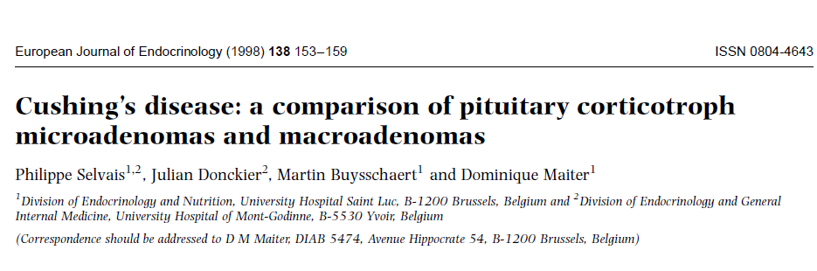

Slide 13
We studied 10 patients suffering from CD caused by a pituitary macroadenoma who were referred to our endocrinological centres and compared them with 11 patients with a microadenoma observed during the same period.
Seven other patients were not included in the analysis (one with malignant CD, two with possible hypothalamic CD, one with a combination of CD with autonomous macronodular adrenal hyperplasia, and three because of insufficient case documentation)

Slide 14
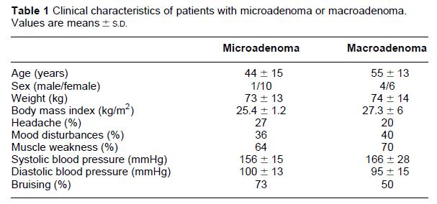

Slide 15
Patients with a microadenoma tended to be younger (44 ± 15 years) than those with macroadenoma (55 ± 13 years)
the diagnosis of their CD was more delayed (time from reported onset of symptoms to diagnosis 1.5 ± 0.8 years compared with 0.7 ± 0.6 years(P <0.05)
Visual field defect was present in 40% of patients with macroadenomas, but none of those with microadenoma (P < 0.05)
EMG tended more often to show a myogenous pattern in those with macroadenomas(67%,compared with28%in patients with microadenoma)

Slide 16
Biological signs of hypercortisolism (hypokalaemia and lymphopenia) were significantly more pronounced in patients with a large tumour .
There was also a non-significant trend toward more pronounced eosinopenia and hyperglycemia (data not shown).
There was no difference in the prevalence of osteoporosis estimated by densitometry or radiological evaluation.

Slide 17
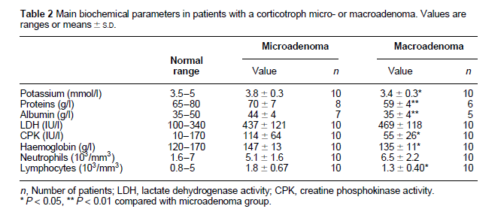

Slide 18
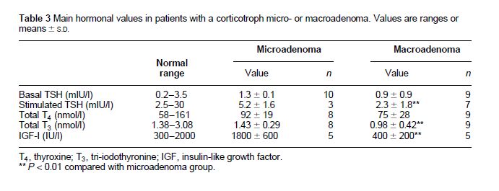

Slide 19
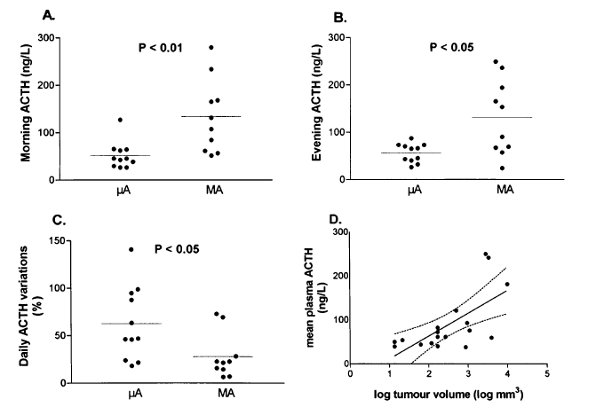
Plasma ACTH concentrations, measured in the morning and in the evening, were significantly greater in those with macroadenoma (Fig. 1A, B)
A relationship was demonstrated between the size of the adenoma and mean plasma ACTH concentration (rS = 0:66, P <0:005; Fig. 1D).
Individual values (̳) and means (continuous lines) are shown. The broken lines in (D) represent confidence intervals.
The relative daily variations of plasma concentrations ofACTH (defined as maximal ACTH minus minimal ACTH, divided by mean ACTH) was significantly blunted in patients with a macroadenoma (P < 0:05, Fig. 1C),.

Slide 20
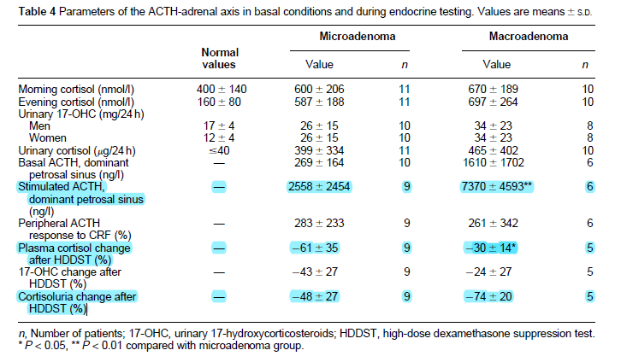
A plasma cortisol suppression greater than 50% was observed in six of nine of the patients with a microadenoma,
but in none of those with a macroadenoma (P < 0:05).
A cortisoluria suppression greater than 50% was observed in five of nine patients with a microadenoma and in
three of five patients with a macroadenoma

Slide 21
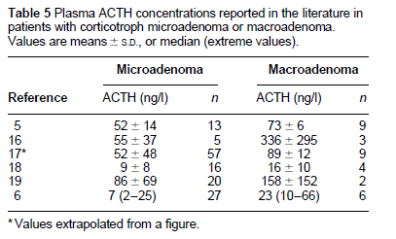

Slide 22
Conclusion
We have now shown here that ACTH concentrations are greater in patients with a corticotroph macroadenoma than in those with a microadenoma.
Our results also suggest that corticotroph macroadenomas are less responsive to suppression by high-dose dexamethasone

Slide 23
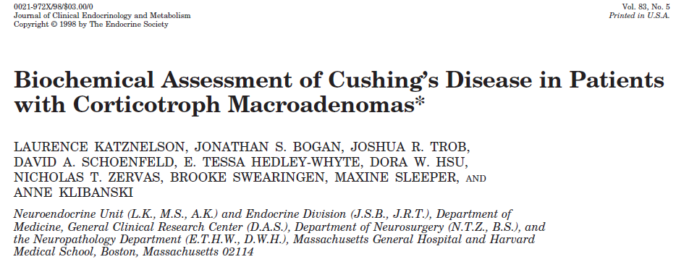

Slide 24
531 patients( Cushing’s syndrome )
were seen at Massachusetts General Hospital between 1979 -1995
261 had Cushing’s disease
Twenty patients met the study inclusion criteria for corticotroph macroadenomas and were analyzed.
Control data were obtained from 24 patients with Cushing’s disease due to a corticotroph microadenoma identified at theNeuroendocrine Clinical Center.

Slide 25
 | macroadenoma | microadenoma
Age | 39±12 | 38±14
Female | 75% | 83%
Visual field deficits | 6 (33%) of the 18 subjects | none of the patients
UFC | 1341 nmol/d (304–69,033) | 877nmol/day (293–2,558 ) (P < 0.05)
urinary 17-OHCS | 52 mmol/d( 25–786 ) | 44 mmol/d(17 to 86 ) (P=0.09)
HDDST (UFC decreased) | 79 ±19% | 91±7% (P=0.04)
17-OHCS excretion decreased | 46±33% | 72 ± 22%
Baseline plasma ACTH above the normal range | 83.3% | 45%(P=0.05).

Slide 26
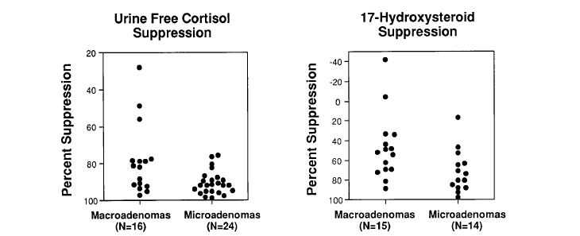
Nine (56%) macroadenoma subjects vs. 22 (92%) microadenoma patients demonstrated at least 80% suppression of UFC
8 (53%) macroadenoma subjects and 12 (86%) microadenoma patients demonstrated at least 50% suppression of 17-OHCS excretion

Slide 27
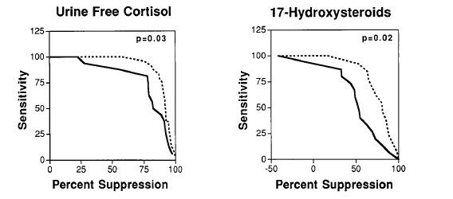
The sensitivity for suppression of each biochemical marker after the HDDSTtest in both groups of patients was assessed by constructing distribution curves,.
A more profound degree of suppression of both UFC and 17-OHCS excretion was found in microadenoma compared to macroadenoma patients at all percent cut-off points

Slide 28
Conclusion
There was a trend for higher plasma ACTH concentrations in patients with corticotroph macroadenomas compared to microadenomas.
These data indicate that, the set-point for glucocorticoid suppressibility is frequently altered in corticotroph macroadenomas compared to that in microadenomas, and the degree of UFC suppression may not be a reliable test in such patients.

Slide 29
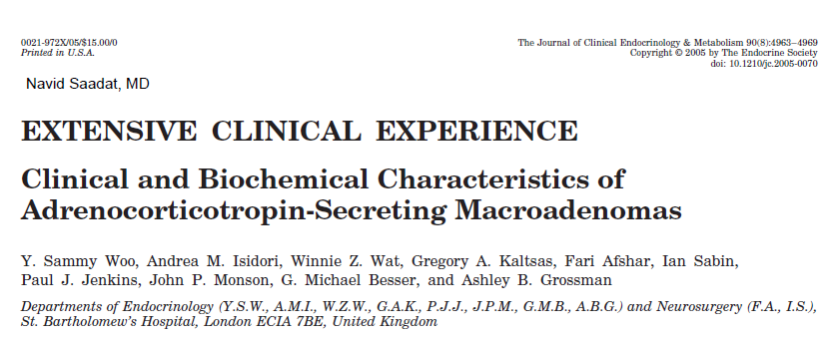

Slide 30
total of 413 patients with a diagnosis of Cushing’s syndrome
at St. Bartholomew’s Hospital in the years 1964–2001
274 patients had pituitary origin.
19 patients fulfilled the criteria for the presence of a macroadenoma
one was subsequently diagnosed with a pituitary carcinoma with liver metastases and was excluded
Two were lost to long-term term follow-up,
and thus the outcomes to treatment were available only in 16

Slide 31
Clinical manifestatin
moon face (94.4%)
Weight gain (77.8%)
central obesity (72.2%)
hypertension (72.2%)
plethora (61.1%)
muscle weakness (61.1%)
bruising (61.1%)
skin thinning (61.1%)
none of these features , was significantly different from those patients with microadenomas
In 27.8%, there was evidence of a visual field defect
but clinical pigmentation was uncommon(5.6%).

Slide 32
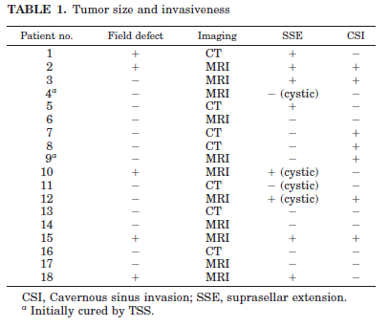
Imaging revealed a suprasellar extension in eight of 18 (44%)
and cavernous sinus invasion in seven of 18 (39%);
in four patients, two with suprasellar extensions and two without, the tumor was at least partly cystic

Slide 33
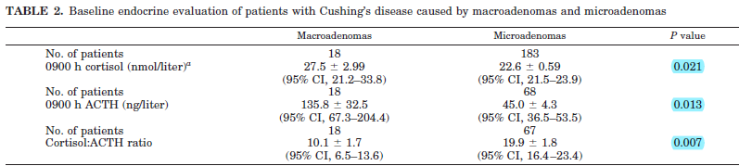
The serum cortisol and plasma ACTH levels were both significantly higher in the macroadenoma group than those with microadenomas(P = 0.021 and P =0.013, respectively)
The cortisol to ACTH ratio also showed a significant difference between the two groups, with the microadenomas showing relatively higher levels of cortisol for a given ACTH

Slide 34
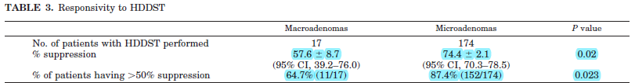
with the macroadenoma patients showing a lesser degree of suppression (57.6 ± 8.7%) compared with the microadenomas (74.4 ± 2.1%)
A threshold of 50% or more suppression during the HDDST was seen in 11 of 17 (64.7%) patients with macroadenomas and 152 of 174 (87.4%) microadenoma patients (P 0.023)

Slide 35
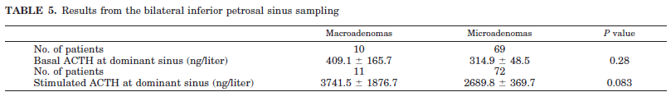
Data for bilateral inferior petrosal sinus sampling were available in 11 patients with macroadenomas
and 72 patients with microadenomas; whereas both basal and stimulated central ACTH levels were higher in patients with macroadenomas, this also failed to reach statistical significance (P 0.28 and 0.083, respectively)

Slide 36
conclusion
the clinical features are broadly similar to other reports on Cushing’s disease, without any clear distinguishing features other than visual compromise in 27.8%
The baseline hormonal assessment of patients with macroadenomas showed , both 0900 h ACTH and cortisol levels being significantly higher than those in microadenomas
the increase in ACTH is more apparent in the macroadenoma patients, and indeed the ratio of ACTH to cortisol suggests that for a given level of ACTH, less cortisol is found in the macroadenoma patients
It is possible that this reflects lowered biological activity of ACTH in patients with macroadenomas

Slide 37
Treatment and outcome
All patients with Cushing’s disease underwent TSS as firstline treatment.
However, only two of 16 (12.5%) patients with macroadenomas were cured after initial TSS, and the remaining 14 not cured by TSS were referred for radiotherapy.
In addition, they received adjunctive therapies including repeat surgery,
conventional external-beam radiotherapy, medical therapy
(metyrapone, ketoconazole, or mitotane depending on patient response and tolerance) and bilateral adrenalectomy, as appropriate

Slide 38
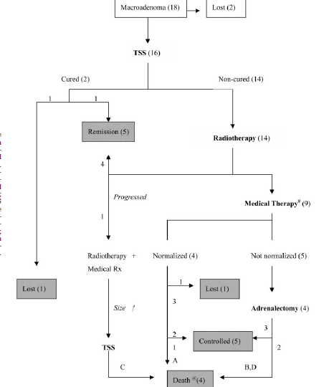
FIG. 4. Flow chart summarizing the
outcomes of therapy of 18 patients with
Cushing’s disease caused by macroadenomas.
#, Medical therapy included metyrapone, ketoconazole, or mitotane.
@, Causes of death were as follows:
patientA, a 73-yr-old woman, died of meningitis
complicating cerebrospinal fluid fistula 15 months after presentation;
patient B, a 56-yr-old man, died 6 months after presentation, but thecause was unknown;
patient C, a 66-yrold woman, died of postoperative pneumonia 50 months after presentation;
patient D was a 64-yr-old woman with
progression of tumor size 3 yr after adrenalectomy
leading to eventual death

Slide 39
In summary, five of 14 (35.7%) patients with macroadenomas went into remission with TSS and radiotherapy.
We analyzed various factors including
age, duration of symptoms,
the presence of cavernous sinus invasion, suprasellar extension,
serum cortisol, plasma ACTH,
the responses to the HDDST and CRH stimulation,
but none was a significant predictor of postoperative cure or the likelihood of remission.

Slide 40
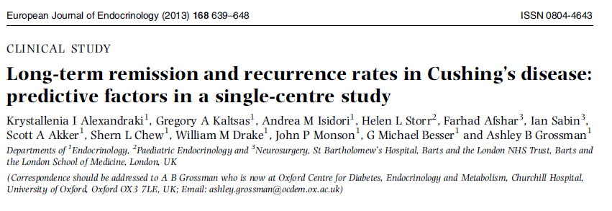

Slide 41
Patients with a diagnosis of CD followed in the Department of Endocrinology at St Bartholomew’s Hospital
between 1969 and 2001
case notes were retrieved from 161 patients from our well-studied and previously published
Of these, 131 patients had a minimum follow-up period of 6 years post-operatively.
Only the four patients who died before the completion of 6 years of follow-up were not included in the specific calculation

Slide 42
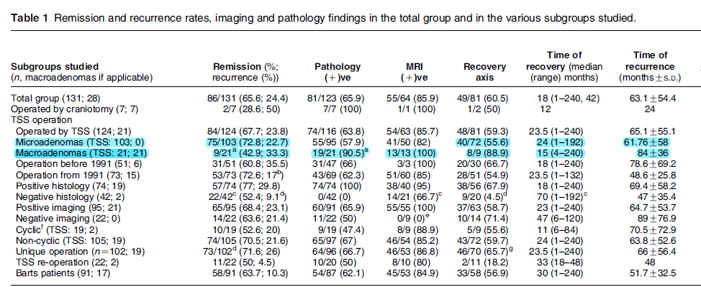

Slide 43
Apparent immediate cure: post-operative 0900 h serum cortisol Level<50 nmol/l
remission: cortisol insufficiency or restoration of ‘normal’ cortisol levels with resolution of clinical features
recurrence: shown by LDDST >50 nmol/l and relapse of hypercortisolemic features.

Slide 44
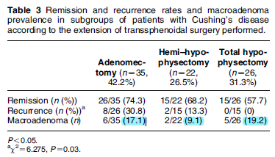
Interestingly, there was no difference in immediate outcome between these procedures

Slide 45
coclusion
Clinical features are similar in a corticotroph macroadenomas and microadenomas
ACTH concentrations are greater in patients with a corticotroph macroadenoma than in those with a microadenoma.
Our results also suggest that corticotroph macroadenomas are less responsive to suppression by high-dose dexamethasone
Remission rate is greater in patients with a corticotroph microadenoma than in those with a macroadenoma

