Slide 2
GENETIC SCREENING — Genetic testing should be considered if a patient has one or more of the following:
Paraganglioma
Bilateral adrenal pheochromocytoma
Unilateral adrenal pheochromocytoma and a family history of pheochromocytoma/paraganglioma
Unilateral adrenal pheochromocytoma onset at a young age (eg, <45 years), or
Other clinical findings suggestive of one of the syndromic disorders
An asymptomatic person at risk for disease on the basis of family history of pheochromocytoma/paraganglioma should have genetic testing only if an affected family member has a known mutation.

Slide 3
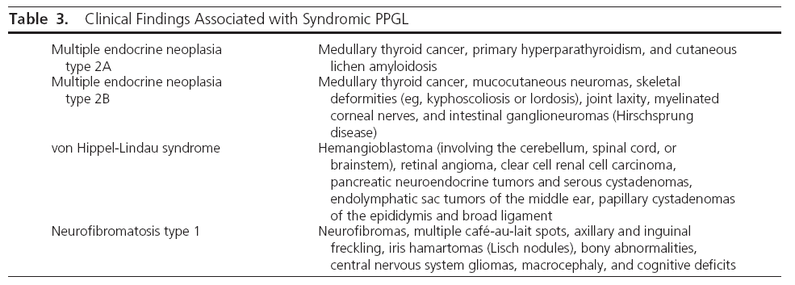

Slide 4
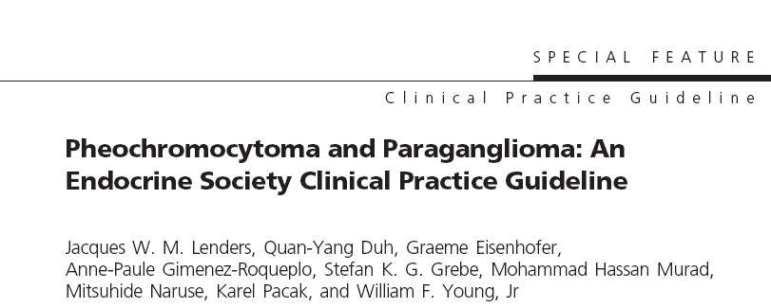
SUMMARY OF RECOMMENDATIONS ( Imaging Studies)
first-choice imaging :CT rather than MRI (excellent spatial resolution of CT for thorax, abdomen, and pelvis. (2| ⨁ ⨁ ⨁ ⃝ )
MRI : in patients with metastatic PPGL, for detection of skull base and neck paragangliomas, in patients with surgical clips that cause artifacts when using CT, in patients with an allergy to CT contrast, and in patients in whom radiation exposure should be limited .(1| ⨁ ⨁ ⨁ ⃝ )
123I-metaiodobenzylguanidine (MIBG) scintigraphy as a functional imaging modality in patients with metastatic PPGL detected by other imaging modalities when radiotherapy using 131I-MIBG is planned, and occasionally in some patients with an increased risk for metastatic disease due to large size of the primary tumor or to extra-adrenal, multifocal (except skull base and neck PPGLs), or recurrent disease. (2| ⨁ ⨁ ⨁ ⃝ )
PET : metastatic PPGL (2| ⨁ ⨁ ⨁ ⃝ )

Slide 5
On CT, PPGLs may be homogeneous or heterogeneous, necrotic with some calcifications, solid, or cystic.
Although between 87 and 100% of PPGLs exhibit a mean attenuation of more than 10 Hounsfield units on unenhanced CT, PPGLs can occasionally have more than 60% washout of contrast agents on 15-minute delayed scanning

Slide 6
SUMMARY OF RECOMMENDATIONS (Genetic Testing)
We recommend that all patients with PPGLs should be engaged in shared decision making for genetic testing. (1| ⨁ ⨁ ⨁ ⃝ )
We recommend the use of a clinical feature-driven diagnostic algorithm to establish the priorities for specific genetic testing in PPGL patients with suspected germline mutations. (1| ⨁ ⨁ ⨁ ⃝ )
We suggest that patients with paraganglioma undergo testing of succinate dehydrogenase (SDH) mutations and that patients with metastatic disease undergo testing for SDHB mutations. (2| ⨁ ⨁ ⨁ ⃝ )
We recommend that genetic testing for PPGL be delivered within the framework of health care. Specifically, pretest and post-test counseling should be available. All tests for PPGL genetic testing should be performed by accredited laboratories. (Ungraded recommendation)

Slide 7
14 different PPGL susceptibility genes
NF1
RET
VHL
SDHD
SDHC
SDHB
EGLN1/PHD2 *
KIF1β *
SDH5/SDHAF2
IDH1 *
TMEM127
SDHA
MAX
HIF2α

Slide 8
The highest frequencies of germline mutations :
SDHB (10.3%), SDHD (8.9%), VHL (7.3%), RET (6.3%), NF1 (3.3%)

Slide 9
Six different familial autosomal dominant diseases can be suspected clinically:
neurofibromatosistype 1 (NF1),
multiple endocrine neoplasia type 2 (MEN2),
von Hippel-Lindau (VHL) syndrome ,
renal cell carcinoma with SDHB mutation ,
Carney triad (paragangliomas, gastric stromal tumors, pulmonary chondromas),
and Carney-Stratakis syndrome (paragangliomas and gastric stromal sarcomas)
in view of the financial costs, genetic testing has limited incremental value in patients with unilateral pheochromocytoma and no syndromic or malignant features and no positive family history
Although there is no agreement upon age cutoff for genetic testing, the likelihood of a mutation
in patients with nonsyndromic PPGLs younger than 45 years is 5-fold higher than in patients older than 45 years

Slide 10
100 patients with a pheochromocytoma-only phenotype and no family history were included.
Patients with extra-adrenal tumours were excluded.
Prevalence of hereditary forms was determined and analyzed according to age at onset, sex. Cost of the genetic analysis was calculated.
Results: A germline mutation in one of the five susceptibility genes (VHL, RET, SDHD, SDHC, SDHB)
was identified in 8% with an age of onset between 13 and 57 years. Among them, six had a bilateral pheochromocytoma and only two had a unilateral tumour. If the guidelines for genetic screening were age of onset less than 50 or bilateral pheochromocytoma, no patients with a hereditary tumour would be missed and a 24% cost reduction would be achieved.

Slide 12
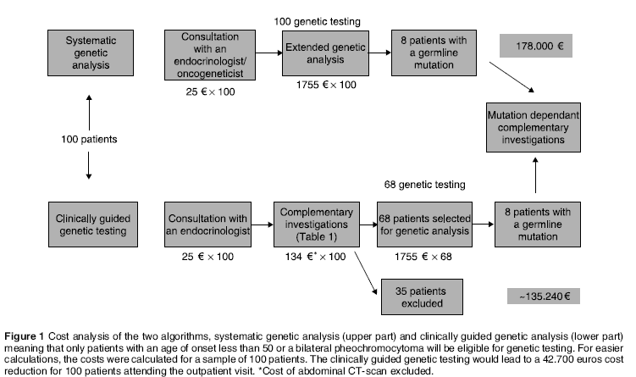
Conclusions: According to these data, a genetic predisposition test for hereditary pheochromocytoma
seems not recommended in patients with a unilateral adrenal tumour diagnosed after 50 in the
absence of familial, clinical, biological or imaging features for a familial disease.

Slide 13
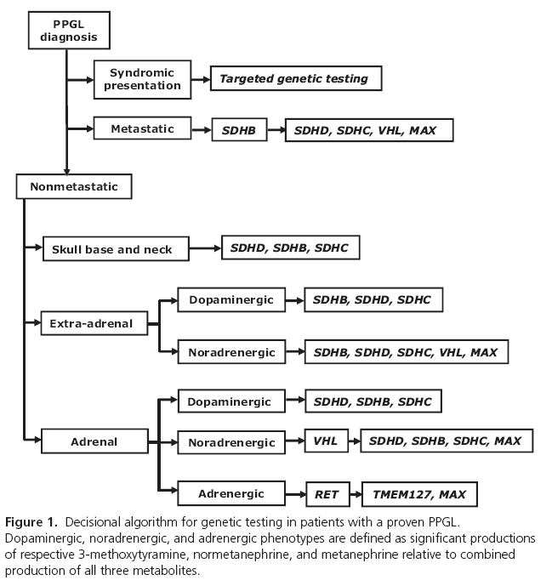

Slide 14
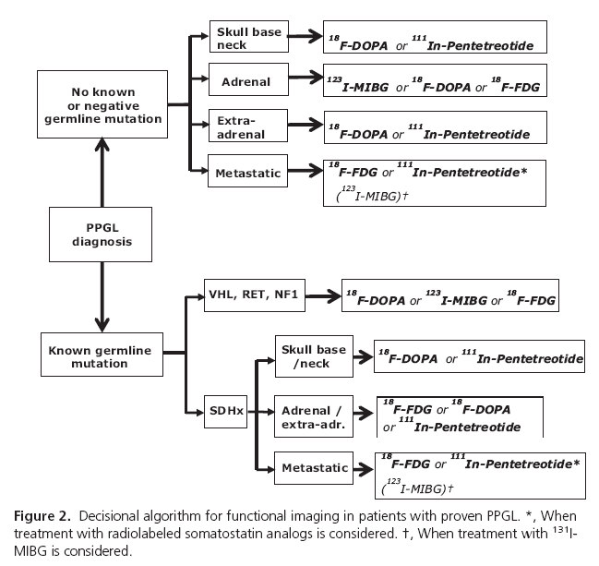

Slide 15
The approximate frequency of pheochromocytoma in these disorders is 10 to 20 percent in VHL syndrome, 50 percent in MEN2, and 0.1 to 5.7 percent with neurofibromatosis type 1
Hereditary PPGL due to TMEM127 or MAX mutations are infrequent, typically diagnosed later in life, and
preferentially adrenal in location; patients frequently have a positive family history .
TMEM127-related PPGLs typically produce epinephrine, whereas the biochemical phenotype of MAX-related tumors is intermediate between adrenergic and noradrenergic
In a large study of patients With non syndromic PPGLs, the prevalence of germline mutations associated with multiple PPGLs was 5-fold higher than for solitary PPGLs (54 vs 11.5%).

Slide 16
Nuclear medicine
Octreotide (Somatostatin) scans
Over 70% of tumours express somatostatin receptors. Imaging is obtained 4 hours (+/- 24/48 hours) after an intravenous infusion. Unfortunately, the kidney also has somatostatin receptors, as do areas of inflammation, mammary glands, liver, spleen, bowel, gallbladder, thyroid gland and salivary glands. As such interpretation can be difficult 5.
I-123 MIBG (metaiodobenzylguanidine)
I-123 MIBG uptake in an adrenal nodule is strong supporting evidence for a phaeochromocytoma. Overall sensitivity is ~ 80% 6. However, as many neuroendocrine tumours demonstrate uptake with MIBG, it is not as specific for phaeochromocytoma outside of the adrenal.

Slide 17
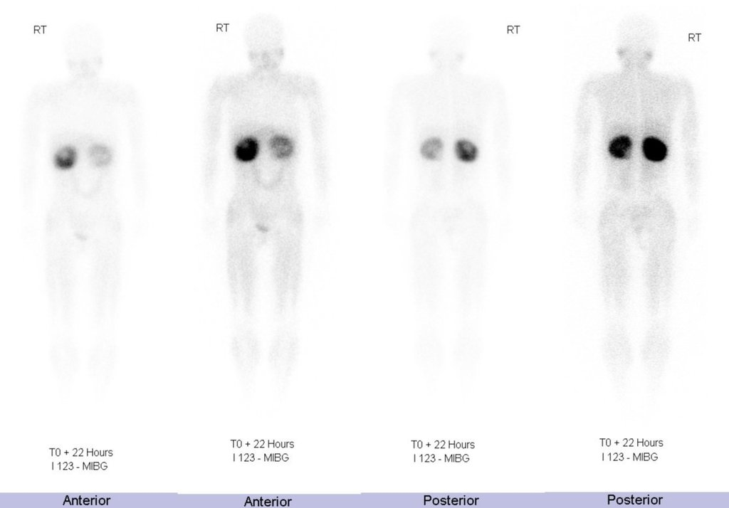
Large bilateral upper abdominal masses of heterogeneous density at the superior aspect of the kidneys. Normal adrenal glands are not seen.
The scintigraphic findings are consistent with bilateral adrenal pheochromocytomas, with markedly increased tracer seen in both adrenal masses.

Slide 18
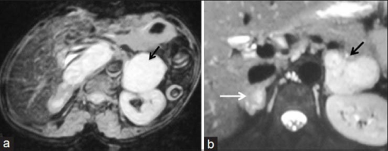
Light bulb sign (phaeochromocytoma)
marked hyperintensity seen on T2 weighted sequences however this finding is neither sensitive nor specific and phaeochromocytomas are more often heterogeneous with intermediate or high T2 signal intensity.
MRI of Pheochromocytoma. T2 weighted axial image (a) showing left suprarenal mass (arrow) which has uniform hyperintense signal intensity (light bulb sign). Similarly, bilateral hyperintense adrenal masses are seen in another patient with bilateral pheochromocytoma (b)

Slide 19
Isolated familial pheochromocytoma ?
In a family with pheochromocytomas in three generations and with at least seven affected members, we investigated by clinical and genetic analyses the presence or absence of associated conditions.
Genetic analysis did not identify any MEN 2-specific RET protooncogene point mutations However, despite the complete absence of other clinical manifestations of the vHL disease (besides pheochromocytomas), a previously undescribed germline mutation in the vHL tumor suppressor gene was found.

Slide 20
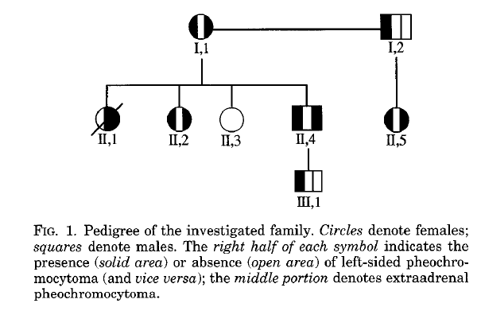
We conclude that in this family the sole occurrence of pheochromocytoma is a variant of vHL disease.

Slide 21
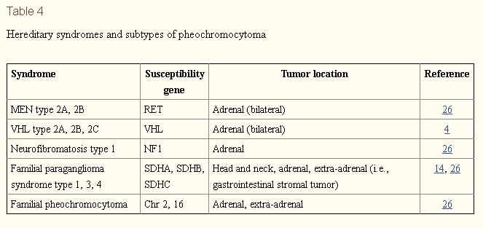

Slide 22
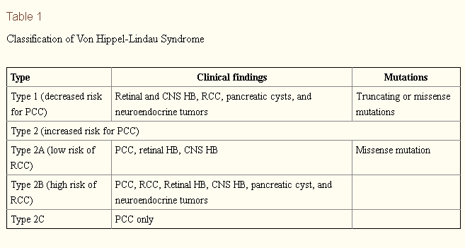

Slide 23
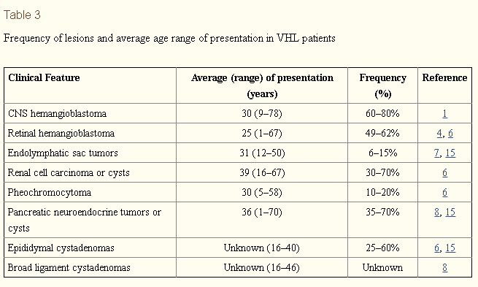

Slide 24
Phenotype of MEN2 versus VHL syndrome — The clinical and biochemical characteristics of pheochromocytomas in MEN2 versus the VHL syndrome were investigated in a study of 19 and 30 patients with these disorders, respectively; the following findings were noted :
MEN2 patients were more symptomatic with a higher incidence of hypertension (primarily paroxysmal).
MEN2 patients all had elevated serum concentrations of metanephrine (the epinephrine metabolite), while all VHL patients had elevated serum normetanephrine concentrations (the norepinephrine metabolite).
Compared to MEN2 tumors, VHL tumors had lower total tissue contents of catecholamines and expression of tyrosine hydroxylase (TH), the rate-limiting enzyme in catecholamine synthesis. They also had much lower expression of phenylethanolamine N-methyltransferase (PNMT, the enzyme that converts norepinephrine to epinephrine) and tissue stores of epinephrine.

Slide 25
Surgery
Familial pheochromocytoma
Patients with familial pheochromocytomas (eg,MEN2, VHL) have a high incidence of bilateral disease.
Cortical-sparing bilateral adrenalectomy (partial adrenalectomy) may be considered for some patients with bilateral pheochromocytomas to prevent permanent glucocorticoid deficiency because some types of familial pheochromocytomas have less metastatic potential .
The management of patients with MEN2 and VHL differs as follows:

Slide 26
Patients with MEN2 have bilateral disease in 30 percent of cases and contralateral disease develops in 50 percent of the MEN2 patients with unilateral disease within 10 years.
For these reasons, when bilateral adrenal pheochromocytomas are present, complete bilateral adrenalectomy is recommended for MEN2 patients.
Patients with some forms of VHL have less diffuse medullary disease and cortical-sparing bilateral adrenalectomy is an option for these patients when bilateral disease is evident on imaging .
Some variant forms of VHL (VHL type 2A) have high malignancy rates and cortical sparing adrenalectomy should be avoided in patients from these kindreds .
Patients with VHL should be referred for genetic counseling and screening for specific mutations associated with these variants.

Slide 27
This was a retrospective observational study conducted in nine university hospital endocrine surgery departments in France and Belgium.
Inclusion was based upon abnormal preoperative hormone tests in patients with pheochromocytoma that normalized after removal of the tumor.
Results
Nine university hospitals contributed 16 patients during a 30 years period covering October 1978 to January 2009, corresponding to 1% of all pheochromocytoma operated on during this period.
Median age was 50.5 (range 31–89) years;

Slide 28
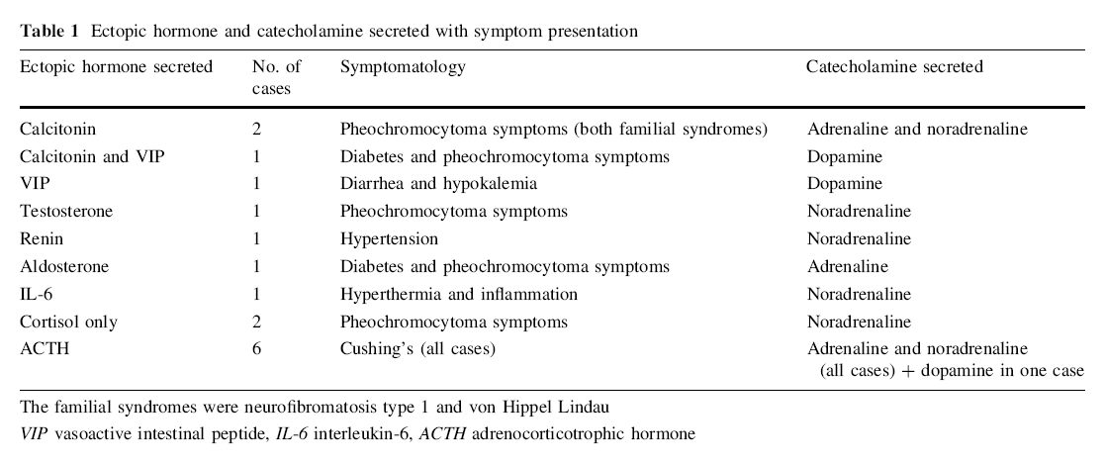

Slide 29
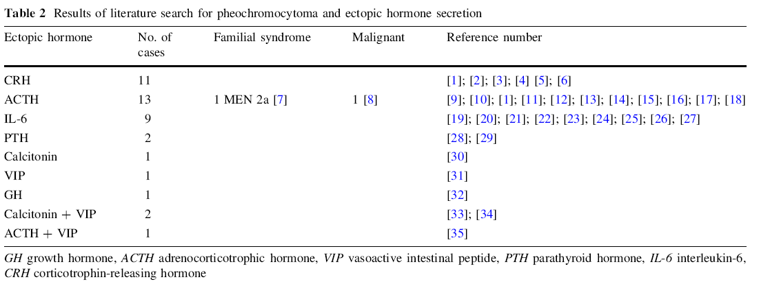
Conclusions Most pheochromocytomas with ectopic secretion are neither malignant nor familial.
Most ectopic hormone-secreting pheochromocytoma cause hypercortisolemia.
Patients with a pheochromocytoma should be worked up for ectopic hormones, because removal of the
pheochromocytoma resolves those symptoms..

Slide 30
A total of 154 consecutive patients with PC (n = 137) or abdominal PG (n = 17) were treated at our unit (the only referral center for western Sweden;
population 1.6 million) between 1950 and 2004 (85 females and 69 males, mean age 51 years).

Slide 31
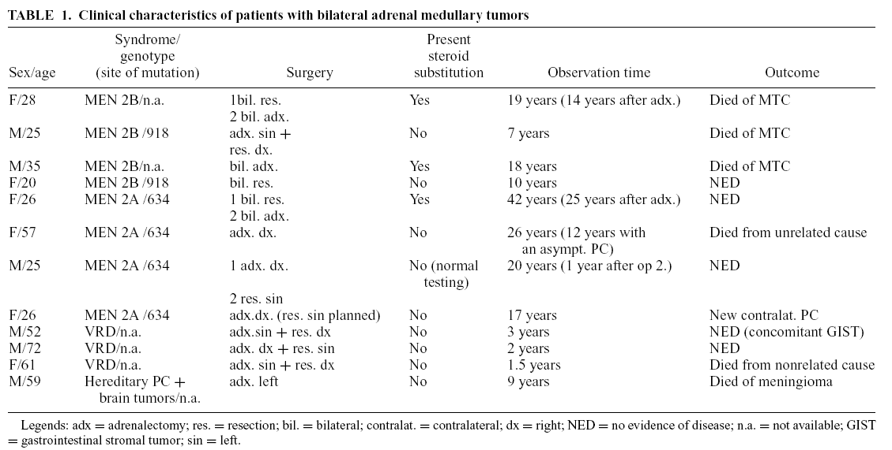
Twelve patients in this series presented with, or developed, bilateral PC

Slide 32
We sequenced MAX in 1,694 patients with PCC or PGL (without mutations in other major susceptibility genes) from 17 independent referral centers.
16 MAX pathogenic mutations were identified in 23 index patients. All had adrenal tumors, including 13 bilateral or multiple PCCs within the same gland (P < 0.001).

Slide 34
A 6-year-old girl who came to us with polyuria and polydipsia for evaluation of suspected diabetes insipidus. She gave a clear history of increased sweating in the recent past. On clinical examination, she was noted to have high blood pressure.
Subsequent investigations revealed a pheochromocytoma. Her polyuria and hypertension resolved immediately after the surgery
Experiments have revealed that noradrenaline-induced inhibition of ADH release worked through a baroreceptor-mediated mechanism .
This baroreceptor-mediated inhibition of ADH release can be blocked with an a adrenergic antagonist, indicating
that inhibition of ADH by noradrenaline acts through a adrenergic receptors (9). Elevated blood pressure also
inhibits ADH through peripheral baroreceptors by increased sympathetic stimulation . The experiments
have revealed that denervation of baroreceptors abolished
the diuretic effect of i.v. noradrenaline.

Slide 35
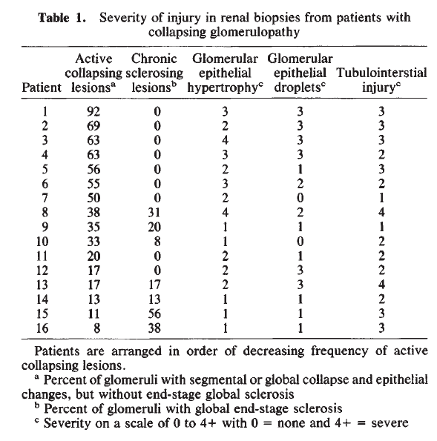
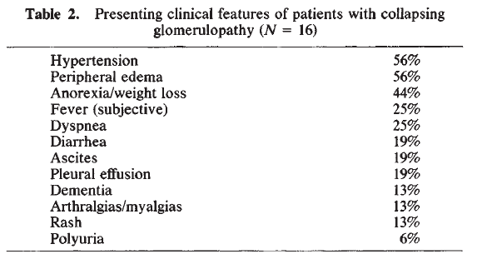

Slide 36
Focal segmental glomerular sclerosis (FSGS) has been observed with renal cell carcinoma, thymoma, and rarely with lung, breast, and esophageal cancers
Bacchetta J, Juillard L, Cochat P, Droz JP. Paraneoplastic glomerular diseases and malignancies. Crit Rev Oncol Hematol 70: 39–58, 2009

Slide 37
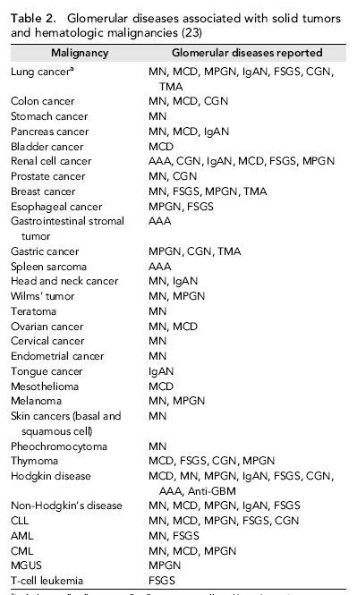
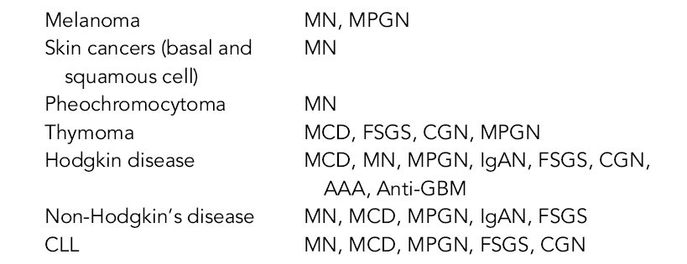

Slide 38
A 22-year-old male patient with focal segmental glomerulosclerosis(FSGS) associated with a pheochromocytoma is reported. Immunofluorescence study of the kidney biopsy specimen demonstrated segmental depositions of IgM, C3 and fibrinogen. Alteration of glomerular basement membrane(GBM) with fibrin strands and platelet aggregates was observed by electron microscopic examination. Administration of prednisolone had no effect on massive proteinuria, but surgical removal of the tumor promptly reduced proteinuria. It was suggested that FSGS can develop in patients with pheochromocytomas, and local hypercoagulation might be responsible for the development of this lesion.

Slide 39
In clinical practice, the coincidence of nephrotic syndrome with pheochromocytoma is very rare. The case is described of a 23-year-old woman who in June 1988 presented with recurrent hypertensive crises, severe asthenia, abundant sweats, orthostatic hypertension and massive proteinuria. Diagnostic tests performed (abdominal ultrasound and CT, urinalysis, renal function tests, plasma levels of metanephrine and normetanephrine, as well as urinary VMA determination) revealed the presence of a pheochromocytoma of the left adrenal gland combined with nephrotic syndrome. Surgical removal of the left adrenal led to immediate normalization of blood pressure and absence of urinary abnormalities. The authors therefore suggest either an immunological pathogenesis or one due to glomerular hyperfiltration.

Slide 40
Summary
MIBG scintigraphy
Genetic test (RET)
UFC ,PTH
Surgery

