Slide 1
Case presentation
17 JAN 2018

Slide 2
Relative Risk of Progression of Diabetic Complications
RELATIVE RISK
Mean A1C
        DCCT Research Group, N Engl J Med 1993, 329:977-986.

Slide 3
Macrovascular Complications as the most important cause of mortality
UKPDS
ADVANCE
VADT
ACCORD
Glycemic control per se doesn't decrease CVD outcome

Slide 4
Primary Objectives of Effective Management
Diagnosis
lGæde P, Vedel P, Larsen N, Jensen GVH, Parving H-H, Pedersen O. Multifactorial intervention and cardiovascular disease in patients with type 2 diabetes. N Engl J Med. 2003;348:383-393.
A1C
%
9
8
7
Reduction
of both
micro- and macro-
vascular
event
rates
…by 75%!
SBP
mm Hg
145
130
LDL
mg/dL
140
100
45
50
55
60
65
70
75
80
85
90
Patient Age
Notes:
Key Points
The primary objectives of effective diabetes management are to reduce A1C to as near-normal levels (ie, 4%–6%) as is possible and safe, to lower systolic blood pressure to <130 mm Hg, and to decrease LDL cholesterol to <100 mg/dL
Achieving target levels of A1C, systolic blood pressure, and LDL cholesterol may reduce the risk of the micro- and macrovascular complications of diabetes by up to 75%
As illustrated in this slide, the objectives of effective diabetes management are to reduce A1C to as near-normal levels as is possible and safe (ie, 4%–6%), lower systolic blood pressure to <130 mm Hg, and to decrease LDL cholesterol to <100 mg/dL. Evidence suggests that achieving these target levels can reduce the risk of both microvascular and macrovascular complications of diabetes by >75%.¹
Most recently, the Steno-2 Study followed 160 patients with type 2 diabetes and microalbuminuria over 7.8 years to determine the effect of intensive treatment on long-term CV and microvascular outcomes. Researchers found that target-driven, intensive treatment consisting of stepwise diet, exercise, and pharmacotherapy for glycemia, microalbuminuria, lipids, and blood pressure resulted in a decreased risk of CV and microvascular events of about 50%. Control group members received conventional treatment in accordance with national guidelines. However, factors leading to diminished degrees of separation between the intensive treatment and control groups (eg, more than 50% of control group members were referred for specialist treatment during the course of the study) led the authors to estimate that the actual risk reduction associated with intensive versus conventional therapy may be even greater than that observed.²
References
American Diabetes Association. Clinical Practice Recommendations. Implications of the United Kingdom Prospective Diabetes Study. Diabetes Care. 2003;26(suppl 1):S28-S32.
Gæde P, Vedel P, Larsen N, Jensen GVH, Parving H-H, Pedersen O. Multifactorial intervention and cardiovascular disease in patients with type 2 diabetes. N Engl J Med. 2003;348:383-393.

Slide 6
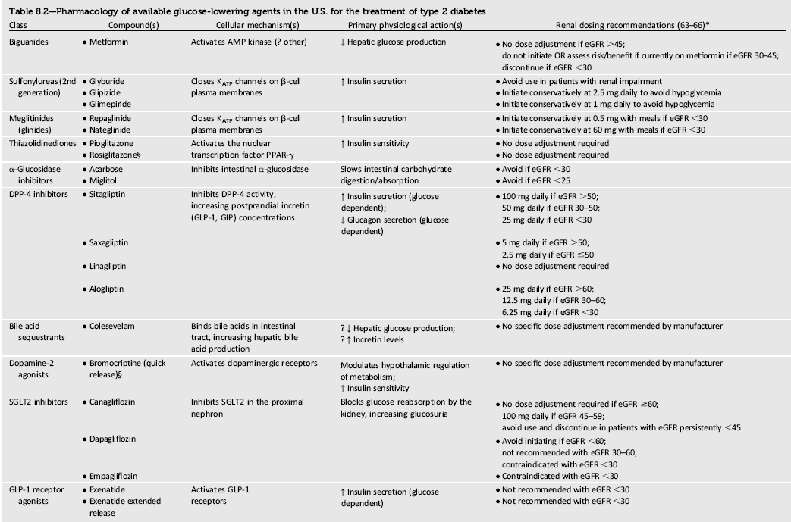

Slide 7
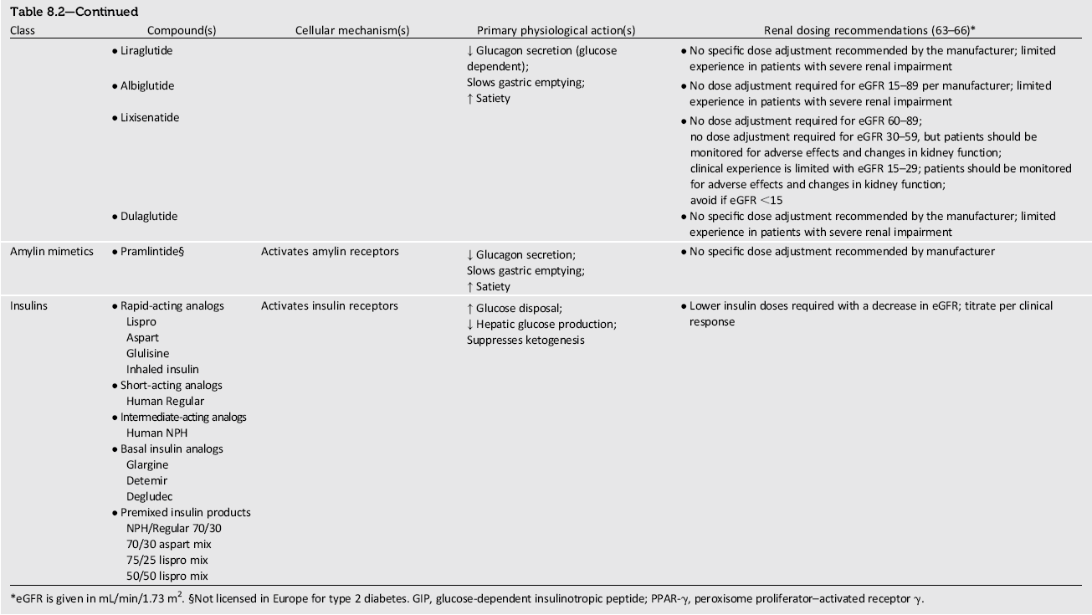

Slide 8
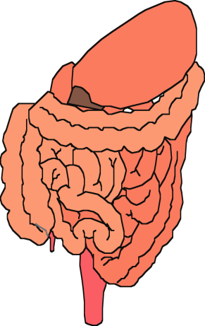
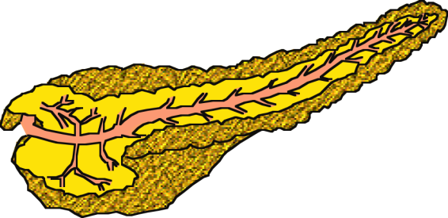


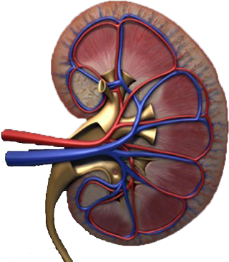
Multiple, Complex Pathophysiological Abnormalities in T2DM
GLP-1R
agonists
Insulin
pancreatic
insulin
secretion
incretin
effect
Glinides
S U s
DPP-4
inhibitors
Amylin
mimetics
pancreatic
glucagon
secretion
_
DA agonists
?
A G I s
gut
carbohydrate
delivery &
absorption
HYPERGLYCEMIA
Metformin
_
T Z D s
Bile acid
sequestrants
+
peripheral
glucose
uptake
hepatic
glucose
production
renal glucose excretion
Adapted from: Inzucchi SE, Sherwin RS in: Cecil Medicine 2011
Notes:
Anti-hyperglycemic drugs for patients with T2DM are targeted at one or more of the pathophysiological abnormalities of this disease. On this slide, the main sites of action of the currently available 12 individual drug classes is depicted. Combination glucose-lowering therapy has become a standard treatment strategy when patients do not adequately respond to a single agent (often metformin.)

Slide 9
Expected HbA_{1c} reduction according to intervention
Intervention | Expected ↓ in HbA_{1c} (%)
Lifestyle interventions | 1 | to | 2%
Metformin | 1 | to | 2%
Sulfonylureas | 1 | to | 2%
Insulin | 1.5 | to | 3.5%
Glinides | 1 | to | 1.5%¹
Thiazolidinediones | 0.5 | to | 1.4%
α-Glucosidase inhibitors | 0.5 | to | 0.8%
GLP-1 agonist | 0.5 | to | 1.0%
Pramlintide | 0.5 | to | 1.0%
DPP-IV inhibitors | 0.5 | to | 0.8%
Nathan DM, et al. Diabetes Care 2009;32:193-203.
Notes:
9

Slide 10
پوشش بیمه | قیمت (تومان) | تعداد | نام دارو
√ | 7500 (19500) | 100 | متفورمین
√ | 4000 | 100 | گلی بن کلامید
√ | 11000 (19000) | 100 | گلی کلازید
√ | 5500 | 100 | ریپگلیناید
√ | 9000 | 100 | ریپگلیناید
√ | 13000 | 100 | ریپگلیناید
● | 32-40-48000 | 100 | گلوتازون (15-30-45)
● | 22-34000 | 100 | آکاربوز
● | 30000 | 30 | زیپتین 50
√ | 12000 | 1 ویال | NPH
√ | 12000 | 1 ویال | Regular
● | 20000 | 100 عدد | سرنگ

Slide 11
Effectiveness
safety profiles
Side effects
Cost
Patient satisfaction
.extraglycemic effect.

Slide 12
ADA-EASD Position Statement Update:
Management of Hyperglycemia in T2DM, 2015
Patient-Centered Approach
“...providing care that is respectful of and responsive to individual patient preferences, needs, and values - ensuring that patient values guide all clinical decisions.”
Gauge patient’s preferred level of involvement.
Explore, where possible, therapeutic choices. Consider using decision aids.
Shared Decision Making – a collaborative process between patient and clinician, using best available evidence and taking into account the patient’s preferences and values.
Final decisions regarding lifestyle choices ultimately lie with the patient.
Diabetes Care 2012;35:1364–1379; Diabetologia 2012;55:1577–1596
Notes:
There is increasing emphasis on ‘patient-centeredness’ in chronic disease management. This has been described by the Institute of Medicine as “providing care that is respectful of and responsive to individual patient preferences, needs, and values – ensuring that patient values guide all clinical decisions.” Shared decision making (SDM) is a key component of patient-centered care. This is of particular importance in those conditions, like diabetes, that necessitate patient involvement in lifestyle changes.

Slide 13
Case 1
خانم نسرین. ش
56 y/o ,Woman, New case of DM
PH: HTN(-) IHD(-) Thalassaemia Minor (+)
Retinopathy(-) Nephropathy(-)
HH: Smoking(-)
W: 93 Kg, H: 162Cm, BMI: 35.4, BP: 130/80
Drug Hx:
  Tab Atorvastatin 20 mg/d,

Slide 14
Case 1
W=93 kg
1395/6/10
Lab Data:
  FBS: 126mg/dl
  A1C: 5.6% (N<6%)
  Cr: 1 mg/dl
  TG: 150 mg/dl
  Total Cholesterol: 164 mg/dl
  HDL Cholesterol: 54 mg/dl
  LDL Cholesterol: 80 mg/dl
  AST: 15
  ALT: 17
  Hb: 11.6
  TSH: 2.58 µIU/ml
  T4: 10.8 µg/dl
خانم نسرین. ش

Slide 15
Case 1
خانم نسرین. ش
What is your recommendation?
Lifestyle Management only (for 3 Month)
Lifestyle Management & Add Metformin
Lifestyle Management & Add sulfonylurea
Lifestyle Management & Add Liraglutide

Slide 16



ADA-EASD Position Statement Update:
Management of Hyperglycemia in T2DM, 2015
3. ANTI-HYPERGLYCEMIC THERAPY
Therapeutic options: Lifestyle
  Weight optimization
  Healthy diet
  Increased activity level
Diabetes Care 2012;35:1364–1379; Diabetologia 2012;55:1577–1596
Notes:
Non-pharmacological options are critically important – they are cost effective and have no side effects, per se. Patients with T2DM should become more physically active, eat a healthy diet and try to optimize body weight. These efforts will result in less insulin resistance, with better blood glucose control the result. There are also additional health benefits from such interventions.

Slide 17
ADA 2017
Metformin monotherapy should be started at diagnosis of type 2 diabetes unless there are contraindications.
Metformin is effective,
safe and
inexpensive,
and may reduce risk of cardiovascular events and death .

Slide 18
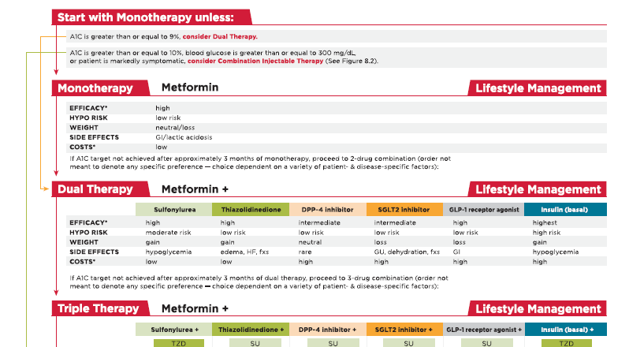

Slide 19
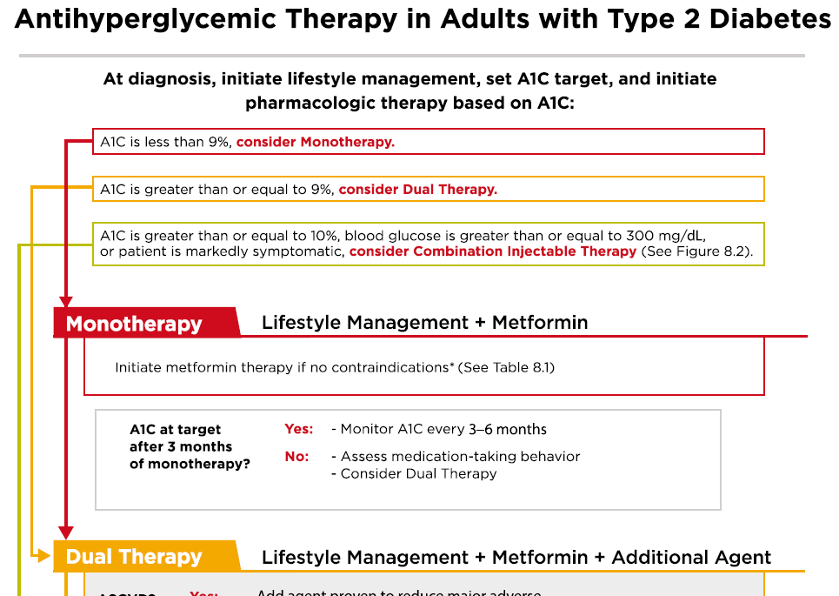

Slide 20
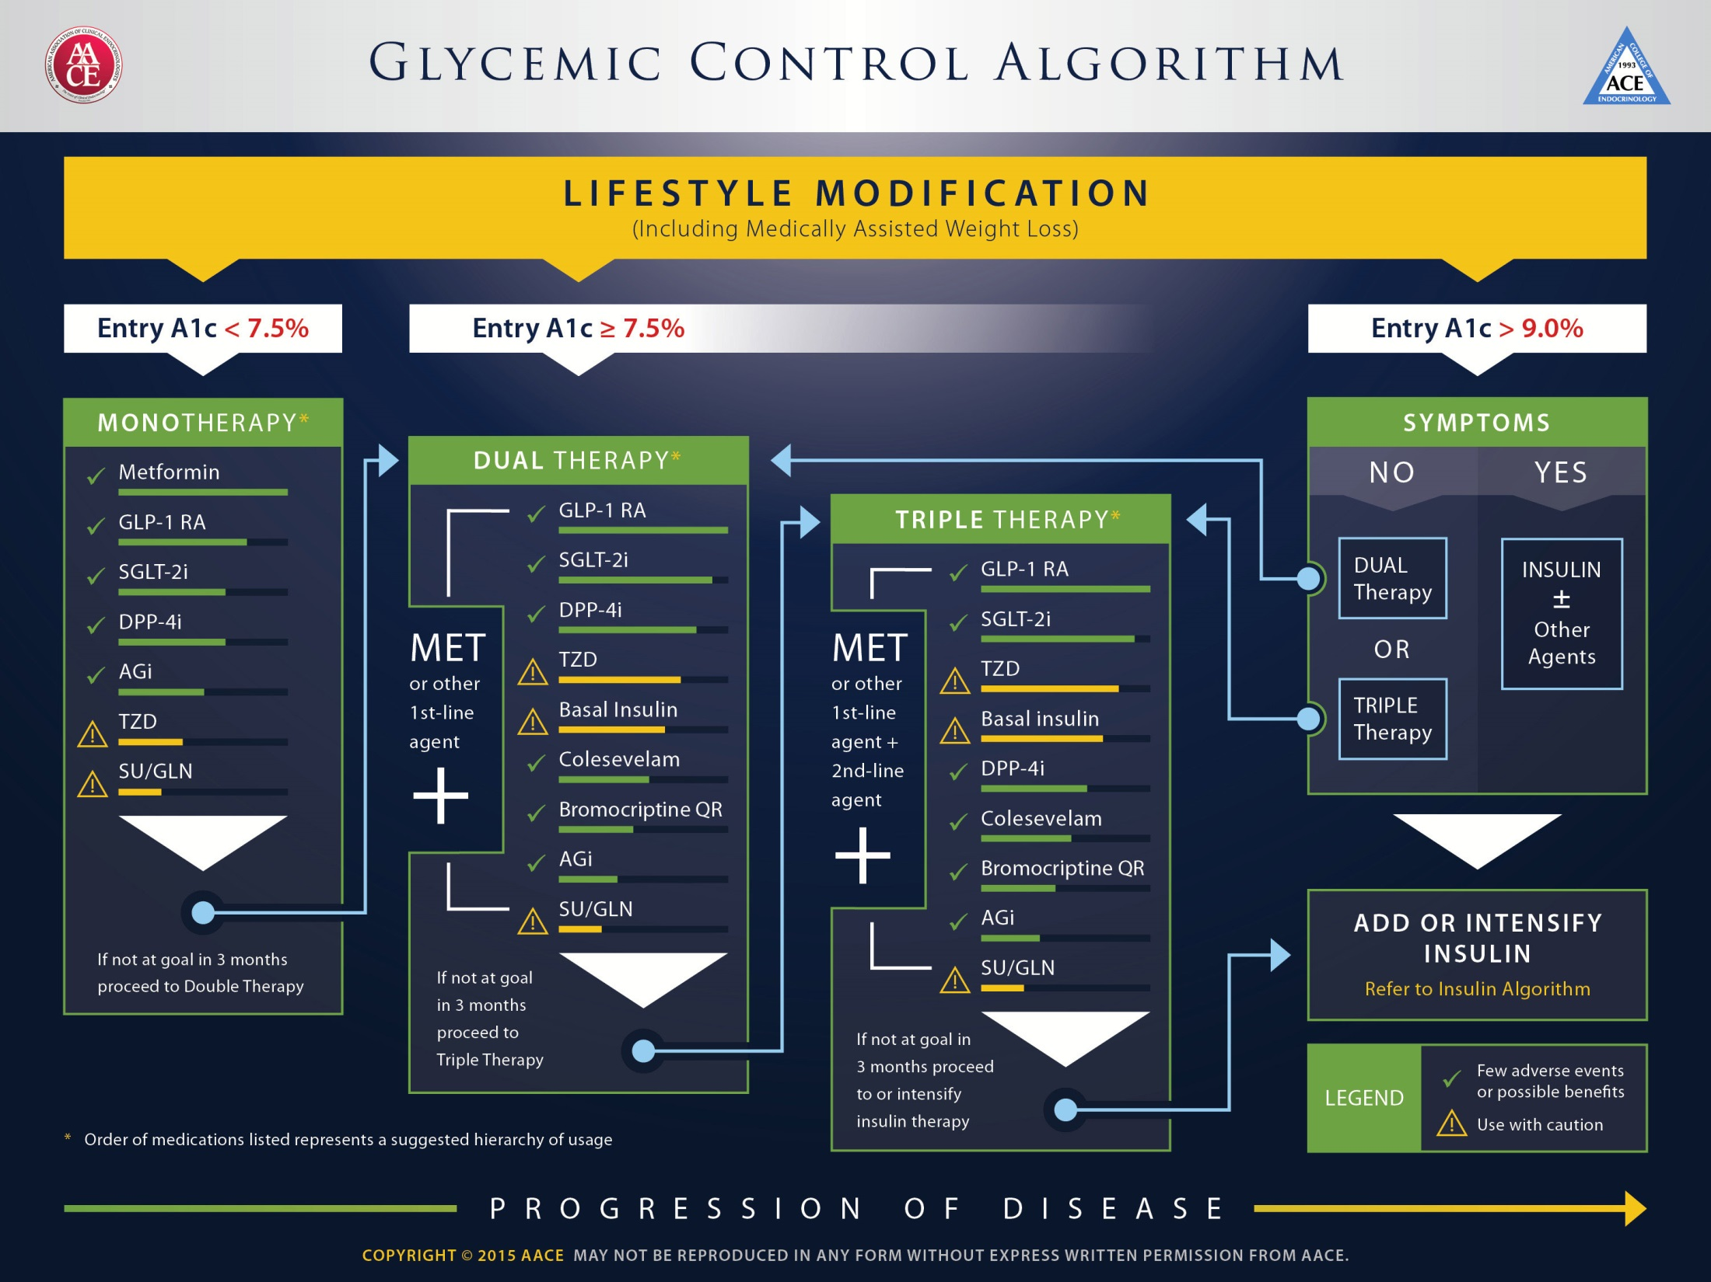

Slide 21
Case 1
خانم نسرین. ش
R
Tab ASA 80 mg/d
TaB Atorvastatin 20 mg/d
Tab Metformin 500 mg/BD

Slide 22
DOSING
We begin with 500 mg once daily with the evening meal and, if tolerated, add a second 500 mg dose with breakfast.
The dose can be increased slowly (one tablet every one to two weeks) as necessary
There is no difference between Extended release and IR
The usual effective dose is 1500 to 2000 mg/day

Slide 23
Case 1
W=93 kg
W=92 kg
BP: 130/80
خانم نسرین. ش
1395/6/10
Lab Data:
  FBS: 126mg/dl
  A1C: 5.6% (N<6%)
  Cr: 1 mg/dl
  TG: 150 mg/dl
  Total Cholesterol: 164 mg/dl
  HDL Cholesterol: 54 mg/dl
  LDL Cholesterol: 80 mg/dl
  AST: 15
  ALT: 17
  Hb: 11.6
  TSH: 2.58 µIU/ml
  T4: 10.8 µg/dl
1395/9/20
Lab Data:
  FBS: 95mg/dl
  A1C: 5.4% (N<6%)
  Cr: 0.9 mg/dl
  TG: 230mg/dl
  Total Cholesterol: 161 mg/dl
  HDL Cholesterol: 39 mg/dl
  LDL Cholesterol: 80 mg/dl
  AST: 16
  ALT: 16
  25(OH)Vit D: 3.3 ng/mL

Slide 24
سایر ارزیابی ها
بررسی از نظر عوارض میکرو واسکولر
  معاینه چشم
  بررسی میکروآلبومین ادرار
  ارزیابی نوروپاتی

Slide 25
GI upset with Metformin
کاهش دوز و شروع تدریجی
تغییر برند (Glucophage)
استفاده از فرآورده های Extended release

Slide 26
Anti-hyperglycemic therapy in T2DM:
Avoidance of weight gain
Diabetes Care 2015;38:140-149; Diabetologia 2015;58:429-442

Slide 27
Case 2
59 y/o ,Man, DM from 15 years ago
PH: HTN(-) IHD(-)
Retinopathy(-) Nephropathy(-)
HH: Smoking(+)
W: 81 Kg, H: 170 Cm, BMI: 28.0, BP: 145/80
Drug Hx:
  Tab Metformin 500 mg/BD
آقای محمد. ر

Slide 28
Case 2
81kg (BMI: 28 Kg/m2 )
آقای محمد. ر
1395/9/20
Lab Data:
  FBS: 188 mg/dl
  A1C: 9 % (N<6%)
  Cr: 1.1 mg/dl
  TG: 79 mg/dl
  Total Cholesterol: 160 mg/dl
  HDL Cholesterol: 58 mg/dl
  LDL Cholesterol: 86 mg/dl
  Hb: 15.4
  TSH: 3
  Urine Pr (24h): 80 mg

Slide 29
Case 2
آقای محمد. ر
What is your recommendation (more than smoking cessation & Lifestyle)?
Increase dose of Metformin to 1500mg/d
Add sulfonylurea
Add Sitagliptin
Add Liraglutide
Add Basal Insulin
Increase dose of Metformin to 1500mg/d
& Add sulfonylurea

Slide 30
Case 2
آقای محمد. ر
R
Tab ASA 80 mg/d
Tab Atorvastatin 10 mg/d
Tab Metformin 1500 mg/d
Tab Gliclazide 80 mg/d or Tab Gliclazide MR 30 mg/d

Slide 31
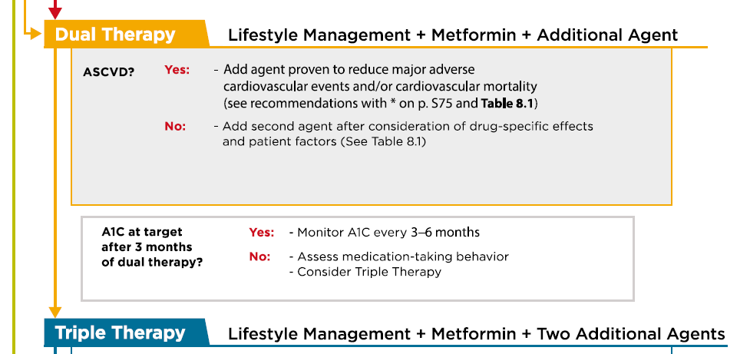

Slide 34
Case 3
آقای غلام. ر
84y/o ,Man, DM from 6 Months ago
Referred by Nephrologist
PH: HTN(+) IHD(-)
Retinopathy(-) Nephropathy(+)
HH: Smoking(-)
W: 70Kg, H: 168Cm, BMI: 24.8, BP: 130/70
Drug Hx:
  Tab Glibenclamide 5 mg/TID,
  Tab Valsartan 80 mg/BID,
  Tab Methoporolol 50mg/BID,
  Tab Amlodipin 5mg/BID,
  Tab ASA 80 mg/d,
  Tab Atorvastatin 10 mg/d.

Slide 35
Case 3
W=70 kg
آقای غلام. ر
1393/9/23
Lab Data:
  FBS: 119 mg/dl
  BS (2hpp): 220 mg/dl
  A1C: 6.6 % (N<6.1%)
  Cr: 1.62 mg/dl
  TG: 96mg/dl
  Total Cholesterol: 187 mg/dl
  HDL Cholesterol: 36 mg/dl
  LDL Cholesterol: 122 mg/dl
  AST: 13
  ALT: 12
  Urine Pr (24h): 2800 mg
eGFR= 38 ml/min/1.73 m2

Slide 36
Renal failure & OHA
eGFR:
The Chronic Kidney Disease Epidemiology Collaboration (CKD-EPI) equation is generally preferred (ADA 2017).
eGFR is routinely reported by laboratories with serum Cr,
eGFR calculators are available from http://www.nkdep.nih.gov.

Slide 37
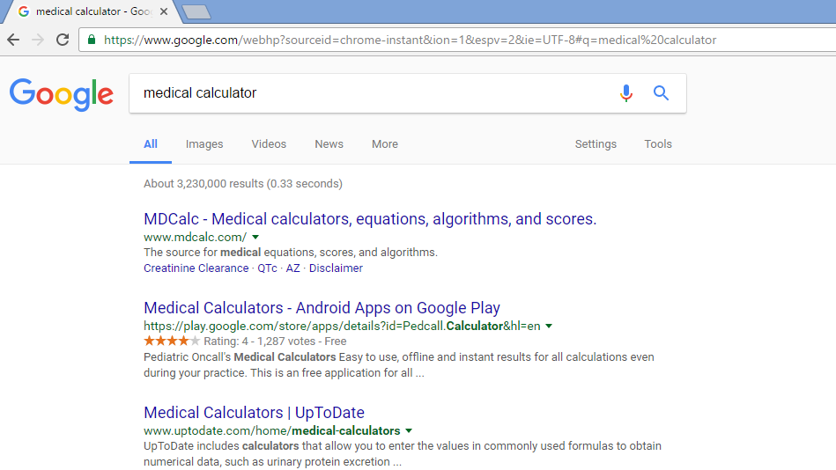

Slide 38
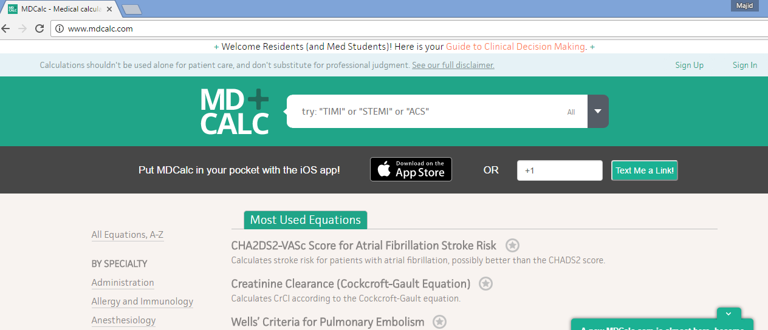

Slide 39
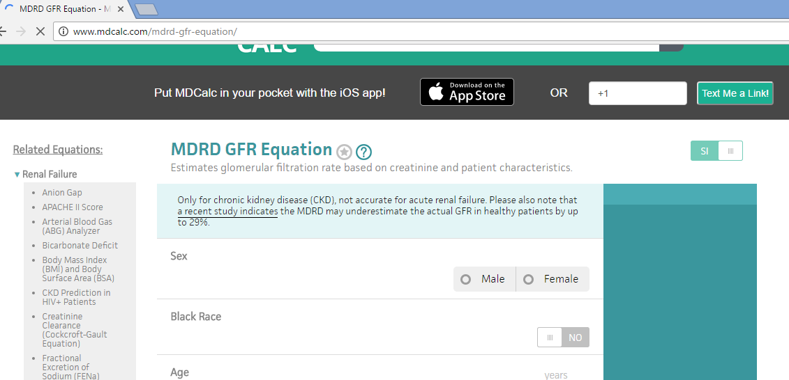

Slide 40


Slide 41
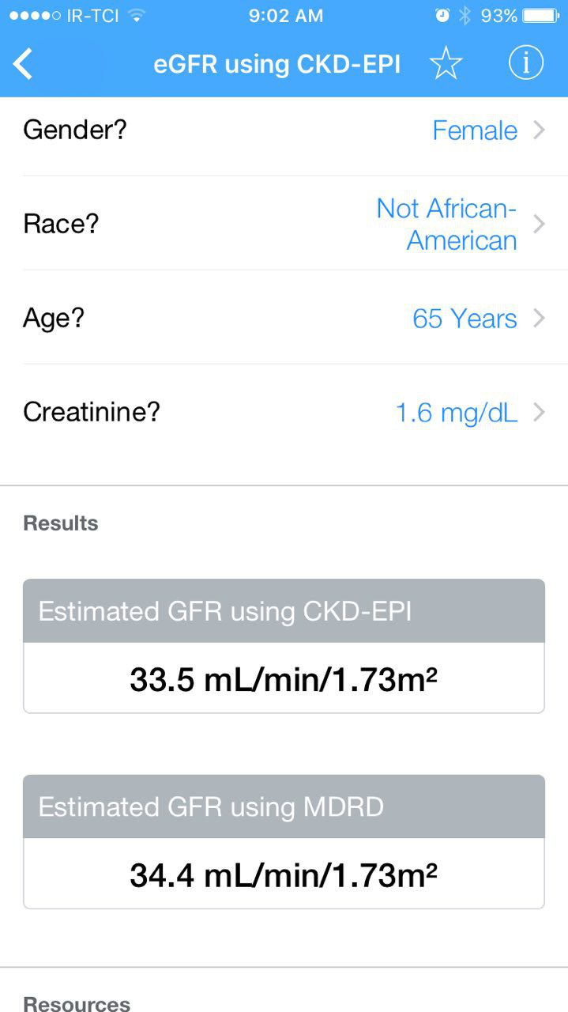

Slide 42
Case 3
آقای غلام. ر
What is your recommendation?
Deacrese dose of Glibenclamide to 10 mg/d
Add Metformin
DC of Glibenclamide & Add Pioglitazone
DC of Glibenclamide & Add Metformin
DC of Glibenclamide & Add safer SU or Repaglinide
DC of Glibenclamide & Add Sitagliptin
DC of Glibenclamide & Add Basal Insulin

Slide 44
Renal failure & Metformin
Many diabetologists as well as practitioners are fear to use metformin in patients with renal problems even if they have only albuminuria.
Nevertheless, analysis of data from may trials from Cochrane Database systematic review in 2010, showed no cases of lactic acidosis in 70490 patient-years of metformin.

Slide 45
Renal failure & Metformin
Kidney function be assessed using (eGFR) instead of blood creatinine concentration.
Metformin may be safely used in patients with eGFR ≥30 mL/min/1.73 m2.

Slide 46
Renal failure & Glibenclamide
Glibenclamide (glyburide) is metabolized in the liver and excreted by the kidneys equally and intestine.
Hypoglycemia may be serious and lasting more than 24 h in CKD.
The drug is contraindicated in eGFR < 60 mL/min.

Slide 47
Renal failure & Gliclazide
Gliclazide is metabolized by the liver to inactive metabolites that are eliminated in the urine.
Thus, gliclazide causes less hypoglycemia than other sulfonylureas.
In eGFR > 30 mL/min gliclazide can be used.

Slide 48
Gliclazide MR
1 tablet of Gliclazide MR 30 mg is comparable to 1 tablet of Gliclazide 80 mg Tablets.
The recommended starting dose is 30 mg daily; taken orally in a single intake at breakfast time.
The maximum recommended daily dose is 120 mg.
The safety and efficacy in children and adolescents have not been established.
There is no or limited amount of data (less than 300 pregnancy outcomes) from the use of gliclazide in pregnant women.
it is preferable to avoid the use of Gliclazide during pregnancy.
It is unknown whether gliclazide or its metabolites are excreted in human milk.
Given the risk of neonatal hypoglycaemia, the product is therefore contra-indicated in breast-feeding mothers.

Slide 49
Renal failure & Repaglinide
Repaglinide is exclusively metabolized in the liver to inactive metabolites and secreted in the bile.
Repaglinide can be used even in CKD stages 4 and 5 without dose reduction.
In patients with a GFR ≤30 ml/min/1.73 m2 starting with a 0.5 mg does before each meal and gradually increasing the dose.

Slide 50
Renal failure & Acarbose
Acarbose is contraindicated in liver cirrhosis and IBD (inflammatory bowel disease).
The National Kidney Foundation (NKF) advise avoiding acarbose if the GFR <30 ml/min/1.73 m2.

Slide 51
Renal failure & GLIPTINES
Sitagliptin:
100 mg daily, regardless of food.
Sitagliptin is excreted in the intact form in the urine.
Dose to be reduced to
50 mg/d if GFR 30-50 or
25 mg/d if GFR <30.
Vildagliptin:
50 mg BID, regardless of food.
reduce the daily dose to
50 mg/d if GFR <50.
Vildagliptin may be associated with an increase in the liver enzymes and is contraindicated in liver impairment.

Slide 52
Renal failure & Pioglitazone
Pioglitazone has only and exclusively hepatic metabolism; This class should be avoided in the presence of heart failure and liver disease.
Pioglitazone increases the risk of bladder cancer and was banned in Japan, India, Australia and Canada.
However, a recent study of a large cohort failed to demonstrate a significant association between pioglitazone use and the risk of bladder cancer.
It does not cause hypoglycemia and it can be given theoretically without dose adjustment at all stages of CKD.
Pioglitazone is related with
  fluid retention,
  anemia and
  osteoporosis.
These side effects complicate the existing problems with anemia and bone disease in subjects with diabetes and CKD.

Slide 53
Renal failure & Liraglutide
Liraglutide is degraded entirely in the body and is not excreted in urine and feces.
These characteristics indicate that we can use in all stages of CKD.
Nevertheless we have not yet clinical studies in patients with eGFR < 60 mL/min.

Slide 54
Effects of Agents Available for T2D
Q4. How are glycemic targets achieved for T2D?
 | Met | GLP1RA | SGLT2I | DPP4I | TZD | AGI | Coles | BCR-QR | SU/ Glinide | Insulin | Pram
Renal impair-ment/ GU | Contra-indicated in stage 3B, 4, 5 CKD | Exenatide contra-indicated CrCl <30 mg/mL | GU infection risk | Dose adjust-ment (except lina-gliptin) | May worsen fluid retention | Neutral | Neutral | Neutral | Increased hypo-glycemia risk | Increased risks of hypo-glycemia and fluid retention | Neutral
GI adverse effects | Mod | Mod* | Neutral | Neutral* | Neutral | Mod | Mild | Mod | Neutral | Neutral | Mod
CHF | Neutral | Neutral | Neutral | Neutral† | Mod | Neutral | Neutral | Neutral | Neutral | Neutral | Neutral
CVD | Possible benefit | Neutral | Neutral | Neutral | Neutral | Neutral | Neutral | Safe | ? | Neutral | Neutral
Bone | Neutral | Neutral | Bone loss | Neutral | Mod bone loss | Neutral | Neutral | Neutral | Neutral | Neutral | Neutral
AGI = α-glucosidase inhibitors; BCR-QR = bromocriptine quick release; Coles = colesevelam; CHF = congestive heart failure; CVD = cardiovascular disease; DPP4I = dipeptidyl peptidase 4 inhibitors; GI = gastrointestinal; GLP1RA = glucagon-like peptide 1 receptor agonists; GU = genitourinary; Met = metformin; Mod = moderate; SGLT2I = sodium-glucose cotransporter 2 inhibitors; SU = sulfonylureas; TZD = thiazolidinediones.
*Caution in labeling about pancreatitis.
†Caution: possibly increased CHF hospitalization risk seen in CV safety trial.
Continued from previous slide

Slide 55
Anti-hyperglycemic therapy in T2DM:
Avoidance of hypoglycemia
Diabetes Care 2015;38:140-149; Diabetologia 2015;58:429-442

Slide 56
Case 3
آقای غلام. ر
R
Tab ASA 80 mg/d
Tab Atorvastatin 10 mg/d
DC of Glibenclamide
Tab Repaglinide 2mg/TID

Slide 57
Case 3
W=70 kg
W=69 kg
آقای غلام. ر
1393/9/23
Lab Data:
  FBS: 119 mg/dl
  BS (2hpp): 220 mg/dl
  A1C: 6.6 % (N<6.1%)
  Cr: 1.62 mg/dl
  TG: 96mg/dl
  Total Cholesterol: 187 mg/dl
  HDL Cholesterol: 36 mg/dl
  LDL Cholesterol: 122 mg/dl
  AST: 13
  ALT: 12
  Urine Pr (24h): 2800 mg
1394/1/15
Lab Data:
  FBS: 101 mg/dl
  BS (2hpp): 233 mg/dl
  A1C: 6.3 % (N<6.1%)
  Cr: 1.54 mg/dl
  TG: 76 mg/dl
  Total Cholesterol: 141 mg/dl
  HDL Cholesterol: 37 mg/dl
  LDL Cholesterol: 80 mg/dl
  AST: 13
  ALT: 14
  Hb: 13.8

Slide 58
Case 4
آقای حبیب ا... ک
60y/o ,Man, DM from 2 years ago
PH: HTN(+) IHD(+) CABG(+) CHF(+) (LVEF=30%)
Retinopathy(-) Nephropathy(-)
HH: Smoking(-)
W: 96 Kg, H: 181 Cm, BMI: 29.3, BP: 130/80
Drug Hx:
  Tab Metformin 500 mg/TID
  Tab Acarbose 50 mg/BD
  Tab Atorvastatin 20 mg/d
  Tab ASA mg/d
  Tab Losartan 20 mg/BD
  Tab digoxin 0.25 mg/d
  Tab Carvedilol 6.25mg/BD

Slide 59
Case 4
W=96 kg
آقای حبیب ا... ک
1394/7/28
Lab Data:
  FBS: 105 mg/dl
  BS (2hpp): 188mg/dl
  A1C: 7.3% (N<6%)
  Cr: 1.1 mg/dl
  TG: 138mg/dl
  Total Cholesterol: 125 mg/dl
  HDL Cholesterol: 32 mg/dl
  LDL Cholesterol: 54 mg/dl
  AST: 24
  ALT: 24

Slide 60
Case 4
آقای حبیب ا... ک
What is your recommendation?
DC of Metformin & Lifestyle Management
DC of Metformin & Add sulfonylurea
DC of Metformin & Add Pioglitazone
DC of Metformin & Add Liraglutide
DC of Metformin & Add Basal Insulin
Keep Metformin & Add Sitagliptin

Slide 61
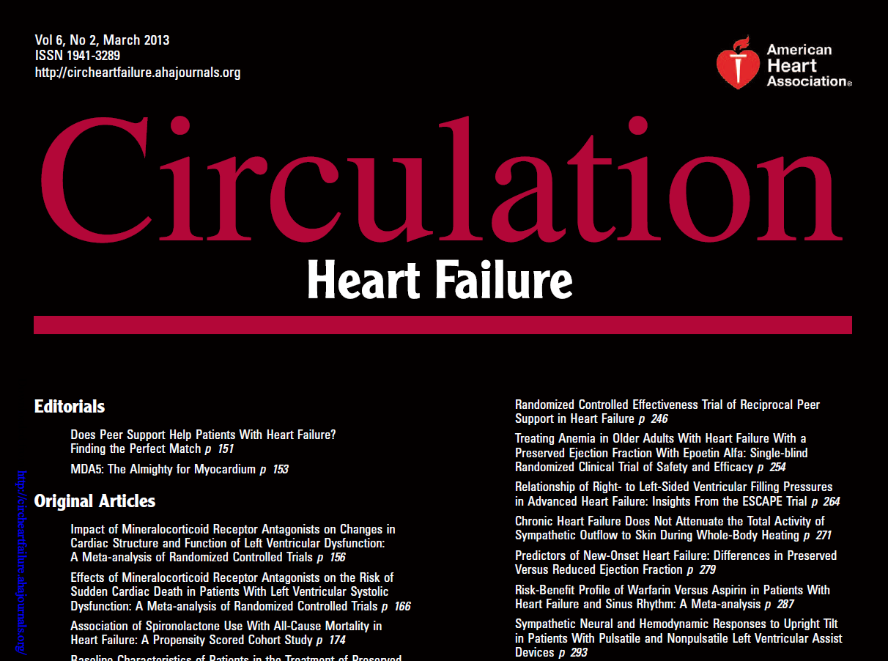
Heart failure & Metformin
Notes:
Historically, metformin had been considered absolutely contraindicated in patients with HF due
to concerns about lactic acidosis.9 However, both the US Food and Drug Administration (2006)
and Health Canada (2010) have removed the absolute HF contraindication from metformin
(although strong warnings persist) 9, 10 in response to observational studies and clinical
experience suggesting that the risk of metformin-associated lactic acidosis is minimal and similar
to that of other diabetes drugs

Slide 62
Heart failure & Metformin
Metformin was associated with reduced mortality compared to controls (mostly sulfonylurea):
  pooled adjusted risk estimates 0.80, (0.74-0.87); P<0.001.
Metformin was associated with a small reduction in all-cause hospitalizations: pooled estimate 0.93, (0.89- 0.98), P=0.01.
Metformin was not associated with increased risk of lactic acidosis.

Slide 63
Heart failure & Metformin
Conclusions:
Metformin is at least as safe as other glucose lowering treatments in patients with diabetes and HF, even in those with reduced LVEF or concomitant CKD.
Metformin should be considered the treatment of choice for those with diabetes and HF.

Slide 64
ADA 2017
In patients with DM-2 with
stable CHF, metformin may be used if eGFR > 30 mL/min,
But should be avoided in unstable or hospitalized patients with CHF.

Slide 65
Case 4
آقای حبیب ا... ک
R
Tab ASA 80 mg/d
Tab Atorvastatin 10 mg/d
Tab Metformin 1500 mg/d
Tab Acarbose 50 mg/d
Tab Sitagliptin 100 mg/d

Slide 66
Case 4
W=96 kg
آقای حبیب ا... ک
W=96 kg
1394/11/8
Lab Data:
  FBS: 105 mg/dl
  BS (2hpp): 188mg/dl
  A1C: 7.3% (N<6%)
  Cr: 1.1 mg/dl
  TG: 138mg/dl
  Total Cholesterol: 125 mg/dl
  HDL Cholesterol: 32 mg/dl
  LDL Cholesterol: 54 mg/dl
  AST: 24
  ALT: 24
1395/3/20
Lab Data:
  FBS: 95mg/dl
  BS (2hpp): 145mg/dl
  A1C: 6.6% (N<6%)
  Cr: 1.1mg/dl

Slide 67
MALBOOSBAF, Ramin. MD.

Slide 68


