Slide 1
In the Name of God
Metabolic Syndrome and Obesity in Children and Adolescents & Evaluation of Homeostasis Model Assessments
Maryam Razzaghy Azar, MD
Professor of Pediatric Endocrinology & Metabolism, IUMS
Metabolic Disorder Research Center, EMRI,TUMS

Slide 2


Slide 3
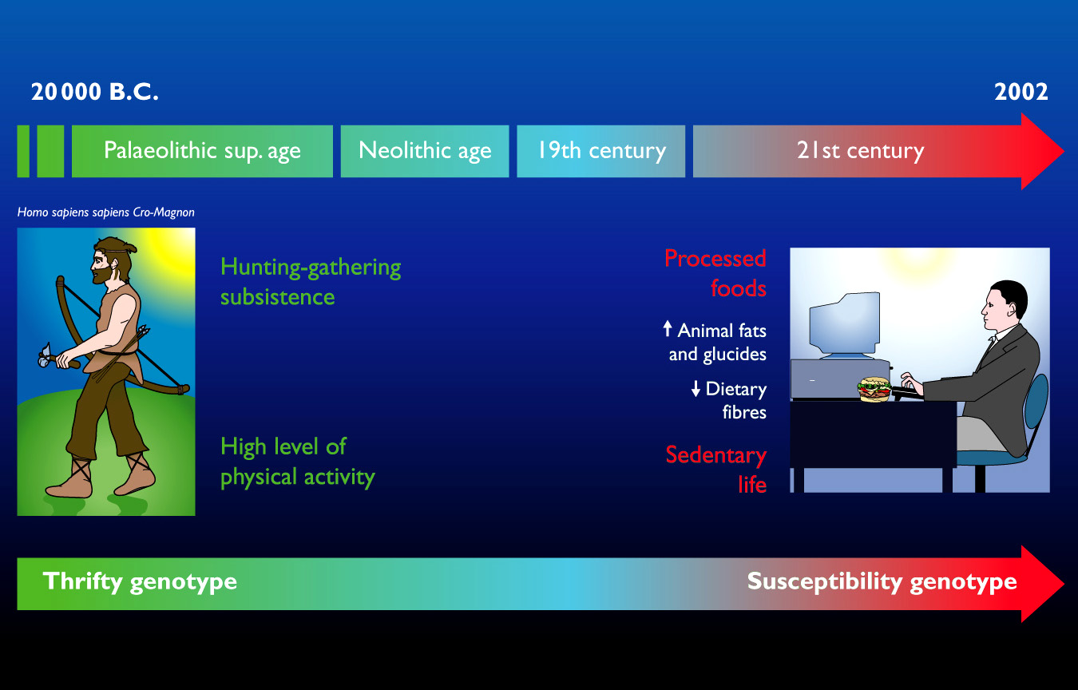

Slide 4

The cover of "The Economist", Dec. 13-19, 2003.

Slide 5


Slide 6


Slide 7


Slide 8


Slide 9


Slide 10


Slide 11
Obesity: time watching TV overwhelms leisure activity in Australia
28
Increasing TV time
Leisure time sport & activity
27
Average BMI for each group
26
TV time
25
24
23
22
21
High
Moderate
Low
Inactive
Total daily physical activity
Adapted from Salmon, Bauman et al IJO 2000; 24:600-606

Slide 12
Definition
Obesity is a chronic disease in the same sense as hypertension and atherosclerosis.
  Obesity has been called,
  "the disease of diseases"
  because of the diversity of complications it produces .

Slide 13
The fat cell
can be viewed as
a type of endocrine cell,
and
adipose tissue
as
an endocrine organ.
It is the hypertrophy and/or hyperplasia of this organ that is the pathologic lesion in obesity.

Slide 14
Excess Adipose Tissue Can Cause Increased Expression of Some Hormones, Suppression of Others, and Can Lead to Inflammation and Disease
Type 2 DM
↑ Lipoprotein Lipase
Hypertension
↑ Lactate
↑ Angiotensinogen
Inflammation
↑ IL-6
Dyslipidemia
Arthritis
á Fat Stores
↑ Insulin
↑ Leptin
↑ FFA
↑ TNF-α
Type 2 DM
Asthma
↑ Adipsin (Complement D)
↑ Resistin
↑ Estrogen
Thrombosis
↑ MCP-1
↑ Plasminogen Activator Inhibitor 1 (PAI-1)
↓ Adiponectin
ASCVD
DM = diabetes mellitus; FFA = free fatty acid; PAI-1 = plasminogen activator inhibitor 1; MCP-1 = monocyte chemo attractant protein-1; TNF-α = tumor necrosis factor alpha; IL-6 = interleukin 6.
Aronne L (after Bray).
Notes:
Excess adipose tissue can cause increased expression of some hormones, suppression of others, and can lead to inflammation and disease
Adipose tissue produces many hormones. One of the most interesting developments over the past few years in our understanding of the many hormones produced by the adipocyte, and an important point, is that normal amounts of these hormones are critical to the normal functioning of the body, but excessive production of these hormones can lead to disease.
For example, in regards to the cardiometabolic risk factors, increased release of angiotencinogen can contribute to hypertension. An increase in free fatty acids release and hyperinsulinism can contribute to dyslipidemia. The release of plasminogen activating inhibitor 1 (PAI-1) can lead to hypercoagulation.
Furthermore, several cytokine hormones, which are all pro-inflammatory, can lead to the inflammatory disorders that are part of the cardiometabolic risk profile, as well as many other complications associated with obesity. In fact, the only anti-inflammatory cytokine hormone that is secreted by the adipocyte is adiponectin, and it is suppressed by an increase in adipose tissue mass, meaning the one hormone that could potentially counteract the negative effects of the other hormones is unable to do so.
This is convincing evidence that excess adipose tissue can lead to a significant component of cardiometabolic risk.

Slide 15





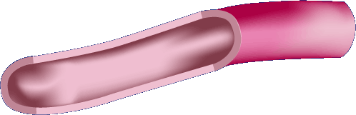
Insulin resistance – reduced response to circulating insulin
Insulin
resistance
IR
Liver
Muscle
Adipose
tissue
↑ Glucose output
↓ Glucose uptake
↓ Glucose uptake
Hyperglycemia
Notes:
The consequences of insulin resistance at the tissue level include reduced glucose uptake into peripheral sites, that is, fat and muscle.
Combined with excessive glucose output by the liver, this leads to hyperglycemia.

Slide 16
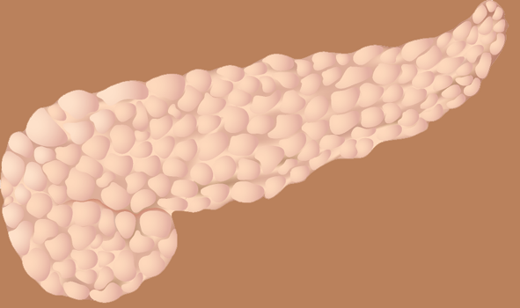
Why does the β-cell fail?
Oversecretion of insulin to compensate for insulin resistance^{1,2}
Glucotoxicity²
Lipotoxicity³
Chronic
hyperglycemia
Pancreas
High circulating free fatty acids
β-cell
dysfunction
¹Boden G & Shulman GI. Eur J Clin Invest 2002; 32:14–23.
²Kaiser N, et al. J Pediatr Endocrinol Metab 2003; 16:5–22.
³Finegood DT & Topp B. Diabetes Obes Metab 2001; 3 (Suppl. 1):S20–S27.
Notes:
At physiological levels, both glucose and free fatty acids stimulate insulin secretion.^{1,2}
β-cell dysfunction may occur as a result of genetic factors.
Chronic hyperglycemia, however, may negatively affect the β-cell through a process known as glucotoxicity.²
Glucotoxicity is the ability of glucose to stimulate the death of β-cells.²
Similarly, chronically elevated free fatty acids have a lipotoxic effect upon the pancreas, inducing β-cell dysfunction.³
Lipotoxicity is the ability of free fatty acids to stimulate the death of β-cells.³
Oversecretion of insulin to compensate for insulin resistance also contributes to β-cell dysfunction.
¹Boden G & Shulman GI. Eur J Clin Invest 2002; 32:14–23.
²Kaiser N, et al. J Pediatr Endocrinol Metab 2003; 16:5–22.
³Finegood DT & Topp B. Diabetes Obes Metab 2001; 3 (Suppl. 1):S20–S27.

Slide 17
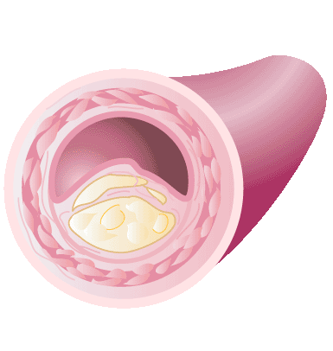
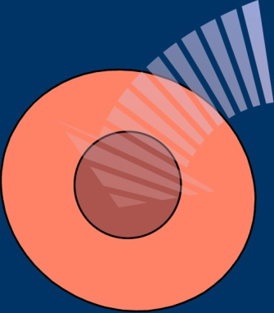
Insulin resistance is linked to a range of cardiovascular risk factors
Hyperglycemia
Dyslipidemia
↑ SNS activity
↑ Na retention
Hypertension
↑ CRP
↑ PAI-1
↑ Fibrinogen
Clotting & inflammation
IR
Insulin
Resistance
Results
in Hyperinsulinemia
Atherosclerosis
Zimmet P. Trends Cardiovasc Med 2002; 12:354–362.
Notes:
Insulin resistance is closely linked to a number of cardiovascular risk factors, collectively known as the Metabolic Syndrome or Insulin Resistance Syndrome.
Components of the Metabolic Syndrome include well known cardiovascular risk factors such as hyperglycemia, dyslipidemia and hypertension. Additional cardiovascular risk factors, that is damage to blood vessels (endothelial dysfunction), clotting abnormalities (hypofibrinolysis) and inflammation, have also been recognized as key components of the Metabolic Syndrome.
Together, the cluster of cardiovascular risk factors that make up the Metabolic Syndrome significantly increases the risk of atherosclerosis.
Zimmet P. Trends Cardiovasc Med 2002; 12:354–362.

Slide 18
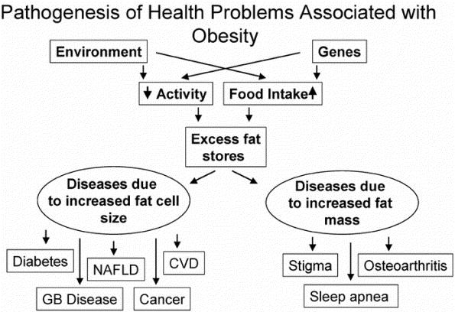
Hypertension
Gout
Stroke
Dementia
Psychosocial problems
Kidney stones
PCOD
Irregular menses &
anovulatory cycles
Fertility may be decreased
Pregnancy-induced HTN, and C/S
Notes:
The pathology of obesity produces the myriad of health related problems.
These health-related problems can be attributed to either the increased mass of fat or the increased release of peptides from enlarged fat cells.

Slide 19

Complications
of Obesity
Increase in morbidity
and mortality
Depends upon the degree of overweight and obesity.
Increase rate of death from all-causes and from cardiovascular disease

Slide 20
INSULIN RESISTANCE
The vicious cycle of insulin resistance
Overeating
Insulin Resistance
Truncal obesity
Hunger
reduced number
Of βcells
Beta cell
burnout
High blood sugar
Craving carbohydrates
Excessive
insulin production

Slide 21
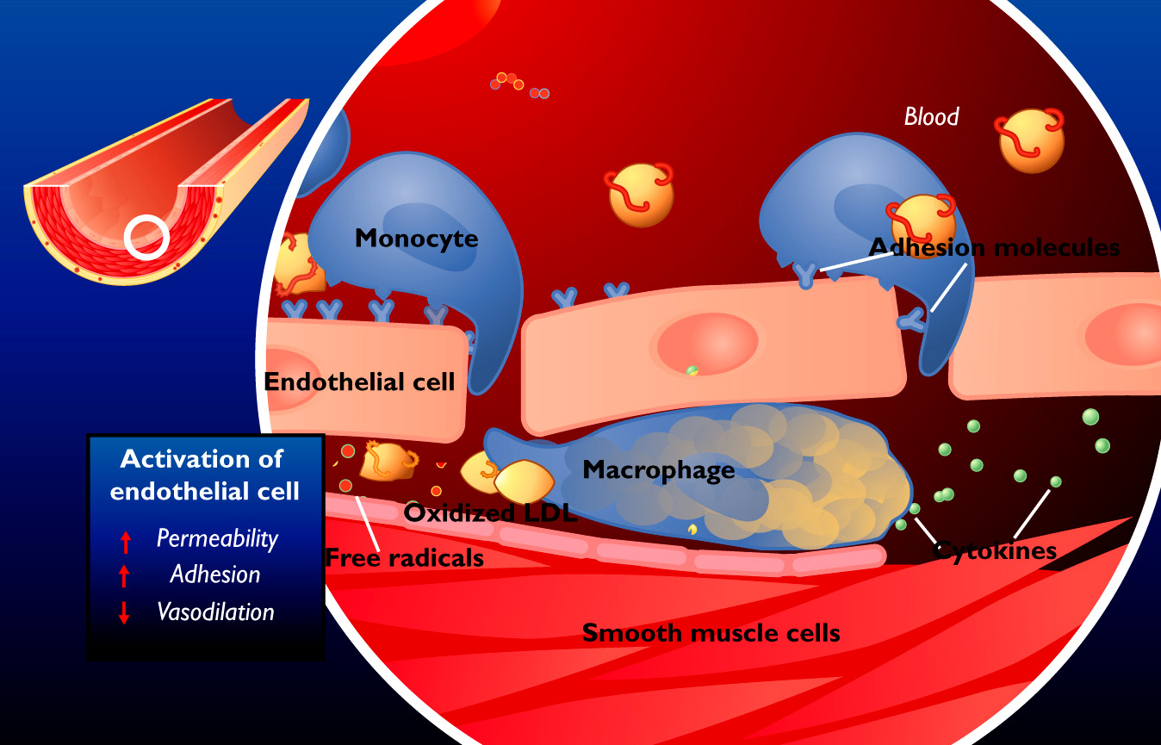
Vascular endothelium modification in atherosclerosis
Notes:
Figure 9 During AS, the integrity of the endothelium is compromised which results in:
increased permeability, which facilitates the penetration of the intima by atherogenic lipoproteins;
increased adhesion, which facilitates migration of monocytes into the subendothelium;
diminished vasodilation, which compromises hemodynamic control.

Slide 22
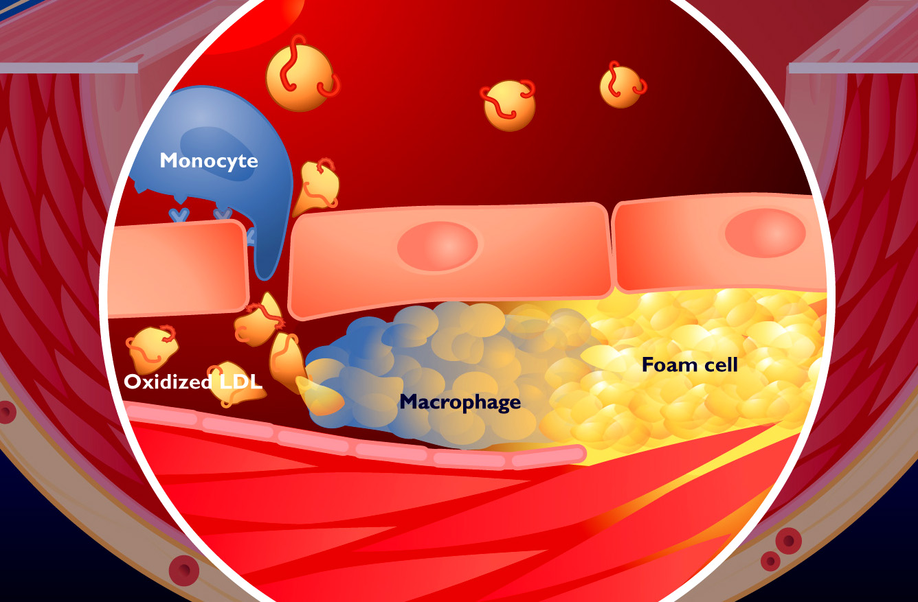
Plaque formation
1 — Fatty streak
Notes:
Figure 10 Monocytes penetrate the intima and are transformed into macrophages and eventually cholesterol-rich foam cells. These activated macrophages scavenge and ingest oxidized low-density lipoprotein (LDL) in the subendothelial space. The progressive accumulation of lipids (intra- and extracellular) forms the fatty streak.

Slide 23
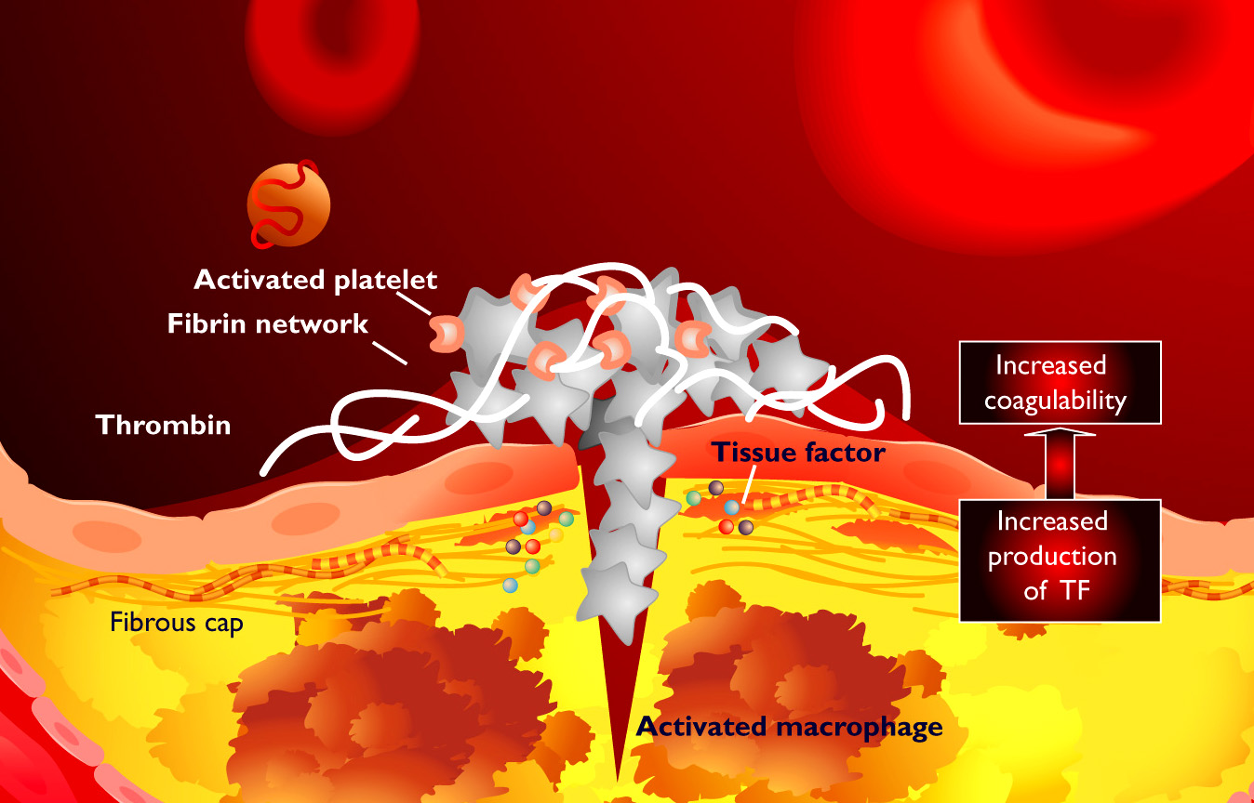
Thrombus formation
The macrophages release coagulation factors
Notes:
Figure 18 Activated macrophages increase TF production, which results in:
further cell recruitment (monocytes and platelets);
increased coagulability, which facilitates thrombosis;
increased predisposition to plaque rupture.

Slide 24
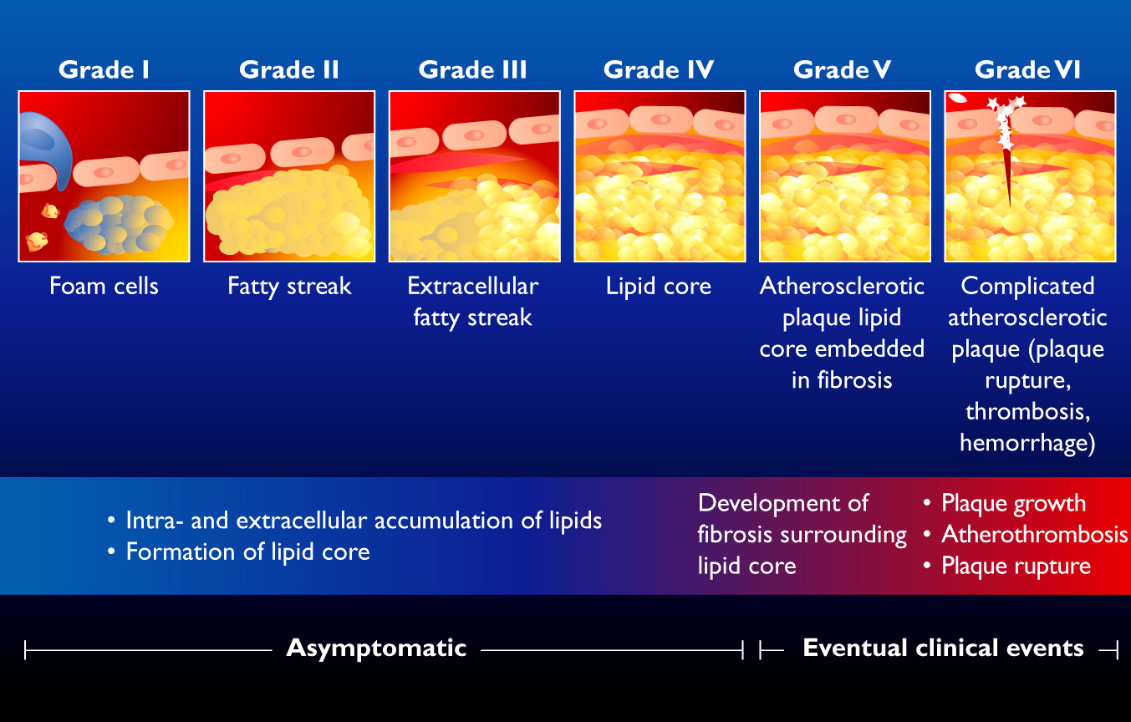
Different stages of atherosclerotic plaque evelopment
Notes:
Figure 8 There are six stages of development of AS:
Grades I – IV: accumulation of lipids, first intracellularly, then extracellularly;
Grade V: fibrosis around the lipid core forming an atherosclerotic plaque;
Grade VI: complicated plaque (rupture, clot or bleed) leading to a clinical event.

Slide 25

Studies of obese men and women have demonstrated that the obstruction occurs in the larynx and is associated with loss of tone of the muscles controlling tongue movement.
An obese young woman with the short, thick neck typically seen in patients with obstructive sleep apnea.

Slide 26


Slide 27
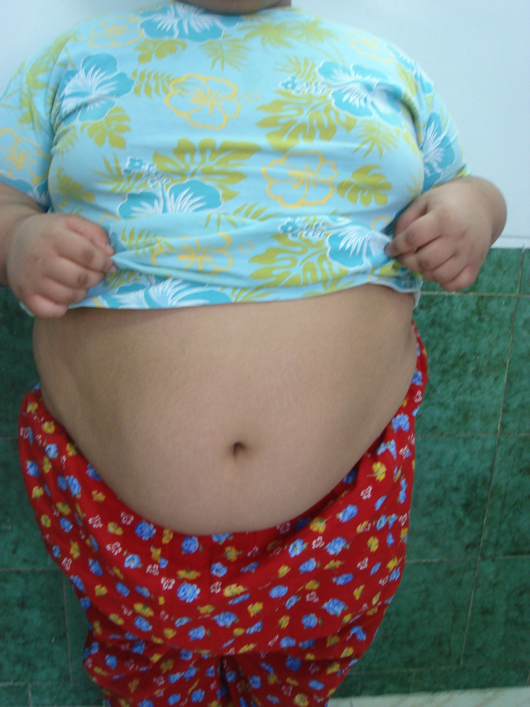
Eight years old girl
with morbid obesity
Sleepiness
Frequent apnea

Slide 28

  Stretch marks (Striae)

Slide 29
Accumulation of abdominal fat on glucose tolerance is independent of total adiposity
FFA Glucose uptake

Slide 30
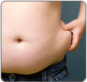

Slide 31
Am J Physiol 1997;273:E425-E432.
J Clin Endocrinol Metab 1999;84:137-144

Slide 32
The environmental impact in Asia on the population's
health burden from diabetes and IGT
Source: Diabetes Atlas, 2nd edition. IDF, 2003.

Slide 33
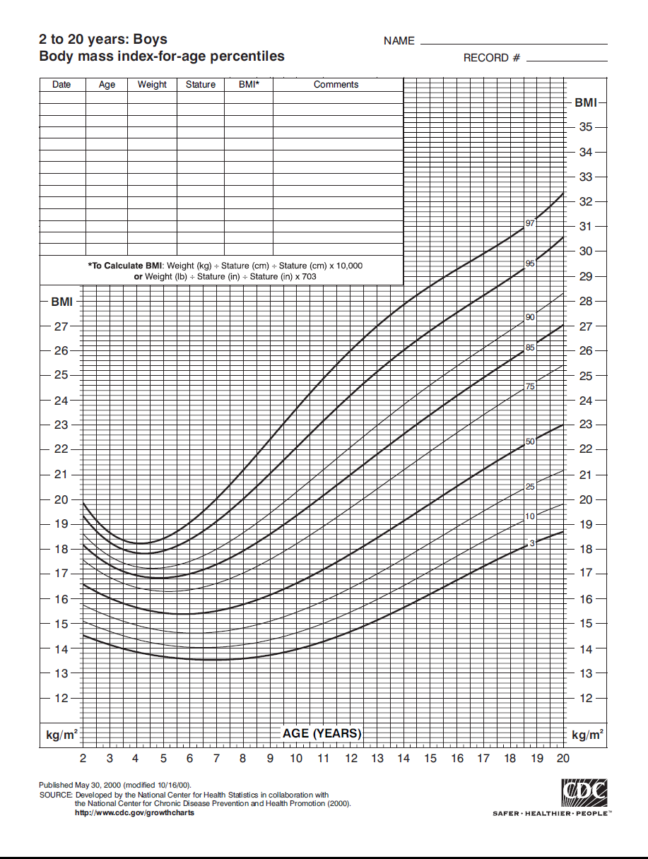
Body Mass Index (BMI)= Weight (kg)
Height (M)²
CDC2000
Normal,
BMI > 5% & < 85%
At risk for overweight
≥ 85% & <95%
Overweight, ≥ 95%.

Slide 34
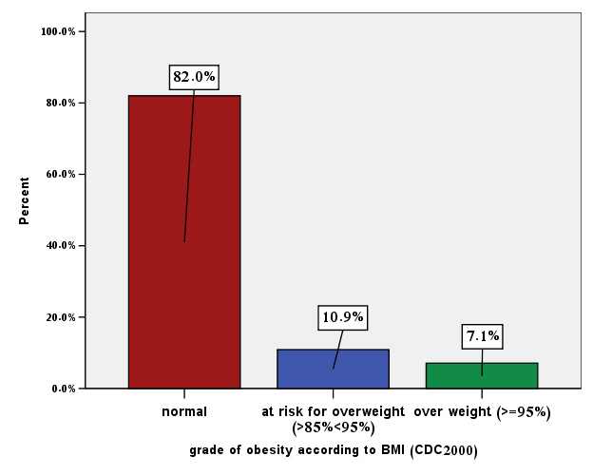
2914 school children in Tehran 2006

Slide 35
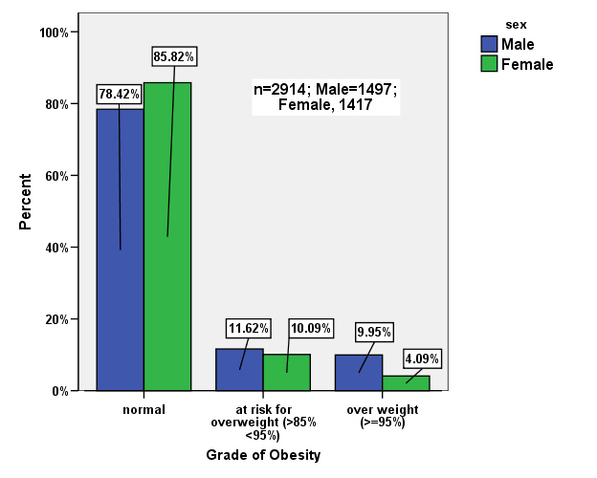

Slide 36
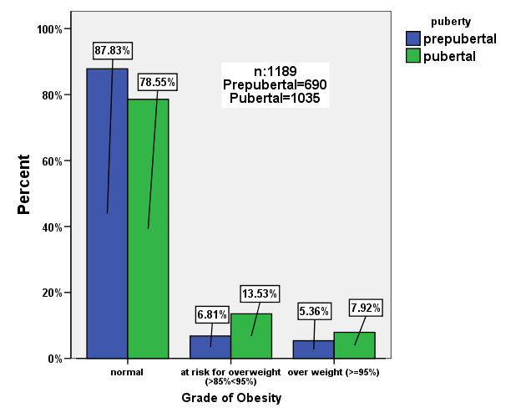

Slide 37
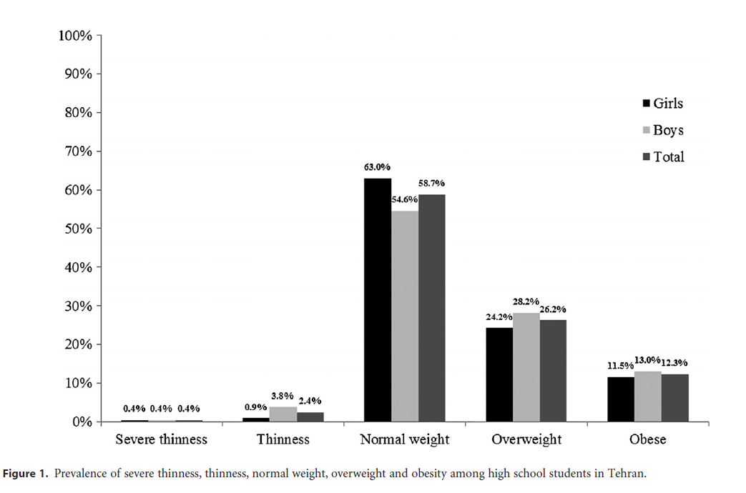
465 adolescents (227 girls, 238 boys)
Jalali-Farahani, et.al. obesity research center, SBUMS,

Slide 38
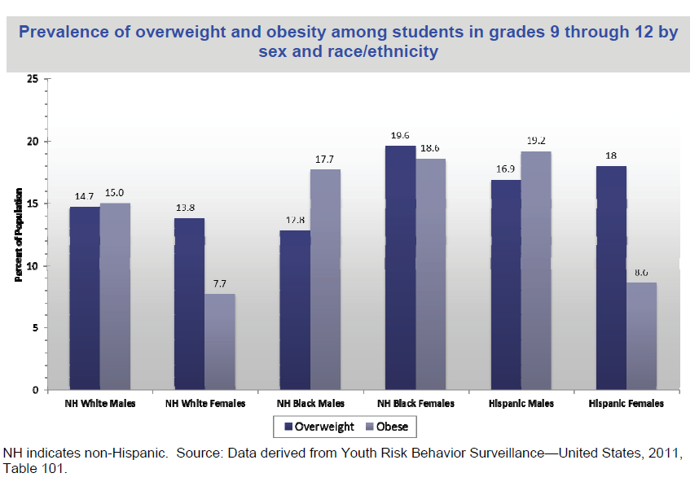

Slide 39
The Metabolic Syndrome: Historical Perspective
1988: Syndrome X
Insulin
Resistance
Hyperglycemia
Visceral Obesity
↑ TG
↓ HDL-C
Hypertension
Coronary Heart Disease , Type 2 Diabetes
Reaven G. Diabetes 1988;37:1565-1607.
Notes:
The metabolic syndrome: historical perspective
The clustering of cardiovascular risk factors including obesity, hypertension, and dyslipidemia has been noted since 1970. However, Professor Reaven at Stanford, in his Banting lecture in 1988, made the important observation that this cluster of risk factors may be linked to insulin resistance. Professor Reaven called this entity "Syndrome X," but it is more commonly called the metabolic syndrome, or the insulin resistance syndrome. Note that Professor Reaven listed glucose intolerance rather than diabetes, since subjects who developed type 2 diabetes need a second deficit, which is impaired insulin secretion. As a result, many or most individuals with insulin resistance will not actually have type 2 diabetes. In his 1988 Banting lecture, Professor Reaven attempted to show that people can have the insulin resistance syndrome even without obesity. However, other investigators such as Després have noted that insulin resistance occurs most often in combination with increases in visceral fat. Not all of the components described in the 1988 Banting lecture are equally strongly related to insulin resistance. A number of techniques including factor analysis have been used to suggest that hypertension has no or only a very weak relationship to insulin resistance.
References:
Reaven GM. Banting lecture 1988: role of insulin resistance in human disease. Diabetes 1988;37:1595-1607.
Pouliot MC, Després JP, Lemieux S, Moorjani S, Bouchard C, Tremblay A, Nadeau A, Lupien PJ. Waist circumference and abdominal sagittal diameter: best simple anthropometric indexes of abdominal visceral adipose tissue accumulation and related cardiovascular risk in men and women. Am J Cardiol 1994;73:460-468.
Hanley AJG, Festa A, D’Agostino RB Jr, Wagenknecht LE, Savage PJ, Tracy RP, Saad MF, and Haffner SM. Metabolic and inflammation variable clusters and prediction of type 2 diabetes: factor analysis using directly measured insulin sensitivity. Diabetes 2004;53:1773-1781.

Slide 40
Metabolic Syndrome: Operational Definition
Supposed to be useful for healthcare providers
Many definitions
  WHO (1998/1999)
  NCEP (2001)
  AACE (2002)
  IDF (2005)
  AHA/NHLBI (2005)
Notes:
Metabolic syndrome: operational definition
A number of groups have tried to develop definitions for clustering of cardiovascular risk factors that might be suitable for clinicians to apply in practice. Early definitions of the metabolic syndrome such as those issued by the World Health Organization (WHO) and the National Cholesterol Education Program (NCEP) differ markedly. However, the more recent definitions such as those issued by the American Heart Association (AHA)/National Heart, Lung, and Blood Institute (NHLBI) and the International Diabetes Federation (IDF) are much more similar and differ mainly in that the IDF requires waist circumference for diagnosis and has lower waist circumference cutpoints.
References:
World Health Organization. Definition, Diagnosis and Classification of Diabetes Mellitus and Its Complications: Report of a WHO Consultation. Geneva: World Health Organization, 1999.
Expert Panel on Detection, Evaluation, and Treatment of High Blood Cholesterol in Adults. Executive summary of the third report of the National Cholesterol Education Program (NCEP) Expert Panel on Detection, Evaluation, and Treatment of High Blood Cholesterol in Adults (Adult Treatment Panel III). JAMA 2001;285:2486-2497.
Einhorn D, Reaven GM, Cobin RH, Ford E, Ganda OP, Handelsman Y, Hellman R, Jellinger PS, Kendall D, Krauss RM, Neufeld ND, Petak SM, Rodbard HW, Seibel JA, Smith DA, Wilson PW. American College of Endocrinology position statement on the insulin resistance syndrome. Endocr Pract 2003;9:237-252.
Alberti KG, Zimmet P, Shaw J, for the IDF Epidemiology Task Force Consensus Group. The metabolic syndrome--a new worldwide definition. Lancet 2005;366:1059-1062.
Grundy SM, Cleeman JI, Daniels SR, Donato KA, Eckel RH, Franklin BA, Gordon DJ, Krauss RM, Savage PJ, Smith SC Jr, Spertus JA, Costa F. Diagnosis and management of the metabolic syndrome: an American Heart Association/National Heart, Lung, and Blood Institute Scientific Statement. Circulation 2005;112:2735-2752.

Slide 41
IDF definition
Triglycerides ≥ 150 mg/dL (1.7 mmol/L)
or specific treatment for this lipid abnormality
HDL cholesterol < 40 mg/dL (1.03 mmol/L) in males
< 50 mg/dL (1.29 mmol/L) in females
or specific treatment for this lipid abnormality
Systolic BP ≥ 130 or diastolic BP ≥ 85 mm Hg
or treatment of previously diagnosed hypertension
Fasting plasma glucose (FPG) ≥ 100 mg/dL
or previously diagnosed type 2 diabetes
If PG is above 100 mg/dL, OGTT is strongly recommended but is not necessary to define presence of the syndrome
If BMI is >30 kg/m², central obesity can be assumed and waist circumference does not need to be measured.

Slide 42
WHO Metabolic Syndrome Definition 1999: Based on Clinical Criteria
Insulin resistance (type 2 diabetes, IFG, IGT)*
Fasting plasma glucose > 110 mg/dL or post OGTT> 140 mg/dL
Plus any 2 of the following:
  Elevated BP (≥140/90 or drug Rx)
  Plasma TG ≥150 mg/dL
  HDL <35 mg/dl (men); <40 mg/dL (women)
  BMI >30 and/or W/H >0.9 (men), >0.85 (women)
  Urinary albumin >20 mg/min; Alb/Cr >30 mg/g
WHO. Definition, Diagnosis and Classification of Diabetes Mellitus and Its Complications: Report of a WHO Consultation. Geneva: WHO, 1999.
Notes:
WHO metabolic syndrome definition 1999: based on clinical criteria
In the 1999 WHO definition of the metabolic syndrome, insulin resistance and/or impaired glucose tolerance is a required feature. Also, the WHO definition includes a number of variables not required by the simpler NCEP definition, namely a) oral glucose tolerance test, b) HOMA-IR, and c) urinary microalbuminuria.
Reference:
World Health Organization. Definition, Diagnosis and Classification of Diabetes Mellitus and Its Complications: Report of a WHO Consultation. Geneva: World Health Organization, 1999.

Slide 43

Definition of metabolic syndrome in children and adolescents
Existence of 3 of 5 factors
BP > 95%
HDL < 5%
Triglyceride > 95%
BMI z score > 2 SDS
Fasting glycemia > 110 mg/dL.
Impaired fasting glycemia (IFG)
Impaired glucose tolerance (IGT)
Impaired postprandial glycemia (IPPG)
were considered according to WHO definitions.

Slide 44
    The prevalence of metabolic syndrome in children and adolescents in different weight groups
Study subjects: 153
60 males, 93 females
Age: 4 – 18 yr (11.2 ± 3)
All the elements of MS were evaluated
Hormone Research 2006; 65(4):83

Slide 45
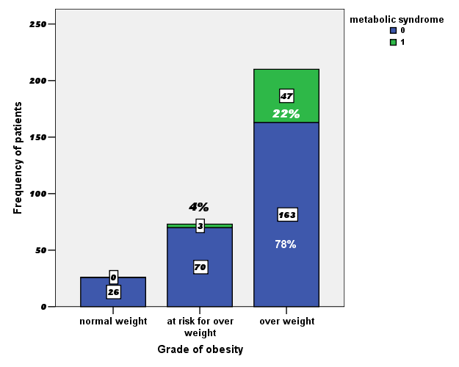
Prevalence of Metabolic Syndrome in Different Weight Groups
<0.001
<0.001

Slide 46
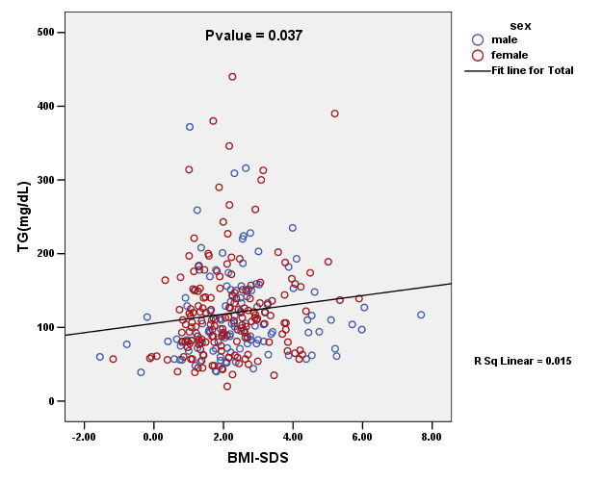
Correlation of Triglyceride level and BMI-SDS

Slide 47
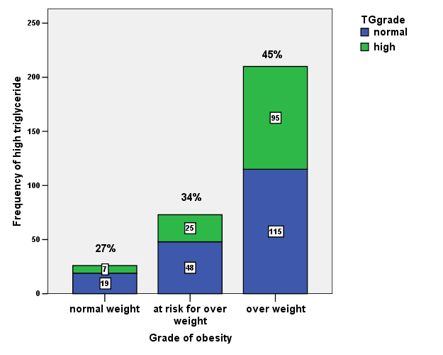
Prevalence of high triglyceride in different weight groups
P=0.043
P=0.045

Slide 48
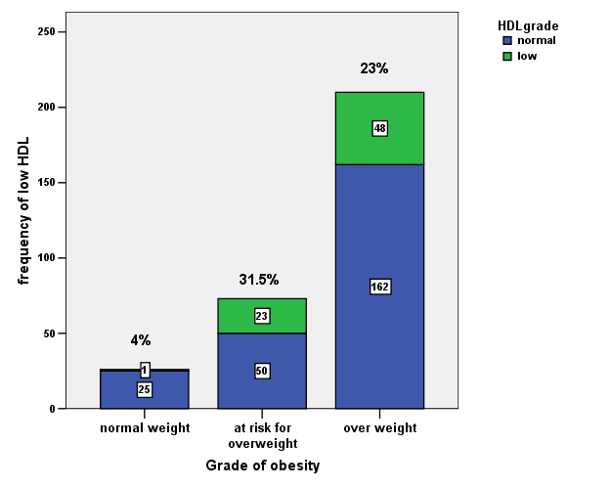
Prevalence of low HDL in different weight groups
P=0.019

Slide 49
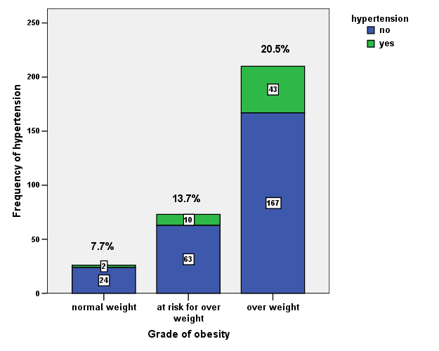
Prevalence of hypertension in different weight groups
P=NS

Slide 50
Study
Insulin sensitivity and beta cell function in children, and comparing the values of different indices
Hormone Research, 2007;68(S1):111,
    Hormone Research, 2007;68(S1):111

Slide 51
Methods
Study subjects: 159 non diabetic
67, males; 92, females, age , 4 – 18 yr (11± 3 yr)
After overnight fast, subjects ingested a solution containing 1.75 g/kg max. 75 g of glucose solution, and venous blood samples were obtained at 0, 30, 60, 90, 120 minutes for determination of plasma glucose (glucose oxidase) and insulin (IRMA).

Slide 52
Beta-cell function indices
HOMA-B index: 20 x ins0’(µU/mL) / (glu0’ – 3.5)(mmol/L)
1st phase insulin secretion
Stumvoll index:
1283 + 1.829 x ins30’ – 138.7 x glu30’ + 3.772 x
ins0’ (insulin, pmol/L; glucose, mmol/L)
Insulin resistance
HOMA-IR: glu0’ (mmol/L) x Ins0’ (µU/mL) / 22.5;
Insulin sensitivity
Matsuda index: 10000 / √glu0’ x ins0’) (mean gluOGTT x mean insOGTT) (glu, mg/dL; ins, µU/mL)
HOMA-IS:1 / HOMA-IR

Slide 53
Insulin resistance and β cell function indices in different weight groups
Indices | NW (n=16) | AROW (26) | OW (27) | OB (90)
Stumvoll | 987±608 | 1591±717 | 1908±764 | 2258±1537
HOMA-B | 66±41 | 124±69 | 144±64 | 195±167
HOMA-IS | 2.1±3.4 | 0.50± 0.59 | 0.38±0.16 | 0.37±0.25
Matsuda | 18±19 | 4.5± 3.8 | 3.7±1.7 | 3.7±3

Slide 54
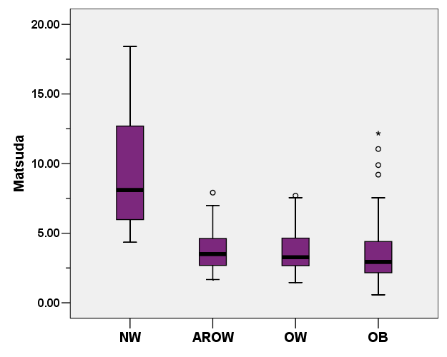

Slide 55
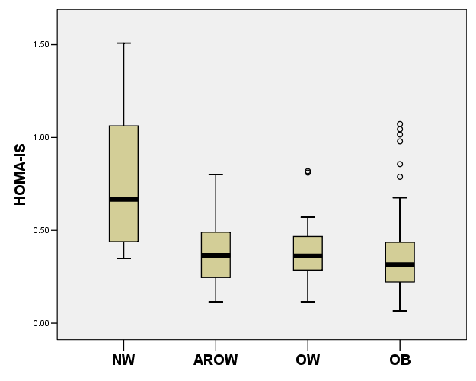
P<0.001

Slide 56
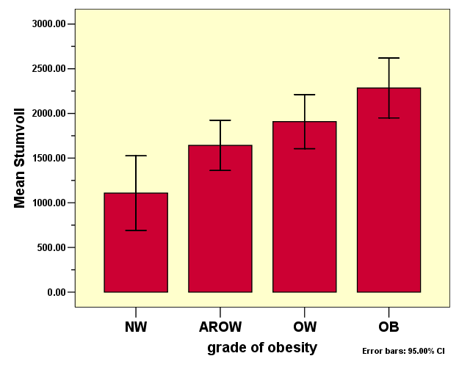
P=0.003
P=0.008
P=0.001
P=0.008

Slide 57
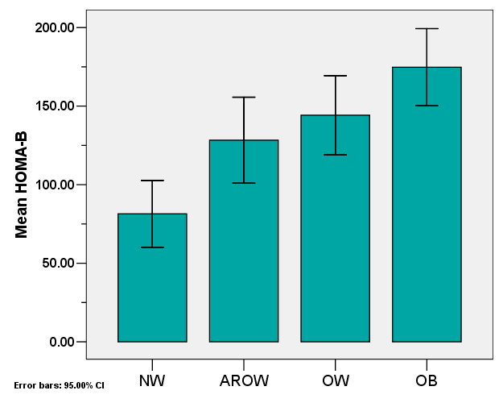
P=0.019
P=0.002
P=0.004
P=0.004

Slide 58
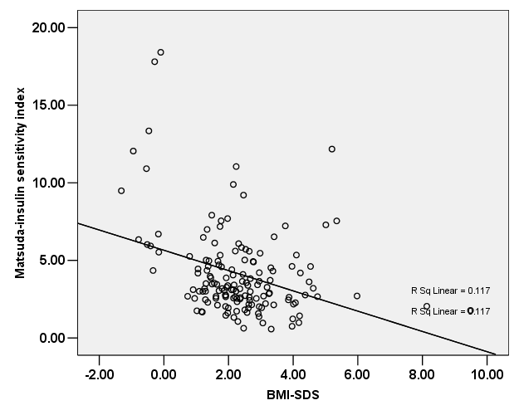
P<0.001

Slide 59
Evaluation of homeostasis model assessment indices in children and adolescents
The aim:
to determine HOMA-B and HOMA-IR in different weight groups
to detect Sensitivity and specificity of HOMA-IR according to increase of β cell function more than normal range for normal weight children
Study subjects: 528 cases
213 males, 315 females
Age 4.5 – 18, (mean ± SD) (10.6±2.9) yr
Hormone Research 72, S3; 2009:407

Slide 60
HOMA indices in different weight groups
Weight group | N | HOMA-B | HOMA-IR
Normal weight | 152 | 86.8 ± 50.6 | 1.8 ± 1.2
At risk for overweight | 108 | 146.4 ± 91 | 2.7 ± 1.7
Overweight | 268 | 193.6 ± 140 | 3.8 ± 2.6
BMI > 2SDS | 209 | 208.25 ± 152 | 4.1 ± 2.7

Slide 61
HOMA-IR
ROC Curve
3.6
sensitivity 79%
Specificity 80%
4.2
sensitivity 74%
Specificity 91%

Slide 62
Conclusion
BMI > 85% is accompanied by increasing beta cell function and decreasing insulin sensitivity , so it could be a risk factor for developing type 2 diabetes in future life
Insulin sensitivity and beta cell function correlate with the degree of obesity

Slide 63
Conclusion (Cont.)
The prevalence of metabolic syndrome is high in overweight children
Obesity in children should be prevented to have healthy adults

Slide 64
Acknowledgment
Dr. Robabeh Ghergherechi
Dr. Kobra Shiasi
Dr. Ali Tale

Slide 65

Thank you for your attention

