Slide 1
ID : 18 years girl ,no married, student
Cc : increased prolactin level despite medical &surgical treatment
PI :early presentation from 1390( 4 years ago ) was blurred vision and headache ( occipital ,tention like, no accompanied with other symptom ex; vomiting or ..)and Amenorrhea ,blurred vision no corrected by glasses ,no other complaint
Then at neurology consultation ; only visual field abnormality no other cranial disorder ,then MRI obtaining , MRI Shows :large intrasellar mass about 55x50 mm with suprasellar extention probable invasion to cavernous sinuses&sellar erosion with cyctic component ….
After MRI ,request LAB data that show ; severe hyperprolactinemia

Slide 8
Early LAB data shows : severe hyperprolactinemia ( 17700 ng/ml) then treatment started with :
Dostinex 1 mg/weekly that increased to 3 mg/weekly within 5-6
months then continued until 1391.12.8 ( 1.5 years)
Levothyroxine 100 micg/day
After 20 day prolactin level decreased to 4300 ng/ml
First Optimetry obtained at 90.9.19 that shows:
Severe V/F Loss & Left Homonymous hemianopsia
Two time optometry repeated at 1391 that shows same results

Slide 12
Patient have amenorrhea and headache and galactorrhea during use of full dose of dostinex
 | 90.7.13 | 90.8.12 | 90.9.19 | 90.11.8 | 91.2.9 | 91.4.17 | 91.6.1 | 92.8.21 | 93.6.10 | 93.11.1 | 94.2.2 | 94.5.1 | 94.6.28
Prolactin ( ng/ml ) | 17700 | 4300 | 1650 mac 36% | 1340 | 950 | 660 | 650 | 1167 | -- | 470 | >470 | 459 | 541
T4 ( mic/ml ) | 9.5 |  |  |  | 1.09 |  | ------ |  |  | 10.8 | 9 |  | 8.6
F T4 ( ng / dlit) |  |  | 0.97 | 1.05 |  | 1.14 | ------- |  | TPOab 326IU/ml |  |  |  | Normal lipid,LFT
T3up | 27.6 |  |  |  |  |  | ------
TSH | 2 |  | 5.4 | 0.8 | 0.4 | 0.5 | ----- | 0.1 | 19.7
FSH ( IU / L ) | 6 |  |  |  | 6.5 |  | -------
LH | 0.7 |  |  |  | 5.0 |  | ------
Corisol 8A.M | 15.7 (mcg / dl ) |  | 585 ( nmol / lit) |  |  |  | ------- | 265 ( nmol / lit) |  | 14.1 (mcg / dl ) | 14.9 (mcg / dl ) |  | 295 ( nmol / lit)
ACTH ( pg / ml ) |  |  |  |  |  |  | ------ | 34.3
IGF 1 | 160 ( ng / ml ) |  |  |  |  |  | -------- | 498

Slide 13
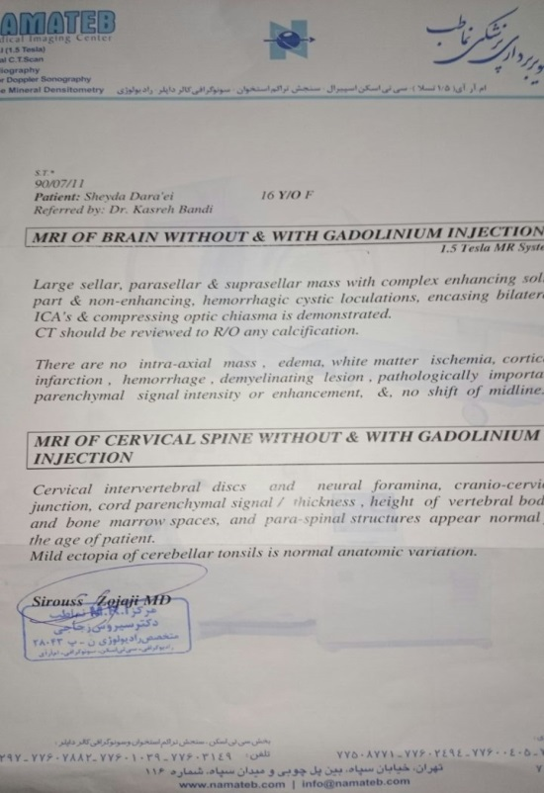
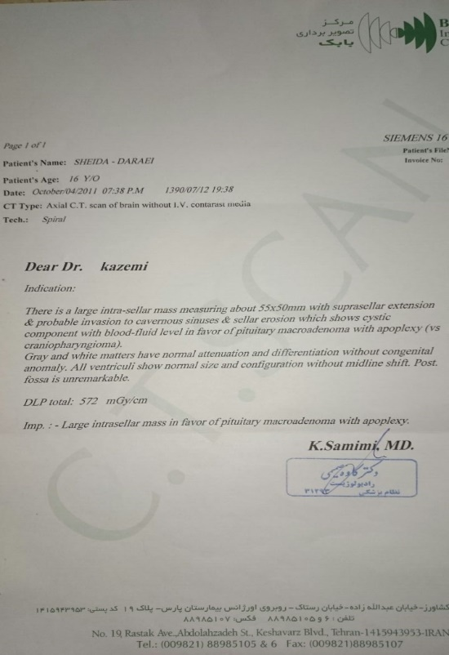
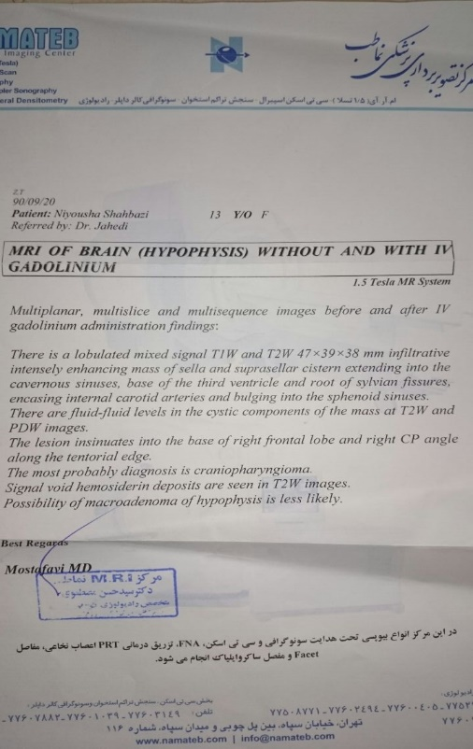
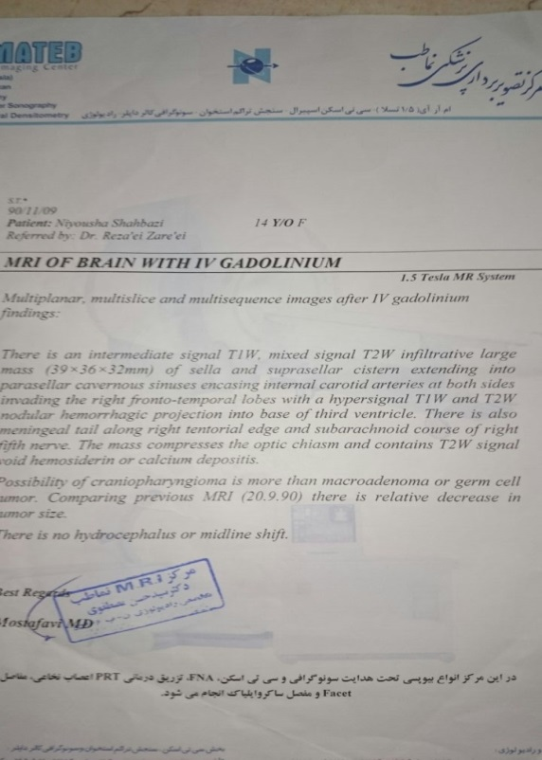
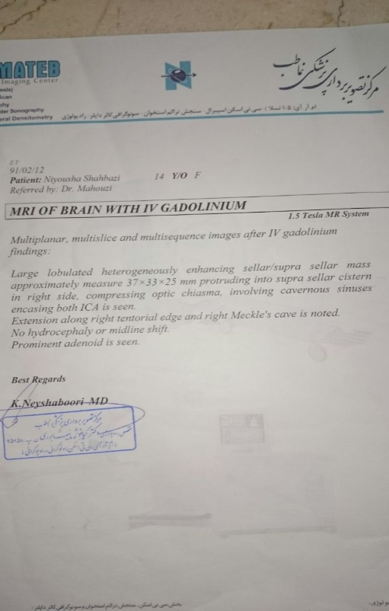

Slide 14
 | 90.7.11 | 90.7.12 | 90.9.20 | 90.11.9 | 91.2.12 | 91.6.4 | 91.10.3 | 92.5.27 | 92.12.8 | 94.7.29
MRI | - | 50x50 mm | 47x39x38 mm | 39x36x32 mm | 37x33x25 mm | 37x27x29 mm | Very little decrease | - | - | 12x10 mm

Slide 19
After treatment with dostinex 3mg/week from 1390 hyperprolactinemia and amenorrhea no treated .
Then patient underwent operation ( in loghman hospital at 91.12.8 ) ; after operation these drugs continued by surgen for 1 year :
dostinex 1 mg/week
Levothyroxine 100 mic/day
Prednisolone 2.5 mg/day
After operation amenorrhea and hyperprolactinemia be continued but headache is resolved.
Then radiotherapy started (33 time within 6 week ) from 92.6.1 to 92.7.15 ( total dose : 5940 centigray )

Slide 22
MRI Report 6 month after surgery( before radiotherapy )

Slide 28
MRI
1393.6.5

Slide 32
From 1393 patient uses these drugs under observation of endocrinologist :
Cabergoline 5 mg/week until recent month and 7 mg/week from 1 month ago .
Levothyroxine 100 micg/day
Prednisolone 2.5 mg/day
Estradiol 1 mg/day for 25 days of a month ( from 1 year ago )
Medroxyprogestrone 5mg/day for ( from 7 month ago ) 10 days of a month (last 10 days of estradiol administration )

Slide 33
94.7.29

Slide 41
Past Medical history :no childhood illness ,no trauma , has taken occasional acetaminophen for headache( birth weight was : 4.5 kg )
Familial H :her mother is hypothyroidism , she has one fat brother
R.O.S :
General : no significant weight changes ,( ONLY 1-2 Kg weight gain per year)
Head: occasional stress headache ,( keep silent by acetaminophen)
Eye : decreased visual field in left side , no blurred vision , but has myopia ( -3.5 d )
,ENT: NO Problem
Chest : no problem, no galactorrhea
Heart : no palpitation , history of mild HTN ( 140/90)
GI : NO PROBLEM

Slide 42
GU: no problem
menorrhagia from 3 months ago ;
Period light flow for 3 days without cramping
Neuromuscular : no syncope no weakness
PHYSICAL EXAMINATION :
General : severe obese ( Height: 162 , Weight: 96 , BMI =36), no anxious , no distress
VS : BP=130/80 , PR= 78 , RR= 16 , T 36.8 AX
Eyes:retinal ex .. Is normal, pupil equal with normal light reaction, no petosis , no pallor of conjunctiva , visual field is abnormal to confrontation ( left homonymous hemianopia )
Skin: no pallor ,warm , no purpura , no hair loss, mild hypertricosis, mild striae on abdomen
Ent&neck : no lymphadenopathy , thyroid not enlarged and without nodules, no moon face
Chest : normal

Slide 43
Heart : s1 and s2 normal , mild systolic murmur , no diastolic murmur
Breast : symmetric , no mass ,no induced galactorrhea, B5
Abdomen : no organomegaly , no other abnormality
Pelvic &rectal: external genitalia normal , p5
Extremities : no abnormality , skin and hair normal on extremities
Neurologic : at mental status was normal : alert, oriented, judgment and mood were normal,,
pupil reaction to light was normal and symmetric ,other cranial
nerves were normal , no gait abnormality , reflexes are normal ,

Slide 44
Abstract :
patient is an 18 years old girl with history of pituitary tumor and
hyperprolactinemia from 4 years ago ( under treatment with
dostinex for 1.5 year ) that undewent ( transsphenoidal pituitary
adenectomy )at 2.5 years ago . After surgery despite
radiotherapy and full dose of dopaminergic agents, she has
hyperprolactinemia and menorrhagia ,and remaining pituitary
tissue .
Other problems : obesity ,mild HTN ? , mild MVP( on echo 94.5.-)
CBC , LFT,RFT , Lipid profile was normal

Slide 45
The End

