Slide 1
IN THE NAME OF GOD
DR. ROYA ALAEI

Slide 2
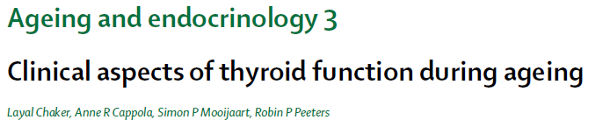
Lancet Diabetes Endocrinol. 2018 Sep;6(9):733-742
DATE: 99/3/12

Slide 3
Globally, mean life expectancy has steadily increased.
The increase in the number of older citizens is accompanied by an increased prevalence of thyroid dysfunction up to 20% in community dwelling individuals aged 65 years and older.
It is not known whether this increase in the prevalence of thyroid dysfunction also indicates pathophysiology in need of treatment.
There is no clear age cutoff to define older people, and the cut-off that were chosen in the articles that we searched depended on many aspects, including the mean age of the population studied and historical considerations (eg, age of retirement).

Slide 4
AGENDA
Changes in the HPT axis and regulation of thyroid hormone action during aging
Changes in thyroid function test results during aging
Diagnosis and epidemiology of thyroid disease in older populations
Thyroid function and age-associated diseases
Treatment considerations in older patients
Directions for future research

Slide 5
AGENDA
Changes in the HPT axis and regulation of thyroid hormone action during aging
Changes in thyroid function test results during aging
Diagnosis and epidemiology of thyroid disease in older populations
Thyroid function and age-associated diseases
Treatment considerations in older patients
Directions for future research

Slide 6
The thyroid gland produces T4 and T3 in approximately a 14-to-1 ratio.
Circulating thyroid hormone concentrations are tightly regulated by the negative feedback mechanism of HPT axis.
Beyond circulating concentrations, transport (ie, by monocarboxylate transporters [MCTs] 8 and 10) and metabolism (ie, through activity of the three deiodinase [DIO] enzymes) of thyroid hormones are organ-specific and cell-specific.

Slide 7
During ageing, changes occur in thyroid structure and function that affect thyroid hormone production, metabolism, transport, and action.
The size of the thyroid gland decreases in older people without nodular disease and the position is more caudal than in younger individuals.
Most evidence regarding changes in thyroid hormone secretion, metabolism, and transport with increasing age comes from rats and mice (table 1).

Slide 8
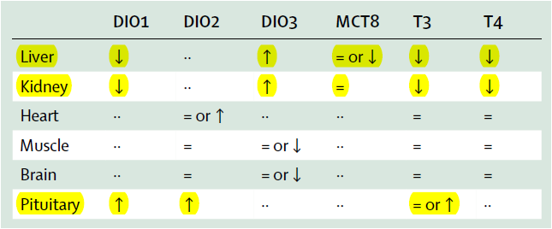
Decreased secretion of thyroid hormones and reduced liver DIO1 activity is seen in rats that are ageing, despite similar TSH plasma concentrations.
In old male rats, MCT8 are reduced in the liver, but not in the kidney.
In a mouse model of accelerated ageing, in the liver and kidney, with decreased DIO1 and increased DIO3 expression, but are largely preserved in the heart, muscle, and brain.

Slide 9
AGENDA
Changes in the HPT axis and regulation of thyroid hormone action during aging
Changes in thyroid function test results during aging
Diagnosis and epidemiology of thyroid disease in older populations
Thyroid function and age-associated diseases
Treatment considerations in older patients
Directions for future research

Slide 10
Most but not all cross-sectional population and laboratory-based studies show a higher mean TSH concentration in older participants.
In contrast, older studies in highly selected groups of healthy older participants suggest an age-dependent decline in TSH secretion.
Differences between these studies are probably due to differences in current and historical iodine intake, as well as selection criteria used in the older studies.
So far, only three prospective analyses of changes in thyroid function with age have been published, each with slightly different results.

Slide 11
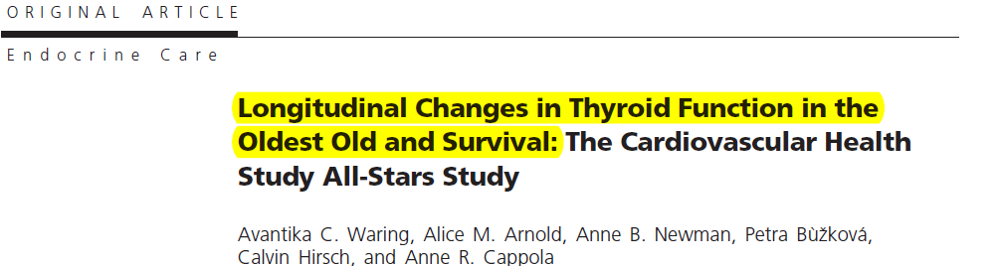
A US study
Cohort of 843 participants who were not taking thyroid medications (mean age 85 yr).
TSH, FT4, total T3, and thyroid peroxidase antibody status were measured in 1992–1993 and 2005–2006. Median follow-up of 13 years.
Deaths were ascertained through February 2011. 287 deaths occurred over a median follow-up of 5.1 yr.
Objective: longitudinal changes in thyroid function in a cohort of elderly individuals and determine the relationship between thyroid function and mortality.
(J Clin Endocrinol Metab 97: 3944–3950, 2012)

Slide 12
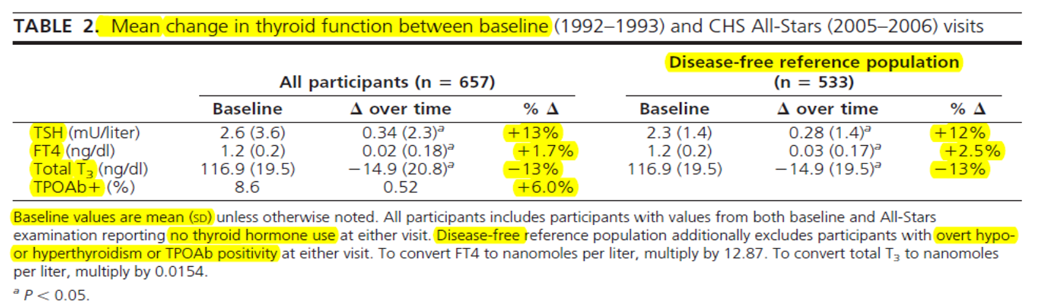
FT4 (0.7–1.7 ng/dl), TT3 (84.4–201.3 ng/dl), TPOAb>37 U/liter to define positivity
Subclinical hypothyroidism (TSH 4.50–19.99 mU/liter with normal FT4)
Euthyroid (TSH 0.45–4.49 mU/liter).

Slide 13
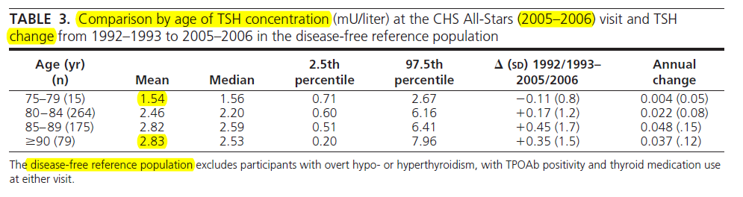

Slide 14
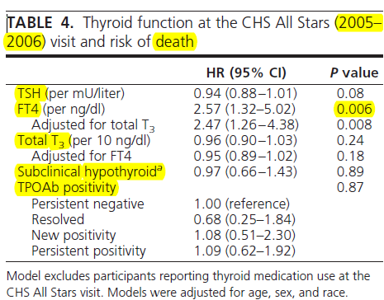
Relationship between 13-yr change in TSH, FT4, and TT3 and mortality was also examined.
TSH increased over time was not associated with increased or decreased mortality
FT4 was positively associated with death
These findings raise concern for treatment of mild elevations of TSH in advanced age.

Slide 15
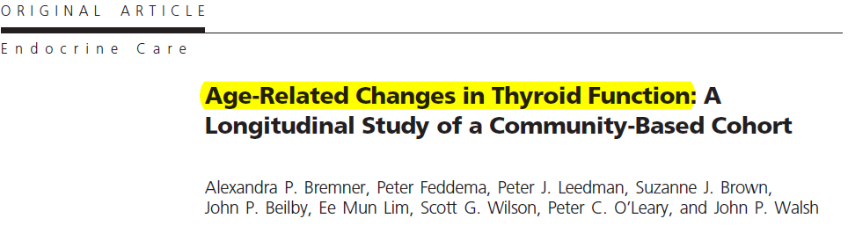
Australia
908 participants without thyroid disease or thyroid antibodies (1981 and 1994) 13 years of follow-up (mean age 45.5 yr).
TSH, free T4, thyroid peroxidase, and thyroglobulin antibodies checked
The Journal of Clinical Endocrinology & Metabolism, Volume 97, Issue 5, 1 May 2012, Pages 1554–1562

Slide 16
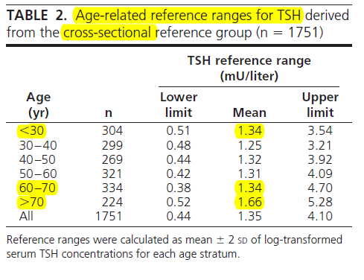
Reference group of 1751 subjects for cross-sectional analysis in 1981

Slide 17
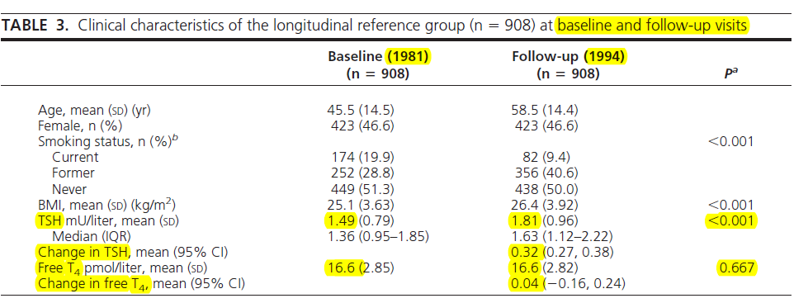
The TSH increase was most marked in the elderly (older than 60 years

Slide 18
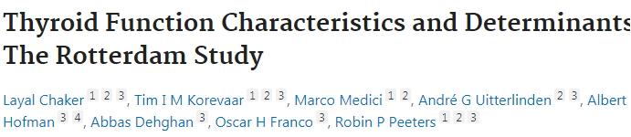
Netherlands ,1002 participants (mean age of 67 years) not taking thyroid medication, (median follow-up of 6·5 years), TSH, FT4 and TPO ab checked.
TSH levels did not change over time, irrespective of age.
FT4 levels increased over time, most prominently those older than 65 years of age (mean increase of 4.5 pmol/L).
Thyroid. 2016;26(9):1195‐1204.

Slide 19
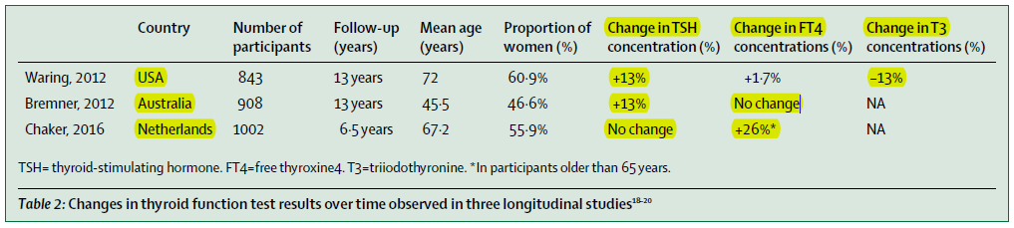


Slide 20
Several studies suggest that individuals aged 65 years and older have a blunted pituitary response to hypothyroidism.
The relation between TSH and FT4 remains complex and the changes that occur with age and the differences within subgroups require further research.

Slide 21
AGENDA
Changes in the HPT axis and regulation of thyroid hormone action during aging
Changes in thyroid function test results during aging
Diagnosis and epidemiology of thyroid disease in older populations
Thyroid function and age-associated diseases
Treatment considerations in older patients
Directions for future research

Slide 22
Thyroid dysfunction is a biochemical diagnosis that relies on the reference ranges of thyroid function tests.
The reference range of TSH depends on the assay used and the population in which it has been measured, but 0·4–4·5 mIU/L is most commonly used.
Some experts suggest use of age-specific reference ranges for TSH.
When age-specific reference ranges are applied, a reclassification from abnormal to normal thyroid function occurs in older people.

Slide 23
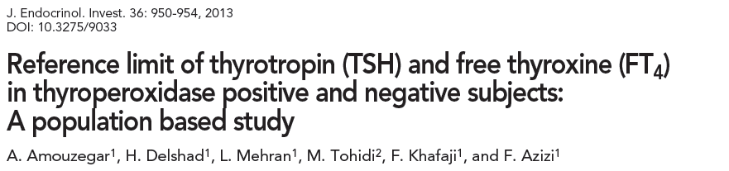
Tehran Thyroid Study (TTS), an ongoing prospective cohort of 5704 randomly selected individuals, age ≥20 yr.
After applying all exclusion criteria except TPOAb positivity (10.5%), data of 2459 participants remained for analysis.
Reference limit analysis was performed for the negative thyroid peroxidase antibody (TPOAb) group.

Slide 24
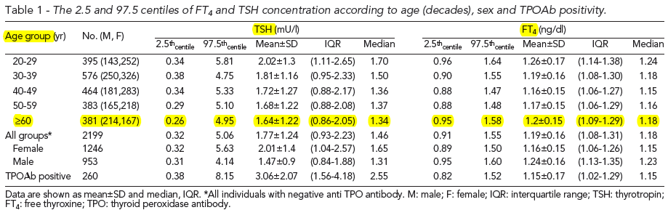

Slide 25
The prevalences of both hyperthyroidism and hypothyroidism increase with increasing age.
Progression from subclinical to clinical hypothyroidism is faster in patients who are positive for anti-thyroid antibodies (4·3% per year for female,with positive TPO ab vs 2·6% per year for female with negative TPO ab)
Thyroid peroxidase antibody positivity more prevalent in older people than in younger people.

Slide 26
Progression from subclinical to clinical hyperthyroidism due to Graves’ disease occurs more often in older patients, although the incidence of Graves’ hyperthyroidism is not higher in older patients.
The distribution of causes of thyroid disease differ between older and younger individuals. Toxic multinodular goitre and toxic adenomas are more often a cause of hyperthyroidism in older individuals than in younger individuals, especially in iodine-deficient areas of the world.

Slide 27
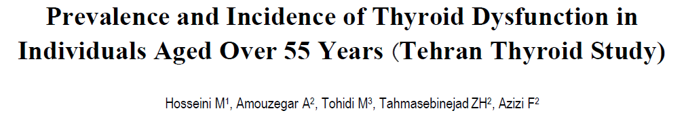
819 Tehranian participants, aged over 55 years from the Tehran Thyroid Study, who were assessed every 3 years for serum free T4 (FT4) and TSH levels and were followed for 10.6 years
Vol 18 No.3 Aug-Sep 2016 Iranian Journal of Endocrinology and Metabolism

Slide 28
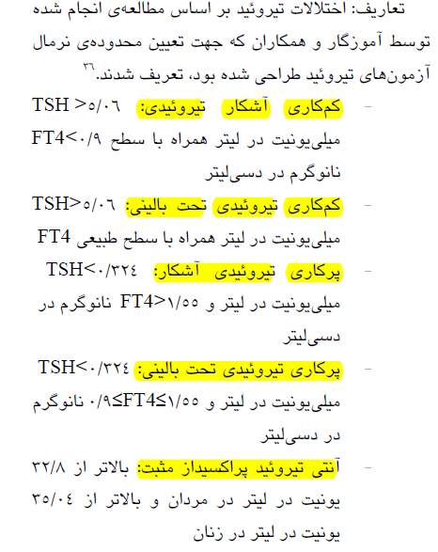
کوهورت، منطقه 3 تهران با میزان دریافت ید کافی ،
افراد با سابقه بیماری تیرویید، مصرف ید رادیواکتیو، جراحی تیرویید یا مصرف آنتی تیرویید، لووتیروکسین یا داروهای اثرگذار بر فانکشن تیرویید مثل امیودارون از مطالعه حذف شدند.

Slide 29
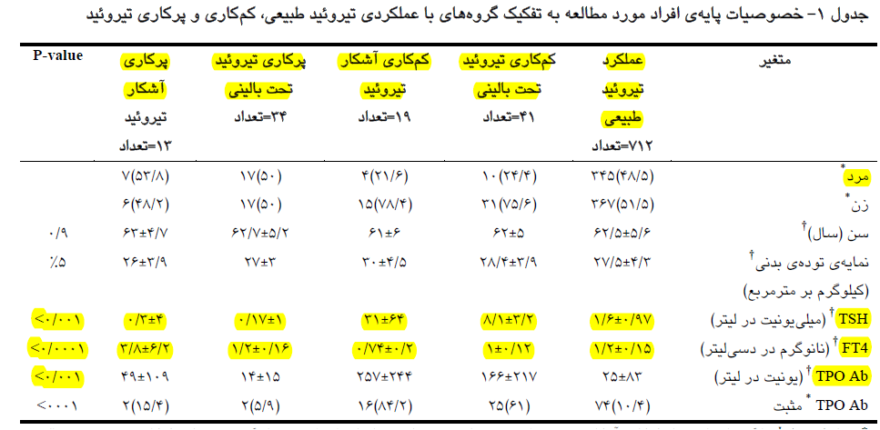
712 (86.9%) : euthyroid
41(5%) subclinical hypothyroidism (SCH) 19(2.4%) : overt hypothyroidism (OH)
34(4.1%): subclinical hyperthyroidism 13(1.5%) : overt hyperthyroidism.
Overall 13% of participants had thyroid dysfunction.

Slide 30
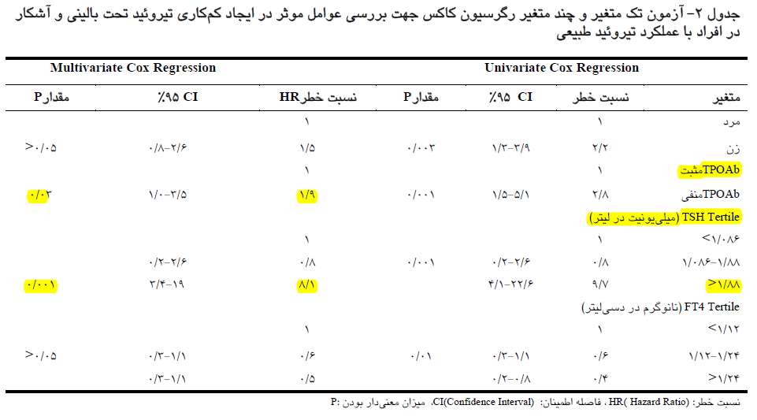
The annual incidence rate of SCH and OH were 8.8 and 7.1 cases per 1000 people respectively.
Multivariate regression analysis showed the risk of hypothyroidism in euthyroid people to be affected by TPO positivity [HR=1.9 (CI 95% 1.04-3.5)] and TSH>1.88 mlu/l [HR=8.1 (CI 95% 3.4-19)].

Slide 31
Subgroups at risk of thyroid disease
Older people as a group are at an increased risk of developing thyroid disease, with women having the highest risk. Thyroid disorders have more often been described in older patients with:
Specific autoimmune diseases (eg, type 1 diabetes)
Type 2 diabetes
Chronic kidney disease
Gastrointestinal diseases (eg, bile stones)
For many of these subgroups it has not been established whether the reported associations are due to coexistence in older people, shared pathophysiological pathways, or causal effects of thyroid function on several phenotypes or vice versa.

Slide 32
In the past decades, certain conditions (eg, psychiatric illnesses) have been diagnosed and treated more often in older patients than in younger patients, leading to an increased risk of medication-induced thyroid dysfunction in this subgroup, caused, for example, by amiodarone, tyrosine kinase inhibitors, or immune checkpoint inhibitors.
This situation can also contribute to an increase in prevalence and incidence of thyroid disease in older individuals.

Slide 33
Challenges in the diagnosis of thyroid disorders in older patients
Changes in thyroid physiology
Increased prevalence of non-thyroidal illness
Comorbidities and Medication use
Differences in clinical presentation of thyroid disease in older patients compared with younger patients.

Slide 34
Increased prevalence of non-thyroidal illness
Non-thyroidal illness typically presents in severely ill individuals, but has also been described in chronically ill patients.
Plasma concentrations of T3 and T4 decrease
whereas TSH concentration is usually within the normal range or below. However, TSH concentration can be elevated in the recovery phase.
In hospitalised and severely ill patients the presence of non-thyroidal illness can hinder or falsely lead to the diagnosis of thyroid disease. Measuring thyroid function again after full recovery is advised, unless thyroid disease is suspected as the cause of illness.

Slide 35
Comorbidities and Medication use
Drugs can also alter the effects of thyroid hormones without causing thyroid disease.
Oral oestrogen, raloxifene, tamoxifen, and glucocorticoids affect concentrations of thyroxine-binding globulin.
and aspirin, non-steroidal anti-inflammatory agents, and heparin affect proteins that bind to thyroid hormones.

Slide 36
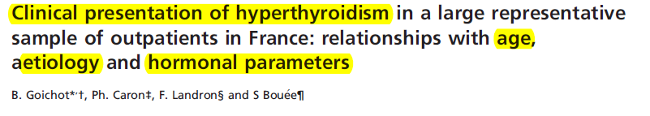
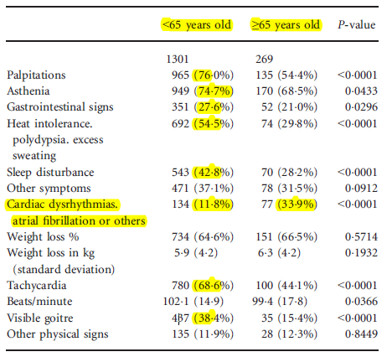
Clinical Endocrinology (2016) 84, 445–451
France
1572 patients with hyperthyroidism

Slide 37
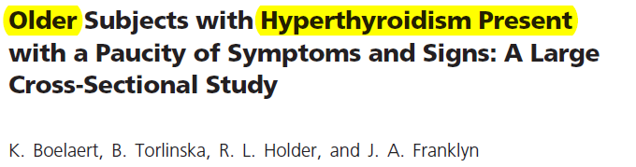
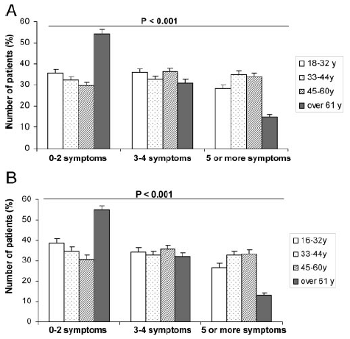
J Clin Endocrinol Metab. 2010 Jun;95(6):2715-26.
UK
More than 50% of patients ≥61 years presented with very few symptoms(two or less) compared with 30% of younger patients.
The prevalence of most signs and symptoms was lower in patients older than 60 years, except for weight loss, shortness of breath, and atrial fibrillation.
A Number of symptoms of hyperthyroidism reported by patients in the respective age groups
B after exclusion of those taking blockers or amiodarone.

Slide 38
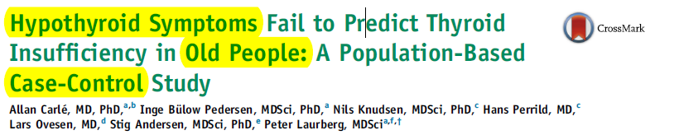
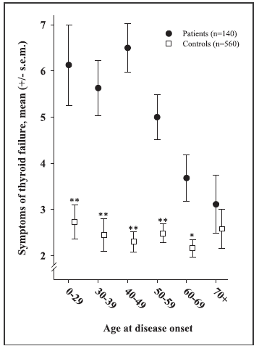
Denmark
140 patients with autoimmune hypothyroidism and a control group of 560 participants.
Mean number of symptoms present at disease onset in autoimmune overt hypothyroidism and controls by different age groups. (*P < .01, **P < .001).
The American Journal of Medicine (2016)129,1082-1092

Slide 39
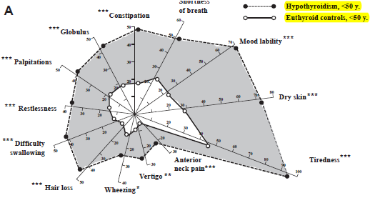
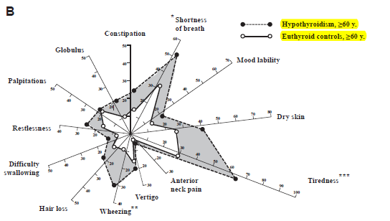
The size of the shaded areas between the 2 lines reflects the usefulness of asking for symptoms when evaluating whether the subjects may be hypothyroid or not.
Good predictive value of a hypothyroidism composite symptom score in patients younger than 50 years AUROC curve of 0.91 in young men), but poor predictive value in older patients, especially women older than 60 years (AUROC curve 0.64).

Slide 40
These studies suggest that the presentation of thyroid dysfunction is often subtle in older individuals, and that clinicians should readily test TSH concentrations in this population.

Slide 41
AGENDA
Changes in the HPT axis and regulation of thyroid hormone action during aging
Changes in thyroid function test results during aging
Diagnosis and epidemiology of thyroid disease in older populations
Thyroid function and age-associated diseases
Treatment considerations in older patients
Directions for future research

Slide 42
Various studies have shown that there is an association between variations in thyroid function and deleterious or protective outcomes in older people.
Overt thyroid dysfunction is always treated upon diagnosis, and therefore observational studies have examined outcomes associated with variations in thyroid function in the context of subclinical thyroid dysfunction or even within the reference range.

Slide 43
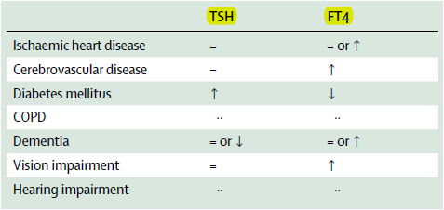
Association of TSH and FT4 in the reference range with the most burdensome chronic non-communicable diseases in older individuals
↑: higher risk of outcome with higher values of thyroid function test.
↓: lower risk of outcome with higher values of thyroid function test
= Indicates no evidence for an altered risk associated with thyroid function test
·· Indicates insufficient evidence on the association.

Slide 44
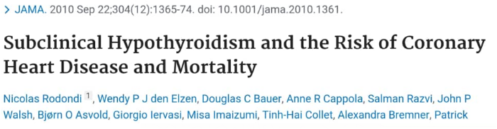
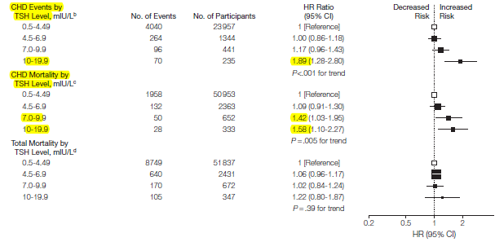
An individual participant data(IPD) meta-analysis from the Thyroid Studies Collaboration (TSC), a consortium of population-based cohort studies
55 000 participants

Slide 45
Other meta-analysis studies:
An IPD meta-analysis from the TSC addressing the association of subclinical hypothyroidism and stroke showed a lower hazard ratio (HR) in participants 65 years and older as compared to younger participants.
A separate IPD meta-analysis from the TSC showed an increased risk of coronary heart disease associated with subclinical hyperthyroidism.
An IPD meta-analysis from the TSC described no general or age-specific association of TSH or FT4 within the reference range with coronary heart disease.

Slide 46
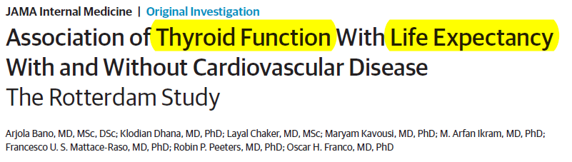
Population-based prospective study, 2017, median follow-up of 8.1 years
7785 participants with TSH and FT4 within the normal range (Mean age 64 years)
Objective: to investigate the association of thyroid function with total LE and LE with and without CVD among euthyroid individuals

Slide 47
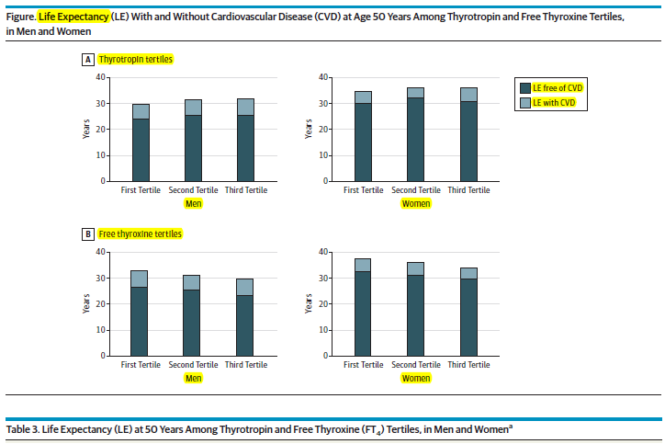
Compared with those in the lowest tertile, men and women in the highest thyrotropin tertile lived 2.0 and 1.4 years longer, respectively, of which, 1.5 and 0.9 years longer without CVD.
Compared with those in the lowest tertile, the difference in life expectancy for men and women in the highest FT4 tertile was −3.2 and −3.5 years, respectively, of which, −3.1 and −2.5 years without CVD

Slide 48
Information on the association of T3 concentrations with clinical outcomes and longevity is scarce.
A study from Rozing and colleagues showed that familial longevity was associated with low T3, suggesting either a role for T3 as a marker of delayed ageing, or as an adaptive mechanism to deal with other consequences of the ageing process.
although low T3 concentrations have been associated with mortality in other studies.
The US study of Waring and colleagues18 did not show a relationship of T3 concentrations with mortality.

Slide 49
Osteoporosis and fracture risk
In an IPD meta-analysis from the TSC (over 5000 participants) with a median age of 72 years:
subclinical hyperthyroidism was associated with increased annual bone loss at the femoral neck with a difference of 0.18% annual decline in bone mineral density (95% CI –0.34 to –0.02) as compared with euthyroid participants.

Slide 50
Another study from the TSC (over 70 000 participants):
Subclinical hyperthyroidism was associated with an increased risk of hip fractures, spine fractures, and other fractures.
Participants with endogenous hyperthyroidism and those with TSH>0.1 mIU/L had the highest fracture risk.
However, the relative risk of fracture did not differ by age, with an age cutoff of 75 years.

Slide 51
Cognitive impairment and dementia
Clinical hypothyroidism is considered a cause of reversible dementia, and routine screening for hypothyroidism Is recommended as part of the medical examinations for the diagnosis of dementia.
However, it is not known to which degree the treatment of hypothyroidism results in complete regression of cognitive impairment.
.

Slide 52
A metaanalysis of 11 prospective cohort studies reported:
an association of subclinical hyperthyroidism, but not subclinical hypothyroidism, with an increased risk of dementia.
Two large prospective population-based cohort studies have described an increased risk of dementia in community-dwelling older people with higher thyroid function.

Slide 53
Depression and quality of life
Depression and lethargy are part of the scope of symptoms attributed to hypothyroidism.
However, recent studies have shown higher thyroid function to be related to increased incidence of depressive symptoms in older populations.

Slide 54
In a Dutch study of 1503 participants ( 70,6 years on average) (period of 8 years) :
Participants with low-to-normal TSH displayed Depressive symptoms more often than participants with a high to normal TSH, with an odds ratio for incident depressive symptoms of 1.85 (95% CI 1.10–3.11) irrespective of thyroid peroxidase antibody concentrations.
In another Dutch cohort study, 606 participants with a high cardiovascular risk and a mean age of 75 years:
Subclinical hyperthyroidism was associated with an increase in Geriatric Depressive Scale scores after 3 years, compared with the euthyroid participants.

Slide 55
Frailty, functional mobility, and physical performance
The ageing process results in a decrease in physiological reserve, and an increased risk of disease and mortality, leading to an increased burden of multimorbidity and polypharmacy.
However, the older population is heterogeneous with respect to their level of physical, mental, and social impairments, with some individuals who are very fit and others who are very frail.
Calendar age alone is a poor marker of the rate of ageing, often referred to as biological age.

Slide 56
Most prospective studies link higher thyroid function such as subclinical hyperthyroidism or per one unit increase in thyroid hormone concentrations to increased frailty and related parameters, such as decreased functional mobility and physical performance in older patients.

Slide 57
Two studies have investigated the effect of thyroid function variations on gait speed and other gait domains (eg, tandem walk) in older people.
In both studies slower gait speed was associated with higher thyroid function, defined either by a continous scale or as high-to-normal FT4 values.
In their analysis, Bano and colleagues showed:
low and high TSH were associated with different gait domains, including changes in tandem walk, base of support and gait velocity.
In a population-based cohort study with over 10 000 community-dwelling middle-aged and older people:
Higher FT4 were associated with a higher risk of age-related macular degeneration.

Slide 58
AGENDA
Changes in the HPT axis and regulation of thyroid hormone action during aging
Changes in thyroid function test results during aging
Diagnosis and epidemiology of thyroid disease in older populations
Thyroid function and age-associated diseases
Treatment considerations in older patients
Directions for future research

Slide 59
Several factors can influence treatment of thyroid disease in older patients:
Uncertainty in diagnosis
Comorbidities
Concomitant drug use
Changes in HPT axis set point.

Slide 60
Clinical hypothyroidism:
Regardless of age at diagnosis, should be treated with levothyroxine. However, in older patients levothyroxine requirements are lower than in younger patients and the American Thyroid Association (ATA) recommends initiating lower doses of levothyroxine to avoid overtreatment and exogenous hyperthyroidism.

Slide 61
Subclinical hypothyroidism:
ETA distinguishes between patients below and above 70 years of age with a more conservative therapy in older patients (eg, a wait and see)
ETA: starting dose of 25 μg LT4 for the treatment of subclinical hypothyroidism in patients with ischaemic heart disease and older patients, in contrast with 50–100 μg of levothyroxine for the general population.
Treatment with LT4/LT3 combination therapy is recommended by the ATA only in the setting of a trial or by the ETA only in specific patient populations (ie, adherent and biochemically well controlled patients with persistent complaints on LT4 treatment).
There are no recommendations for combination therapy specific to older patients, and not many trials that include this age group.

Slide 62
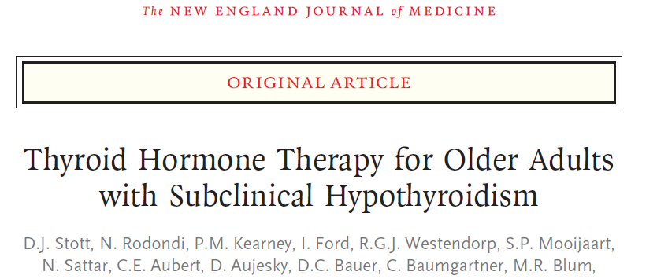
TRUST trial: Double-blind, randomized, placebo-controlled, 1 year
737 older patients persistent subclinical hypothyroidism (368:levothyroxine-369:placebo) (average age of 74 years and median TSH of 5.75 (4.60 to 19.99) mIU/L)
Objective: to determine whether levothyroxine provided clinical benefits in older persons
N Engl J Med 2017;376:2534-44.

Slide 63
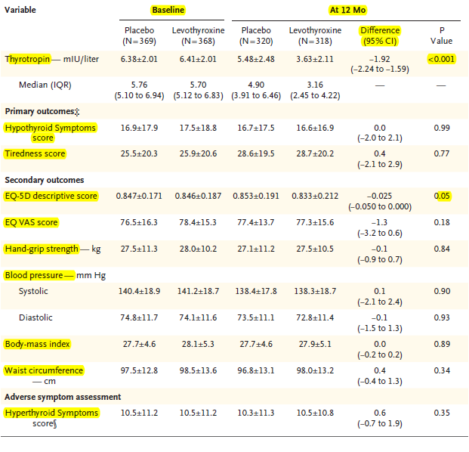

Slide 64
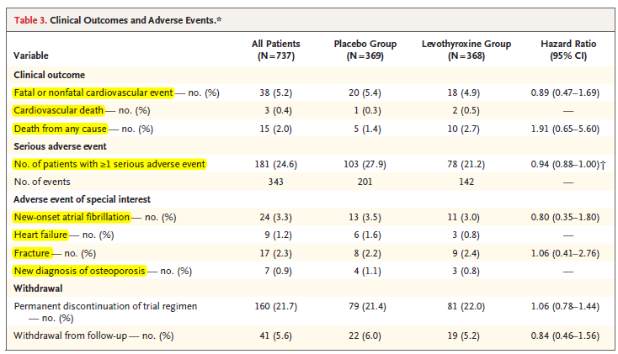

Slide 65
The trial showed no benefit of treatment with levothyroxine on thyroid-specific quality of life, the primary endpoint of the trial.
Furthermore, there was no difference in a range of secondary endpoints including daily functioning, overall quality of life, muscle strength, and cognition.
However, the trial was underpowered to assess effects on cardiovascular disease.
TRUST trial Against routine T4 treatment in older patients with subclinical hypothyroidism, especially in those with mild hypothyroidism and low symptom burden.

Slide 66
Specific subgroups such as those with higher TSH concentrations, high symptom burden, positive thyroid peroxidase antibodies, and the oldest patients (>80 years) were not assessed or under-represented, so no definitive conclusions could be made for these subgroups.
More research is required so that definitive answers can be obtained for specific subgroups such as those with high Symptom burden, higher TSH concentrations, younger participants, or older participants.
Carefully studied treatment trials in individual patients should also be considered.

Slide 67
Only 7% of all randomised controlled trials specifically target older patients.
In the absence of randomised controlled trials, observational studies may be a good alternative to provide individual treatment recommendations.
there are still unanswered questions about the effects of levothyroxine on cardiovascular risk and about symptoms in older individuals with more severe subclinical hypothyroidism and those with symptomatology.

Slide 68
Guideline recommendations for management of subclinical hypothyroidism are based on observational studies including collaborative IPD meta-analyses, because large randomised controlled trials with hard clinical endpoints are scarce.
A Cochrane review of 11 randomised clinical trials included heterogeneous populations, treatment durations, and outcomes in 350 participants and showed that levothyroxine replacement therapy did not result in a significant difference in health-related quality of life and symptoms, compared with placebo or no treatment.
There were no trials with a primary outcome of cardiovascular disease or mortality, but there was some evidence indicating that levothyroxine replacement improves some parameters of lipid profiles and left ventricular function.

Slide 69
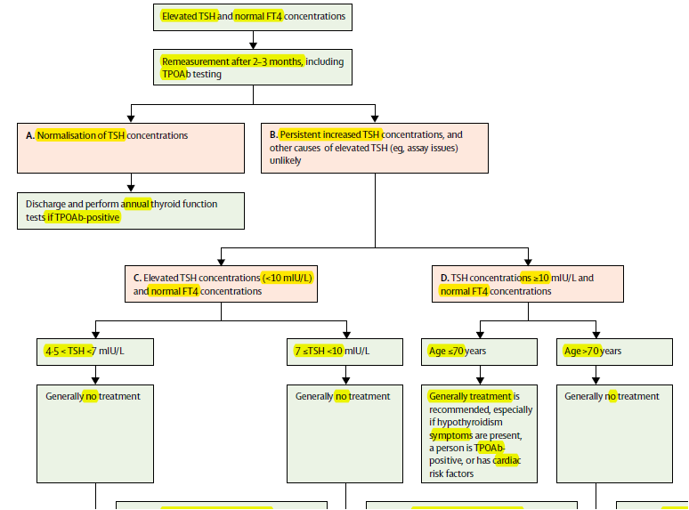

Slide 70
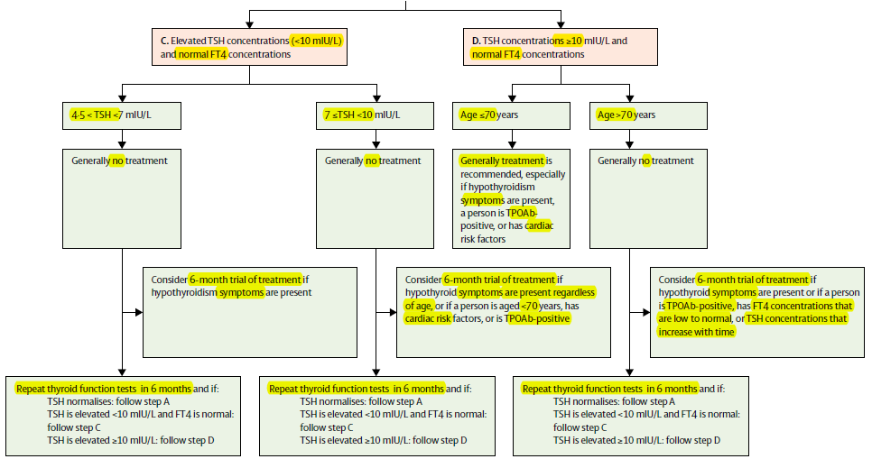

Slide 71
Clinical hyperthyroidism:
Treatment in older patients predominantly depends on its underlying cause.
In the USA, in contrast with Europe or Latin America, radioactive iodine (RAI) therapy is preferred over antithyroid drugs for the treatment of Graves’ disease.
In some situations antithyroid drugs are considered a preferred treatment, for example in patients with a low life expectancy.
RAI is also preferred for treatment of toxic adenoma or multinodular goitre in older patients, with surgery being contraindicated in those with an increased surgical risk.

Slide 72
If RAI treatment is chosen in older patients and those with comorbid conditions, there is an increased risk for transient worsening of hyperthyroidism and preventive measures should be taken. These measures include pretreatment with beta-adrenergic blocking drugs and with methimazole.
However, the risks associated with RAI in frail older patients compared with healthy older patients are unknown, making individual treatment choices in older patients challenging.

Slide 73
Subclinical hyperthyroidism:
No trials are available to show the effects of treatment of subclinical hyperthyroidism on cardiovascular, musculoskeletal, or neurological outcomes in any age group.
Based on the available observations, treatment for subclinical hyperthyroidism is indicated at any TSH in patients >65 years, and treatment is similar to that of clinical hyperthyroidism.
The ETA provides a schematic overview of diagnosis and management of subclinical hyperthyroidism, with a distinction between patients above and below 65 years of age (figure 2).

Slide 74
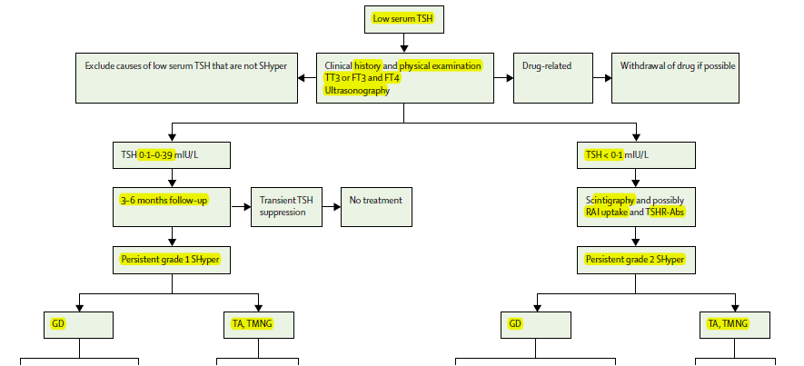

Slide 75
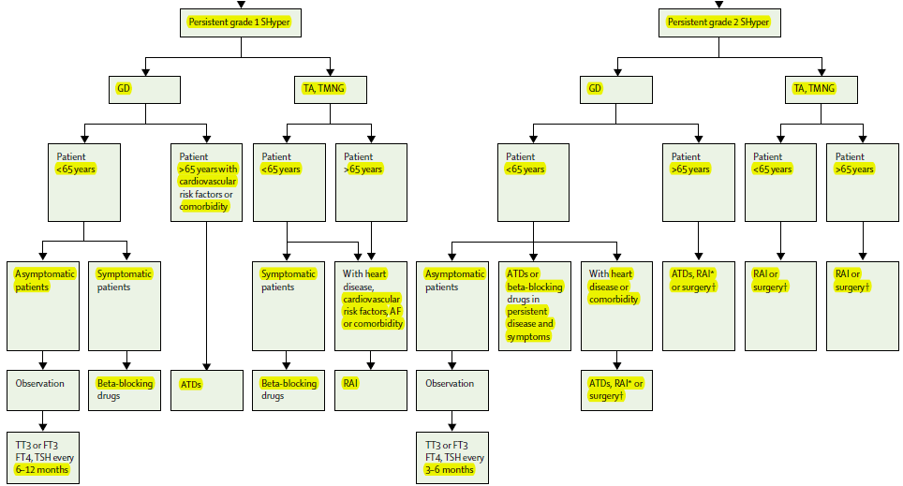

Slide 76
AGENDA
Changes in the HPT axis and regulation of thyroid hormone action during aging
Changes in thyroid function test results during aging
Diagnosis and epidemiology of thyroid disease in older populations
Thyroid function and age-associated diseases
Treatment considerations in older patients
Directions for future research

Slide 77
Thyroid function changes with age and conversely, thyroid function can alter processes and outcomes in ageing.
Determining the direction of causality is complex and challenging, but also crucial in the discussion concerning thyroid function reference ranges as well as diagnosis and treatment of thyroid disorders.

Slide 78
Collecting follow-up data on thyroid function earlier in life (ie, from 40 years of age or younger) can help to better distinguish between the causes of alterations in thyroid function due to temporal trends, changes over time, or ageing.
Several studies have shown that older people might have a tolerance to TSH concentrations beyond the upper reference range and others have associated subclinical hypothyroidism with a higher life expectancy.
In agreement with these findings, higher FT4 concentrations have been associated with adverse outcomes and decreased life expectancy within current reference ranges.

Slide 79
Future studies investigating the effect of age-specific reference ranges on outcomes relevant to thyroid function, including cardiovascular, musculoskeletal, and neurological disease, and with a focus on both TSH and FT4 serum concentrations, could lead towards optimal health ranges for thyroid function in older people.
These studies can serve to inform future trials investigating treatment thresholds for thyroid dysfunction in older adults.

Slide 80


