Slide 1
in the name of god

Slide 2
36 years old male with headache, dizziness, palpitation, tremor and sweating
Dr. Mohammad Nabi Sanaei
Resident of internal medicine
Shahid Beheshti university of medical sciences
Taleghani hospital

Slide 3
Chief complaint:
Flank pain with dizziness, palpitation, sweating and headache
Present illness:
Patient is a 35 years old male, farmer, from Rasht, who developed with sudden onset episodes of dizziness, headache, palpitation, flushing, tremor and sweating since 2.5 months ago, he also had a left side flank pain since then, his pain is constant, compressive, without any response to any condition, without refer to anywhere, due to the pain he went to a nephrologist.

Slide 4
A SBP of 170 was detected and sonography, BUN, Cr, and U/A was checked for him. Losartan 25 mg BD was started. After that his condition get worse, recurrence of attacks elevated and episodes of orthostatic changes added to his problems, his attacks repeated 1 to 3 times/week, and he disabled due to orthostatic changes, in sonography an adrenal mass was detected, so further evaluation was done and he referred here for better evaluation.
Neg. history of chest pain or syncopal attack
Neg. history of weight gain
Neg. history of weight loss, anxiety, normal apetide

Slide 5
Drug history:
Losartan 25 mg PO BD sice 3 monthes ago
Past medical history:
Decreased visual acuity since 5-6 years ago
Surgical history:
Appendectomy 17 years ago
Habitual history:
Negative smoking, opium addiction or alcohol abuse
Family history:
His father had some skin lesion same as him
His mother, three brothers and one sister are healthy

Slide 6
Physical exam:
General appearance: A young male, not ill nor toxic, awake and orient without any distress
Vital sign: BP: 120/70, Neg. tilt, PR: 78, RR:16, OT: 36.8
Wt: 85 Kg, Ht: 183 cm, BMI: 25.38 kg/m2
HEENT: NL mucosa, Neg. pigmentation, NL Conj., Flat JVP, Neg. LAP, NL Thyroid, Neg. moon face, Neg. fat pad, Pigmented nodules in iris (lisch nodule), Rt. Eye visual acuity without correction: 8/10, left eye visual acuity without correction: hand motion, left eye exotropia

Slide 7
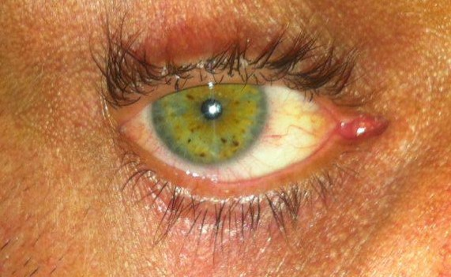

Slide 8
Lung: Clear without rale or wheeze
Heart: NL. S1 S2 without murmur
Abdomen: soft without organomegaly or tenderness
Ext.: NL without edema, Neg. skeletal deformity
Neurologic exam: MP 5/5, DTR 2/2, Neg. focal neurologic deficit
skin: axillary brown patches (axillary freckle), Neg. inguinal freckles, some brown patches with different size in chest, abdominal wall and back (café au lait) with maximum size of 2.5 * 1.5 cm in back, >6 >1*1 cm , small skin papules (neurofibroma) with maximum size of 0.8 * 0.5 cm in anterior and posterior part of trunk and upper limbs, Neg. striae

Slide 9
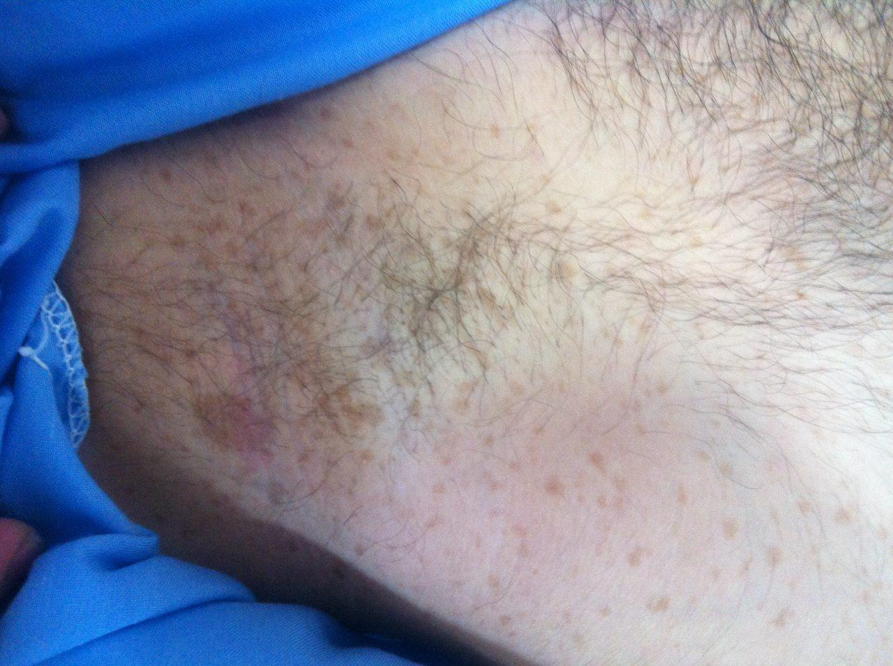

Slide 10
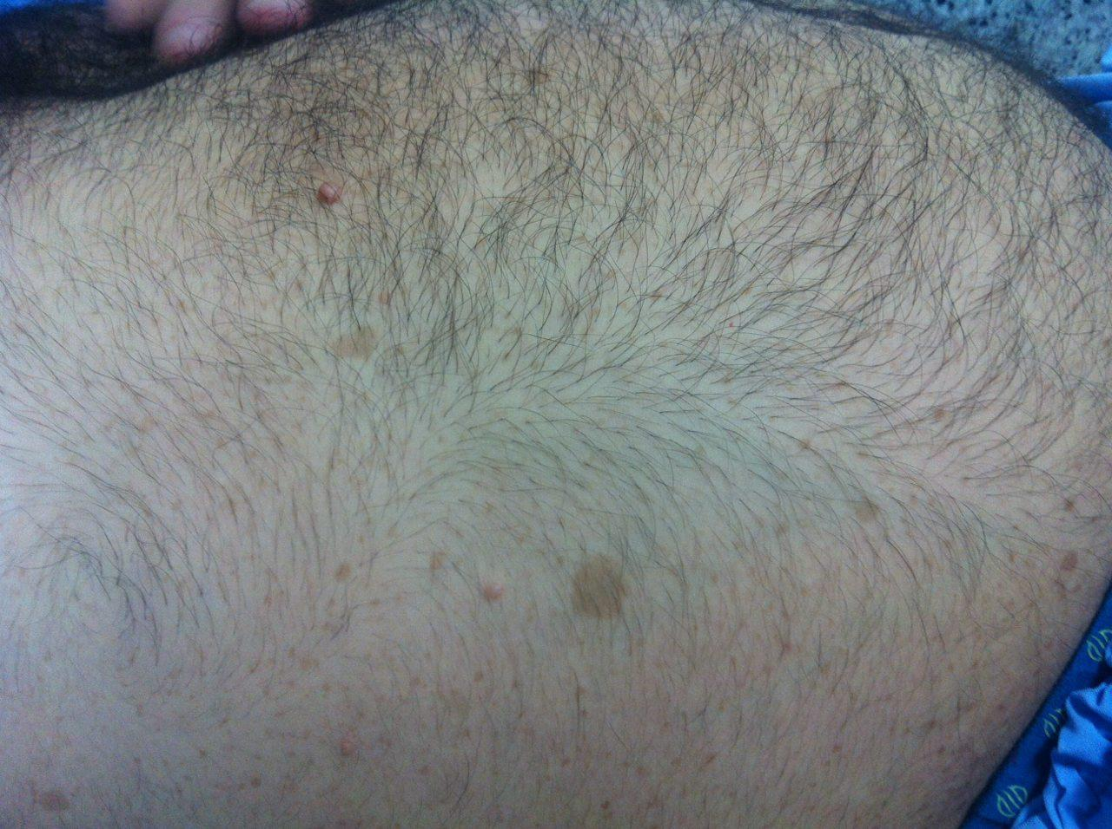

Slide 11
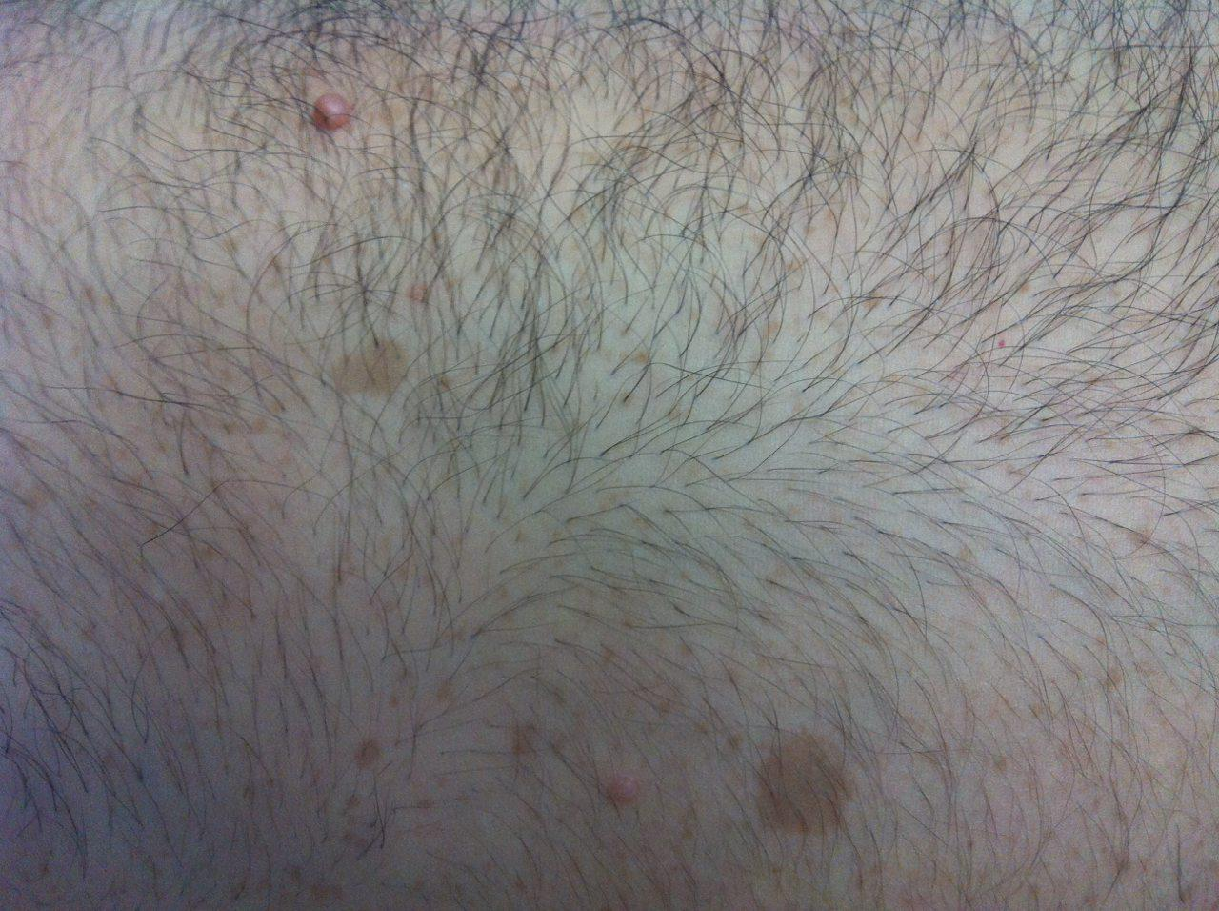

Slide 13
Lab data:
Unit | 96.8.13 | 96.7.18 | Rasht
Micro L |  | 13000 | WBC
g/dl |  | 16.4 | Hb
FL |  | 87.1 | MCV
Micro L |  | 367000 | PLT
Mg/dl | 14 | 21 | BUN
Mg/dl | 1.3 | 1.5 | Cr
Mg/dl |  | 179 | TG
Mg/dl |  | 265 | CHOL
IU/L |  | 46 | AST
IU/L |  | 48 | ALT
IU/L |  | 2.6 | TSH
Mg/dl |  | 105 | FBS

Slide 14
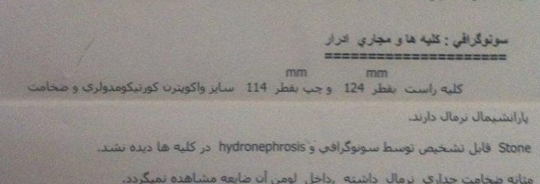

Slide 15
Range | Unit | 96.8.22 | Rasht
135-145 | Meq/L | 143 | Na
3.5-5.5 | Meq/L | 4.8 | k
 |  |  | 24 hr urin
800-1800 | ML/24hrs | 900 | volume
1000-2000 | Mg/24hrs | 1404 | Cr
10-100 | Micro gr/24hrs | 217 | Cortisol
Up to 350 | Micro gr/24hrs | 1503 | Metanephrin
Up to 13.6 | Mg/24hrs | 44 | VMA
2.8-30 | Micro gr/24hrs | 18.4 | Aldosterone
30-400 | Pg/ml | 151 | Aldosterone up.
4.5-24 | Micro gr/dl | 16.78 | Cortisol (8AM)

Slide 16
CT Scan

Slide 17
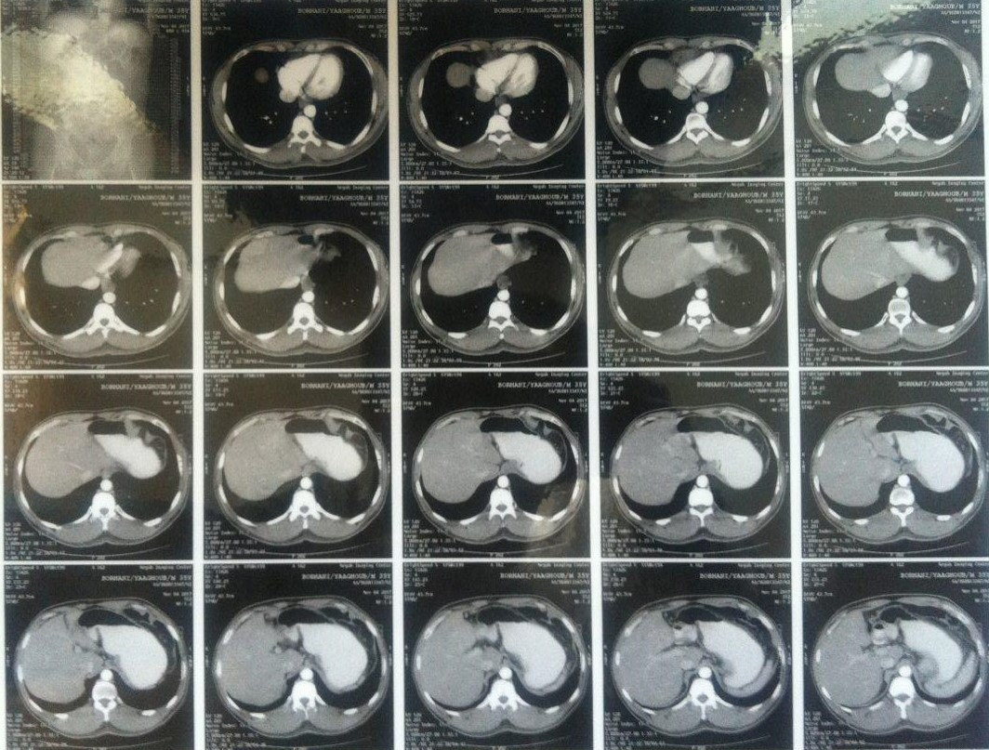

Slide 23
Here in Taleghani hospital

Slide 24
Losartan hold
Phenoxybenzamine started and elevated till 80 mg daily (Poor controlled blood pressure but minimal orthostatic changes) then changed to prazocin due to unavailability (Good controlled blood pressure but recurrent orthostatic hypotension)
Surgeon consult was done
Ophthalmologist consult was done
B-blocker and calcium channel blocker added later
Re work up

Slide 25
Range | Unit | 96/9/2 | Taleghani
4000-11000 | Micro L | 10400 | WBC
13-16 | g/dl | 16.3 | Hb
80-100 | FL | 85.9 | MCV
150-400 | Micro L | 354000 | PLT
7-20 | Mg/dl | 17 | BUN
0.7-1.4 | Mg/dl | 1.1 | Cr
135-145 | Meq/L | 141 | Na
3.5-5 | Meq/L | 4 | K
8.5-10 | Mg/dl | 8.8 | Ca
2.5-5 | Mg/dl | 3.6 | Ph
3.5-5.2 | Gr/dl | 4.9 | Alb

Slide 26
Range | Unit | 96/9/2 | Taleghani
- | Mg/dl | 286 | TG
- | Mg/dl | 209 | Chol
- | Mg/dl | 42 | LDL
- | Mg/dl | 123 | HDL
3-6 |  | 4.6 | Hb A1C
0-20 | Mm/h | 6 | ESR
0-6 | Mg/L | 4 | CRP

Slide 27
Range | Unit | 96/9/19 | 96/9/13 | 96/9/11 |  |  | Gholhak
171-536 | Nmol/L |  |  | 405 |  | Base | Cortisol 8 AM
171-536 | Nmol/L |  | 13.5 |  |  | Low dose | Cortisol 8 AM
1.6-13.9 | Pmol/L | 0.7 |  |  |  |  | ACTH
Range | Unit | 96/9/19 | 96/9/13 | 96/9/9 | 96/9/2 | 96/9/1 | Markazi
6.2-19.4 | Micro gr/dl |  |  |  |  | 10.38 | Cortisol 8 AM
7.2-63.3 | Pgr/ml |  |  |  |  | 34.6 | ACTH
5> | Micro gr/dl |  |  |  | 10.17 |  | Cortisol Dexa.
50-190 | Micro gr/24 hrs |  |  | 165 |  |  | UFC (Base)
 | Ml/24 hrs |  |  | 1400 |  |  | Volume
0.8-2 | Gr/24 hrs |  |  | 1.8 |  |  | Cr
50-190 | Micro gr/24 hrs |  | 15.4 |  |  |  | UFC (Low dose)
 | Ml/24 hrs |  | 1200 |  |  |  | Volume
0.8-2 | Gr/24 hrs |  | 1.8 |  |  |  | Cr
50-190 | Micro gr/24 hrs | 22.4 |  |  |  |  | UFC (High dose)
 | Ml/24 hrs | 2200 |  |  |  |  | Volume
0.8-2 | Gr/24 hrs | 1.4 |  |  |  |  | Cr

Slide 28
Ophthalmologist consult:
Visual acuity: right: 8/10, left: hand motion
Lisch nodules in iris
Left eye exotropia
Left eye exudative RD and possibility of choroidal metastatic leison
Right eye macular pigmentary lesion possibility of nevus
Plan: Orbit CT-Scan, refer to eye oncologist
Oncologist:
Left eye vasoproliferative tumor, need surgery after blood pressure control and discharge from endocrinology service

Slide 29
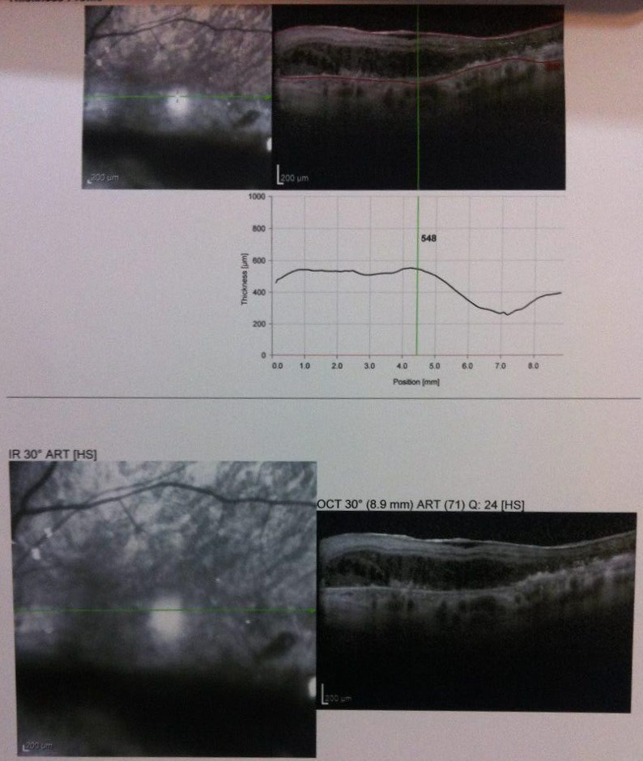

Slide 30
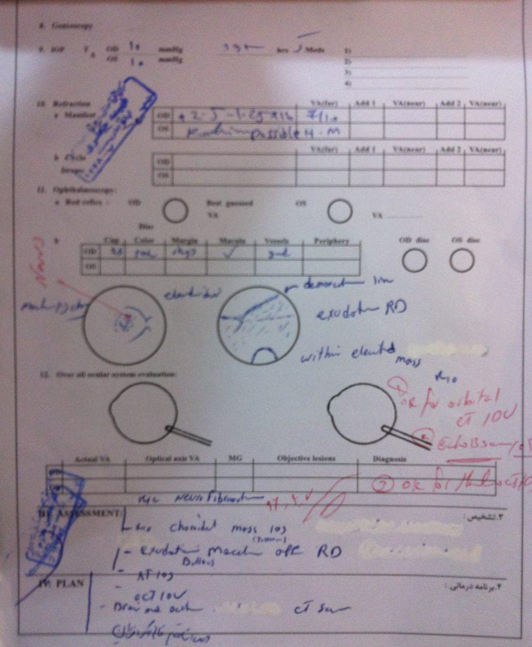

Slide 32
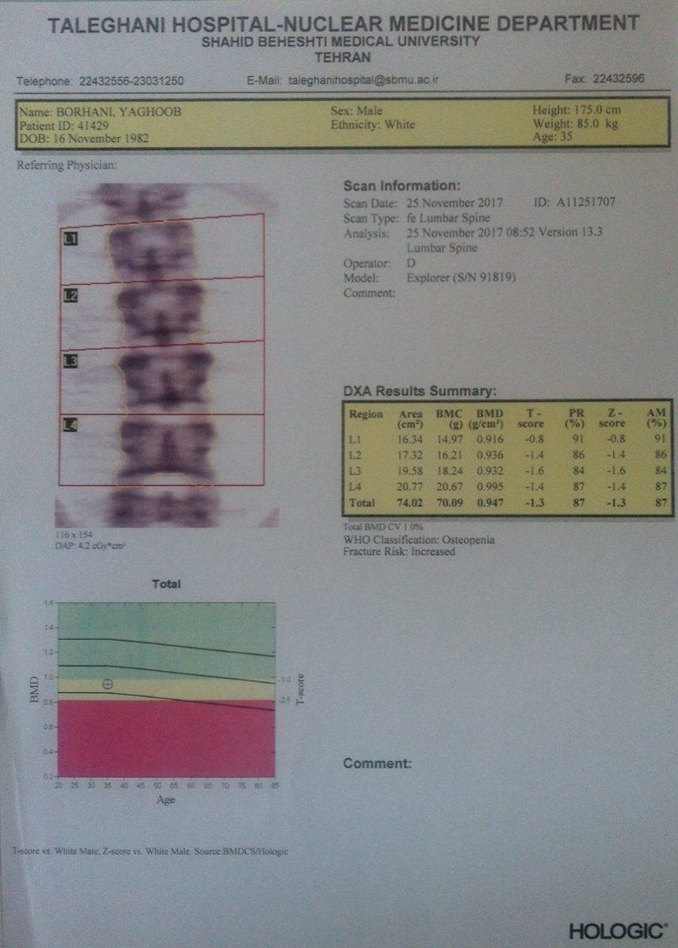
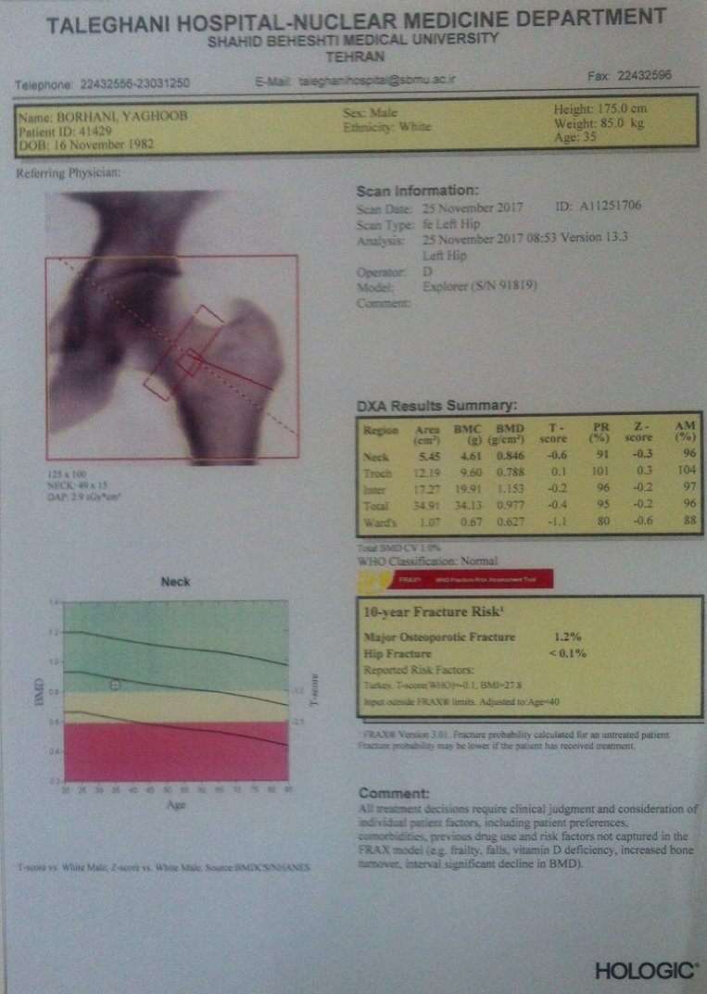

Slide 34
Summary:
A 35 years old male with flank pain and episodes of dizziness, tremor, palpitation and sweating, high blood pressure and orthostatic hypotention attacks
Lisch nodules, axillary freckles and café au laits in exam
An adrenal mass in sonography and CT-Scan
High levels of 24hrs urine metanephrine and cortisol
Retinal leisons

Slide 35
Thanks for your attention

