Slide 1

In the name of GOD
The Compassionate & The Merciful

Slide 2
Screening & diagnosis of gestational diabetes
Dr Fahimeh Ramezani Tehrani
Dr Samira Behboudi
Reproductive Endocrinology Research Center
Research Institute of Endocrine Sciences
Shahid Beheshti University of Medical Sciences

Slide 3
agenda
What is the optimal strategies for detection and diagnosis of GDM?
Universal screening vs. high risk group screening
Does screening for GDM affect infant or maternal morbidity or mortality?
Controversies issues

Slide 4

who principles of early disease detection
Condition
The condition sought should be an important health problem
There should be a recognizable latent or early symptomatic stage
The natural history of the condition, including development from latent to declared disease, should be adequately understood.
Test
There should be a suitable test or examination.
The test should be acceptable to the population.
Treatment
There should be an accepted treatment for patients with recognized disease.
Screening program
Facilities for diagnosis and treatment should be available.
The cost of case-finding (including diagnosis and treatment of patients diagnosed) should be economically balanced in relation to possible expenditure on medical care as a whole.
Case-finding should be a continuing process and not a “once and for all” project.

Slide 5
Screening vs. Diagnostic Tests
  Screening test:
    Differentiates apparently healthy BUT diseased individuals from those that probably do not have the disease
    Objective: Early detection of a disease condition in apparently healthy individuals
Diagnostic test:
  Identify and/or confirm a disease condition in individuals
  Objective: Case finding within a population that is probably “diseased”

Slide 6

Gestational
Diabetes mellitus

Slide 7
Prevalence
Prevalence
GDM affecting between 4% and 18% of pregnancies
  Racial and ethnic groups
  Testing method and diagnostic criteria
  Mean maternal age and weight

Slide 8
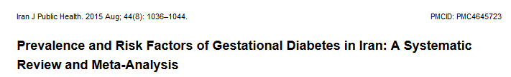
Prevalence of Gestational Diabetes in Iran
RESULTS:
Twenty-four paper
the prevalence of GDM was 3.41% (the highest and the lowest prevalence rates were 18.6% and 1.3% respectively).

Slide 9
significance
Maternal morbidity
  Early :
    Preeclampsia/gestational hypertension
    Operative delivery
    Induction of labour
    Placental abruption? Postpartum hemorrhage? Postpartum infection?
  Late :
    Diabetes type II
    Hypertension?
Perinatal-neonatal morbidity/morbidity
  Birth trauma
  Fetal organomegaly (hepatomegaly, cardiomegaly)
  Still birth, Perinatal death
  Preterm birth
  Macrosomia
  Neonatal respiratory problems
  metabolic complications (hypoglycemia, hyperbilirubinemia, hypocalcaemia)
Long term sequelae of in utero exposure
  Obesity
  Diabetes type II
  Dyslipidaemia?
  Hypertension?
  impaired fine and gross motor functions, and higher rates of inattention and/or hyperactivity

Slide 10
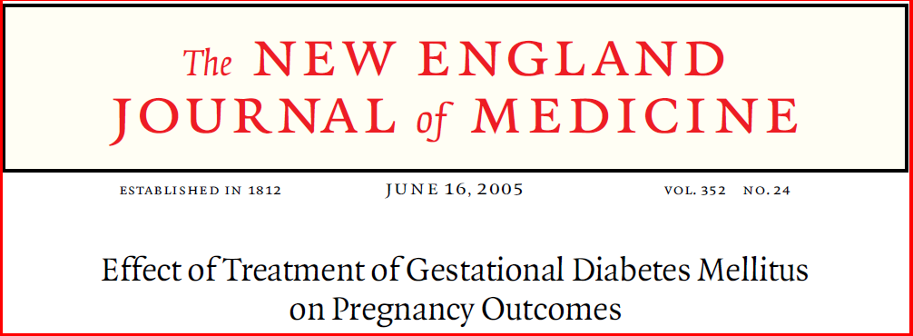
Impact of early detection & treatment
Australian Carbohydrate Intolerance Study in Pregnant Women
ACHOIS

Slide 11
Study procedure
Women between 24 and 34 weeks’ gestation who had GDM randomly assigned to 2 groups
  Intervention (receive dietary advice, blood glucose monitoring, and insulin therapy ), n=490
  Control (routine care), n=510
Primary outcomes among the infants were a composite measure of serious perinatal complications (one or more of the following: death, shoulder dystocia, bone fracture, and nerve palsy),admission to the neonatal nursery, and jaundice requiring phototherapy.
Secondary outcomes included gestational age at birth, birth weight

Slide 12
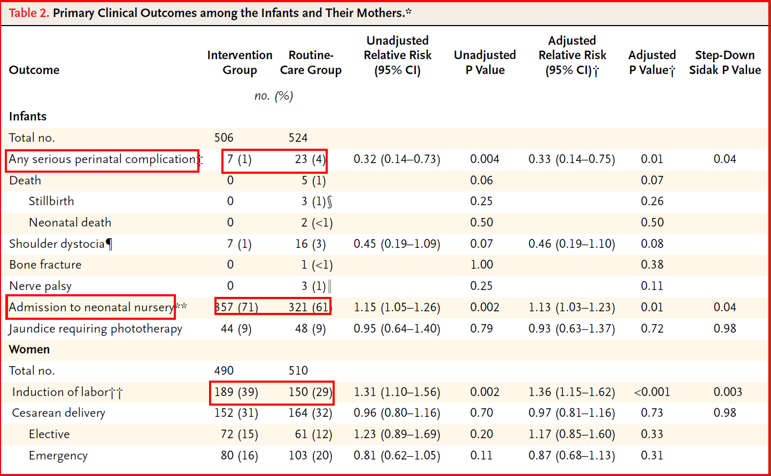

Slide 13
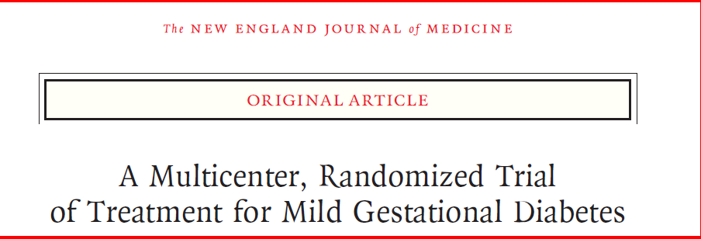
2009
Women who were in the 24th to 31st week of gestation with
mild GDM ( an abnormal result on an OGTT but a FBS < 95 mg/dl
were randomly assigned to usual prenatal care (control group) or dietary intervention,self-monitoring of blood glucose, and insulin therapy, if necessary (treatment
group).
The primary outcome was a composite of stillbirth or perinatal death and
neonatal complications, including hyperbilirubinemia, hypoglycemia, hyperinsulinemia, and birth trauma.

Slide 14
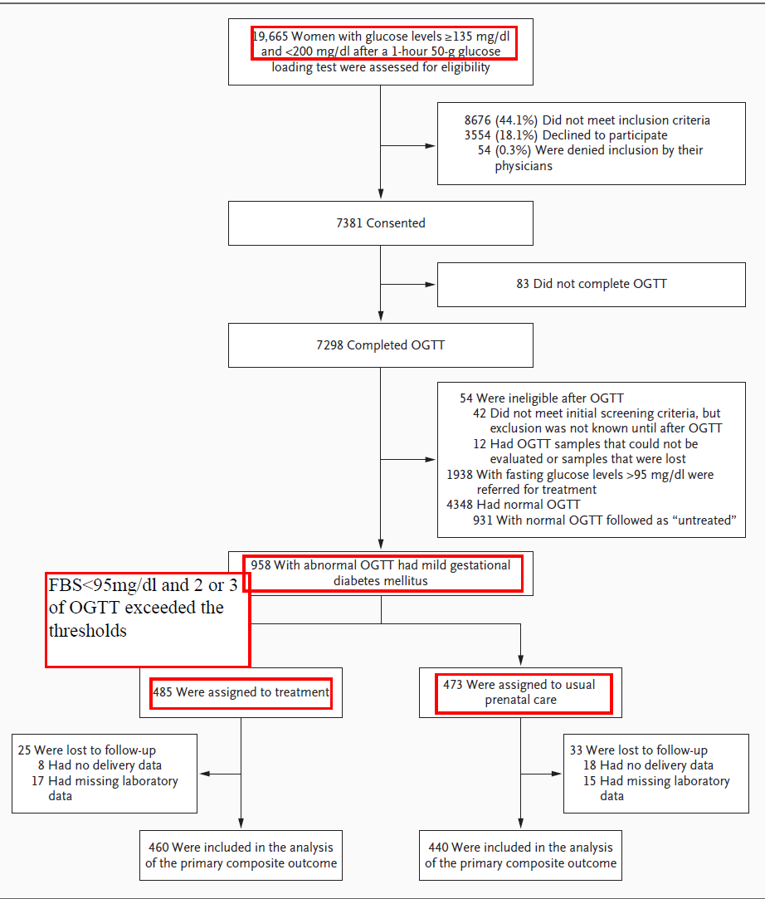

Slide 15
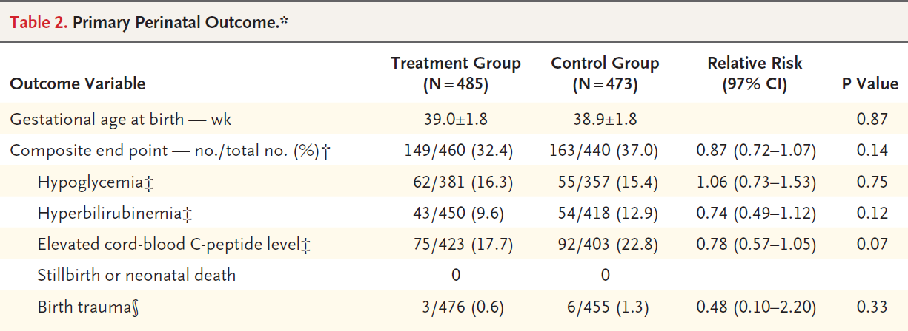
results

Slide 16

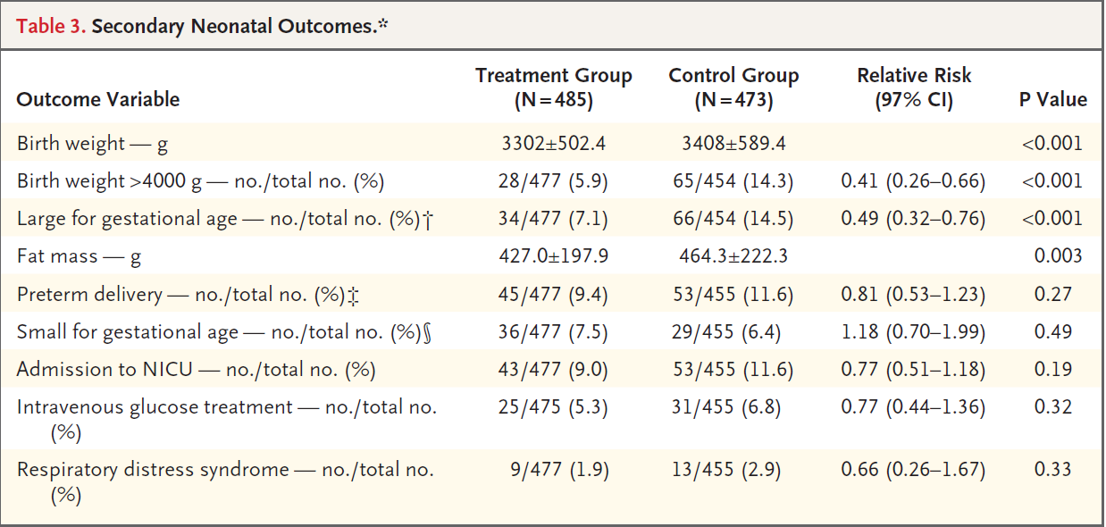
Results

Slide 17
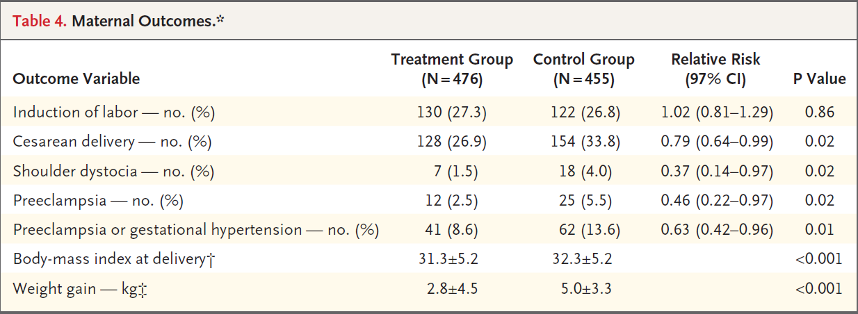
results

Slide 18
In conclusion
Although the primary composite outcome in this trial was not significantly reduced with treatment, the results of our study provide further evidence that among women with GDM normal fasting glucose levels, treatment reduces rates of fetal overgrowth, cesarean delivery, and preeclampsia.

Slide 19
No consensus on:
Optimal strategies for detection and diagnosis
Its clinical significance and benefit of treatment
Appropriate treatment goals and methods

Slide 20
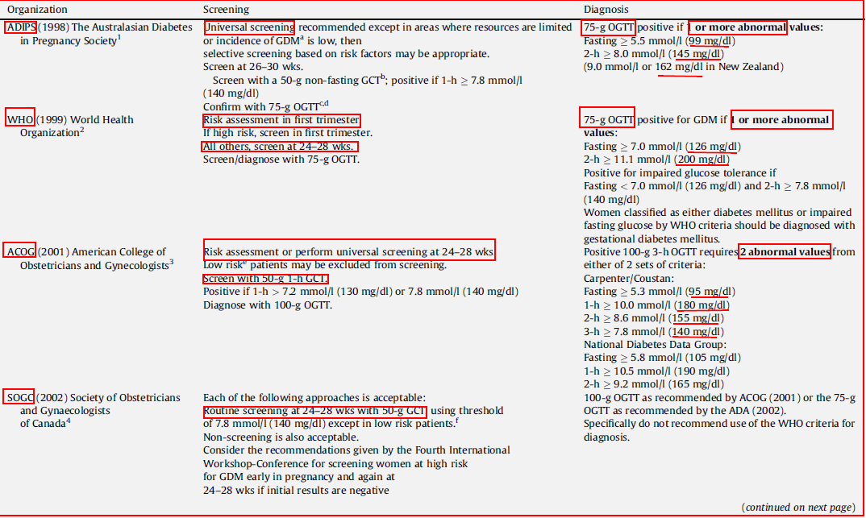

Slide 21
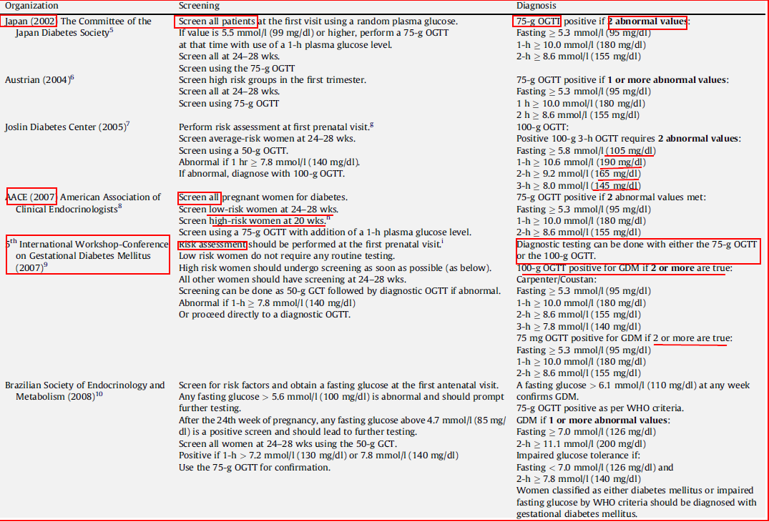

Slide 22
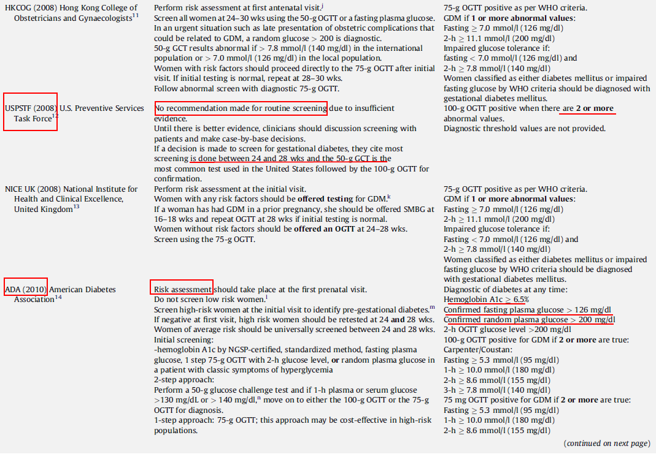

Slide 23
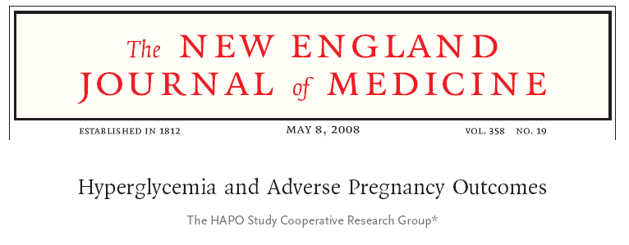
The study was planned to clarify the risks of adverse outcomes associated with various degrees of maternal glucose intolerance less severe than that in overt diabetes mellitus

Slide 24
Study procedure
25,505 pregnant women at 15 centers in nine countries underwent 75-g OGTT at 24 to 32 w of gestation
Primary outcomes were birth weight above the 90th percentile for gestational age, primary cesarean delivery, clinically diagnosed neonatal hypoglycemia and cord-blood serum C-peptide level above the 90th percentile
Secondary outcomes were delivery before 37 weeks of gestation, shoulder dystocia or birth injury, need for intensive neonatal care, hyperbilirubinemia, and preeclampsia

Slide 25
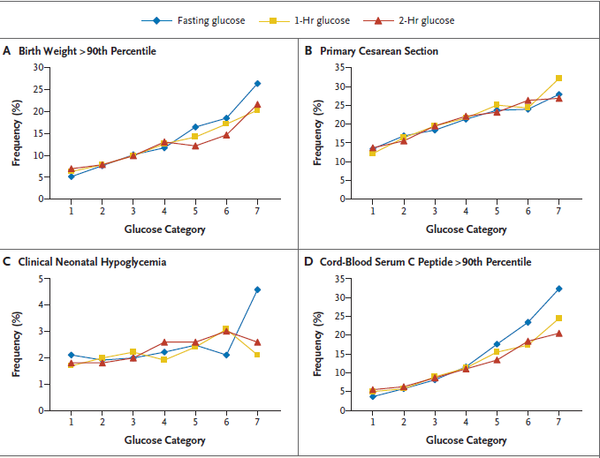
Frequency of Primary Outcomes across the Glucose Categories
Hyperglycemia and Adverse Pregnancy Outcomes NEJM 2008

Slide 26
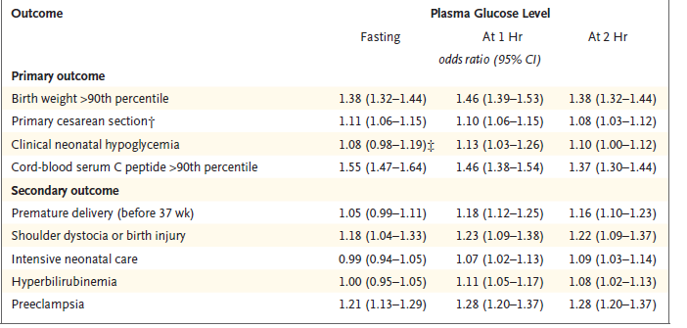
Adjusted Odds Ratios for Associations between Maternal Glycemia as a Continuous Variable and Primary and Secondary Perinatal Outcomes.*

Slide 27
conclusion
These results support that increasing glucose concentration less severe than diabetes is associated with fetal overgrowth, specifically adiposity.
A strong and continuous association between neonatal fat content and maternal glycemia and with fetal insulin levels as measured by cord C-peptide concentrations.
Relationships persisted even when potential confounding variables such as field center, BMI, height, gestational age, smoking status, and alcohol use were taken into account
The results of HAPO study need to be translated to a practical guide line

Slide 28
Screening for gdm
For whom?
What is the optimal timing?
What is the optimal modalities?
What are the optimal thresholds?

Slide 29
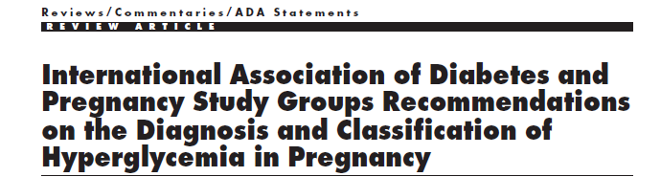

Slide 30
Definition
Previous definition
But
Increasing prevalence of obesity and lack of routine glucose screening/testing in this age group
About 10 percent of women classified as having gestational diabetes have circulating islet-cell antibodies; these women may have a "latent" form of diabetes
Gestational diabetes in lean pregnant women, need for insulin treatment of gestational diabetes, diabetic ketoacidosis during pregnancy, and postpartum hyperglycemia suggest preexisting unrecognized diabetes
Gestational diabetes has been used to define women with onset or first recognition of abnormal glucose tolerance during pregnancy

Slide 31
Who should be screened? When?
Risk assessment for GDM should be undertaken at the first prenatal visit
Women with clinical characteristics consistent
with a high risk of GDM should undergo glucose testing as soon as feasible
If negative, high risk women should be retested at 24 and 28 wks.
Other women should be universally screened between 24-28 wks

Slide 32
Risk factor for gestational diabetes
A family history of diabetes, especially in first degree relatives
Pre pregnancy weight ≥110 percent of ideal body weight or body mass index over 30 kg/m2 or significant weight gain in early adulthood , between pregnancies, early to mid pregnancy
Age greater than 25 years
Previous delivery of a baby greater than 4.1 kg
Personal history of abnormal glucose tolerance
Member of an ethnic group with higher than the background rate of type 2 diabetes (e.g. African-American, Native American, South or East Asian, Pacific Islander).
Previous unexplained prenatal loss or birth of a malformed child
Maternal birth weight greater than 4.1 kg or less than 2.7 kg
Glycosuria at the first prenatal visit
Polycystic ovary syndrome
Current use of glucocorticoids

Slide 33
Initial screening
hemoglobin A1c by NGSP-certified standardized method
fasting plasma glucose
1 step 75-g OGTT with 2-h glucose level, or random plasma glucose in a patient with classic symptoms of hyperglycemia (this approach may be cost-effective in high-risk populations)
2-step approach:Perform a 50-g glucose challenge test and if 1-h plasma or serum glucose >130 mg/dL or > 140 mg/dl,n move on to either the 100-g OGTT or the 75g

Slide 34
International Association of Diabetes and Pregnancy Study Group (IADPSG) 2010
American Diabetes Association (ADA) 2011
Overt diabetes:
1.A1C ≥6.5%. The test should be performed in a laboratory using a method that is NGSP certified and standardized to the DCCT assay (confirmed by repeat testing)
OR
2. FPG ≥126 mg/dl (7.0 mmol/l). Fasting is defined as no caloric intake for at least 8 h. (confirmed by repeat testing)
OR
3. 2-h plasma glucose ≥200 mg/dl (11.1 mmol/l) during an OGTT. The test should be performed as described by the World Health Organization, using a glucose load containing the equivalent of 75 g anhydrous glucose dissolved in water (confirmed by repeat testing)
OR
  4. In a patient with classic symptoms of hyperglycemia or hyperglycemic crisis, a random plasma glucose ≥200 mg/dl (11.1 mmol/l), subsequently confirmed by elevated fasting plasma glucose or A1C
GDM :
  FBS ≥92 mg/dl and <126 mg/dl
      1 h 180 mg/dl
      2 h 153 mg/dl

Slide 35
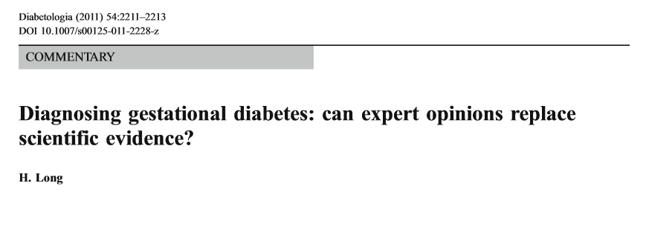
Gestational diabetes melitus
The diagnosis of GDM is made when any of the following plasma glucose values in 75 g OGTT are exceeded from:
  FBS ≥92 mg/dl and <126 mg/dl
  1 h 180 mg/dl
  2 h 153 mg/dl
These criteria:
Have lower cut-off points to diagnose GDM
will increase the prevalence of GDM: as 18% of all pregnant women will be labeled as abnormal

Slide 36
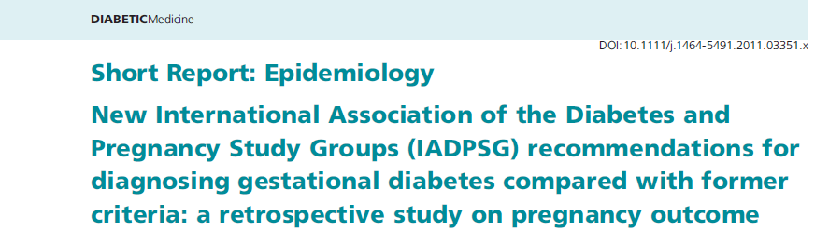

WHAT IS THE IMPACT OF LOWERING THE THRESHOLDS
in women previously classifiable as 'normal' according to the 4th International Workshop Conference on gestational diabetes criteria
but reclassified as 'abnormal' according to the new recommendations
clinical and metabolic characteristics and pregnancy outcome

Slide 37
WHAT IS THE IMPACT OF LOWERING THE THRESHOLDS
Using the new IADPSG criteria, 3953 pregnancies were retrospectively reclassified as 1815 women with normal GTT and 2138 with GD, 112 (2.8%) of whom would have been classified as normal according to the older criteria.
Caesarean section was significantly more frequent and the ponderal index for the newborn significantly higher in these reclassified women than in those classified as normal, and their basal glucose levels correlated significantly with the ponderal index

Slide 38

Cost
Benefit
Impact of screening for and treatment of mild GDM affect infant or maternal morbidity or mortality
Number of additional prenatal visits
Hospital cost
Dietician visits
Induction of labour
Insulin therapy
Additional fetal wellbeing tests
Admission in NICU

Slide 39
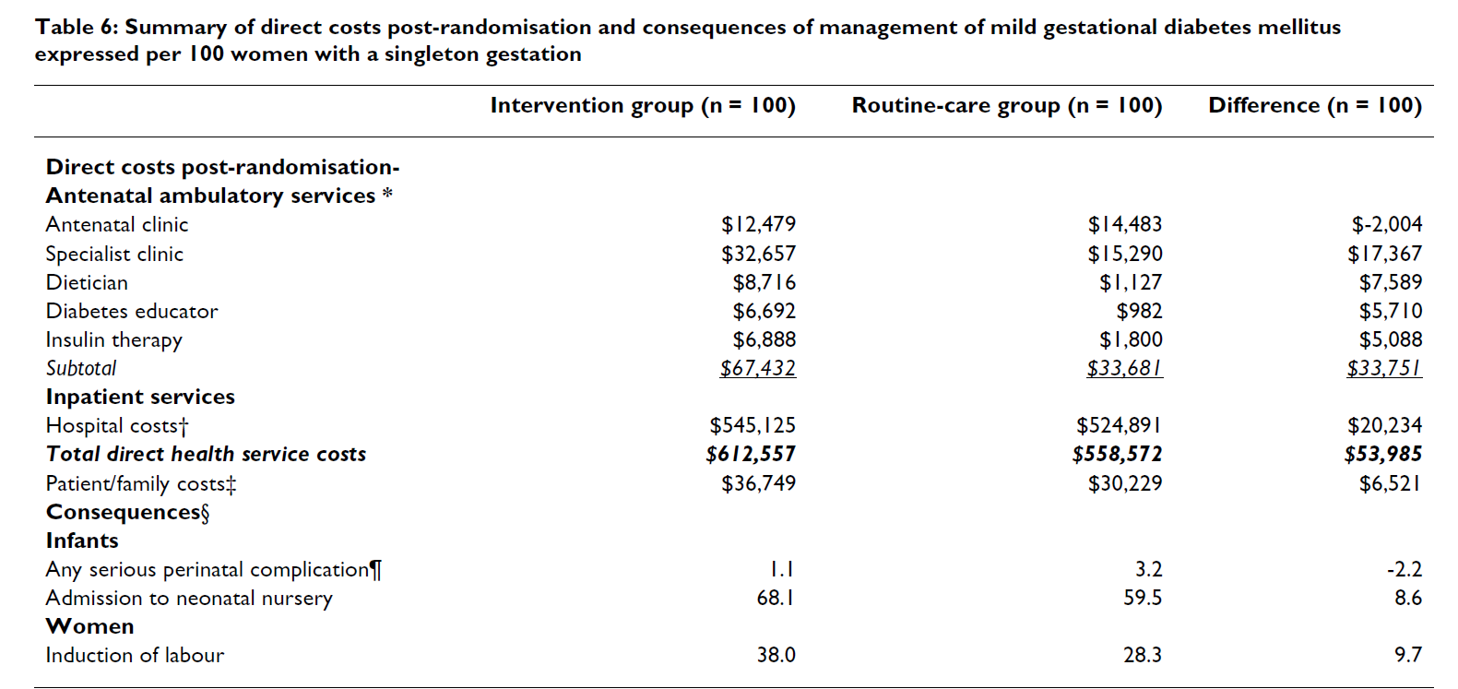
Costs and consequences of treatment for mild gestational diabetes mellitus – evaluation from the ACHOIS randomized trial
BMC Pregnancy and Childbirth 2007
$60,506
1.1
3.2
68.1
59.5
38.0
28.3

Slide 40
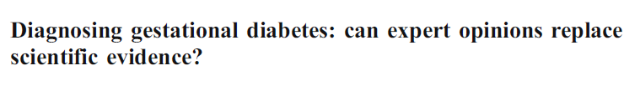

Diabetologia, 2011
An extra 1,702 cases of
GDM would have to be
Diagnosed and treated
To avoid 140 cases of LGA
21 cases of shoulder dystocia
16 cases of birth injury

Slide 41
Take home messages
First prenatal visit
  Measure FPG, A1C, or RPG on all or only high-risk women
    If results indicate overt diabetes, treatment and follow-up as for preexisting diabetes
    If results not diagnostic of overt diabetes and FPG are 92–126 mg/dL , diagnose as GDM
If results not diagnostic of overt diabetes and FPG are <92 mg/dL, test for GDM from 24–28 weeks with a 75 g OGTT
  2–h 75 g OGTT, performed after an overnight fast, on all women not previously found to have overt diabetes or GDM during testing earlier in this pregnancy:
    Overt diabetes if FPG ≥126 mg/dL (7.0 mmol/L)
    GDM if one or more values equals or exceeds thresholds
      FPG are 92–126 mg/dL
      1 h 180 mg/dl
      2 h 153 mg/dl
    Normal if all values on OGTT less than thresholds indicated
Postpartum glucose testing Should be performed for all women diagnosed with overt diabetes during pregnancy or GDM

Slide 42

Thank you

