Slide 1
Gestational DM
Pathophysiology and Epidemiology
F. Hosseinpanah
Obesity Research Center
Research Institute for Endocrine sciences
Shahid Beheshti University
of Medical Sciences
January19,2012
Tehran

Slide 2
Outline
Brief review of pathophysiology
Risk factors of GDM
Reported prevalence in Iran
Trend of obesity in Iran
Impact of new criteria on prevalence of GDM
Conclusion

Slide 3
Early pregnancy
Increased glucose-stimulated insulin secretion
Unchanged or enhanced peripheral (muscle) insulin sensitivity
Unchanged basal hepatic glucose production
Normal or slightly improved glucose tolerance
Normal sensitivity to the blood glucose–lowering effect of exogenously administered insulin

Slide 4
Late pregnancy
Rising concentrations of several diabetogenic hormones
Increased peripheral insulin resistance
Progressive increase in basal & postprandial insulin (up to 2 fold in third trimester)
lower insulin action in late normal pregnancy than in non pregnant women (50-70%)
Basal endogenous hepatic glucose production increases by 16–30%

Slide 5
Maternal-Fetal metabolism
Anabolic phase:
- Normal or increased sensitivity to insulin
- lower plasma glucose level
- lipogeneses, glycogen stores increases
Catabolic phase (Accelerated starvation):
- Maternal insuln resistance
- Increased transport of nutritients trough placental membrane
- lipolysis

Slide 6
Maternal adaptation
The maternal response is characterized by a switch from carbohydrate to fat utilization that is facilitated by both insulin resistance and increased plasma concentrations of lipolytic hormones
After an overnight fast the maternal fasting capillary whole blood glucose concentration falls , while plasma ketone and free fatty acid concentrations rise
Mother preferentially use fat (eg, free fatty acids, triglycerides, ketone bodies)
Preserve much of the available glucose and amino acids (especially alanine) for the fetus

Slide 7
Hormones associated with modifications in insulin secretion and action
Estrogens ↑ Insulin concentration
↑ Insulin binding
Progesterone ↓ Glucose transport
↓ Insulin binding
↓insulin-induced hepatic
gluconeogenesis

Slide 8
Hormones associated with modifications in insulin secretion and action….
Cortisol ↑ Insulin resistance
↓ Phosphorylation of insulin receptor
↓IRS-1
hPL, GH ↓ Insulin sensitivity
↑ Insulin secretion
↑ Insulin synthesis
↑ Utilization and glucose oxidation
↑ cAMP metabolism
↑ β-cell number
↑ β-cell mass
Leptin ↑ Insulin resistance
Glucagon ↑ Insulin resistance

Slide 9
Pathophysiology of GDM
The development of gestational diabetes is associated with a much greater severity of insulin resistance than normal pregnant wome
The degree of insulin resistance seems to be influenced by obesity & inheritance
Gestational diabetes mellitus occurs when a woman's pancreatic function is not sufficient to overcome the insulin resistance

Slide 10
Pathophysiology of GDM
The predominant pathogenic factor in GDM could be inadequate insulin secretion
GDM occurs as a result of a combination of insulin resistance and decreased insulin secretion

Slide 11
Prevalence
GDM complicates approximately 1% to 14% of all pregnancies
In low-risk populations, such as those found in Sweden, the prevalence in population-based studies is lower than 2%
in high-risk populations, such as the Native American Cree, Northern Californian Hispanics and Northern Californian Asians, reported prevalence rates ranging from 4.9% to 12.8%.
Curr Diab Rep (2010) 10:224–228

Slide 12
Reasons for differences in reported prevalence
Different diagnostic criteria
Different screening policies
Different definitions, screening strategies and awareness of type 2 diabetes
Maternal age
Racial/ethnic composition of population
Obstet Gynecol Clin North Am. 2007 June ; 34(2):

Slide 13
Definition
Any degree of glucose intolerance with onset or first recognition during pregnancy

Slide 14
New terminology
Overt diabetes
Gestational diabetes
IADPSG , 2010

Slide 15
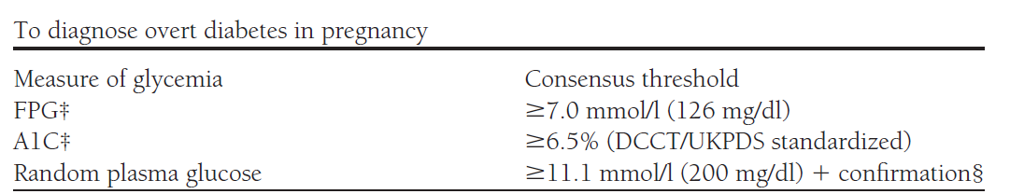
Overt Diabetes

Slide 16
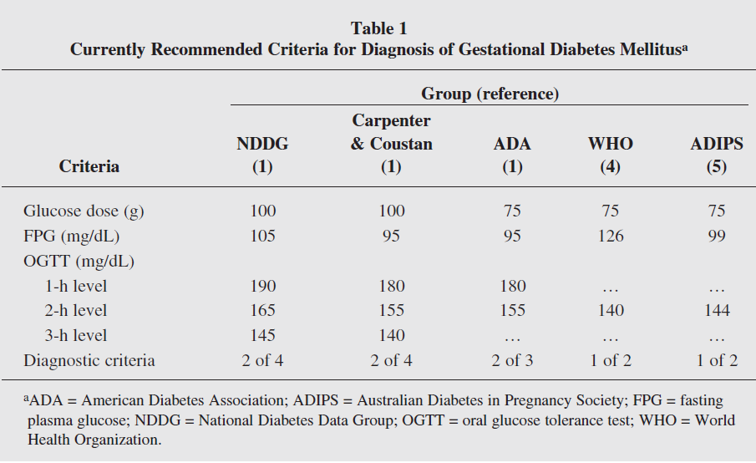

Slide 17
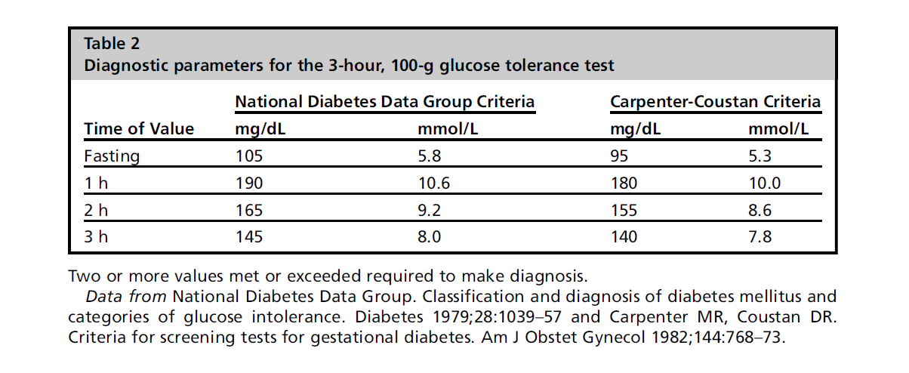

Slide 18
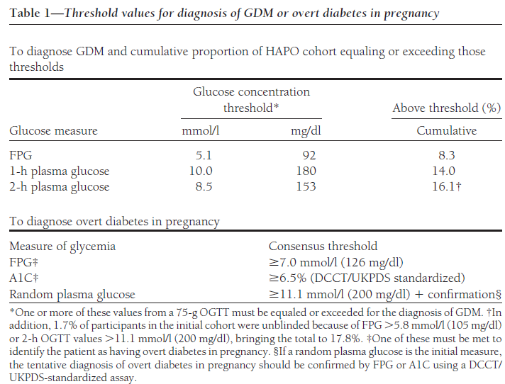

Slide 19
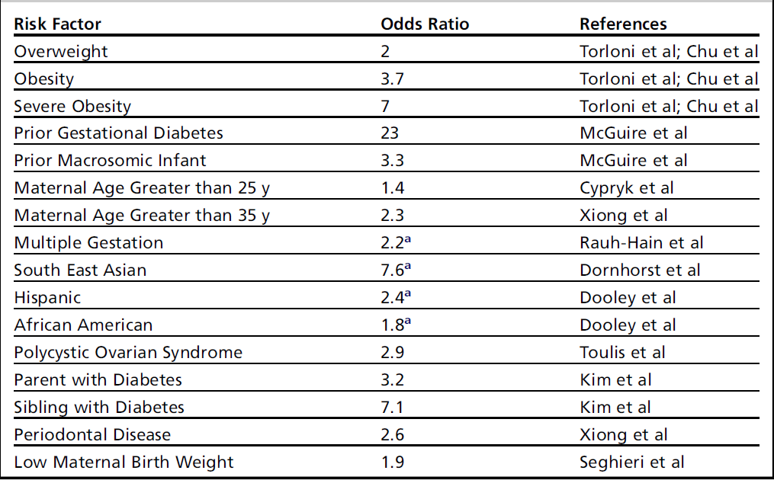
Risk factors

Slide 20
Epidemiological studies in Iran
Larijani B, et al. Cost analysis of different screening strategies for gestational diabetes mellitus. Endocr Pract 2003;9:504–509.
Keshavarz M, et al. Gestational diabetes in Iran: incidence, risk factors and pregnancy outcomes. Diabetes Res Clin Pract 2005;69:279–286.
Hadaegh F , et al. Prevalence of gestational diabetes mellitus in southern Iran (Bandar Abbas City). Endocr Pract 2005;11:313–318.

Slide 21
Epidemiological studies in Iran..
Hossein-Nezhad A et al , Prevalence of gestational diabetes mellitus and pregnancy outcomes in Iranian women.Taiwan J Obstet Gynecol. 2007 Sep;46(3):236-41
Maghbooli Z et al ,Relationship between leptin concentration and insulin resistance .Horm Metab Res. 2007 Dec;39(12):903-7
Shirazian N et al, Comparison of different diagnostic criteria for gestational diabetes mellitus based on the 75-g oral glucose tolerance test: a cohort study . Endocr Pract 2008 Apr;14(3):312-7
Shirazian N et al , Screening for gestational diabetes: usefulness of clinical risk factors .Arch Gynecol Obstet. 2009 Dec;280(6):933-7

Slide 22
Prevalence% | Sample size | Diagnostic method | Year | Author
4.7 | 2416 | 50&100g GTT | 2003 | Tehran | Larijani
8.9 | 800 | 50&100g GTT | 2005 | Bandar-abbas | Hadaegh
4.8 | 1310 | 50&100g GTT | 2005 | Shahrood | Keshavarz
4.7 | 2416 | 50&100g GTT | 2003 | Tehran | Hosseinnezad
7 | 741 | 50&100g GTT | 2007 | Tehran | Maghbooli
6.1 | 670 | 75g GTT | 2008 | Tehran | Shirazian
7.4 | 924 | 75gGTT | 2009 | Tehran | Shirazian

Slide 23
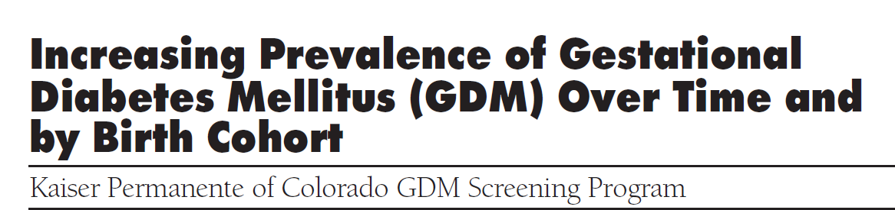
This report is based on 36,403 KPCO singleton pregnancies occurring between 1994 and 2002 and examines trends in GDM prevalence among women with diverse ethnic backgrounds
Diabetes Care 28:579–584, 2005

Slide 24
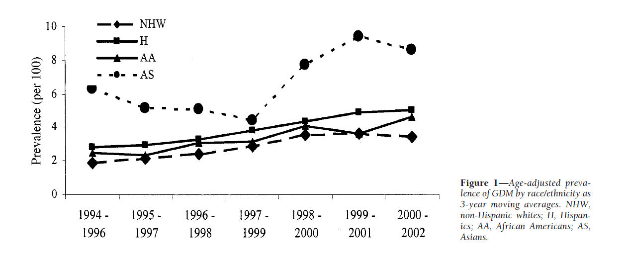
The prevalence of GDM among KPCO members doubled from 1994 to 2002
(2.1– 4.1%, P 0.001)

Slide 25
Key messages
Prevalence of GDM is increasing in a universally screened multiethnic population
Given the etiology of type 2 diabetes , the observed increase probably reflects the well-documented obesity epidemic

Slide 26
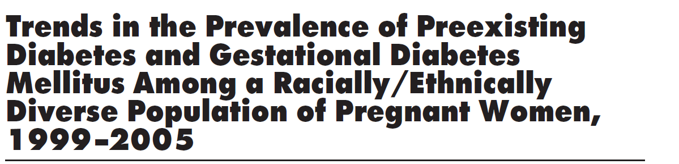
The age- and race/ethnicity-adjusted prevalence of preexisting diabetes during pregnancy doubled during the 7-year study period
The prevalence of GDM was quite similar in 1999 and 2005. It rose until 2002 but then declined to the previous level
Diabetes Care 31:899–904, 2008

Slide 27
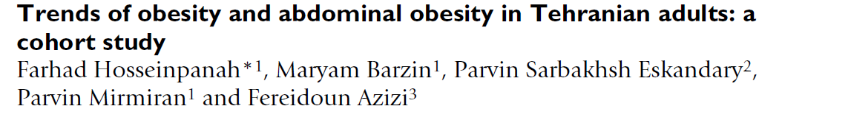
To examine trends of obesity and abdominal obesity among Tehranian adults during a median follow-up of 6.6 years.
BMC Public Health 2009, 9:426

Slide 28
Trend in females
 | Obesity | Central obesity
Phase I | 31.5 % | 76.7%
Phase II | 37.7% | 83.8%
Phase III | 38.6% | 83.6%

Slide 29
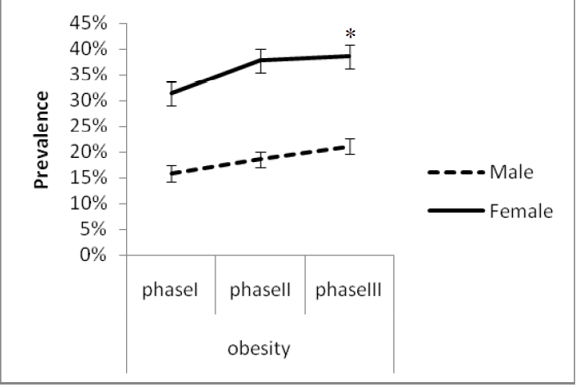

Slide 30
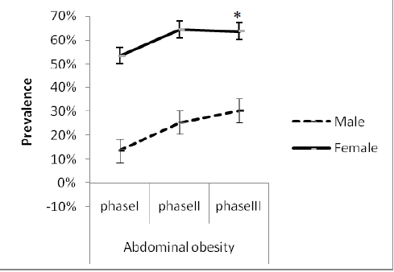

Slide 31
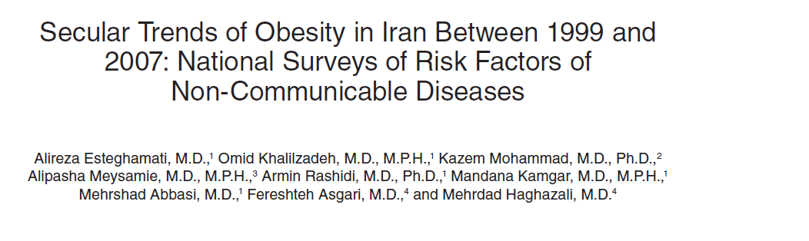
To determine secular trends of overweight and obesity among Iranian adults (25–64 years old) within an 8-year period (1999–2007)

Slide 32
 | 0verweight | Obesity
1999 | 32.2% | 13.6%
2005 | 35.8% | 19.6%
2007 | 36.3% | 22.3%

Slide 33
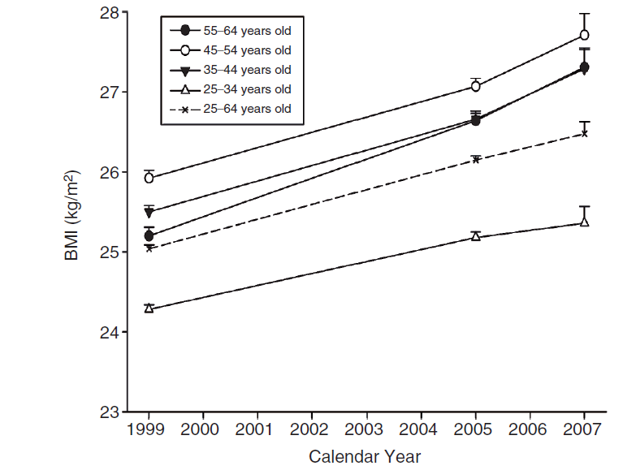
25.3
26.14
26.47

Slide 34
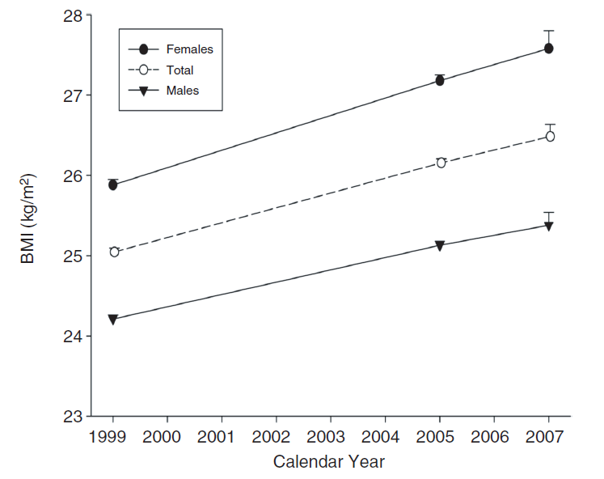

Slide 36
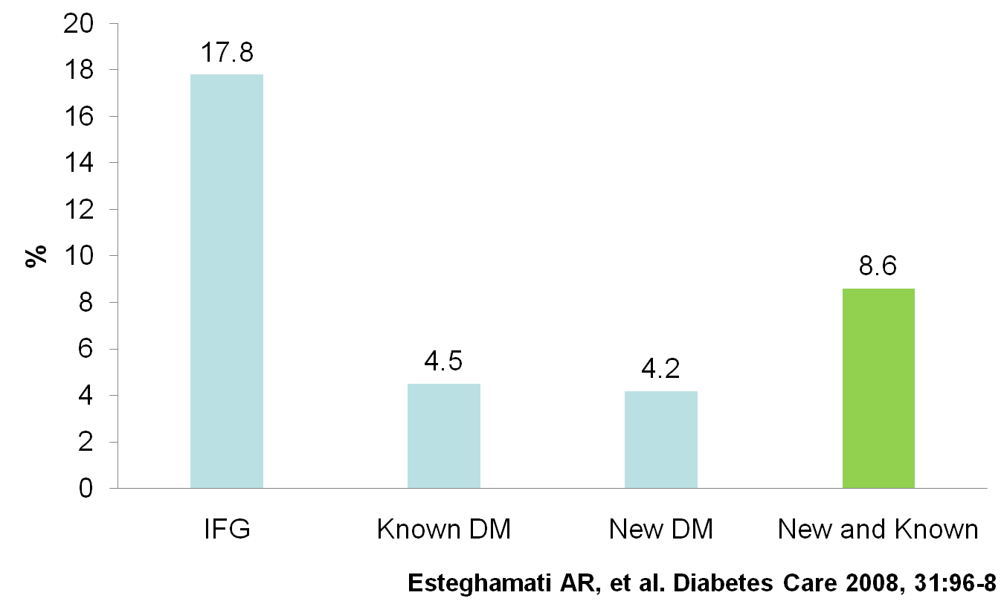
Prevalence of Diabetes and Impaired Fasting Glucose in the adult (20-64 years) urban population of Iran

Slide 37
Incidence rate of Type 2 diabetes in the adult population (≥20 years) of Tehran

Slide 38
There is no report regarding the trend of GDM in Iran !?

Slide 39
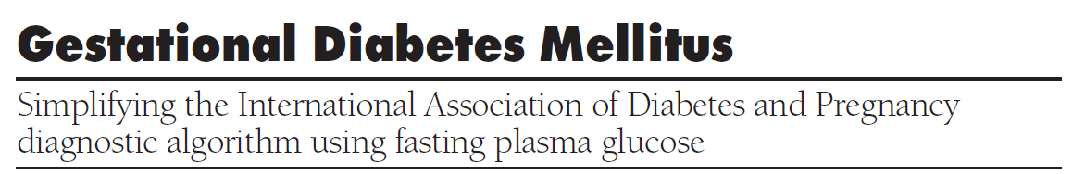
Aim: Impact of new IADPSG criteria on diagnosis of GDM compared with ADA criteria
Diabetes Care 33:2018–2020, 2010

Slide 40
Method
Sample Size: 1283 pregnant women
Universal screening with 75gOGTT at 24-28weeks of gestation
ADA and new IADPSG criteria were applied

Slide 41
Results
ADA criteria identified 12.9%women with GDM
ADPSG criteria identified 37.7% women with GDM

Slide 42
Key message
The IADPSG criteria increased GDM prevalence nearly threefold

Slide 43

Clinical and metabolic characteristics, and pregnancy outcome, in women previously classifiable as ‘normal’ according to IWC criteria, but reclassified as ‘abnormal’ according to the new recommendations were assessed
Diabet. Med. 28, 1074–1077 (2011)

Slide 44
Methods
Using the new IADPSG criteria, 3953 pregnancies were retrospectively reclassified as 1815 women with normal glucose tolerance and 2138 with gestational diabetes, 112 (2.8%) of whom would have been classified as normal according to the older criteria

Slide 45
Results
The women reclassified to ‘IADPSG—gestational diabetes’ were younger than those in the ‘IWC—gestational diabetes’ group and had a lower pre-pregnancy BMI.

Slide 46
Caesarean section was significantly more frequent (P < 0.01) and the ponderal index for the newborn significantly higher in these reclassified women than in those classified as normal (P < 0.0001)
 | ‘IWC—gestational diabetes’ | Reclassified group | IADPS G-normal’
Cesarean section | 40.9% | 43.6% | 31.1%
Ponderal index | 2.80±0.39 | 2.95± 0.61 | 2.77± 0.34

Slide 47

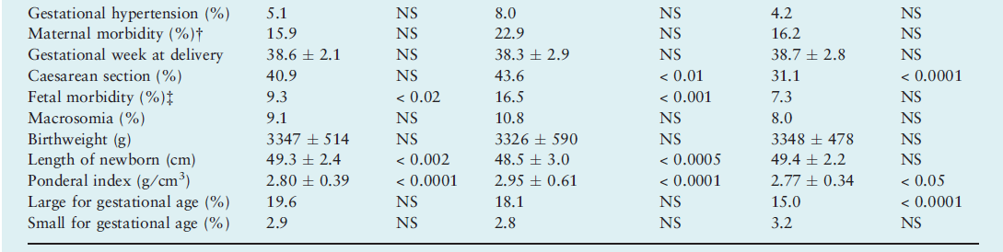

Slide 48
Key message
The new criteria for diagnosing GDM identified a group of women previously classifiable as normal according to IWC , but revealing metabolic characteristics and pregnancy outcomes resembling those of women who would have been considered to have GDM by the previous criteria

Slide 49
Conclusion
Pregnancy is characterized by insulin resistance and hyperinsulinemia, thus it may predispose some women to develop diabetes
Gestational diabetes occurs when pancreatic function is not sufficient to overcome the insulin resistance created by changes in diabetogenic hormones during pregnancy
Prevalence of GDM in a population is reflective of the prevalence of type 2 diabetes in that population

Slide 50
Conclusion
The prevalence of GDM in Iran varies between 4.7% and 8.9% ,which represents a moderate prevalence rate, compared with figures reported elsewhere
Based on increasing trend of obesity in Iran, it seems that the prevalence of GDM is also increasing ??
The IADPSG criteria can increases GDM prevalence

Slide 51

Thank you for your attention

