Slide 2


Research Institute
For
Endocrine Sciences
Tehran, I.R. Iran

Slide 3
Research Institute for Endocrine Sciences SBUMS
Department
Of
Endocrinology
Endocrine
Clinics
9
Research
Centers
Tehran Lipid and
Glucose Study
Research
Laboratories

Slide 4
Research Centers of Research Institute for Endocrine Science
The Endocrine and Metabolism Research Center
The Research Center for the Prevention of Metabolic Disorders
The Research Center for Prevention and Treatment of Obesity
The Research Center for Reproductive Endocrinology
The Research Center of Nutrition and Endocrine
The Research Center of Cellular and Molecular Endocrinenology
The Research Center of Endocrine Physiology
The Research Center for Determinants of Health
Research Development Center for Endocrinology
Medical Laws and Ethics Research Center

Slide 5
Department of Endocrinology
Teaching endocrinology first began in 1979 in the Department of Internal Medicine at Taleghani Hospital in Tehran. Since 1986, the Department of Endocrinology began its mission independently.
As of 1985, the department had begun training endocrinologists as the first post-specialety training in Iran. Headed by Professor Fereidoon Azizi

Slide 6
Golden Mondays for 30 years
On Monday mornings, between 07:30-08:30 AM, a journal club is held under the directorship of Professor Azizi in an evidence-based format in English, which has been as a successful pattern at the university.
Ward round with all attending physicians, fellows and residents is held for 2 hours.
A weekly conference is also held every Monday between 11:00-12:00 AM with the presence of all attending physicians and the fellows.

Slide 7
Clinics
The Endocrinology Clinics visit patients every Saturday, Sunday, Tuesday, and Wednesday in an out-patient basis with the visits done by the attending physicians, fellows, residents and students.
In line with the above clinics serve at least 150 outpatient visit weekly

Slide 8
The RIES SBMU Research laboratories
The RIES Research Lab is divided into three labs:
1) Biochemistry Lab: Routine and specialized bio-chemistry tests, including bio-chemical analyses and enzyme activities
2) Endocrinology Lab: Classic endocrines tests
3) Basic Research Lab : Endocrine receptors, cytokines, metal ions etc.

Slide 9
Research Institute for Endocrine Sciences
Shahid Beheshti University of Medical Seciences
National Endocrine Laboratory
Acting as:
Reference laboratory for national programs of IDD & DM
Designing and preparation of endocrine diagnostic kits
Training of endocrine laboratory personnel both nationally and regionally

Slide 10
Research Institute for Endocrine Sciences
Shahid Beheshti University of Medical Sciences
Manpower Training
  Subspecialty Training in Endocrinology
    Graduate training program offered to 6 specialists in internal medicine for 2 years
  PhD in Molecular Medicine
  PhD in Research
  Continuing Medical Education for:
GP's & internists
Weakly grand rounds
Weakly journal clubs
Monthly endocrine conferences

Slide 11
Research Institute for Endocrine Sciences
Shahid Beheshti University of Medical Seciences
Workshops (National and International)
Iodine Deficiency Disorders
Diabetes Mellitus
Obesity
Research methodology
Management of endocrine disorders

Slide 12
موضوعات مطرح شده در رابطه با پیشگیری از بیماری‌های تیروئید
پیشگیری ابتدایی و اولیه
1. اصلاح کمبود ید
2. قطع مصرف دخانیات
3. ارتباط مصرف الکل و پرکاری تیروئید
پیشگیری ثانویه
1. کم‌کاری مادرزادی تیروئید
2. اختلالات زیربالینی تیروئید
3. تشخیص سرطان تیروئید با اولتراسونوگرافی
4. غربالگری تیروئید گره‌دار با کالسی‌تونین
5. غربالگری با RET
6. غربالگری تیروئید در حاملگی
7. افتالموپاتی گریوز
پیشگیری ثالثیه
8. بیماری‌های یاتروژنیک
9. حاملگی و اختلالات تیروئید
10. توقف بیماری با مراقبت‌های مطلوب

Slide 13
Guideline of the American Thyroid Association for the diagnosis and Management of Thyroid Disease during Pregnancy and Postpartum
The American Thyroid Association Taskforce on Thyroid Disease During Pregnancy and postpartum
Alex Stargnaro-Green (Chair), Marcos Abalovich, Erik Alexander, Fereidoun Azizi,
Jorge Mestman, Roberto Negro, Angelina Nixon, Elizabeth N. Pearce, Office P. Soldin, Scott Sullivan and Wilmar Wiersinga
84 Questions
76 Recommendations
Thyroid 2011; 21: 1081-1125

Slide 14
HOW SHOULD GRAVES’ HYPERTHYROIDISM BE TREATED IN LACTATING WOMEN?
Methimazole in doses up to 20-30 mg daily is safe for lactating mothers and their infants.
PTU is a second-line agent due to concerns about severe hepatotoxicity, but is safe for lactating mothers and their infants in doses up to 300 mg daily.
Azizi F et al J Endocrinol Invest 2006; 29:244
Azizi F et al. J Ped Endocrinol Metab 2003; 16: 1239
Azizi F et al. J Clin Endocrinol Metab 2000; 85: 3233

Slide 15
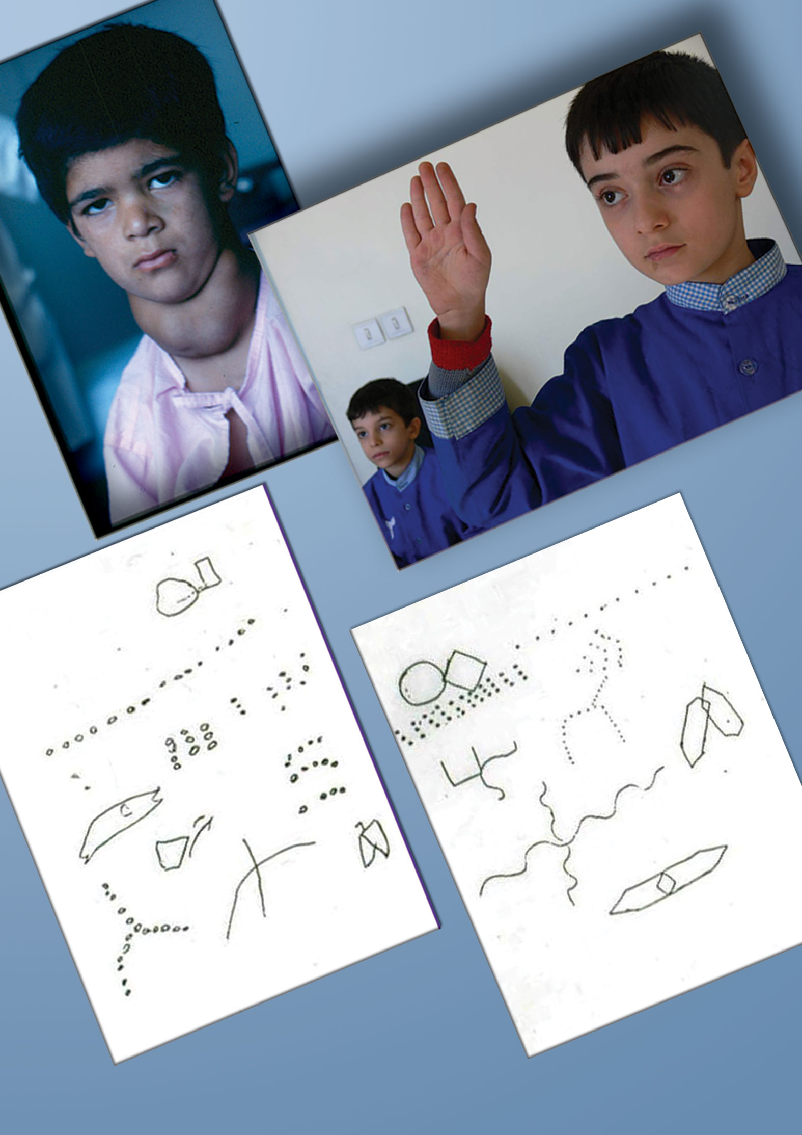

Slide 16
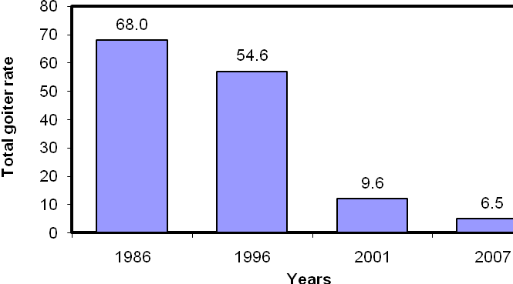
Median urinary iodine excretion in 4 national surveys in the I.R.Iran
Total goiter rate in 4 national surveys in the I.R. Iran
Azizi F. Thyroid International 2009;4:1

Slide 17
تاثير حذف كمبود يد در
سلامت جامعه ايراني
پيشگيري از بروز گواتر در بيش از 25 ميليون متولدين 23 سال اخير
افزايش 66،000،000 ضريب هوشي در كودكان و نوجوانان
صرفه جويي 17،500،000،000،000ريال
(12،000،000،000 يورو) در هزينه هاي بهداشتي درماني

Slide 18
وضعیت ید ادرار بزرگسالان (تهران، 88-1387)
Nazeri P, Mirmiran P, Mehrabi Y, et al. Thyroid 2010; 20: 1399-1406.

Slide 19
کاستی های میانه ید ادرار دانش آموزان در
استان های مختلف کشور (1388)
میانه ید ادرار کمتر از 100 میکروگرم در لیتر:
        آذربایجان غربی (72)، خوزستان (86)، لرستان (91)، تهران (97)
ید ادرار بیشتر از 50 میکروگرم در لیتر در بیش از 20 درصد نمونه ها
        آذربایجان غربی، خوزستان، لرستان، تهران
        زنجان، سیستان و بلوچستان، قم، همدان
سئوال: وضعیت تغذیه در مادران باردار چگونه است؟

Slide 20

Tehran Lipid
and
Glucose Study

Slide 21
Study design
The Tehran Lipid and Glucose Study was designed in two phases. Phase I was a cross sectional study conducted between 1999 and 2001. Phase II began in 2001 as a prospective study. The reference population in this study consists of individuals aged 3 years and over living in District 13 in Tehran.
Notes:
16

Slide 22
Age distribution of men and women participated in the Tehran Lipid & Glucose Study
Age groups (years) | Phase 1 (1999-2001) |  | Phase 4 (2011-2013)
 | No. | Percent | No. | Percent
3-9 | 1372 | 9.1 | 482 | 3.8
10-19 | 3265 | 21.8 | 1454 | 11.3
20-29 | 2297 | 15.3 | 2372 | 18.5
30-39 | 2665 | 17.8 | 2098 | 16.4
40-49 | 2012 | 13.4 | 2295 | 17.9
50-59 | 1595 | 10.6 | 1769 | 13.8
60-69 | 1342 | 8.9 | 1316 | 10.3
≥ 70 | 475 | 3.1 | 1036 | 8.1
<20 |  | 31 |  | 15
20-49 |  | 47 |  | 53
>50 |  | 22 |  | 32
Total | 15005 | 100
Notes:
17

Slide 23
Study Design” phase I
Invitation to TLGS unit
by social workers
Reception
(Demographic data acquisition)
Lab (blood sampling for
biochemical tests of
serum glucose and lipids)
Anthropometry
(plus ECG for >30 years cases)
Collecting complete past medical history,
BP, Thyroid exam and dietary habit
Outcome
measurements

Slide 24
برنامه ريزي براي اجراي طرح
در سه مرحله
اول: بررسي عوامل خطر و پيامدها قبل از مداخله
دوم: مداخله براي اصلاح شيوه زندگي
سوم: بررسي عوامل خطر و پيامدها پس از مداخله

Slide 25


TLGS Cohort
63.2 %
Phase 1
Phase 2
Phase 3
Phase 4
Phase 5
1380-1377
1384-1380
1387-1384
1390-1387
1390 -….
15005
57.9 %
71.9 %
71.0 %
?
Continuous NCD outcomes follow-up

Slide 26
The physical activity of men and women aged over 25 years
Women
Men
Azizi F et al. Soc Prev Med 2002; 47: 408-26

Slide 27
Notes:
18

Slide 28
Cumulative frequency of cardiovascular risk factors in adults including hypertension, generalized obesity, central obesity, smoking, diabetes mellitus, total cholesterol≥240 mg/dl, LDL cholesterol≥160, HDL cholesterol<35, and triglycerides≥400mg/dl in Tehranian adult population, Tehran Lipid and Glucose study
5
4
3
2
1
0
≥
Azizi F et al. Soc Prev Med 2002; 47: 408-26

Slide 29
High prevalence of diabetes and abnormal glucose tolerance in adult population (≥20 years) of Tehran
Hadaegh F. et al. BMC Public Health 2008. 8:176

Slide 30
Rostambeigi et al. Diab Res Clin Pract 2010; 88: 117

Slide 31
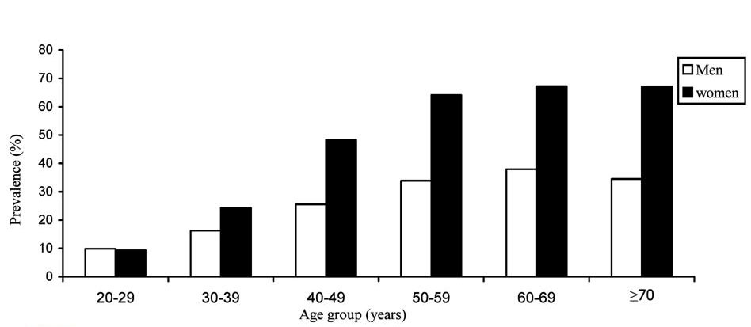
Age- specefic prevalence of metabolic
syndrome by sex in Tehran’s adult population
The unadjusted prevalence of the metabolic syndrome in the study population was 30.1% (CI_{95%} : 29.2-31.0)
F. Azizi et al. Diabet Res Clin Prac 2003;61(1):29 -37

Slide 32
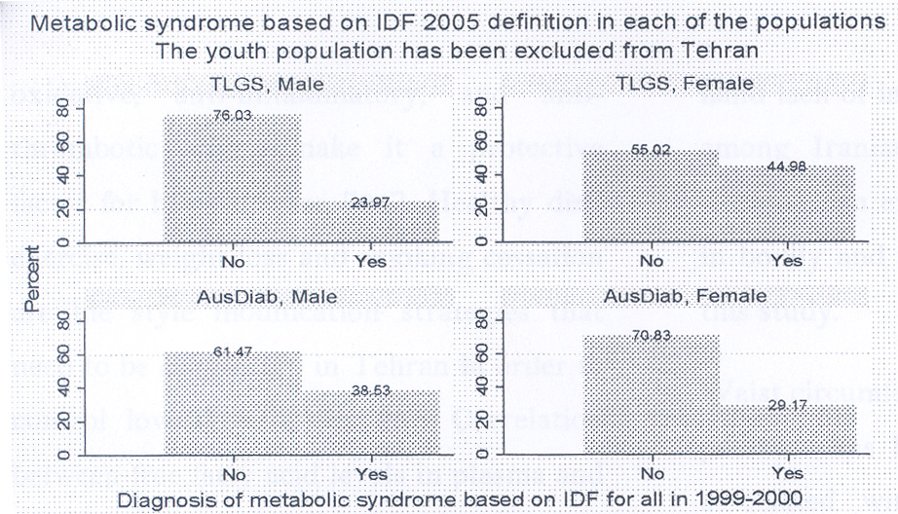
The Prevalence of metabolic syndrome based on IDF 2005 definition in TLGs and AusDiab studies
Rostambeigi et al. Diab Res Clin Pract 2010; 88: 117

Slide 33
PHASE II: Intervention
LIFE STYLE MODIFICATION
TO PREVENT :
NON-COMMUNICABLE DISEASES AND NCD RISK FACTORS
Design: A Controlled Field Trial

Slide 34
طرح ملي قند و ليپيد تهران
طرح ويژه “ تغيير در شيوه زندگي
مرکز تحقيقات غدد درون ريز
دانشگاه علوم پزشکي شهيد بهشتي

Slide 35
از سال 1381 مرحله دوم طرح آغاز شده و جمعيت اوليه به دو گروه تقسيم شده‌اند. در 5000 نفر مداخلات براي اصلاح شيوه زندگي از طريق آموزش براي تغيير در عادات غذايي و افزايش فعاليت بدني و حذف مصرف سيگار به همراه پيشگيري ثانويه براي افراد مبتلا به عوامل خطرساز NCD انجام مي‌شود.

Slide 36
پيشگيري اوليه
Primary Prevention
● تغيير در عادات غذايي
● افزايش فعاليت بدني
● ترك دخانيات
● كاهش استرسها و تطابق با آنها

Slide 37
پيشگيري ثانويه
Secondary Prevention
● كاهش ليپيدهاي سرم
● درمان فشار خون
● كنترل ديابت
● كاهش وزن, تغذيه, فعاليت بدني
● ترك دخانيات
● آسپيرين

Slide 38
پيامدها
تكرار مطالعات KAP
مطالعات تغذيه اي و فعاليت بدني
اندازه گيري : Surroguates
    وزن , BMI,WHR, مصرف دخانيات , فشارخون , گلوكز و
    ليپيدهاي سرم , EKG, سوالات Rose
Outcomes
    CVD اثبات شده , MI
    عوارض ديابت
    سرطانها
    مرگ

Slide 39
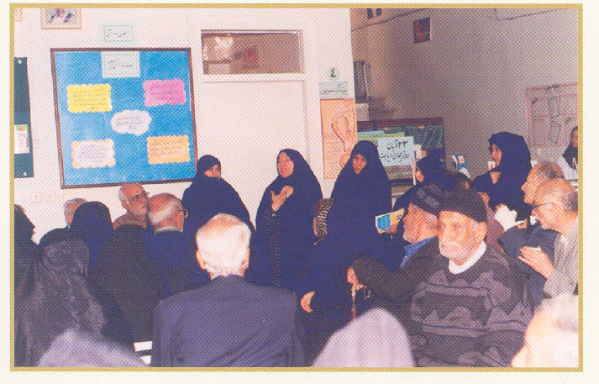
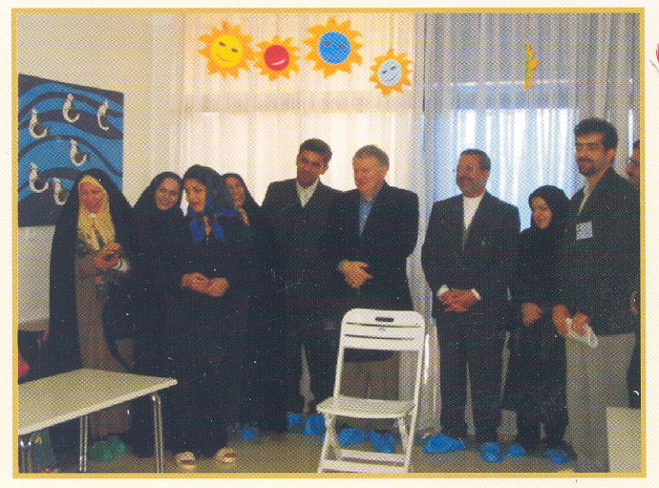
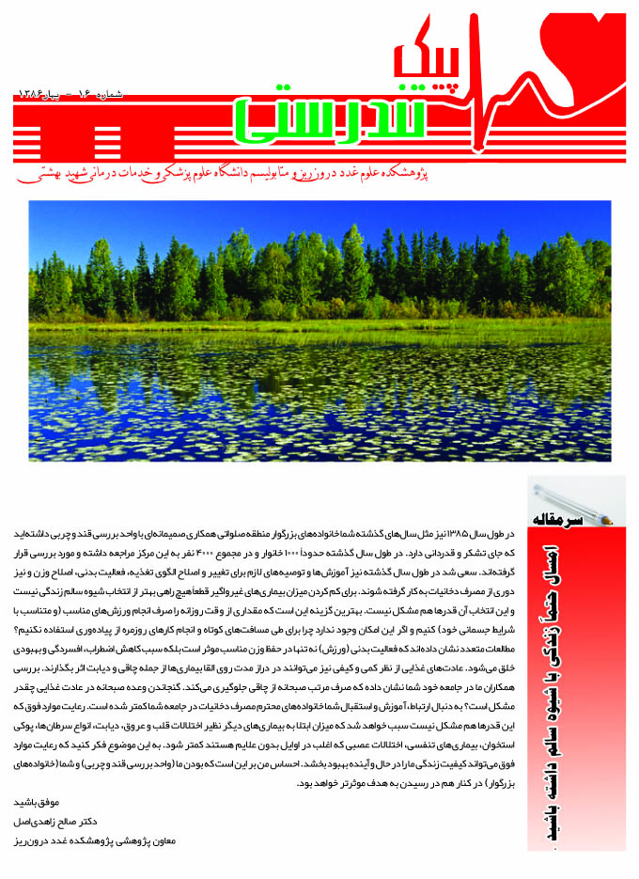
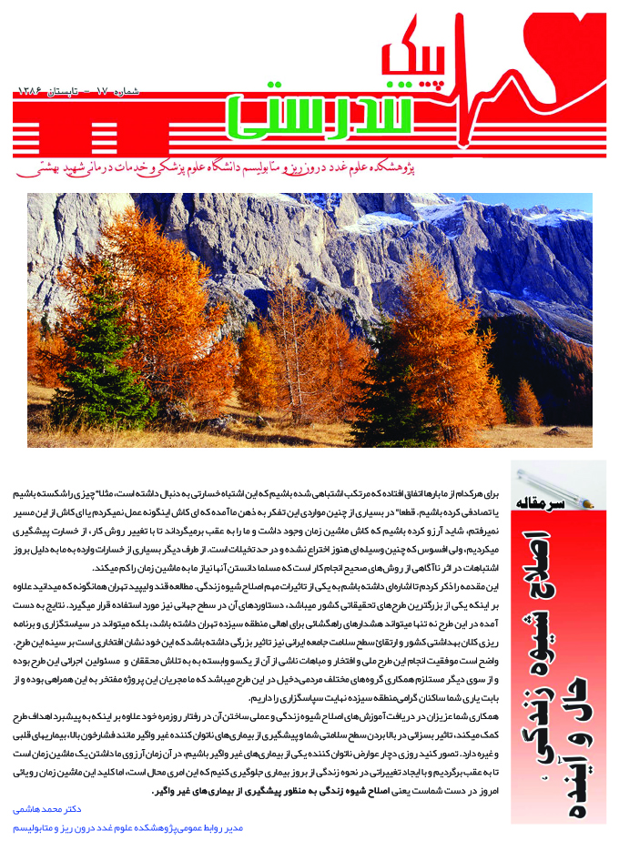
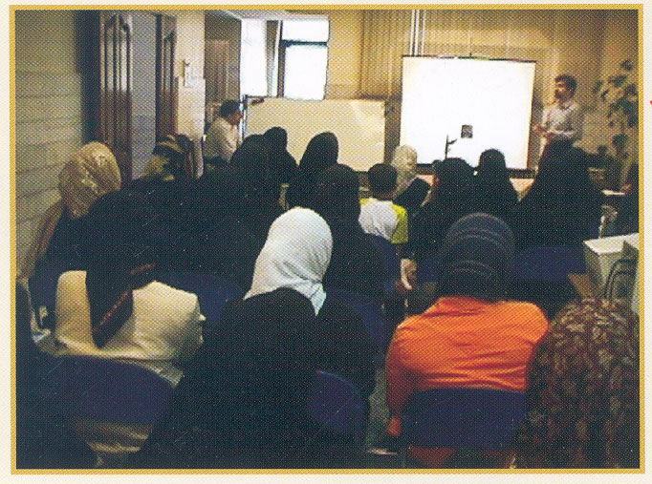

Slide 40
Allocation
People under coverage of the Salavati health center, approximately 1200 families consisting of 5000 individuals were allocated to the groups targeted for intervention. The remaining, approximately 10,000 subjects, under coverage of the other two health centers, served as controls.

Slide 41
Intervention
Lifestyle intervention has been directed towards changes: in nutritional habits, increase in physical activities, decrease in cigarette smoking, and better management of stress
Azizi F, et al. Trials 2009; 10:5

Slide 42

Changes in Control
Cohort

Slide 43
Incidence rate of type 2 diabetes in the adult population (≥20 years) of Tehran
Harati H, et al. BMC Public Health 2009

Slide 46
Modifiable
risk
factors
Important in causality
Important in public health

Slide 47
Modifiable
risk
factors
Important in causality
Important in public health
* میزانی که زمان تا Event را کم می کند.
† اگر حذف شود چند درصد Event در جامعه کم می شود.

Slide 48
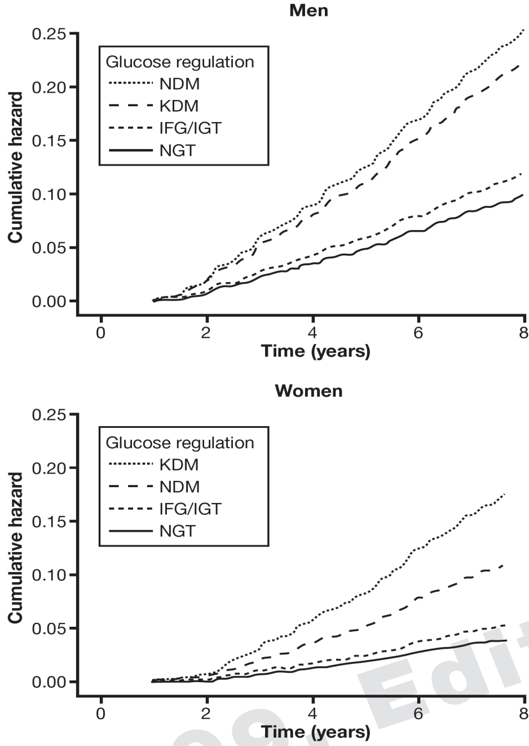
Age-adjusted cumulative hazard of cardiovascular disease
for glucose regulation categories
In both genders NGT and IFG/IGT categories had relatively the same cumulative hazards. In the male population, there was no difference between NDM and KDM categories regarding the cumulative hazards of CVD; however, in women the KDM category had higher cumulative hazard than the NDM category.
NGT: normal glucose tolerance
IFG/IGT: impaired fasting glucose or impaired glucose tolerance
NDM: newly diagnosed diabetes mellitus
KDM: known diabetes mellitus
Hadaegh et al. J Endocrinol Invest 2009; 9: 724

Slide 49
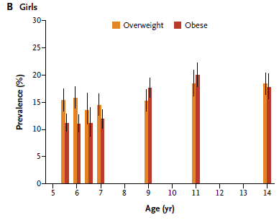
Trend of overweight and obesity prevalence among children in USA and Tehran
USA
TLGS

Slide 50
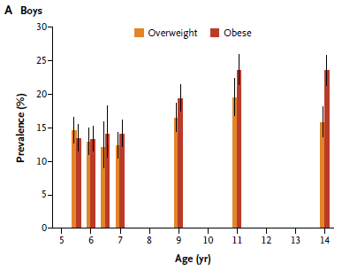
Trend of overweight and obesity prevalence among children in USA and Tehran
USA
TLGS

Slide 51
Cumulative incidence of obesity from baseline through fifth phase of TLGS, according to weight in baseline, and risk ratio for overweight versus normal weight children
Variable | Normal weight at baseline (N= 557) | Overweight at baseline (N=47) | Risk ratio for overweight vs. normal weight (95% CI)
 | Cumulative incidence (95% CI) | Cumulative incidence (95% CI)
 | % | %
All children | 18.8 (15.2-22.4) | 51.3 (35.6-67.0) | 4.55 (2.33-8.90)
Boys | 22.0 (16.6-27.4) | 50.0 (28.1-71.9) | 3.55 (1.34-9.02)
Girls | 15.7 (11.0-24.4) | 52.6 (30.7-74.5) | 5.95 (2.26-15.63)

Slide 52
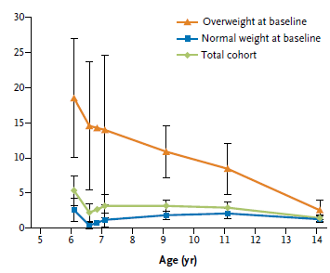
Annual incidence of overweight and obesity among children between phase 1 and phase 4 according to baseline weight
USA
TLGS

Slide 53
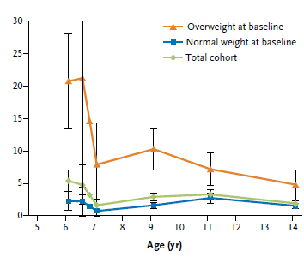
Annual incidence of overweight and obesity among children between phase 1 and phase 4 according to baseline weight
USA
TLGS

Slide 54
Changes following
lifestyle modification

Slide 55
Intervention
Control

Slide 56
Results
The change in the prevalence of metabolic syndrome components
Over the time in cases and controls
Prevalence (%)
Cases
Controls

Slide 57
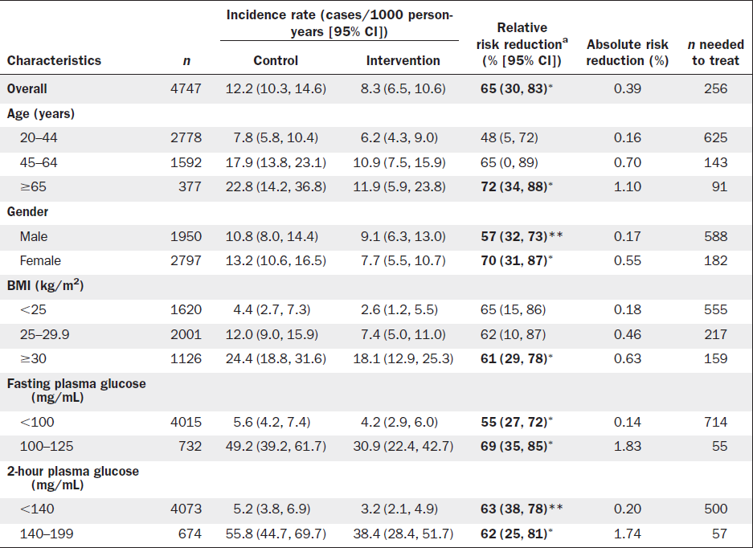
Harati et al. Am J Prev Med. 2010 Jun;38(6):628-636.e1.

Slide 58

Daily Cigarette Smoking (men)

Slide 59
Scientific Achievements of ERC
Articles : 1128
Published in International English Journals 568
Published in Scientific Farsi Journals 560
Books Published in English 6
Books Published in Farsi 25
Research Proposals (ongoing) 115
Research Proposals (accomplished) 600
International Research collaboration 30

Slide 60
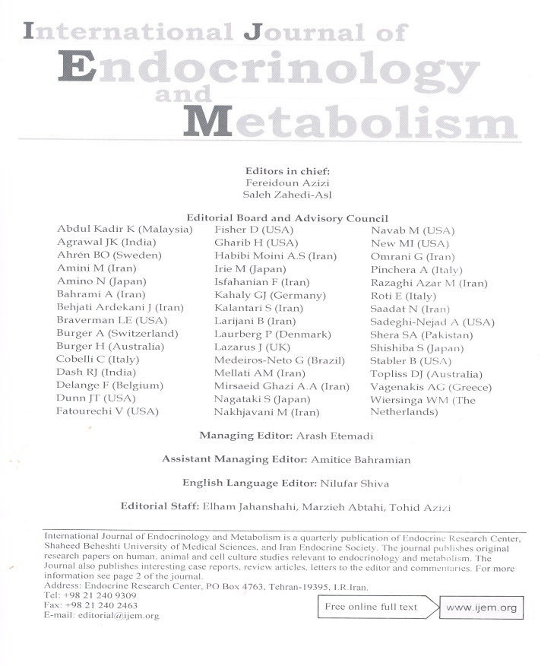
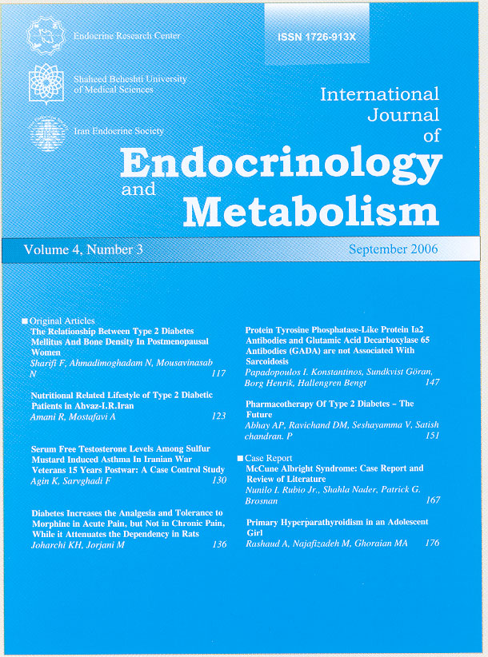
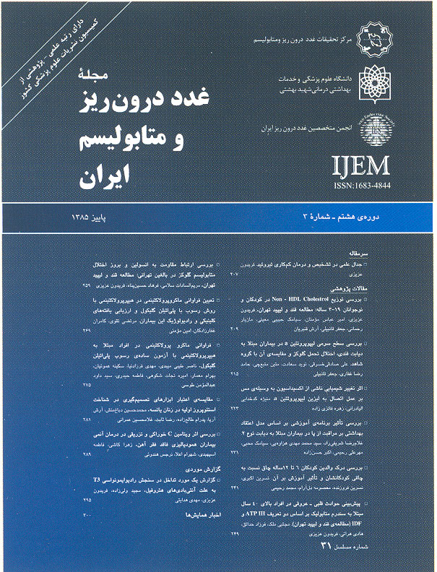

Slide 61
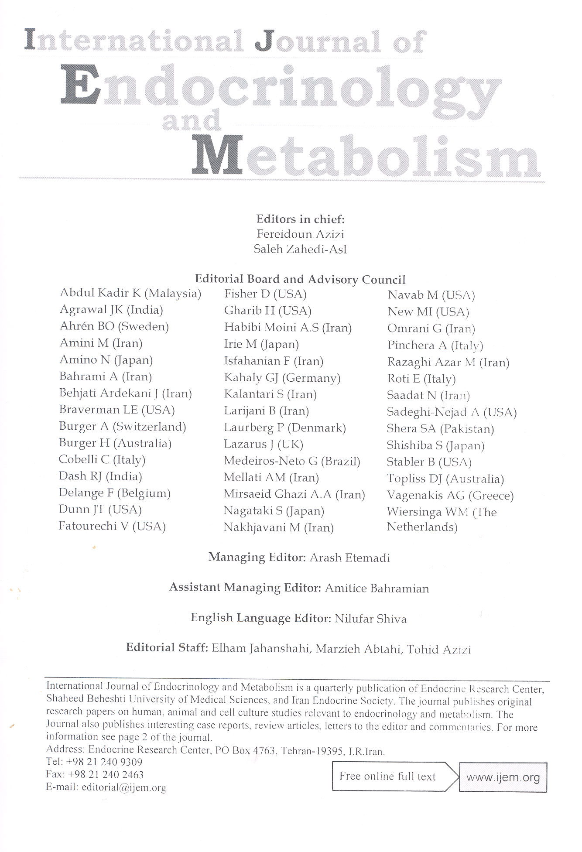
با آمتياز علمي پژوهشي

Slide 62

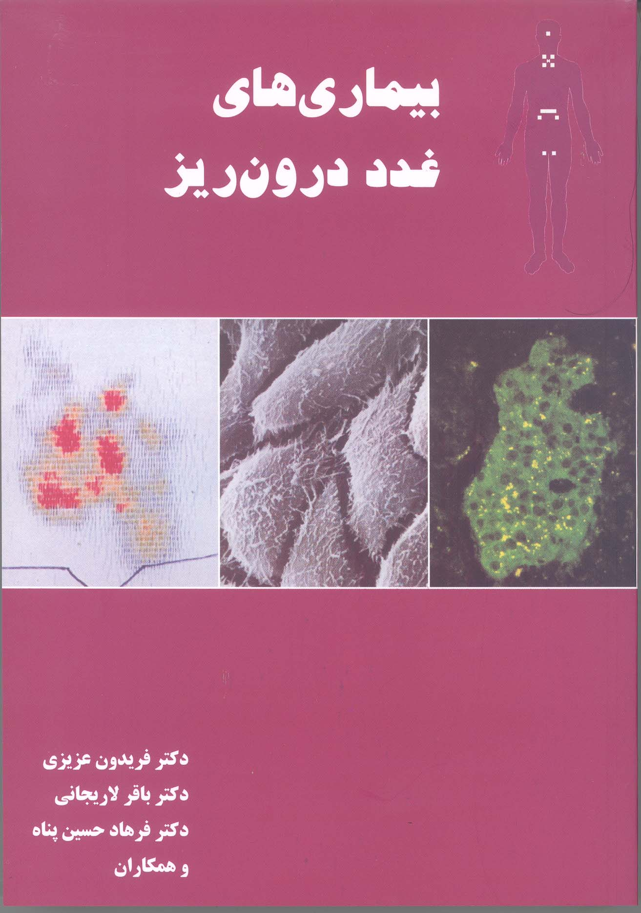
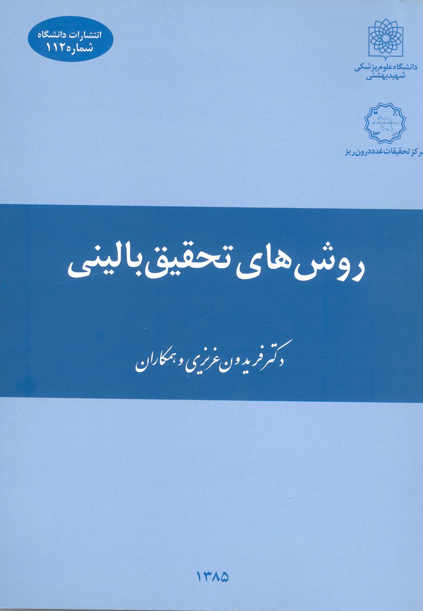
Published Books

Slide 63
Collaboration with WHO
RIES-SBUMS, has been in close collaboration with WHO EMRO during the last 35 years. The main activities include:
Two regional training courses on monitoring and evaluation of IDD elimination program held for 23 representatives from 12 countries of EMR in 2001 and for 39 representatives from 20 countries of EMR, East Europe and Central Asia in ‏2002.
The “Tehran Glucose and Lipid Study” (TLGS) conducted from 1998 to 2001, and initiation of “Interventions for change of life style’’ in a population sample of Tehran. The findings have been presented at WHO sponsored meetings in Isfahan 2001 Beirut 2002 and Cairo 2013.
Participation of the director of the ERC-SBUMS as WHO-EMRO advisor and consultant on multiple occasions to address IDD, diabetes, NCD and medical education in various countries of the region, EMRO and Geneva meetings.
Publication of the book “Assessment, Monitoring and Evaluation of IDD in the Middle East and Eastern Mediterranean countries” 2002.
Participation in the Regional Consultation in Diabetes Prevention and Control; Feb.2-5, 2003,Tehran , I.R. Iran.
Training for many countries of the region.

Slide 64
Islamic Scientific Citation ( ISC)
نفر اول دانشمند برتر ISC
و نفرات سوم و هفتم در بين ده نفر اول
از پژوهشكده علوم غدد درون ريز ريز و متابوليسم دانشگاه علوم پزشكي شهيد بهشتي مي باشد.

Slide 65
Research Institute for Endocrine Sciences (SBUMS)
Main office for scientific and professional societies:
    Iran Endocrine Society
    Iran Obesity Society
    Association of Editors of Iranian Medical Journals

Slide 66
موفقيت هاي بين المللي
برنده جايزه كشور كويت در پيشگيـري از بيماري هاي متابوليــك ( اهدا از طرف WHO- 2007)
برنده جايزه ناكاتاكي از فدراسيون انجمنهاي تيروئيد آسيا و اقيانوسيه (AOTA)
عضويت بورد و هماهنگ كننده كشورهاي خاور ميانه و شمال آفريقا، اجلاس بين المللي مبارزه با اختلالات كمبود يد ( ICCIDD)
عضويت در Task Force بيماري هاي تيروئيد و بارداري انجمن تيروئيد آمريكا (ATA)
عضویت در کمیته کنترل NCD سازمان جهانی بهداشت EMRO و کمیته حذف چاقی کودکان، ژنو

Slide 67


Slide 68
Research Institute for Endocrine Sciences
Shaheed Beheshti University of Medical Seciences
Workshops (National and International)
Iodine Deficiency Disorders
Diabetes Mellitus
Obesity
Research methodology
Management of endocrine disorders

Slide 69
Research Institute for Endocrine Sciences
Shaheed Beheshti University of Medical Seciences
National Endocrine Laboratory
Acting as:
Reference laboratory for national programs of IDD & DM
Designing and preparation of endocrine diagnostic kits
Training of endocrine laboratory personnel both nationally and regionally

Slide 70
Research Institute for Endocrine Sciences
Shaheed Beheshti University of Medical Sciences
Manpower Training
  Subspecialty Training in Endocrinology
    Graduate training program offered to 6 specialists in internal medicine for 2 years
  PhD in Molecular Medicine
  PhD in Research
  Continuing Medical Education for:
GP's & internists
Weakly grand rounds
Weakly journal clubs
Monthly endocrine conferences

Slide 71
Research Centers of Research Institute for Endocrine Science
The Endocrine and Metabolism Research Center
The Research Center for the Prevention of Metabolic Disorders
The Research Center for Prevention and Treatment of Obesity
The Research Center for Reproductive Endocrinology
The Research Center of Nutrition and Endocrine
The Research Center of Cellular and Molecular Endocrinenology
The Research Center of Endocrine Physiology
The Research Center for Determinants of Health
Research Development Center for Endocrinology

Slide 72
Collaboration with WHO
ERC-SBUMS, has been in close collaboration with WHO EMRO during the last 15 years. The main activities include:
Two regional training courses on monitoring and evaluation of IDD elimination program held for 23 representatives from 12 countries of EMR in 2001 and for 39 representatives from 20 countries of EMR, East Europe and Central Asia in ‏2002.
The “Tehran Glucose and Lipid Study” (TLGS) conducted from 1998 to 2001, and initiation of “Interventions for change of life style’’ in a population sample of Tehran. The findings have been presented at WHO sponsored meetings in Isfahan 2001, and Beirut 2002.
Participation of the director of the ERC-SBUMS as WHO-EMRO advisor and consultant on multiple occasions to address IDD, diabetes and medical education in various countries of the region.
Publication of the book “Assessment, Monitoring and Evaluation of IDD in the Middle East and Eastern Mediterranean countries” 2002.
Paticipation in the Regional Consultation in Diabetes Prevention and Control; Feb.2-5, 2003,Tehran , I.R.Iran.

Slide 73
Study design
Tehran Lipid and
Glucose Study
The Tehran Lipid and Glucose Study was designed in two phases. Phase I was a cross sectional study conducted between 1999 and 2001. Phase II is a prospective study and has began late in 2001. The reference population in this study consists of individuals aged 3 years and over living in District 13 in Tehran.
Cumulative frequency of cardiovascular risk factors in adults including hypertension, generalized obesity, central obesity, smoking, diabetes mellitus, total cholesterol≥240 mg/dl, LDL cholesterol≥160, HDL cholesterol<35, and triglycerides≥400mg/dl in Tehranian adult population, Tehran Lipid and Glucose study.
MEN
WOMEN

Slide 75
Some characteristics of the participants in the Tehran Lipid and Glucose Study
Community Mobilization
training of trainers from the community
Activities to improve KAP
sport and physical activity
education through social gatherings
education in mosques, parks, gymnasiums,etc
shops, restaurants, offices
Characteristic | Phase 1 (before) | Phase 2 (after)
Total number | 9724 | 9274
Cases | 3700 | 4343
Controls | 6024 | 4931
Male-to-female ratio
Cases | 3/4 | 3/4
Controls | 3/4 | 3/4
Age (years)
Cases | 43±15 | 43±15
Controls | 43±15 | 44±16
Metabolic syndrome (%)*
Cases | 33.1 | 29.4
Controls | 31.8 | 33.7
Prevalence of metabolic syndrome components
before and after intervention in both cases and controls
Adjusted for age and sex
Results
The change in the prevalence of metabolic syndrome components
Over the time in cases and controls
 | High FBS |  | Central obesity |  | Low HDL-C |  | High TGs |  | High Blood pressure
 | Before | After | Before | After | Before | After | Before | After | Before | After
Intervention | 13.2 | 11.8 | 33.2 | 33.6 | 69.4 | 70.8 | 47.1 | 39.9 | 35.0 | 25.9
Control | 12.6 | 13.9 | 31.0 | 37.7 | 69.4 | 78.4 | 47.0 | 42.7 | 33.0 | 26.7
P-value | 0.18 | 0.003 | 0.026 | <0.001 | 0.41 | <0.001 | 0.47 | 0.006 | 0.036 | 0.38
Prevalence (%)
Cases
Controls

Slide 76
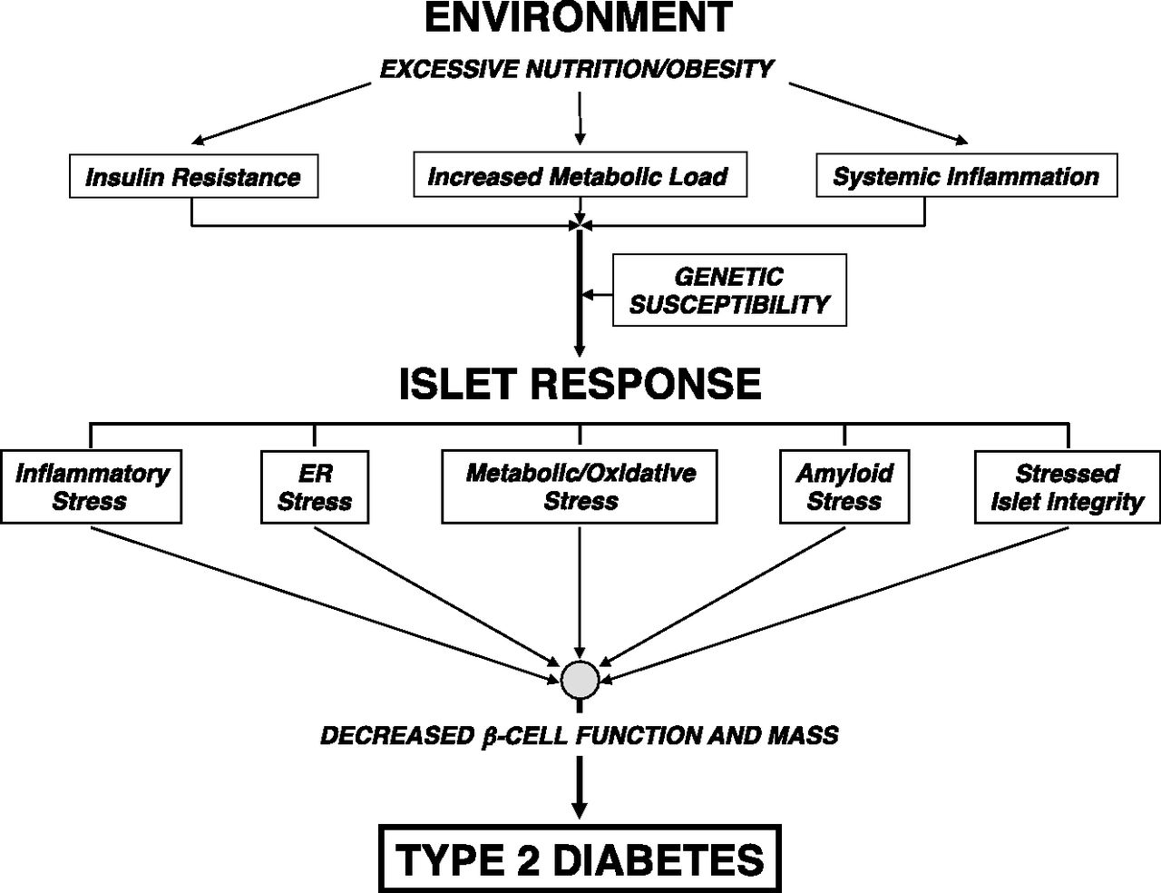
Stressors on the β-cell in the pathogenesis of T2D.
Halban P A et al. Dia Care 2014;37:1751-1758
Notes:
Stressors on the β-cell in the pathogenesis of T2D. In the excessive nutritional state found in obesity, hyperglycemia and hyperlipidemia develop, increasing metabolic load coupled with concurrent inherent insulin resistance and chronic inflammation. The pancreatic islet response to this new environment is likely variable among individuals with differing genetic susceptibility but may include inflammatory stress, ER stress, metabolic and oxidative stress (e.g., glucotoxicity, lipotoxicity, and glucolipotoxicity), amyloid stress, and loss of islet cell integrity. If untreated, these interrelated stressors increase with time, promoting β-cell dysfunction (coupled with increased glucagon secretion) and ultimately loss of β-cell mass and possibly dedifferentiation that mark the onset of T2D.

Slide 77
WHO Collaborating Center for Research and Training on Endocrine Science
The Terms of References:
To attain, upgrade and expand new knowledge in various aspects of endocrine sciences.
To compile, upgrade and classify latest information related to endocrinology in particular IDD and DM.
To train qualified personnel for education and research in endocrinology.
To collaborate with national, regional and international health organizations and scientific centers in research and training in endocrinology.

Slide 78
New Terms of References (TOR)
To serve as a research-based information center and referral for the study in various aspects of endocrine disorders and management of iodine deficiency disorders, diabetes mellitus and obesity.
To conduct training courses for general practitioners in collaboration with WHO and build capacity for public health workers research in endocrinology and related issues.
To contribute, individually and within networks, WHO programmed activities, whether in support of country programmes or by participating in international cooperative activities

Slide 79
Research Institute for Endocrine Sciences (SBUMS)
Main office for scientific and professional societies:
    Iran Endocrine Society
    Iran Obesity Society
    Association of Editors Iranian Medical Journal

