Slide 1
Clinical Utility of TSH Receptor Antibodies
A.H. Ghanooni M.D.
Fellow in Endocrinology in SBMU
July 2017

Slide 2
Agenda
TRAb generation in Graves’ disease(GD)
TRAb tests for diagnosing GD and Methods for Measuring TRAb
Difference between thyroid-stimulating Ig (TSI), TSH-binding inhibiting (TBI) Ig
Diagnostic Use of TRAb Tests
Prognostic Use of TRAb Tests (Are TRAb levels predictive of relapse and/or response to antithyroid drug therapy in GD?)
TRAb in pregnant women with Graves’ disease
TRAb in Graves’ Ophthalmopathy

Slide 3
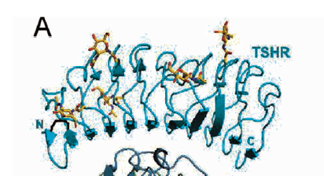
How is TRAb generated?
The TSH receptor is a G protein-coupled receptor
synthesized as a 764 amino acid polypeptide
A and B chains, linked by disulphide bonds
The extracellular A subunit is shed resulting in the generation of self-antigens which are presented in the context of MHC class II molecules, leading to activation of nonself-tolerant CD4+ T cells, eventually resulting in the production of stimulatory antibodies.

Slide 4
Methods for Measuring TRAb

Slide 5
Competition-based assays—TBI assays
first-generation assays :
used porcine thyroid membrane extracts and detected the inhibition of binding of radio- labeled TSH to these membranes.
the inhibition of binding of I-125-labeled TSH to the recombinant TSHR was measured in liquid phase.
low functional and diagnostic sensitivity

Slide 6
Second generation assays:
solid-phase ELISA assays
simplifying the assay and increasing accuracy; and
fluorescent readout instead of the radioactive readout.

Slide 7
Third-generation assay:
replaced the inhibition of binding to TSHR of labeled bovine TSH with inhibition of binding of labeled monoclonal human TSHR-stimulating antibody, M22.
The goal of using the monoclonal anti-TSHR antibody instead of bovine TSH was to increase sensitivity because M22 and patients’ TRAb bind to similar TSHR epitopes.

Slide 8
Assays that detect cAMP production—TSI assays
The first generation of TSI assays used human thyroid cell monolayers incubated with patients’ sera and measured cAMP production
After the cloning and sequencing of the TSHR, a second-generation TSI assay was developed using Chinese hamster ovary (CHO) cells transfected with the human TSHR.
Using CHO cells expressing human TSHR increased the TSI sensitivity to 85–90%.
To simplify and potentially automate the TSI assay, a third-generation TSI assay was developed employing a luciferase reporter to detect increased cAMP production in cells expressing TSHR that are incubated with GD patients’ IgG.

Slide 9
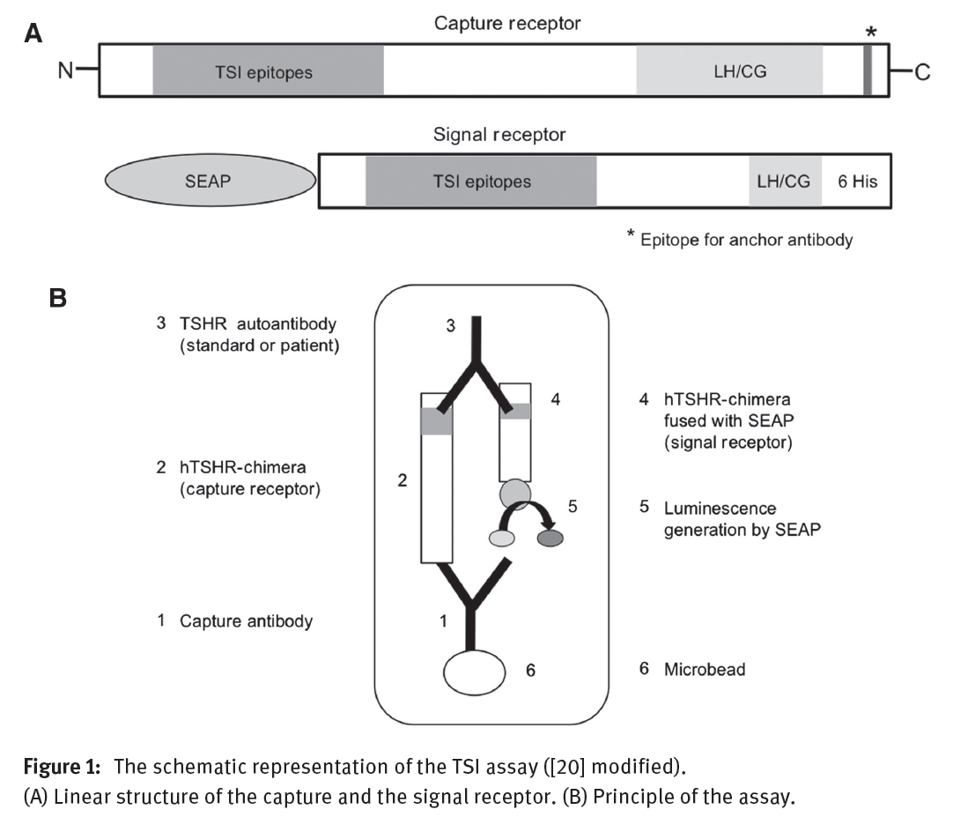

Slide 10
Diagnostic Use of TRAb Tests

Slide 11
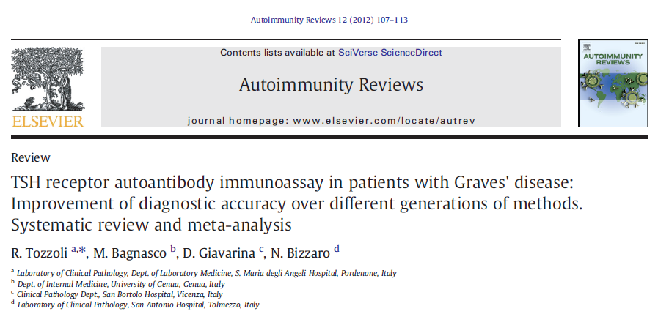
The aim of this systematic review and meta-analysis is to verify the diagnostic performance of TRAb detected with 2nd and 3rd generation immunoassay methods.
quantitative immunoassays, on untreated patients with GD as the index disease (sensitivity) and on a control group of either healthy subjects or patients affected by other thyroid diseases (specificity).

Slide 12
Finally, 21 articles were selected for meta-analysis.
total number of 3081 patients and 3795 controls
sensitivity and specificity of TRAb assays:
2nd generation : 97.1% and 97.4%,
3rd generation 98.3% and 99.2%,
with little difference between the types of immunoassay methods employed (human or porcine receptor, manual or automated procedure).
The likelihood of a TRAb-positive individual to have GD is 1367- to 3420-fold greater (depending upon the type of assay) compared to a TRAb-negative person.

Slide 13
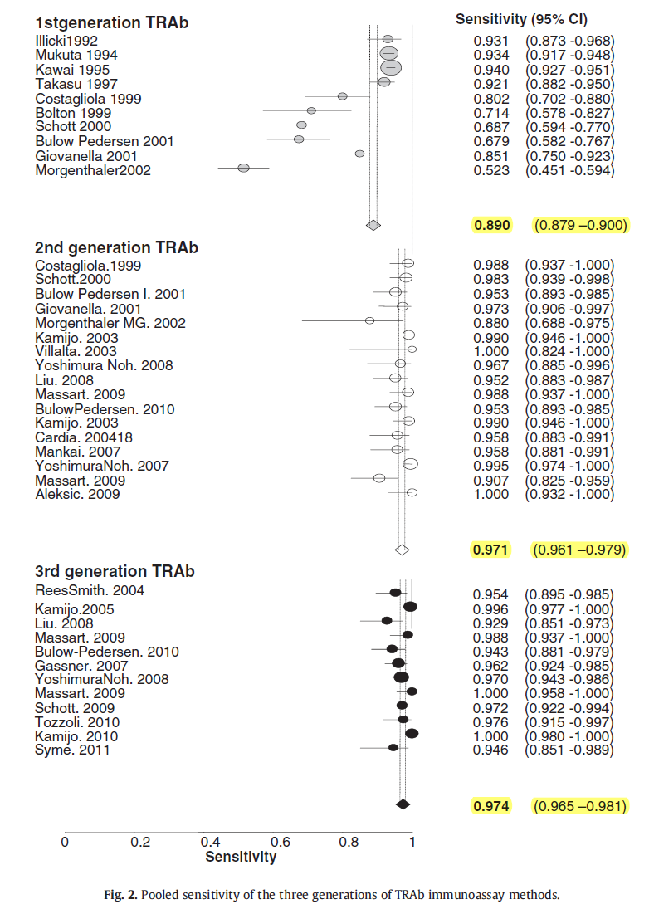

Slide 14
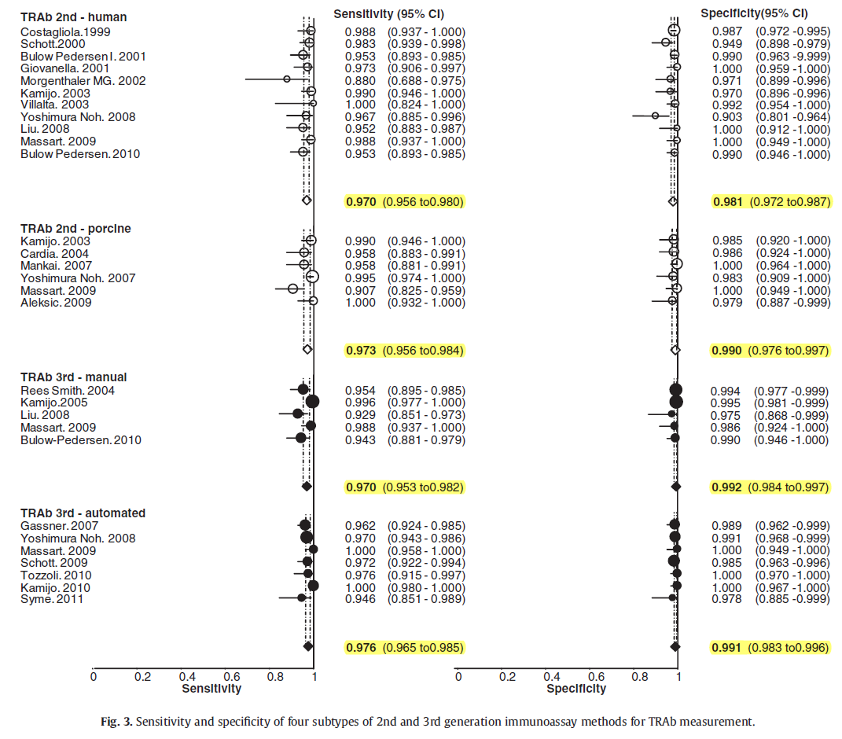

Slide 15
Key message

Slide 16
Diagnostic Use of TRAb Tests
TRAb is not primary test in the initial workup of hyperthyroidism.
ATA Guidelines in management of Hyperthyroidism 2016 :

Slide 17
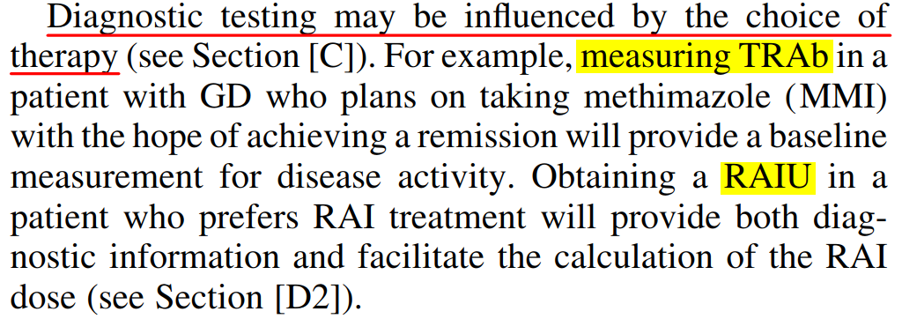
ATA Guidelines in management of Hyperthyroidism 2016 :
the cost of RAIUS = $1000 in the United States,
third-generation TRAb tests = $70

Slide 18
TRAb in distinguish GD from Subacute painless thyroiditis (SPT)
The clinical presentation of SPT may be similar to GD, with thyrotoxicosis and a diffuse, non-nodular goiter.
Almost all patients with SPT test positive for thyroid peroxidase antibodies, but so do up to 70% of patients with GD , so this excellent test for thyroid autoimmunity, in general, cannot distinguish the 2 conditions.
TRAb are also very useful in distinguishing postpartum thyroiditis from de novo or relapsing GD in lactating women, when RAIU+S must be avoided.
The 5–15% of patients with SPT or postpartum thyroiditis that may have positive TRAb is a special concern.
So misdiagnosis of GD would have clinical relevance

Slide 19
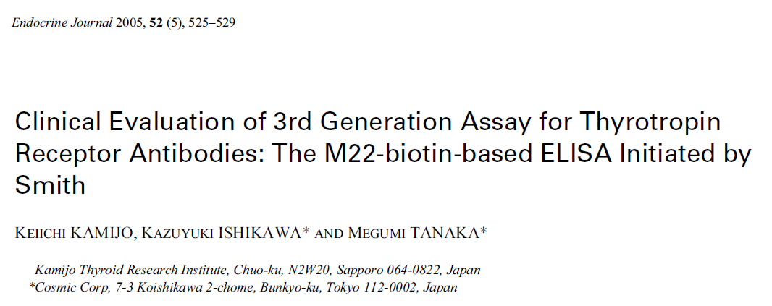
232 healthy individuals
244 untreated patients with GD

Slide 20
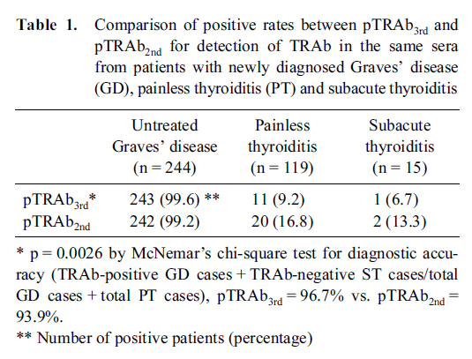

Slide 21
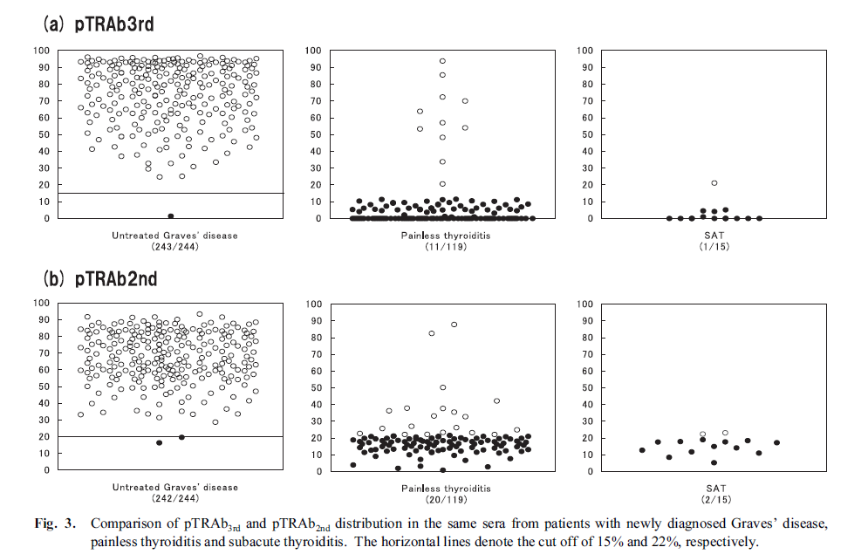

Slide 22
Key Message
pTRAb 3rd assay has significantely (p = 0.0026) superior diagnostic accuracy for GD and PT, compared to that of pTRAb 2nd assay.

Slide 23
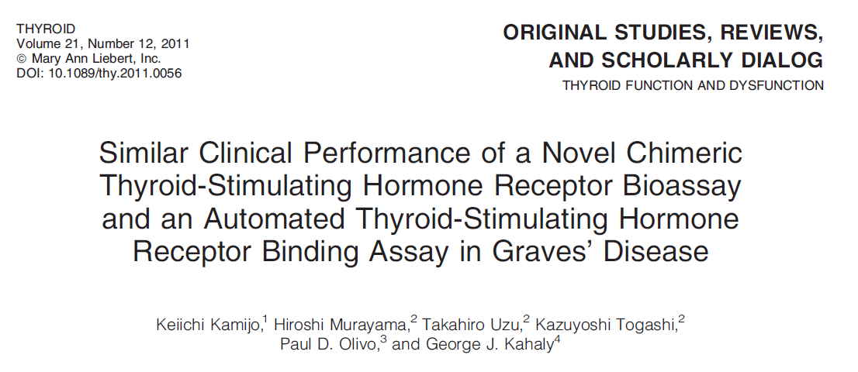
106 untreated GD , 80 autoimmune PT
compared two distinct detection methods for TSHRAb :
Mc4- TSAb assay, which detects the signal of cAMP production through Mc4 chimeric TSHR binding with TSHRAbs in a patient’s serum.
The other was the M22-TRAb assay, which detects the inhibition rate of the M22 monoclonal antibody bound to the wild-type TSHR by TSHRAb in a patient’s serum.

Slide 24
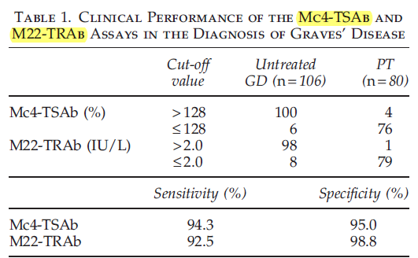
There was no significant difference in the positive rates in patients with untreated GD between Mc4-TSAb and M22-TRAb assays.
In addition, for PT, the negative rate of Mc4-TSAb was not significant compared with the M22-TRAb.
Overall, there was no clinical significant difference in the accuracy of GD and PT diagnosis between Mc4-TSAb and M22-TRAb.

Slide 25
Key Message
With regard to the relatively high rate of discordancy, a combination of both assays could reduce the presence of TSHRAb-seronegative GD.

Slide 26
Prognostic Use of TRAb Tests

Slide 27
Prognostic Use of TRAb Tests
the determination of whether a remission was achieved has been for many years obtained via an antithyroid drug discontinuation trial.
Several indicators have been studied as tools to predict the risk of such relapses in patients on antithyroid drugs, such as age, gender, the thyroid volume, the thyroid vascularity, degree of thyroiditis, iodine status, and others.
all these variables are in fact surrogate measures of persistent unregulated TSHR stimulation in the form of TRAb, which indeed is the ultimate cause of the relapse.

Slide 28
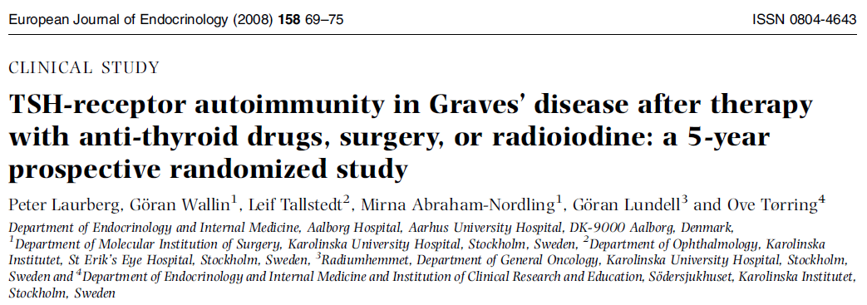
131 patients with newly diagnosed Graves’ hyperthyroidism aged 20–55 years were randomized to medical therapy (n=48), thyroid surgery (n=47), or radioiodine therapy (n=36).
Anti-thyroid drugs were withdrawn after 18 months of therapy.
TSH-receptor antibodies (TRAb) in serum were measured before and for 5 years after the initiation of therapy.

Slide 29
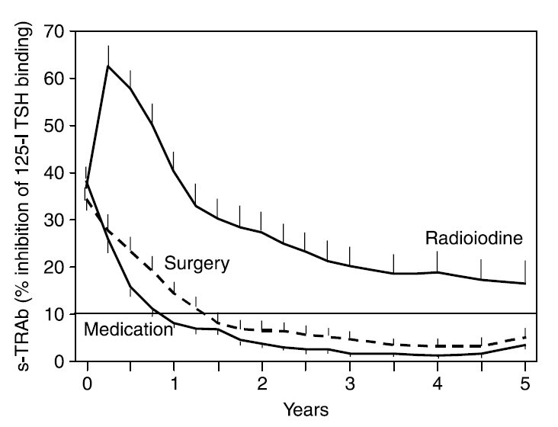
Figure 1 Variations in TSH-receptor antibodies in serum after randomly assigning patients with Graves’ hyperthyroidism to treatment. After therapy, all values were significantly higher for the radioiodine group when compared with values for the medical or surgical therapy groups (P<0.01).

Slide 30
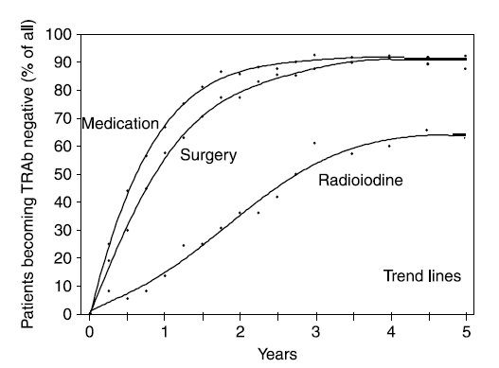
Figure 2 Fractions of patients becoming TRAb-negative (value below 10%) after radioiodine (n=36; radioiodine was only given to patients >35 years of age), surgery (n=47), or medical therapy (n=48). Dots indicate values for the point of time indicated. Lines are trend lines. Medical therapy was given for 18 months.

Slide 31
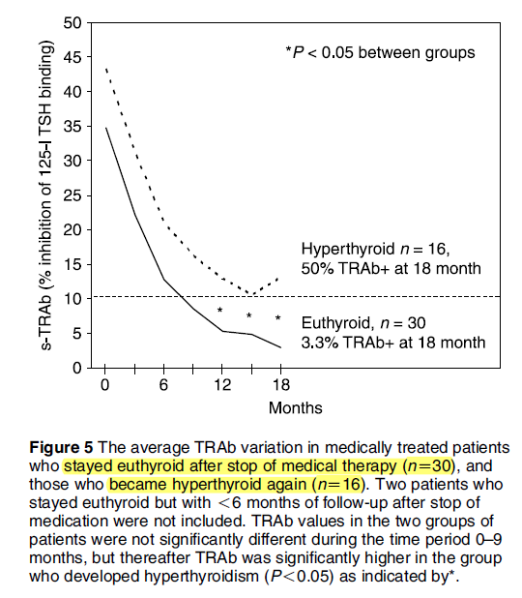

Slide 32
Key Messages
A gradual decline in TRAb was noted in patients treated with ATDs and surgery, with disappearance of TRAb in 70% to 80% of patients after 18 months.
RAI therapy on the other hand led to increased TRAb levels for 1 year, followed by a gradual decline over the following years.
About a third of patients treated with ATDs developed recurrence of hyperthyroidism after stopping medication. These patients had persistently positive TRAb levels 18 months after therapy, with a further increase in levels at the time of recurrence, but below the baseline value.

Slide 33
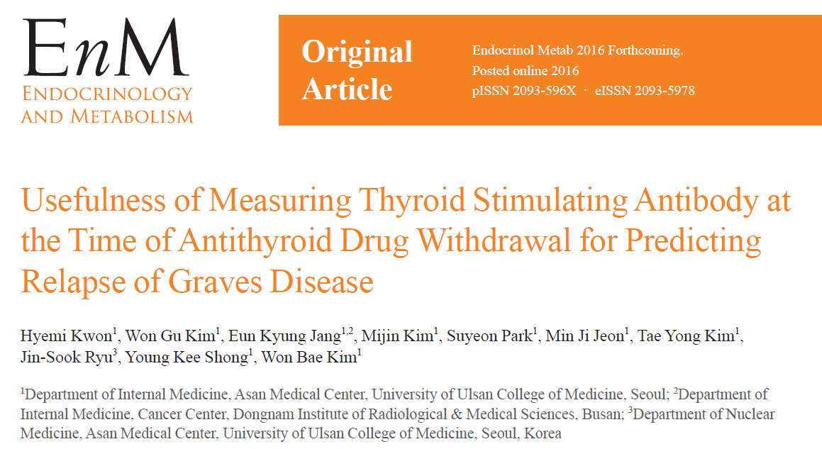

Slide 34
This study compared measurement TSAb and TBII at ATD withdrawal to predict relapse.
This retrospective study enrolled 74 GD patients who were treated between 2005 and 2012 at Asan Medical Center in Seoul, Korea.
Patients were divided into the TSAb or TBII groups. Patients in the TSAb group received follow-up using the TSAb bioassay (n=35), and patients in the TBII group received follow-up using the TBII assay (n=39).
ATDs were discontinued when the serum fT4 and TSH levels of the patients were within the normal range for ≥6 months while receiving the minimum maintenance dose of ATDs .
Median treatment duration with ATDs was 21 months

Slide 35
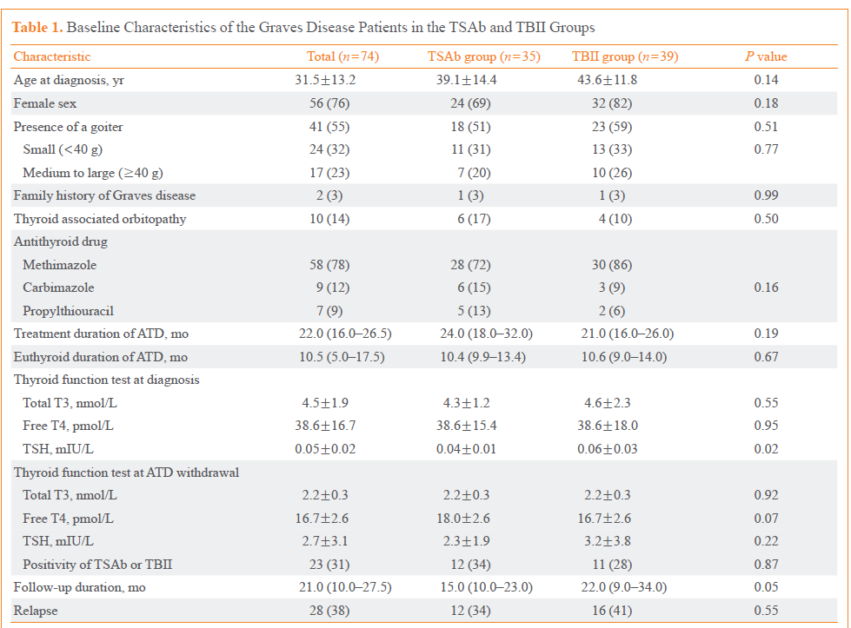

Slide 36
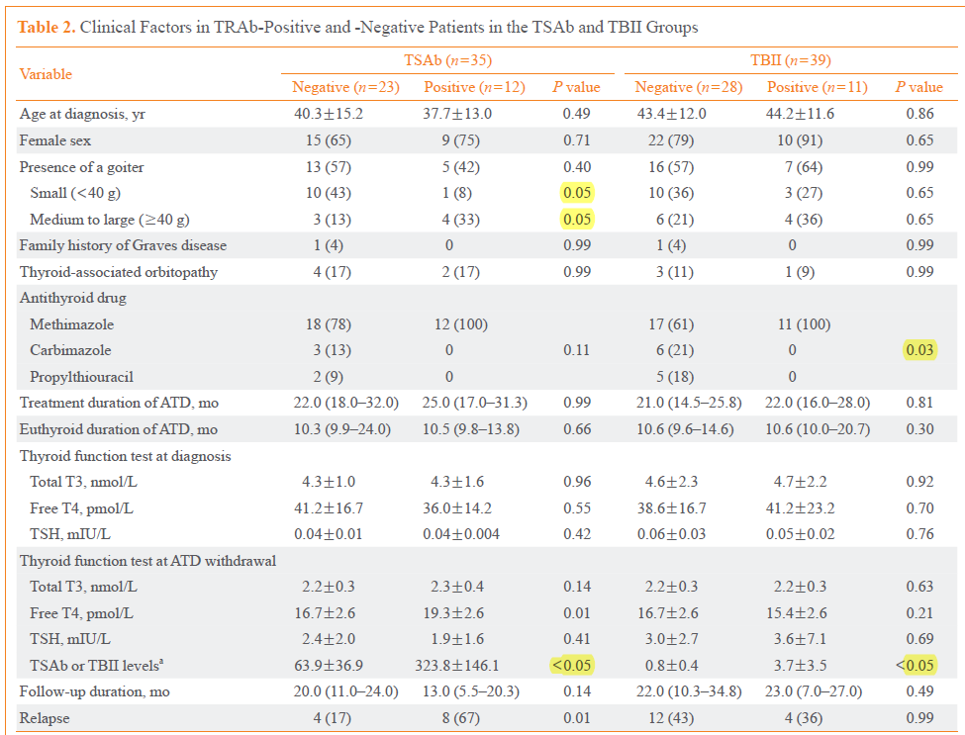

Slide 37
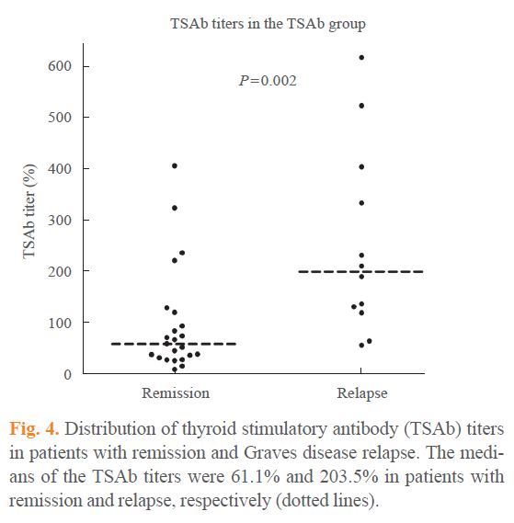

Slide 38
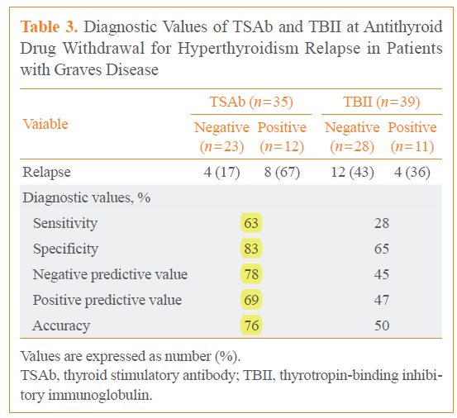

Slide 39
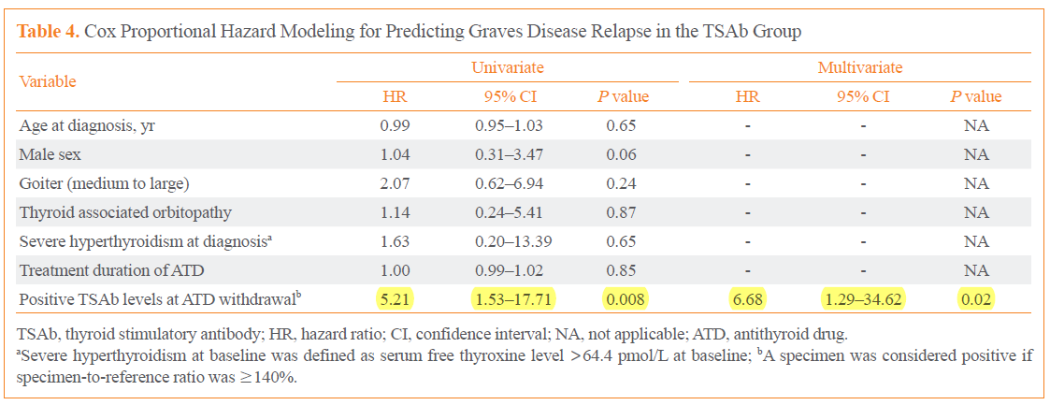

Slide 40
Key Message
TSAb assessment at the time of ATD withdrawal could be useful for predicting relapse in ATD-treated GD patients.
However, TBII at ATD withdrawal cannot predict GD hyperthyroidism relapse.
Measuring TSAb before ATD withdrawal could assist with clinical decision-making for GD patients.

Slide 41
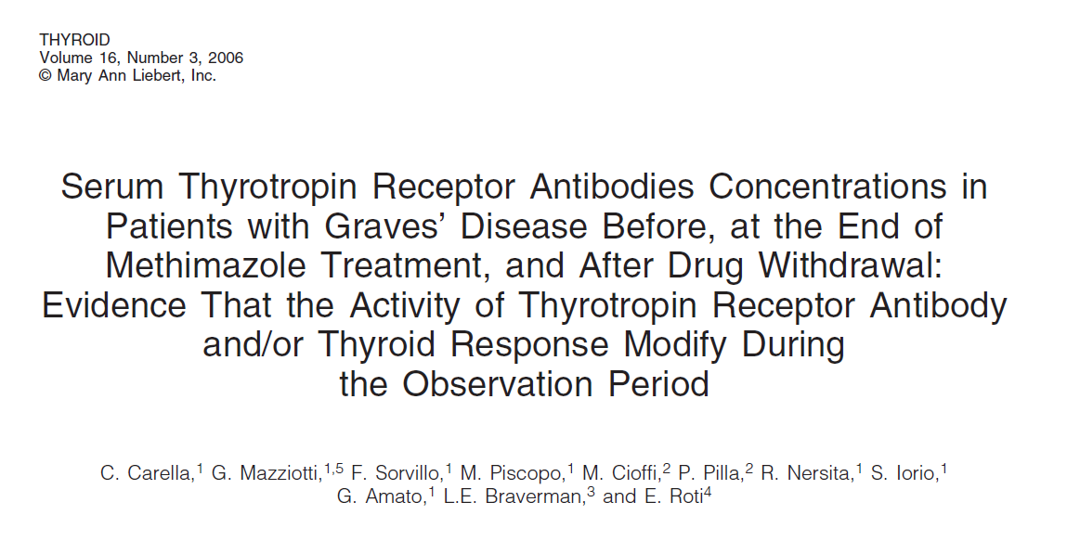
retrospective analysis of serum thyrotropin receptor antibody (TRAb) concentrations measured by a second-generation radioreceptor assay
58 patients with Graves’ disease (GD) at the onset of the disease, at the end of 18 month methimazole (MMI) treatment, and after MMI withdrawal
evaluate the correlation between the presence of these antibodies and the relapse of hyperthyroidism.
Sixty healthy subjects were enrolled as a control group.

Slide 42
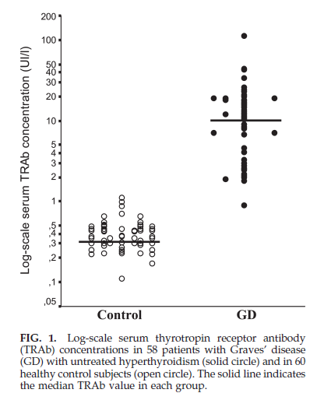

Slide 43
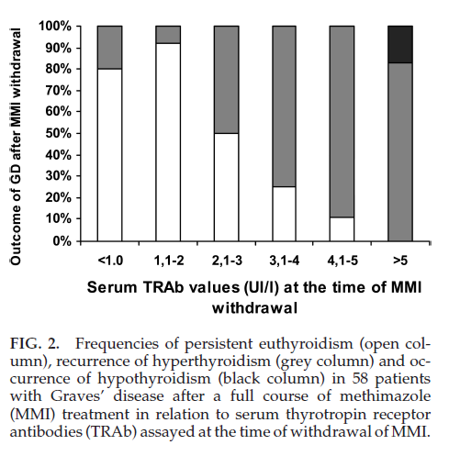

Slide 44
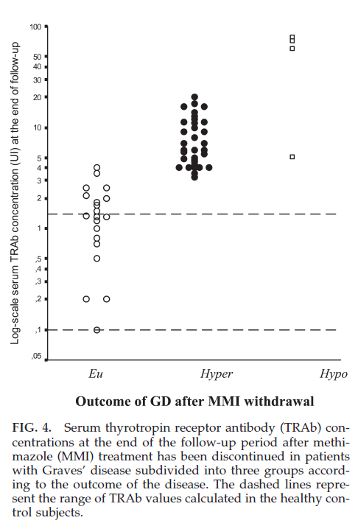

Slide 46
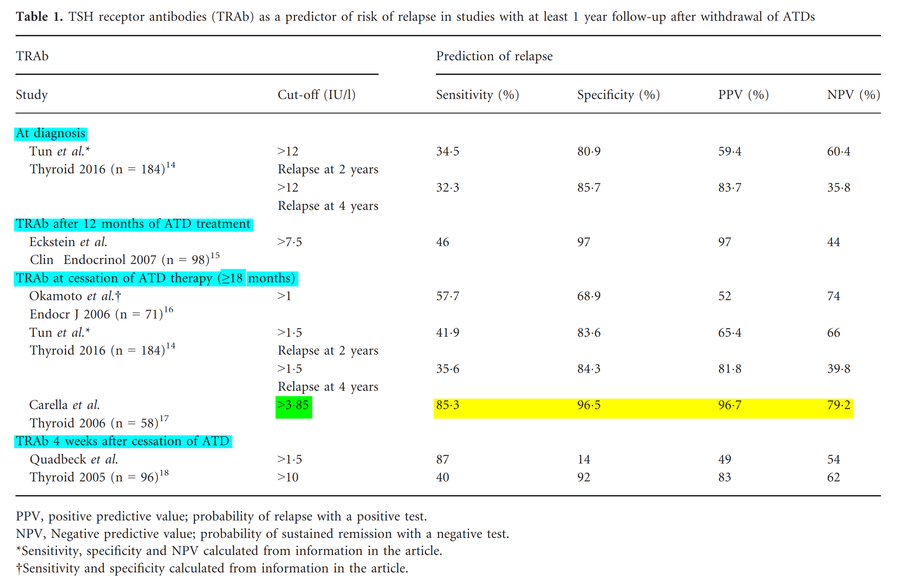
About 20% of patients with TRAb <3.85 IU/l in this study had relapse; but they relapsed much later compared to those with TRAb≥3.85 IU/l (median time to relapse56 vs 8 weeks).

Slide 47
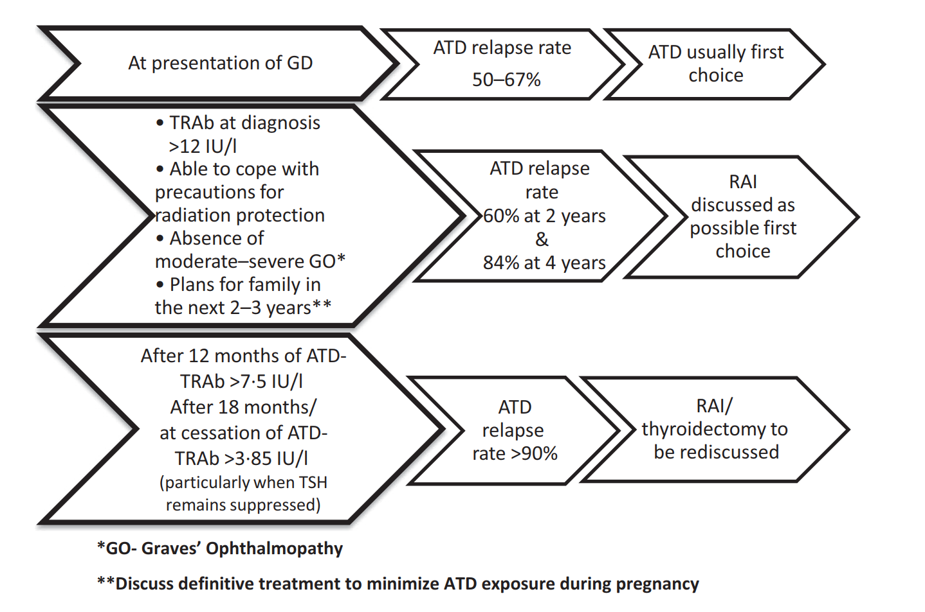

Slide 48
The 2016 American Thyroid Association (ATA) guidelines for diagnosis and management of hyperthyroidism

Slide 50
TRAB in Pregnancy: Maternal–Fetal Transfer

Slide 51
TRAb in Pregnancy
TRAb, like all IgG, can readily cross the placenta;
can stimulate the fetal thyroid, triggering fetal thyrotoxicosis
fetal thyrotoxicosis can cause serious complications to the fetus and mother, including :
Intrauterine growth
congestive heart failure,
fetal hydrops,
placental abruption,
preterm delivery, (4% to 11% of mothers treated for hyperthyroidism and in 53% of thyrotoxic mothers who remain untreated )
miscarriage,
pre-eclampsia (14% of mothers with uncontrolled hyperthyroidism)

Slide 52
TRAb in Pregnancy
Thyrotoxicosis estimated to complicate approximately 0.2% of pregnancies
fetal or neonatal thyrotoxicosis reported to develop in about 1–5% of the babies of mothers with a current or past GD.

Slide 53
TRAb in Pregnancy
frequency of neonatal hyperthyroidism among the offspring of women with Graves' disease has been estimated to be 0.6% .
Other estimates of the frequency of neonatal hyperthyroidism in mothers with Graves' disease are considerably higher, ie, 7.5% to 9.6%
levels of TRAb typically are reduced during pregnancy
Studies were shown significant decrease in TRAb levels with a significant rebound postpartum
Even women with previously treated GD who are rendered euthyroid by antithyroid medications or hypothyroid by thyroidectomy or radioiodine ablation can still have high levels of TRAb in their sera, which can cause fetal and neonatal thyrotoxicosis.
J Clin Endocrinol Metab, June 2013, 98(6):2247–2255

Slide 54
TRAb in Pregnancy
The best predictor of fetal or neonatal thyrotoxicosis in pregnant women with GD is the presence of TRAb, which has been estimated to have a predictive value of 42% .

Slide 55
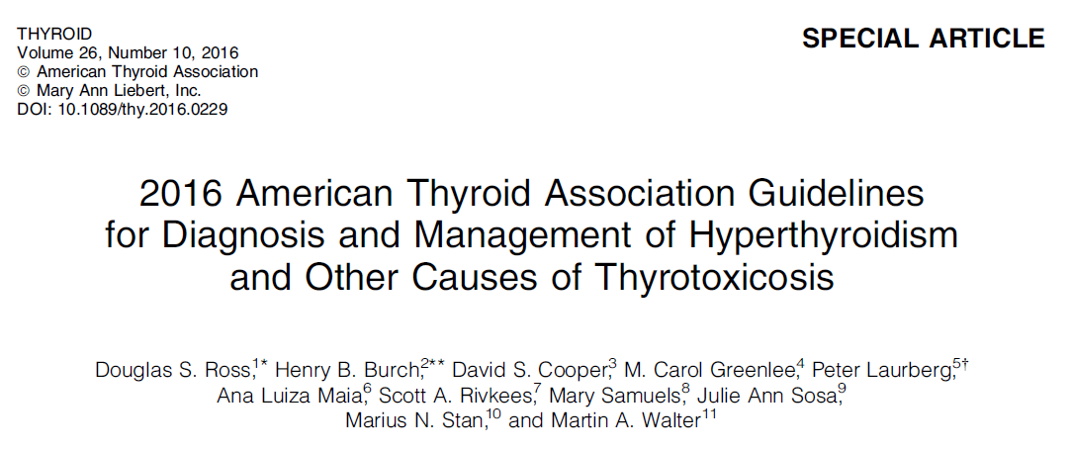

Slide 56
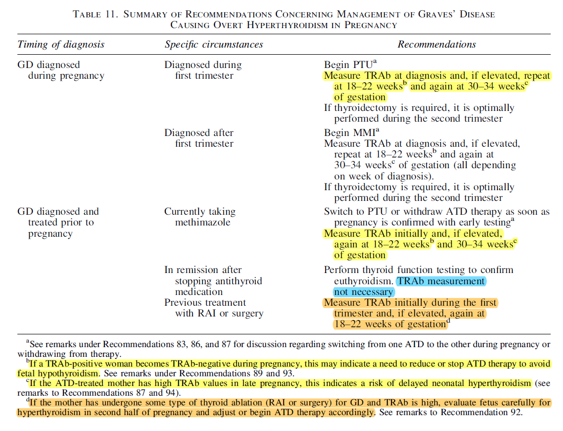

Slide 57
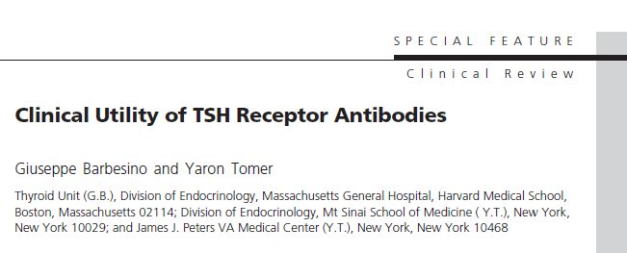
The ATA guidelines do not discuss the assays to be used to determine the presence of TRAb in the mother. We believe that a screening TBI assay should be performed and, if positive, a TSI assay should follow.
Another less preferred option is to perform only the TSI assay using a third-generation bioassay, but this carries the risk of missing TSHR-blocking antibodies (TBAb).
Some investigators have suggested that the presence of TBAb in pregnancy can be responsible for some cases of congenital hypothyroidism, especially in babies born to mothers with primary atrophic hypothyroidism.

Slide 58
1.6 million newborns screened from 1984–1989 in New York State Newborn screening
only 9 of 788 had positive TBAb
only 2% of babies born with congenital hypothyroidism is the cause TBAb (overall incidence,1:180 000 newborns)

Slide 59
TRAb in Graves’ Ophthalmopathy

Slide 60
TRAb in Graves’ Ophthalmopathy
Although the role of TRAb in the pathogenesis of GO remains uncertain, the antibody tracks with GO in many aspects.
The prevalence and the severity of GO increases with the TRAb concentration.
In the largest available series of patients with GO and no overt hyperthyroidism (euthyroid GO), greater than 90% had positive TSI. In this particular study, TBI were found in only 50% of patients.
(Thyroid. 2000;10:1093–1100)

Slide 61
TRAb in Graves’ Ophthalmopathy
TRAb rise in the months or years after radioactive iodine treatment of GD, a period in which the risk of worsening or onset of GO also rises.
One would suspect the 2 events to be linked, but the only study that has addressed this point (employing a first-generation assay) did not find an association between the post-radioiodine TRAb surge and the occurrence of GO.
The same study found that pre-radioiodine TRAb levels did not predict the later onset of GO.

Slide 62
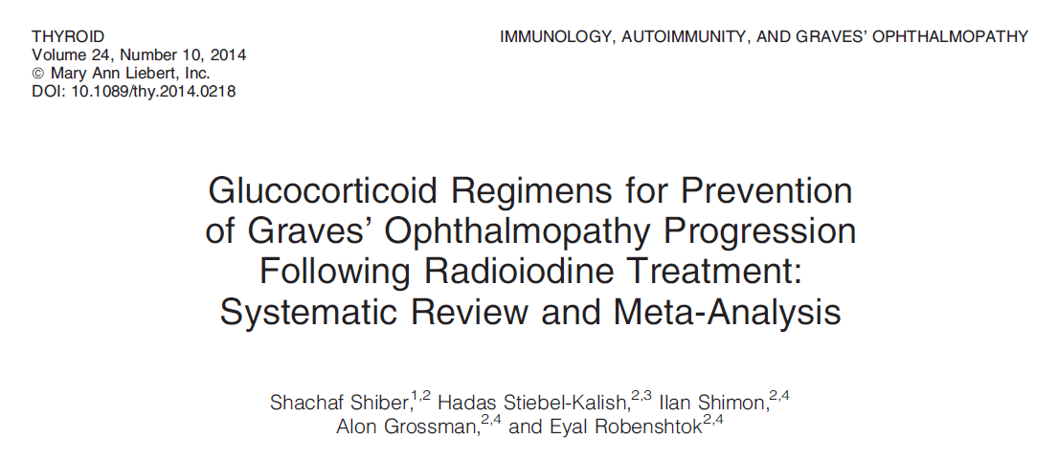
TRAb in Graves’ Ophthalmopathy
A meta-analysis of eight randomized controlled trials and retrospective controlled trials evaluated 850 patients treated with RAI for GD
comparing steroid therapy vs placebo or no treatment to prevent progression of GO.
Prednisone (0.4–0.5 mg/kg tapered over 3 months) was the best validated regimen for use in patients with mild-to-moderate GO who had high risk of progression, while low-dose prednisone (0.2–0.3 mg/kg tapered over four to 5 weeks) was found to be useful in patients with mild GO and in patients without preexisting GO who had risk factors (smoking and/or elevated TRAb).

Slide 63
TRAb in Graves’ Ophthalmopathy
In summary, the data presently available support the routine use of TRAb in:
1- confirming the diagnosis in patients with euthyroid GO and
2- determine the need for steroid prophylaxis in those treated with RAI.

Slide 64
Conclusions
Novel TRAb tests are now adequate for a reliable and inexpensive diagnosis of GD, thus allowing us to reserve expensive nuclear medicine scanning to select situations.
TRAb measurements at presentation and after 12 and/or 18 months of ATD therapy predict the risk of relapse, and could potentially guide treatment choices.
In patients on methimazole, a positive TRAb is helpful in suggesting that it is not yet time to stop the medication.
TRAb tests are also used in the prediction of the rare neonatal transfer of GD, with the main purpose of reassuring most women or intensive fetal monitoring to the few others with persistent high-titer TRAb.
the data presently available support the routine use of TRAb in confirming the diagnosis in patients with euthyroid GO.

