Slide 1
Sexual Dysfunction and Background Disease
MS, Hosseini,associate professor of endocrinology,Baqiatallah university of medical science

Slide 2
Agenda
Introduction
Endocrine diseases and sexual dysfunction
Diabetes
Androgen deficiency
Hyperprolactinemia
Hypothyroidism
Hypethyroidism
Metabolic syndrome
Non endocrine diseases

Slide 3
Introduction
Male sexual dysfunction are common among men of all ages, ethnicities, and cultural backgrounds. It had been estimated that more than 152 million men worldwide experienced erectile dysfunction in 1995, and this number will rise to approximately 322 million by the year 2025
Sexual problems are highly prevalent in women. In the United States, approximately 40 percent of women have sexual concerns and 12 percent report distressing sexual problems
Br J Urol Int1999 84:50–56
Obstet Gynecol 2008; 112:970

Slide 4
Diabetes and sexual dysfunction
Diabetes has been associated with sexual dysfunction both in men and in women
Diabetes is an established risk factor for sexual dysfunction in men; a threefold increased risk of ED was documented in diabetic compared with non diabetic men
Among women, the evidence regarding the association between diabetes and sexual dysfunction is less conclusive, although most studies have reported a higher prevalence of female sexual dysfunction (FSD) in diabetic women as compared with nondiabetic women
J Urol. 1994;151(1):54–61 /Diabetes Care. 2003;26(4):1093–1099 /J Sex Med. 2009;6(6):1719–1728
Diabetes Care. 2009;32(5): 780–785 /Diabetes Care. 2008;31(8):1580–1581 /J Sex Med. 2008;5(4):878–886 /Int J Impot Res. 2010;22(3):204–209_179–184 /Diabetes Care. 2003;26(2):409–414 /Diabetes Care. 2006;29(2): 312–316

Slide 5
Diabetes and sexual dysfunction…
It is still not clear whether hyperglycemia, may participate in the pathogenetic mechanisms of sexual dysfunction in diabetes
Diabetic people may present with several clinical conditions, including hypertension, overweight and obesity, metabolic syndrome, cigarette smoking, or atherogenic dyslipidemia, which are themselves risk factors for sexual dysfunction in both sexes
J Urol. 2004;171(6 Pt 1):2341–2345/ Diabetes Care. 2005;28(5):1201–1203/
J Sex Med. 2010;7(4 Pt 2):1598–1607/ J Sex Med. 2012;9(3):641–651 / J Sex Med. 2009;6(6): 1696–1703 / Diabetes Care. 2005;28(3):756

Slide 6
Diabetes and Erectile Dysfunction
the prevalence of ED in diabetes did not distinguish between type 1 and type 2 diabetes
The occurrence of ED is 10–15 years earlier in men with diabetes, ED is more severe and less responsive to oral drugs in diabetes, leading to reduced quality of life
Advanced age and longer duration of diabetes have been associated with an increased risk of ED in diabetic patients
The role of hyperglycemia as a risk factor for the development of ED in diabetic men is still not clear
Diabetes Care. 2002;25(8):1458–1463/ Diabetes Care. 2005;28(7):1739–1744 /J Urol. 1994;151(1):54–61 / Diabetes Care. 2003;26(4):1093–1099 / N Engl J Med. 1998;338(20):1397–1404 / J Endocrinol Invest. 2013;36(10):864–868 / Diabetici. Diabetes Care. 1998;21(11):1973–1977 / J Sex Med. 2010;7(4 Pt 2):1598–1607 / Int J Impot Res. 2010;22(3):204–209

Slide 7
Pathogenesis of ED in diabetes
The pathogenesis of ED in diabetes is multifactorial including vasculopathy, neuropathy, visceral adiposity, insulin resistance, and hypogonadism
Diabetic vasculopathy concerns macroangiopathy, microangiopathy
Diagnosis of ED may be seen as a sentinel event that should prompt the investigation of CAD in asymptomatic diabetic men
Endothelial dysfunction in diabetes is manifested as the decreased bioavailability of NO, the accumulation of advanced glycation end products; increased levels of oxygen free radicals
Diabetes Care. 2005;28(5):1201–1203/ J Am Coll Cardiol. 2004;43(2):185–186

Slide 8
Pathogenesis of ED in diabetes
Microvascular disease determines ischemic damage in the distal circulation and autonomic and peripheral neuropathy
Both somatic and autonomic neuropathies may contribute to diabetes-induced ED due to the impairment of sensory impulses from the penis to the reflexogenic erectile center
Insulin resistance and visceral adiposity, are associated with a pro inflammatory state that results in the decreased availability and activity of NO
Subnormal testosterone concentrations have been found in 25% of men with type 2 diabetes in association with inappropriately low LH and FSH concentrations
Urol Clin North Am. 2001;28(2):289–308 /Clin Pharmacol Ther. 2011;90(1):169–173 /J Clin Endocrinol Metab. 2004;89(11):5462–5468/Diabetes Care. 2007;30(4):911–917

Slide 9
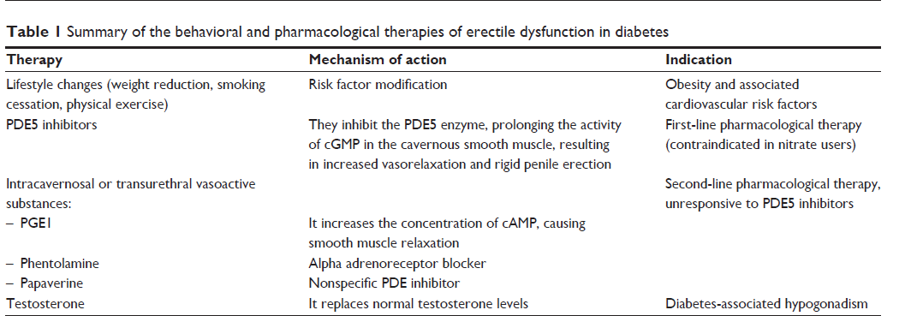
Diabetes, Metabolic Syndrome and Obesity: Targets and Therapy 2014:7 95–105

Slide 10
Pathogenesis of female sexual dysfunction in diabetes
Sexual disorders reported in women with diabetes include the reduction or loss of sexual interest or desire, arousal or lubrication difficulties, dyspareunia, and loss of the ability to reach orgasm
The pathogenesis of FSD in diabetes is multifactorial including, infections, hyperglycemia ,vascular and neurological damage, and hormonal disorders
Hyperglycemia reduces the hydration of the vaginal mucus membranes, producing poor vaginal lubrication and dyspareunia
Hyperglycemia increases the risk of genitourinary infections which, in turn, may lead to vaginal discomfort and dyspareunia
Practical Diabetes. 2013;30(8):327–331 /Curr Diab Rep. 2005;5(3):230–236

Slide 11
Pathogenesis of female sexual dysfunction in diabetes…
Vascular abnormalities, including atherosclerotic damage and diabetes-induced endothelial dysfunction, may be responsible for reducing the engorgement of the clitoris and for reducing lubrication of the vagina
Diabetic neuropathy may further contribute to the pathogenesis of sexual dysfunctions by altering both the normal transduction of sexual stimuli and the triggered sexual response
Depression is strongly associated with diabetes and seems to be the principally established determinant of sexual dysfunction in women with diabetes
Hormones (Athens). 2011;10(3): 196–206 /Practical Diabetes. 2013;30(8):327–331 /Am J Health Syst Pharm. 2004;61(2):160–173; quiz 175 /Diabetes Care. 2005;28(1):177–185

Slide 12
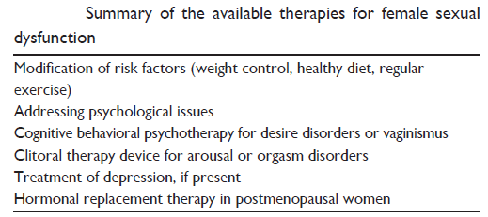
Diabetes, Metabolic Syndrome and Obesity: Targets and Therapy 2014:7

Slide 13
Androgen deficiency and sexual dysfunction
Testosterone regulates many domains of sexual function in men and women
The mechanisms by which testosterone regulates sexual desire in either gender are poorly understood
The incidence of sexual dysfunction in men with low androgen activity and the threshold concentration of serum testosterone in which sexual symptoms arise at any age are not known
Testosterone regulates nitric oxide synthase;it has exertstrophic effects on cavernosal smooth muscle and ischiocavernosus and bulbospongiosus muscles; and is necessary for the veno-occlusive response
Low testosterone might reduce sexual desire indirectly through its effects on mood
J Clin Endocrinol Metab 2000; 85: 2839–53/Steroids 1999; 64: 605–09

Slide 14
Androgen deficiency and sexual dysfunction(men)
Androgen deficiency often results in reduced libido or sexual desire (hypoactive sexual desire disorder), loss or reduction of spontaneous evening and morning or sexually stimulated erections (erectile dysfunction), and, if severe, reduced or absent ejaculation
Low testosterone can be caused by primary testicular failure or Secondary
gonadal failure because of deficiency of LH, FSH, or GnRH
Psychoneuroendocrinology. 1995;20(7):743-753

Slide 15
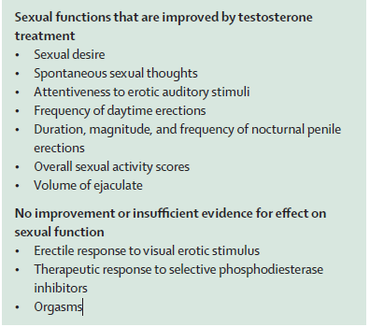
Androgen deficiency and sexual dysfunction(men)
Treatment of androgen-deficient men with testosterone improves some but not all domains of sexual function, as shown in open-label
Lancet 2007; 369: 597–611

Slide 16
Androgen deficiency and sexual dysfunction (women)
The incidence of sexual dysfunction in women with low testosterone activity is unknown
Low testosterone in women is associated with bilateral oophorectomy, panhypopituitarism, primary adrenal insufficiency, Turner’s syndrome, glucocorticoid treatment, oral contraceptive use, and chronic illness related to HIV infection, lupus, and chronic obstructive pulmonary disease
Lancet 2007; 369: 597–611

Slide 17
Androgen deficiency and sexual dysfunction (women)….
The evidence that women’s sexual function is a target of androgen action stems mainly from studies of T therapy given to postmenopausal women reporting low sexual desire
These data show that T therapy may influence all aspects of sexual response by improving desire, subjective arousal, and vaginal blood flow and increasing frequency of orgasm
Neither epidemiological cross sectional community-based studies nor clinical studies have demonstrated a lower limit of androgens or androgen precursors that can be used to identify women with diminished sexual function
Cochrane Database Syst Rev. 2005; 4:CD004509/J Sex Med. 2007; 4:209–217/Arch Gen Psychiatry. 2000;57:149–153/Ann Intern Med. 2008;148:569–577/J Clin Endocrinol Metab. 2005;90:3847–3853/J Clin Endocrinol Metab. 2005;90:4836–4845

Slide 18
female androgen deficiency syndrome
Three essential criteria for the diagnosis of female androgen deficiency syndrome have been proposed
1-Clinical symptoms of androgen deficiency must be present, including diminished wellbeing, persistent and unexplained fatigue, decreased desire, lowered sexual receptivity, and reduced pleasure
2-Female androgen deficiency syndrome should be diagnosed only in oestrogenised women
3-Free testosterone levels should be at or below the lowest quartile for young women
Fertil Steril 2002; 77: 660–65
Fertil Steril 2002; 77 (suppl 4): 1–99

Slide 19
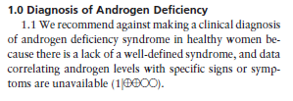
J Clin Endocrinol Metab 99: 3489–3510, 2014

Slide 20
Androgen deficiency and sexual dysfunction (women,treatment)….
Testosterone therapy in FSD:
Benefits:In two large studies (n562, n532) of TTP, 300g/d, in surgically menopausal women on oral estrogen therapy, all domains of sexual function(arousal, pleasure, orgasm, self-image, reduced concern, and responsiveness) improved to a statistically significantly greater extent with TTP than with placebo
J Clin EndocrinolMetab. 2005;90:5226–5233/Obstet Gynecol. 2005;105:944–952
Lack of benefits:two large phase III RCTs showed no benefit(sexually satisfying events per month and the level of sexual desire ) of transdermal Tgel over placebo
Am Heart J. 2012;163:27–32/J Sex Med. 2012; 3:171

Slide 21
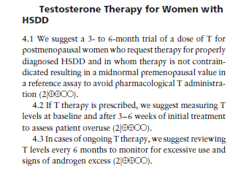
J Clin Endocrinol Metab 99: 3489–3510, 2014

Slide 22
J Clin Endocrinol Metab 99: 3489–3510, 2014

Slide 23
Hyperprolactinaemia and Sexual Dysfunction(men)
Sexual dysfunction because of decreased desire or erectile dysfunction is the most common symptom on presentationin men with hyperprolactinaemia
Hyperprolactinaemia affects 1–5% of men who present with erectile dysfunction
About 75% of men with macroprolactinomas and 50% of men with micro prolactinomas report reduced sexual desire or erectile dysfunction
Prog Urol 1999; 9: 1097–01
J Clin Endocrinol Metab 2004; 89: 621–25

Slide 24
Hyperprolactinaemia and Sexual Dysfunction(women)
Women commonly present with menstrual irregularities, infertility, and galactorrhoea, rather than with sexual dysfunction
However, hyperprolactinaemic women without depression or other hormonal disorders have reported lower scores for sexual desire, arousal,
lubrication, orgasm, and satisfaction than have controls
J Urol 2005; 174: 1921–25

Slide 25
Hyperprolactinaemia and Sexual dysfunction(Treatment)
sexual dysfunction with hyperprolactinaemia should be treated with DA
Erectile function (nocturnal penile tumescence) improves after 6 months in 97% of hyperprolactinaemic men, compared with 13% of controls, and that testosterone and semen analyses becomes in the normal range in most hyperprolactinaemic men at 24 months
J Clin Endocrinol Metab 2004; 89: 621–25/ J Clin Endocrinol Metabol 2004; 89: 1704–11
sexual dysfunction, including erectile dysfunction and loss of libido, persistedin 43% of hyperprolactinaemic men, despite normalization of testosterone levels and semen analyses
Eur J Endocrinol 2003; 148: 325–31
Clinical experience that dopamine agonists improve sexual desire or arousal in hyperprolactinaemic women has not been confirmed by data

Slide 26
Hypothyroidism and sexual dysfunction
The incidence of sexual dysfunction in men and women with hypothyroidism is unknown
A survey of 600 men with erectile dysfunction detected unsuspected hypothyroidism in 6%.
Both low sexual desire in men and erectile dysfunction have been linked to hypothyroidism
Hypothyroid men have lower concentrations of free testosterone and SHBG than do controls, and this may contribute to sexual dysfunction
The incidence of sexual dysfunction in hypothyroid women is unknown
JAMA 1983; 249: 1736–40
J Endocrinol Invest 2003; 26: 372–80
Int J Impot Res 2006; 18: 111–14

Slide 27
Hypothyroidism and sexual dysfunction(Treatment)
In a small observational study, hypoactive sexual desire, delayed ejaculation, and erectile dysfunction improved in14 men after recovery from hypothyroidism
The decreased free testosterone and SHBG levels in men with primary hypothyroidism return to normal after thyroxine replacement
Data on any sexual consequences after treatment in women with hypothyroidism are absent
JAMA 1983; 249: 1736–40
Data on any sexual consequences are absent
Int J Impot Res 2006; 18: 111–14/ Clin Endocrinol (Oxf) 2000; 52: 197–201

Slide 28
Hyperthyroidism and sexual Dysfunction
One small case series suggests that most men with hyperthyroidism have some form of sexual dysfunction(hypoactive sexual desire, premature or delayed ejaculation, or erectile dysfunction)
Hyperthyroidism is reported in a small fraction of men who present with erectile dysfunction
Sexual function in hyperthyroid women has not been studied
J Clin Endocrinol Metab 2005; 90: 6472–79
Eur Urol 2004; 46: 615–22

Slide 29
Hyperthyroidism and sexual Dysfunction…
The mechanism by which high thyroxine levels might cause erectile and ejaculatory dysfunction is unclear
A small observational study showed that hypoactive sexual desire, premature and delayed ejaculation, and erectile dysfunction improved in 34 men after recovery from hyperthyroidism
The sex steroids and semen return to normal with return of the euthyroid state
J Clin Endocrinol Metab 2005; 90: 6472–79
Eur Urol 2004; 46: 615–22

Slide 30
Metabolic syndrome and Sexual Dysfunction
Erectile dysfunction is strongly associated with risk factors for coronary artery disease; not surprisingly, men with metabolic syndrome have a higher rate of erectile dysfunction than do controls
In uncontrolled prospective studies, 43% of men presenting with erectile dysfunction met the criteria for metabolic syndrome
The risk of erectile dysfunction is correlated with several components of metabolic syndrome
In one study, women with metabolic syndrome had lower Female Sexual Function Index scores and satisfaction rates than did age-matched control
Int J Impot Res 2005; 17: 391–98/J Sex Med 2005; 2: 96–103 /Int J Impot Res 2005; 7: 224–26/Diabetes Care 2005; 28: 756

Slide 31
Metabolic syndrome and Sexual Dysfunction
Metabolic syndrome is associated with endothelial dysfunction, penile vascular compromise, which underlie erectile dysfunction in men
The underlying mechanisms of sexual dysfunction in women with metabolic syndrome are unknown
There are no studies on the effect of treatment of metabolic syndrome per se on sexual function in men or women
Am J Cardiol 2005; 96: 57–61

Slide 32
Non endocrine diseases and Sexual Dysfunction

Slide 33
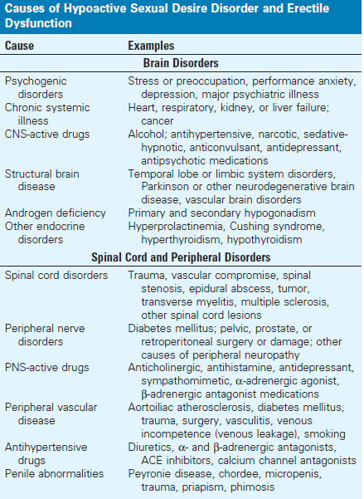
Non endocrine diseases and Sexual Dysfunction

Slide 35
Chronic Kidney Disease and Sexual Dysfunction
Endocrine abnormalities are common in patients with CKD and lead to sexual dysfunction
Common clinical problems include disturbances in menstruation in women, erectile dysfunction in men, and decreased libido and infertility in both sexes
Organic factors tend to be prominent and are related to uremia and other comorbid illnesses
Psychological factors and depression may exacerbate the primary problem. Alterations in the hypothalamic-pituitary axis are seen early in CKD and tend to worsen after patients start dialysis
ACKD, 2007. 14, 119–125

Slide 36
Chronic Kidney Disease and Sexual Dysfunction
Hypogonadism plays a dominant role in male sexual function, whereas changes in hypothalamic-pituitary function predominate in female sexual dysfunction
In patients on dialysis, treatment strategies include optimizing dose of dialysis, correction of anemia with erythropoietin, and correction of hyperparathyroidism
Successful kidney transplantation may restore normal sexual function, especially in younger patients
ACKD, 2007. 14, 119–125

Slide 37
تشکر از توجه شما

Slide 38
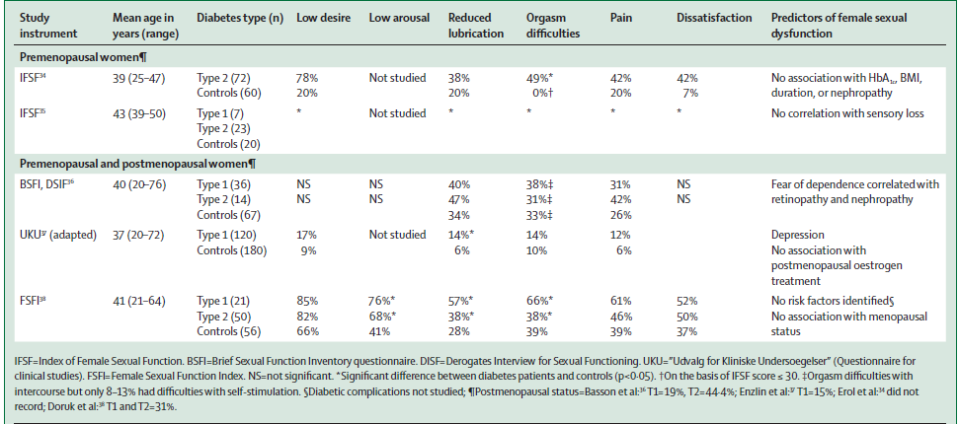
Sexual function in women with diabetes
Lancet 2007; 369: 597–611

