Slide 1
Obesity and Infertility
Dr.Taheripanah
IRHRC .
Shahid Beheshti Medical University
Notes:
Obesity, particularly the abdominal phenotype, is associated with several reproductive disturbances. Whereas mechanisms by which obesity affect fertility are complex and still not completely understood, an important role appears to be played by the presence of a condition of functional hyperandrogenism and hyperinsulinaemia, which accompanies the insulin-resistant state

Slide 2
Obesity: Epidemiology
Obesity : is the new worlwide epidemic of obesity and related morbidity significantly affects fertility and reproduction in both men and women
In USA and Europe
  60% of all women are overweight (BMI>25 kg/m²)
    30% of them are obese (BMI>30 kg/m²)
    6% of them are morbidly obese (BMI>40 kg/m²)
  50% of women 25-44 years old are overweight
    20% of them are obese
Definition of obesity
  Body Mass Index (BMI): 18.5 – 25 – 30 – 35 – 40 kg/m²
  waist circumference to define truncal/abdominal obesity

Slide 3
Classification of obesity (according to WHO)
Underweight | <18.5
Normal | 18.5-24.9
Overweight | 25-29.9
Obesity Class I (obese) | 30-34.9
Obesity Class II (severe obesity) | 35-39.9
Obesity Class III (morbid obesity) | >40

Slide 4
Different Aspects of Obesity in Reproduction
Effect of obesity on natural reproductive potential
Effect of obesity on infertility treatment and IVF results
Effect of obesity on pregnancy complications and outcomes
Effect of obesity on the health of the child

Slide 5
Pathophysiology of Obesity Regarding Fertility
  Obesity affects the endocrine system
  Endocrine changes with central obesity
      Insulin resistance results in suppression of hepatic SHBG
      Increased ovarian androgen synthesis and increased circulating free androgen
      Increased aromatization of androgens to estrogen in adipose tissue
      Leptin, a peptide secreted by adipocytes, inhibits ovarian follicular activity and steroidogenesis

Slide 6
Effect of Obesity on Fertility
Natural Reproduction
  One third to half of overweight and obese women have irregular menstrual cycles
  Negatively affects natural reproduction through the interference of ovulation
  May reduce natural fecundity in ovulatory women- may involve potential adverse effects of insulin resistance
  Direct correlation between increasing BMI and cycle irregularity
  Obesity frequently seen in PCOS patients and PCOS most common endocrinopathy in women
  With weight reduction, ovulatory function and pregnancy rates frequently improve

Slide 7
Obesity and Impaired Reproductive Potential
Pathophysiological
  Unable to receive the semen
  Menstrual irregularity
  Secondary sexual dysfunction
    Decreased dopamine activity and increased serotonin level in brain(Brody,2004)
Psychological
sociobiological

Slide 8
Obesity and Infertility
obese women: x3 times at risk of infertility
  In the presence of irregular cycles
    Associated with oligo-anovulation
  In the presence of regular cycles
    Probability of pregnancy is reduced by 5% for every BMI unit that
    exceeds 29 kg/m²
      Anovulation even with regular cycles
      Release of oocytes with reduced fertilization potential
      Endometrial abnormalities
Underlying mechanisms
  Insulin resistance
  Hyperandrogenism
  Elevated leptin levels and leptin resistance

Slide 9
Obesity and IVF outcomes
problems with the studies
  Retrospective: nearly all
  Heterogeneity: clinical, methodological, statistical
    different cut-off values for BMI
    analysis of overweight and obese women as one group
    different stimulation protocols
    different starting doses of gonadotropins
    different metabolic and endocrine patterns in each woman
  Unable to adjust for confounders
    Age
    PCOS
    Poor response
    Type of obesity (truncal)

Slide 10
Obesity and infertility treatment
There was insufficient evidence to show negative outcome and cycle cancelation in the obese patients
    ( Retrospective study in 1300 cycle of IVF ,Dokras ,2006 , Obstet Gynecol)
They need more medication and higher dose of drugs
We need more evidence to establish this subject
( systematic review ,Orvieto, 2oo9) Mid East Fertil J , 2013 )
Notes:
Nevertheless, many reports did not demonstrate a higher risk of negative outcomes such as cycle cancelation, fewer oo- cytes or embryos or low pregnancy rates in obese women. A large retrospective study on 1300 women undergoing IVF failed to settle a relationship between BMI and the rates of clinical pregnancy or live birth [2]. Maheshwari et al. [3], in a systematic review on the effect of overweight in women under- going assisted reproductive techniques found that there was insufficient evidence to conclude that high BMI is associated with reduced live birth rate. Orvieto et al. [6]

Slide 11
Obesity and Assisted Reproductive Technologies (A.R.T.)
Obesity can be main, secondary or accompanying infertility factor
High prevalence of OW or OB women who need A.R.T.
The impact of obesity on A.R.T. outcomes is debatable

Slide 12
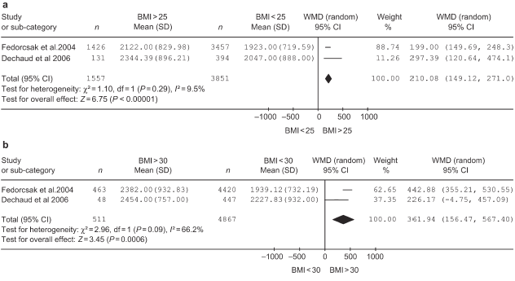
Obesity and Ovarian Stimulation
Total dose of gonadotropins: higher in OW and OB
WMD: weighted mean difference
Maheshwari et al, 2007 : 37 papers for effects of obesity on ART- 12 papers actually included

Slide 13
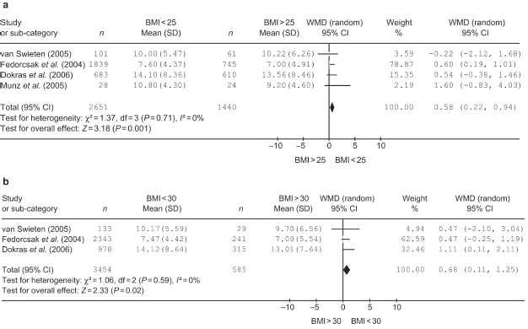
Obesity and Ovarian Stimulation
Retrieved oocytes: fewer in OW and OB
WMD: weighted mean difference
Maheshwari et al, 2007

Slide 14
Obesity and Oocyte Retrieval
Number of retrieved oocytes in OW/OB women
  Metanalysis of Maheshwari et al(2007): significantly decreased number
  Decreased number: 9 studies
  Similar number: 9 studies
Mechanisms
  Fewer growing follicles
  Technically difficult retrievals
    there are no studies confirming more difficult retrievals

Slide 15
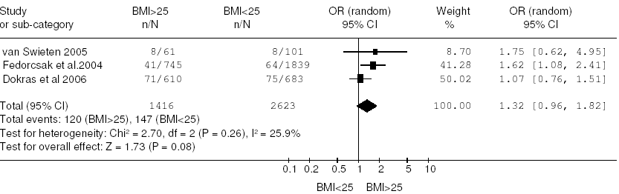
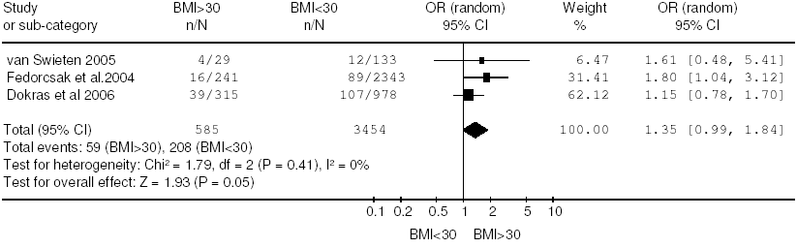
Obesity and Ovarian Stimulation
Cancellation rates: higher in OW and OB
  `
OR: odds ratio
Maheshwari et al, 2007

Slide 16
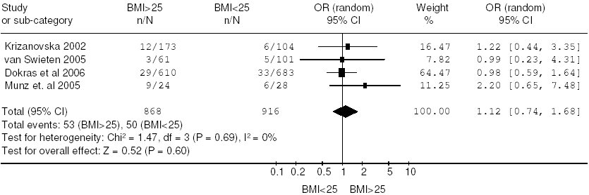
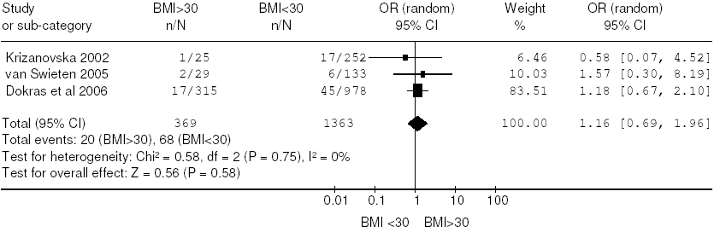
Obesity and Ovarian Stimulation
OHSS: higher in OW and OB
OR: odds ratio
Maheshwari et al, 2007

Slide 17
Obesity and Ovarian Stimulation
Bellver et al, 2009: the largest single center study (6500 IVF cycles)
  Total dose of gonadotropins: higher in OW and OB
  Number of retrieved oocytes: similar in NW/OW/OB
  Peak E2 levels: similar in NW/OW/OB
Studies with opposite conclusions [number of studies]
  Same response to gonadotropins in NW/OW/OB [4]
  Lower dose of gonadotropins in OB [5]
  Fewer days of stimulation in OB [3]
  Similar peak E2 levels [8]

Slide 18
Obesity and Ovarian Stimulation
‘Gonadotropin Resistance’
Exogenous FSH threshold increases with BMI
  Greater amount of body surface
  Differences in absorption and metabolic clearance
  Altered peripheral steroid metabolism and decreased SHBG levels
  Impaired absorption due to increased subcutaneous fat (not likely)
Role of leptin: high levels – resistance in OB
  High intra-follicular levels: associated with gonadotropin resistance
    Inhibitory effect on developing follicles
    Inhibits FSH and LH stimulated steroidogenesis in granulosa cells

Slide 19
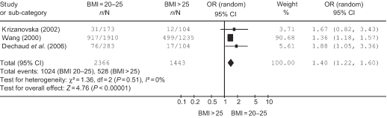
Obesity and Pregnancy Rates
BMI >25 vs 20-25: lower pregnancy rates
Maheshwari et al, 2007

Slide 20
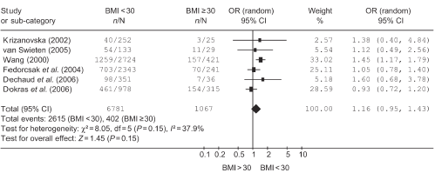
Obesity and Pregnancy Rates
BMI >30 vs <30: Lower Pregnancy Rates
Maheshwari et al, 2007

Slide 21
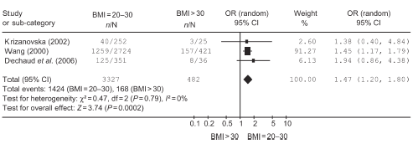
Obesity and Pregnancy Rates
BMI >30 vs 20-30: lower pregnancy rates
Maheshwari et al, 2007

Slide 22
Obesity and Pregnancy Rates
Metwally et al, 2007
no effect of BMI on clinical pregnancy rates
Martinuzzi et al, 2008
trend to lower implantation and ongoing pregnancy rates in
PCOS patients with high BMI
Sneed et al, 2008
analysis of the interaction BMIxAGE effect on pregnancy rates
in younger ages (<35 years) BMI has a significant negative impact
on implantation, pregnancy, and livebirth rates
it may be reasonable to delay treatment in younger women and
recommend weight loss

Slide 23
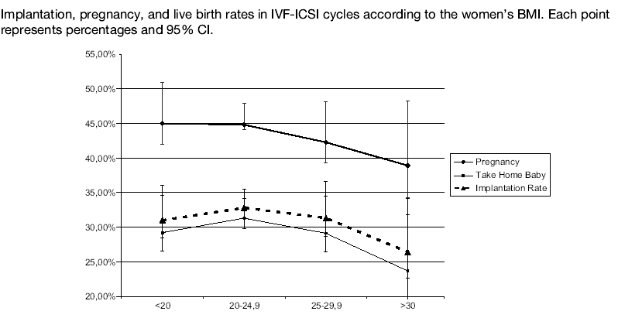
Obesity and Pregnancy Rates
In obese: Lower implantation, pregnancy, livebirth rates
In overweight: Lower implantation, pregnancy, livebirth rates
Raising BMI by 1 unit: odds for pregnancy decrease by 0.98
Reducing BMI by 1 unit: odds for pregnancy increase by 1.19
Bellver et al, 2009

Slide 24
Mechanisms for Reduced Pregnancy Rates
Difficult embryo transfers (ET)?
  ET under ultrasound guidance improves pregnancy rates
    proven [Cochrane Review, 2007]
  In obese: difficulty to see the air-bubble of the catheter and
  tendency for blood in the catheter tip [Martinuzzi et al, 2008]
Impaired oocyte-embryo quality?
Impaired endometrial receptivity?

Slide 25
Mechanisms for Impaired oocyte/embryo quality
High doses of gonadotropins due to ‘resistance’
  Impair embryo quality
    Abnormal embryonic development
    Reduced invasional capacity of blastocyst
  Induce defects in embryos and oocytes
  Induce chromosomal defects in oocytes
Inverse correlation between BMI and intra-follicular HCG concentrations
  Low concentrations affect embryo quality
  Becomes significant in obese women

Slide 26
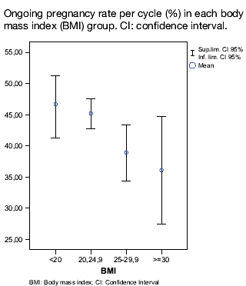
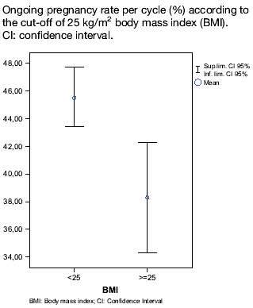
Obesity and Endometrium
Bellver et al, 2007
2656 first oocyte donation cycles
Lower implantation and pregnancy rates as BMI increases
Higher miscarriage rate as BMI increases
Lower ongoing pregnancy rate in OW and OB
ongoing PR
in BMI<25: 45.5%
in BMI>25: 38.3%

Slide 27
Obesity and Endometrium
Bellver et al, 2007
2656 first oocyte donation cycles
Excess weight may exert an extra-ovarian detrimental effect
The effect on the endometrium seems subtle but should be taken into account
Being overweight implies negative impact as being obese
Hyper-estrogenic state
  due to
    High activity of aromatase system: increased E production
    Decreased SHBG: increased free E2 delivered to target tissues
    Increased estrone – decreased inactive metabolites
  Results in
    Extremely thick endometrium: if>14mm is associated with lower PR (controversial)
    More endometrial polyps and more multiple polyps
Defective endometrium
  due to inverse correlation between BMI and
    E and PG receptors in endometrium
    LIF in endometrial glands
    leukocyte subpopulations

Slide 28
Mechanisms for impaired endometrium
Other effects
  Leptin resistance in peripheral tissues
  Insulin resistance and hyperinsulinemia
    Reduced glycodelin in endometrium: associated with recurrent pregnancy loss
    Reduced IGF-binding protein (facilitates adhesion at maternal-fetal surface)
  Increased acute phase proteins & pro-inflammatory cytokines (IL6, PAI-1, TNFa)
    Negative effect on endometrium and early embryonic development

Slide 29
Impact of obesity in Egg Recipients
Berewer , 2013,Fertil Steril
 | Implantation (%) | Clinical pregnancy (%)
Lean | 40.4 | 56.9
Normo weight | 39.9 | 55.9
Overweight | 38.5 | 54.3
Obese | 30.9 | 45.3
Notes:
In the lean, normoweight, overweight, and obese groups, the implantation rate was 40.4%, 39.9%, 38.5%, and 30.9%, clinical pregnancy rate was 56.9%, 55.9%, 54.3%, and 45.3%, and live-birth rate was 38.6%, 37.9%, 34.9%, and 27.7%, respectively. However, clinical miscarriage rates were similar in all the groups.
CONCLUSION(S):
Female obesity impairs the reproductive outcome of ovum donation probably as a result of reduced uterine receptivity.

Slide 30
Obesity and pregnancy complications
Increased miscarriage
PIH
Gestational diabetes
Induction of labor or C/S
Structural anomalies related to BMI
  25 .01-30 1.25
  30.01-40 1.58
  >40 3.41
All complications will be corrected in obese patinets but not is overweight(BMI>35kg/m2)
(Callaway, 2006 , Med J Austr)
Notes:
Obesity and pregnancy complications
Some reports demonstrated an increased miscarriage rate in obese women following spontaneous conception or assisted reproduction. However, removal of other confounding agents such as age and PCOS will show that miscarriage rate will not be higher in obese women undergoing ART [5].
Undoubtedly, obesity is associated with obstetric complica- tions such as pre-eclampsia, gestational diabetes, induction of labor and Cesarean section. This risk is correct when observed in obese but not just overweight patients (BMI < 35 kg/m2).
Maternal obesity has been claimed to be associated with an augmented risk of structural anomalies. Callaway et al. [1], showed that the adjusted ORs for congenital anomalies were 1.25 (0.85–1.87) for BMI 25.01–30kg/m2, 1.58 (1.02–2.46)
for BMI 30.01–40kg/m2 and 3.41 (1.67–6.94) for BMI > 40 kg/m2 compared with women with normal weight. These data, however, need to be read in the framework of risks in other clinical conditions such as diabetes in women with normal BMI. Maternal obesity has been suspected of being responsible for adult disease in the offspring, the exact mech- anism for such programing imperfections has yet to be con- vincingly proven.

Slide 31
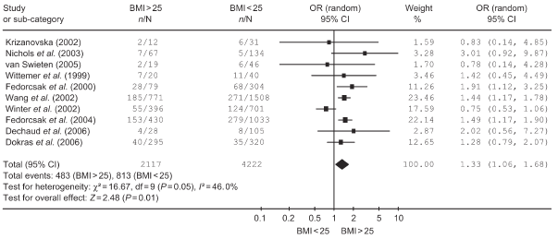
Obesity and miscarriages
BMI >25 vs <25: higher miscarriage rates
Maheshwari et al, 2007

Slide 32
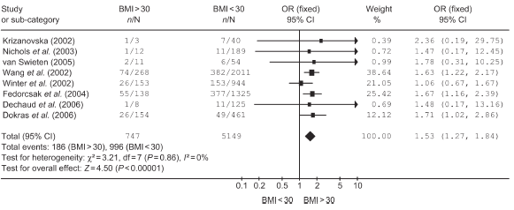
Obesity and miscarriages
BMI >30 vs <30: higher miscarriage rates
Maheshwari et al, 2007

Slide 33
BMI cut-off for Fertility Treatment
There is not any cut-off point for infertility treatment
NICE guideline : BMI <29kg/m2
BFS society guideline : fertility treatment should be postponed until BMI is less than 35kg/m2, but the BMI<30kg/m2 is better in women under 37 and normal FSH
Newzeland: reject the fertility treatment in women with BMI > 32kg/m2
This controversy means that a strict BMI rule is impracticable and unenforceable
Notes:
The evidence underlying recommendations for BMI cut-off for providing fertility treatment is weak and many of these BMI cut off values are random and perhaps based on experts’ opin- ions. The National Institute of Clinical Excellence (NICE) guideline suggests that it is appropriate to achieve a BMI of less than 29 kg/m2 prior to fertility treatment. The British Fer- tility Society (BFS) guideline endorses that fertility treatment should be postponed until a woman’s BMI is less than 35 kg/m2, but a BMI < 30 kg/m2 is better in women under 37 with normal FSH. In New Zealand, clinical priority access criteria implemented in 2000, confines women with BMI > 32 kg/m2 from having fertility treatment. This contro- versy means that a strict BMI rule is impracticable and unenforceable.
Although many studies advocate that weight loss improves reproductive performance, this is difficult to accomplish for many women. Conventional approaches such as lifestyle amendment, dietary control, increasing physical activity and pharmacotherapy such as metformin or orlistat produce di- verse results. Most fruitful weight loss intrusions result in 5– 10 kg weight loss per woman and this may be insufficient to permit them to cross a subjective BMI brink.
4. Conclusion
Overweight and obesity is common in women of reproductive age. Those who are choosing to postpone childbearing for the weight reduction should balance the negative effects of aging
versus obesity on fertility and perinatal outcomes. In women over 36, age has been shown to employ a stouter negative ef- fect on oocyte number, number of mature and fertilized oo- cytes, clinical pregnancy and live birth rates. However, there is no strong evidence for the association between obesity and live birth in infertile women. Thus, there is insufficient proof to refute women fertility treatment on grounds of BMI. Weight loss should be invigorated wherever possible and pre- conception counseling should be accessible.

Slide 34
Similar morphokinetic patterns in embryos derived from obese and normoweight infertile women: A time –lapse study
Embryos from obese and normo weight infertile women showed similar cleavage patterns, but occurring more slowly, to those from fertile donors.
These differences were statistically significant for:
t2 (time of cleavage to two-blastomere embryo) (P = 0.016),
t3 (P = 0.014),
t4 (P = 0.003)
t5 (P = 0.040).
Belver,Hum Reprod. 2013 ,
Notes:
Semin Reprod Med. 2012 Dec;30(6):507-16. doi: 10.1055/s-0032-1328879. Epub 2012 Oct 16.
Female obesity and assisted reproductive technologies.
Kumbak B, Oral E, Bukulmez O.
Source
IVF Unit, Department of Obstetrics and Gynecology, Fırat University Medical School, Elazig, Turkey.
Abstract
Obesity has grown to epidemic proportions, and currently nearly half of the reproductive-age women are overweight or obese. Risks, success rates, and economic aspects of infertility treatments in obese women have been extensively investigated. Unfavorable ovarian stimulation characteristics like increased gonadotropin consumption, fewer selected follicles, and lower number of retrieved oocytes have been observed in obese women undergoing assisted reproductive technologies (ART). There seems to be a strong association between increased body mass index and lower pregnancy and live-birth rates and increased miscarriage rate. Coexisting factors like age and polycystic ovary syndrome status have also been blamed for these adverse effects. The mechanisms underlying those adverse outcomes, whether ovarian or endometrial, still remain to be fully elucidated. Moreover, maternal, perinatal, and neonatal complications have also been reported to be higher in obese pregnant women. Hence in some countries strict restrictions exist for access to elective fertility treatment in obese women. However, it is controversial if these policies are socially and ethically acceptable. Furthermore, because weight reduction is not an easy task, it may lead to the decreased probability of conception due to the advancing reproductive age for many obese women. Thus weight reduction should be encouraged and patients counseled accordingly, but whether restriction for fertility treatment is implemented in obese women remains a matter of debate. There remains much to be known regarding the association between obesity and ART.

Slide 35
The impact of bariatric surgery on IVF outcomes
It is better to postpone to 12-18 months after surgery due to vitamin deficiency
From 5 patients after Bariatric surgery three of them became pregnant
The patient will be high risk after surgery due to preterm and IUGR due to vitamin deficiency and gastric disorders during pregnancy
Tan,Seminar in Reprodcutive 2012

Slide 36
obesity and IVF: Conclusions
Even though no evidence-based consensus obesity may have negative effects on
Ovarian stimulation parameters
Oocyte and embryo quality
Fertilization rates
Embryo transfer
Implantation rates
Pregnancy rates
Miscarriage rates

Slide 37
obesity and IVF: conclusions
fewer growing follicles
fewer retrieved
oocytes
difficult retrievals
reduced
implantation
and
pregnancy
rates
poor quality of oocytes
low fertilization rates
poor quality of embryos
poor outcome
impaired embryotransfer due to technical problems
increased
miscarriage
rates
impairment of endometrium and its receptivity

Slide 38


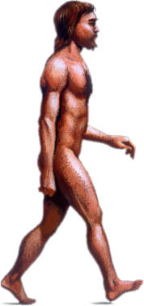


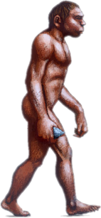
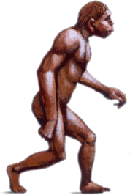

The Struggle Over the Millenia to Eliminate Arduous Effort Could Not Foresee Modern Technology

Slide 39
Lower fecundity in Obese women
The relative risk of anovulatory subfertiltiy in the obese women with BMI > 27 was 3.1 times of normal BMI( Hassan & Killik,2004)
0.1 unit increase in WHR led to a 30% decrease in probability of conception (Zaadstra,1993)
Leptin and hypothalic axis
Sexual dysfunction
  Unable to receive the semen
  Menstrual irregularity
  Secondary sexual dysfunction
    Decreased dopamine activity and increased serotonin level in brain(Brody,2004)

Slide 40
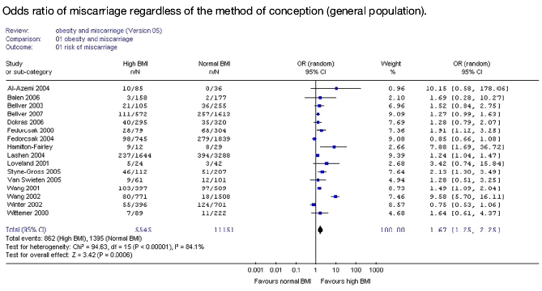
obesity and miscarriages
BMI >25 vs <25: higher miscarriage rates
Metwally et al, 2008: 25 studies(1964-2006) – 16 studies included – 16696 patients

Slide 41
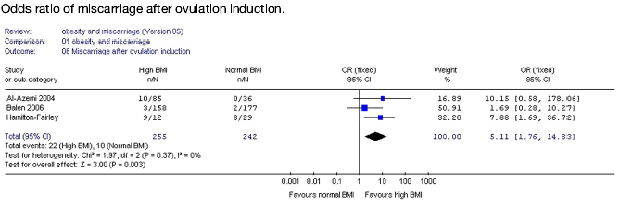
obesity and miscarriages
Odds ratio of miscarriage after ovulation induction: BMI>25 vs. <25: higher miscarriage rates
Odds ratio of miscarriage after IVF/ICSI: BMI>25 vs. <25: higher miscarriage rates
OR 1.52, 95%CI 0.88-2.61
Metwally et al, 2008
BUT problem with inclusion criteria (old age, PCOS) and publication bias (negative studies)

Slide 42
Mechanisms for Increased Miscarriages
Hormonal alterations
  Endometrial receptivity
  Trophoblast function
  Early embryo development
Insulin resistance
  Impaired progesterone release: inhibits normal corpus luteum function
  Reduced IGF binding protein
  Reduced aνb3 integrin
  Reduced adhesion molecules
  Reduced glycodelin in endometrium
Leptin
  when high or resistance: leads to insulin resistance state
  when low: detrimental to early embryo development and trophoblast invasion

Slide 43
obesity and IVF: most recent studies
Keltz et al, 2010
male overweight status was associated with significantly lower
clinical pregnancy rate after IVF (53.2% vs 33.6%), but not after ICSI
ICSI may overcome some obesity-related impairement of sperm-egg
interaction
Zhang et al, 2010
obese women
  higher FSH dose – more stimulation days – fewer oocytes – lower fertilization rates
overweight women
  fewer oocytes – lower fertilization rates –
  fewer cleavaged, high-grade and cryopreserved embryos
no differences in pregnancy/miscarriage/live birth rates
Vilarino et al, 2010
no differences in
  FSH dose-number of oocytes-fertilization rate-embryo quality-
  frozen embryos
  clinical pregnancy/miscarriage/live birth rates

Slide 44
Obesity and Ovarian Stimulation
Conflicting results
May be due to confounders
  PCOS
    Martinuzzi et al(2008): similar need for FSH but PCOS patients started with lower dose
    Dokras et al(2006): in BMI>40, PCOS patients had fewer cancellations and stimulation days compared to non-PCOS
  age
    Sneed at al (2008): high BMI has a more profound negative effect in number of retrieved oocytes in younger patients
    Martinuzzi et al (2008): included only young patients and found no effect of BMI on ovarian response

