Slide 1
In the name of God

Slide 2
Case presentation
Prepared by : Dr Atoosa Larijani
1400/9/22

Slide 3
Patient history
57-year-old man
Born & live in Gonbad kavous
Source of History : Patient , reliable
Chief complaint : Refer for endocrine evaluation due to high calcium

Slide 4
Present Illness
A 57-year-old man with bilateral lower limb pain preferably on the right, got worse with weight bearing from 6 months ago .
Fatigue : +
Weight Loss : + 16 kg
Anorexia: +
Bone pain : +
Depression: - Confusion : - Nausea : - Vomiting : - Constipation : - Polyuria : - back pain: - polydipsia : - Dysphagia: - Dyspene activity : -

Slide 5
Past history
History of kidney stones 4 years and 1 week ago
Smoker : Negative
Drug history : Negative
Past medical history : Negative
History of surgery : Negative
Fracture history : Negative

Slide 6
Family history
Family history of fractures : Negative
Problems of the mandible or maxilla : Negative
History of surgery on the mandible or maxilla : Negative
Family history of neck surgery : Negative

Slide 7
Physical examination
57-year-old man
BP: 125/70
BMI: 22
Bilateral lower limb force : 5/5
Tenderness on the right femur
Patrick test on the right : positive
Normal gait
Blind left eye
Mass in the jaw : Negative
Spine Tenderness : Negative

Slide 8
Lab Data
8/28 | 8/27 | 8/26 | 8/25 | 8/24 | 8/16
11.8 | 11.5 | 11.9 | 9.3 | 9.8 | 16.1 | Ca
 | 2.5 |  |  |  | 2.82 | P
 |  |  |  |  | 1756 | ALP
 |  |  |  |  | 1425 | PTH
 |  |  |  |  | 73.3 | Vit D3
1.4 |  | 1.7 |  | 1.9 |  | Cr

Slide 9
Urin 24 hour
1100 | Vol
689 | Cr
468 | Pro
325 | Ca

Slide 10
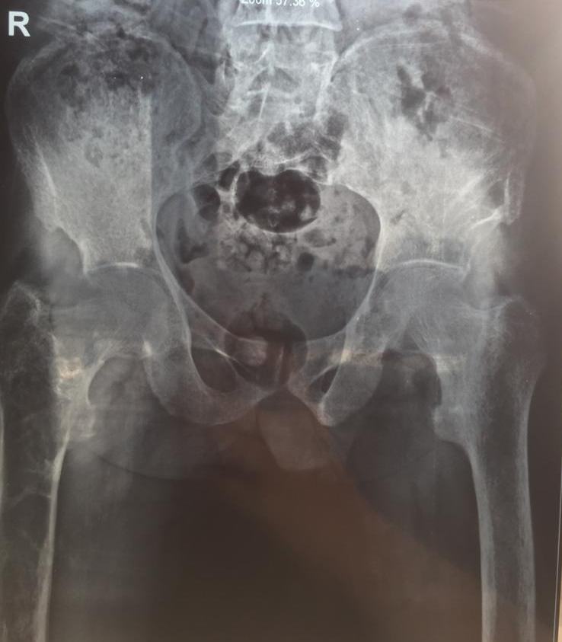
Hip radiology

Slide 11
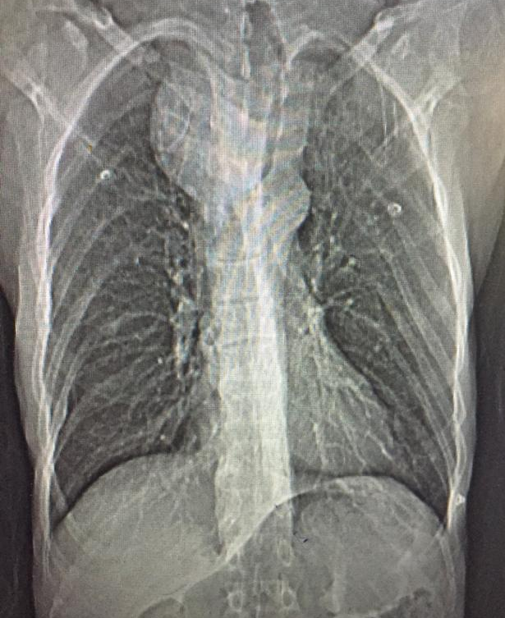
Chest X-Ray

Slide 12
CT without contrast

Slide 13
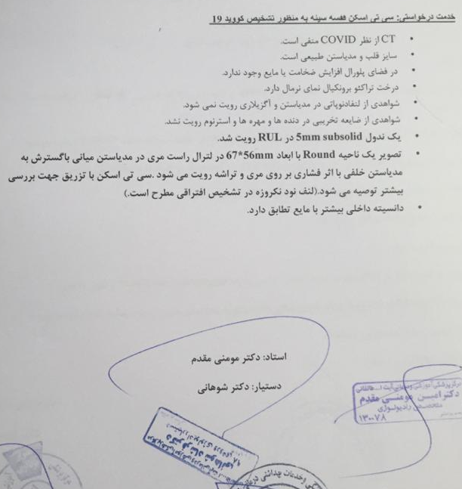
Lung CT Scan

Slide 14
CT with contrast

Slide 15
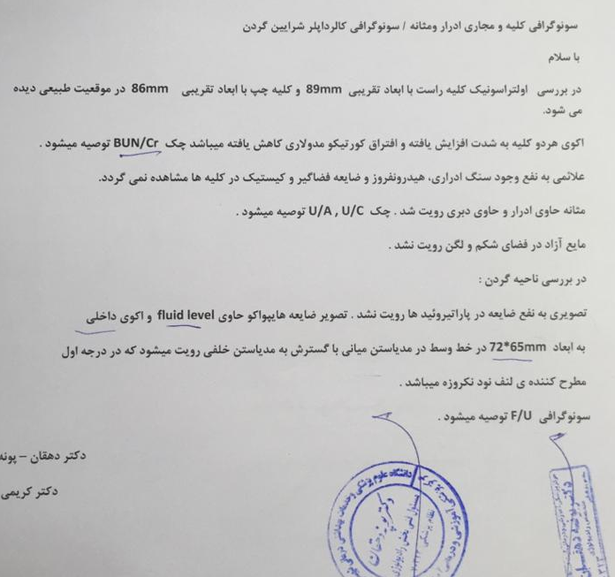
Sonography

Slide 16
BMD

Slide 17
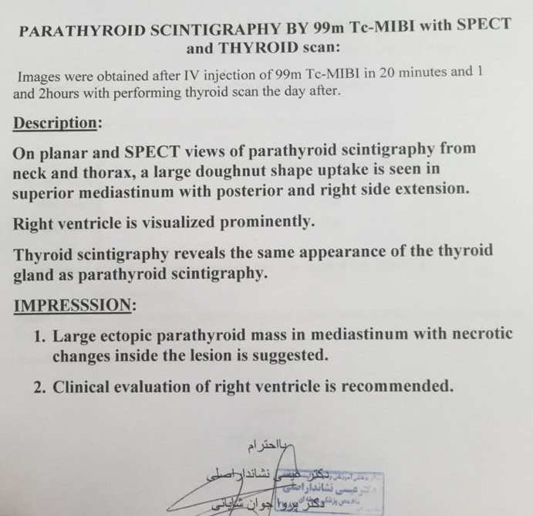
Tc 99-MIBI with SPECT

Slide 18
Problems List
A 57-year-old man with bilateral lower limb pain preferably on the right got worse with weight bearing from 6 months ago .
Fatigue : +
Weight Loss : 16 kg
Anorexia: +
Bone pain : +
Ca , ALP , PTH: High
Bone cystic lesions
Low bone density
Cystic mass in the middle mediastinum with a compressive effect on the esophagus and trachea

Slide 19
Diagnosis
Parathyroid carcinoma

Slide 20
Questions
When is parathyroid carcinoma considered for the patient?
What genetic syndromes cause parathyroid carcinoma?
When is genetic disease considered to be the cause of hyperparathyroidism?
What genes should be checked in a patient with parathyroid carcinoma?
What is the HPT-Jaw syndrome?
Why genetic testing is done for HPT-Jaw syndrome in parathyroid carcinoma ?
What is the prognosis of patients?
What is the treatment and follow-up of patients?
What should be do for following screening in CDC73 mutation carriers?

Slide 21
Clinical and biochemical features that should raise the suspect of parathyroid carcinoma:
Calcium albumin corrected > 3 mmol/L & ca >13 + PTH > 3 times the upper limit of normal range
parathyroid lesion > 3 cm at ultrasonography
Palpable neck mass (> 3 cm) in hypercalcemic patient with hyperparathyroidism
Hypercalcemia with unilateral cord palsy in patients that have never been undergone to surgical cervical operation
Concomitant severe renal and skeletal involvement in a hypercalcemic patient with hyperparathyroidism
Primary hyperparathyroidism in patient with Jaw tumor and/or belonging to a family with HPT/JT syndrome
Ultrasonographic features of an extrathyroidal neck lesion apparently belonging to a parathyroid
lesion eventually infiltrating the surrounding tissues
Local invasion and metastases found intraoperatively or before surgery on sesta MIBI parathyroid scintigraphy and/or on CT scans
Salcuni AS,, Parathyroid Carcinoma, Best Practice & Research Clinical Endocrinology & Metabolism 2018

Slide 22
high serum and urinary levels of human chorionic gonadotropin (hCG), especially its hyperglycosylated isoform, have been reported in PC, but not in PA patients, and have shown to be predictive of death and hip fractures,
Further studies are needed to elucidate the role of hCG as a potential tumor marker in PC
Salcuni AS,, Parathyroid Carcinoma, Best Practice & Research Clinical Endocrinology & Metabolism 2018

Slide 23
Questions
When is parathyroid carcinoma considered for the patient?
What genetic syndromes cause parathyroid carcinoma?
When is genetic disease considered to be the cause of hyperparathyroidism?
What genes should be checked in a patient with parathyroid carcinoma?
What is the HPT-Jaw syndrome?
Why genetic testing is done for HPT-Jaw syndrome in parathyroid carcinoma ?
What is the prognosis of patients?
What is the treatment and follow-up of patients?
What should be do for following screening in CDC73 mutation carriers?

Slide 24
Studies of hereditary and syndromic forms of PC:
hyperparathyroidism-jaw tumor syndrome (HPT-JT)
familial isolated primary hyperparathyroidism (FIHP)
multiple endocrine neoplasia types 1 and 2 (MEN1 and MEN2) (99.9% of MEN1-related tumors are benign)
have revealed some genetic mechanisms underlying PC.
Molecular genetics of syndromic and non-syndromic forms of parathyroid carcinoma Hum mutat 2017

Slide 25
Questions
When is parathyroid carcinoma considered for the patient?
What genetic syndromes cause parathyroid carcinoma?
When is genetic disease considered to be the cause of hyperparathyroidism?
What genes should be checked in a patient with parathyroid carcinoma?
What is the HPT-Jaw syndrome?
Why genetic testing is done for HPT-Jaw syndrome in parathyroid carcinoma ?
What is the prognosis of patients?
What is the treatment and follow-up of patients?
What should be do for following screening in CDC73 mutation carriers?

Slide 26
Young age onset (<40 years)
Multiglandular involvement,
Cystic, fibrotic , atypical parathyroid involvements,
Family members with hypercalcemia
Coexistence ossifying jaw fibroma, renal, tumor of the uterine, endocrine pancreas, thyroid, pituitary, adrenal gland
Parathyroid carcinoma
Parathyroid Carcinoma Clinical Endocrinology & Metabolism 2018

Slide 28
Questions
When is parathyroid carcinoma considered for the patient?
What genetic syndromes cause parathyroid carcinoma?
When is genetic disease considered to be the cause of hyperparathyroidism?
What genes should be checked in a patient with parathyroid carcinoma?
What is the HPT-Jaw syndrome?
Why genetic testing is done for HPT-Jaw syndrome in parathyroid carcinoma ?
What is the prognosis of patients?
What is the treatment and follow-up of patients?
What should be do for following screening in CDC73 mutation carriers?

Slide 29
In sporadic PC include germline MEN1 and rearranged during transfection (RET) mutations
Tumoral allelic loss in RB1, TP53, BRCA2 genes (somatic alterations)
A down-regulation of the TBX1 gene
ADCK1, FAT3, AKAP9, ZEB1
Molecular genetics of syndromic and non-syndromic forms of parathyroid carcinoma Hum mutat 2017

Slide 30
HRPT2(CDC73) mutations cause HPT-JT:
can be identified in up to 70% of patients with PC
in only ∼2% of parathyroid adenomas.
CDC73 germline mutations occur in 20%-40% of patients with sporadic PC and may reveal unrecognized HPT-JT.
This indicates that CDC73 mutations are major driver mutations in the etiology of PCs.
Molecular genetics of syndromic and non-syndromic forms of parathyroid carcinoma Hum mutat 2017

Slide 31
Questions
When is parathyroid carcinoma considered for the patient?
What genetic syndromes cause parathyroid carcinoma?
When is genetic disease considered to be the cause of hyperparathyroidism?
What genes should be checked in a patient with parathyroid carcinoma?
What is the HPT-Jaw syndrome?
Why genetic testing is done for HPT-Jaw syndrome in parathyroid carcinoma ?
What is the prognosis of patients?
What is the treatment and follow-up of patients?
What should be do for following screening in CDC73 mutation carriers?

Slide 32
HPT–JT is a rare autosomal dominant caused by inactivating
germ-line mutations of HRPT2 gene (CDC73), It is characterized by
familial HPT, ossifying jaw tumors, and other associated Neoplasms and increased risk of parathyroid carcinoma
Primary hyperparathyroidism : (80%) the main finding of HPT-JT syndrome, usually caused by a single-gland parathyroid involvement parathyroid carcinoma may occur in approximately (15-20%)
Benign and malignant uterine involvement :(50%) second most common clinical feature including leiomyomas, endometrial hyperplasia, adenomyosis, multiple adenomyomatous polyps, and adenosarcomas
Parathyroid Carcinoma Clinical Endocrinology & Metabolism 2018

Slide 33
Renal Involvement: (25–50%) Cystic kidney disease is the most common renal manifestation of this syndrome. some patients often develop hamartomas and rare renal tumors, such as adult Wilms’s tumors and mixed epithelial-stromal tumors (MEST).
Ossifying fibromas of the maxilla/mandible : (15%), benign and generally slowgrowing tumors arising from the periodontal ligament in molar or premolar areas. Enlarging visible or palpable mass, or in some cases, they are only detected on dental X-ray imaging. they appear to be radiographically radiolucen . complete surgical removal is the recommended treatment based on the size, location, and symptoms of the lesion.
Parathyroid Carcinoma Clinical Endocrinology & Metabolism 2018

Slide 34
Questions
When is parathyroid carcinoma considered for the patient?
What genetic syndromes cause parathyroid carcinoma?
When is genetic disease considered to be the cause of hyperparathyroidism?
What genes should be checked in a patient with parathyroid carcinoma?
What is the HPT-Jaw syndrome?
Why genetic testing is done for HPT-Jaw syndrome in parathyroid carcinoma ?
What is the prognosis of patients?
What is the treatment and follow-up of patients?
What should be do for following screening in CDC73 mutation carriers?

Slide 35
In about 30% of patient with a diagnosis of PC, germline mutations of some genes (mainly CDC73) lead to identify the carriers among relatives and early detect a parathyroid lesion.
In patients bearing a germline mutation of CDC73 gene, regular surveillance for jaw tumor, renal lesions and uterine tumors is indicated.
Molecular genetics of syndromic and non-syndromic forms of parathyroid carcinoma Hum mutat 2017

Slide 36
PHPT is the main finding of HPT-JT syndrome and is found in almost 100% of mutation carriers typically in late adolescence or early adulthood.
earliest reported age of hypercalcemia is 7 years .
median age of diagnosis of pHPT reported was 27 years (range 12–58)
Clinical Features, Treatment, and Surveillance of Hyperparathyroidism-Jaw Tumor Syndrome: An Up-to-Date and Review of the Literature 2019

Slide 37
Questions
When is parathyroid carcinoma considered for the patient?
What genetic syndromes cause parathyroid carcinoma?
When is genetic disease considered to be the cause of hyperparathyroidism?
What genes should be checked in a patient with parathyroid carcinoma?
What is the HPT-Jaw syndrome?
Why genetic testing is done for HPT-Jaw syndrome in parathyroid carcinoma ?
What is the prognosis of patients?
What is the treatment and follow-up of patients?
What should be do for following screening in CDC73 mutation carriers?

Slide 38
Prognosis
5-year survival range from 85 to 91% and 10-year survival from 49 to 87.6%
The causes of death are usually complications of untreatable hypercalcemia rather than tumor burden
The best chance of cure is the complete surgical resection with microscopically negative margins.
Other prognostic factors:
older age (> 65 years)
male gender
tumor size
presence of distant metastases
higher serum calcium level at diagnosis (> 15 mg/dL)
loss of parafibromin expression
vascular invasion,
Parathyroid Carcinoma Clinical Endocrinology & Metabolism 2018

Slide 39
Recurrence is common in PC patients; indeed, it has been observed in about 50% of operated patients 2-4 years after initial surgery even if prolonged disease-free survival interval up to 23 years has been reported
Parathyroid Carcinoma Clinical Endocrinology & Metabolism 2018

Slide 40
Questions
When is parathyroid carcinoma considered for the patient?
What genetic syndromes cause parathyroid carcinoma?
When is genetic disease considered to be the cause of hyperparathyroidism?
What genes should be checked in a patient with parathyroid carcinoma?
What is the HPT-Jaw syndrome?
Why genetic testing is done for HPT-Jaw syndrome in parathyroid carcinoma ?
What is the prognosis of patients?
What is the treatment and follow-up of patients?
What should be do for following screening in CDC73 mutation carriers?

Slide 41
Reduction of hypercalcemia should be reached with debulking of tumoral tissues when possible, and medical treatment (hydration, bisphosphonates and/or denosumab, and cinacalcet)
The primary surgical treatment of PC is at least the en-bloc resection of parathyroid and ipsilateral thyroid lobe
Since recurrences are frequent, multiple surgical interventions are often needed
Patients with PC should be followed up for their lifetime
Parathyroid Carcinoma Clinical Endocrinology & Metabolism 2018

Slide 42
At initial presentation, lymph node metastases have been observed in up to 15-20% and distant metastases in 1%. (mainly at lung but also at liver, bone and other tissues as brain)
The management of recurrent or metastatic disease :
mainly surgical
Radiotherapy and chemotherapy does not demonstrate to be effective in the treatment of PC
Ultrasound-guided percutaneous ethanol injection has been employed in a patient with recurrent unresectable PC with a transitory decrease in PTH and calcium levels
Radiofrequency ablation has been used for treatment of pulmonary or hepatic metastases of functioning PC
Parathyroid Carcinoma Clinical Endocrinology & Metabolism 2018

Slide 43
Follow-up
The aim of Follow-up (FU) is early detection of loco regional recurrence and/or metastases for lifetime:
Measuring of calcium and PTH biannually for the first 5 years, then annually
Performing neck ultrasounds annually
In patients that were not operated on with en-bloc resection:
closer FU should be performed
Measuring calcium and PTH every 3 months for the first 3 years, then biannually till 5th year, finally yearly lifelong
Parathyroid Carcinoma Clinical Endocrinology & Metabolism 2018

Slide 44
Questions
When is parathyroid carcinoma considered for the patient?
What genetic syndromes cause parathyroid carcinoma?
When is genetic disease considered to be the cause of hyperparathyroidism?
What genes should be checked in a patient with parathyroid carcinoma?
What is the HPT-Jaw syndrome?
Why genetic testing is done for HPT-Jaw syndrome in parathyroid carcinoma ?
What is the prognosis of patients?
What is the treatment and follow-up of patients?
What should be do for following screening in CDC73 mutation carriers?

Slide 45
Biannual evaluation of Ca and PTH for pHPT screening, possibly starting at the age of 5 and periodic parathyroid ultrasound examination
Panoramic X-ray dental imaging at least every 5 years
Monitor for kidney lesions by periodic renal ultrasound examination, MRI, or CT scan at least every 5 years, starting at the age of diagnosis
regular gynecologic care, including pelvic ultrasound examination with eventually further imaging studies if clinically indicated Starting at the reproductive age in women .
Clinical Features, Treatment, and Surveillance of Hyperparathyroidism-Jaw Tumor Syndrome: An Up-to-Date and Review of the Literature 2019

Slide 46
Thank you for your attention

