Slide 1
Type1Diabetes Through the Life Span: A Position Statement of the American Diabetes Association
Diabetes Care June 16, 2014
MaryamRezaei.MD

Slide 2
This position statement summarizes available data speciﬁc to the comprehensive care of individuals with type 1 diabetes.
The goal is to enhance our ability to
recognize and manage type 1 diabetes, to prevent its associated complications,
and to eventually cure and prevent this disease.

Slide 3
INCIDENCE AND PREVALENCE OF TYPE 1 DIABETES
The exact number of individuals with type 1 diabetes around the world is not known, but in the U.S., there are estimated to be up to 3 million.
Worldwide 78,000 youth are diagnosed with type 1 diabetes annually.

Slide 4
The number of adults living with type 1 diabetes is increasing due to two factors:
1) the rising number of new-onset cases of type 1 diabetes in adults, including those diagnosed with latent autoimmune diabetes in adults (LADA), and
2) individuals with childhood-onset diabetes are living longer

Slide 5
CLASSIFICATION AND DIAGNOSIS
Type 1 diabetes has traditionally been diagnosed based on clinical catabolic symptoms
suggestive of insulin deﬁciency:
polyuria, polydipsia, weight loss, and marked hyperglycemia that is nonresponsive to oral agents.
It is classiﬁed as an autoimmune disease with progressive b-cell destruction, resulting in a physiological dependence on exogenous insulin.

Slide 6
Pancreatic Autoantibodies
Pancreatic autoantibodies are characteristic of type 1 diabetes.;98% of individuals with autoantibodies at diagnosis GADA, islet cell antibodies (ICA), insulin autoantibodies (IAA), protein tyrosine phosphatase antibodies (ICA512 or IA2A), and zinc transporter protein (ZnT8).

Slide 7
Family History
Type 1 diabetes has a genetic predilection and, in some cases, can be predicted in family members.
The overall prevalence of type 1 diabetes in the U.S. is ;0.3%, but if a ﬁrst-degree relative has diabetes, the empiric risk of being affected is ;5% , representing a 15-fold increase among family members

Slide 8
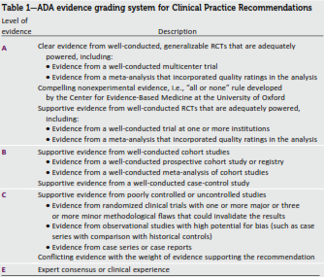

Slide 9
Diagnosis
The American Diabetes Association’s (ADA’s) diagnostic criteria for type 1and type 2 diabetes are the same. (A)
Consider measurement of pancreatic autoantibodies to conﬁrm the diagnosis of type 1 diabetes. (B)
Identiﬁcation of At-Risk Relatives
Inform type 1 diabetic patients of the opportunity to have their relatives tested for type 1 diabetes risk in the setting of a clinical research study. (B)

Slide 10
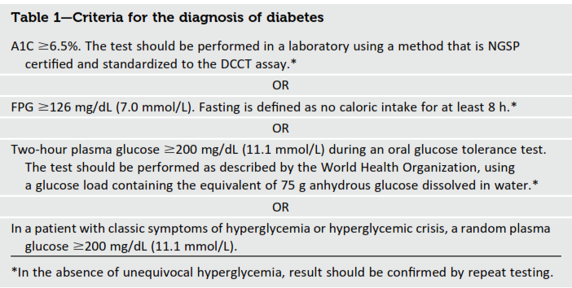

Slide 11
INITIAL EVALUATION AND FOLLOW-UP
General Considerations
All patients with type 1 diabetes need age-appropriate care, with an understanding of their speciﬁc needs and limitations

Slide 13
Transition of Care From Pediatric to Adult Providers
The ADA recognizes that this is a challenging time and recommends a strong, practical transition plan to anticipate the up-coming changes. A successful transition plan should be initiated early (e.g., early teenage years).

Slide 15
Coexistent Autoimmunity
Celiac Disease
1–16% of individuals compared with 0.3–1% in the general population
Screening for celiac disease with serum levels of tissue transglutaminase or antiendomysial antibodies should be considered soon after the diagnosis of diabetes and/or if symptoms develop.

Slide 16
Individuals who test positive should be referred to a gastroenterologist for possible small-bowel biopsy
Asymptomatic at-risk children should have a biopsy

Slide 17
Adrenal insufﬁciency may also deteriorate metabolic control with increased risk of symptomatic hypoglycemia and may reduce linear growth in children.
About one-quarter of children with type1 diabetes have thyroid autoantibodies (thyroid peroxidase antibodies or antithyroglobulin antibodies) at the time of diagnosis.
Thyroid dysfunction is more common in adults with type 1 diabetes .
Women are more commonly affected than men.

Slide 19
Chronic Complications in Children
Retinopathy, nephropathy, and neurop-athy rarely have been reported in prepubertal children and children with
diabetes duration of only 1–2 years ,they may occur after the onset puberty or after 5-10 years of diabetes

Slide 20
Nephropathy
Optimize glucose control to reduce the risk or slow the progression of nephropathy. A
Optimize blood pressure control to reduce the risk or slow the progression of nephropathy. A
Screening
Perform an annual test to quantitate urine albumin excretion in type 1 diabetic patients with diabetes duration of $5 years. B

Slide 21
Treatment
c An ACE inhibitor or ARB for the
primary prevention of diabetic kidney
disease is not recommended in
diabetic patients with normal blood
pressure and albumin excretion ,30
mg/24 h. B
c Either ACE inhibitors or ARBs (but not
both in combination) are
recommended for the treatment of
the nonpregnant patient with
modestly elevated (30–299 mg/24 h)
C or higher levels (.300 mg/24 h) of
urinary albumin excretion. A

Slide 22
For people with diabetes and diabetic
kidney disease (albuminuria .30 mg/
24 h), reducing the amount of dietary
protein below usual intake is not
recommended because it does not

Slide 23
alter glycemic measures,
cardiovascular risk measures, or the
course of GFR decline. A
c When ACE inhibitors, ARBs, or
diuretics are used, monitor serum
creatinine and potassium levels for
the development of increased
creatinine or changes in potassium. E

Slide 24
Continued monitoring of urine
albumin excretion to assess both
response to therapy and
progression of disease is
reasonable. E
c When eGFR is ,60 mL/min/1.73 m
,
evaluate and manage potential
complications of CKD. E
c Consider referral to a physician
experienced in the care of kidney
disease for uncertainty about the
etiology of kidney disease, difﬁcult
management issues, or advanced
kidney disease. B

Slide 25
Retinopathy
Optimize glycemic control to reduce the risk or slow the progression of retinopathy. A
Optimize blood pressure control to reduce the risk or slow the progression of retinopathy. A
Screening
Adults with type 1 diabetes should have an initial dilated and comprehensive eye examination by an ophthalmologist or optometrist within 5 years after the onset of diabetes. B

Slide 26
If there is no evidence of retinopathy for one or more eye exams, then exams every 2 years may be considered. If diabetic retinopathy is present subsequent examinations for type 1 and type 2 diabetic patientsshould be repeated annually by an ophthalmologist or optometrist. If retinopathy is progressing or sight threatening, then examinations will be required more frequently. B

Slide 27
Women with preexisting diabetes who are planning pregnancy or who have become pregnant should have a comprehensive eye examination and be counseled on the risk of development and/or progression of diabetic retinopathy. Eye examination should occur in the ﬁrst trimester with close follow-up throughout pregnancy and for 1 year postpartum. B

Slide 28
Neuropathy
c All patients should be screened for distal symmetric polyneuropathy ( 5 years after the diagnosis of type 1) diabetes and at least annually thereafter, using simple clinical tests. B
c Electrophysiological testing or referral to a neurologist is rarely needed, except in situations where the clinical features are atypical. E

Slide 29
Medications for the relief of speciﬁc symptoms related to painful DPN and autonomic neuropathy are recommended because they may reduce pain B and improve quality of life. E

Slide 30
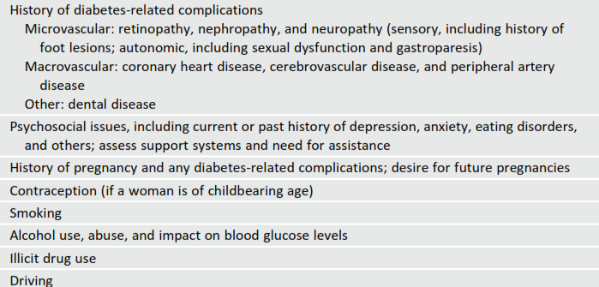

Slide 31
Access to health care
Access to health care should include clinicians with expertise in type 1 diabetes management, including an endocrinologist, a registered dietitian,a diabetes educator, a mental health professional, an exercise specialist/physiologist, and specialists required to treat diabetes complications (E)

Slide 32
Routine follow-up
(generally quarterly) should include review of SMBG,CGM and pump data , A1C measurement, evidence for acute and/or chronic complications of diabetes (particularly episodes of DKA and mild and/or severe hypoglycemia), measurement of blood pressure and weight (and heightinchildren),
foot exam, inspection of injection/insertion sites, and discussion of psychosocial and educational needs (E)

Slide 33
Providers should routinely document the patient’s age and disease duration When clinically indicated, laboratory measures such as lipids, renal function measurements, and antibodies for associated autoimmun disease (thyroid or celiac disease) should be documented (E)

Slide 34
Parent/guardian involvement in care is required throughout childhood,with a gradual shift in responsibility of care from the parent/guardian to the youth (E)

Slide 35
Health care for adults should be focused on the needs of the individual throughout the various stages of their life, with age-appropriate evaluation and treatment (E)
Evaluation and treatment of CVD risk should be individualized (E)

Slide 36
Immunizations should be given as recommended by the Centers for Disease Control and Prevention (CDC) for children/adults in general and people with diabetes specifically(C)
C

Slide 37
Consider screening for celiac disease by measuring IgA antitissue transglutaminase or antiendomysial antibodies,with documentation of normal total serum IgA levels, soon after the diagnosis of diabetes and/or if symptoms develop. Refer the patient to agastroenterologist if the test is positive(E)

Slide 38
Consider screening for thyroid peroxidase and
thyroglobulin antibodies soon after diagnosis(E)
Screen for thyroid dysfunction by measuring TSH concentrations soon after type 1 diabetes diagnosis (and after stable metabolic control). If normal, consider rechecking every 1–2 years or more frequently if the patient develops unusual glycemic variation or symptoms of thyroid dysfunction or thyromegaly. (E)

Slide 39
Assess psychosocial status annually and more often as needed; treat and/or refer to a mental health professional as indicated(E)

Slide 40
Diabetes education should occur at diagnosis and
upon transition to adult diabetes care and should
be an ongoing process. The information needs to
be individualized and continually adapted to the
patient’s needs.

Slide 41
DSME AND DSMS
Individuals with type 1 diabetes and parents/caregivers (for individuals aged ,19 years) should receive culturally sensitive and developmentally appropriate individualized DSME and DSMS according to national standards for DSME and DSMS when their diabetes is diagnosed and routinely thereafter (B)

Slide 42
Additional Considerations for Pediatrics
Education should be provided to appropriate school personnel as a significant portion of achild’s day is spent in school. (E)

Slide 43
The developing teenager must be educated
about the transition to adult health care,
beginning in early to mid adolescence, with
increasing efforts to establish self-reliance in
diabetes care beginning at least 1 year prior
to the transition. Even after the transition to
adult care is made, support an reinforcement
are recommended (E)

Slide 44
Additional Considerations for Adults
Adult learning theory can be used to tailor DSME and DSMS to the age, life stage, culture, literacy/numeracy,knowledge, experience, and cognitive ability of the patient (C)

Slide 45
Depression screening and discussion about psychosocial issues are important components of the diabetes visit.
Special attention should be paid to diabetes related
distress, fear of hypoglycemia(and hyperglycemia), eating disorders, insulin omission, subclinical depression,
and clinical depression.

Slide 46
Age-appropriate screenings for
psychosocial issues is a component of most
diabetes visits. Any concerns should be
pursued through treatment that may include
referral to a mental health specialist. (E)

Slide 47
Directly ask about diabetes-related family conﬂict and stress and negotiate an acceptable resolution with the child/adolescent and parent(s).
How-ever, if family conﬂict is extremely entrenched and cannot be resolved by the diabetes team, referral should be made to a mental health specialist who is knowledgeable about type 1 diabetes in youth and family functioning. (C)
Notes:
maryam

Slide 48
NUTRITION THERAPY
Each patient should have an individualized food plan based on food preferences, schedule, and physical activity.

Slide 49
Individualized medical nutrition therapy is
recommended for all people with type 1
diabetes as an effective component of the
overall treatment plan (A)
Monitoring carbohydrate intake,whether by
carbohydrate counting or experience-
based estimation,remains a key strategy in
achieving glycemic control (B)

Slide 50
If adults with type 1 diabetes choose to drink alcohol, they should be advised to do so in moderation(one drink per day or less for adult women and two drinks per day or less foradult men).
Adults should be advised that alcohol can lower blood glucose levels and that driving after drinking alcohol is contraindicated.(E)

Slide 51
PHYSICAL ACTIVITY AND EXERCISE
exercise creates challenges for people with type 1 diabetes due to the increased risk for both hypoglycemia and hyperglycemia.
when people with type 1 diabetes are deprived of insulin for 12–48 h and are ketotic, exercise can worsen hyperglycemia and ketosis.
Physical activity increases hypoglycemia risk during and immediately following exercise, and, again, about 7–11 h postexercise.

Slide 52
Exercise should be a standar recommendation as it is for individuals without diabetes however recommendations may need modiﬁcations due to the presence of macro- and microvascular diabetes complications.(E)

Slide 53
Patients of all ages (or caregivers of
children) should be educated about the
prevention and management of
hypoglycemia that may occur during or after
exercise(E)
Patients should be advised about safe
pre exercise blood glucose levels (typically
100 mg/dL or higher (depending on the
individual and type of physical activity)(E)

Slide 54
Reducing the prandial insulin dose for the
meal/snack preceding exercise and/or
increasing food intake can be used to help
raise the preexercise blood glucose level
and reduce hypoglycemia.(E)
A reduction in overnight basal insulin the
night following exercise may reduce the
risk for delayed exercise induce
hypoglycemia.(C)

Slide 55
SMBG should be performed as frequently
as needed (before, during,and after exercise) in order
toprevent,detect, and treat hypoglycemia and
hyperglycemia(E)
Source(s) of simple carbohydrate should be readily
available before,during, and after exercise to prevent
and treat hypoglycemia(E)

Slide 56
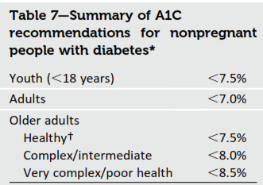
TREATMENT TARGETS

Slide 57
Lifestyle, psychosocial, and medical circumstances should be considered when recommending glycemic goals for all age-groups(E)

Slide 58
Glycemic Control Goals in Pediatrics
optimizing glycemic control in adolescent patients with type 1 diabetes is especially challenging.
The traditional recommendations are an A1C goal of ,8.5% for youth under the age of 6 years, ,8% for those 6–12 years old, and ,7.5% for those13–19 years old.
An A1C goal of ,7.5%is recommended across all pediatric age-groups. (E)
the overall recommendation has included
the goal to achieve as close to
normal blood glucose and A1C levels as
ispossiblewithouttheoccurrenceof
severe, recurrent hypoglycemia
c An A1C goal of ,7.5%is recommended
across all pediatric age-groups. (E)

Slide 59
The ADA strongly believes that blood glucose and A1C targets should be individualized with the goal of achieving the best possible control while minimizing the risk of severe hyperglycemia and hypoglycemia and maintaining normal growth and development.
Currently, treatment strategies for children recommend physiological insulin replacement with modern strategies and treatment tools.

Slide 60
Lowering A1C to below or around 7% has been shown to reduce microvascular complications of diabetes, and,if achieved soon after the diagnosis of diabetes, is associated with long-term reduction in macrovascular disease Therefore, a reasonable A1C goal for many nonpregnant adults with type 1 diabetes is ,7%. (B)

Slide 61
Providers might reasonably suggest more stringent A1C goals (such as,6.5%) for select individual patients,if this can be achieved without signiﬁcant hypoglycemia or other adverse effects of treatment.Appropriate patients might include those with a short duration of diabetes, a long life expectancy, hypoglycemia awareness, and no signiﬁcant CVD. (C)

Slide 62
Less stringent A1C goals (such as,8.5%) may be appropriate for patients with a history of severe hypoglycemia, hypoglycemia unawareness,limited life expectancy, advanced microvascular/macrovascular complications,or extensive comorbid conditions.(B)
Glycemic control for those of any age with type 1 diabetes should be assessed based on frequent SMBG levels(and CGM data, if available) in addition to A1C in order to direct changes in therapy. (B)

Slide 63
SMBG is a crucial component of effective therapy.
SMBG results are useful in preventing hypoglycemia, adjusting medications and understanding the impact of appropriate nutrition therapy and physical activity.
More frequent SMBG is correlated to lower A1C levels
SMBG frequency and timing should be dictated by the
patient’sspeciﬁc needs and goals.

Slide 64
Patients with type 1 diabetes should perform SMBG prior to meals and snacks, at a minimum, and at other times, including postprandially to assess insulin-to-carbohydrate ratios; at bedtime; midsleep; prior to, during, and/or after exercise; when they suspect low blood glucose; after treating low blood glucose until they have restored normoglycemia;when correcting a high blood glucose level; prior to critical tasks such as driving; and at more frequent inter-vals during illness or stress. (B)

Slide 65
Individuals with type 1 diabetes need to test strips for blood glucose testing.Regardless of age, individuals may require10 or more strips daily to monitor for hypoglycemia, assess insulin needs prior to eating, and determine if their blood glucose level is safe enough for overnight sleeping. (B)

Slide 66
Perform the A1C test quarterly in most patients with type 1 diabetes and more frequently as clinically indicated(i.e., pregnancy). (A)

Slide 67
Most individuals with type 1 diabetes should be treated with multiple daily insulin injections (three or more injections per day of prandial insulin and one to two injections of basal insulin) or CSII. (A)
Most individuals with type 1 diabetes should be educated in how to match prandial insulin dose to carbohydrate intake, premeal blood glucose, and anticipated activity. (E)

Slide 68
Most individuals with type 1 diabetes should use insulin analogs to reduce hypoglycemia risk. (A)
All individuals with type 1 diabetes should be taught how to manage blood glucose levels under varying circumstances, such as when ill or receiving glucocorticoids or for those on pumps, when pump problems arise. (E)

Slide 69
Child caregivers and school personnel should be taught how to administer insulin based on provider orders when a child cannot self-manage and is out of the care and control of his or her parent/guardian. (E)

Slide 70
b-CELL REPLACEMENT THERAPY
Pancreas Transplants
Islet Transplantation

Slide 71
Consider solid organ pancreas transplantation simultaneously with kidney transplantation in patients with type 1diabetes who have an indication for kidney transplantation and are poorly controlled with large glycemic excursions.(B)
Consider solid organ pancreas transplantation after kidney transplantation in adult patients with type 1 diabetes who have already received a kidney transplant. (C)

Slide 72
Judiciously consider solid organ pancreas transplantation alone in adults with type 1 diabetes, unstable glucose control, hypoglycemia unawareness,and an increased risk of diabetesrelated mortality, who have attempted all of the more traditional approaches to glycemic control and have remained unsuccessful. (C)

Slide 73
Consider referral to research centers for protocolized islet cell transplantation in patients with type 1 diabetes and debilitating complications of diabetes who are interested in research possibilities and ﬁt the criteria for the research protocol. (E)

Slide 74
ADJUNCTIVE THERAPIES
Pramlintide
Pramlintide, an amylin analog, is an agent that delays gastric emptying,blunts pancreatic secretion of glucagon,and enhances satiety.
It is an FDAapproved therapy for use in type 1 diabetic patients and has been shown to reduce A1C, induce weight loss, and lower insulin dose
it is only indicated for adults.

Slide 75
Incretin-Based Therapies
Sodium-Glucose Cotransporter 2 Inhibitors
Metformin
Two randomized controlled trials are currently under way evaluating metformin in type 1 diabetic patients.
Sodium-Glucose Cotransporter 2
Inhibitors

Slide 76
Pramlintide may be considered for use as adjunctive therapy to prandial insulin in adults with type 1 diabetes failing to achieve glycemic goals. (B)
Evidence suggests that adding metformin to insulin therapy may reduce insulin requirements and improve metabolic control in overweight/obese patients and poorly controlled adolescents with type 1 diabetes, but evidence from larger longitudinal studies is required. (C)

Slide 77
Current type 2 diabetes medications(GLP-1 agonists, DPP-4 inhibitors, and SGLT2 inhibitors) may be potential therapies for type 1 diabetic patients,but require large clinical trials before use in type 1 diabetic patients. (E)

Slide 78
HYPOGLYCEMIA
Hypoglycemia unawareness is related to a reduced it can occur in the setting of recurrent hypoglycemia or autonomic failure and can be reversed by scrupulous
avoidance of hypoglycemia.

Slide 79
Individuals with type 1 diabetes, or their caregivers, should be asked about symptomatic and asymptomatic hypoglycemia at each encounter. (E)

Slide 80
Glucose (15–20 g) is the preferred treatment for the conscious individual with hypoglycemia, although any form of carbohydrate may be used. If the SMBG result 15 min after treatment shows continued hypoglycemia,the treatment should be repeated.Once blood glucose concentration returns to normal, the individual should consume a meal or snack to preven recurrence of hypoglycemia. (E)
Glucagon should be prescribed for all individuals with type 1 diabetes.Caregivers or family members of these individuals should be instructed in it administration. (E)

Slide 81
Hypoglycemia unawareness or one or more episodes of severe hypoglycemia should trigger re evaluation of the treatment regimen. (E)
Insulin-treated patients with hypoglycemia unawareness or an episode of severe hypoglycemia should be ad-vised to raise their glycemic targets to strictly avoid further hypoglycemia for at least several weeks to partially reverse hypoglycemia unawareness and reduce the risk of future episodes. (B)

Slide 82
Individuals and caregivers of individuals with type 1 diabetes should be educated and reminded annually how to prevent DKA, including a review of sick-day rules and the critical importance of always administering insulin and monitoring both glucose and ketone levels. (B)

Slide 83
Insulin omission is the major cause of DKA; therefore, individuals with type 1 diabetes must have access to an uninterrupted supply of insulin. (E)
Standard protocols for DKA treatment should be available in emergency departments and hospitals. (E)

Slide 84
CVD SCREENING AND TREATMENT
people with type 1 diabetes are at increased risk for CVD
An adult with childhood onset type 1 diabetes of 20-year duration has a substantially increased risk of coronary artery disease of 1% per year
For people with type 1 diabetes, providers need to individualize assess-ment and treatment options
people with type 1 diabetes are
at increased risk for CVD, particularly
those with additional risk factors.

Slide 85
Therapy for those under age 40 years with less than a 20-year diabetes duration (or over age 75 years) should be considered on an individual basis, though, depending on overall risk, an LDL cholesterol ,100 mg/dL has been
suggested as an appropriate goal with statin intervention for those with LDL cholesterol levels of 130–160 mg/dL.(E)

Slide 86
Individuals with type 1 diabetes aged 40–75 years may beneﬁt from moderateto-intensive statin therapy with consideration of diabetes duration and CVD risk factors. (B)

Slide 87
Pregnancy
Type 1 diabetes affects approximately 0.1–0.2% of all pregnancies
Women who are planning pregnancy or who are pregnant may need to test blood glucose levels frequently (often10 or more times daily) to reach and maintain a near-normal A1C level with-out excessive hypoglycemia

Slide 88
Blood pressure goals of systolic blood pressure 110–129 mmHg and diastolic blood pressure 65–79 mmHg are reasonable.
Lower blood pressure levels may be associated with impaired fetal growth.
Anti hypertensive drugs known to be effective and safe in pregnancy include methyldopa,labetalol, diltiazem, clonidine, and prazosin.

Slide 89
Eye examinations should occur in the ﬁrst trimester with close follow-up throughout pregnancy and for 1 year postpartum because of the risk of rapid retinopathy progression during pregnancy.
All pregnant women with type 1 diabetes should be screened for thyroid disease early in pregnancy.( 31% )

Slide 90
Starting at puberty, preconception counseling should be incorporated into routine diabetes clinic visits for all adolescents and women of childbearing potential, and appropriate birth control techniques should be discussed with women who do not desire pregnancy. (C)

Slide 91
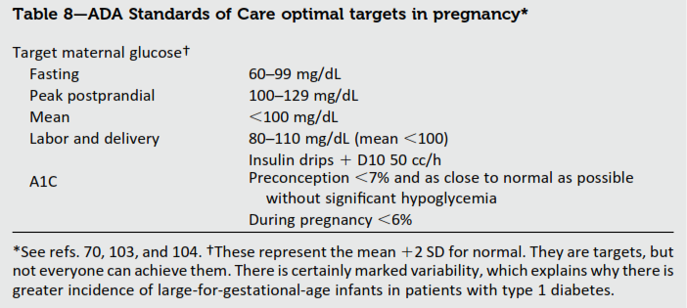

Slide 92
As most pregnancies are unplanned,consider the potential risks and beneﬁts of medications that are contraindicated in pregnancy in all adolescents and women of childbearing potential and counsel women using such medications accordingly. (E)
c

Slide 93
Such medications should be evaluated prior to conception, as drugs commonlyused to treat diabetes and its complications may be contraindicated or not recommended in pregnancy, including statins, ACE inhibitors, angiotensin receptor blockers, and most noninsulin therapies. (B)

Slide 94
Prenatal vitamins with folate should be started with preconception planning to reduce the risk for birth defects.(B)
All pregnant women with type 1 diabetes should be screened for thyroid disease early in pregnancy. (B)

Slide 95
Women contemplating pregnancy should be evaluated and, if indicated,treated for diabetic retinopathy, nephropathy,neuropathy, and CVD.(B)
A1C levels should be as close to normalas possible (7%) before conception is attempted.(B)
Nutritional intake should be optimized . (E)

Slide 96
Inpatient Management and Outpatient Procedures
people with type 1 diabetes will be at high risk for hypoglycemia during prolonged fasting and are at risk for ketosis if insulin is inappropriately withheld.
Outpatient procedures should be performed with the awareness that individuals with type 1 diabetes may have difﬁculty fasting for long periods of time (more than 10 h) prior to a procedure.

Slide 97
All patients admitted to the hospital should have type 1 diabetes clearly identiﬁed in the medical record. (E)
SMBG should be ordered to ﬁtthe patient’s usual insulin regimen with modiﬁcations as needed based on clinical status. (E)

Slide 98
Goals for blood glucose levels are the same as for people with type 2 diabetes or hospital-related hyperglycemia.(E)
A plan for preventing and treating hypoglycemia should be established for each patient. (E)

Slide 99
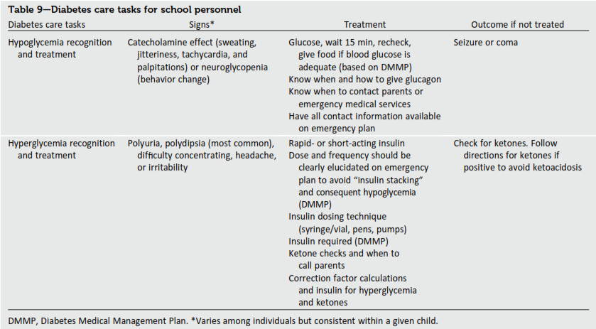

Slide 100
Older Adults
hyperglycemia can lead to symptoms of dehydration and hyperglycemic crises. while chronic hyperglycemia is detrimental, hypoglycemia may be more of a concern in some older adults

Slide 101
Older adults who are functional,cognitively intact, and have signiﬁcant life expectancy should receive diabetes care with goals similar to those developed for younger adults. E
Glycemic goals for some older adults might reasonably be relaxed, using individual criteria, but hyperglycemia leading to symptoms or risk of acute hyperglycemic complications should be avoided in all patients. E

Slide 102
Other cardiovascular risk factors should be treated in older adults .
Treatment of hypertension is indicated in virtually all older adults, and lipid and aspirin therapy may beneﬁt those with life expectancy at least equal to the time frame of primary or secondary prevention trials. E

Slide 103
