Slide 1
A Case Report of Hypoglycemia
Boshra Rezvankhah, MD
Research Institute for Endocrine Sciences
Shahid Beheshti university of medical sciences
August 21 , 2017
Tehran

Slide 2
DDx

Slide 4
Non-Islet Cell Tumors
Endocrine Reviews. May 13, 2013

Slide 5
Endocrine Reviews. May 13, 2013

Slide 7
We analyzed the medical records of 78 patients with NICTH (M/F 44/34, age 62 ± 1.8, range; 9–86 years.) whose serum contained a large amount of big IGF-II.
Hepatocellular carcinoma and gastric carcinoma were the most common causes of NICTH.
The diameters of the tumors were more than 10 cm in 70% of the patients.
Hypoglycemic attack was the onset of disease in 31 of 65 cases (48%).
Twenty-five of 47 (53%) patients had decreased serum potassium levels.

Slide 10
J Clin Endocrinol Metab , 2014

Slide 11
Diagnosis
Depending on the specific IGF-II assay used, the IGF-II levels may or may not be elevated in NICTH.
Even if IGF-II levels are normal (approximate normal range, 275–750 ng/mL, depending on the laboratory used), the IGF-I levels are suppressed under 100 ng/mL
The IGF-II:IGF-I ratio is elevated above the normal molar ratio of 3:1 and often approaching or exceeding 10:1.
There is no commercially available assay for big IGF-II

Slide 12
In cases in which it is unclear whether hypoglycemia is due to IGF-II or another etiology (eg, liver failure due to metastatic disease with depleted glycogen stores), a glucagon-stimulation test can be employed.
Next step in diagnosis is cross-sectional imaging of the chest, abdomen,and pelvis to identify a tumor, given that the vast majority of reported cases of NICTH involve a tumor in one of these sites(1/3 interthorasic,2/3 intra abdominal & retroperitoneal)

Slide 13
Isolated ACTH deficiency
Epidemiological study of IAD in a Japanese cohort, population size: 1.15-1.17 million-inhabitants, has shown that its prevalence and incidence were 19.1 cases/million and 0.9 cases/year/million, respectively, whereas 85.9 case/million and 5.3 cases/year/million, respectively, for acromegaly in the same cohort.
The prevalence of secondary AI, most commonly due to glucocorticoid administration, is much higher than that of primary AI, with an estimate of 150–280 cases per million.
Isolated ACTH Deficiency: Epidemiology, Clinical Features and Secretory Dynamics of Plasma ACTH By a Novel Ultrasensitive EIA 2014

Slide 14
Autoimmune
Most cases are caused by an autoimmune process;frequent association with other autoimmune endocrine disorders
The presence of antipituitary antibodies in the serum of 10 of 21 patients.
2017 Up To Date

Slide 15
Genetic causes:
Mutations in the POMC gene
A syndrome of early onset obesity and secondary adrenal insufficiency has been described in seven patients with homozygous or compound heterozygous loss-of-function mutations in the proopiomelanocortin (POMC) gene. Their heterozygote relatives were unaffected, indicating a recessive mode of inheritance.
Cleavage enzyme defect
Another cause of isolated ACTH deficiency is a congenital defect leading to impaired function of pro-hormone convertase 1 (PC1), which cleaves ACTH from POMC.
TPIT gene mutations
TPIT is a transcription factor necessary for differentiation of the corticotroph cell and POMC production; TPIT gene mutations may be the most common genetic cause of neonatal isolated ACTH deficiency (IAD). All parents of the neonates with TPIT mutations were unaffected carriers, confirming a recessive mode of inheritance. Although IAD due to TPIT mutations is a rare
2017 Up To Date

Slide 16
Reactive Hypoglycemia
Reactive hypoglycemia refers to hypoglycemia that occurs after meals. Any condition that causes fasting hypoglycemia,for example, insulinoma,hypopituitarism,alcoholism,sulfonylurea ingestion, hypothyroidism, growth hormone deficiency,and cortisol deficiency,can also cause postprandial hypoglycemia.
Nevertheless, some conditions are associated with hypoglycemia only after meal ingestion. These conditions fall into four categories: alimentary, prediabetes, idiopathic, and functional hypoglycemia
Degroot-2016

Slide 17
Idiopathic Reactive Hypoglycemia
Idiopathic reactive hypoglycemia is an extremely rare condition.
For this diagnosis to be made, patients must demonstrate arterial/capillary hypoglycemia (<50 mg/dL; 2.8 mmol/L) after everyday meals (not OGTTs), which is associated with symptoms of hypoglycemia that are relieved by carbohydrate ingestion
Without any other known cause (e.g., prior gastrointestinal surgery, peptic ulcer disease, glucose intolerance, endocrine deficiency)
Degroot-2016

Slide 20
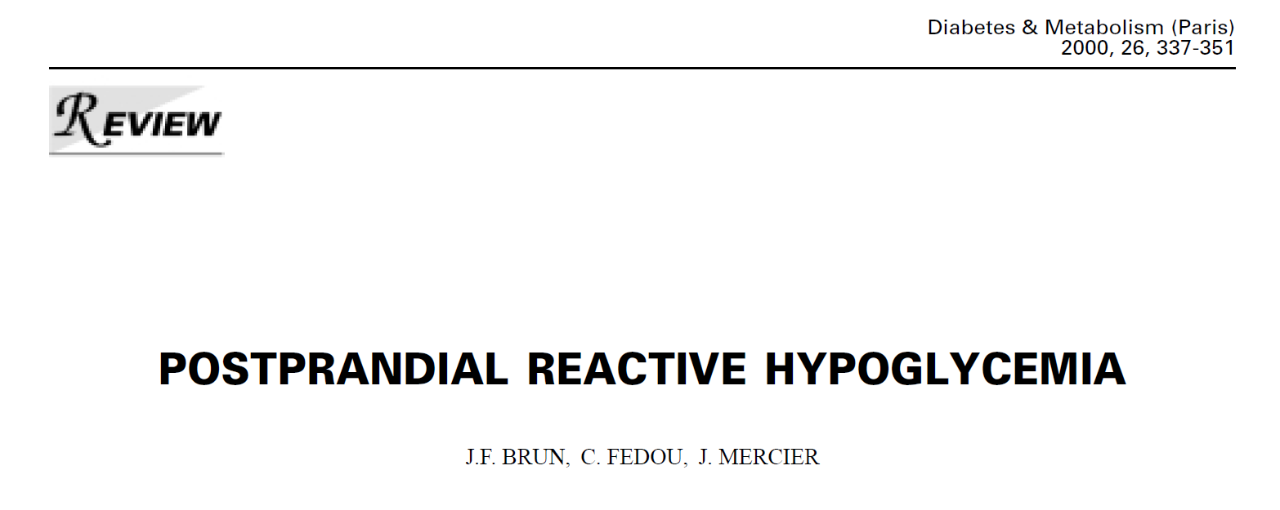

Slide 21
Pathophisiology:
Impaired glucagon counterregulatory responses,
Excessive GLP-1 secretion,
Abnormal neuroendocrine regulation of insulin release,
Increased insulin sensitivity,
Increased β-adrenergic sensitivity,
Renal glycosuria

Slide 22
Dietary Treatment
Low carbohydrate diet & frequent small split meals.
Avoidance of rapidly absorbed sugar & soft drinks rich in glucose.
Addition of soluble dietary fibers.
If the patient experiences aggravation of symptoms in presence of low carbohydrate diet,one should suspect 1-6 diphosphatase enzyme deficiency and the diet should be increased in carbohydrate

Slide 23
Pharmacological Approach
a-glucosidase inhibitor (treatment of choice)
Metformin,Atropin, ,Probanthin,Phenytoin,Propranolole,Ca Antagonist,Diazoxide
Somatostatin analogues (in severe cases due to glucose-6-phosphatase deficiency)

Slide 24
What about Factitious Hypoglycemia?

Slide 25
J Clin Res Pediatr Endocrinol 2014;6(4):258-261

Slide 26
Non-Insulin Mediated Idiopathic Postprandial Hypoglycemia??
What's our plan for the patient?

Slide 27
Thank You

